Slide 1

Accessing and Managing Multiple Clouds (Infrastructures) with Cloudmesh
June 24 2014
BigSystem 2014 - Software-Defined Ecosystems at HPDC Vancouver Canada
Gregor von Laszewski
Fugang Wang
Geoffrey Fox

Slide 2
Introduction
Cloud computing has become an integral factor for managing infrastructure by research organizations and industry.
  Public clouds: Amazon, Microsoft, Google, Rackspace, HP, and others.
  Private clouds: set up by internal Information Technology (IT) departments and made available as part of the general IT infrastructure
  “HPC Clouds”: Non hypervisor or high performance hypervisor based systems managed like clouds
Can we leverage all of them?
How to deal with the frequent changing technologies?
  Minimal changes to users that only want to run an application!
Use “Software Defined Infrastructure” and “Software Defined Applications”
FutureGrid has required this capability to build different software environments dynamically on it’s hardware
Describe our Cloudmesh software approach

Slide 3
CloudMesh Architecture
Tightly integrated software infrastructure toolkit to deliver
  a software-defined distributed system encompassing virtualized and bare-metal infrastructure, networks, application, systems and platform software with a unifying goal of providing Computing Testbeds as a Service (CTaaS).
This system is termed Cloudmesh to symbolize:
  The creation of a tightly integrated mesh of services targeting multiple IaaS frameworks
  The ability to federate a number of resources from academia and industry. This includes existing FutureGrid infrastructure, Amazon Web Services, Azure, HP Cloud, Karlsruhe using several IaaS frameworks
  The creation of an environment in which it becomes easier to experiment with platforms and software services while assisting with their deployment.
  The exposure of information to guide the efficient utilization of resources.
Cloudmesh exposes both hypervisor-based and bare-metal provisioning to users.
Access through command line, API, and Web interfaces.

Slide 4
Cloudmesh Functionality
Notes:
Due to its integrated services Cloudmesh provides the ability to be an onramp for other clouds.
It provides information services to various system level sensors to give access to sensor and utilization data. Internally, it can be used to optimize the system usage.
The provisioning experience from FutureGrid has taught us that we need to provide
the creation of new clouds (rain)
the repartitioning of resources between services (cloud shifting)
and the integration of external cloud resources in case of over provisioning (cloud bursting)
As we deal with many IaaS frameworks, we need an abstraction layer on top of the IaaS framework.
Experiment management is conducted with workflows controlled in shells, Python/iPython, as well as systems such as OpenStack's Heat.
Accounting is supported through additional services such as user management and charge rate management.
Not all features are yet implemented. Figure shows the main functionality that we target at this time to implement.

Slide 5
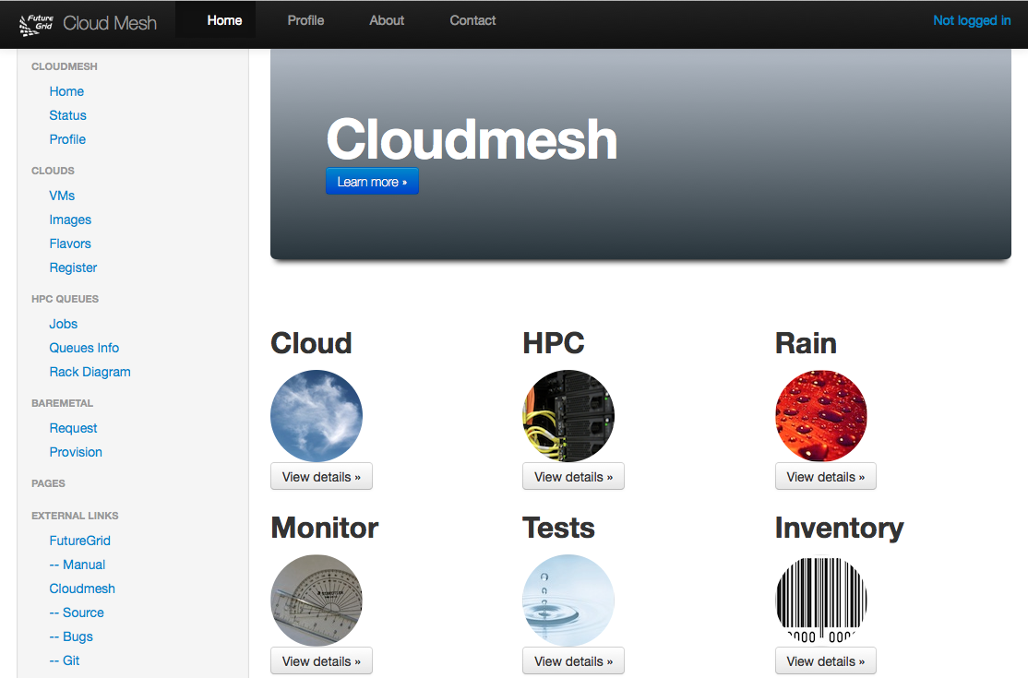
Cloudmesh User Interface
Notes:
A starting window allows to chose from the different functionality

Slide 6
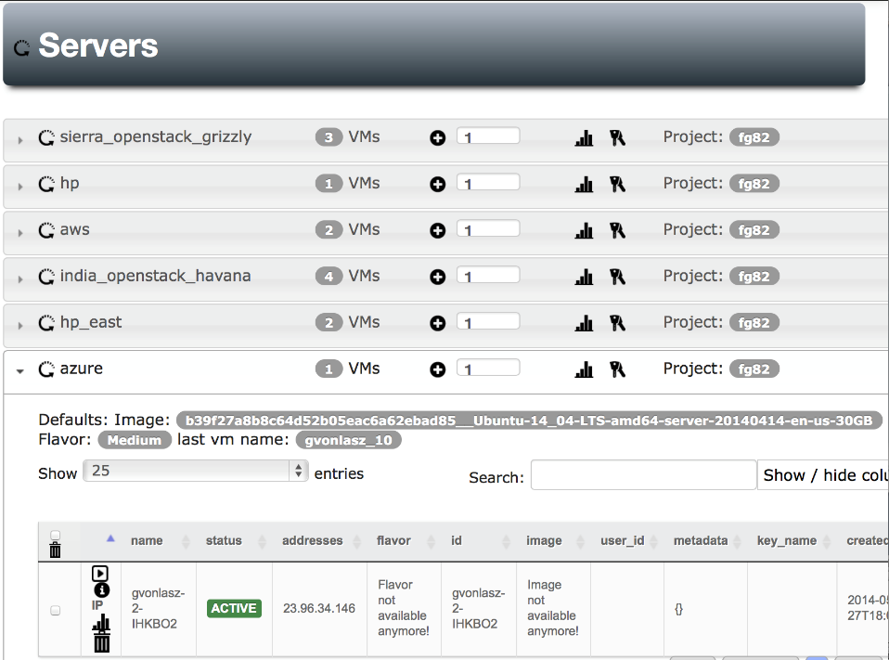
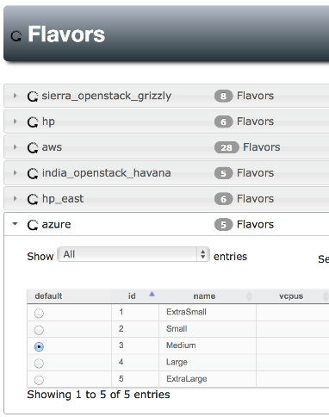
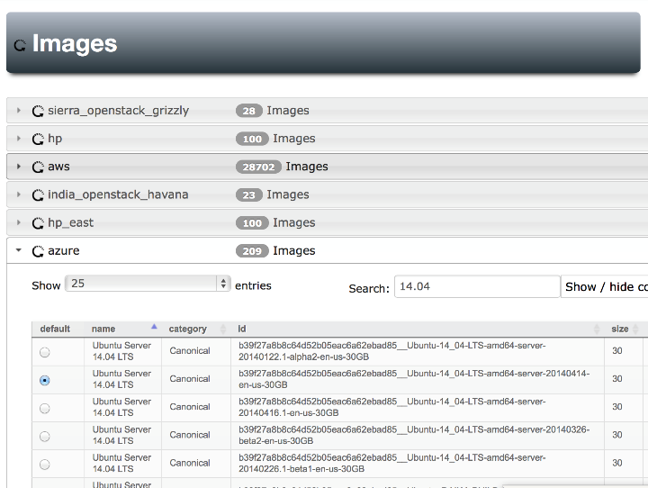
Notes:
Yes Azure is also there, Our gui can easily handle searching for images , we can set defaults for each cloud (images & flavors), pressing the + button will give us a new server with the specified defaults

Slide 7
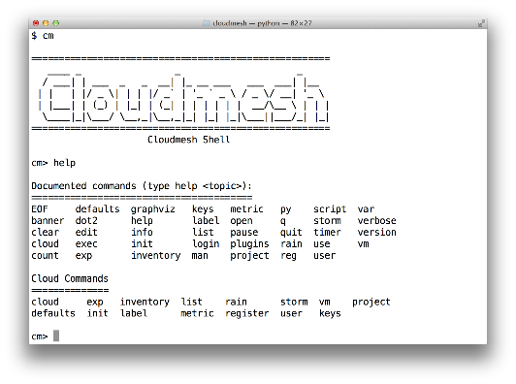
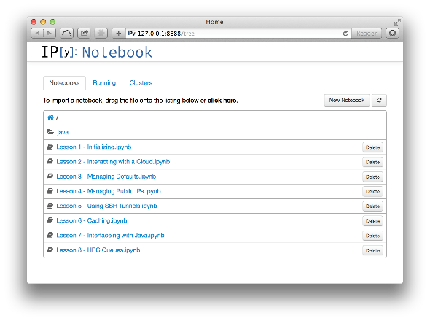
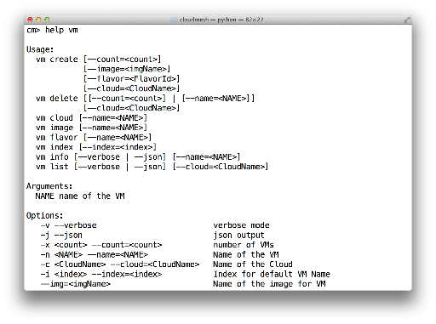
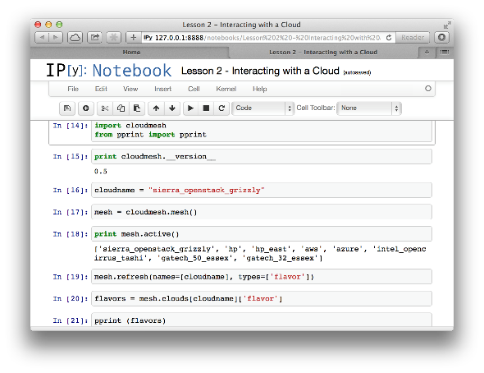
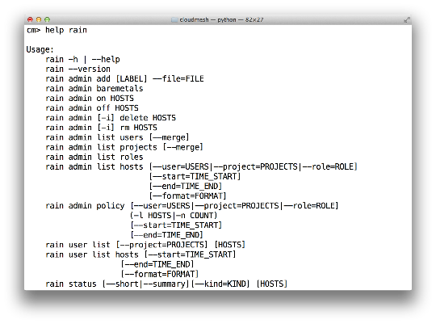
Cloudmesh Shell & bash & IPython
Notes:
Cloudmesh provides more than shell commands it has an integrated shell

Slide 8
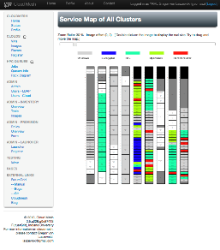
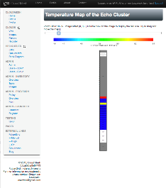
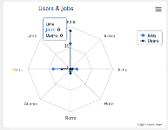
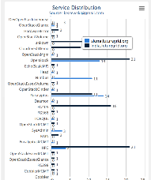
Monitoring and Metrics Interface
Service Monitoring
Energy/Temperature Monitoring
Monitoring of Provisioning
Integration with other Tools
  Nagios, Ganglia, Inca, FG Metrics, Monalytics
Accounting metrics
Notes:
Naturally we want to monitor

Slide 9
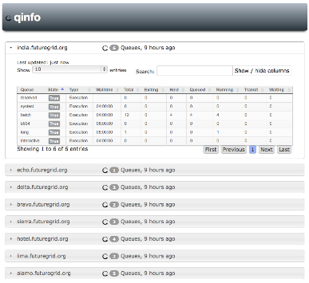
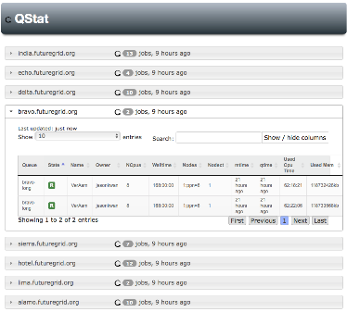
Operation and Monitoring - HPC
Notes:
Naturally we can monitor HPC queues, specila is that FG uses multiple queues on the same login node to control several different platforms. Cloudmesh nad its GUI allows to distinguish them

Slide 10
FutureGrid offers
Computing Testbed as a Service
FutureGrid uses
Testbed-aaS Tools
Provisioning
Image Management
IaaS Interoperability
NaaS, IaaS tools
Expt management
Dynamic IaaS NaaS
DevOps
CS Research Use e.g. test new compiler or storage model
Class Usages e.g. run GPU & multicore
Applications
Software
(Application
Or Usage) SaaS
Cloud e.g. MapReduce
HPC e.g. PETSc, SAGA
Computer Science e.g. Compiler tools, Sensor nets, Monitors
Platform
PaaS
CloudMesh is a CTaaS tool that uses Dynamic Provisioning and Image Management to provide custom environments for general target systems
Involves (1) creating,
(2) deploying, and
(3) provisioning
of one or more images in a set of machines on demand
Infra
structure
IaaS
Software Defined Computing (virtual Clusters)
Hypervisor, Bare Metal
Operating System
Network
NaaS
Software Defined Networks
OpenFlow GENI

Slide 11
Terms (Cloud & HPC)
Public cloud:
  a service provider makes resources available to users over the public internet. This includes compute, storage, and applications. FutureGrid offers a public cloud to its users.
Private cloud:
  access to services may have additional restrictions. Restrictions could include a limited set of authorized users to the services offered or possible restrictions regarding exposing services on the public internet. FutureGrid offers the ability to set up private clouds for special projects. Examples include modified OpenStack deployments or reserved resources for classes.
Hybrid cloud:
  a combination of public and private clouds.
Multi-cloud:
  access to a number of different clouds that may even use different IaaS or PaaS offerings.
HPC service:
  a cloud service that allows the ability to run high performance computing jobs, for example on a compute cluster offering MPI.
Provider consortium:
  is a (virtual) organization that integrates resources from multiple providers. We also can refer to such a consortium as a multi-cloud Grid.

Slide 12
Terms (Cloud, HPC, Provisioning)
Cloud Bursting:
  Use (external) clouds to provide additional (cloud) resources on demand
Cloud Shifting
  Move executing jobs from one cloud to another
Provisioning:
  A process to install the operating system, data and software to enable access to it.
Rain:
  Process developed in FutureGrid that provisions the operating system, but allows the deployment and configuration of useful and complex services to be run on one or multiple machines in order to provide a service utilizing potentially distributed resources or services. It also contains the ability to re-provision servers and services, that is, services may be suspended and the resources used to run the service may be used by other services.
Cloudmesh:
  Expands Rain to general infrastructure

Slide 13
Background - FutureGrid
Many requirements originate from FutureGrid.
  This is a high performance and grid testbed that allowed scientists to collaboratively develop and test innovative approaches to parallel, grid, and cloud computing.
  Users can deploy their own hardware and software configurations on a public/private cloud, and run their experiments.
  Provides an advanced framework to manage user and project affiliation and propagates this information to a variety of subsystems constituting the FutureGrid service infrastructure. This includes operational services to deal with authentication, authorization and accounting.
Important features of FutureGrid:
  Metric framework that allows us to create usage reports from all of our IaaS frameworks. Developed from systems aimed at XSEDE
  Repeatable experiments can be created with a number of tools including Cloudmesh. Provisioning of services and images can be conducted by Rain.
  Multiple IaaS frameworks including OpenStack, Eucalyptus, and Nimbus.
  Mixed operation model. a standard production cloud that operates on-demand, but also a set of cloud instances that can be reserved for a particular project.
FutureGrid coming to end but preserving CTaaS tools as Cloudmesh

Slide 14
Functionality Requirements
Provide virtual machine and bare-metal management in a multi-cloud environment with very different policies and including
  FutureGrid resources,
  External clouds from research partners,
  Public clouds,
  My own cloud
Provide multi-cloud services and deployments controlled by users & provider
Enable raining of
  Operating systems (bare-metal provisioning),
  Services
  Platforms
  IaaS
Deploy and give access to Monitoring infrastructure across a multi-cloud environment
Support management of reproducible experiments

Slide 15
Usability Requirements
Provide multiple interfaces including
  command line tool and command shell
  Web portal and RESTful services
  Python API
Deliver a toolkit that is
  open source
  Extensible
  easily deployable
  documented

Slide 16
Cloudmesh Definitions I
Project: The research activity to be supported by Cloudmesh. A project has roles and users assigned. The roles imply which types of SDDS can be used by users in the project
  FutureGrid has some roles but need to expand
  This definition supported by FutureGrid [portal
User: Project participants
  Users have individual authorization roles and roles inherited from projects with which they are involved
  Users are assigned to projects by project lead
  Public projects can be joined by any Cloudmesh user
Experiment: The activity unit for Cloudmesh
SDDS: Software Defined Distributed System
SDDSL: Specification Language for SDDS; essentially exists from various sources

Slide 17
Cloudmesh Definitions II
Infrastructure: Clusters: Computers, Storage, Network with some reason to be treated as one: Infrastructure has
  Type as in different Amazon Instance Types
  Management Structure
  Provisioning rules for administrators
  Usage rules for users of particular roles
  A current state
  A time interval ranging from transient to a longer term persistence and including a scheduled start time
    Note storage could often need to be persistent
Virtual Infrastructure: Dynamically defined Slices of Infrastructure
Federated Virtual Infrastructure is a Software Defined Distributed System SDDS assigned to a Cloudmesh user for an Experiment in a Project

Slide 18
SDDS Software Defined Distributed Systems
Cloudmesh builds infrastructure as SDDS consisting of one or more virtual clusters or slices with extensive built-in monitoring
These slices are instantiated on infrastructures with various owners
Controlled by roles/rules of Project, User, infrastructure
User in Project
Python or REST API
Request
Execution in Project
One needs general hypervisor and bare-metal slices to support FG research
The experiment management system is intended to integrates ISI Precip, FG Cloudmesh and tools latter invokes
Enables reproducibility in experiments.
Repository
SDDSL
Results
Request
SDDS
CMMon
CMPlan
User Roles
CMExec
Infrastructure (Cluster, Storage, Network, CPS)
Select
Plan
Requested SDDS as federated Virtual Infrastructures
CMProv
#1Virtual infra.
Instance Type
Current State
Management Structure
Provisioning Rules
Usage Rules (depends on user roles)
Linux
Image and Template Library
#2 Virtual infra.
#3Virtual infra.
Windows
Linux
#4 Virtual infra.
User role and infrastructure rule dependent security checks
Mac OS X

Slide 19
Cloudmesh Definitions III
Cloudmesh Image: The software that is loaded on an Infrastructure to provision it.
  For nodes, image is loaded on bare metal or a hypervisor
  Images created as described below
Cloudmesh Image Template: An abstract specification of an Image used to define an implementation that is valid across multiple Infrastructures: three steps
  Templates as a set of one or more scripts/XML specifications
  Generic or base images that can be modified on general devops principles.
  Host specific Images
FutureGrid has a prototype Image and Template Library
  Note templates are preferred model as template description is what we mean by Software defined Systems
  However one may only have an image in some cases and also provisioning speed is improved by taking templates and pre-generating images for particular infrastructures

Slide 20
Cloudmesh Definitions IV
Cloudmesh Matchmaker CMPlan chooses appropriate Infrastructures that can be used by CMProv to satisfy a user requested SDDS (not implemented)
CloudMesh Provisioner CMProv takes a user request in SDDSL and a chosen Infrastructure and provisions the infrastructure in accordance with user roles, Infrastructures current state, management usage and provisioning rules and generates requested virtual infrastructure
  CMProv uses appropriate Cloudmesh Images and Templates and capabilities of Cloudmesh depend on availability of appropriate images/templates
CMExec produces the users’ requested SDDS as a federation of Virtual Infrastructures created by CMProv
CMMon sets up monitoring and experiment management infrastructure (incomplete)

Slide 21
CloudMesh Administrative View of SDDS aaS
CM-BMPaaS (Bare Metal Provisioning aaS) is a systems view and allows Cloudmesh to dynamically generate anything and assign it as permitted by user role and resource policy
  FutureGrid machines India, Bravo, Delta, Sierra, Foxtrot are like this
  Note this only implies user level bare metal access if given user is authorized and this is done on a per machine basis
  It does imply dynamic retargeting of nodes to typically safe modes of operation (approved machine images) such as switching back and forth between OpenStack, OpenNebula, HPC on Bare metal, Hadoop etc.
CM-HPaaS (Hypervisor based Provisioning aaS) allows Cloudmesh to generate "anything" on the hypervisor allowed for a particular user
  Platform determined by images available to user
  Amazon, Azure, HPCloud, Google Compute Engine
CM-PaaS (Platform as a Service) makes available an essentially fixed Platform with configuration differences
  XSEDE with MPI HPC nodes could be like this as is Google App Engine and Amazon HPC Cluster. Echo at IU (ScaleMP) is like this
  In such a case a system administrator can statically change base system but the dynamic provisioner cannot

Slide 22
CloudMesh User View of SDDS aaS
Note we always consider virtual clusters or slices with nodes that may or may not have hypervisors
BM-IaaS: Bare Metal (root access) Infrastructure as a service with variants e.g. can change firmware or not
H-IaaS: Hypervisor based Infrastructure (Machine) as a Service. User provided a collection of hypervisors to build system on.
  Classic Commercial cloud view
PSaaS Physical or Platformed System as a Service where user provided a configured image on either Bare Metal or a Hypervisor
  User could request a deployment of Apache Storm and Kafka to control a set of devices (e.g. smartphones)

Slide 23
Cloudmesh Infrastructure Types
Nucleus Infrastructure:
  Persistent Cloudmesh Infrastructure with defined provisioning rules and characteristics and managed by CloudMesh
Federated Infrastructure:
  Outside infrastructure that can be used by special arrangement such as commercial clouds or XSEDE
  Typically persistent and often batch scheduled
  CloudMesh can use within prescribed provisioning rules and users restricted to those with permitted access; interoperable templates allow common images to nucleus
Contributed Infrastructure
  Outside contributions to a particular Cloudmesh project managed by Cloudmesh in this project
  Typically strong user role restrictions – users must belong to a particular project
  Can implement a Planetlab like environment by contributing hardware that can be generally used with bare-metal provisioning

Slide 24
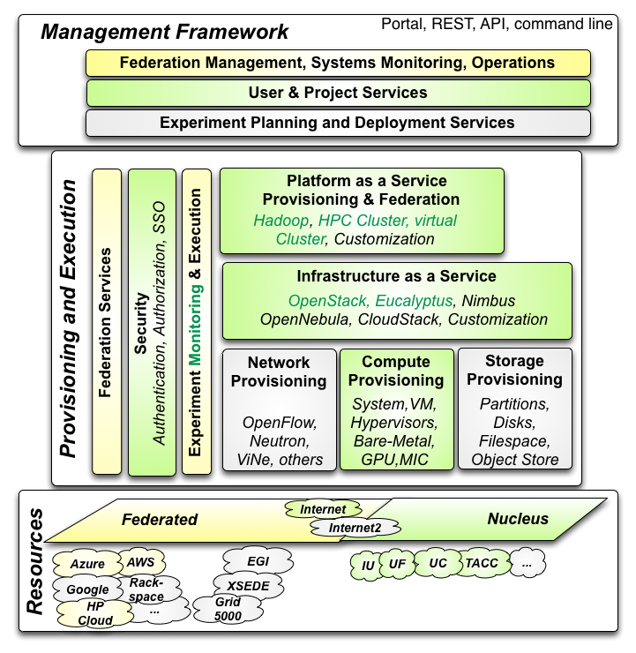

Architecture
Cloudmesh Management Framework for monitoring and operations, user and project management, experiment planning and deployment of services needed by an experiment
Provisioning and execution environments to be deployed on resources to (or interfaced with) enable experiment management.
Resources.
FutureGrid, SDSC Comet, IU Juliet

Slide 25
Building Blocks of Cloudmesh
Uses internally Libcloud and Cobbler
Accesses via abstractions external systems/standards
OpenPBS, Chef,
Openstack (including tools like Heat), AWS EC2, Eucalyptus, Azure
Xsede user management (Amie) via Futuregrid
Implementing Slurm, OCCI, Ansible, Puppet
Evaluating Razor, Juju, Xcat (Original Rain used this), Foreman

Slide 26
Details on Cloudmesh Functionality
Due to its integrated services Cloudmesh provides the ability to be an onramp for other clouds.
It provides information services to various system level sensors to give access to sensor and utilization data. Internally, it can be used to optimize the system usage.
The provisioning experience from FutureGrid has taught us that we need to provide
  the creation of new clouds (rain)
  the repartitioning of resources between services (cloud shifting)
  and the integration of external cloud resources in case of over provisioning (cloud bursting)
As we deal with many IaaS frameworks, we need an abstraction layer on top of the IaaS framework.
Experiment management is conducted with workflows controlled in shells, Python/iPython, as well as systems such as OpenStack's Heat.
Accounting is supported through additional services such as user management and charge rate management.
Not all features are yet implemented. Figure shows the main functionality that we target at this time to implement.

Slide 27
User and Project Management
FutureGrid user and project services simplify the application processes needed to obtain user accounts and projects.
We have demonstrated in FutureGrid the ability to create accounts in a very short time, including vetting projects and users – allowing fast turn-around times for the majority of FutureGrid projects with an initial startup allocation.
  We also have shown that we can integrate with other services on user management such as XSEDE, we also have access to the technical team that integrated OSG into XSEDE and the XSEDE TAS project
Cloudmesh re-uses this infrastructure and also allows users to manage proxy accounts to federate to other IaaS services to provide an easy interface to integrate them.

Slide 28
Experiment Planning - Future
Imagine a shopping cart which will allow checking out of predefined repeatable experiment templates.
  Cost is associated with an experiment making
  Clearing house of images
  Clearing house of complex deployments.
  Integrated accounting framework allowing a usage cost model
  The cost model will be based not only on number of core hours used, but also the capabilities of the resource, the time, and special support it takes to set up the experiment. We will expand upon the metrics framework of FutureGrid that allows measuring of VM and HPC usage and associate this with cost models. Benchmarks will be used to normalize the charge models.

Slide 29
Cloudmesh Provisioning and Execution
Bare-metal Provisioning
  Originally developed a provisioning framework in FutureGrid based on xCAT and Moab. (Rain)
  Due to limitations and significant changes between versions we replaced it with a framework that allows the utilization of different bare-metal provisioners.
  At this time we have provided an interface for cobbler and are also targeting an interface to OpenStack Ironic.
Virtual Machine Provisioning
  An abstraction layer to allow the integration of virtual machine management APIs based on the native IaaS service protocols. This helps in exposing features that are otherwise not accessible when quasi protocol standards such as EC2 are used on non-AWS IaaS frameworks. It also prevents limitaions that exist in current implementations, such as libcloud to use OpenStack.
Network Provisioning (Future)
  Utilize networks offering various levels of control, from standard IP connectivity to completely configurable SDNs as novel cloud architectures will almost certainly leverage NaaS and SDN alongside system software and middleware. FutureGrid resources will make use of SDN using OpenFlow whenever possible though the same level of networking control will not be available in every location.

Slide 30
Provisioning – Cont’d
Storage Provisioning (Future)
  Bare-metal provisioning allows storage provisioning and making it available to users
Platform, IaaS, and Federated Provisioning (Current & Future)
  Integration of Cloudmesh shell scripting, and the utilization of DevOps frameworks such as Chef or Puppet.
Resource Shifting (Current & Future)
  We demonstrated via Rain the shift of resources allocations between services such as HPC and OpenStack or Eucalyptus.
  Developing intuitive user interfaces as part of Cloudmesh that assist administrators and users through role and project based authentication to move resources from one service to another.

Slide 31
Testing Resource Federation
We successfully federated resources from
  Azure
  Any EC2 cloud
  AWS,
  HP cloud
  Karlsruhe Institute of Technology Cloud
  four FutureGrid clouds
    Various versions of OpenStack and Eucalyptus.
    It would be possible to federate with other clouds that run other infrastructure such as Tashi or Nimbus.
    Integration with OpenNebula is desirable due to strong EU importance

Slide 32
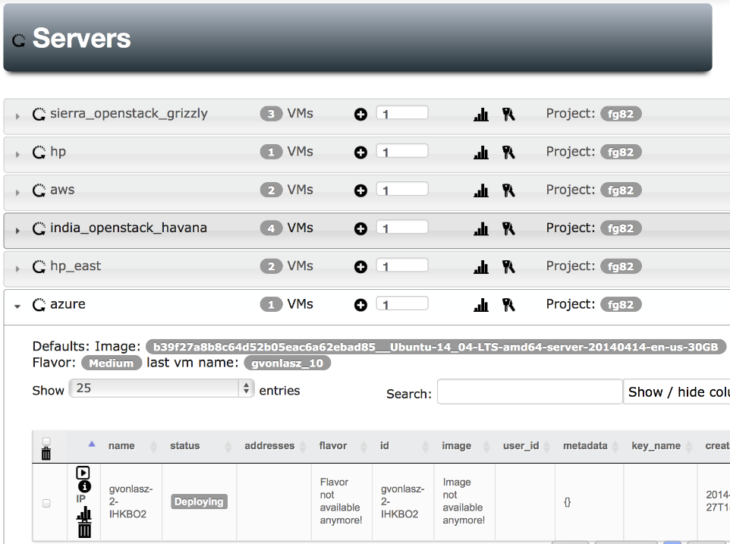
Federated VM Management

Slide 33
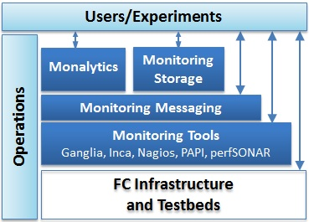
CMMon Monitoring Components of CloudMesh
Leverage best practices and expertise from projects including FutureGrid and XSEDE now and with GENI possible in future
Provide transparency of the infrastructure and deep, pervasive instrumentation capabilities (bare metal up to application level)
  Commercial cloud monitoring focuses on load monitoring (app auto-scaling)
Available to user experiments through the proposed shopping cart interface
Easily configurable and extensible
Other Aspects
  Benchmarks
  Security Monitoring
  Energy Monitoring
Cloudmesh

Slide 34
Monitoring and Accounting
Cloudmesh must be able to access empirical data about the properties and performance of the underlying infrastructure beyond what is available from commercial cloud environments. The component of Cloudmesh accomplishing this is called Cloud Metrics.
We developed a federated cloud metric service that aggregates the information from distributed clusters and a variety of heterogeneous IaaS services, such as OpenStack, Eucalyptus, and Nimbus. The main components of Cloudmesh Metrics enable
  (a) the measurement of the resource allocation across several IaaS platforms
  (b) the generation of data in regards to utilization
  (c) the comparison of data via definable metrics to mine the usage statistics
  (d) the display of the information through a convenient user interface
  (e) the availability of a simple command line interface and shell language, and
  (f) the automatic creation of resource reports in printed format for arbitrary time periods.

Slide 35
Cloudmesh Metric Architecture
The Cloudmesh metric architecture is based on the integration of an secure RESTful service, that utilizes a simple abstraction layer to interface with the various cloud services to obtain needed information gathered under authorization constraints.
The data is hosted in a NOSQL database to allow mining of the data in map/reduce frameworks.
Data can be ingested either directly through the database via the API, or through REST calls that are mitigated through message queues with AMPQ.
Adapters can be written to integrate new information providers for other clouds.
Policies can be used to limit the amount of information presented to other users or projects.

Slide 36
Type of Monitoring | Tools Used | Types of experiments
Physical host monitoring | Ganglia | Performance evaluation of domain science applications.
Energy monitoring | IPMI | Power/thermally driven data center & scheduling algorithms, consolidation, and mobile experiments.
Network monitoring | perfSONAR, Periscope | Network monitoring is essential for experiments from HPC, in which messaging patterns and fabric contention are significant to performance, to distributed computing in data movement is a key cost.
IaaS monitoring | Synaps, Stackwatch, | Auto-scaling experiments.
Low-level IaaS monitoring | Libvirt, libpcap | Experiments that are performance or energy oriented
Application performance monitoring | PAP/PAPI-V | Application performance analysis, including comparisons between virtual and bare-metal performance, as well as “steal-time,” i.e., the time that's used by other VMs in the cloud which might be included in "my" per-process timing results
Integrated monitoring with analytics | Monalytics | Scalable distributed behavior monitoring, debugging, anomaly detection in large-scale multi-tier, multi-runtime applications
Operational infrastructure monitoring | Inca, IU metrics and accounting, Nagios | Adaptive application simulation experiments driven by real-world trace data (e.g., service uptime, usage).

Slide 37
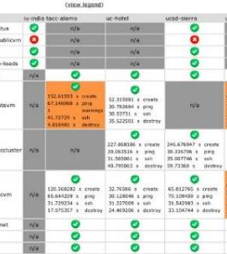
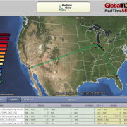
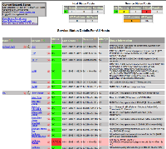
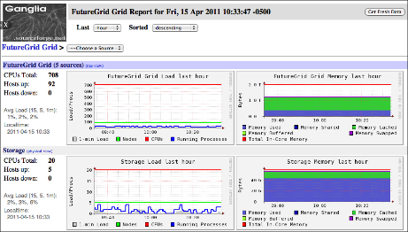
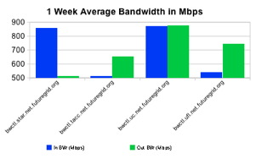
Operations Monitoring

Slide 38
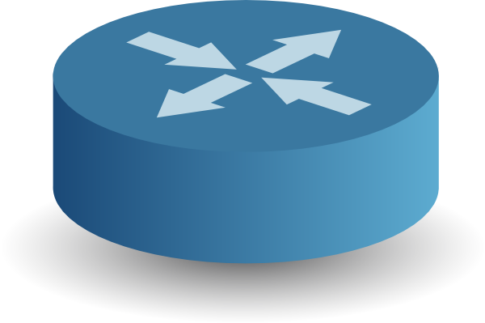
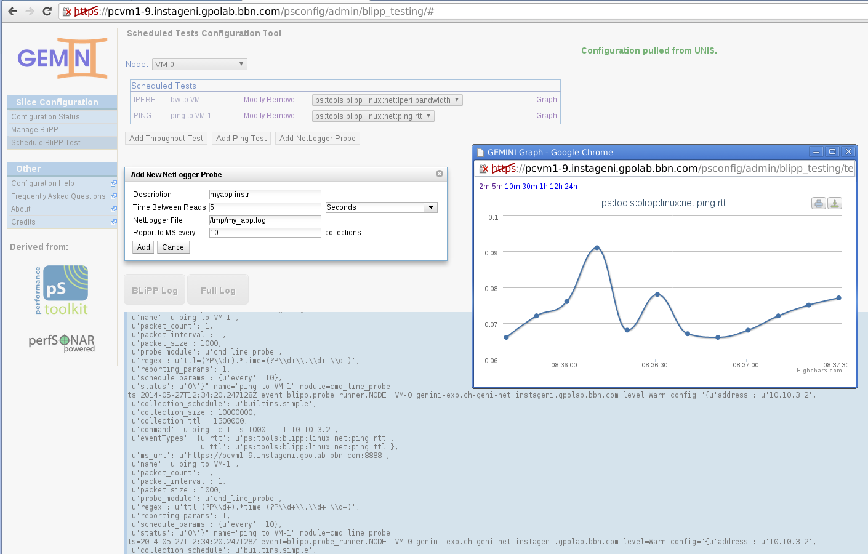
Experiment Instrumentation and Measurement
FutureGrid
Resource
Periscope from the GEMINI project in GENI
Monitors (BLiPPs) at all system layers
  Application
  Virtual machine OS
  Physical host OS
  Network (active, passive, SDN)
Hierarchy of storage and discovery services
  host, rack, global
Flexible, per-slice authentication
libvirt
BLiPP
FutureGrid VM
BLiPP
CM App
PAPI-V,
Monalytics
Storage
BLiPP

Slide 39
CloudMesh Status
First version of Cloudmesh released with a focus on the development of three of its components. This includes
  virtual machine management in multi-clouds
  cloud metrics in multi-clouds
  and bare-metal provisioning.
Cloudmesh has been successfully used in FutureGrid. A GUI and a Cloudmesh shell is available for easy usage by users.
  It has been used by users while deploying it on their local machines
  it also has been demonstrated as a hosted service.
A RESTful interface to the management functionality is under development.
Cloudmesh is an open source project. It uses python and Javascript.
  WE ARE OPEN, CONTACT laszewski@gmail.com TO JOIN

Slide 40
Related Work - Phantom
Phantom is a tool targeting users of IaaS
  Monitors the health of resources and automatically provisions and configures new ones based on demand
  This may be good for an individual user, but limits the flexibility for the administrator of a cloud.
  Uses libcloud which has limitations
What makes Cloudmesh different
  Not only EC2 clouds. Nova, Azure
  Support for native IaaS protocols not only libcloud
  Access to bare-metal provisioning.
  We not only target the user reusing existing IaaS, we target a better IaaS by being able to modify the scheduling algorithms for better better utilization of the IaaS. Thus we do not just do user-based resource scavenging

Slide 41
Related - RightScale
RightScale enables users to manage multi-cloud infrastructure
  Amazon Web Services (AWS)
  Rackspace Cloud
  Windows Azure
  Google Compute Engine
Migrating workloads between private clouds and public clouds.
It also offers a cloud cost estimator, allowing customers to assess expenses they are charged by comparing their workload on various cloud providers.
Our effort is different because
  it is an open source toolkit
  allows the deployment not only as a hosted service managed by one entity, but also allows the deployment by a provider, provider consortium, or even the user.

Slide 42
Related Work – API IaaS libraries (Python)
Boto
  An integrated interface to current and future infrastructural services offered by Amazon Web Services.
  Lots of interfaces to many services offered by AWS
    Targets AWS
Apache libcloud
  Python library for interacting with many of the popular cloud service providers using a unified API.
    Has limited image management functionality in EC2
    Has support for many providers. If one uses Openstack one should not use the EC2 interface but the OS based interface.

Slide 43
Other Related Efforts
Cloud federation such as efforts planned for future versions of OpenStack.
Standards efforts
  Provide an interesting approach to multi-cloud interoperability
  Standards are good, but as libcloud shows libraries that are defacto standards have limitations (EC2 image management).
  Limit rapid innovation innovation brought forward by individual IaaS offerings. E.g., OpenStack (Nova) vs EC2
  OCCI is an example of a standards effort not based on the API level.

Slide 44
Conclusions
Design of a toolkit called Cloudmesh that allows to access to multiple clouds through convenient interfaces. This includes command line, a command shell, REST, as well as a graphical user interface.
Cloudmesh is under active development and has shown its viability for accessing more than EC2 based clouds. Native interfaces to OpenStack, Azure, as well as any EC2 compatible cloud have been delivered and virtual machine management enabled.
An important contribution of Cloudmesh is that it provides a sophisticated interface to bare metal provisioning capabilities that not only can be used by administrators, but also by authorized users. A role based authorization service makes this possible.
Furthermore, we have developed a multi-cloud metrics framework that leverages information from various IaaS frameworks.
Future enhancements will include network and storage provisioning.
PLEASE JOIN CLOUDMESH DEVELOPMENT ….

Slide 45
VM Management across multiple Clouds
KIT
HP Cloud
FG OpenStack Cloud
Notes:
Many many IaaS

Slide 46
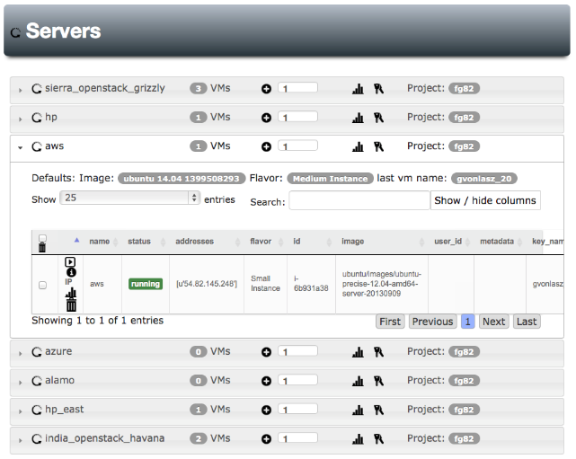
Federated VM Management - AWS
AWS
Notes:
Naturally we can do AWS

Slide 47
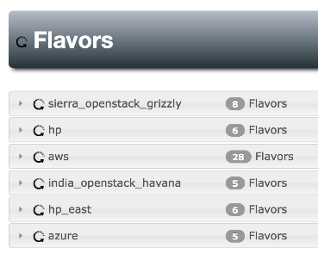
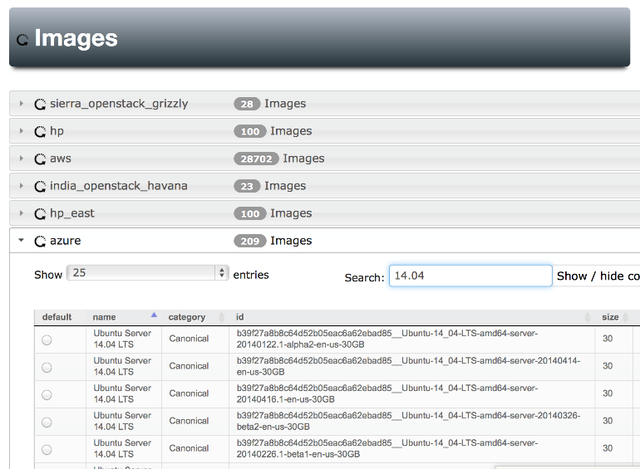
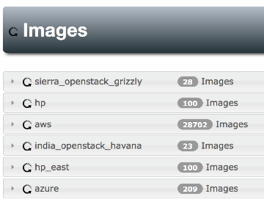
Federated VM Management

Slide 48
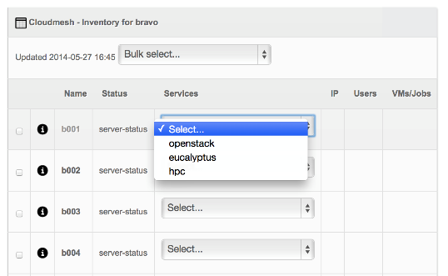
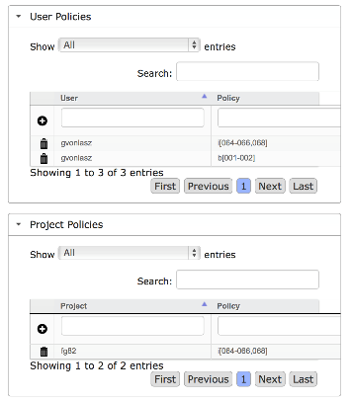
Bare-metal provisioning - Future
Service reassignment
Access Policies
Notes:
This is cool, bare metal is exposed to authorized users only. The administrator is offered a view to conduct service reasignment through shifting

Slide 49
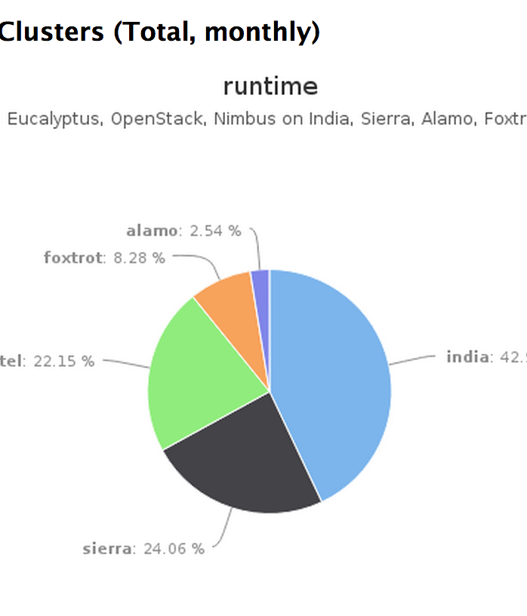
IU’s IaaS Metric Framework
We have a variety of metrics for the clouds in FG
  Runtime
  IaaS count
  Usage
  Resource Specific
  Flexible Metric report

Slide 51
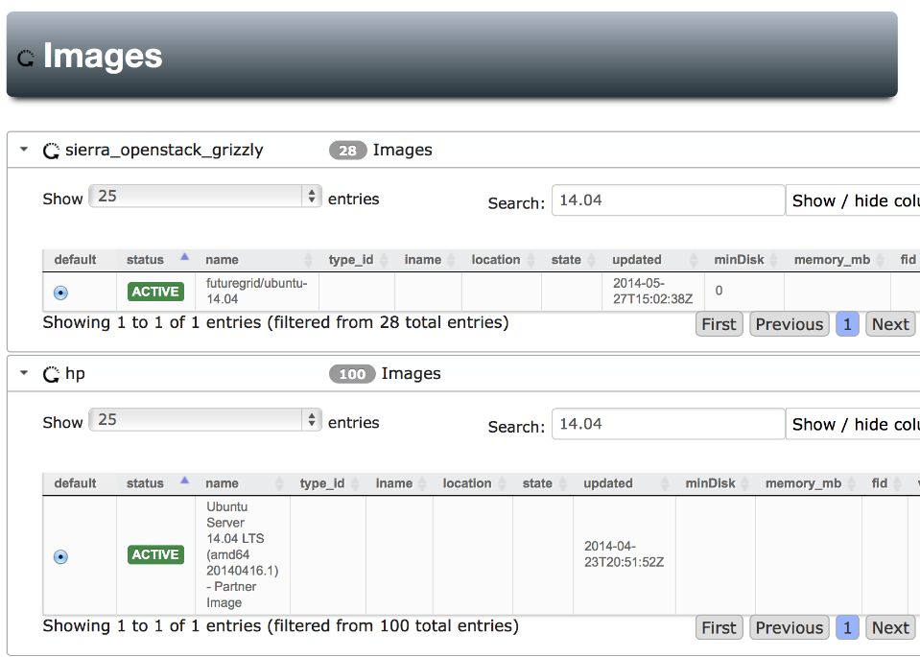

Slide 52
Cloudmesh Metric Components
Data Collector and Metric service. One of the fundamental services needed is a data collector. It collects relevant data from a variety of sources including resource databases, log files, and data reporters. Hence, to integrate new cloud services into the data collectors we have to define a data model, as well as data sources that populate the data model with data. Currently, data collectors are available for OpenStack, Eucalyptus, and Nimbus but not limited to these platforms. Dependent on the IaaS framework they obtain the data from different sources such as log files or databases. Beneficial information to be collected includes detailed information about the virtual machines (VM), the users and/or projects starting them, memory usage over the lifetime of the VMs, errors associated with VMs during runtime, or at startup. One of the issues to be addressed is, if such data should be directly accessed in the production environment offered by the IaaS framework. Practical experience with FutureGrid has shown that the analysis of the data poses a significant amount of stress on the originating resource, making it impractical to offer a detailed report and metric system on the original data sources. Hence, it is important that we replicate it when the information we request is involved in a detailed analysis. For some smaller scale queries, as the one posed by most users, direct access is sufficient and desirable for the live view of the system in order to provide information about how many VMs are currently running, on which system and by whom.

Slide 53
Cloudmesh Metric Components
Metric Analyzer. The data collected provides the opportunity to analyze it for specific needs in a repeated fashion or provide filters and services for further specialized analysis. The FutureGrid metric framework therefore provides a metric analyzer component with a convenient interface for analyzing the data not only on an automated fashion, but also interactively through a simple metrics analyzer shell. Information of interest includes yearly, monthly, and/or weekly usage information by user, project, resource, provider, and the agglomerated in- formation. Our scripting environment provides this information and is run at predefined intervals or upon request. In the future, we will be enhancing the service to allow users to schedule queries to conduct specific analysis. To avoid repeated analysis, metric result caching is conducted. Thus, if a query has been executed in the past the result is cached and returned without reanalysis (if not forced). To more easily facilitate fast and distributed calculation of the results by multiple users, we will base future versions of the Cloudmetric system on NoSQL database technologies.

Slide 54
Accessing Cloudmesh Metrics
Early on we recognized that the access of information and the metrics must be provided through a variety of interfaces. This includes command shells, programming API's, REST interfaces, graphical user interfaces, and printable reports.
  Interactive Command Shell. To simplify the interactive use, we have developed a python command shell called CMD3 that allows the dynamic load of additional commands, thus making it ideal to define new analytic methods
  REST API. We are currently building access through a convenient REST API to allow easy access from Web frameworks, but also integration from arbitrary programming languages Programming API. We have provided a robust API interface in python to access the basic analytical functions useful for many users and reused by the interactive command shell and the REST service.
  Graphical Representation and Printable Reports. Using our basic API and command shell, we have integrated them into the Python sphinx framework to expose the metric data in a convenient form and present the data online via charts or in a PDF report. As sphinx offers the export of data reports in PDF, we leverage this framework and do not have to develop a separate framework for it. The sphinx framework service is currently enhanced, allowing customizable interactive queries to the metric and data sources. The data can be represented visually in various chart forms such as bar graphs, line charts, or pie charts. A template for generating a quarterly and yearly report of the data exists making adaptation to additional resources or other provider consortia easy.
  Furthermore, the data can be exported in a variety of formats such as JSON or CSV making it possible to use other tools, such as excel for data post processing.

