Slide 1
Utilizing HUBzero to Create and Test an Educational Hub from CReSIS Educational Data
Justin Deloatch
Elizabeth City State University
Notes:
Intro- name grad student school and

Slide 2
What is HUBzero
Open Source Software Platform
Toolbox
Websites
Research
Education
Scientific collaboration
Notes:
Hub Zero is an open source software platform meaning that is free for the user and can be install by anyone
Hub zero is a toolbox for Scientist and Researchers used to create websites for the reason of research education an scientific collaboration for their community and others to see.

Slide 3
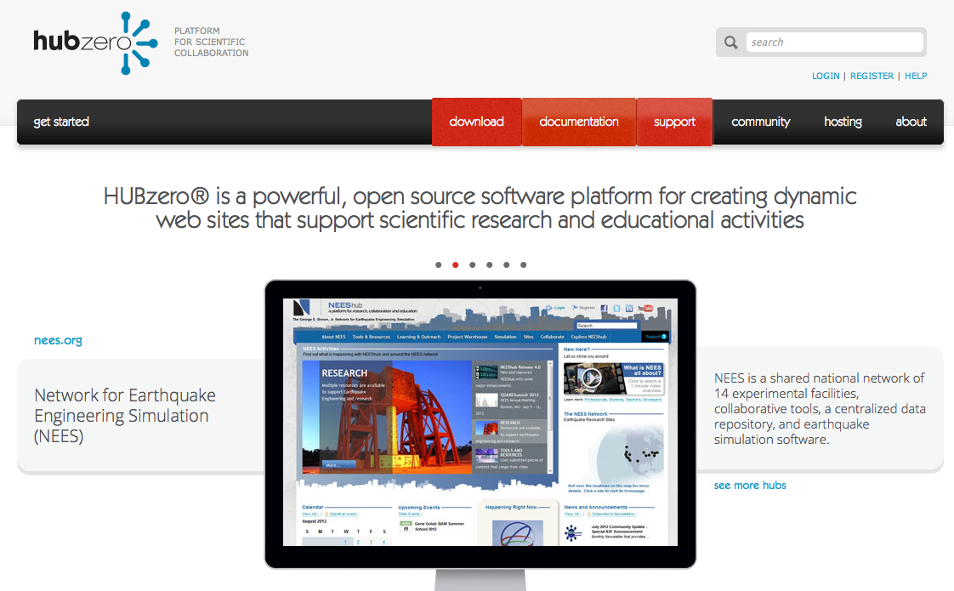
Open Source
Download: http://hubzero.org/download
Notes:
As I said it’s an open source software which can be installed from this site.

Slide 4

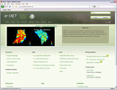

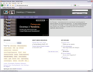
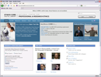
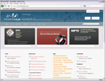
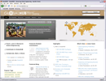
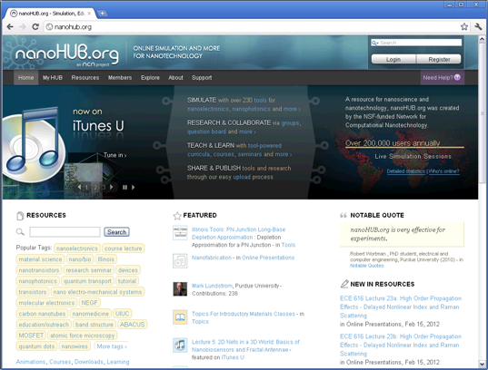
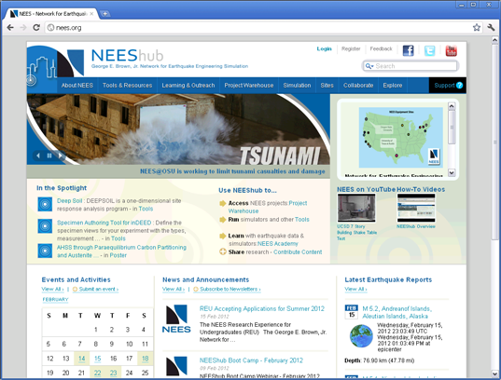



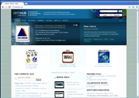
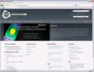

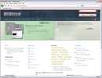
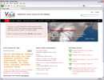
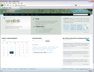
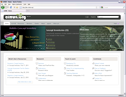
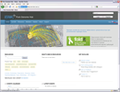

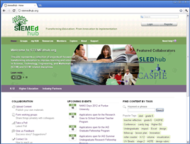
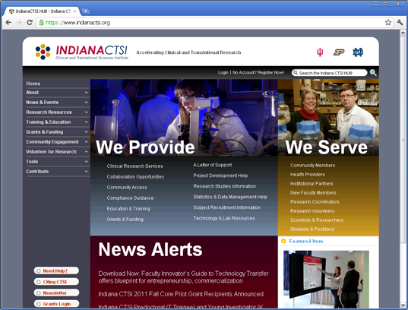
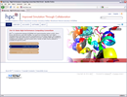
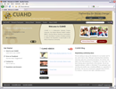
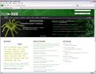
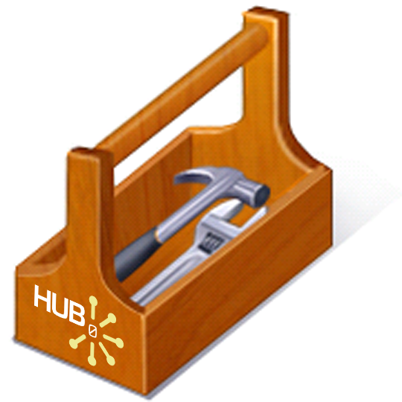
Many other Hubs
40+ sites worldwide
Notes:
So far it has been used to create lots of websites
There's about 40 + are running sites worldwide
A lot the them are at Purdue University since that’s where it all started
Its about 27at Purdue and about 15, 16 more at Russia, South America,
There really starting to pop up now.

Slide 5


Website
Creates and manages the website
Can only view the website for what it is
Notes:
In a regular website there might be 1 or 2 developers depending on how demanding the website is.
They create the information and manage information for the users
The users have no way to edit or change the website because they don’t have rights to.
So basically they can only view the website for what it is.
So if they did want to add something they would have to go through the develop
But HUBzero is different

Slide 6
WHY ???
Notes:
WHY??
So why do Scientist really want to make that jump to HubZero and invest their valuable time for this free software??
Well the reason is because of the apps.
Think about it as app store for scientists where people can publish a tool to do what ever you want

Slide 7
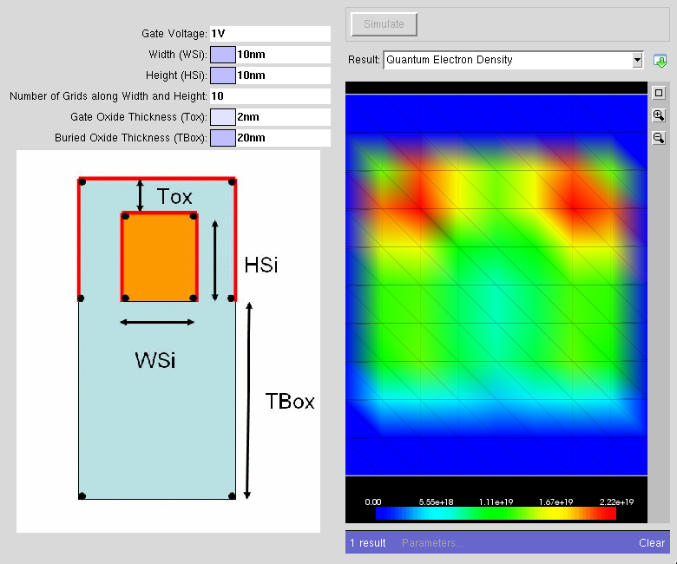
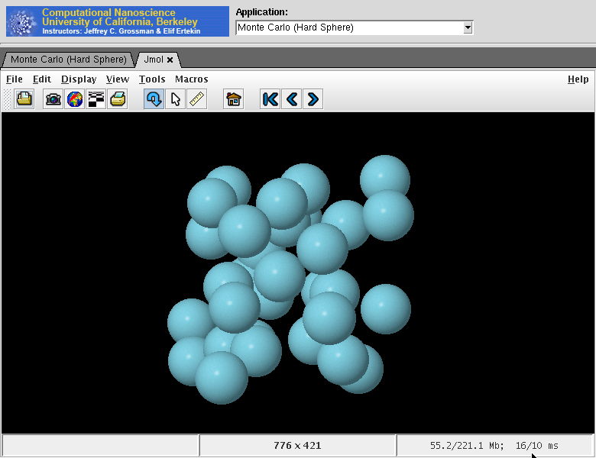
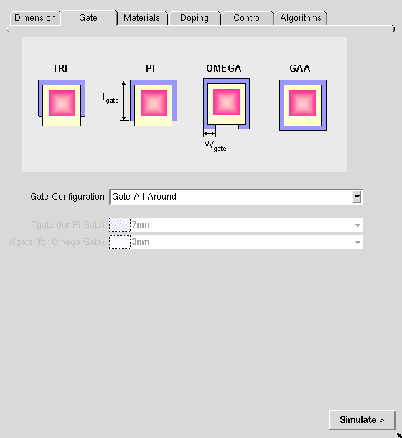
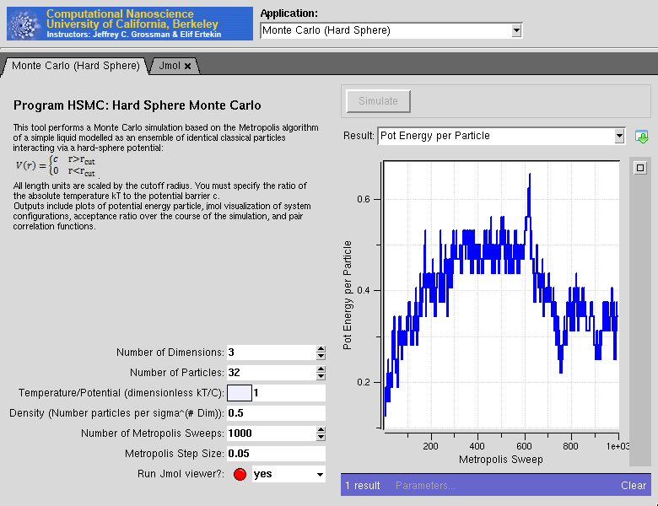
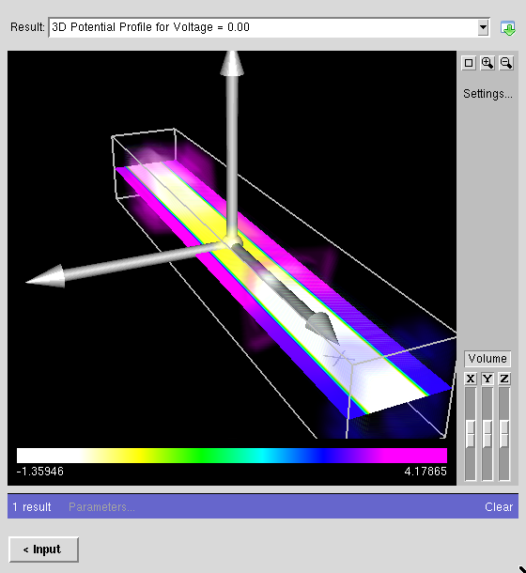

Apps
Apps/tools
Apps created/uploaded by your community
Access from any machine
Powered by the cloud
Integrated GUI
Used for research and education
Notes:
Apps can be created and uploaded by people in your community meaning not only the web developers can upload information to the hub but other users can also so there is really no limitation to who can uploading valuable information
You can get access to your hub from any machine meaning that the user does not have to have it locally install. It also means that your not limited to Windows, Mac or Linux machines
Its powered by the cloud which I will go more into detail later
It has an integrated GUI meaning that its easier for the user to even if they are not a experience coder
And with all of these factor its easier for the hub to be used for its main purpose, research and education

Slide 8



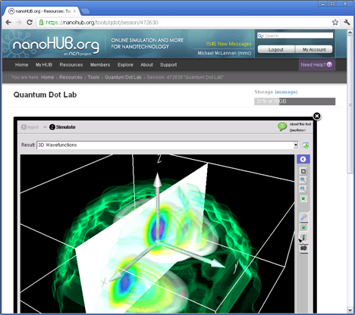






Accessible from any machine
Source code bundles
Binaries
Hello,
I am grad student from the UK. Your tool not compile for me. I get errors. That’s a not very nice.
32-bit
64-bit
Hey, can you help me?
It doesn’t work on my machine!
Live tools accessible
from any web browser
. . .
Notes:
Now usually when when developers put stuff up for download you get emails saying that, Hey This is not compatible with my machine and how do I get to work. Can you help me?
Or developers put up binaries. Binaries are a computer file containing machine-readable information that must be read by an application
But now users have to deal with having a 32 bit or 64 bit machine. Or windows or mac or linux and it a big hassle.
So Instead of all those problems Hubzero tools are setup server side. So pick any broswer and access your hub,
From there you have access to your tool running server side

Slide 9





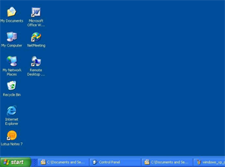
Powered by the Cloud
Locally
Installed
Program
Notes:
Normally when users download and install programs, they install them locally onto their own machine
Now using Hubzero, the tool that’s installed goes through your computer and into the Hub which uses Grid Data management is capable of sending your jobs off to TeraGrid DiaGrid and a lot more others to process your data

Slide 10
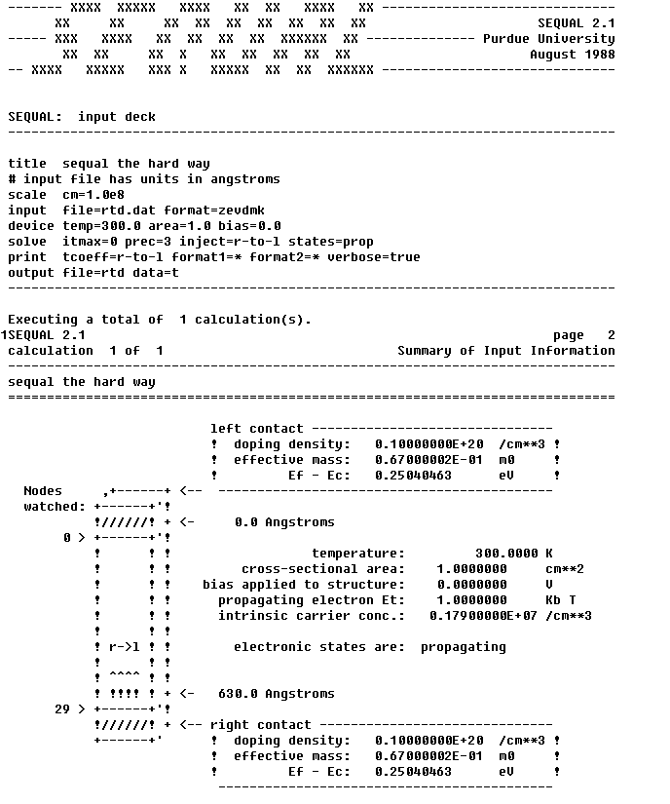
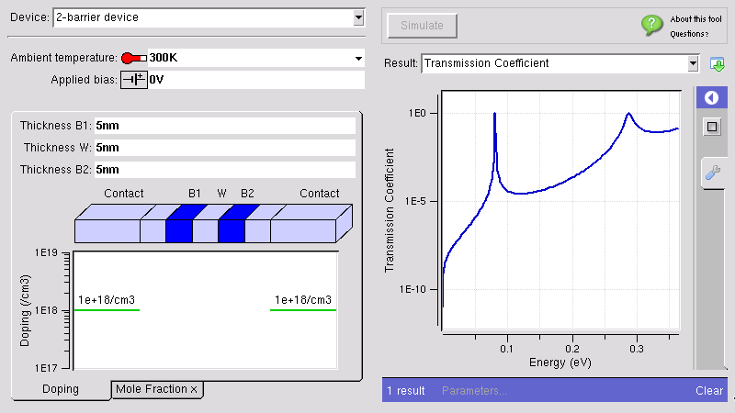



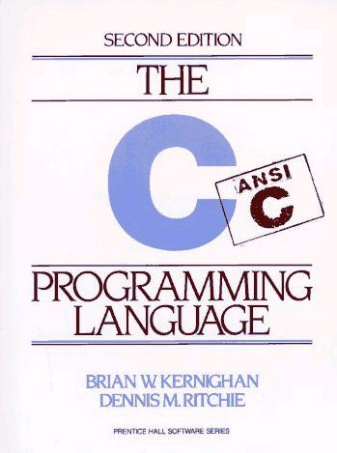

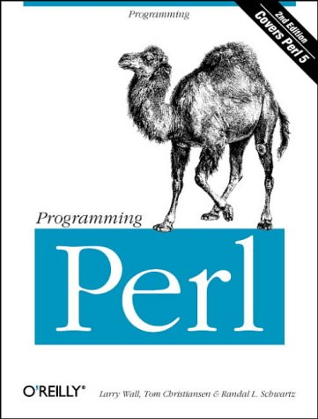


Integrated Visualization
inputs
outputs
Rappture
Rapid Application Infrastructure
Open Source (rappture.org)
Create standard desktop apps
Works with your favorite
programming language
Notes:
Now the Visual part of hubzero is done with a program called Rappture
It stands for Rapid Application Infrastructure
And one of the best things about Rappture is that it works with all of these programs languages such as
Matlab, Octave, Fortran, C Python Perl Java and Ruby to created your GUI

Slide 11
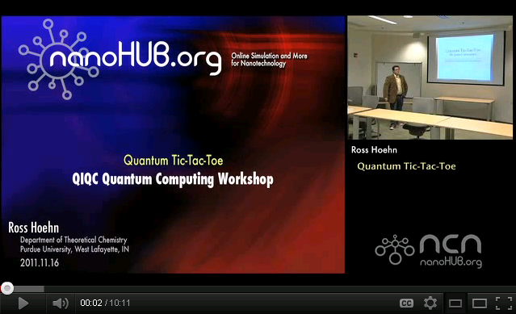
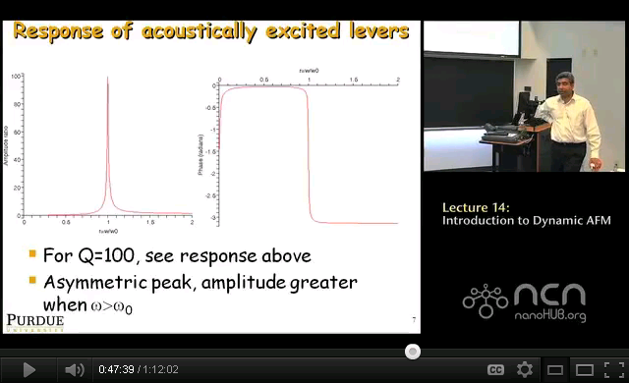
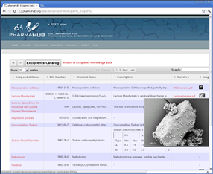
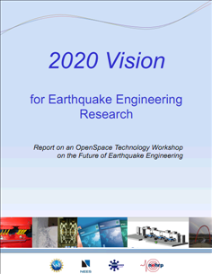
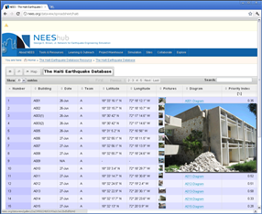
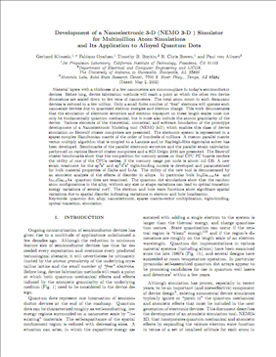
Hub Powered by Your Community
More than just apps
Seminars
Tutorials
Simulation &
Modeling Tools
Data from
Experiments
Tech Reports
Teaching Materials
Notes:
Hub zero as you know can allow simulations and modeling tools but users can put up more than just apps
You can add seminars and tutorials for your community
You can add reports teaching materials that usually just sit in the cabinet until you bring them out
You can also put up live data from experiments and also users to interact with the data.

Slide 12

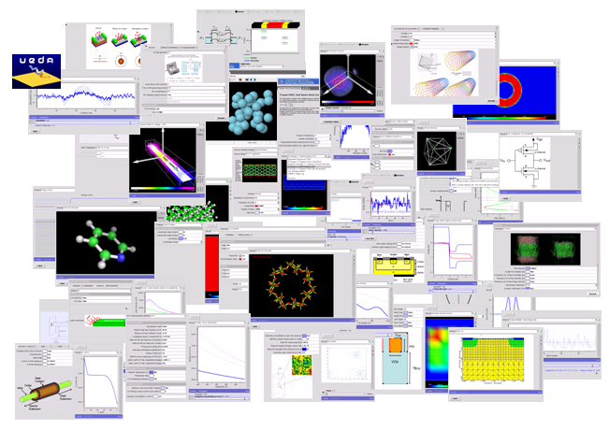
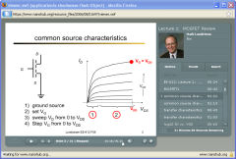
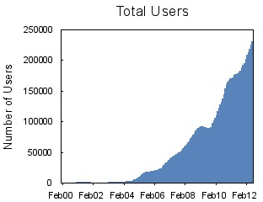
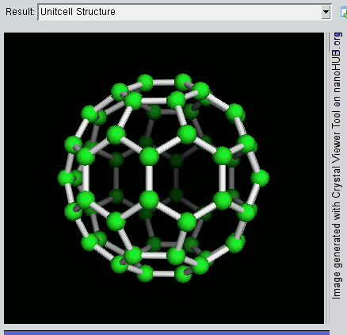
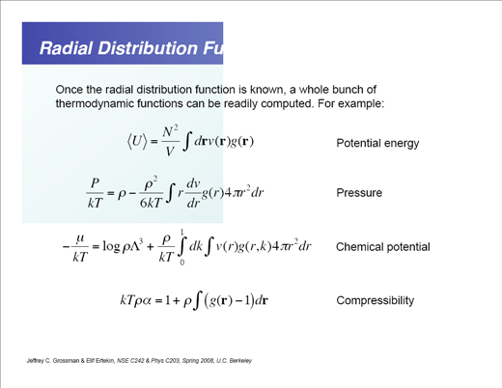
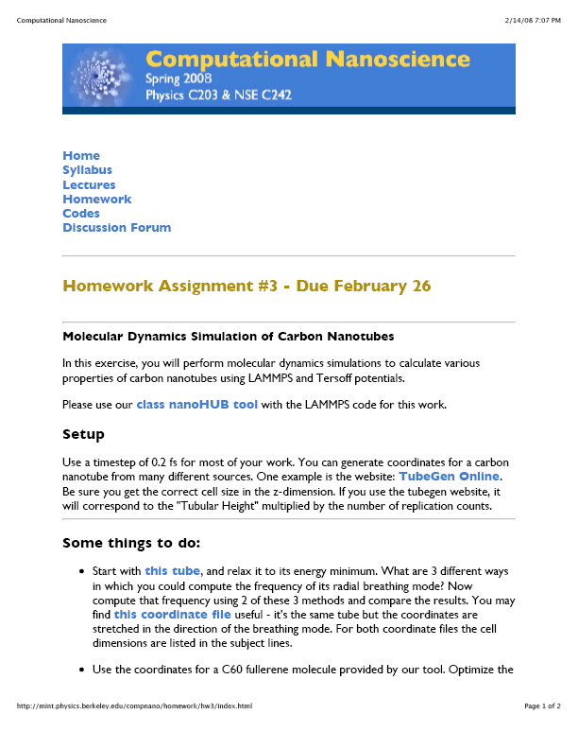
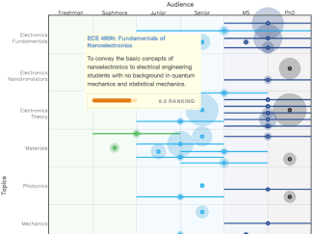
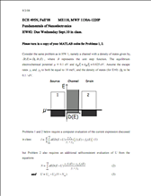
Example: nanoHUB.org
Network for
Computational
Nanotechnology
Established in 2002
235 simulation tools
1,890 seminars
230,000 users
535 teaching materials
64 courses

Slide 13
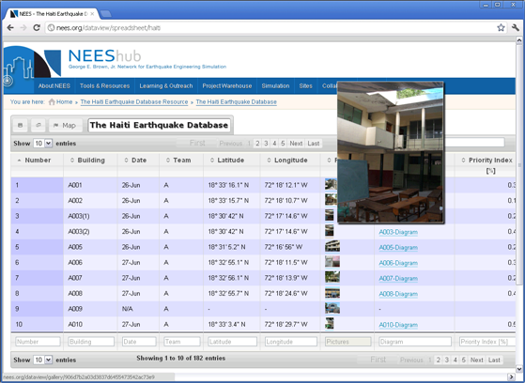


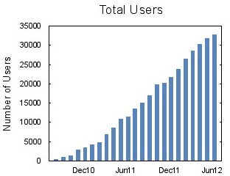
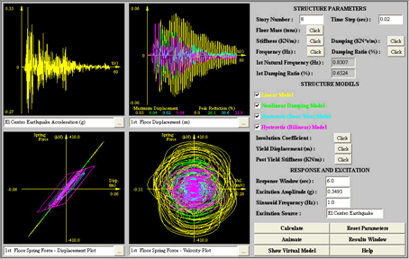
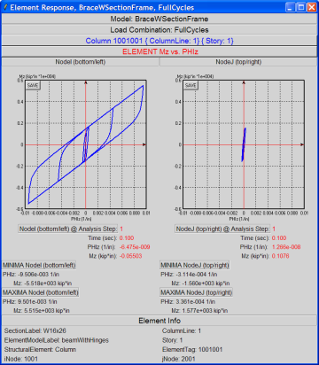





Example: NEES.org
George E. Brown, Jr.
Network for
Earthquake Engineering
Simulation
201 projects
9 databases
32,000 users
56 simulation tools
974 other

Slide 14

Why HUBzero?
Works for different scientific communities
Engineering
Healthcare
Environment
Education
Computing

Slide 15
So … HUBzero?
Notes:
So again Why HUBzero?
Why do I care so much about HUBzero

Slide 16





Thesis Topic
Notes:
I was given this topic for my Thesis
CReSIS which stands for the center of remote sensing of ice sheets which is funded by the National Science Foundation and has a mission of developing new technologies and computer models to measure and predict the response of sea level change to the mass balance of ice sheets in Greenland and Antarctica.
Now the way they gather this data is with a plane with ice penetrating radar. Once they have this data they put it for use.

Slide 17
Research Question
How can the PolarEDHub be utilized to access a database with CReSIS educational data for the purposes of research, education and scientific collaboration?

Slide 18
Downloads & Installations
Software
  VMware Fusion 5.0.3
  HUBzero version 1.1
  FileZilla 3.7.1.1
  VMware ESXi 5.0
Data
  CReSIS Educational Files
    Mrs. Cheri Hamilton
      K-12 Educational Director for CReSIS
Notes:
These are the various software that was used for this project.
Vmware fusion, which is a virtual machine manager that runs on your pc and allows you to run others OS’s on your current OS.
HUBzero which is the open source software for the purpose of research education and scientific collaboration
FilleZilla which is a free FTP client, which makes it easier to upload files to a server.
Vmware ESXi which isjust like vm ware fusion however its meant to run on a server which you can manage which VM is online
CReSIS educatinla files which are on the cresis site

Slide 19



Running VMware and HUBzero
First VMware
  Base
HUBzero
  Ip-address

Slide 20

Starting Point
Notes:
When I first got the hub set up, this is the basic layout of the hub. Notice the different components and sections. These are called Module. So Modules are basically extensions on an article page.

Slide 21


Back-end vs Front-end
Back-end
  Admin work
  Joomla
    Code, CSS, HTML, PHP
Front-end
  Users gets to see
  Pretty

Slide 22

Back-end vs Front-end
Notes:
This is a screenshot of the back-end of the hub and the front-end of the hub, Here I am inputting the text in for our partners.

Slide 23


Inputting Images
SCP
MV
Notes:
Here are screenshots of me inputting images into the hub. Since the hub is installed in a virtual machine I couldn't’t copy and paste these images into the hub. I had to use a terminal command called SCP which means secure copy which then allows me to get access to that file within the virtual machine. Then the mv command was used to move the images to the correct location.

Slide 24

FileZilla
FTP client
After manually installing the CReSIS documents
Notes:
FileZilla actually saved me a lot of time with uploading the files to the server. In order for the database to work the files needed to be in a place where I can link to them.

Slide 25

HUBzero v1.1
No database component
Database
Notes:
With Version 1.1 of HUBzero, there was no database component. So I started creating my own links that would link to the documents on the server. Honestly, It wouldn't have been pretty to stuff 100 links on a website and make the user search for each document. And these links alone took me a couple weeks to complete. It gets very ugly in the back-end.

Slide 26

New Version
October 2013 HUBzero pushed out a newer version
V 1.2
Projects
  Database
    Searchable
    Sortable
    Pretty
Notes:
With in the projects sections users can collaborate, they can set do it list, they can check off whats been done, they can create and upload files for the community.

Slide 27

Database - Excel
Excel
  CSV
Trick
  Types
  DataStart
Notes:
In order to set up a database in HUBzero you have to first create a Excel file with the information that you would like to display. The trick is that you have to give each column a type that the column below will be reading in.

Slide 28


Database - Process
Projects- Upload a file using CSV
Create a database using that file
After the process is complete the data is interactive.
Notes:
First you have to create a

Slide 29

Database
CSV file

Slide 30

Database
Interactive database
  Searchable
  Sortable
Notes:
Years

Slide 31

Feedback and Results
Did you enjoy using the PolarEDHub?
Please provide the ease of use for locating documents?
Would you use this PolarEDHub if you were teaching students on a lesson in polar education?
Would you recommend the PolarEDHub to other teachers?
Would you use the PolarEDHub to upload your educational documents if you were teaching an online course?
Could you see yourself collaborating with other professors about educational topics on the PolarEDHub?

Slide 32
Future Work
To make a future proof way of updating the hub
Successfully install the PolarEDHub on server
To invite teachers to collaborate on the PolarEDHub

Slide 33
References
Bibliography
A platform for research, collaboration and education. (2013, 10 5). Retrieved from NEEShub: http://nees.org
Anderson, D. (2012). BOINC Enhancement and Integration with HUBzero . Berkeley.
Bartlett. (2005, 5 12). New pressures for growing educational capacity. Retrieved 1 3, 2014, from https://www.wcu.edu/ceap/houghton/readings/technology_trends.html
Brain, M. (2011, 9 12). If the polar ice caps melted, how much would the oceans rise? Retrieved 1 1, 2014, from HowStuffWorks: http://science.howstuffworks.com/environmental/earth/geophysics/question473.htm
CReSIS. (n.d.). Retrieved from CReSIS: https://www.cresis.ku.edu/about
DiGirolamo, N. E. (2012, 7 25). Satellite Data Indicates Unprecedented Greenland Ice Sheet Surface Melt. Retrieved 6 12, 2013, from Science, Space and Robots: http://www.sciencespacerobots.com/satellite-data-indicates-unprecedented-greenland-ice-sheet-surface-melt-72520122
ECSU Report on Climate Change in NC/Relevant Research at ECSU. (2008). Retrieved from http://www.northcarolina.edu/nctomorrow/ECSU_climate_change_report.pdf
FileZilla. (2013, 08 07). FileZilla. Retrieved 09 13, 2013, from FileZilla: https://filezilla-project.org/client_features.php
G.Klimeck, M. L. (2006, Jan). The NCN: Science, Sumulation, and Cyber Services. IEEE Conference on Emerging Technologies , 496-500.
Gogineni, P. (2009). CReSIS Project Summary - Draft.
Guo, Z., Singh, R., & Pierce, M. (2009). Building the PolarGrid Portal Using Web 2.0 and OpenSocial. GCE '09: Proceedings of the 5th Grid Computing Environments Workshop. Portland: ACM.
Hossain, M. M., & Robinson, M. G. (2011). How to Motivate US Students to Pursue STEM. Nevada : David Publishing.
hubzero. (n.d.). About Us. Retrieved 8 12, 2013, from HUBzero: https://hubzero.org/about
Huebner, E. (2013, 9 14). Configuring and Customizing. Retrieved 10 21, 2013, from HUBZero: http://hubzero.org/resources/1026
Joolma! (n.d.). Joomla! for Beginners. Retrieved September 12, 2013, from Beginners - Joomla!: docs.joomla.org/Beginners
Joomla! (2013, 06 19). Joomla! Offical Documentation. Retrieved 09 10, 2013, from Joomla!: http://docs.joomla.org/Main_Page
Klimeck, G., McLennan, M., Brophy, S., Adams III, G., & Lundstrom, M. (2008). nanoHUB.org: Advancing Education and Research in Nanotechnology. Computing in Science and Engineering.
McLennan, M. The Hub Concept for Scientific Collaboration. Rosen Center for Advanced Computing.
McLennan, M. (n.d.). The Rappture Toolkit. Retrieved from http://www.rappture.org
nanoHUB. (2013, 10 15). nanoHUB. Retrieved from Online Simulation and More for Nanotechnology: http://nanohub.org
Schaeffer, U. (2012, 3 5). Knowledge is power: why education matters. Retrieved 8 12, 2013, from DW: http://www.dw.de/knowledge-is-power-why-education-matters/a-15880356
VMware. (2013, 10 17). Company. Retrieved from VMware: www.vmware.com
Why STEM? (n.d.). Retrieved 06 2013, from Change The Equation: http://changetheequation.org/why-stem
XSEDE. (2012, 9 10). Education Outreach. Retrieved 5 12, 2013, from XSEDE: https://www.xsede.org/education-outreach-blog/-/blogs/386663

Slide 34
Acknowledgements
Dr. Linda Hayden
Dr. Geoffrey Fox
Dr. Yolanda Anderson
Dr. Malcolm Lecompte
Mrs. Cheri Hamilton
Mr. Jeff Wood
Mr. Jeaime Powell
Mr. Marc Roberson

Slide 35

Questions

