Slide 1
Accelerating Machine Learning with Model-Centric Approach on Emerging Architectures
Many-Task Computing on Clouds, Grids, and Supercomputers Workshop (MTAGS)
November 14, 2016
Salt Lake City, Utah
Judy Qiu
Associate Professor of Intelligent Systems Engineering
Indiana University
SALSA

Slide 2


Outline
1. Motivation: Machine Learning Applications
2. A Faster Machine Learning solution on Intel Xeon/Xeon Phi Architectures
3..\ Harp-DAAL Framework: Design and Implementations
4. Conclusions and Future Work
SALSA

Slide 3



Acknowledgements
Bingjing Zhang | Thomas Wiggins | Langshi Chen | Meng Li | Bo Peng | Yiming Zou
SALSA HPC Group
School of Informatics and Computing
Indiana University
Rutgers University
Virginia Tech
Kansas University
Arizona State University
State University of New York at Stony Brooke
University of Utah
Digital Science Center
Indiana University
Intel Parallel Computing Center
IPCC

Slide 4
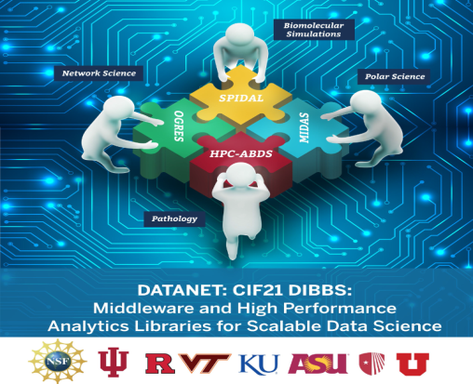

Slide 5
Motivation
Machine learning is widely used in data analytics
Need for high performance
  Big data & Big model
  ”Select model and hyper parameter tuning" step need to run the training algorithm for many times
Key: optimize for efficiency
  What is the 'kernel' of training?
  Computation model
SALSA
Notes:
model structure + computation pattern + synchronization mechanism

Slide 6
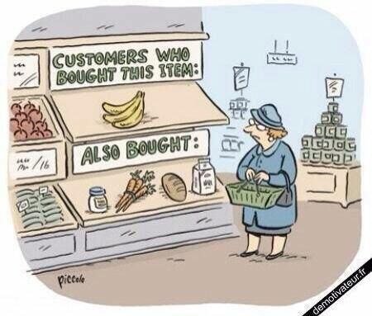
Recommendation Engine
Show us products typically purchased together
Curate books and music for us based on our preferences
Have proven significant because they consistently boost sales as well as customer satisfaction
SALSA

Slide 7

Fraud Detection
Identify fraudulent activity
Predict it before it has occurred saving financial services firms millions in lost revenue.
Analysis of financial transactions, email, customer relationships and communications can help
SALSA

Slide 8
More Opportunities…
Predicting customer “churn” – when a customer will leave a provider of a product or service in favor of another.
Predicting presidential elections, whether a swing voter would be persuaded by campaign contact.
Google has announced that it has used Deep Mind to reduce the energy used for cooling its datacenter by 40 per cent.
Imagine...
SALSA
Notes:
http://www.theenergycollective.com/david-k-thorpe/2386482/a-challenge-for-googles-deep-mind-solving-the-jevons-paradox
http://www.thefiscaltimes.com/Articles/2013/01/21/The-Real-Story-Behind-Obamas-Election-Victory

Slide 9
The Process of Data Analytics
Define the Problem
  Binary or multiclass, classification or regression, evaluation metric, …
Dataset Preparation
  Data collection, data munging, cleaning, split, normalization, …
Feature Engineering
  Feature selection, dimension reduction, …
Select model and hyper paramenter tuning
  Random Forest, GBM, Logistic Regression, SVM, KNN, Ridge, Lasso, SVR, Matrix Factorization, Neural Networks, …
Output the best models with optimized hyper parameters
SALSA

Slide 10
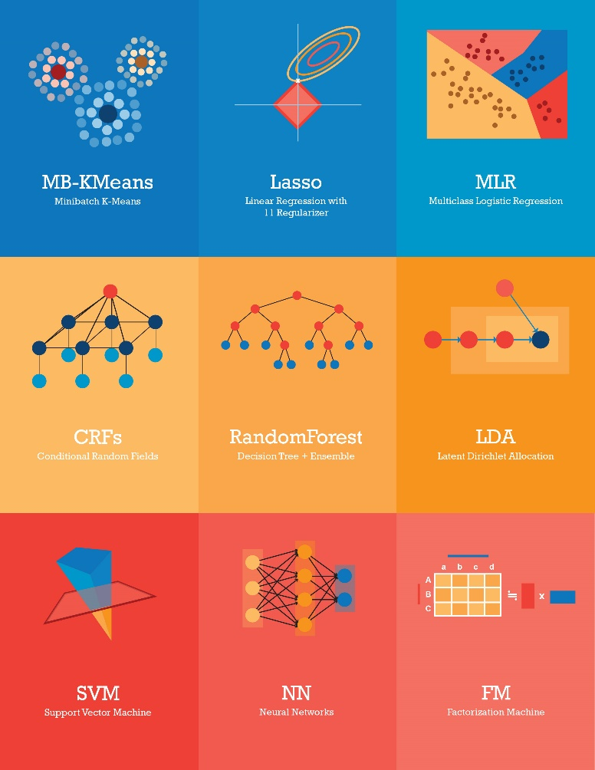
Challenges from Machine Learning Algorithms
Machine Learning algorithms in various domains:
Biomolecular Simulations
Epidemiology
Computer Vision
They have:
Iterative computation workload
High volume of training & model data
Traditional Hadoop/MapReduce solutions:
Low Computation speed (lack of multi-threading)
High data transfer overhead (disk based)
SALSA

Slide 11
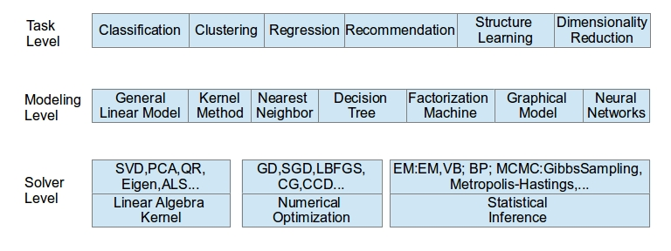
Taxonomy for ML Algorithms
Task level: describe functionality of the algorithm
Modeling level: the form and structure of model
Solver level: the computation pattern of training
SALSA

Slide 12
Outline
1. Motivation: Machine Learning Applications
2. A Faster Machine Learning solution on Intel Xeon/Xeon Phi Architectures
3. Harp-DAAL Framework: Design and Implementations
4. Conclusions and Future Work
SALSA

Slide 13
Emerging Many-core Platforms
Comparison of Many-core and Multi-core Architectures
Much more number of cores
Lower single core frequency
Higher data throughput
How to explore computation and Bandwidth of KNL for Machine Learning applications ?
SALSA

Slide 14
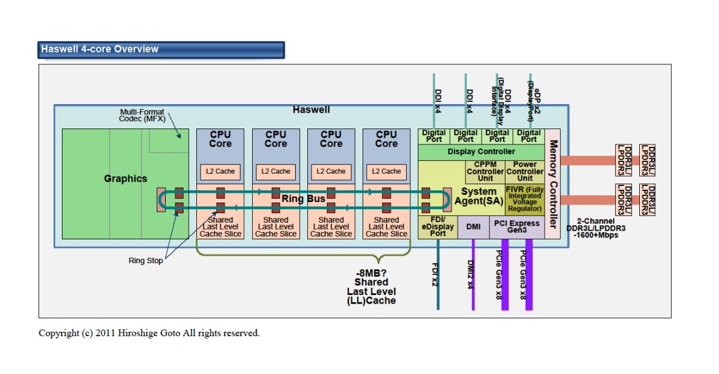
Intel Xeon/Haswell Architecture
Much more number of cores
Lower single core frequency
Higher data throughput
SALSA

Slide 15
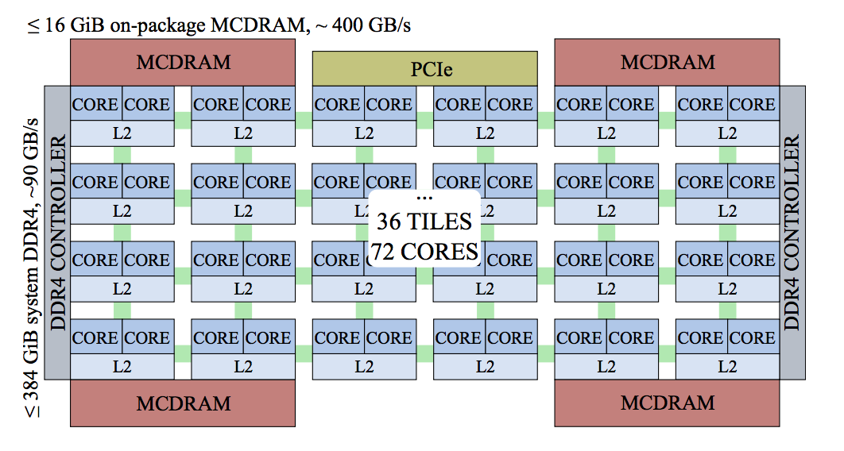
Intel Xeon Phi (Knights Landing) Architecture
Up to 72 cores, 288 threads connected in a 2D-mesh
High bandwidth (> 400 GB/s) Memory (MCDRAM)
Up to 144 AVX512 vectorization units (VPUs)
3 Tflops (DP) performance delivery
Omni-path link among processors (~ 100 GB/s)
SALSA

Slide 16
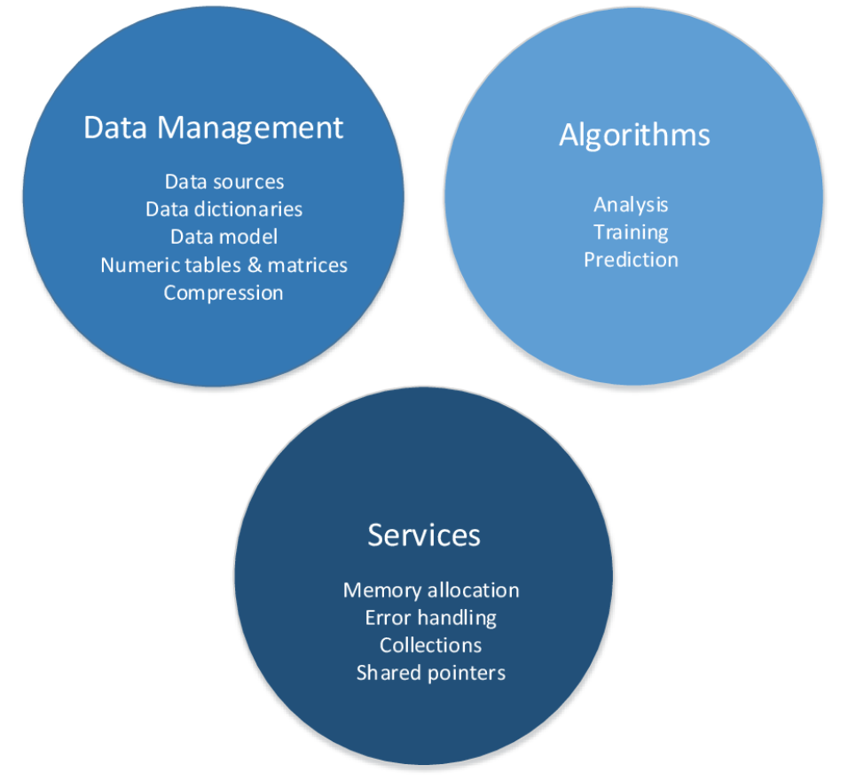
DAAL: Intel’s Data Analytics Acceleration Library
DAAL is an open-source project that provides:
Algorithms Kernels to Users
    Batch Mode (Single Node)
    Distributed Mode (multi nodes)
    Streaming Mode (single node)
Data Management & APIs to Developers
    Data structure, e.g., Table, Map, etc.
    HPC Kernels and Tools: MKL, TBB, etc.
    Hardware Support: Compiler
SALSA

Slide 17
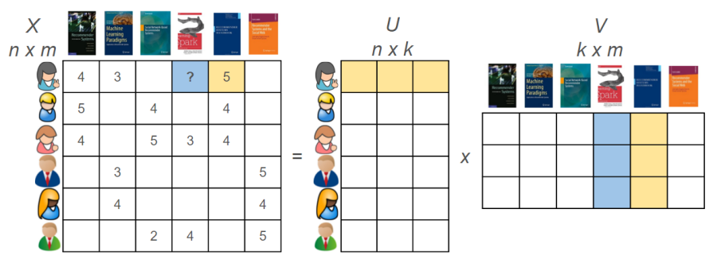

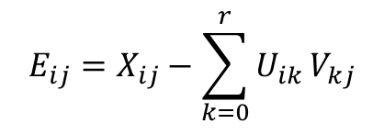
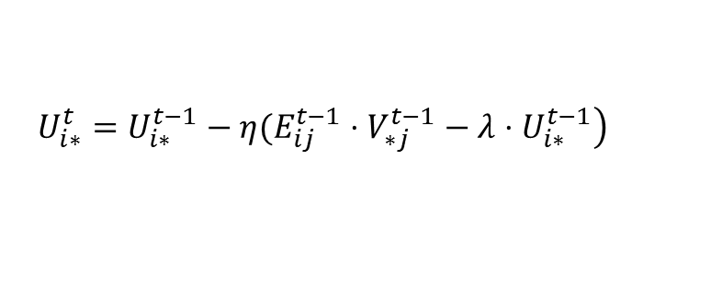
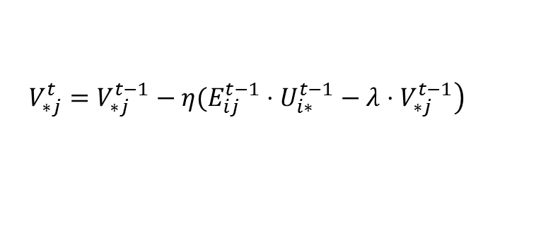
Case Study: Matrix-Factorization Based on SGD (MF-SGD)
X$=UV$
Decompose a large matrix into two model matrices, used in Recommender systems
$$E_{ij}=X_{ij}−\sum_{k=0}^{r}{U_{ik}}V_{kj}$$
Large Training Data: Tens of millions of points
Large Model Data: m, n could be millions
Random Memory Access Pattern in Training
$$\left.U_{i∗}^{t}=U_{i∗}^{t−1}−η(E_{ij}^{t−1}⋅V_{∗j}^{t−1}−λ⋅U_{i∗}^{t−1}\right)$$
$$\left.V_{∗j}^{t}=V_{∗j}^{t−1}−η(E_{ij}^{t−1}⋅U_{i∗}^{t−1}−λ⋅V_{∗j}^{t−1}\right)$$
SALSA

Slide 18
Intra-node Performance: DAAL-MF-SGD vs. LIBMF
LIBMF: a start-of-art open source MF-SGD package
Only single node mode
Highly optimized for memory usage
We compare our DAAL-MF-SGD kernel with LIBMF on a single KNL node, using YahooMusic dataset
SALSA

Slide 19
Intra-node Performance: DAAL-MF-SGD vs. LIBMF
DAAL-MF-SGD delivers a comparable training time for each iteration with that of LIBMF
DAAL-MF-SGD has a better convergence speed than LIBMF, using less iterations to achieve the same convergence.
SALSA

Slide 20
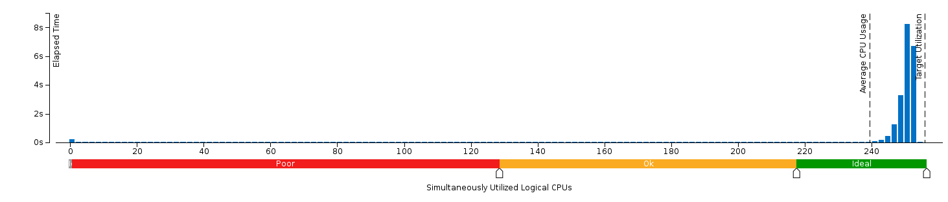
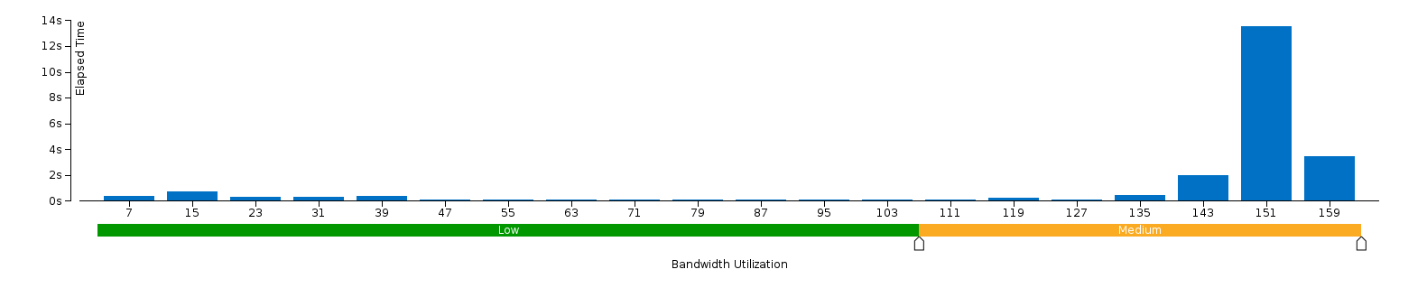
CPU utilization and Memory Bandwidth on KNL
DAAL-MF-SGD utilizes more than 95% of all the 256 threads on KNL
DAAL-MF-SGD uses more than half of the total bandwidth of MCDRAM on KNL
We need to explore the full usage of all of MCDRAM’s bandwidth (around 400 GB) to further speed up DAAL-MF-SGD
CPU (threads) utilization on KNL
Memory Bandwidth Usage on KNL
SALSA

Slide 21
Intra-node Performance: Haswell Xeon vs. KNL Xeon Phi
DAAL-MF-SGD has a better performance on KNL than on Haswell CPU, because it benefits from
KNL’s AVX512 vectorization
High Memory Bandwidth
KNL has
3x speeds up by vectorization
1.5x – 4x speeds up to Haswell
SALSA

Slide 22
Machine Learning using Harp Framework
SALSA

Slide 23
The Growth of Model Sizes and Scales of Machine Learning Applications
2014
2015
SALSA

Slide 24
Challenges of Parallelization Machine Learning Applications
Big training data
Big model
Iterative computation, both CPU-bound and memory-bound
High frequencies of model synchronization
SALSA

Slide 25
Parallelizing Machine Learning Applications
Machine Learning Application
Implementation
Machine Learning Algorithm
Programming Model
Computation Model
SALSA

Slide 26
Types of Machine Learning Applications and Algorithms
Expectation-Maximization Type
  K-Means Clustering
  Collapsed Variational Bayesian for topic modeling (e.g. LDA)
Gradient Optimization Type
  Stochastic Gradient Descent and Cyclic Coordinate Descent for classification (e.g. SVM and Logistic Regression), regression (e.g. LASSO), collaborative filtering (e.g. Matrix Factorization)
Markov Chain Monte Carlo Type
  Collapsed Gibbs Sampling for topic modeling (e.g. LDA)
SALSA

Slide 27
Inter/Intra-node Computation Models
Model-Centric Synchronization Paradigms
(A)
(B)
Model
Model1
Model2
Model3
Process
Process
Process
Process
Process
Process
Synchronized algorithm
The latest model
Synchronized algorithm
The latest model
(C)
(D)
Model
Model
Process
Process
Process
Process
Process
Process
Synchronized algorithm
The stale model
Asynchronous algorithm
The stale model
SALSA

Slide 28
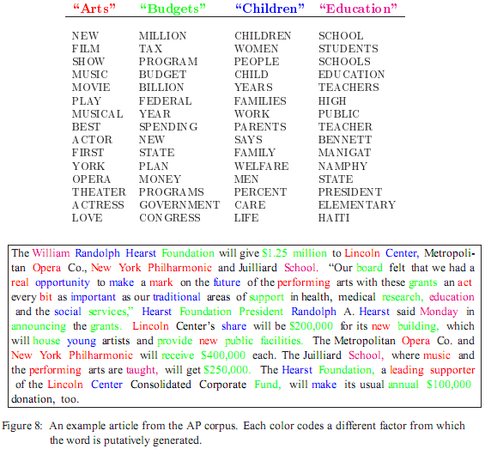
Case Study: LDA mines topics in text collection
Huge volume of Text Data
  Information overloading
  What on earth is inside the TEXT Data?
Search
  Find the documents relevant to my need (ad hoc query)
Filtering
  Fixed info needs and dynamic text data
What's new inside?
  Discover something I don't know
Blei, D. M., Ng, A. Y. & Jordan, M. I. Latent Dirichlet Allocation. J. Mach. Learn. Res. 3, 993–1022 (2003).
SALSA

Slide 29
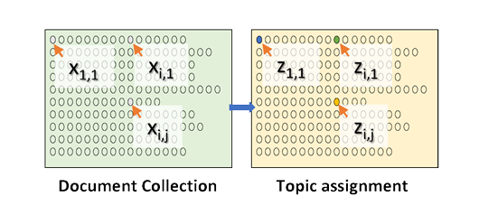
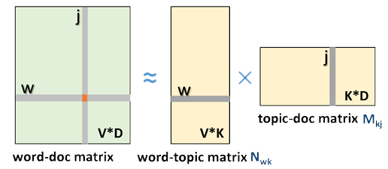
LDA and Topic model
Topic Models is a modeling technique, modeling the data by probabilistic generative process.
Latent Dirichlet Allocation (LDA) is one widely used topic model.
Inference algorithm for LDA is an iterative algorithm using share global model data.
Document
Word
Topic: semantic unit inside the data
Topic Model
  documents are mixtures of topics, where a topic is a probability distribution over words
Global Model Data
3.7 million docs
10k topics
1 million words
  Normalized co-occurrence matrix
  Mixture components
  Mixture weights
SALSA

Slide 30
The Comparison of LDA CGS Model Convergence Speed
The parallelization strategy can highly affect the algorithm convergence and the system efficiency. This brings us four questions:
What part of the model needs to be synchronized?
The parallelization needs to decide which model parts needs synchronization.
When should the model synchronization happen?
In the parallel execution timeline, the parallelization should choose the time point to perform model synchronization.
Where should the model synchronization occur?
The parallelization needs to tell the distribution of the model among parallel components, what parallel components are involved in the model synchronization.
How is the model synchronization performed?
The parallelization needs to explain the abstraction and the mechanism of the model synchronization.
rtt & Petuum: rotate model parameters
lgs & lgs-4s: one or more rounds of model synchronization per iteration
Yahoo!LDA: asynchronously fetch model parameters
SALSA

Slide 31
Inter-node Computation Models
(Training Data Items Are Partitioned to Each Process)
Computation Model A
Computation Model B
  Once a process trains a data item, it locks the related model parameters and prevents other processes from accessing them. When the related model parameters are updated, the process unlocks the parameters. Thus the model parameters used in local computation are always the latest.
  Each process first takes a part of the shared model and performs training. Afterwards, the model is shifted between processes. Through model rotation, each model parameters are updated by one process at a time so that the model is consistent.
Computation Model C
Computation Model D
  Each process first fetches all the model parameters required by local computation. When the local computation is completed, modifications of the local model from all processes are gathered to update the model.
  Each process independently fetches related model parameters, performs local computation, and returns model modifications. Unlike A, workers are allowed to fetch or update the same model parameters in parallel. In contrast to B and C, there is no synchronization barrier.
SALSA

Slide 32
Intra-node Computation Models
(Training Data Items Are Scheduled to Each Thread)
Computation Model A
Computation Model B
  Once a thread trains a data item, it locks the related model parameter and prevents other threads from accessing it. When the model parameter is updated, the thread unlocks the parameter. Thus the model parameters used per thread are always the latest.
  Each thread first takes a part of the shared model and performs training. Afterwards, the model part is sent or scheduled to another thread. Model parameters in each model part are updated by one thread at a time so that the model is consistent.
Computation Model C
Computation Model D
  Each thread has a copy of the related model parameters. When the local computation is completed, modifications of the local model from all threads are combined to update the model.
  Each thread independently reads the related model parameters, performs computation, and update the parameters. Unlike A, threads are allowed to read or write the same model parameter in parallel.
SALSA

Slide 33
Intra-node: Schedule Data Partitions to Threads
(only Data Partitions in Computation Model A, C, D; Data and/or Model Partitions in B)
(A) Dynamic Scheduler
(B) Static Scheduler
(A) Dynamic Scheduler
I
I
I
  All computation models can use this scheduler.
  All the inputs are submitted to one queue.
  Threads dynamically fetch inputs from the queue.
  The main thread can retrieve the outputs from the output queue.
I
I
I
Thread
Thread
Thread
Thread
Thread
Thread
(B) Static Scheduler
  All computation models can use this scheduler.
  Each thread has its own input queue and output queue.
  Each thread can submit inputs to another thread .
  The main thread can retrieve outputs from each task’s output queue.
O
O
O
O
O
O
SALSA

Slide 34
Harp Framework
Harp
Input (Training) Data
1
Load
1
Load
1
Load
Harp is an open-source project developed by
Indiana University.
MPI-like collective communication operations that are highly optimized for big data problems.
Harp has efficient and innovative computation models for different machine learning problems.
Task
Task
Task
Current Model
Current Model
Current Model
2
Compute
2
Compute
2
Compute
4
Iteration
New Model
New Model
New Model
3
3
3
Collective Communication (e.g. Allreduce, Rotation)
SALSA

Slide 35
Harp Features
Abstraction
Distributed computing
Management
Data
Computation
Collective
Dynamic scheduler
Arrays & Objects
Pool-based
Event-driven
Multi-threading
Partitions & Tables
Static scheduler
Schedulers
SALSA

Slide 36
Data Types
Arrays & Objects
Primitive Arrays
ByteArray, ShortArray, IntArray, FloatArray, LongArray, DoubleArray
Serializable Objects
Writable
Partitions & Tables
Partition
An array/object with partition ID
Table
The container to organize partitions
Key-value Table
Automatic partitioning based on keys
SALSA

Slide 37
APIs
Scheduler
Collective
broadcast
Event Driven
reduce
allgather
allreduce
regroup
pull
push
rotate
getEvent
waitEvent
sendEvent
DynamicScheduler
StaticScheduler
SALSA

Slide 38
Case Study: LDA and Matrix-Factorization Based on SGD and CCD
Dataset | Node Type
 | Xeon E5 2699 v3 (each uses 30 Threads) | Xeon E5 2670 v3 (each uses 20 Threads)
clueweb1 | Harp CGS vs. Petuum (30) | Harp CGS vs. Petuum (60)
clueweb2 | Harp SGD vs. NOMAD (30) Harp CCD vs. CCD++ (30) | Harp SGD vs. NOMAD (60) Harp CCD vs. CCD++ (60)
SALSA

Slide 39
Collapsed Gibbs Sampling for Latent Dirichlet Allocation
SALSA

Slide 40
Matrix Factorization
SALSA

Slide 41
Features of Model Update in Machine Learning Algorithms
I. The algorithms can converge even when the consistency of a model is not guaranteed to some extent.
II. The update order of the model parameters is exchangeable.
III. The model parameters for update can be randomly selected.
Algorithm Examples
Collapsed Gibbs Sampling for Latent Dirichlet Allocation
Stochastic Gradient Descent for Matrix Factorization
Cyclic Coordinate Descent for Matrix Factorization
SALSA

Slide 42
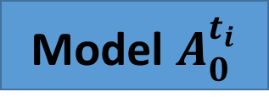
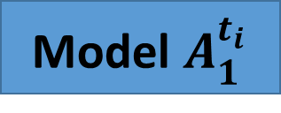
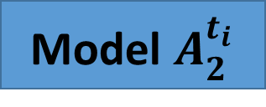
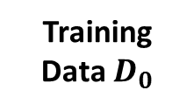
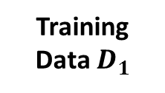
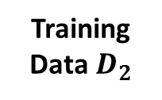
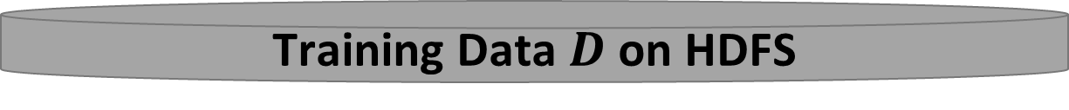
A Parallelization Solution using Model Rotation
3
Iteration Control
2
Rotate Model
Maximizing the effectiveness of parallel model updates for algorithm convergence
Worker 0
Worker 1
Worker 2
Model $A_{0}^{t_{i}}$
Model $A_{1}^{t_{i}}$
Model $A_{2}^{t_{i}}$
Minimizing the overhead of communication for scaling
Training Data $D_{0}$
Training Data $D_{1}$
Training Data${ D}_{2}$
1
Local Compute
Load, Cache & Initialize
Training Data $D$ on HDFS
SALSA

Slide 43







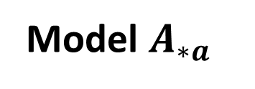
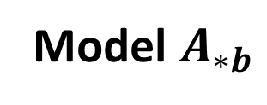


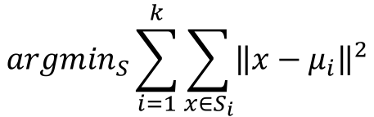



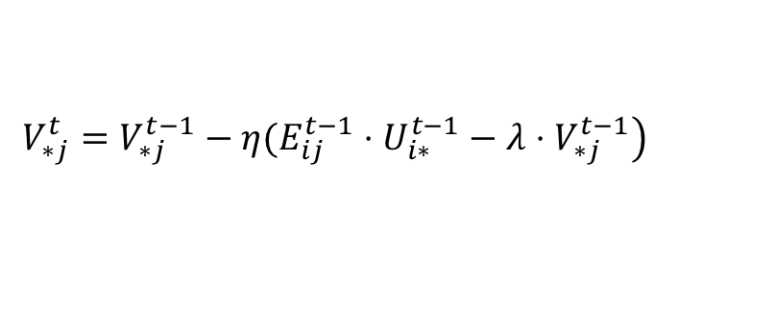










Pipeline Model Rotation
Model $A_{∗a}$
Model $A_{∗b}$
Worker 0
Worker 1
Worker 2
$$A_{0a}$$
$$A_{1a}$$
$$A_{2a}$$
Time
$$A_{0b}$$
$$A_{1b}$$
$$A_{2b}$$
$$A_{2a}$$
$$A_{0a}$$
$$A_{1a}$$
$$A_{2b}$$
$$A_{0b}$$
$$A_{1b}$$
$$A_{1a}$$
$$A_{2a}$$
$$A_{0a}$$
$$A_{1b}$$
$$A_{2b}$$
$$A_{0b}$$
$$A_{0a}$$
$$A_{1a}$$
$$A_{2a}$$
$$A_{0b}$$
$$A_{1b}$$
$$A_{2b}$$
Shift
Shift
Shift
SALSA

Slide 44
Dynamic Rotation Control for LDA CGS and MF SGD
Multi-Thread Execution
Model Parameters
From Rotation
Model Related Data
Computes until the time arrives, then starts model rotation
Other Model Parameters
From Caching
SALSA

Slide 45
CGS Model Convergence Speed
LDA Dataset | Documents | Words | Tokens | CGS Parameters
clueweb1 | 76163963 | 999933 | 29911407874 | $$K=10000,α=0.01, β=0.01$$
60 nodes x 20 threads/node
30 nodes x 30 threads/node
SALSA

Slide 46
When the model likelihood converges to −1.37×10¹¹
Harp is 45% faster.
Harp is 18% faster.
SALSA

Slide 47
SGD Model Convergence Speed
MF Dataset | Rows | Columns | Non-ZeroElements | SGD Parameters
clueweb2 | 76163963 | 999933 | 15997649665 | $$K=2000, λ=0.01,ε=0.001$$
60 nodes x 20 threads/node
30 nodes x 30 threads/node
SALSA

Slide 48
When the test RMSE value converges to 1.61
Harp is 58% faster.
Harp is 93% faster.
SALSA

Slide 49
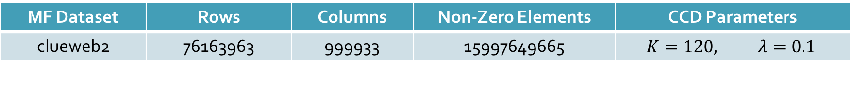
CCD Model Convergence Speed
MF Dataset | Rows | Columns | Non-Zero Elements | CCD Parameters
clueweb2 | 76163963 | 999933 | 15997649665 | $$K=120, λ=0.1$$
60 nodes x 20 threads/node
30 nodes x 30 threads/node
SALSA

Slide 50
When the test RMSE value converges to 1.68
Harp is 53% faster.
Harp is 101% faster.
SALSA

Slide 51
Outline
1. Motivation: Machine Learning Applications
2. A Faster Machine Learning solution on Intel Xeon/Xeon Phi Architectures
3. Harp-DAAL Framework: Design and Implementations
4. Conclusions and Future Work
SALSA

Slide 52
Harp-DAAL: High Performance Machine Learning Framework
Harp
1. Java API
2. Local computation: Java threads
3. Communication: Collective MapReduce
Harp-DAAL
1. Java API
2. Local Computation: DAAL
3. Communication: Collective MapReduce
DAAL
1. Java & C++ API
2. Local computation: MKL, TBB
3. Communication: MPI & Hadoop & Spark
SALSA

Slide 53
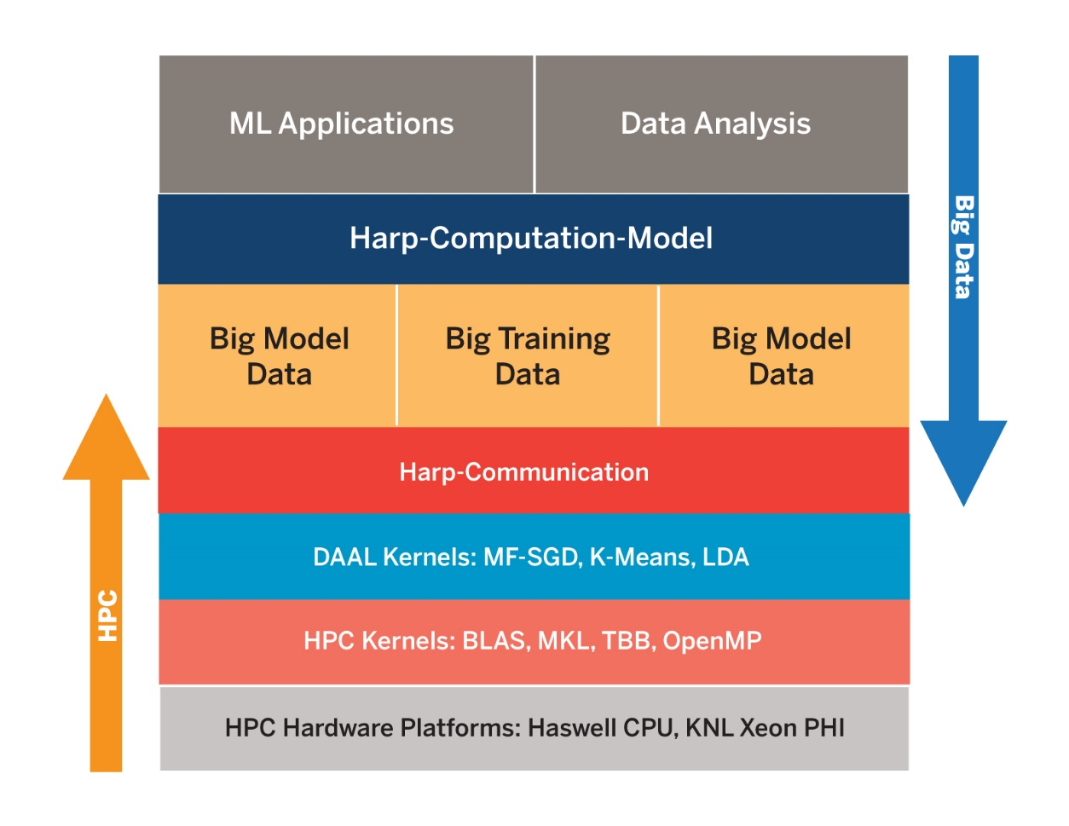
Harp-DAAL in the HPC-BigData Stack
Harp-DAAL is at the intersection of HPC and Big Data stacks, which requires:
Interface: User friendly, consistent with other Java written Data analytics Apps.
Low level Kernels: highly optimized for HPC platforms such as many-core architecture
Models: inherit Harp’s computation models for different ML algorithms
SALSA

Slide 54
Inter-node Performance: Harp-DAAL-Kmeans vs. Harp-Kmeans
Inter-node test is done on two Haswell E5-2670 v3 2.3GHz nodes. We vary the size of input points and the number of centroids (clusters)
By using DAAL-Harp’s high performance kernels, DAAL-Harp-Kmeans has a 2x to 4x speeds up over Harp-Kmeans
SALSA

Slide 55
Inter-node Performance: Harp-DAAL-SGD vs. Harp-SGD
The Inter-node test is done on two Haswell E5-2670 v3 2.3GHz nodes. We use two datasets
MovieLens, a small set with 9301274 points
Yahoomusic a large set with 252800275 points
For both datasets, we have around 5% to 15% speeds up by using DAAL-SGD within Harp.
There are still some overheads of interfacing DAAL and Harp, which requires further investigation.
SALSA

Slide 56
Interface Overhead between DAAL and Harp
We decompose the training time into different phases. There are two overhead of interface
Harp-DAAL Interface
  Conversion between data structures
JNI interface
  Data movement from Java heap to out-of-heap buffer for C++ native kernels in DAAL
The two overheads could take up to 25% of the total training time, which must be optimized in the future work.
Rewrite some Harp codes to create shared memory space between DAAL and Harp
Add more Harp compatible data structures to DAAL
SALSA

Slide 57
Outline
1. Motivation: Machine Learning Applications
2. Harp-DAAL Framework: Design and Implementations
3. A Faster Machine Learning solution on Intel Xeon/Xeon Phi Architectures
4. Conclusions and Future Work
SALSA

Slide 58
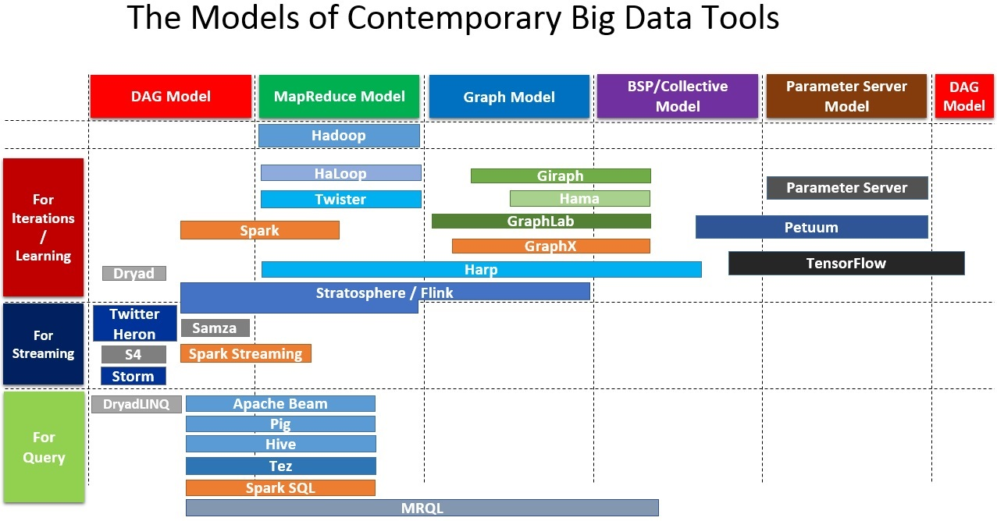
The Models of Contemporary Big Data Tools

Slide 59
Programming Models
Comparison of Iterative Computation Tools
Spark
Harp
Parameter Server
Worker
Server Group
Driver
Daemon
Daemon
Worker
Worker
Worker Group
Worker Group
Worker
Daemon
Various Collective Communication Operations
Asynchronous Communication Operations
Implicit Data Partitioning
Implicit Communication
Explicit Data Partitioning
Explicit Communication
Explicit Data Partitioning
Implicit Communication
M. Zaharia et al. “Spark: Cluster Computing with Working Sets”. HotCloud, 2010.
B. Zhang, Y. Ruan, J. Qiu. “Harp: Collective Communication on Hadoop”. IC2E, 2015.
M. Li, et al. “Scaling Distributed Machine Learning with the Parameter Server”. OSDI, 2014.
SALSA

Slide 60
Harp: a Hadoop plug-in based on map-collective models
Programming Model
Architecture
MapReduce Model
MapCollective Model
MapReduce Applications
MapCollective Applications
M
M
M
M
Application
M
M
M
M
MapReduce V2
Harp
Shuffle
R
R
Collective Communication
+ Event Driven
Framework
Resource Manager
YARN
MPI-like collective communication operations that are highly optimized for big data problems.
A Hadoop Plug-in to integrate with the ecosystems.
Efficient and innovative computation models for different machine learning problems.
SALSA

Slide 61
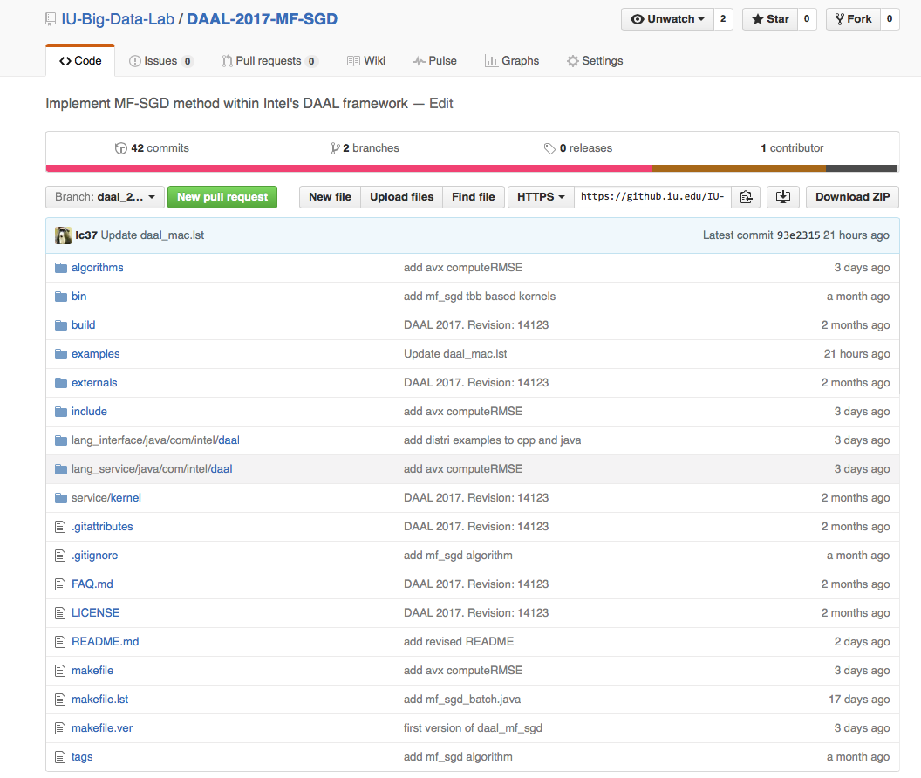
Hadoop/Harp-DAAL: Prototype and Production Code
Source codes available on Indiana University’s Github account
An example of MF-SGD is at
https://github.iu.edu/IU-Big-Data-Lab/DAAL-2017-MF-SGD
Harp-DAAL follows the same standard of DAAL’s original codes
improve DAAL’s existed algorithms for distributed usage
add new algorithms to DAAL’s codebase.
Harp-DAAL’s kernel is also compatible with other communication tools.
SALSA

Slide 62
Summary and Future Work
Identification of Apache Big Data Software Stack and integration with High Performance Computing Stack to give HPC-ABDS
    ABDS (Many Big Data applications/algorithms need HPC for performance)
    HPC (needs software model productivity/sustainability)
Identification of 4 computation models for machine learning applications
HPC-ABDS Plugin Harp: adds HPC communication performance and rich data abstractions to Hadoop by development of Harp library of Collectives to use at Reduce phase
    Broadcast and Gather needed by current applications
    Discover other important ones (e.g. Allgather, Global-local sync, Rotation pipeline)
Integration of Hadoop/Harp with Intel DAAL and other libraries
Implement efficiently on each platform (e.g. Amazon, Azure, Big Red II, Haswell/KNL Clusters)
SALSA

