Slide 1
Data Intensive Clouds
Tools and Applications
May 2, 2013
Judy Qiu
xqiu@indiana.edu
http://SALSAhpc.indiana.edu
School of Informatics and Computing
Indiana University
Notes:
The term SALSA or Service Aggregated Linked Sequential Activities, is derived from Hoare’s Concurrent Sequential Processes (CSP)

Slide 2
Important Trends
  In all fields of science and throughout life (e.g. web!)
  Impacts preservation, access/use, programming model
    new commercially supported data center model building on compute grids
Data Deluge
Cloud Technologies
Multicore/
Parallel Computing
eScience
  Implies parallel computing important again
    Performance from extra cores – not extra clock speed
  A spectrum of eScience or eResearch applications (biology, chemistry, physics social science and
  humanities …)
  Data Analysis
  Machine learning

Slide 3
Challenges for CS Research
Science faces a data deluge. How to manage and analyze information?
Recommend CSTB foster tools for data capture, data curation, data analysis
―Jim Gray’s
Talk to Computer Science and Telecommunication Board (CSTB), Jan 11, 2007
There’re several challenges to realizing the vision on data intensive systems and building generic tools (Workflow, Databases, Algorithms, Visualization ).
Cluster-management software
Distributed-execution engine
Language constructs
Parallel compilers
Program Development tools
. . .

Slide 4
Data Explosion and Challenges
Data Deluge
Cloud Technologies
Multicore/
Parallel Computing
eScience

Slide 5
Data We’re Looking at
  Biology DNA sequence alignments (Medical School & CGB)
  (several million Sequences / at least 300 to 400 base pair each)
  Particle physics LHC (Caltech)
  (1 Terabyte data placed in IU Data Capacitor)
  Pagerank (ClueWeb09 data from CMU)
  (1 billion urls / 1TB of data)
  Image Clustering (David Crandall)
  (7 million data points with dimensions in range of 512 ~ 2048, 1 million clusters; 20 TB intermediate data in shuffling)
  Search of Twitter tweets (Filippo Menczer)
  (1 Terabyte data / at 40 million tweets a day of tweets / 40 TB decompressed data)
High volume and high dimension require new efficient computing approaches!

Slide 6
Data Explosion and Challenges
Data is too big and gets bigger to fit into memory
For “All pairs” problem O(N²),
PubChem data points 100,000 => 480 GB of main memory
(Tempest Cluster of 768 cores has 1.536TB)
We need to use distributed memory and new algorithms to solve the problem
Communication overhead is large as main operations include matrix multiplication (O(N²)), moving data between nodes and within one node adds extra overheads
We use collective communications between nodes and concurrent threading internal to node on multicore clusters
Concurrent threading has side effects (for shared memory model like CCR and OpenMP) that impact performance
sub-block size to fit data into cache
cache line padding to avoid false sharing

Slide 7
Cloud Services and MapReduce
Data Deluge
Cloud Technologies
Multicore/
Parallel Computing
eScience

Slide 8
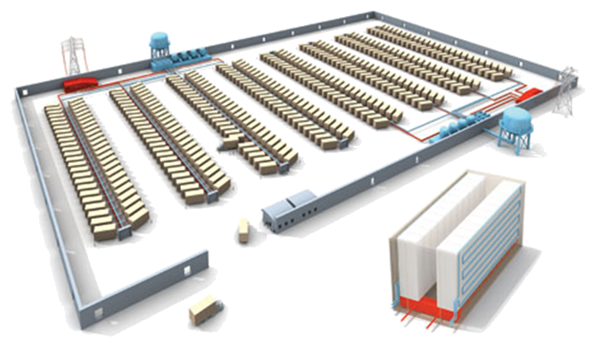
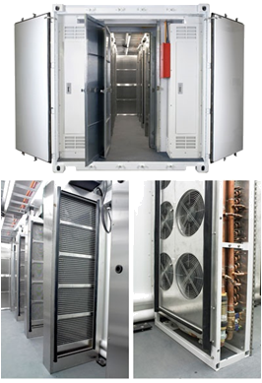
Clouds as Cost Effective Data Centers
Builds giant data centers with 100,000’s of computers; ~ 200-1000 to a shipping container with Internet access
“Microsoft will cram between 150 and 220 shipping containers filled with data center gear into a new 500,000 square foot Chicago facility. This move marks the most significant, public use of the shipping container systems popularized by the likes of Sun Microsystems and Rackable Systems to date.”
―News Release from Web

Slide 9
Clouds hide Complexity
Cyberinfrastructure
Is “Research as a Service”
SaaS: Software as a Service
(e.g. Clustering is a service)
PaaS: Platform as a Service
IaaS plus core software capabilities on which you build SaaS
(e.g. Azure is a PaaS; MapReduce is a Platform)
IaaS (HaaS): Infrasturcture as a Service
(get computer time with a credit card and with a Web interface like EC2)

Slide 10
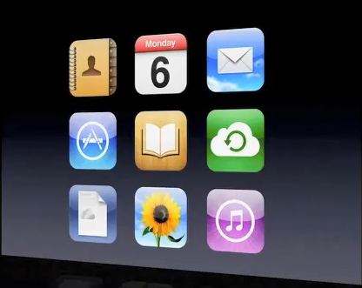
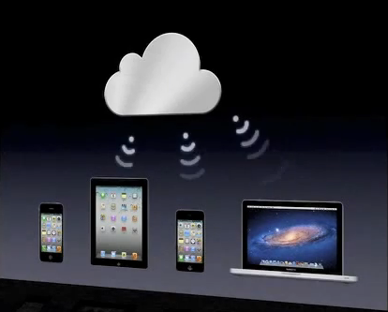
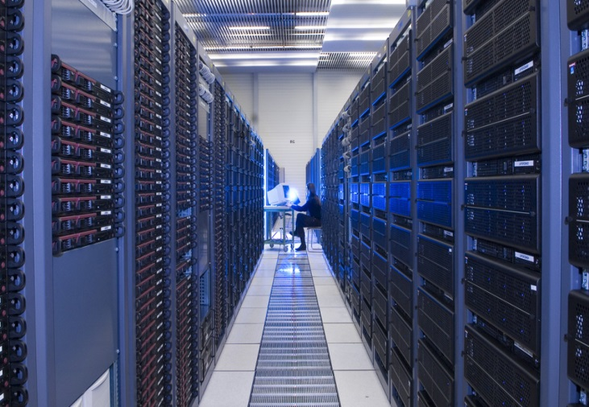
What is Cloud Computing?
Historical roots in today’s web-scale problems
Large data centers
Different models of computing
Highly-interactive Web applications
Case Study 1
Case Study 2
A model of computation and data storage based on “pay as you go” access to “unlimited” remote data center capabilities
YouTube; CERN

Slide 11
Parallel Computing and Software
Data Deluge
Cloud Technologies
Parallel Computing
eScience

Slide 12
MapReduce Programming Model & Architecture
Google, Apache Hadoop, Dryad/DryadLINQ (DAG based and now not available)
Master Node
Worker Nodes
Data Partitions
Record readers
Read records from
data partitions
map(Key , Value)
Distributed
File System
Intermediate <Key, Value> space partitioned using a key partition function
Inform
Master
Local disks
Sort input <key,value> pairs to groups
Sort
Download data
reduce(Key , List<Value>)
Schedule Reducers
Output
Distributed
File System
Map(), Reduce(), and the intermediate key partitioning strategy determine the algorithm
Input and Output => Distributed file system
Intermediate data => Disk -> Network -> Disk
Scheduling =>Dynamic
Fault tolerance (Assumption: Master failures are rare)
Notes:
How elaborate this should be?

Slide 13
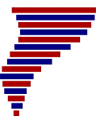
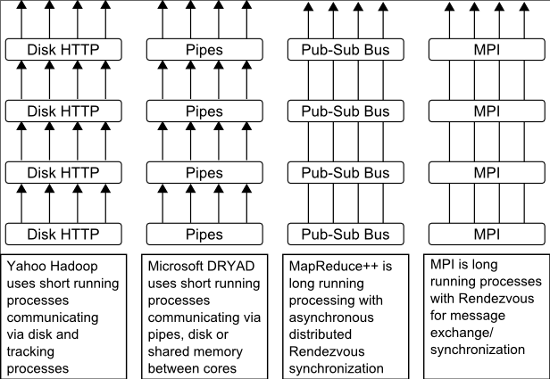
Twister (MapReduce++)
Pub/Sub Broker Network
Map Worker
M
Streaming based communication
Intermediate results are directly transferred from the map tasks to the reduce tasks – eliminates local files
Cacheable map/reduce tasks
  Static data remains in memory
Combine phase to combine reductions
User Program is the composer of MapReduce computations
Extends the MapReduce model to iterative computations
Worker Nodes
R
Reduce Worker
D
D
MR
Driver
User
Program
M
M
M
M
D
MRDeamon
R
R
R
R
Data Read/Write
Communication
Data Split
File System
Iterate
Static
data
Configure()
User Program
Map(Key, Value)
δ flow
Reduce (Key, List<Value>)
Combine (Key, List<Value>)
Different synchronization and intercommunication mechanisms used by the parallel runtimes
Close()

Slide 14
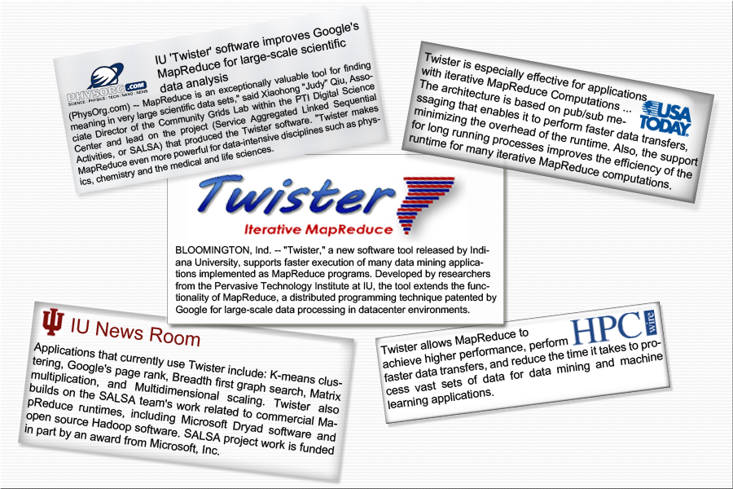
Twister New Release

Slide 15
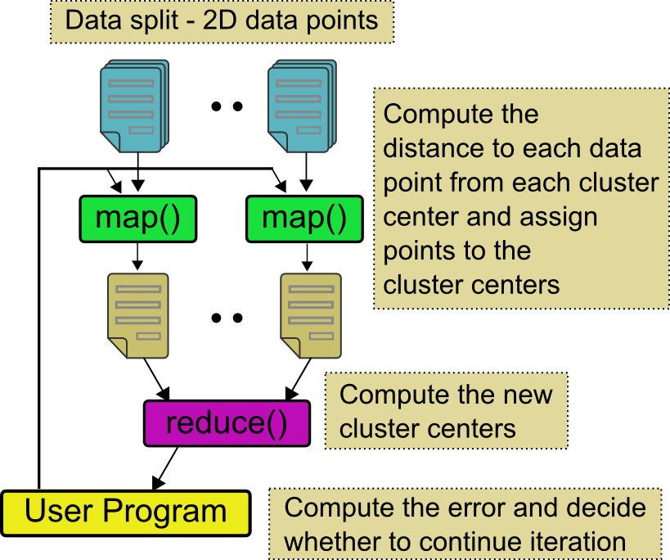
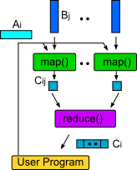
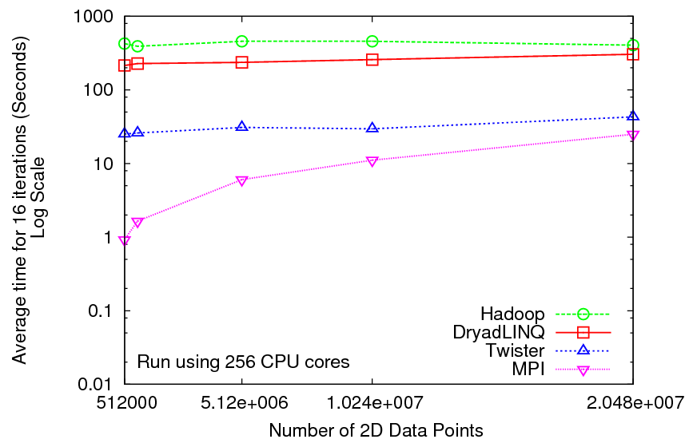
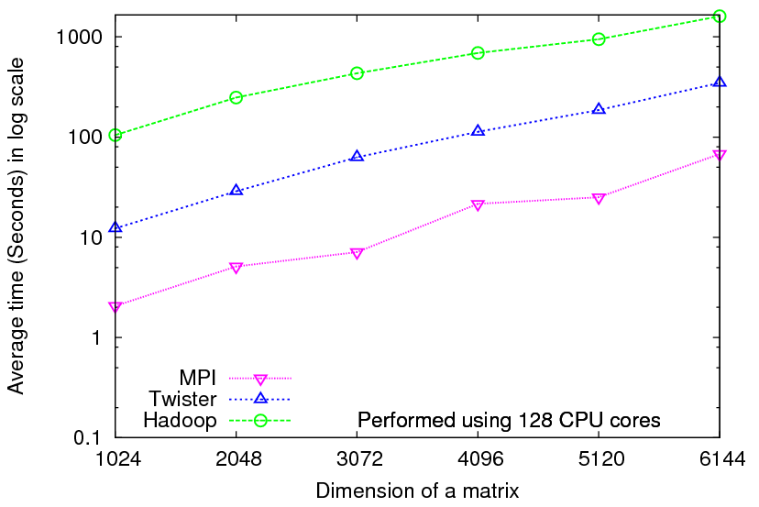
Iterative Computations
K-means
Matrix Multiplication
Performance of K-Means
Parallel Overhead Matrix Multiplication

Slide 16
Data Intensive Applications
Data Deluge
Cloud Technologies
Multicore
eScience

Slide 17
Applications & Different Interconnection Patterns
Map Only (Embarrassingly Parallel) | Classic MapReduce | Iterative Reductions | Loosely Synchronous
CAP3 Gene Analysis Document conversion (PDF -> HTML) Brute force searches in cryptography Parametric sweeps PolarGrid Matlab data analysis | High Energy Physics (HEP) Histograms Distributed search Distributed sorting Information retrieval Calculation of Pairwise Distances for genes | Expectation maximization algorithms Clustering - K-means Deterministic Annealing Clustering - Multidimensional Scaling MDS Linear Algebra | Many MPI scientific applications utilizing wide variety of communication constructs including local interactions - Solving Differential Equations and - particle dynamics with short range forces
Input
iterations
Input
Input
map
map
map
Pij
reduce
Output
reduce
Domain of MapReduce and Iterative Extensions
MPI

Slide 18
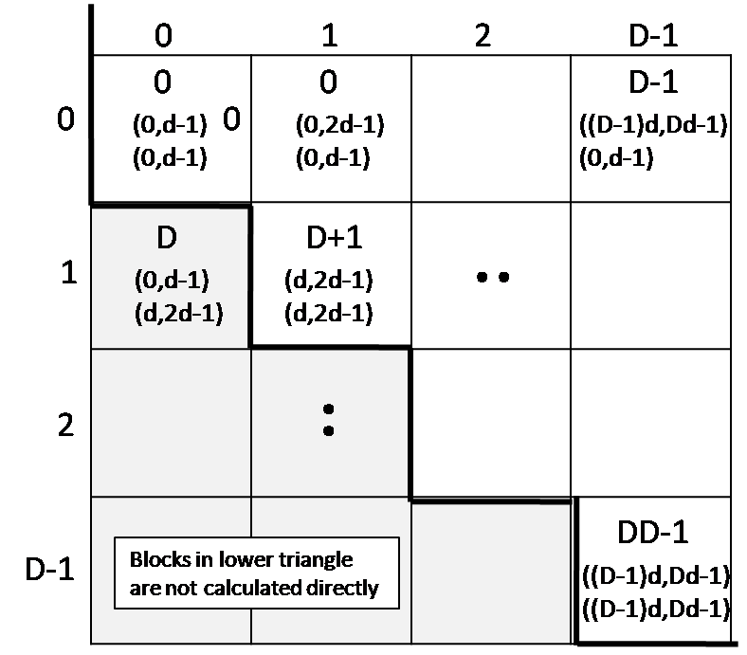
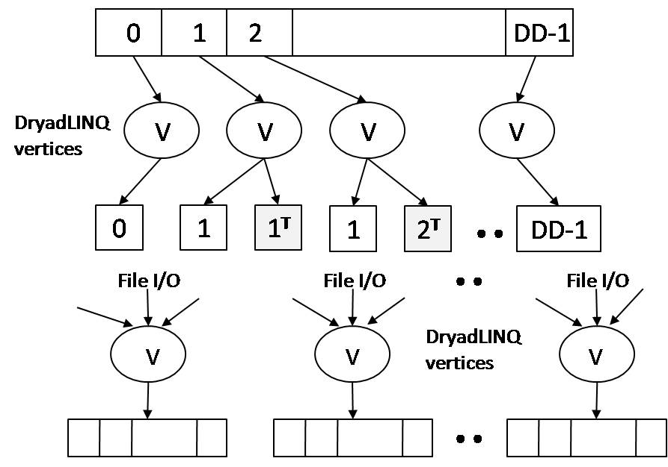
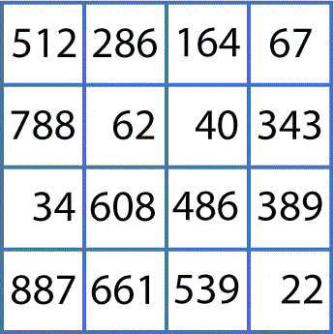
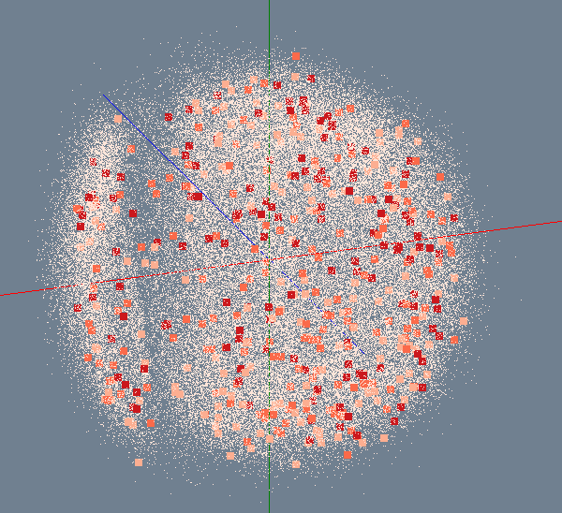

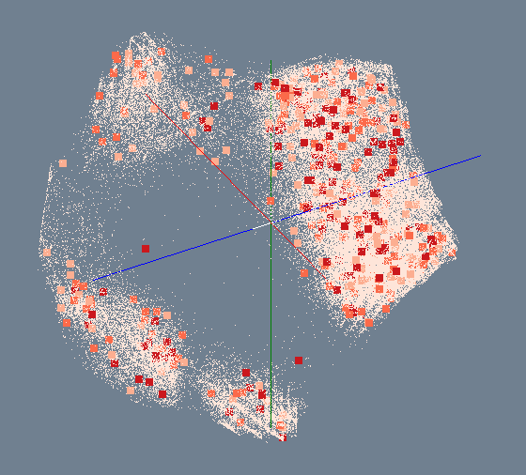
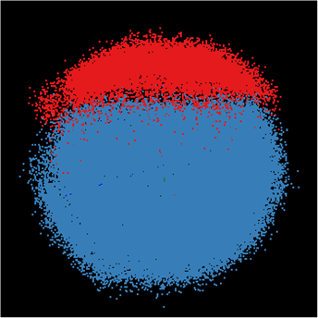
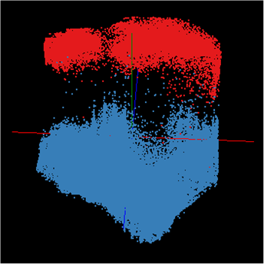
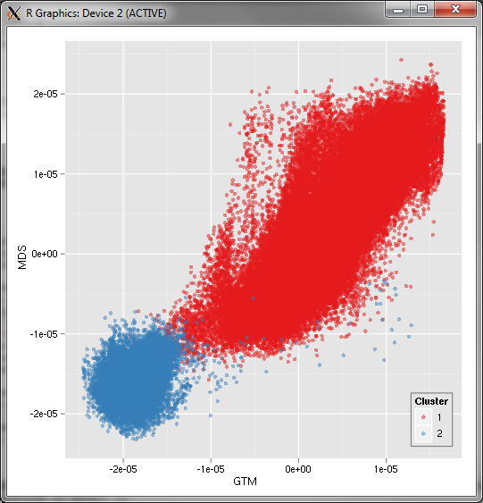
Bioinformatics Pipeline
Gene Sequences (N = 1 Million)
Pairwise Alignment & Distance Calculation
Distance Matrix
Select Reference
Reference Sequence Set (M = 100K)
Reference Coordinates
N - M Sequence Set (900K)
Interpolative MDS with Pairwise Distance Calculation
x, y, z
Multi-Dimensional Scaling (MDS)
O(N²)
N - M Coordinates
x, y, z
Visualization
3D Plot

Slide 19
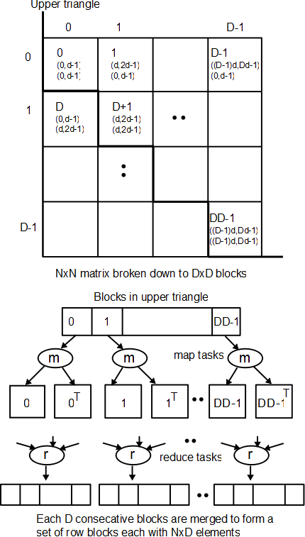
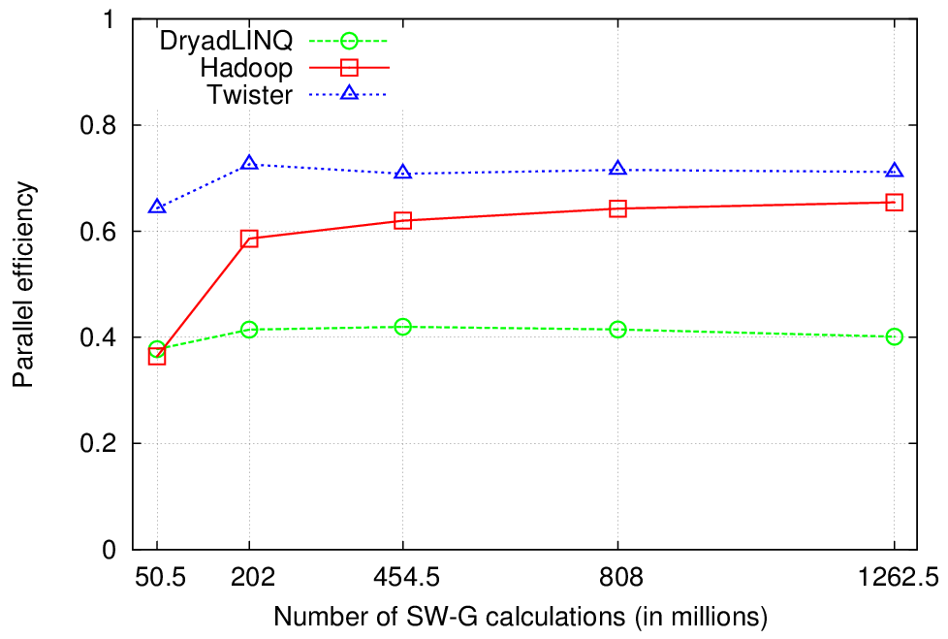

Pairwise Sequence Comparison
Using 744 CPU cores in Cluster-I
Compares a collection of sequences with each other using Smith Waterman Gotoh
Any pair wise computation can be implemented using the same approach
All-Pairs by Christopher Moretti et al.
DryadLINQ’s lower efficiency is due to a scheduling error in the first release (now fixed)
Twister performs the best

Slide 20
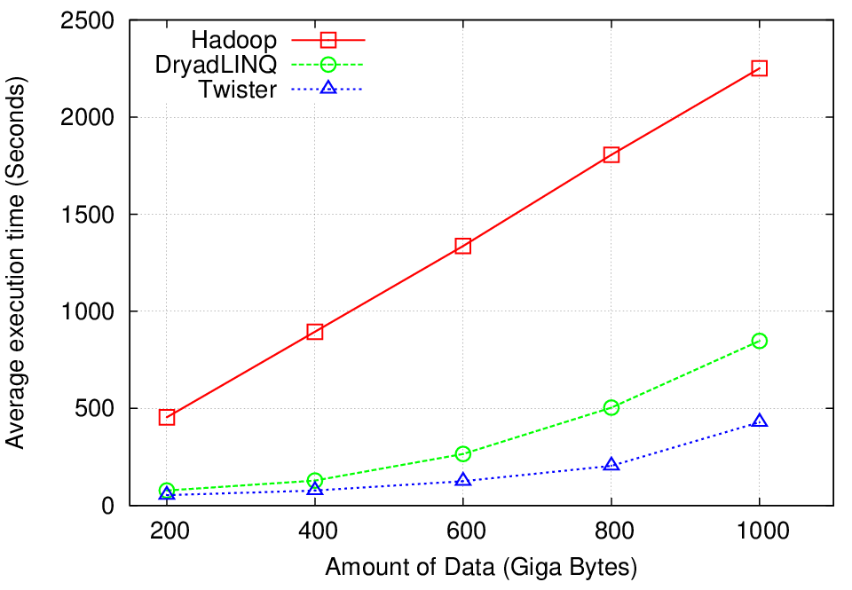

High Energy Physics Data Analysis
HEP data (binary)
256 CPU cores of Cluster-III (Hadoop and Twister) and Cluster-IV (DryadLINQ).
map
map
ROOT[1] interpreted
function
Histograms (binary)
reduce
ROOT interpreted
Function – merge
histograms
combine
Final merge operation
Histogramming of events from large HEP data sets as in “Discovery of Higgs boson”
Data analysis requires ROOT framework (ROOT Interpreted Scripts)
Performance mainly depends on the IO bandwidth
Hadoop implementation uses a shared parallel file system (Lustre)
  ROOT scripts cannot access data from HDFS (block based file system)
  On demand data movement has significant overhead
DryadLINQ and Twister access data from local disks
  Better performance
[1] ROOT Analysis Framework, http://root.cern.ch/drupal/

Slide 21
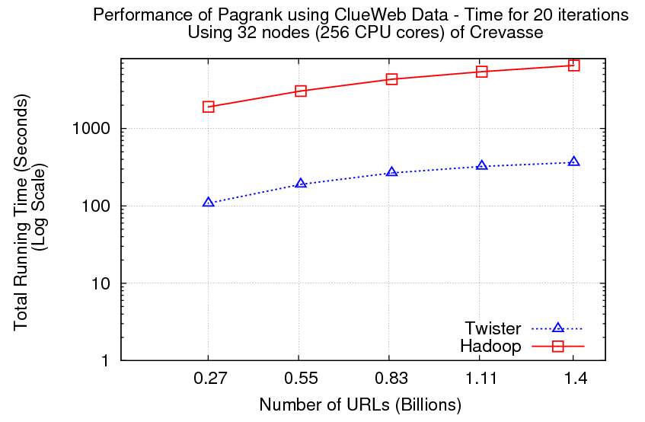
Pagerank
Partial Adjacency Matrix
Current
Page ranks (Compressed)
M
Partial
Updates
R
Iterations
C
Partially merged
Updates
Well-known pagerank algorithm [1]
Used ClueWeb09 [2] (1TB in size) from CMU
Hadoop loads the web graph in every iteration
Twister keeps the graph in memory
Pregel approach seems more natural to graph based problems
[1] Pagerank Algorithm, http://en.wikipedia.org/wiki/PageRank
[2] ClueWeb09 Data Set, http://boston.lti.cs.cmu.edu/Data/clueweb09/

Slide 22
Iterative MapReduce Frameworks
Twister^{[1]}
  Map->Reduce->Combine->Broadcast
  Long running map tasks (data in memory)
  Centralized driver based, statically scheduled.
Daytona^{[3]}
  Iterative MapReduce on Azure using cloud services
  Architecture similar to Twister
Haloop^{[4]}
  On disk caching, Map/reduce input caching, reduce output caching
  Spark^{[5]}
  Iterative Mapreduce Using Resilient Distributed Dataset to ensure the fault tolerance
  Mahout^{[6]}
  Apache open source data mining iterative Mapreduce based on Hadoop
  DistBelief^{[7]}
  Apache open source data mining iterative Mapreduce based on Hadoop
Notes:
iMapReduce, Twister -> single wave..
Iterative MapReduce: Haloop, Twister @IU, Spark
Map-Reduce-Merge: enable processing heterogeneous data sets
MapReduce online: online aggregation, and continuous queries

Slide 23
Parallel Computing and Algorithms
Data Deluge
Cloud Technologies
Parallel Computing
eScience

Slide 24
Parallel Data Analysis Algorithms on Multicore
Developing a suite of parallel data-analysis capabilities
  Clustering using image data
  Parallel Inverted Indexing using for HBase
  Matrix algebra as needed
    Matrix Multiplication
    Equation Solving
    Eigenvector/value Calculation

Slide 25
Intel’s Application Stack

Slide 26

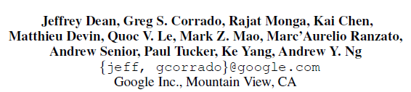
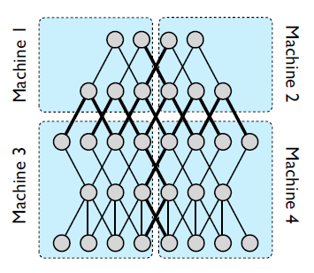
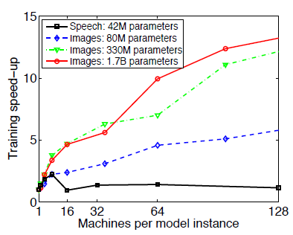
NIPS 2012: Neural Information Processing Systems, December, 2012.

Slide 27
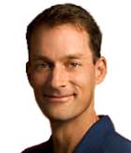


Jeffrey Dean
Andrew Ng

Slide 28
What are the Challenges to Big Data Problem?
Traditional MapReduce and classical parallel runtimes cannot solve iterative algorithms efficiently
  Hadoop: Repeated data access to HDFS, no optimization to data caching and data transfers
  MPI: no natural support of fault tolerance and programming interface is complicated
  We identify “collective communication” is missing in current MapReduce frameworks and is essential in many iterative computations.
    We explore operations such as broadcasting and shuffling and add them to Twister iterative MapReduce framework.
    We generalize the MapReduce concept to Map Collective noting that large collectives are a distinguishing feature of data intensive and data mining applications.

Slide 29
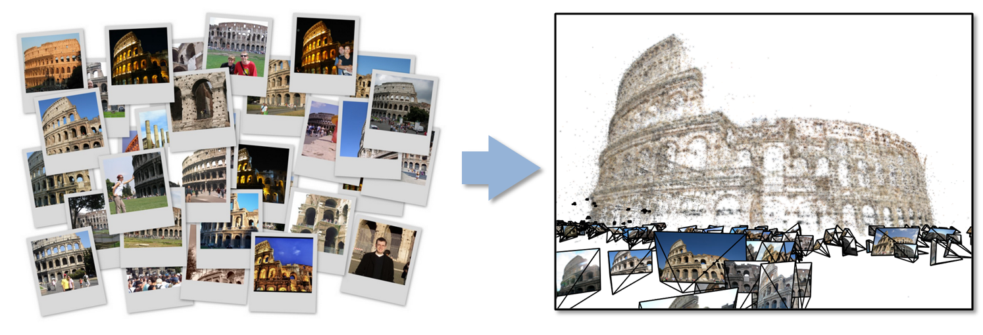
Data Intensive Kmeans Clustering
Case Study 1
  ─ Image Classification: 7 million images; 512 features per image; 1 million clusters
  10K Map tasks; 64G broadcasting data (1GB data transfer per Map task node);
  20 TB intermediate data in shuffling.

Slide 30
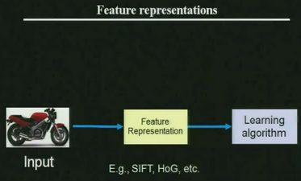
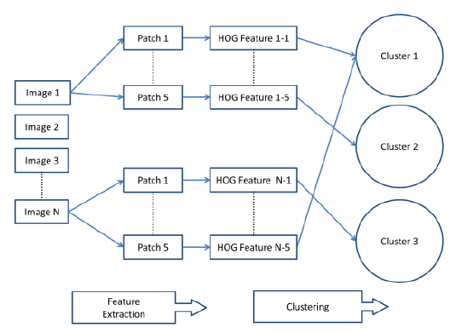
Workflow of Image Clustering Application

Slide 31
High Dimensional Image Data
K-means Clustering algorithm is used to cluster the images with similar features.
In image clustering application, each image is characterized as a data point (vector) with dimension in range 512 ~ 2048. Each value (feature) ranges from 0 to 255.
Around 180 million vectors in full problem
Currently, we are able to run K-means Clustering up to 1 million clusters and 7 million data points on 125 computer nodes.
  10K Map tasks; 64G broadcast data (1GB data transfer per Map task node);
  20 TB intermediate data in shuffling.

Slide 32
Twister Collective Communications
Broadcast
Broadcasting
  Data could be large
  Chain & MST
Map Collectives
  Local merge
Reduce Collectives
  Collect but no merge
Combine
  Direct download or Gather
Map Tasks
Map Tasks
Map Tasks
Map Collective
Map Collective
Map Collective
Reduce Tasks
Reduce Tasks
Reduce Tasks
Reduce Collective
Reduce Collective
Reduce Collective
Gather

Slide 33
Twister Broadcast Comparison
(Sequential vs. Parallel implementations)

Slide 34
Twister Broadcast Comparison
(Ethernet vs. InfiniBand)
Notes:
Experiment on 16 nodes on Sith cluster of ORNL. The broadcast algorithm is BST from Bingjing's work.
Each computing node has 32 cores (4 x 8cores AMD 2.3GB CPU) and 64GB main memory. They are connected by Mellanox InfiniBand interconnection. The average bandwidth is around 2GB/s and latency is microsecond level. All nodes are configured with a 86TB Lustre file system.

Slide 35
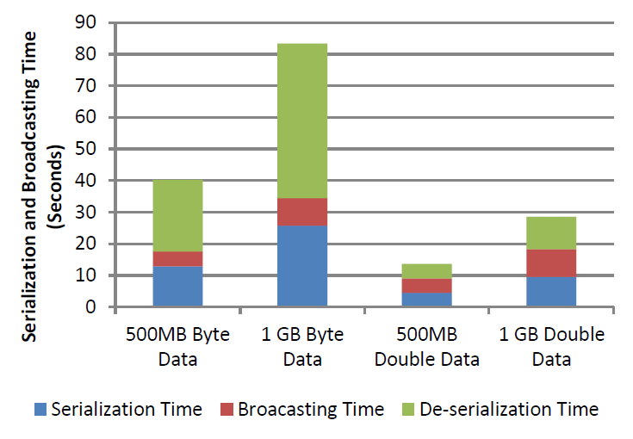
Serialization, Broadcasting and De-serialization

Slide 36
Topology-aware Broadcasting Chain
Core Switch
10 Gbps Connection
Rack Switch
Rack Switch
Rack Switch
1 Gbps Connection
Compute Node
Compute Node
Compute Node
Compute Node
Compute Node
Compute Node
Compute Node
Compute Node
Compute Node
pg1-pg42
pg43-pg84
pg295–pg312

Slide 37
Bcast Byte Array on PolarGrid with 1Gbps Ethernet

Slide 38
Triangle Inequality and Kmeans
Dominant part of Kmeans algorithm is finding nearest center to each point
O(#Points * #Clusters * Vector Dimension)
Simple algorithms finds
min over centers c: d(x, c) = distance(point x, center c)
But most of d(x, c) calculations are wasted as much larger than minimum value
Elkan (2003) showed how to use triangle inequality to speed up using relations like
d(x, c) >= d(x,c-last) – d(c, c-last)
c-last position of center at last iteration
So compare d(x,c-last) – d(c, c-last) with d(x, c-best) where c-best is nearest cluster at last iteration
Complexity reduced by a factor = Vector Dimension and so this important in clustering high dimension spaces such as social imagery with 512 or more features per image

Slide 39
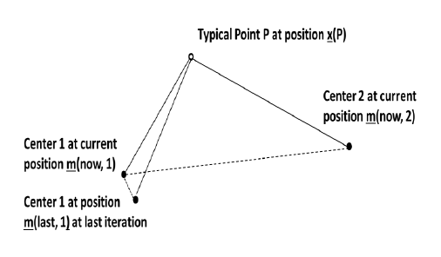
Fast Kmeans Algorithm
Graph shows fraction of distances d(x, c) calculated each iteration for a test data set
200K points, 124 centers, Vector Dimension 74

Slide 40
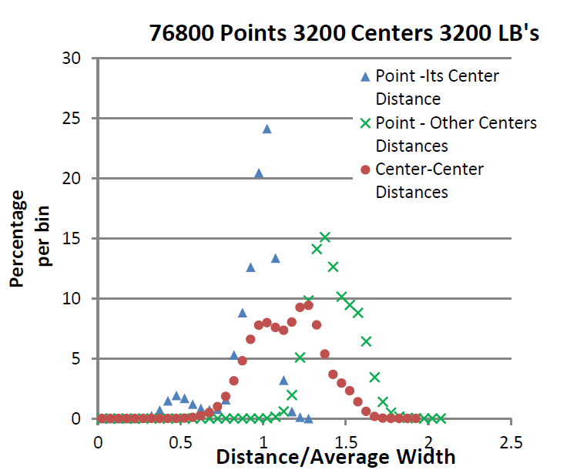
Results on Fast Kmeans Algorithm

Slide 41
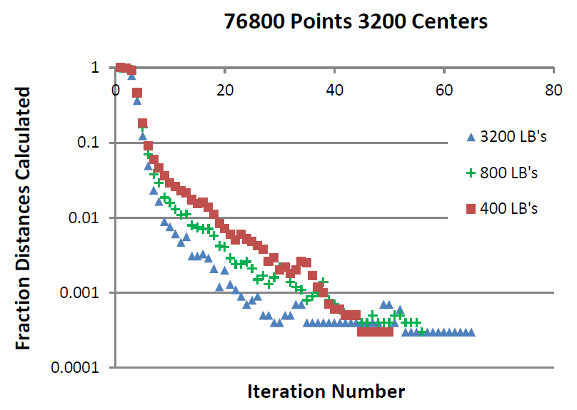
Fraction of Point-Center Distances

Slide 42
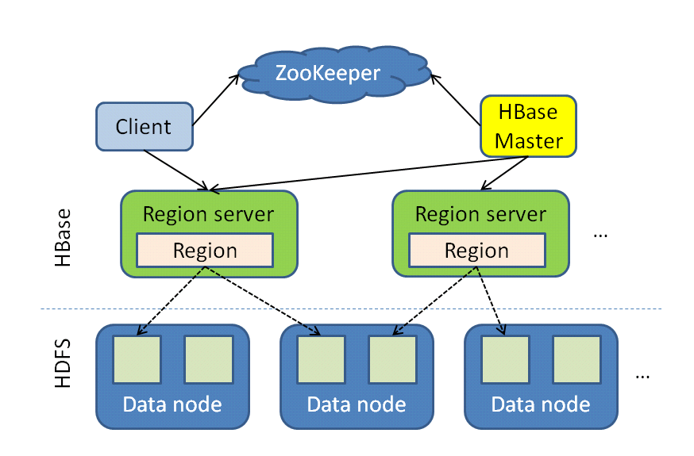
HBase Architecture
Case Study 1
Tables split into regions and served by region servers
Reliable data storage and efficient access to TBs or PBs of data, successful application in Facebook and Twitter
Good for real-time data operations and batch analysis using Hadoop MapReduce
Problem: no inherent mechanism for field value searching, especially for full-text values

Slide 43
IndexedHBase System Design
Dynamic HBase deployment
Data Loading (MapReduce)
CW09DataTable
Index Building (MapReduce)
Term-pair Frequency Counting (MapReduce)
PageRankTable
CW09FreqTable
CW09PosVecTable
CW09PairFreqTable
Web Search Interface
Performance Evaluation (MapReduce)
LC-IR Synonym Mining Analysis (MapReduce)

Slide 44
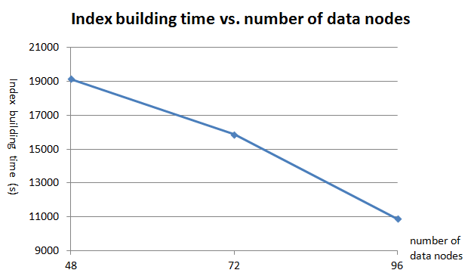
Parallel Index Build Time using MapReduce
We have tested system on ClueWeb09 data set
Data size: ~50 million web pages, 232 GB compressed, 1.5 TB after decompression
Explored different search strategies
Notes:
The reasons for non-linear index building performance are:
(1) Our index building MapReduce job deals with data in one table, but HBase handles load balancing on the whole system level instead of single table level. As a result, although the workload is balanced at the whole system level, some tables may have unbalanced data sizes among different region servers;
(2) Our index building job is not a map phase only job. It requires a reduce phase and a lot of shuffling and sorting happens between map and reduce, which leads to the non-linear performance improvements.

Slide 45

Architecture for Search Engine
Data Layer
Apache Lucene
crawler
Inverted Indexing System
Business Logic Layer
mapreduce
Web UI
PHP script
HBase Tables
1. inverted index table
2. page rank table
ClueWeb’09 Data
Hive/Pig script
Apache Server on Salsa Portal
HBase
Presentation Layer
Thrift client
Thrift Server
Hadoop Cluster
on FutureGrid
Ranking System
SESSS YouTube Demo
Pig script

Slide 46
Applications of Indexed HBase
Combine scalable NoSQL data system with fast inverted index look up
Best of SQL and NoSQL
Text analysis: Search Engine
Truthy Project: Analyze and visualize the diffusion of information on Twitter
  Identify new and emerging bursts of activity around memes (Internet concepts) of various flavors
  Investigate competition model of memes on social network
  Detect political smears, astroturfing, misinformation, and other social pollution
Medical Records: Identify patients of interest (from indexed Electronic Health Record EHR entries)
  Perform sophisticated Hbase search on data sample identified
  About 40 million tweets a day
  The daily data size was ~13 GB compressed (~80 GB decompressed) a year ago (May 2012), and 30 GB compressed now (April 2013).
  The total compressed size is about 6-7 TB, and around 40 TB after decompressed.

Slide 47
Traditional way of query evaluation
Meme index
get_tweets_with_meme([memes], time_window)
Time index
#usa:
1234
2346
… (tweet id)
#love:
9987
4432
… (tweet id)
2012-05-10:
7890
3345
… (tweet id)
2012-05-11:
9987
1077
… (tweet id)
Meme index
Time index
IDs of tweets containing [memes]
IDs of tweets within time window
results
Challenges: 10s of millions of tweets per day, and time window is normally in months – large index data size and low query evaluation performance

Slide 48
Customizable index structures stored in HBase tables
Text Index Table
tweets
12393
13496
… (tweet ids)
“Beautiful”
2011-04-05
2011-05-05
…
Meme Index Table
tweets
12393
13496
… (tweet ids)
“#Euro2012”
2011-04-05
2011-05-05
…
Embed tweets’ creation time in indices
Queries like get_tweets_with_meme([memes], time_window) can be evaluated by visiting only one index.
For queries like user_post_count([memes], time_window), embed more information such as tweets’ user IDs for efficient evaluation.

Slide 49
Distributed Range Query
get_retweet_edges([memes], time_window)
Customized meme index
Subset of tweet IDs
Subset of tweet IDs
Subset of tweet IDs
……
MapReduce for counting retweet edges (i.e., user ID -> retweeted user ID)
results
For queries like get_retweet_edges([memes], time_window), using MapReduce to access the meme index table, instead of the raw data table

Slide 50
Convergence is Happening
Multicore
Clouds
Data intensive application with basic activities:
capture, curation, preservation, and analysis (visualization)
Data Intensive
Paradigms
Cloud infrastructure and runtime
Parallel threading and processes

Slide 51
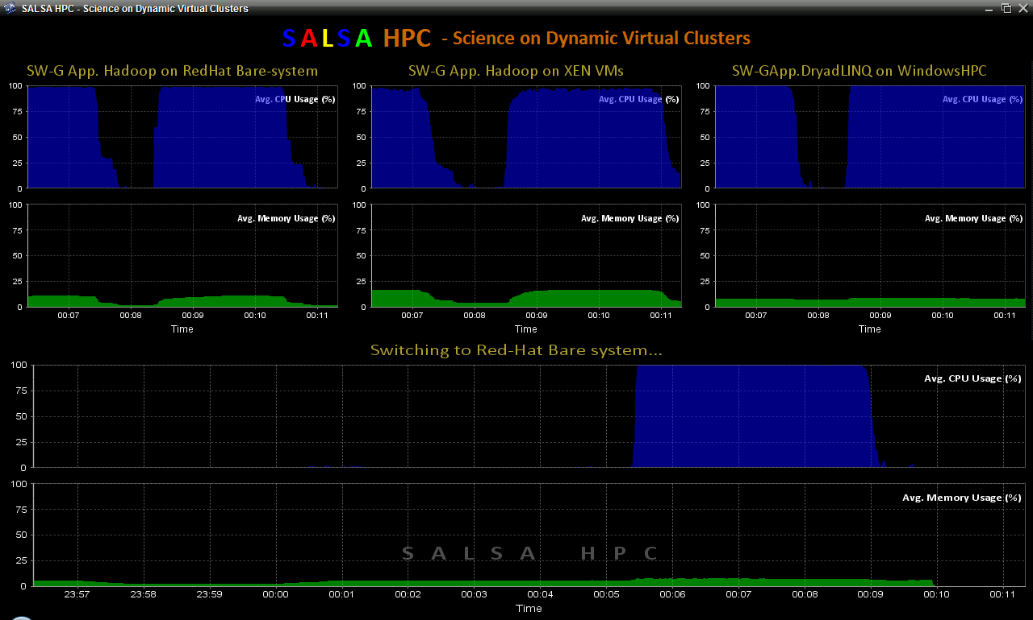
Dynamic Virtual Clusters
Dynamic Cluster Architecture
Monitoring & Control Infrastructure
Monitoring Infrastructure
Monitoring Interface
Pub/Sub Broker Network
SW-G Using Hadoop
SW-G Using Hadoop
SW-G Using DryadLINQ
Linux
Bare-system
Linux on Xen
Windows Server 2008 Bare-system
Virtual/Physical Clusters
Summarizer
XCAT Infrastructure
XCAT Infrastructure
Switcher
iDataplex Bare-metal Nodes
(32 nodes)
iDataplex Bare-metal Nodes
Switchable clusters on the same hardware (~5 minutes between different OS such as Linux+Xen to Windows+HPCS)
Support for virtual clusters
SW-G : Smith Waterman Gotoh Dissimilarity Computation as an pleasingly parallel problem suitable for MapReduce style applications

Slide 52
SALSA HPC Dynamic Virtual Clusters Demo
At top, these 3 clusters are switching applications on fixed environment. Takes ~30 Seconds.
At bottom, this cluster is switching between Environments – Linux; Linux +Xen; Windows + HPCS. Takes about ~7 minutes.
It demonstrates the concept of Science on Clouds using a FutureGrid cluster.

Slide 53
Summary of Plans
Support Scientific Simulations (Data Mining and Data Analysis)
Kernels, Genomics, Proteomics, Information Retrieval, Polar Science, Scientific Simulation Data Analysis and Management, Dissimilarity Computation, Clustering, Multidimensional Scaling, Generative Topological Mapping
Applications
Security, Provenance, Portal
Programming Model
Services and Workflow
High Level Language
Runtime
Cross Platform Iterative MapReduce (Collectives, Fault Tolerance, Scheduling)
Storage
Distributed File Systems
Object Store
Data Parallel File System
Linux HPC
Bare-system
Amazon Cloud
Windows Server HPC
Bare-system
Azure Cloud
Grid Appliance
Infrastructure
Virtualization
Virtualization
Hardware
CPU Nodes
GPU Nodes

Slide 54


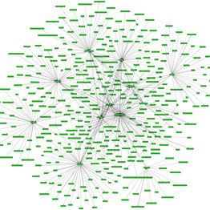
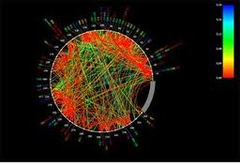







Big Data Challenge
Peta 10^15
Tera 10^12
Pig Latin
Giga 10^9
Mega 10^6

Slide 55






Acknowledgement
SALSA HPC Group
http://salsahpc.indiana.edu
School of Informatics and Computing
Indiana University

Slide 56
References
M. Isard, M. Budiu, Y. Yu, A. Birrell, D. Fetterly, Dryad: Distributed data-parallel programs from sequential building blocks, in: ACM SIGOPS Operating Systems Review, ACM Press, 2007, pp. 59-72
J.Ekanayake, H.Li, B.Zhang, T.Gunarathne, S.Bae, J.Qiu, G.Fox, Twister: A Runtime for iterative MapReduce, in: Proceedings of the First International Workshop on MapReduce and its Applications of ACM HPDC 2010 conference June 20-25, 2010, ACM, Chicago, Illinois, 2010.
Daytona iterative map-reduce framework. http://research.microsoft.com/en-us/projects/daytona/.
Y. Bu, B. Howe, M. Balazinska, M.D. Ernst, HaLoop: Efficient Iterative Data Processing on Large Clusters, in: The 36th International Conference on Very Large Data Bases, VLDB Endowment, Singapore, 2010.
Matei Zaharia, Mosharaf Chowdhury, Michael J. Franklin, Scott Shenker, Ion Stoica, University of Berkeley. Spark: Cluster Computing with Working Sets. HotCloud’10 Proceedings of the 2nd USENIX conference on Hot topics in cloud computing. USENIX Association Berkeley, CA. 2010.
Yanfeng Zhang , Qinxin Gao , Lixin Gao , Cuirong Wang, iMapReduce: A Distributed Computing Framework for Iterative Computation, Proceedings of the 2011 IEEE International Symposium on Parallel and Distributed Processing Workshops and PhD Forum, p.1112-1121, May 16-20, 2011
Tekin Bicer, David Chiu, and Gagan Agrawal. 2011. MATE-EC2: a middleware for processing data with AWS. In Proceedings of the 2011 ACM international workshop on Many task computing on grids and supercomputers (MTAGS '11). ACM, New York, NY, USA, 59-68.
Yandong Wang, Xinyu Que, Weikuan Yu, Dror Goldenberg, and Dhiraj Sehgal. 2011. Hadoop acceleration through network levitated merge. In Proceedings of 2011 International Conference for High Performance Computing, Networking, Storage and Analysis (SC '11). ACM, New York, NY, USA, , Article 57 , 10 pages.
Karthik Kambatla, Naresh Rapolu, Suresh Jagannathan, and Ananth Grama. Asynchronous Algorithms in MapReduce. In IEEE International Conference on Cluster Computing (CLUSTER), 2010.
T. Condie, N. Conway, P. Alvaro, J. M. Hellerstein, K. Elmleegy, and R. Sears. Mapreduce online. In NSDI, 2010.
M. Chowdhury, M. Zaharia, J. Ma, M.I. Jordan and I. Stoica, Managing Data Transfers in Computer Clusters with Orchestra SIGCOMM 2011, August 2011
M. Zaharia, M. Chowdhury, M.J. Franklin, S. Shenker and I. Stoica. Spark: Cluster Computing with Working Sets, HotCloud 2010, June 2010.
Huan Liu and Dan Orban. Cloud MapReduce: a MapReduce Implementation on top of a Cloud Operating System. In 11th IEEE/ACM International Symposium on Cluster, Cloud and Grid Computing, pages 464–474, 2011
AppEngine MapReduce, July 25th 2011; http://code.google.com/p/appengine-mapreduce.
J. Dean, S. Ghemawat, MapReduce: simplified data processing on large clusters, Commun. ACM, 51 (2008) 107-113.

Slide 57
Comparison of Runtime Models
 | Twister | Hadoop | MPI
Language | Java | Java | C
Environment | clusters, HPC, cloud | clusters, cloud | HPC, super computers
Job Control | Iterative MapReduce | MapReduce | parallel processes
Fault Tolerance | iteration level | task level | added fault tolerance
Communication Protocol | broker, TCP | RPC, TCP | TCP, shared memory, Infiniband
Work Unit | thread | process | process
Scheduling | static | dynamic, speculative | static

Slide 58
Comparison of Data Models
 | Twister | Hadoop | MPI
Application Data Category | scientific data (vectors, matrices) | records, logs | scientific data (vectors, matrices)
Data Source | local disk, DFS | local disk, HDFS | DFS
Data Format | text/binary | text/binary | text/binary/ HDF5 /NetCDF
Data Loading | partition based | InputSplit, InputFormat | customized
Data Caching | in memory | local files | in memory
Data Processing Unit | Key-Value objects | Key-Value objects | basic types, vectors
Data Collective Communication | broadcasting, shuffling | broadcasting, shuffling | multiple kinds

Slide 59





Problem Analysis
Entities and Relationships in Truthy data set
User
User
User
Follow
Mention
Tweet
User
memes
Retweet

Slide 60
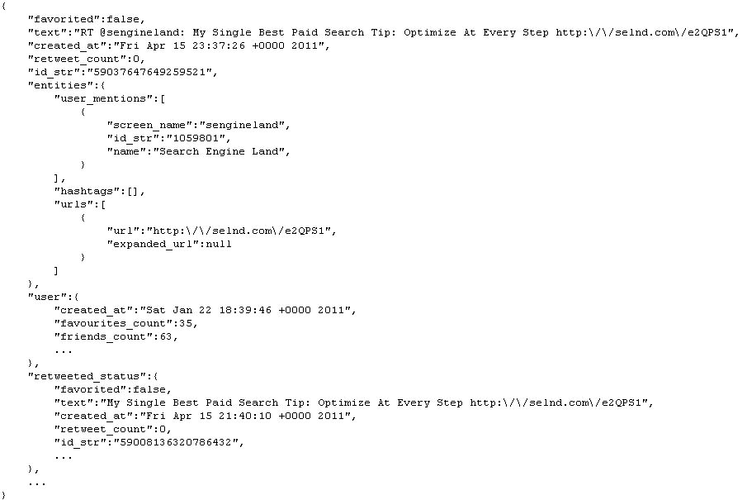
Problem Analysis
Example piece of Truthy data set

Slide 61
Problem Analysis
Examples of time-related queries and measurements:
- get_tweets_with_meme([memes], time_window)
- get_tweets_with_text(keyword, time_window)
- timestamp_count([memes], time_window)
{2010-09-31: 30, 2010-10-01: 50, 2010-10-02: 150, ...}
- user_post_count([memes], time_window)
{"MittRomney": 23,000, "RonPaul": 54,000 ... }
- get_retweet_edges([memes], time_window)
- measure meme life time (time between first tweet and last tweet about a meme) distribution

Slide 62
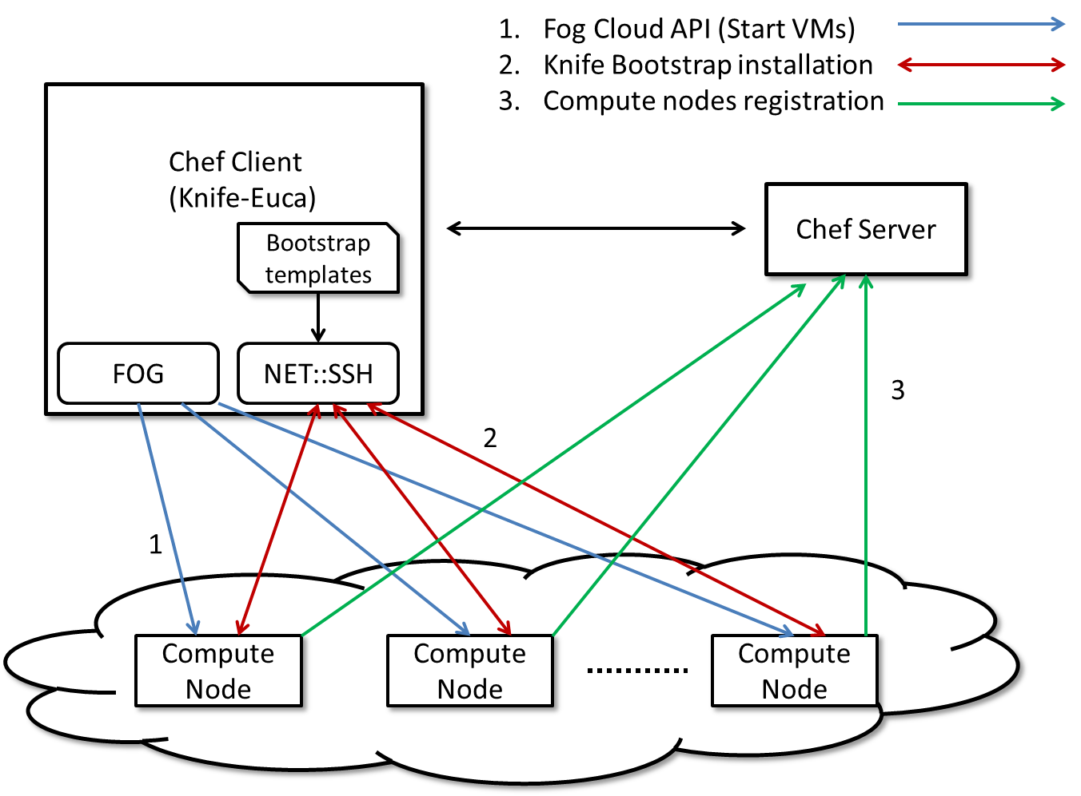
Chef Study

Slide 63

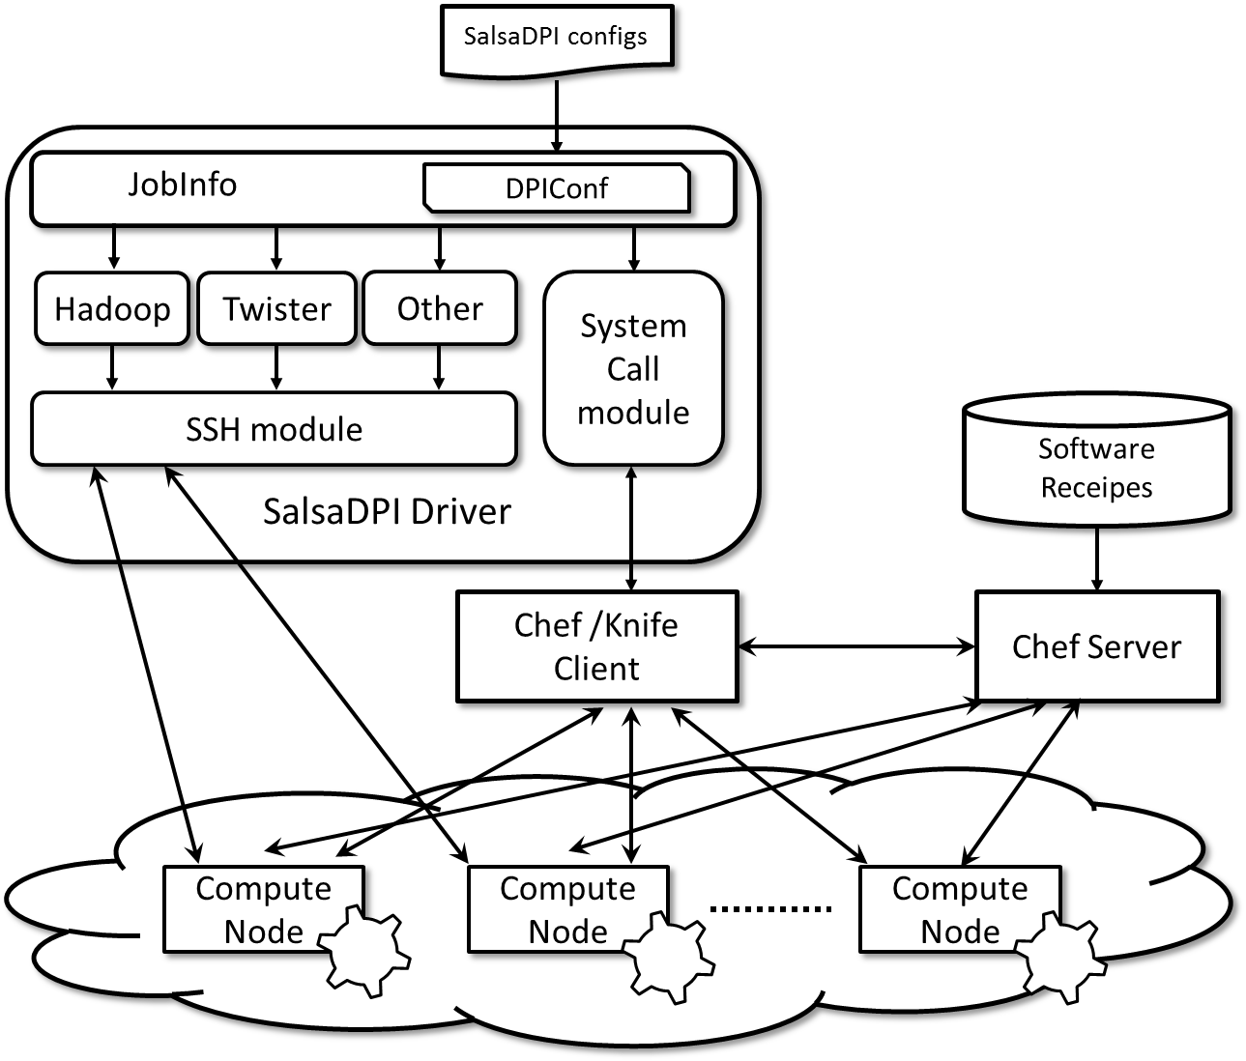
What is SalsaDPI? (Cont.)
SalsaDPI
  Provide configurable (API later) interface
  Automate Hadoop/Twister/other binary execution
*Chef Official website: http://www.opscode.com/chef/

Slide 64

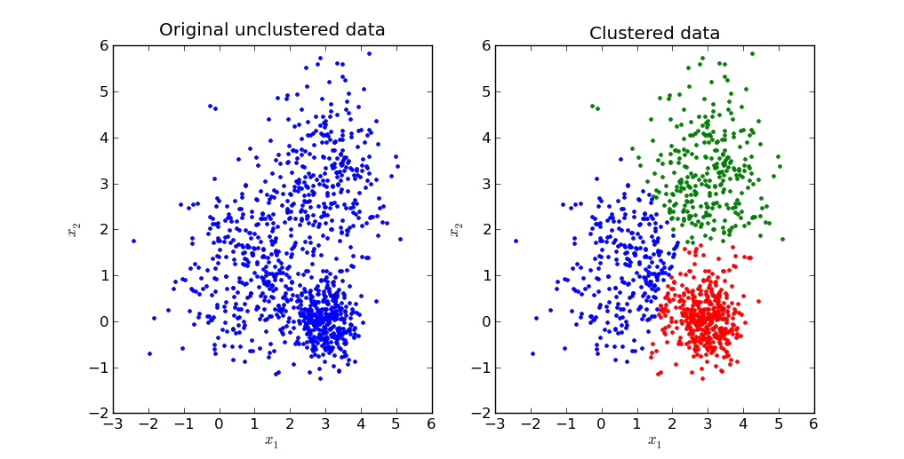





Motivation
Background knowledge
  Environment setting
  Different cloud infrastructure tools
  Software dependencies
  Long learning path
Automatic these complicated steps?
Solution: Salsa Dynamic Provisioning Interface (SalsaDPI).
  One-click deploy

Slide 65
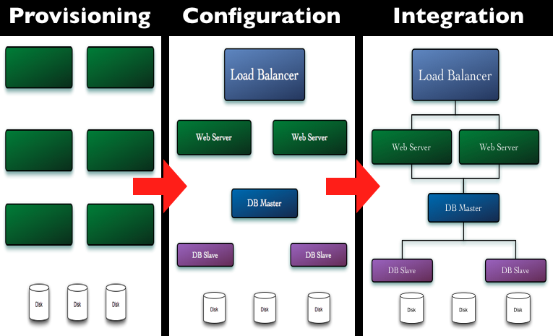
Chef
open source system
traditional client-server software
Provisioning, configuration management and System integration
contributor programming interface
Graph source: http://wiki.opscode.com/display/chef/Home

Slide 66
Chef Study
Fog Cloud API (Start VMs)
Knife Bootstrap installation
Compute nodes registration
Chef Client (Knife-Euca)
Chef Server
Bootstrap templates
FOG
NET::SSH
3
2
1
Compute Node
Compute Node
Compute Node

Slide 67
SalsaDPI configs
JobInfo
DPIConf
Hadoop
Twister
Other
System Call module
SSH module
Software Recipes
SalsaDPI Driver
Chef /Knife Client
Chef Server
Compute Node
Compute Node
Compute Node

Slide 68
Summary of Plans
Intend to implement range of biology applications with Dryad/Hadoop/Twister
FutureGrid allows easy Windows v Linux with and without VM comparison
Initially we will make key capabilities available as services that we eventually implement on virtual clusters (clouds) to address very large problems
  Basic Pairwise dissimilarity calculations
  Capabilities already in R (done already by us and others)
  MDS in various forms
  GTM Generative Topographic Mapping
  Vector and Pairwise Deterministic annealing clustering
Point viewer (Plotviz) either as download (to Windows!) or as a Web service gives Browsing
Should enable much larger problems than existing systems
  Will look at Twister as a “universal” solution

Slide 69

Building Virtual Clusters
Towards Reproducible eScience in the Cloud
Separation of concerns between two layers
Infrastructure Layer – interactions with the Cloud API
Software Layer – interactions with the running VM

Slide 70
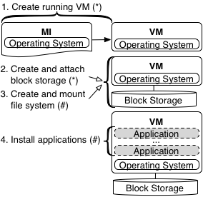
Separation Leads to Reuse
Infrastructure Layer = (*) Software Layer = (#)
By separating layers, one can reuse software layer artifacts in separate clouds

Slide 71
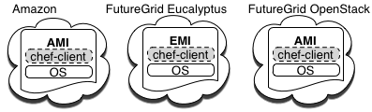

Design and Implementation
Equivalent machine images (MI) built in separate clouds
Common underpinning in separate clouds for software installations and configurations
Extend to Azure
Configuration management used for software automation

Slide 72
Cloud Image Proliferation

Slide 73
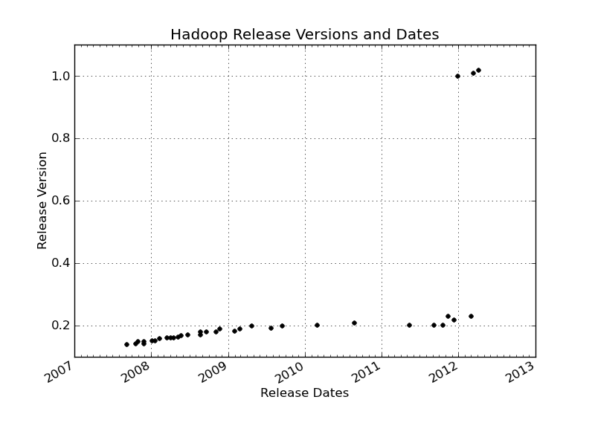
Changes of Hadoop Versions

Slide 74
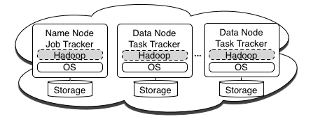
Implementation - Hadoop Cluster
Hadoop cluster commands
knife hadoop launch {name} {slave count}
knife hadoop terminate {name}

Slide 75
Running CloudBurst on Hadoop
Running CloudBurst on a 10 node Hadoop Cluster
knife hadoop launch cloudburst 9
echo ‘{"run list": "recipe[cloudburst]"}' > cloudburst.json
chef-client -j cloudburst.json
CloudBurst on a 10, 20, and 50 node Hadoop Cluster

Slide 76
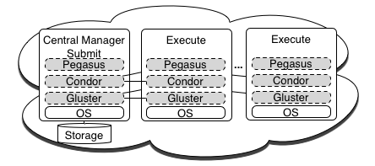
Implementation - Condor Pool
Condor Pool commands
knife cluster launch {name} {exec. host count}
knife cluster terminate {name}
knife cluster node add {name} {node count}

Slide 77

Implementation - Condor Pool
Ganglia screen shot of a Condor pool in Amazon EC2
80 node – (320 core) at this point in time

Slide 78
Big Data Challenge
Peta 10^15
Tera 10^12
Pig Latin
Giga 10^9
Mega 10^6

Slide 79
Collective Communication Primitives for Iterative MapReduce
Generalize MapReduce to MapCollective implemented optimally on each CPU-Network configuration
n^{th}
Iteration
Initial
Routing
System or
User
Collectives
(n+1)^{th}
Iteration
Final
Routing
Map₁
Map₁
Map₂
Map₂
Iterate
Map_{N}
Map_{N}

Slide 80
Fraction of Point-Center Distances
Fraction of Point-Center Distances calculated for 3 versions of the algorithm for 76800 points and 3200 centers in a 2048 dimensional for three choices of lower bounds LB kept per point

Slide 81
One-click Deployment on Clouds

Slide 82



What is SalsaDPI? (High-Level)
SalsaDPI Jar
Chef Client
Chef Server
OS
User
Conf.
2. Retrieve conf. Info. and request Authentication and Authorization
3. Authenticated and Authorized to execute software run-list
5. Submit application
commands
Bootstrap VMs
with a conf. file
6. Obtain Result
4. VM(s) Information
Apps
Apps
Apps
S/W
S/W
S/W
Chef
Chef
Chef
OS
OS
OS
VM
VM
VM
* Chef architecture http://wiki.opscode.com/display/chef/Architecture+Introduction

Slide 83

Web Interface
http://salsahpc.indiana.edu/salsaDPI/
One-Click solution
Extend to OpenStack
and commercial clouds
Support storage such as
Walrus (Eucalyptus) , Swift (OpenStack)
Test scalability
Compare Engage (Germany), Cloud-init (Ubuntu), Phantom (Nimbus), Horizon (OpenStack)
Futures

Slide 84








Acknowledgement
Bingjing Zhang
Thilina Gunarathne
Fei Teng
Xiaoming Gao
Stephen Wu
Prof. David Crandall
Computer Vision
Prof. Filippo Menczer
Complex Networks and Systems
Prof. Geoffrey Fox
Parallel and Distributed
Computing

Slide 85
Others
Mate-EC2^{[8]}
  Local reduction object
Network Levitated Merge^{[9]}
  RDMA/infiniband based shuffle & merge
Asynchronous Algorithms in MapReduce^{[10]}
  Local & global reduce
MapReduce online^{[11]}
  online aggregation, and continuous queries
  Push data from Map to Reduce
Orchestra^{[12]}
  Data transfer improvements for MR
iMapReduce^{[13]}
  Async iterations, One to one map & reduce mapping, automatically joins loop-variant and invariant data
CloudMapReduce^{[14]} & Google AppEngine MapReduce^{[15]}
  MapReduce frameworks utilizing cloud infrastructure services
Notes:
Orchestra : Broadcast and shuffle improvements…

Slide 86
Summary of Initial Results
Cloud technologies (Dryad/Hadoop/Azure/EC2) promising for Biology computations
Dynamic Virtual Clusters allow one to switch between different modes
Overhead of VM’s on Hadoop (15%) acceptable
Inhomogeneous problems currently favors Hadoop over Dryad
Twister allows iterative problems (classic linear algebra/datamining) to use MapReduce model efficiently
  Prototype Twister released

Slide 87
Future Work
The support for handling large data sets, the concept of moving computation to data, and the better quality of services provided by cloud technologies, make data analysis feasible on an unprecedented scale for assisting new scientific discovery.
Combine "computational thinking“ with the “fourth paradigm” (Jim Gray on data intensive computing)
Research from advance in Computer Science and Applications (scientific discovery)
Notes:
A glimpse of the future and motivation

