Slide 1

SALSA Group Research Activities
April 27, 2011

Slide 2
Research Overview
MapReduce Runtime
  Twister
  Azure MapReduce
Dryad and Parallel Applications
NIH Projects
  Bioinformatics
  Workflow
  Data Visualization – GTM/MDS/PlotViz
Education

Slide 3
Twister &
Azure MapReduce

Slide 4
What is Twister?
Twister is an Iterative MapReduce Framework which supports
  Customized static input data partition
  Cacheable map/reduce tasks
  Combining operation to converge intermediate outputs to main program
  Fault recovery between iterations

Slide 5
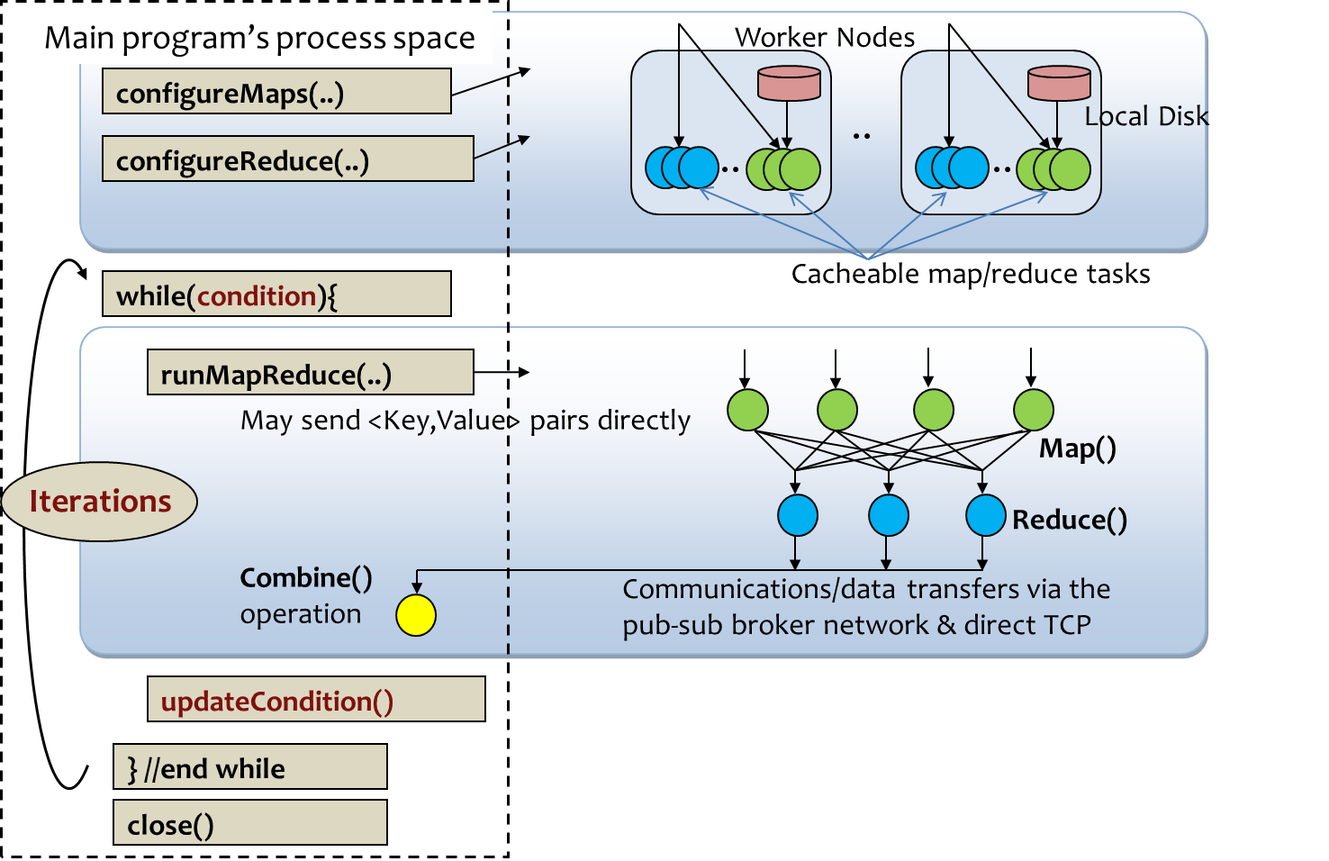
Twister Programming Model

Slide 6
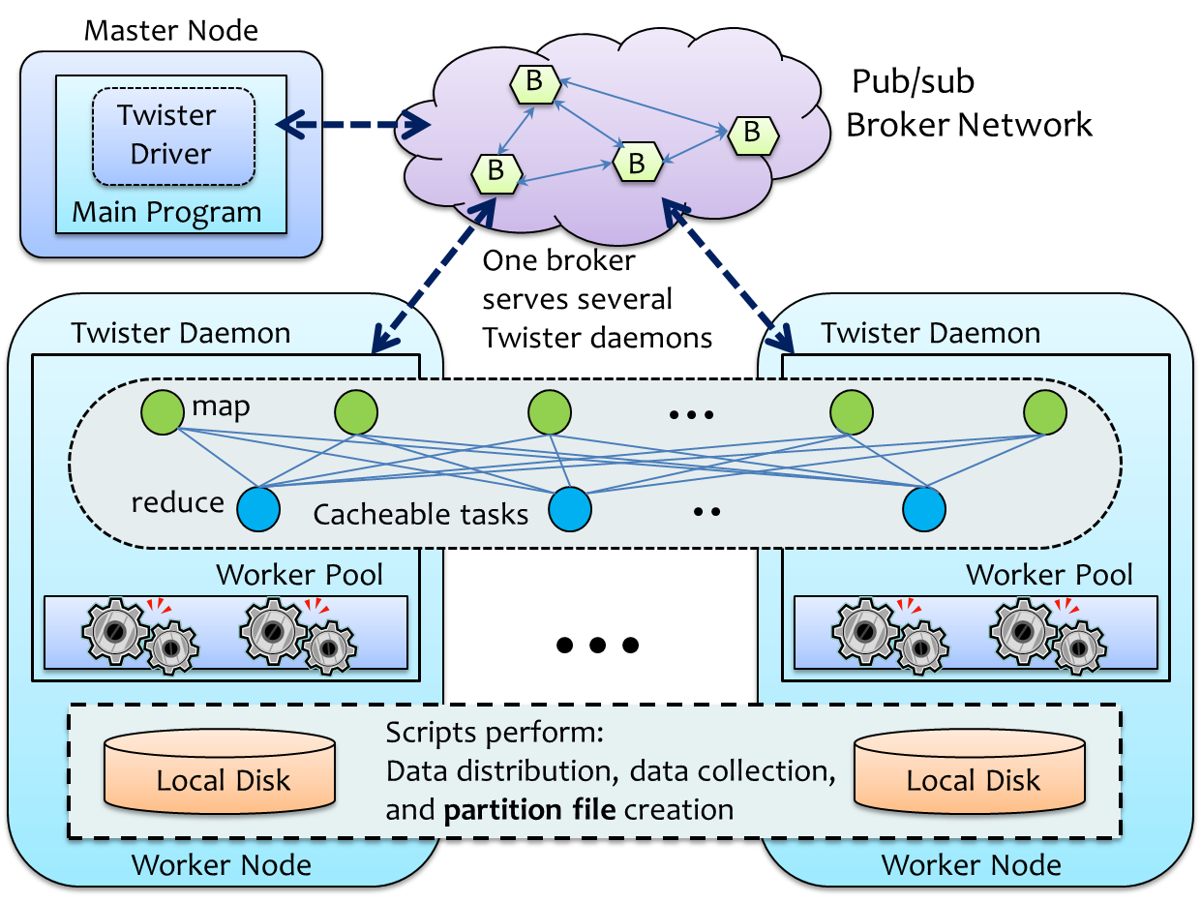
Twister Architecture

Slide 7
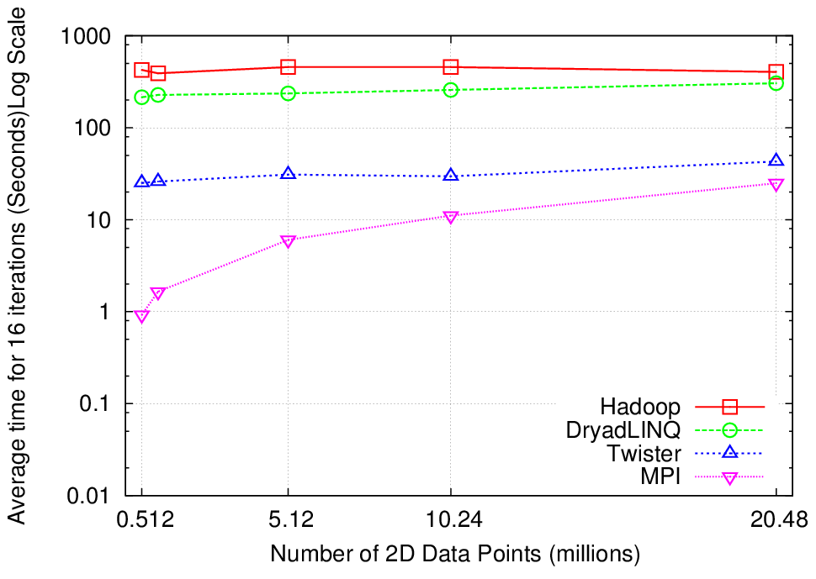
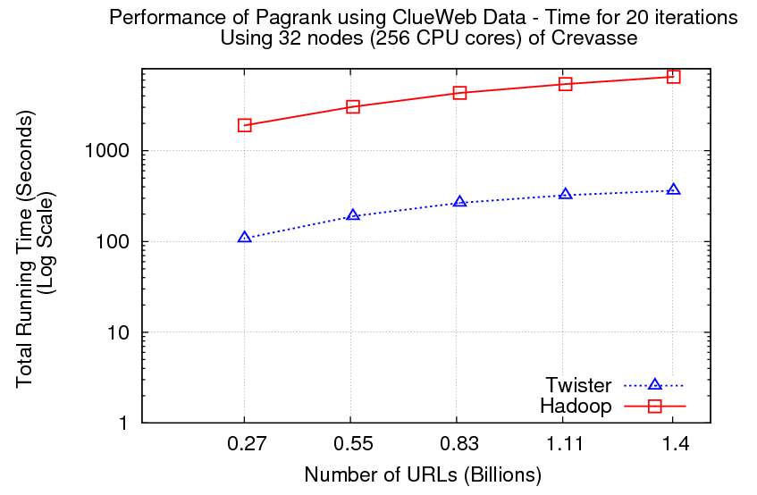
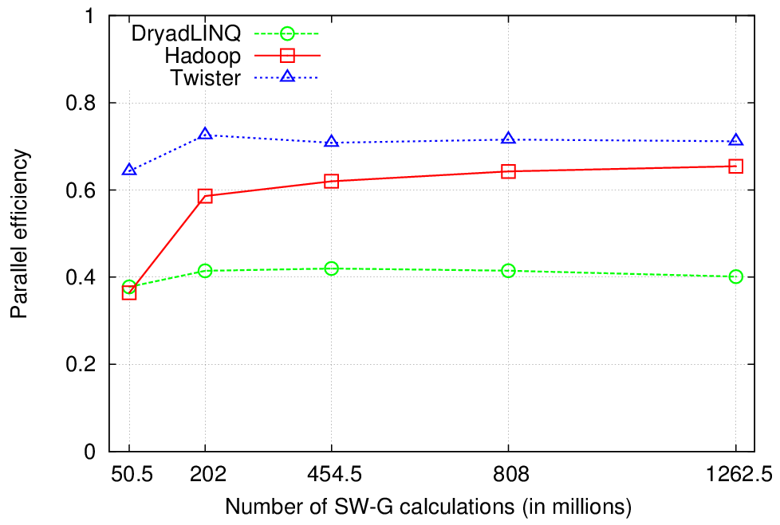
Applications and Performance

Slide 8
MapReduceRoles for Azure
MapReduce framework for Azure Cloud
Built using highly-available and scalable Azure cloud services
  Distributed, highly scalable & highly available services
  Minimal management / maintenance overhead
  Reduced footprint
Hides the complexity of cloud & cloud services from the users
Co-exist with eventual consistency & high latency of cloud services
Decentralized control
  avoids single point of failure

Slide 9
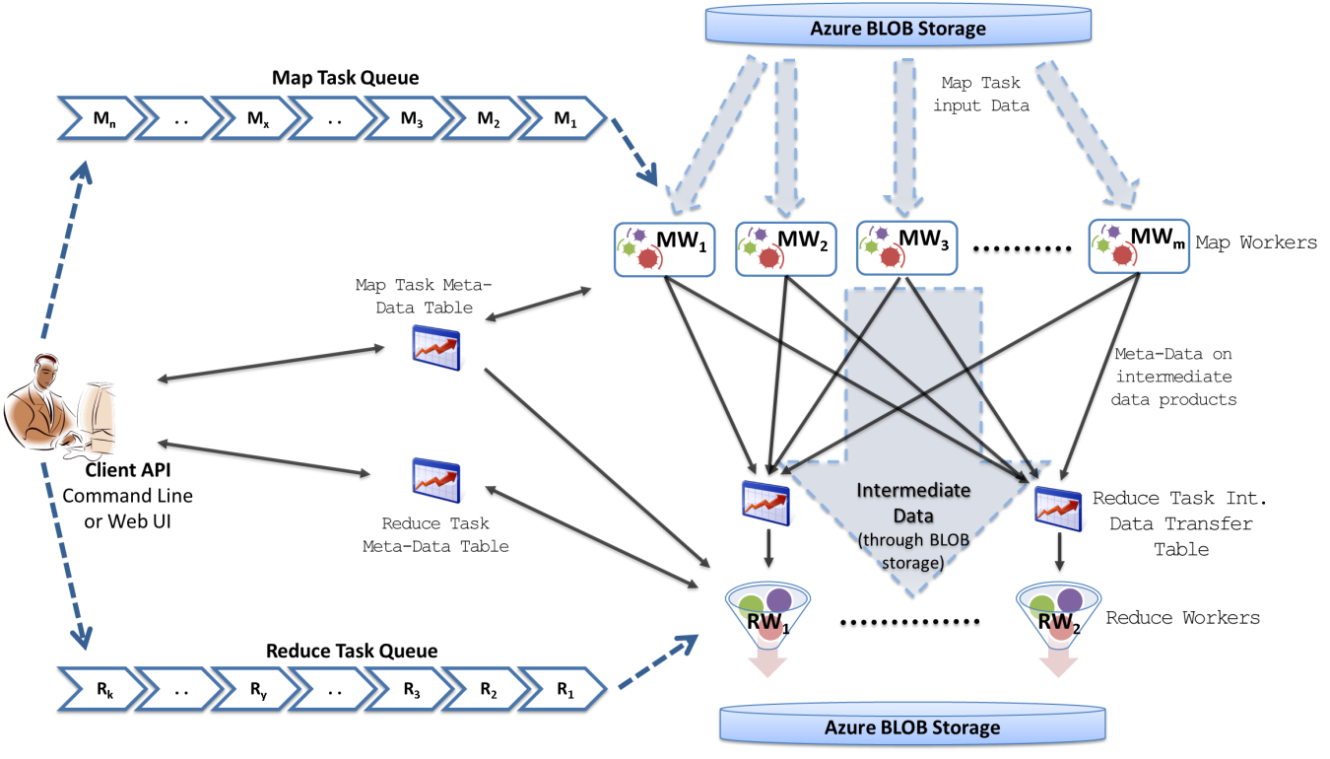
MapReduceRoles for Azure
Supports dynamically scaling up and down of the compute resources.
Fault Tolerance
Combiner step
Web based monitoring console
Easy testing and deployment
Notes:
We use Azure Queues for scheduling, Tables to store meta-data and monitoring data, Blobs for input/output/intermediate data storage.

Slide 10
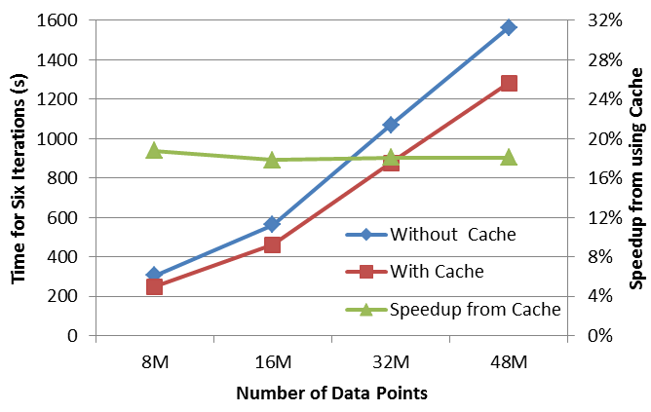
Twister for Azure
Iterative MapReduce Framework for Microsoft Azure Cloud.
Merge Step
In-Memory Caching of static data
Cache aware hybrid scheduling using Queues as well as using a bulletin board
Kmeans Performance with/without data caching.
Notes:
In our current work, we extend MR4Azure to support iterative mapreduce computations. We added an additional merge step to the programming model, where the computations decides whether to go for a new iteration or not. We also support in-memory caching of static data between iterations and we developed a hybrid scheduling strategy to perform cache aware scheduling.

Slide 11

Performance Comparisons
BLAST Sequence Search
Kmeans Scaling speedup
Kmeans Increasing number of iterations
Cap3 Sequence Assembly
Smith Watermann Sequence Alignment

Slide 12
Dryad &
Parallel Applications

Slide 13
DryadLINQ CTP Evaluation
The beta version released on Dec 2010
Motivation:
  Evaluate key features and interface in DryadLINQ
  Study parallel programming model in DryadLINQ
Three applications
  SW-G bioinformatics application
  Matrix Matrix Multiplication
  PageRank

Slide 14
Parallel programming model
DryadLINQ store input data as DistributedQuery<T> objects
It splits distributed objects into partitions with following APIs:
  AsDistributed()
  RangePartition()
Common LINQ providers
Provider | Base class
LINQ-to-objects | IEnumerable<T>
PLINQ | ParallelQuery<T>
LINQ-to-SQL | IQueryable<T>
LINQ-to-? | IQueryable<T>
DryadLINQ | DistributedQuery<T>

Slide 15
SW-G bioinformatics application
Workload balance issue
  SW-G tasks are inhomogeneous in CPU time.
  Skewed distributed input data cause in-balance workload distribution
  Randomized distributed input data can alleviate above issue
Static and Dynamic optimization in Dryad/DryadLINQ

Slide 16
Matrix-Matrix Multiplication
Parallel programming algorithms
  Row split
  Row Column split
  2 dimensional block decomposition in Fox algorithm
Multi core technologies in .NET
  TPL, PLINQ, Thread pool
Hybrid parallel model
  Port multi-core to Dryad
  task to improve performance

Slide 17
PageRank
Grouped Aggregation
  A core primitive of many distributed programming models.
  Two stage:1) Partition the data into groups by some keys 2) Performs an aggregation over each groups
DryadLINQ provide two types of grouped aggregation
  GroupBy(), without partial aggregation optimization.
  GroupAndAggregate(), with partial aggregation.

Slide 18
NIH Projects

Slide 19
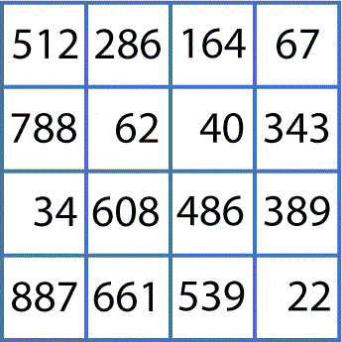
Sequence Clustering
Smith-Waterman / Needleman-Wunsch with
Kimura2 / Jukes-Cantor / Percent-Identity
MPI.NET Implementation
C# Desktop Application based on VTK
Pairwise Clustering
Cluster Indices
Pairwise Alignment & Distance Calculation
Gene Sequences
Visualization
3D Plot
Distance Matrix
Coordinates
Multi-Dimensional Scaling
MPI.NET Implementation
Chi-Square / Deterministic Annealing
MPI.NET Implementation
* Note. The implementations of Smith-Waterman and Needleman-Wunsch algorithms are from Microsoft Biology Foundation library

Slide 20

Scale-up Sequence Clustering with Twister
Gene Sequences (N = 1 Million)
e.g. 25 Million
Pairwise Alignment & Distance Calculation
O(MxM)
Select Reference
Reference Sequence Set (M = 100K)
Distance Matrix
Reference Coordinates
N - M Sequence Set (900K)
Interpolative MDS with Pairwise Distance Calculation
x, y, z
Multi-Dimensional Scaling (MDS)
O(MxM)
O(Mx(N-1))
N - M Coordinates
x, y, z
Visualization
3D Plot

Slide 21
Services and Support
Web Portal and Metadata Management
CGB work
  // todo - Ryan

Slide 22
GTM vs. MDS
GTM
MDS (SMACOF)
Purpose
Non-linear dimension reduction
Find an optimal configuration in a lower-dimension
Iterative optimization method
Input
Vector-based data
Non-vector (Pairwise similarity matrix)
Objective
Function
Maximize Log-Likelihood
Minimize STRESS or SSTRESS
Complexity
O(KN) (K << N)
O(N²)
Optimization
Method
EM
Iterative Majorization (EM-like)

Slide 23

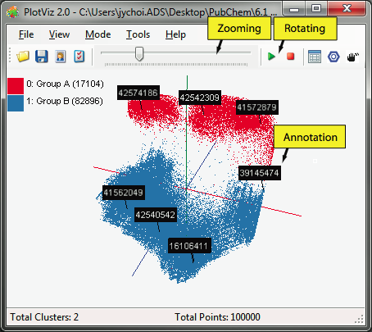

PlotViz
3-D Map File
SPARQL query
PlotViz
Meta data
Light-weight client
DrugBank
CTD
QSAR
Visualization Algorithms
PubChem
Chem2Bio2RDF
Parallel dimension reduction algorithms
Aggregated public databases

Slide 24
Education

Slide 25

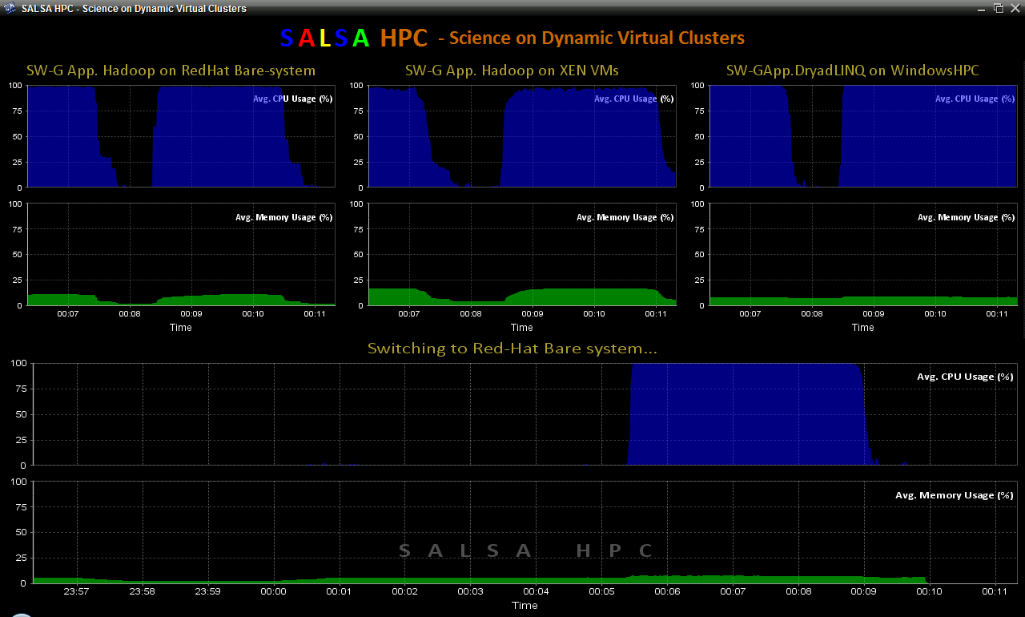
SALSAHPC Dynamic Virtual Cluster on FutureGrid -- Demo at SC09
Demonstrate the concept of Science on Clouds on FutureGrid
Dynamic Cluster Architecture
Monitoring & Control Infrastructure
Monitoring Infrastructure
Monitoring Interface
Pub/Sub Broker Network
SW-G Using Hadoop
SW-G Using Hadoop
SW-G Using DryadLINQ
Linux
Bare-system
Linux on Xen
Windows Server 2008 Bare-system
Virtual/Physical Clusters
Summarizer
XCAT Infrastructure
XCAT Infrastructure
Switcher
iDataplex Bare-metal Nodes
(32 nodes)
iDataplex Bare-metal Nodes

Slide 26

SALSAHPC Dynamic Virtual Cluster on FutureGrid -- Demo at SC09
Demonstrate the concept of Science on Clouds using a FutureGrid cluster
http://salsahpc.indiana.edu/b534
http://salsahpc.indiana.edu/b534projects

