Slide 1
Remarks on MOOC’s
SC13 Birds of a Feather November 20 2013
Geoffrey Fox
gcf@indiana.edu
Informatics, Computing and Physics
Indiana University Bloomington

Slide 2
Background
MOOC’s are a “disruptive force” in the educational environment
Coursera, Udacity, Khan Academy and many others
MOOC’s have courses and technologies
Google Course Builder and OpenEdX are open source MOOC technologies
Blackboard and others are learning management systems with (some) MOOC support

Slide 3
MOOC Style Implementations
Courses from commercial sources, universities and partnerships
Courses with 100,000 students (free)
Georgia Tech a leader in rigorous academic curriculum – MOOC style Masters in Computer Science (pay tuition, get regular GT degree)
Indiana University a much more modest Data Science certificate with 4 MOOC courses Spring 2014
Interesting way to package tutorial material for computers and software e.g.
FutureGrid has had 24 EOT projects over last year (semester courses to workshops)
Support by MOOC modules on how to use FutureGrid

Slide 4
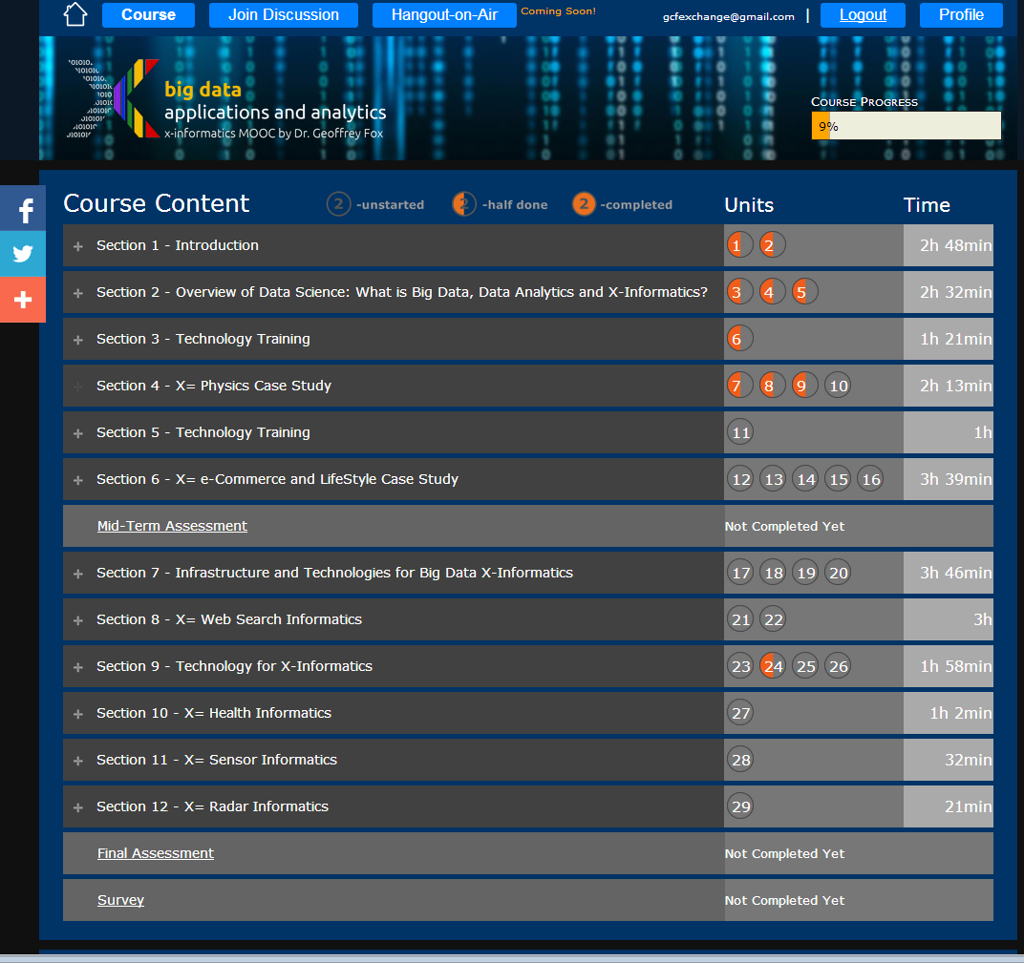
Example Google
Course Builder
MOOC
4 levels
Course
Section (12)
Units(29)
Lessons(~150)
Units are ~ traditional lecture
Lessons are ~10 minute segments
http://x-informatics.appspot.com/course

Slide 5
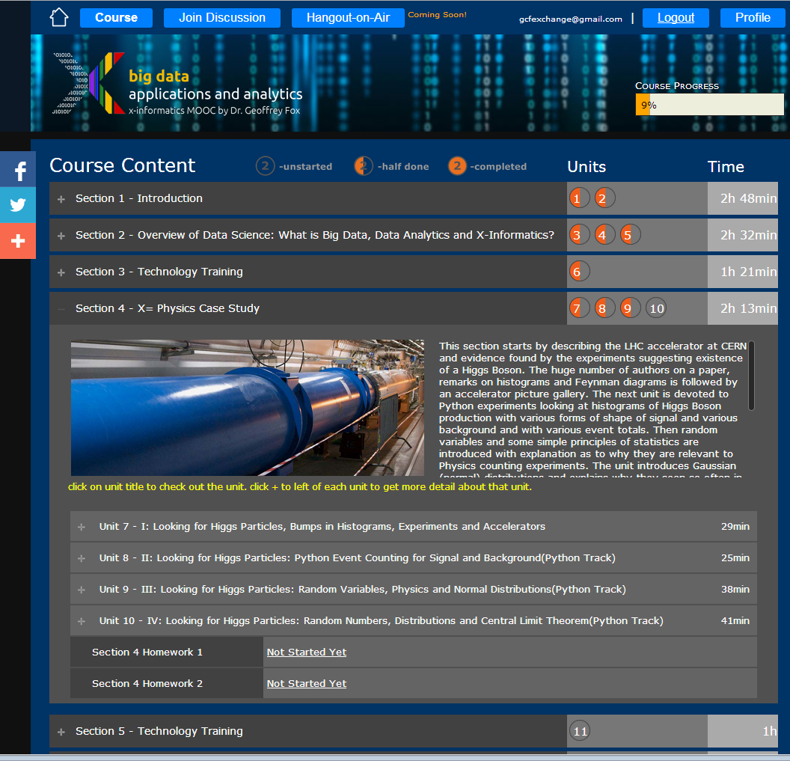
Example Google
Course Builder
MOOC
The Physics Section expands to 4 units and 2 Homeworks
Unit 9 expands to 5 lessons
Lessons played on Youtube
“talking head video + PowerPoint”
http://x-informatics.appspot.com/course

Slide 9
MOOCs in SC community
Activities like CI-Tutor and HPC University are community activities that have collected much re-usable education material
MOOC’s naturally support re-use at lesson or higher level
e.g. include MPI on XSEDE MOOC as part of many parallel programming classes
Need to develop agreed ways to use backend servers (HPC or Cloud) to support MOOC laboratories
Students should be able to take MOOC classes from tablet or phone
Parts of MOOC’s (Units or Sections) can be used as modules to enhance classes in outreach activities

Slide 10
Cloud MOOC Repository
http://iucloudsummerschool.appspot.com/preview

