Slide 1
Cloud Data mining and FutureGrid
SC10 New Orleans LA
AIST Booth
November 17 2010
Geoffrey Fox
gcf@indiana.edu
http://www.infomall.org http://www.futuregrid.org
Director, Digital Science Center, Pervasive Technology Institute
Associate Dean for Research and Graduate Studies, School of Informatics and Computing
Indiana University Bloomington

Slide 2
FutureGrid key Concepts I
FutureGrid is an international testbed modeled on Grid5000
Rather than loading images onto VM’s, FutureGrid supports Cloud, Grid and Parallel computing environments by dynamically provisioning software as needed onto “bare-metal” using Moab/xCAT
Image library for MPI, OpenMP, Hadoop, Dryad, gLite, Unicore, Globus, Xen, ScaleMP (distributed Shared Memory), Nimbus, Eucalyptus, OpenNebula, KVM, Windows …..
The FutureGrid testbed provides to its users:
A flexible development and testing platform for middleware and application users looking at interoperability, functionality and performance
Each use of FutureGrid is an experiment that is reproducible
A rich education and teaching platform for advanced cyberinfrastructure classes
Growth comes from users depositing novel images in library

Slide 3
Dynamic Provisioning Results
Number of nodes
Time elapsed between requesting a job and the jobs reported start time on the provisioned node. The numbers here are an average of 2 sets of experiments.

Slide 4
FutureGrid key Concepts II
Support Computer Science and Computational Science
Industry and Academia
Asia, Europe and Americas
Note most current use Education, Computer Science Systems and Biology
Very different from TeraGrid use
FutureGrid has ~5000 distributed cores with a dedicated network and a Spirent XGEM network fault and delay generator
Key early user oriented milestones:
June 2010 Initial users
November 1 2010 Increasing number of users allocated by FutureGrid
Apply now to use FutureGrid on web site www.futuregrid.org

Slide 5
FutureGrid Partners
Indiana University (Architecture, core software, Support)
Collaboration between research and infrastructure groups
Purdue University (HTC Hardware)
San Diego Supercomputer Center at University of California San Diego (INCA, Monitoring)
University of Chicago/Argonne National Labs (Nimbus)
University of Florida (ViNE, Education and Outreach)
University of Southern California Information Sciences (Pegasus to manage experiments)
University of Tennessee Knoxville (Benchmarking)
University of Texas at Austin/Texas Advanced Computing Center (Portal)
University of Virginia (OGF, Advisory Board and allocation)
Center for Information Services and GWT-TUD from Technische Universtität Dresden. (VAMPIR)
Red institutions have FutureGrid hardware

Slide 6
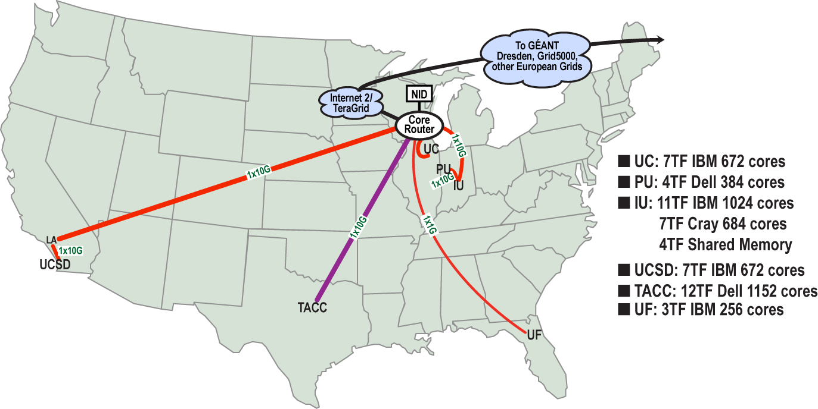
FutureGrid: a Grid/Cloud/HPC Testbed
Operational: IU Cray operational; IU , UCSD, UF & UC IBM iDataPlex operational
Network, NID operational
TACC Dell finished acceptance tests
INCA Node Operating Mode Statistics
NID: Network Impairment Device
Private Public
FG Network

Slide 7
Network & Internal Interconnects
FutureGrid has dedicated network (except to TACC) and a network fault and delay generator
Can isolate experiments on request; IU runs Network for NLR/Internet2
(Many) additional partner machines will run FutureGrid software and be supported (but allocated in specialized ways)
Machine | Name | Internal Network
IU Cray | xray | Cray 2D Torus SeaStar
IU iDataPlex | india | DDR IB, QLogic switch with Mellanox ConnectX adapters Blade Network Technologies & Force10 Ethernet switches
SDSC iDataPlex | sierra | DDR IB, Cisco switch with Mellanox ConnectX adapters Juniper Ethernet switches
UC iDataPlex | hotel | DDR IB, QLogic switch with Mellanox ConnectX adapters Blade Network Technologies & Juniper switches
UF iDataPlex | foxtrot | Gigabit Ethernet only (Blade Network Technologies; Force10 switches)
TACC Dell | alamo | QDR IB, Mellanox switches and adapters Dell Ethernet switches

Slide 8
Network Impairment Device
Spirent XGEM Network Impairments Simulator for jitter, errors, delay, etc
Full Bidirectional 10G w/64 byte packets
up to 15 seconds introduced delay (in 16ns increments)
0-100% introduced packet loss in .0001% increments
Packet manipulation in first 2000 bytes
up to 16k frame size
TCL for scripting, HTML for manual configuration

Slide 9
FutureGrid Usage Model
The goal of FutureGrid is to support the research on the future of distributed, grid, and cloud computing
FutureGrid will build a robustly managed simulation environment and test-bed to support the development and early use in science of new technologies at all levels of the software stack: from networking to middleware to scientific applications
The environment will mimic TeraGrid and/or general parallel and distributed systems – FutureGrid is part of TeraGrid (but not part of formal TeraGrid process for first two years)
Supports Grids, Clouds, and classic HPC
It will mimic commercial clouds (initially IaaS not PaaS)
Expect FutureGrid PaaS to grow in importance
FutureGrid can be considered as a (small ~5000 core) Science/Computer Science Cloud but it is more accurately a virtual machine or bare-metal based simulation environment
This test-bed will succeed if it enables major advances in science and engineering through collaborative development of science applications and related software

Slide 10
Some Current FutureGrid users I

Slide 11
Some Current FutureGrid users II

Slide 12
OGF’10 Demo
SDSC
Rennes
Grid’5000 firewall
UF
Lille
UC
Sophia
ViNe provided the necessary inter-cloud connectivity to deploy CloudBLAST across 5 Nimbus sites, with a mix of public and private subnets.

Slide 13
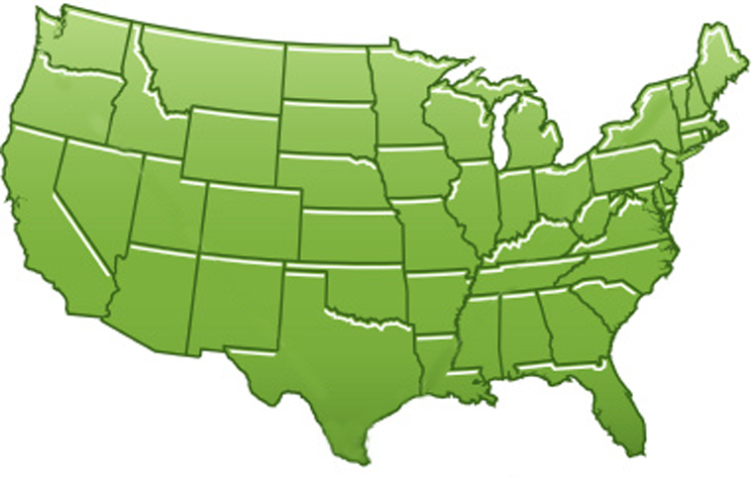
300+ Students learning about Twister & Hadoop
MapReduce technologies, supported by FutureGrid.
July 26-30, 2010 NCSA Summer School Workshop
http://salsahpc.indiana.edu/tutorial
Washington
University
University of
Minnesota
Michigan
State
Johns
Hopkins
Univ.Illinois
at Chicago
Iowa
State
Penn
State
IBM Almaden
Research Center
Notre
Dame
University of
California at
Los Angeles
Indiana
University
San Diego
Supercomputer
Center
University of
Texas at El Paso
University of
Arkansas
University
of Florida

Slide 14
Software Components
Portals including “Support” “use FutureGrid” “Outreach”
Monitoring – INCA, Power (GreenIT)
Experiment Manager: specify/workflow
Image Generation and Repository
Intercloud Networking ViNE
Virtual Clusters built with virtual networks
Performance library
Rain or Runtime Adaptable InsertioN Service: Schedule and Deploy images
Security (including use of isolated network), Authentication, Authorization,

Slide 15
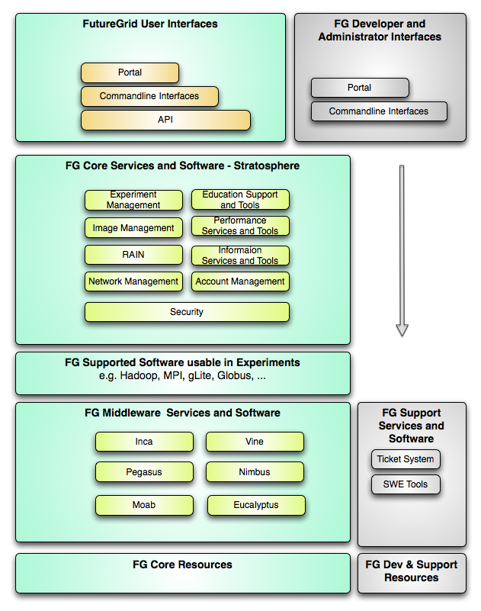
FutureGrid Layered Software Stack
User Supported Software usable in Experiments e.g. OpenNebula, Charm++, Other MPI, Bigtable

Slide 16
FutureGrid Interaction with Commercial Clouds
We support experiments that link Commercial Clouds and FutureGrid with one or more workflow environments and portal technology installed to link components across these platforms
We support environments on FutureGrid that are similar to Commercial Clouds and natural for performance and functionality comparisons
These can both be used to prepare for using Commercial Clouds and as the most likely starting point for porting to them
One example would be support of MapReduce-like environments on FutureGrid including Hadoop on Linux and Dryad on Windows HPCS which are already part of FutureGrid portfolio of supported software
We develop expertise and support porting to Commercial Clouds from other Windows or Linux environments
We support comparisons between and integration of multiple commercial Cloud environments – especially Amazon and Azure in the immediate future
We develop tutorials and expertise to help users move to Commercial Clouds from other environments

Slide 17
FutureGrid Viral Growth Model
Users apply for a project
Users improve/develop some software in project
This project leads to new images which are placed in FutureGrid repository
Project report and other web pages document use of new images
Images are used by other users
And so on ad infinitum ………

Slide 18
194 papers submitted to main track; 48 accepted; 4 days of tutorials

Slide 19
Philosophy of Clouds and Grids
Clouds are (by definition) commercially supported approach to large scale computing
So we should expect Clouds to replace Compute Grids
Current Grid technology involves “non-commercial” software solutions which are hard to evolve/sustain
Maybe Clouds ~4% IT expenditure 2008 growing to 14% in 2012 (IDC Estimate)
Public Clouds are broadly accessible resources like Amazon and Microsoft Azure – powerful but not easy to customize and perhaps data trust/privacy issues
Private Clouds run similar software and mechanisms but on “your own computers” (not clear if still elastic)
Platform features such as Queues, Tables, Databases currently limited
Services still are correct architecture with either REST (Web 2.0) or Web Services
Clusters are still critical concept for MPI or Cloud software

Slide 20
Grids MPI and Clouds
Grids are useful for managing distributed systems
Pioneered service model for Science
Developed importance of Workflow
Performance issues – communication latency – intrinsic to distributed systems
Can never run large differential equation based simulations or datamining
Clouds can execute any job class that was good for Grids plus
More attractive due to platform plus elastic on-demand model
MapReduce easier to use than MPI for appropriate parallel jobs
Currently have performance limitations due to poor affinity (locality) for compute-compute (MPI) and Compute-data
These limitations are not “inevitable” and should gradually improve as in July 13 Amazon Cluster announcement
Will probably never be best for most sophisticated parallel differential equation based simulations
Classic Supercomputers (MPI Engines) run communication demanding differential equation based simulations
MapReduce and Clouds replaces MPI for other problems
Much more data processed today by MapReduce than MPI (Industry Informational Retrieval ~50 Petabytes per day)

Slide 21
Cloud Computing: Infrastructure and Runtimes
Cloud infrastructure: outsourcing of servers, computing, data, file space, utility computing, etc.
Handled through Web services that control virtual machine lifecycles.
Cloud runtimes or Platform: tools (for using clouds) to do data-parallel (and other) computations.
Apache Hadoop, Google MapReduce, Microsoft Dryad, Bigtable, Chubby and others
MapReduce designed for information retrieval but is excellent for a wide range of science data analysis applications
Can also do much traditional parallel computing for data-mining if extended to support iterative operations
MapReduce not usually on Virtual Machines

Slide 22
MapReduce
Data Partitions
Map(Key, Value)
A hash function maps the results of the map tasks to reduce tasks
Reduce(Key, List<Value>)
Reduce Outputs
Implementations (Hadoop – Java; Dryad – Windows) support:
Splitting of data
Passing the output of map functions to reduce functions
Sorting the inputs to the reduce function based on the intermediate keys
Quality of service

Slide 23
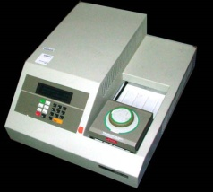
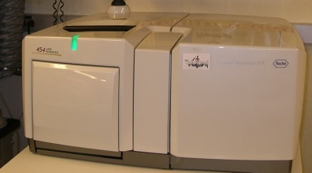
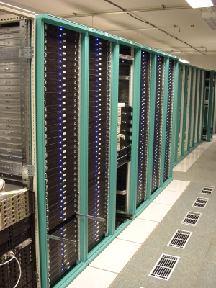
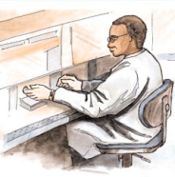
MapReduce “File/Data Repository” Parallelism
Map = (data parallel) computation reading and writing data
Reduce = Collective/Consolidation phase e.g. forming multiple global sums as in histogram
Instruments
Iterative MapReduce
Map Map Map Map
Reduce Reduce Reduce
Communication
Reduce
Portals /Users
Disks
Map₁
Map₂
Map₃

Slide 24
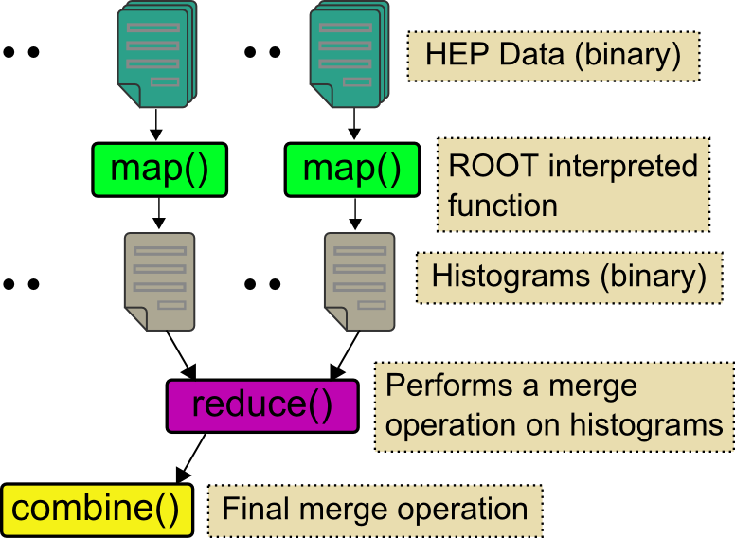
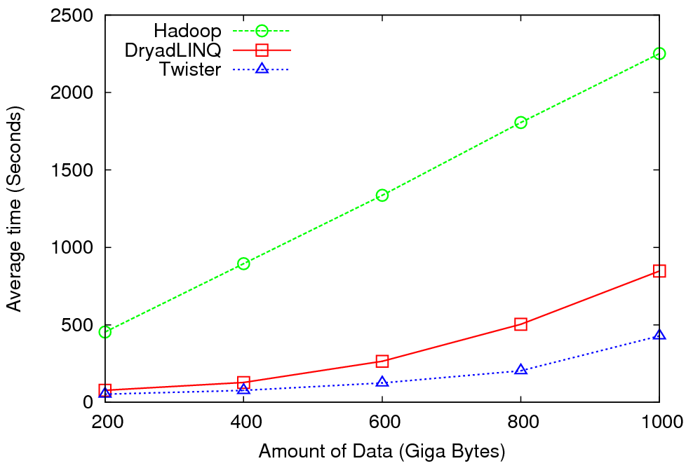
High Energy Physics Data Analysis
An application analyzing data from Large Hadron Collider (1TB but 100 Petabytes eventually)
Input to a map task: <key, value>
key = Some Id value = HEP file Name
Output of a map task: <key, value>
key = random # (0<= num<= max reduce tasks)
value = Histogram as binary data
Input to a reduce task: <key, List<value>>
key = random # (0<= num<= max reduce tasks)
value = List of histogram as binary data
Output from a reduce task: value
value = Histogram file
Combine outputs from reduce tasks to form the final histogram

Slide 25
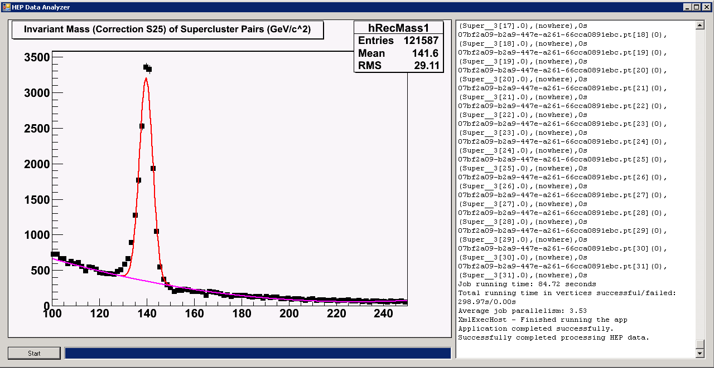
Reduce Phase of Particle Physics “Find the Higgs” using Dryad
Higgs in Monte Carlo
Combine Histograms produced by separate Root “Maps” (of event data to partial histograms) into a single Histogram delivered to Client

Slide 26
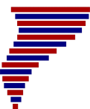
Application Classes
Old classification of Parallel software/hardware in terms of
5 (becoming 6) “Application architecture” Structures)
1 | Synchronous | Lockstep Operation as in SIMD architectures | SIMD
2 | Loosely Synchronous | Iterative Compute-Communication stages with independent compute (map) operations for each CPU. Heart of most MPI jobs | MPP
3 | Asynchronous | Computer Chess; Combinatorial Search often supported by dynamic threads | MPP
4 | Pleasingly Parallel | Each component independent – in 1988, Fox estimated at 20% of total number of applications | Grids
5 | Metaproblems | Coarse grain (asynchronous) combinations of classes 1)-4). The preserve of workflow. | Grids
6 | MapReduce++ | It describes file(database) to file(database) operations which has subcategories including. Pleasingly Parallel Map Only Map followed by reductions Iterative “Map followed by reductions” – Extension of Current Technologies that supports much linear algebra and datamining | Clouds Hadoop/ Dryad Twister
Notes:
CGL-MapReduce is an example of MapReduce++ -- supports MapReduce model with iteration (data stays in memory and communication via streams not files)

Slide 27
Applications & Different Interconnection Patterns
Map Only | Classic MapReduce | Iterative Reductions MapReduce++ | Loosely Synchronous
CAP3 Analysis Document conversion (PDF -> HTML) Brute force searches in cryptography Parametric sweeps | High Energy Physics (HEP) Histograms SWG gene alignment Distributed search Distributed sorting Information retrieval | Expectation maximization algorithms Clustering Linear Algebra | Many MPI scientific applications utilizing wide variety of communication constructs including local interactions
- CAP3 Gene Assembly - PolarGrid Matlab data analysis | - Information Retrieval - HEP Data Analysis - Calculation of Pairwise Distances for ALU Sequences | Kmeans Deterministic Annealing Clustering - Multidimensional Scaling MDS | - Solving Differential Equations and - particle dynamics with short range forces
Input
iterations
Input
Input
map
map
map
Pij
reduce
Output
reduce
Domain of MapReduce and Iterative Extensions
MPI

Slide 28
Fault Tolerance and MapReduce
MPI does “maps” followed by “communication” including “reduce” but does this iteratively
There must (for most communication patterns of interest) be a strict synchronization at end of each communication phase
Thus if a process fails then everything grinds to a halt
In MapReduce, all Map processes and all reduce processes are independent and stateless and read and write to disks
As 1 or 2 (reduce+map) iterations, no difficult synchronization issues
Thus failures can easily be recovered by rerunning process without other jobs hanging around waiting
Re-examine MPI fault tolerance in light of MapReduce
Twister (later) will interpolate between MPI and MapReduce

Slide 29
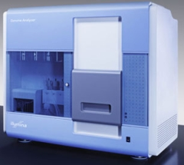
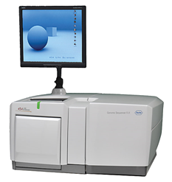
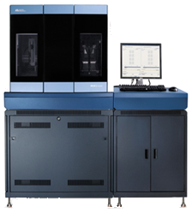
DNA Sequencing Pipeline
MapReduce
Pairwise
clustering
Sequence
alignment
Dissimilarity
Matrix
N(N-1)/2 values
Visualization
Plotviz
FASTA File N Sequences
Blocking
block
Pairings
MPI
MDS
Read Alignment
Illumina/Solexa Roche/454 Life Sciences Applied Biosystems/SOLiD
Internet
Modern Commercial Gene Sequencers
This chart illustrate our research of a pipeline mode to provide services on demand (Software as a Service SaaS)
User submit their jobs to the pipeline. The components are services and so is the whole pipeline.

Slide 30
Alu and Metagenomics Workflow All Pairs
Data is a collection of N sequences. Need to calculate N² dissimilarities (distances) between sequences.
These cannot be thought of as vectors because there are missing characters
Step 1: Calculate N² dissimilarities (distances) between sequences
Step 2: Find families by clustering (using much better methods than Kmeans). As no vectors, use vector free O(N²) methods
Step 3: Map to 3D for visualization using Multidimensional Scaling (MDS) – also O(N²)
Note N = 50,000 runs in 10 hours (the complete pipeline above) on 768 cores
Need to address millions of sequences; develop new O(NlogN) algorithms
Currently using a mix of MapReduce (step 1) and MPI as steps 2,3 use classic matrix algorithms
Twister could do all steps as MDS, Clustering just need MPI Broadcast/Reduce

Slide 31
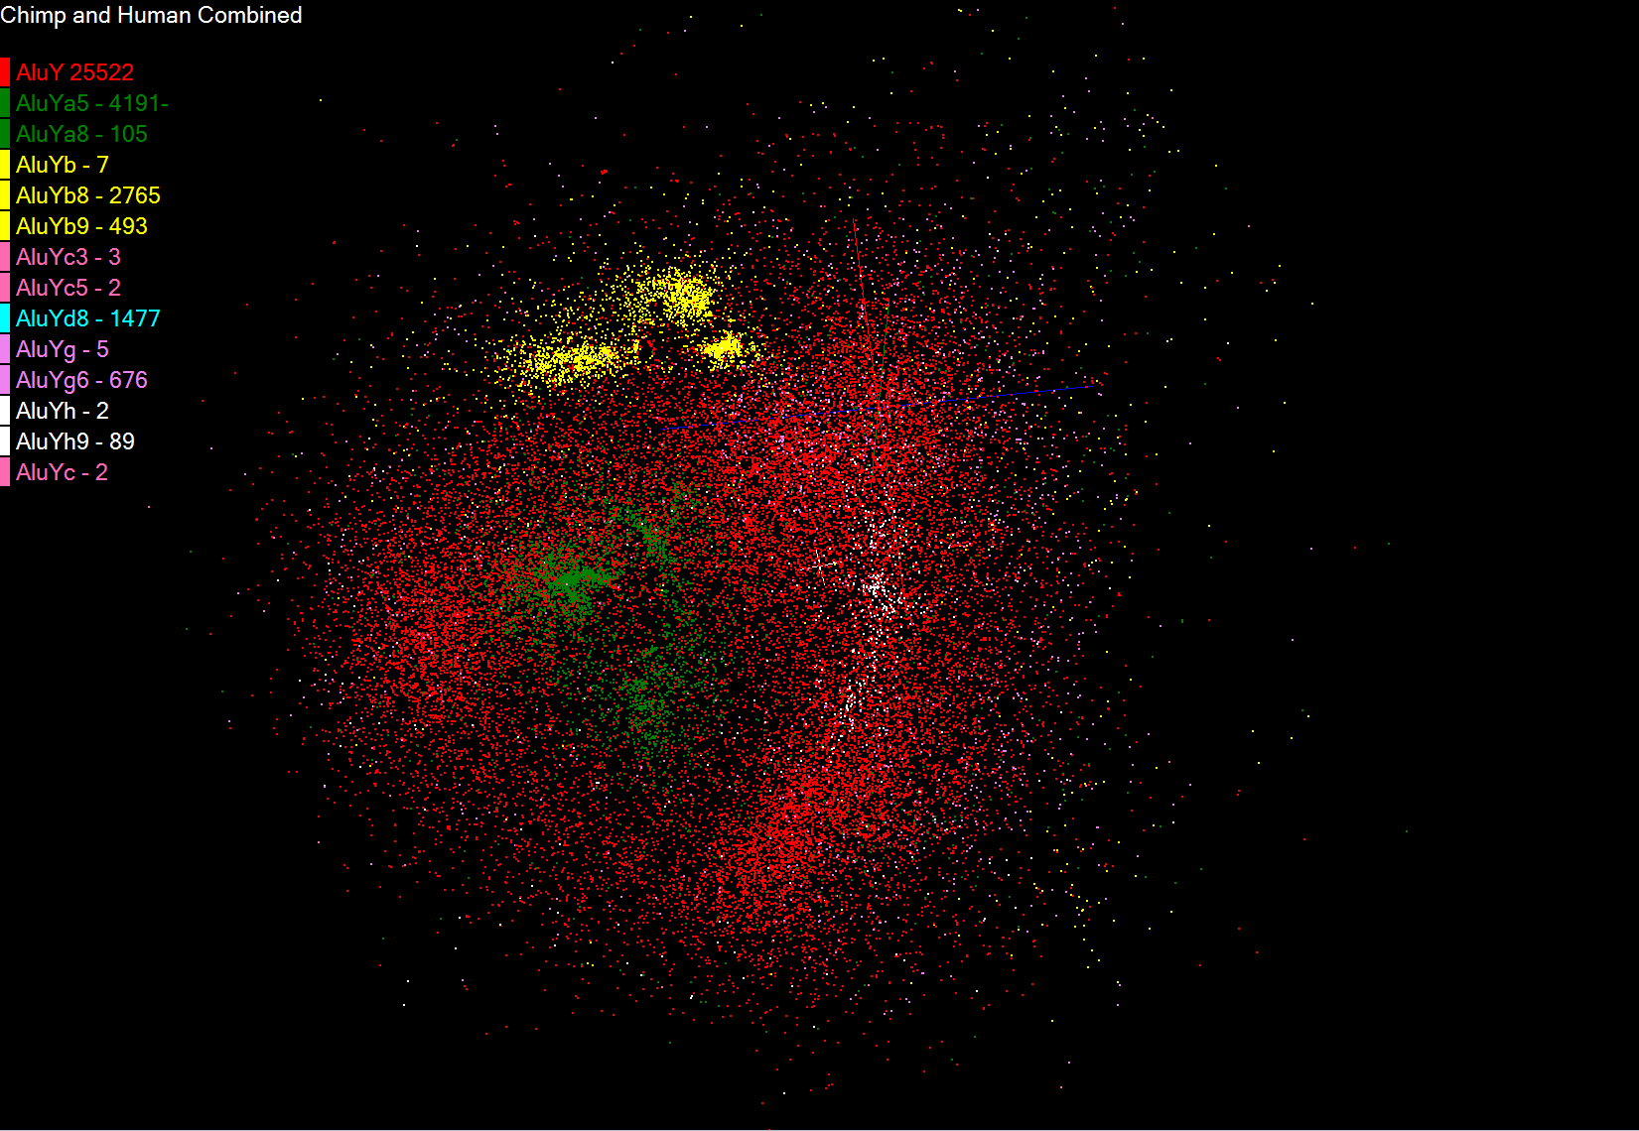
Alu Families
This visualizes results of Alu repeats from Chimpanzee and Human Genomes. Young families (green, yellow) are seen as tight clusters. This is projection of MDS dimension reduction to 3D of 35399 repeats – each with about 400 base pairs

Slide 32
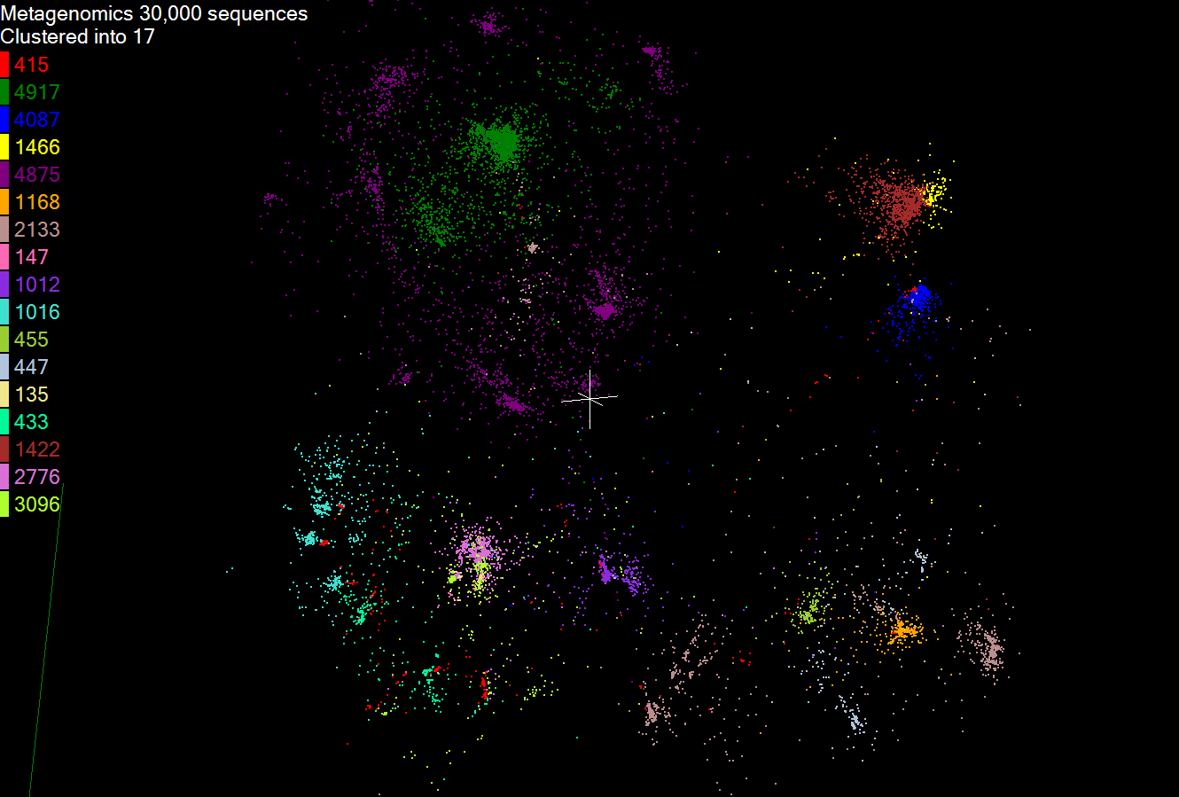
Metagenomics
This visualizes results of dimension reduction to 3D of 30000 gene sequences from an environmental sample. The many different genes are classified by clustering algorithm and visualized by MDS dimension reduction

Slide 33
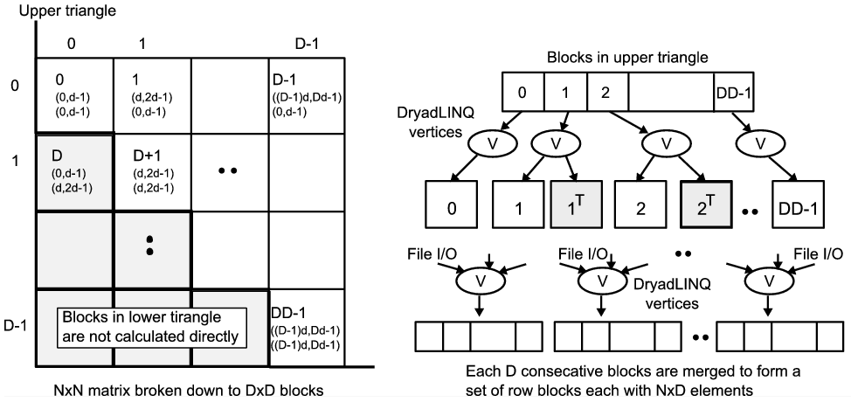
All-Pairs Using DryadLINQ
125 million distances
4 hours & 46 minutes
Calculate Pairwise Distances (Smith Waterman Gotoh)
Calculate pairwise distances for a collection of genes (used for clustering, MDS)
Fine grained tasks in MPI
Coarse grained tasks in DryadLINQ
Performed on 768 cores (Tempest Cluster)
Moretti, C., Bui, H., Hollingsworth, K., Rich, B., Flynn, P., & Thain, D. (2009). All-Pairs: An Abstraction for Data Intensive Computing on Campus Grids. IEEE Transactions on Parallel and Distributed Systems , 21, 21-36.

Slide 34
Hadoop/Dryad Comparison Inhomogeneous Data I
Inhomogeneity of data does not have a significant effect when the sequence lengths are randomly distributed
Dryad with Windows HPCS compared to Hadoop with Linux RHEL on Idataplex (32 nodes)

Slide 35
Hadoop/Dryad Comparison Inhomogeneous Data II
This shows the natural load balancing of Hadoop MR dynamic task assignment using a global pipe line in contrast to the DryadLinq static assignment
Dryad with Windows HPCS compared to Hadoop with Linux RHEL on Idataplex (32 nodes)

Slide 36
Hadoop VM Performance Degradation
Perf. Degradation = (T_{vm} – T_{baremetal})/T_{baremetal}
15.3% Degradation at largest data set size

Slide 37
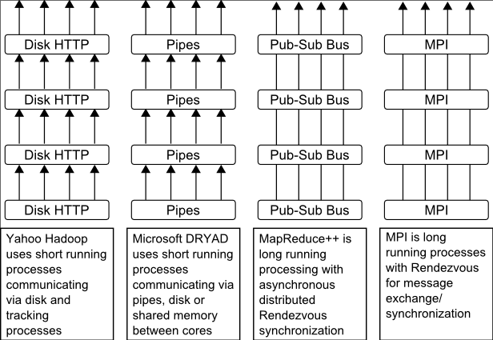
Twister
Pub/Sub Broker Network
Map Worker
M
Worker Nodes
R
Reduce Worker
Streaming based communication
Intermediate results are directly transferred from the map tasks to the reduce tasks – eliminates local files
Cacheable map/reduce tasks
Static data remains in memory
Combine phase to combine reductions
User Program is the composer of MapReduce computations
Extends the MapReduce model to iterative computations
D
D
MR
Driver
User
Program
M
M
M
M
D
MRDeamon
R
R
R
R
Data Read/Write
Communication
Data Split
File System
Iterate
Static
data
Configure()
User Program
Map(Key, Value)
δ flow
Reduce (Key, List<Value>)
Combine (Key, List<Value>)
Different synchronization and intercommunication mechanisms used by the parallel runtimes
Close()

Slide 38
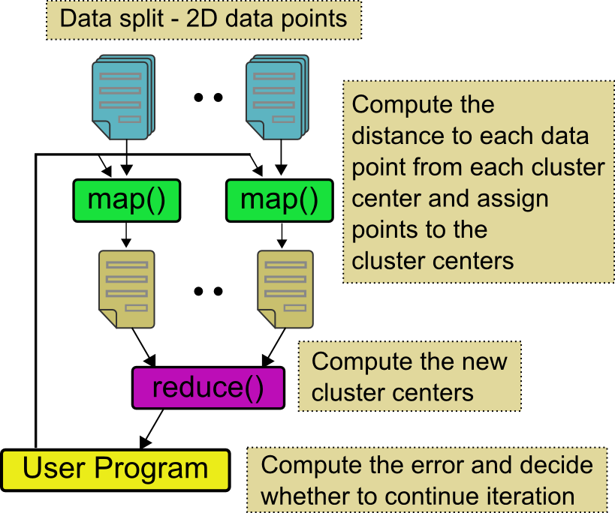
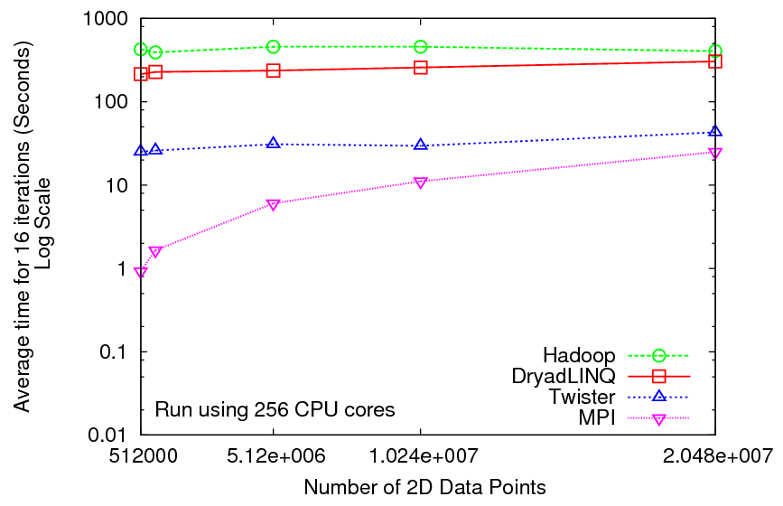
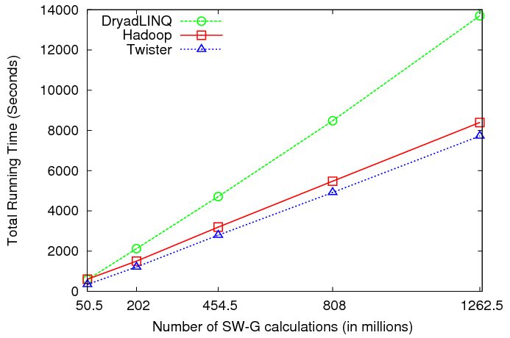
Iterative and non-Iterative Computations
K-means
Smith Waterman is a non iterative case and of course runs fine
Performance of K-Means

Slide 39
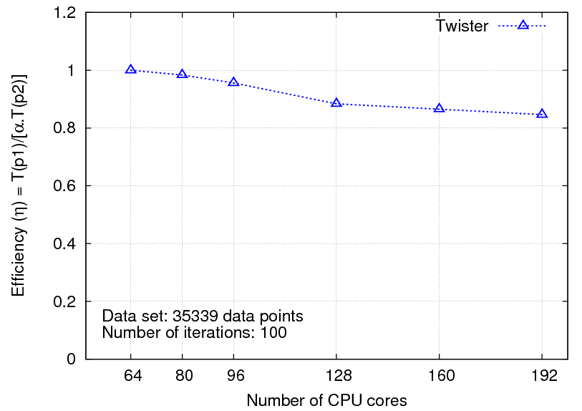
Multi-dimensional Scaling
While(condition)
{
<X> = [A] [B] <C>
C = CalcStress(<X>)
}
While(condition)
{
<T> = MapReduce1([B],<C>)
<X> = MapReduce2([A],<T>)
C = MapReduce3(<X>)
}
Iterative
Maps high dimensional data to lower dimensions (typically 2D or 3D)
SMACOF (Scaling by Majorizing of COmplicated Function)[1]
[1] J. de Leeuw, "Applications of convex analysis to multidimensional scaling," Recent Developments in Statistics, pp. 133-145, 1977.

Slide 40
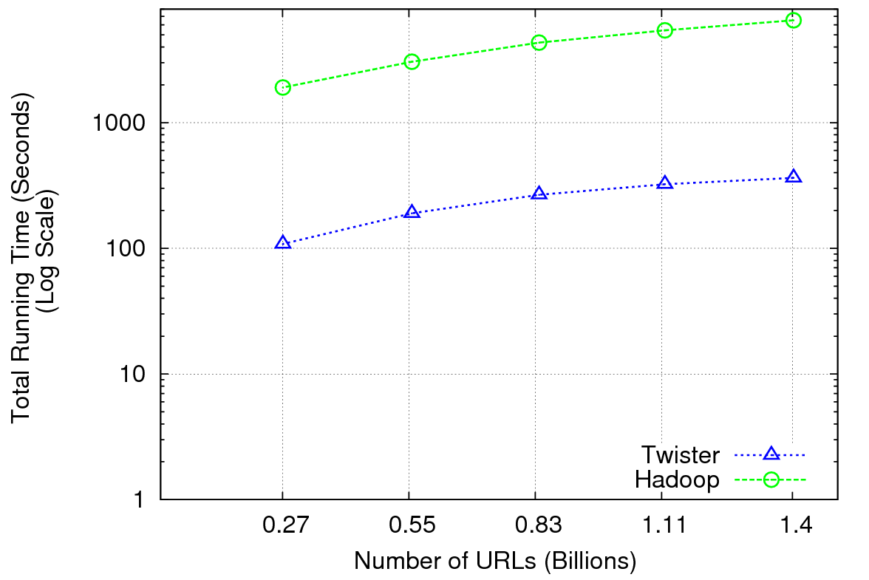
Performance of Pagerank using ClueWeb Data (Time for 20 iterations) using 32 nodes (256 CPU cores) of Crevasse

Slide 41
TwisterMPIReduce
PairwiseClustering MPI
Multi Dimensional Scaling MPI
Generative Topographic Mapping MPI
Other …
TwisterMPIReduce
Azure Twister (C# C++)
Java Twister
Microsoft Azure
FutureGrid
Local Cluster
Amazon EC2
Runtime package supporting subset of MPI mapped to Twister
Set-up, Barrier, Broadcast, Reduce

Slide 42
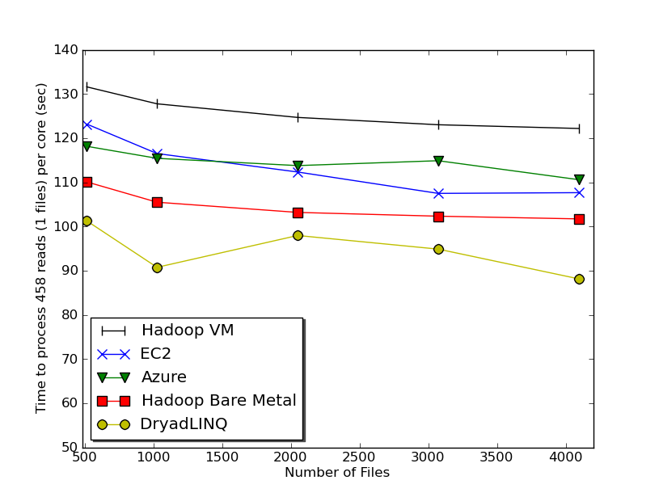
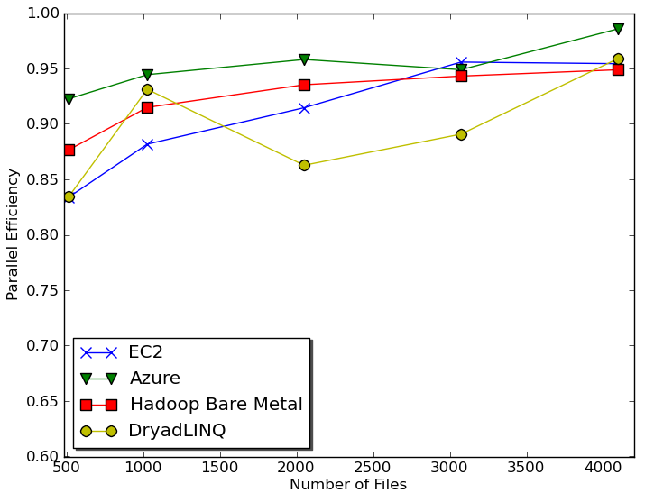
Sequence Assembly in the Clouds
Cap3 Parallel Efficiency
Cap3 – Time Per core per file (458 reads in each file) to process sequences

Slide 43
Early Results with Azure/Amazon MapReduce

Slide 44
SWG Cost
Notes:
This is just the cost for the compute instances. In addition to this, there will be minor charges for the data storage for EMR & AzureMR. Also there will be additional minor charges for the queue service and table service for AzureMR.
Cost presented here are amortized for the actual time (time/3600 * num_instances * instance_price_per_hour), assuming the remaining time of the instance hour have been put to useful work.
Note: EMR & Hadoop-EC2 requires one extra node to act as the master node (included in the cost calculation)

Slide 45
Research and Clouds I
Clouds are suitable for “Loosely coupled” data parallel applications
Quantify “loosely coupled” and define appropriate programming model
“Map Only” (really pleasingly parallel) certainly run well on clouds (subject to data affinity) with many programming paradigms
Parallel FFT and adaptive mesh PDA solver probably pretty bad on clouds but suitable for classic MPI engines
MapReduce and Twister are candidates for “appropriate programming model”
1 or 2 iterations (MapReduce) and Iterative with large messages (Twister) are “loosely coupled” applications
How important is compute-data affinity and concepts like HDFS

Slide 46
Research and Clouds II
Platforms: exploit Tables as in SHARD (Scalable, High-Performance, Robust and Distributed) Triple Store based on Hadoop
What are needed features of tables
Platforms: exploit MapReduce and its generalizations: are there other extensions that preserve its robust and dynamic structure
How important is the loose coupling of MapReduce
Are there other paradigms supporting important application classes
What are other platform features are useful
Are “academic” private clouds interesting as they (currently) only have a few of Platform features of commercial clouds?
Long history of search for latency tolerant algorithms for memory hierarchies
Are there successes? Are they useful in clouds?
In Twister, only support large complex messages
What algorithms only need TwisterMPIReduce

Slide 47
Research and Clouds III
Can cloud deployment algorithms be devised to support compute-compute and compute-data affinity
What platform primitives are needed by datamining?
Clearer for partial differential equation solution?
Note clouds have greater impact on programming paradigms than Grids
Workflow came from Grids and will remain important
Workflow is coupling coarse grain functionally distinct components together while MapReduce is data parallel scalable parallelism
Finding subsets of MPI and algorithms that can use them probably more important than making MPI more complicated
Note MapReduce can use multicore directly – don’t need hybrid MPI OpenMP Programming models
Develop Publish-Subscribe optimized for Twister communication

