Slide 1
Data Science for Life Sciences Research & the Public Good
Geoffrey Fox November 16, 2016 gcf@indiana.edu discussing NSF14-43054 Datanet: CIF21 DIBBs: Middleware and High Performance Analytics Libraries for Scalable Data Science
Arizona State, Indiana (lead), Kansas, Rutgers, Stony Brook, Virginia Tech, and Utah
Life Science needs many things, but I can only help in a few ways
Data Science education: IUB data science masters started Fall 2014 and now has enrollment of 549.
HPC-ABDS: High Performance Computing Enhanced Apache Big Data Stack combines functionality and usability of community software with performance of HPC.
Executes on Comet or Amazon or … using virtual clusters
SPIDAL Scalable Parallel Interoperable Data Analytics Library outperforms Mahout MLlib R using general High Perf principles
Have general algorithms; ready to parallelize others

Slide 2
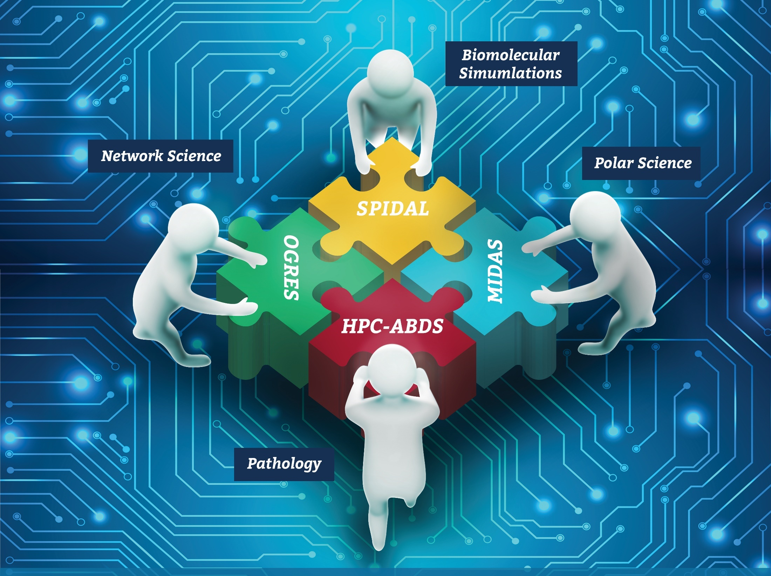
Co-designing Building Blocks Collaboratively
Software: MIDAS HPC-ABDS

Slide 3
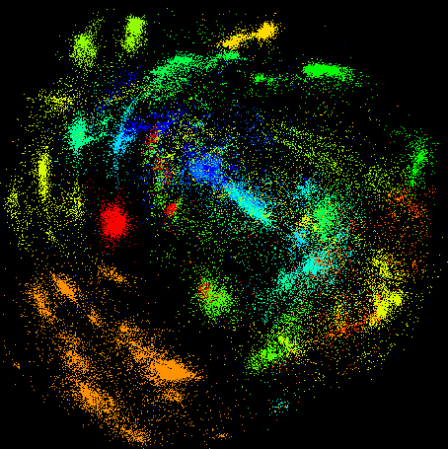
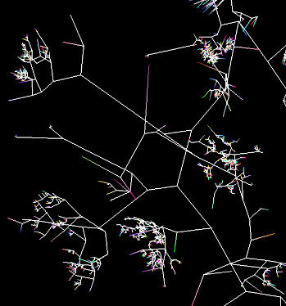
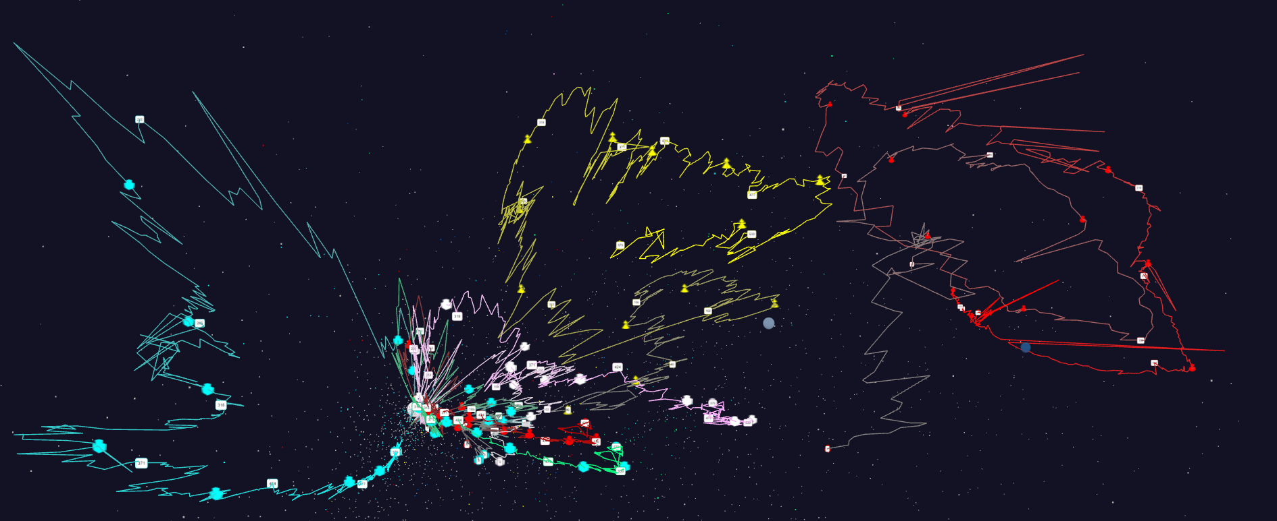
Some large scale analytics
100,000 fungi
Sequences
Eventually
120 clusters
3D phylogenetic tree
LCMS Mass Spectrometer Peak Clustering. Sample of 25 million points. 700 clusters
Jan 1 2004 → December 2015
Daily Stock Time Series in 3D

