Slide 1
Deterministic Annealing and Robust Scalable Data mining for the Data Deluge
Petascale Data Analytics: Challenges, and Opportunities (PDAC-11)
Workshop at SC11 Seattle
November 14 2011
Geoffrey Fox
gcf@indiana.edu
http://www.infomall.org http://www.futuregrid.org
Director, Digital Science Center, Pervasive Technology Institute
Associate Dean for Research and Graduate Studies, School of Informatics and Computing
Indiana University Bloomington

Slide 2
Goal
We are building a library of parallel data mining tools that have best known (to me) robustness and performance characteristics
Big data needs super algorithms?
A lot of statistics tools (e.g. in R) are not the best algorithm and not well parallelized
Deterministic annealing (DA) is one of better approaches to global optimization
Removes local minima
Addresses overfitting
Faster than simulated annealing
Return to my heritage (physics) in an approach I called Physical Computation (23 years ago) (methods based on analogies to nature)
Physics systems find true lowest energy state if you anneal
i.e. you equilibrate at each temperature as you cool

Slide 3
Five Ideas
Deterministic annealing (mean field) is better than many well-used global optimization problems
No-vector problems are O(N²)
For no-vector case, an develop new O(N) or O(NlogN) methods as in “Fast Multipole and OctTree methods”
Map high dimensional data to 3D and use classic methods developed to speed up O(N²) 3D particle dynamics problems
Low dimension mappings of data to both visualize and apply geometric hashing
Can run expectation maximization on clouds and HPC

Slide 4
Uses of Deterministic Annealing
Clustering
Vectors: Rose (Gurewitz and Fox)
Clusters with fixed sizes and no tails (Proteomics team at Broad)
No Vectors: Hofmann and Buhmann (Just use pairwise distances)
Dimension Reduction for visualization and analysis
Vectors: GTM
No vectors: MDS (Just use pairwise distances)
Can apply to (but little practical work)
Gaussian Mixture Models
Latent Dirichlet Allocation (typical informational retrieval/global inference) done as Probabilistic Latent Semantic Analysis with Deterministic Annealing

Slide 5
Deterministic Annealing I
Gibbs Distribution at Temperature T P(χ) = exp( - H(χ)/T) / ∫ dχ exp( - H(χ)/T)
Or P(χ) = exp( - H(χ)/T + F/T )
Minimize Free Energy combining Objective Function and Entropy F = < H - T S(P) > = ∫ dχ {P(χ)H + T P(χ) lnP(χ)}
Where χ are (a subset of) parameters to be minimized
Simulated annealing corresponds to doing these integrals by Monte Carlo
Deterministic annealing corresponds to doing integrals analytically (by mean field approximation) and is naturally much faster than Monte Carlo
In each case temperature is lowered slowly – say by a factor 0.99 at each iteration

Slide 6
Deterministic Annealing
F({y}, T)
Solve Linear Equations for each temperature
Nonlinear effects mitigated by initializing with solution at previous higher temperature
Configuration {y}
Minimum evolving as temperature decreases
Movement at fixed temperature going to local minima if not initialized “correctly

Slide 7
Deterministic Annealing II
For some cases such as vector clustering and Gaussian Mixture Models one can do integrals by hand but usually will be impossible
So introduce Hamiltonian H₀(χ, ε) which by choice of ε can be made similar to real Hamiltonian H_{R}(χ) and which has tractable integrals
P₀(χ) = exp( - H₀(χ)/T + F₀/T ) approximate Gibbs for H
F_{R} (P₀) = < H_{R} - T S₀(P₀) >|₀ = < H_{R} – H₀> |₀ + F₀(P₀)
Where <…>|₀ denotes ∫ dχ P_{o}(χ)
Easy to show that real Free Energy (the Gibb’s inequality) F_{R} (P_{R}) ≤ F_{R} (P₀) (Kullback-Leibler divergence)
Expectation step E is find ε minimizing F_{R} (P₀) and
Follow with M step (of EM) setting χ = <χ> |₀ = ∫ dχ χ P_{o}(χ) (mean field) and one follows with a traditional minimization of remaining parameters

Slide 8
Implementation of DA-PWC
Clustering variables are M_{i}(k) (these are χ in general approach) where this is probability point i belongs to cluster k
In Central or PW Clustering, take H₀ = ∑_{i=1}^{N} ∑_{k=1}^{K} M_{i}(k) ε_{i}(k)
Central clustering has ε_{i}(k) = (X(i)- Y(k))² and M_{i}(k) determined by Expectation step
H_{Central} = ∑_{i=1}^{N} ∑_{k=1}^{K} M_{i}(k) (X(i)- Y(k))²
H_{central} and H₀ are identical
Centers Y(k) are determined in M step
<M_{i}(k)> = exp( -ε_{i}(k)/T ) / ∑_{k=1}^{K} exp( -ε_{i}(k)/T )
Pairwise Clustering Hamiltonian given by nonlinear form
H_{PC} = 0.5 ∑_{i=1}^{N} ∑_{j=1}^{N} δ(i, j) ∑_{k=1}^{K} M_{i}(k) M_{j}(k) / C(k)
with C(k) = ∑_{i=1}^{N} M_{i}(k) as number of points in Cluster k
δ(i, j) is pairwise distance between points i and j
And now linear (in M_{i}(k)) H₀ and quadratic H_{PC} are different

Slide 9
General Features of DA
Deterministic Annealing DA is related to Variational Inference or Variational Bayes methods
Markov Chain Monte Carlo is simulated annealing
In many problems, decreasing temperature is classic multiscale – finer resolution (√T is “just” distance scale)
We have factors like (X(i)- Y(k))² / T
In clustering, one then looks at second derivative matrix of F_{R} (P₀) wrt ε and as temperature is lowered this develops negative eigenvalue corresponding to instability
Or have multiple clusters at each center and perturb
This is a phase transition and one splits cluster into two and continues EM iteration
One can start with just one cluster

Slide 10
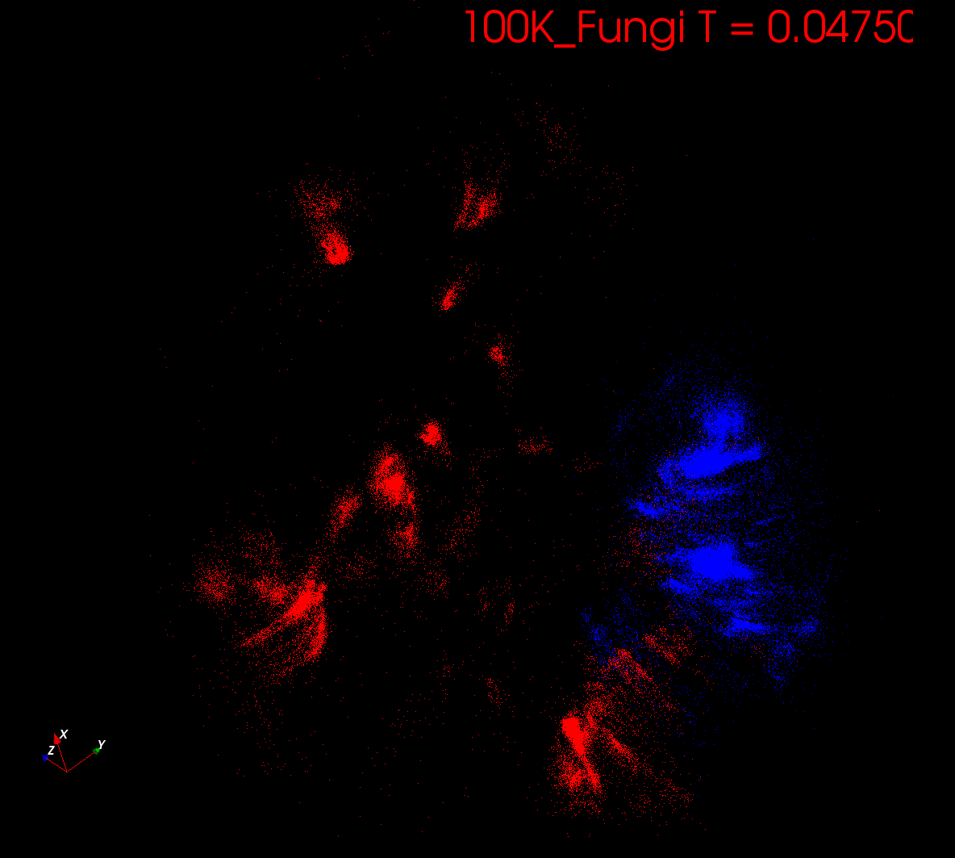
Start at T= “∞” with 1 Cluster
Decrease T, Clusters emerge at instabilities

Slide 11
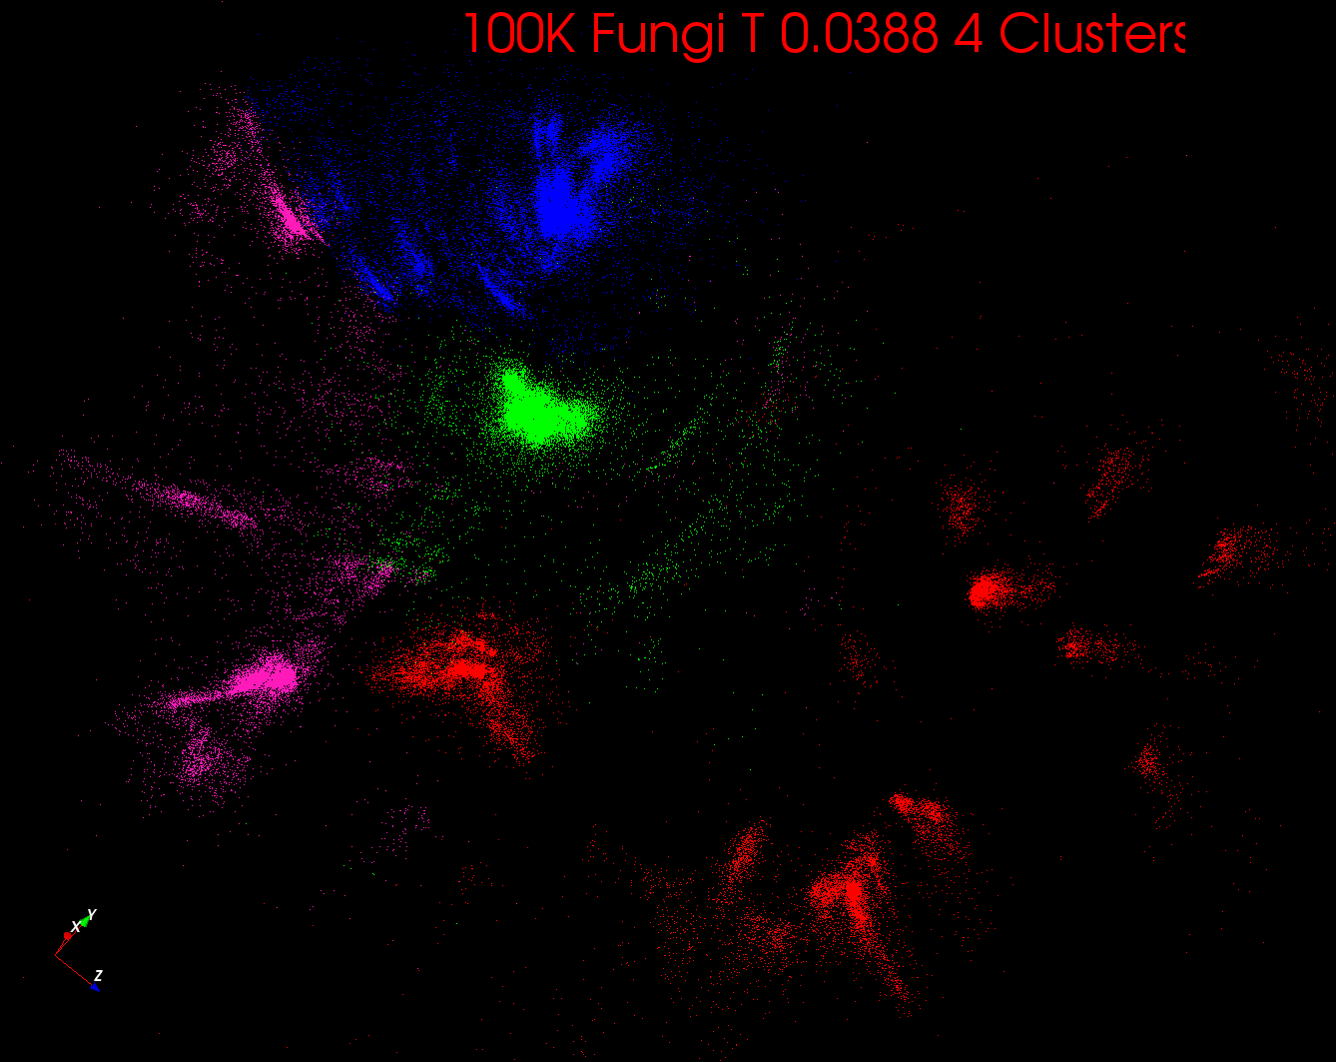

Slide 12
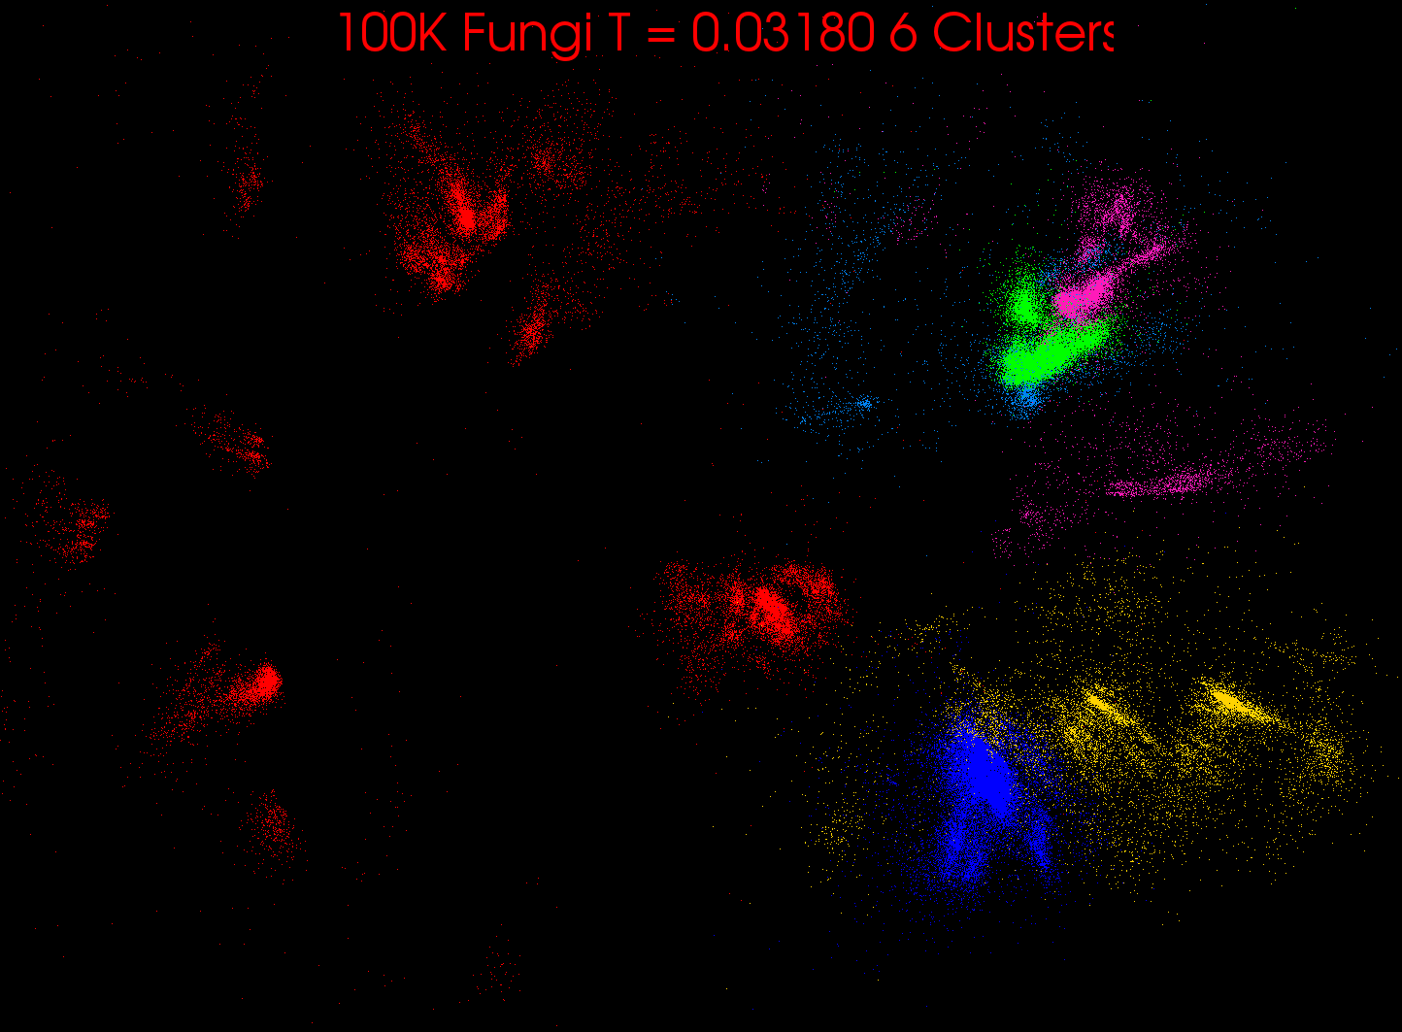

Slide 13
Rose, K., Gurewitz, E., and Fox, G. C. ``Statistical mechanics and phase transitions in clustering,'' Physical Review Letters, 65(8):945-948, August 1990.
My #5 most cited article (387 cites)

Slide 14
DA-PWC EM Steps (E is red, M Black) k runs over clusters; i,j points
A(k) = - 0.5 ∑_{i=1}^{N} ∑_{j=1}^{N} δ(i, j) <M_{i}(k)> <M_{j}(k)> / <C(k)>²
B_{α}(k) = ∑_{i=1}^{N} δ(i, α) <M_{i}(k)> / <C(k)>
ε_{α}(k) = (B_{α}(k) + A(k))
<M_{i}(k)> = p(k) exp( -ε_{i}(k)/T )/∑_{k=1}^{K} p(k) exp(-ε_{i}(k)/T)
C(k) = ∑_{i=1}^{N} <M_{i}(k)>
p(k) = C(k) / N
Loop to converge variables; decrease T from ∞; split centers by halving p(k)
Steps 1 global sum (reduction)
Step 1, 2, 5 local sum if <M_{i}(k)> broadcast

Slide 15
Multidimensional Scaling MDS
Map points in high dimension to lower dimensions
Many such dimension reduction algorithms (PCA Principal component analysis easiest); simplest but perhaps best is MDS
Minimize Stress σ(X) = Σ_{i<j=1}^{n} weight(i,j) (δ(i, j) - d(X_{i} , X_{j}))²
δ(i, j) are input dissimilarities and d(X_{i} , X_{j}) the Euclidean distance squared in embedding space (3D usually)
SMACOF or Scaling by minimizing a complicated function is clever steepest descent (expectation maximization EM) algorithm
Computational complexity goes like N² * Reduced Dimension
There is Deterministic annealed version of it which is much better
Could just view as non linear χ² problem (Tapia et al. Rice)
Slower but more general
All parallelize with high efficiency

Slide 16
Implementation of MDS
One tractable form was linear Hamiltonians
Another is Gaussian H₀ = Σ_{i=1}^{n} (X(i) - μ(i))² / 2
Where X(i) are vectors to be determined as in formula for Multidimensional scaling
H_{MDS} = Σ_{i< j=1}^{n} weight(i,j) (δ(i, j) - d(X(i) , X(j) ))²
Where δ(i, j) are observed dissimilarities and we want to represent as Euclidean distance between points X(i) and X(j)
H_{MDS} is quartic or involves square roots, so we need the idea of an approximate Hamiltonian H₀
The E step is minimize Σ_{i< j=1}^{n} weight(i,j) (δ(i, j) – constant.T - (μ(i) - μ(j))² )²
with solution μ(i) = 0 at large T
Points pop out from origin as Temperature lowered

Slide 17
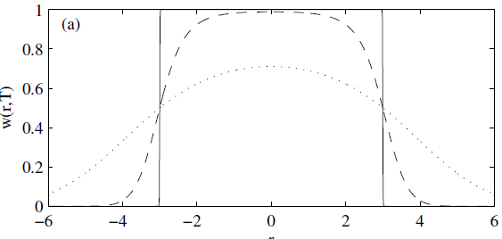
Trimmed Clustering
Clustering with position-specific constraints on variance: Applying redescending M-estimators to label-free LC-MS data analysis (Rudolf Frühwirth , D R Mani and Saumyadipta Pyne) BMC Bioinformatics 2011, 12:358
H_{TCC} = ∑_{k=0}^{K} ∑_{i=1}^{N} M_{i}(k) f(i,k)
f(i,k) = (X(i) - Y(k))²/2σ(k)² k > 0
f(i,0) = c² / 2 k = 0
The 0’th cluster captures (at zero temperature) all points outside clusters (background)
Clusters are trimmed (X(i) - Y(k))²/2σ(k)² < c² / 2
Another case when H₀ is same as target Hamiltonian
Proteomics Mass Spectrometry
T = 1
T = 0
T = 5
Distance from cluster center

Slide 18
High Performance Dimension Reduction and Visualization
Need is pervasive
Large and high dimensional data are everywhere: biology, physics, Internet, …
Visualization can help data analysis
Visualization of large datasets with high performance
Map high-dimensional data into low dimensions (2D or 3D).
Need Parallel programming for processing large data sets
Developing high performance dimension reduction algorithms:
MDS(Multi-dimensional Scaling), used earlier in DNA sequencing application
GTM(Generative Topographic Mapping)
DA-MDS(Deterministic Annealing MDS)
DA-GTM(Deterministic Annealing GTM)
Interactive visualization tool PlotViz
We are supporting drug discovery by browsing 60 million compounds in PubChem database with 166 features each
Notes:
With David Wild

Slide 19
Pairwise and MDS are O(N²) Problems
100,000 sequences takes a few days on 768 cores 32 nodes Windows Cluster Tempest
Could just run 440K on 4.4² larger machine but lets try to be “cleverer” and use hierarchical methods
Start with 100K sample run fully
Divide into “megaregions” using 3D projection
Interpolate full sample into megaregions and analyze latter separately
See http://salsahpc.org/millionseq/16SrRNA_index.html

Slide 20
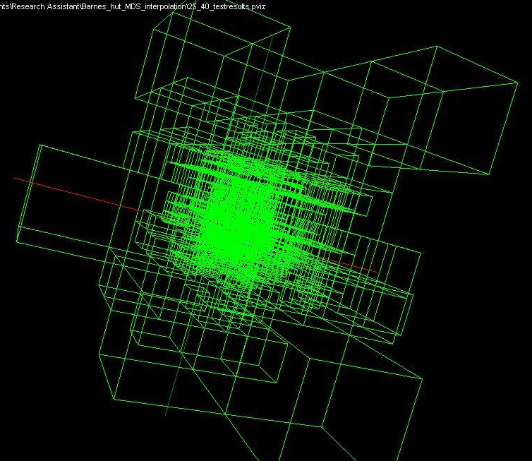
Use Barnes Hut OctTree originally developed to make O(N²) astrophysics O(NlogN)

Slide 21
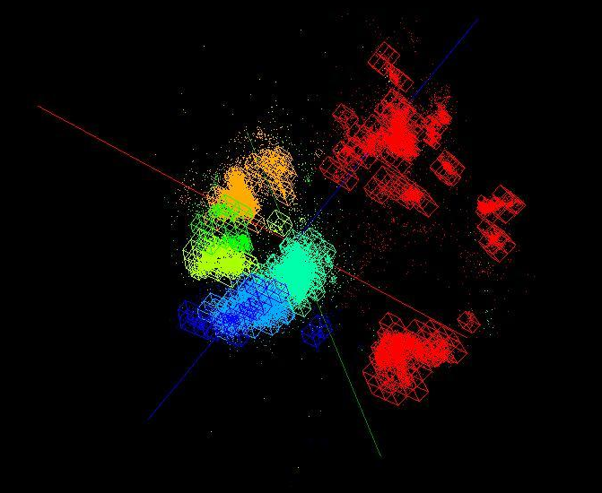
OctTree for 100K sample of Fungi
We use OctTree for logarithmic interpolation

Slide 22
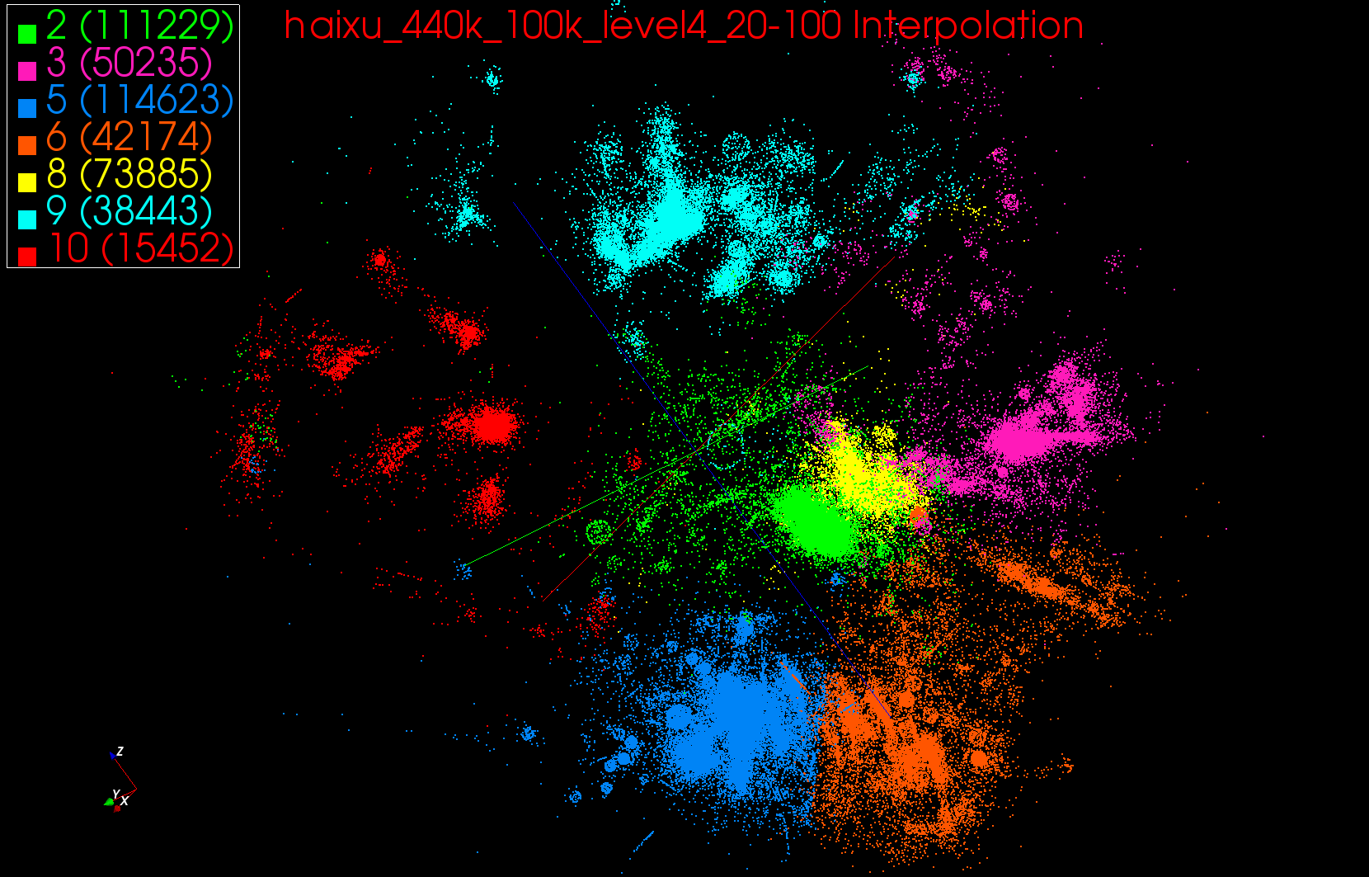
440K Interpolated

Slide 23
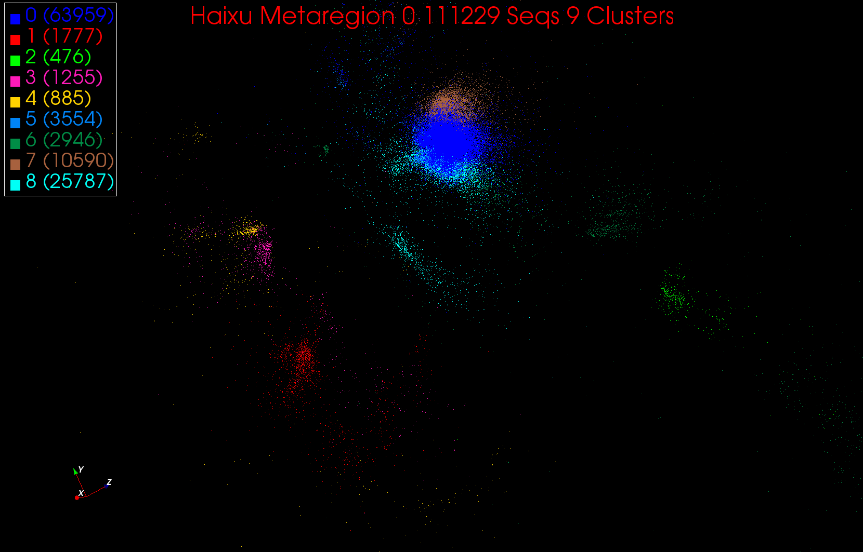
A large cluster in Region 0

Slide 24
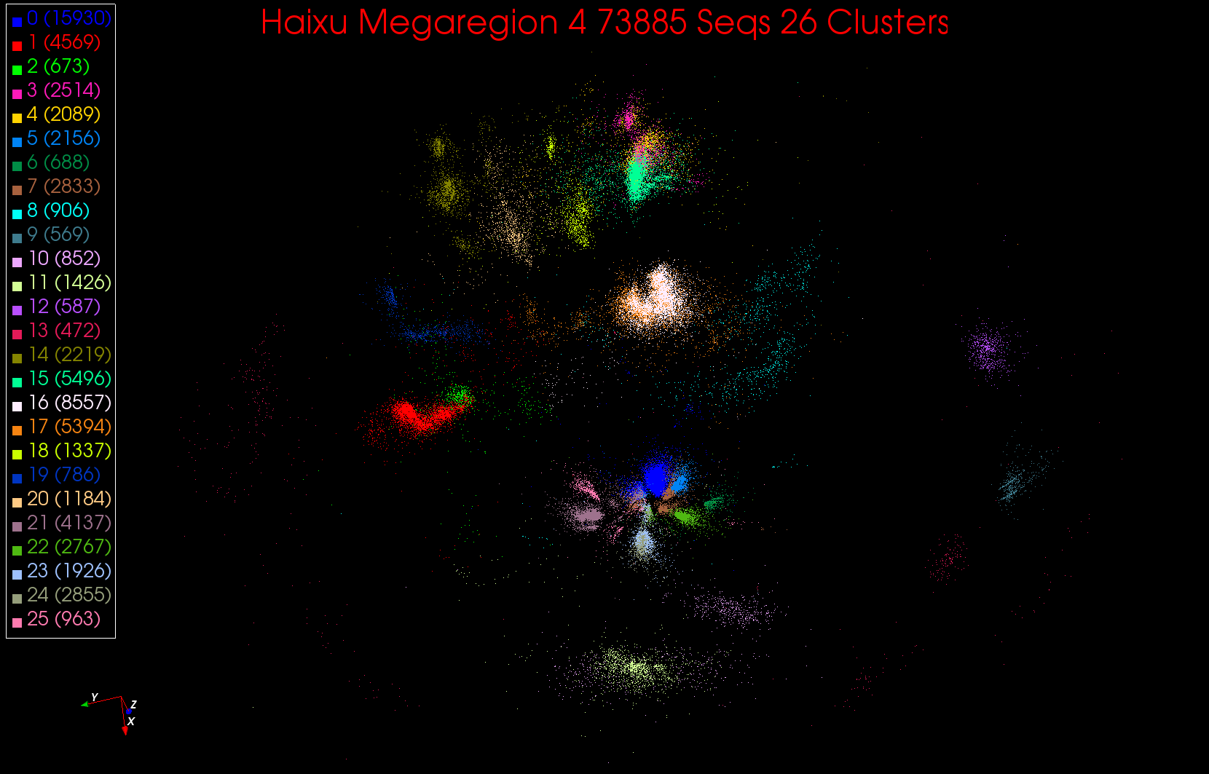
26 Clusters in Region 4

Slide 25
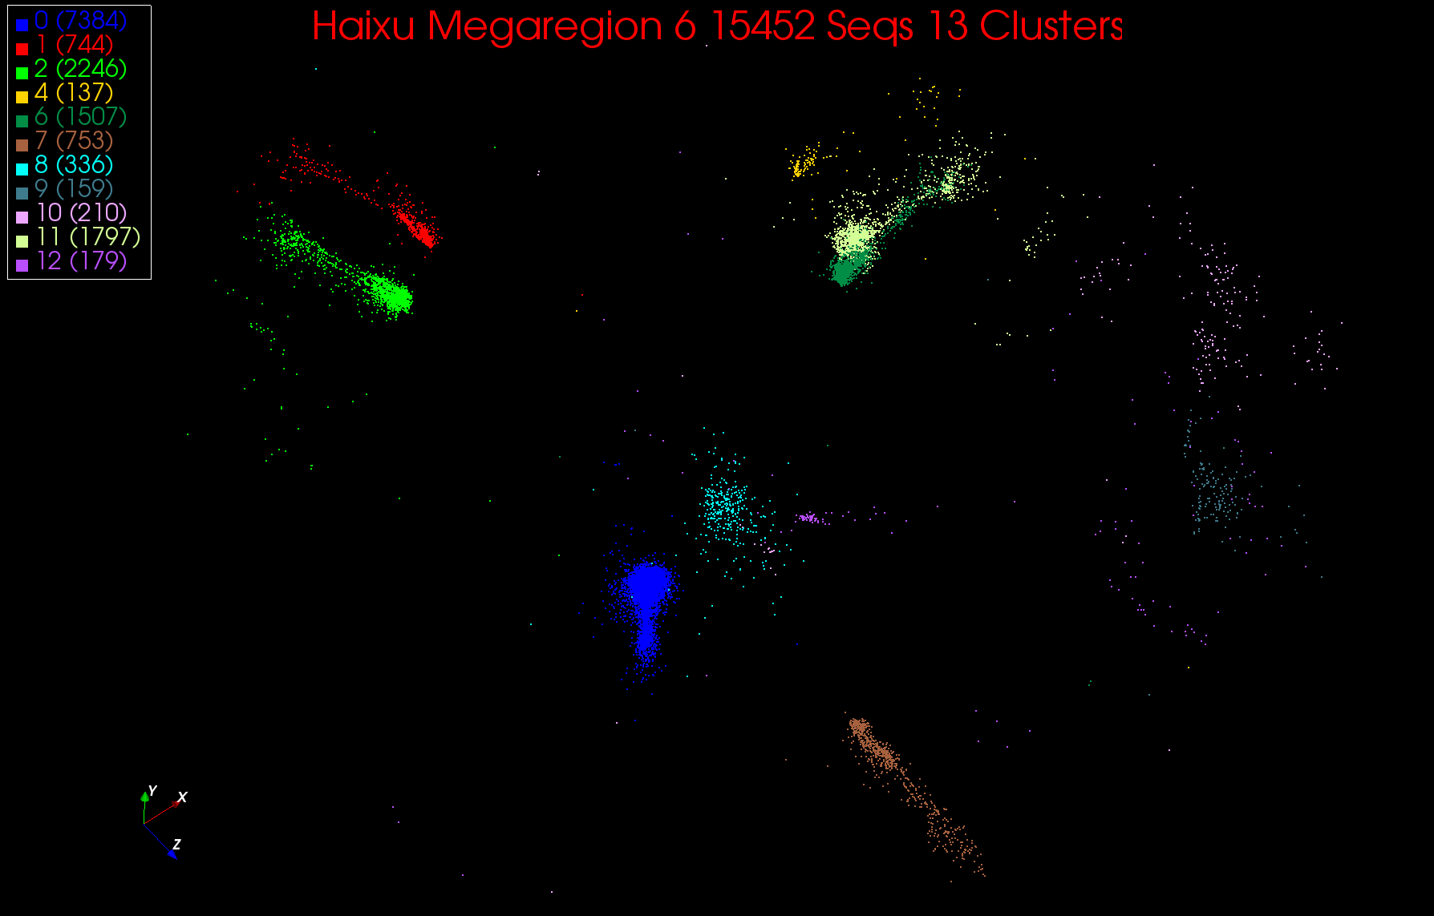
13 Clusters in Region 6

Slide 26
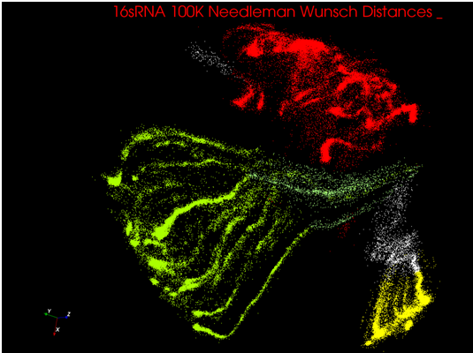
Understanding the Octopi

Slide 27
The octopi are globular clusters distorted by length dependence of dissimilarity measure
Sequences are 200 to 500 base pairs long
We restarted project using local (SWG) not global (NW) alignment

Slide 28
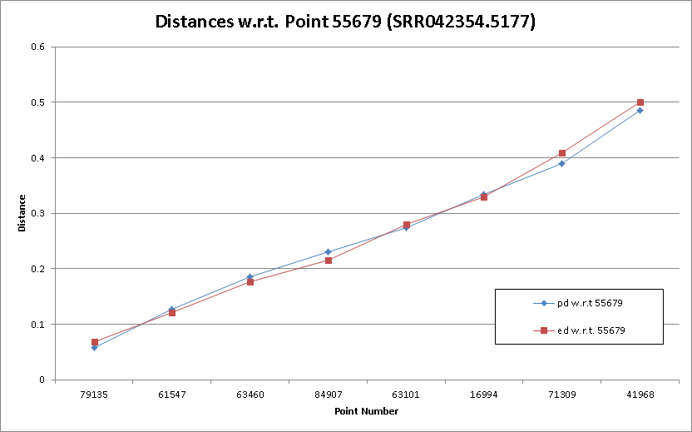
Note mapped (Euclidean 3D shown as red) and abstract dissimilarity (blue) are very similar

Slide 29
What was/can be done where?
Dissimilarity Computation (largest time)
Done using Twister on HPC
Have running on Azure and Dryad
Used Tempest (24 cores per node, 32 nodes) with MPI as well (MPI.NET failed(!), Twister didn’t)
Full MDS
Done using MPI on Tempest
Have running well using Twister on HPC clusters and Azure
Pairwise Clustering
Done using MPI on Tempest
Probably need to change algorithm to get good efficiency on cloud but HPC parallel efficiency high
Interpolation (smallest time)
Done using Twister on HPC
Running on Azure

Slide 30
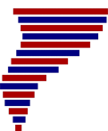
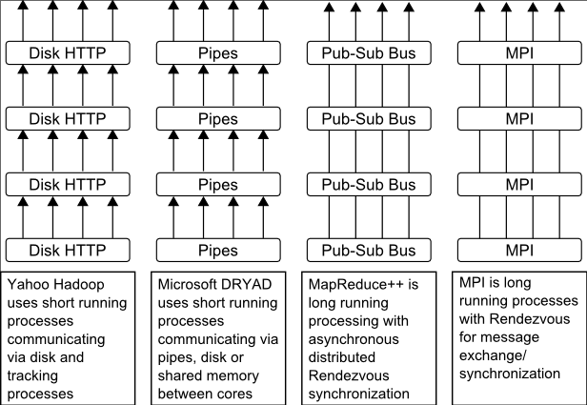
Twister
Pub/Sub Broker Network
Map Worker
M
Worker Nodes
R
Reduce Worker
Streaming based communication
Intermediate results are directly transferred from the map tasks to the reduce tasks – eliminates local files
Cacheable map/reduce tasks
Static data remains in memory
Combine phase to combine reductions
User Program is the composer of MapReduce computations
Extends the MapReduce model to iterative computations
D
D
MR
Driver
User
Program
M
M
M
M
D
MRDeamon
R
R
R
R
Data Read/Write
Communication
Data Split
File System
Iterate
Static
data
Configure()
User Program
Map(Key, Value)
δ flow
Reduce (Key, List<Value>)
Combine (Key, List<Value>)
Different synchronization and intercommunication mechanisms used by the parallel runtimes
Close()

Slide 31
Expectation Maximization and Iterative MapReduce
Clustering and Multidimensional Scaling are both EM (expectation maximization) using deterministic annealing for improved performance
EM tends to be good for clouds and Iterative MapReduce
Quite complicated computations (so compute largish compared to communicate)
Communication is Reduction operations (global sums in our case)
See also Latent Dirichlet Allocation and related Information Retrieval algorithms similar EM structure

Slide 32
May Need New Algorithms
DA-PWC (Deterministically Annealed Pairwise Clustering) splits clusters automatically as temperature lowers and reveals clusters of size O(√T)
Two approaches to splitting
Look at correlation matrix and see when becomes singular which is a separate parallel step
Formulate problem with multiple centers for each cluster and perturb ever so often spitting centers into 2 groups; unstable clusters separate
Current MPI code uses first method which will run on Twister as matrix singularity analysis is the usual “power eigenvalue method” (as is page rank)
However not super good compute/communicate ratio
Experiment with second method which “just” EM with better compute/communicate ratio (simpler code as well)

Slide 33
Next Steps
Finalize MPI and Twister versions of Deterministically Annealed Expectation Maximization for
Vector Clustering
Vector Clustering with trimmed clusters
Pairwise non vector Clustering
MDS SMACOF
Extend O(NlogN) Barnes Hut methods to all codes
Allow missing distances in MDS (Blast gives this) and allow arbitrary weightings (Sammon’s method)
Have done for χ² approach to MDS
Explore DA-PLSI as alternative to LDA
Exploit better Twister and Twister4Azure runtimes

