Slide 1
SCSI: Platforms & Foundations: Cyberinfrastructure
Socially Coupled Systems & Informatics: Science, Computing & Decision Making in a Complex Interdependent World
Arlington VA
July 14 2010
Geoffrey Fox
gcf@indiana.edu
http://www.infomall.org http://www.futuregrid.org
Director, Digital Science Center, Pervasive Technology Institute
Associate Dean for Research and Graduate Studies, School of Informatics and Computing
Indiana University Bloomington

Slide 2
Important Trends
Data Deluge in all fields of science
  Including Socially Coupled Systems?
Multicore implies parallel computing important again
  Performance from extra cores – not extra clock speed
  GPU enhanced systems can give big power boost
Clouds – new commercially supported data center model replacing compute grids (and your general purpose computer center)
Light weight clients: Sensors, Smartphones and tablets accessing and supported by backend services in cloud
Commercial efforts moving much faster than academia in both innovation and deployment

Slide 3

Gartner 2009 Hype Curve
Clouds, Web2.0
Service Oriented Architectures
Social Software Suites
Social Network Analysis

Slide 4


Clouds as Cost Effective Data Centers
Builds giant data centers with 100,000’s of computers; ~ 200
-1000 to a shipping container with Internet access
“Microsoft will cram between 150 and 220 shipping containers filled with data center gear into a new 500,000 square foot Chicago facility. This move marks the most significant, public use of the shipping container systems popularized by the likes of Sun Microsystems and Rackable Systems to date.”

Slide 5


The Data Center Landscape
Range in size from “edge” facilities to megascale.
Economies of scale
  Approximate costs for a small size center (1K servers) and a larger, 50K server center.
Technology | Cost in small-sized Data Center | Cost in Large Data Center | Ratio
Network | $95 per Mbps/ month | $13 per Mbps/ month | 7.1
Storage | $2.20 per GB/ month | $0.40 per GB/ month | 5.7
Administration | ~140 servers/ Administrator | >1000 Servers/ Administrator | 7.1
Each data center is
11.5 times
the size of a football field

Slide 6
















X as a Service
SaaS: Software as a Service imply software capabilities (programs) have a service (messaging) interface
  Applying systematically reduces system complexity to being linear in number of components
  Access via messaging rather than by installing in /usr/bin
IaaS: Infrastructure as a Service or HaaS: Hardware as a Service – get your computer time with a credit card and with a Web interface
PaaS: Platform as a Service is IaaS plus core software capabilities on which you build SaaS
Cyberinfrastructure is “Research as a Service”
SensaaS is Sensors (Instruments) as a Service (cf. Data as a Service)
Something like PolicyaaS is presumably Policy as a Service (Wisdom as a Service)
Other Services
Clients

Slide 7
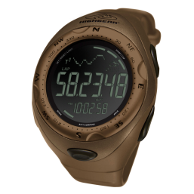

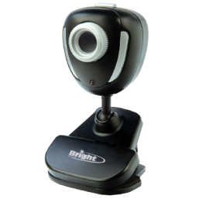



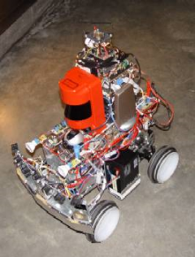
Sensors as a Service sensor clients backend by dynamic cloud proxy and analyzed in parallel by Mapreduce
Sensors as a Service
Sensor Processing as a Service (MapReduce)

Slide 9
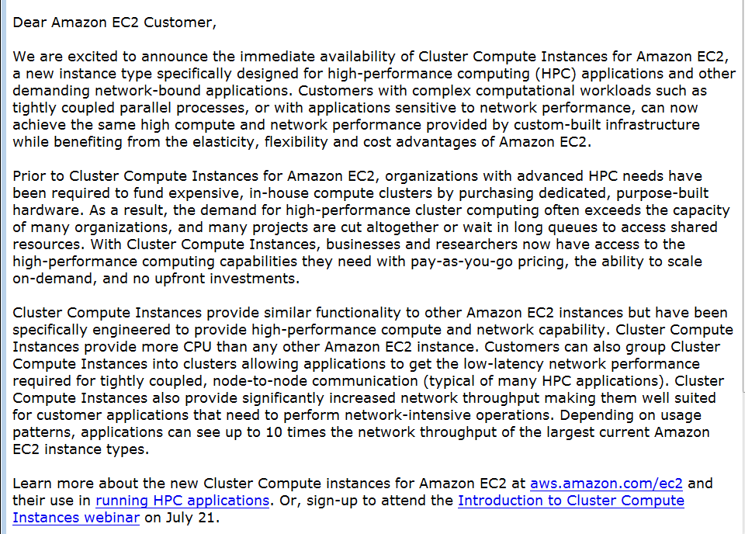
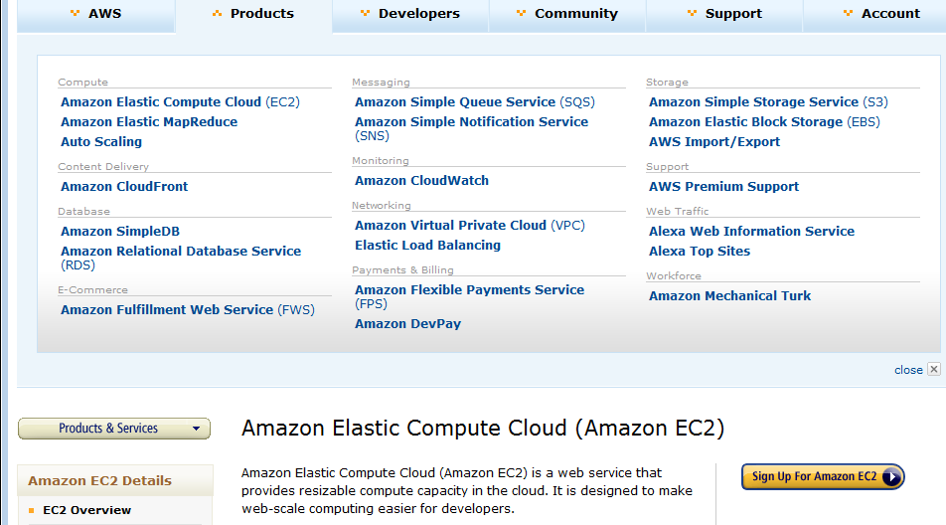
Amazon offers a lot!
The Cluster Compute Instances use hardware-assisted (HVM) virtualization instead of the paravirtualization used by the other instance types and requires booting from EBS, so you will need to create a new AMI in order to use them. We suggest that you use our Centos-based AMI as a base for your own AMIs for optimal performance. See the EC2 User Guide or the EC2 Developer Guide for more information.
The only way to know if this is a genuine HPC setup is to benchmark it, and we've just finished doing so. We ran the gold-standard High Performance Linpack benchmark on 880 Cluster Compute instances (7040 cores) and measured the overall performance at 41.82 TeraFLOPS using Intel's MPI (Message Passing Interface) and MKL (Math Kernel Library) libraries, along with their compiler suite. This result places us at position 146 on the Top500 list of supercomputers. The input file for the benchmark is here and the output file is here.

Slide 10
Philosophy of Clouds and Grids
Clouds are (by definition) commercially supported approach to large scale computing
  So we should expect Clouds to replace Compute Grids
  Current Grid technology involves “non-commercial” software solutions which are hard to evolve/sustain
  Maybe Clouds ~4% IT expenditure 2008 growing to 14% in 2012 (IDC Estimate)
Public Clouds are broadly accessible resources like Amazon and Microsoft Azure – powerful but not easy to customize and perhaps data trust/privacy issues
Private Clouds run similar software and mechanisms but on “your own computers” (not clear if still elastic)
  Platform features such as Queues, Tables, Databases limited
Services still are correct architecture with either REST (Web 2.0) or Web Services
Clusters are still critical concept

Slide 11
Grids MPI and Clouds + and -
Grids are useful for managing distributed systems
  Pioneered service model for Science
  Developed importance of Workflow
  Performance issues – communication latency – intrinsic to distributed systems
  Can never run differential equation based simulations or most datamining in parallel
Clouds can execute any job class that was good for Grids plus
  More attractive due to platform plus elastic on-demand model
  Currently have performance limitations due to poor affinity (locality) for compute-compute (MPI) and Compute-data
  These limitations are not “inevitable” and should gradually improve as in July 13 Amazon Cluster announcement
  Will never be best for most sophisticated differential equation based simulations
Classic Supercomputers (MPI Engines) run communication demanding differential equation based simulations

Slide 12
Clouds have both Infrastructure and Platform
Cloud infrastructure: outsourcing of servers, computing, data, file space, utility computing, etc.
  Handled through Web services that control virtual machine lifecycles.
Cloud runtimes or Platform: tools (for using clouds) to do data-parallel (and other) computations. For example
  Apache Hadoop, Google MapReduce, Microsoft Dryad
  MapReduce designed for information retrieval but is excellent for a wide range of science data analysis applications
  Can also do much traditional parallel computing for data-mining if extended to support iterative operations
  Distributed table data structure: Google Bigtable, Chubby …
  Compute—data affinity with data parallel file systems GFS HDFS

Slide 13
MapReduce
Data Partitions
Map(Key, Value)
A hash function maps the results of the map tasks to reduce tasks
Reduce(Key, List<Value>)
Reduce Outputs
Hadoop and Dryad Implementations support:
  Splitting of data
  Passing the output of map functions to reduce functions
  Sorting the inputs to the reduce function based on the intermediate keys
  Quality of service

Slide 14






MapReduce “File/Data Repository” Parallelism
Map = (data parallel) computation reading and writing data
Reduce = Collective/Consolidation phase e.g. forming multiple global sums as in histogram
Instruments
Iterative MapReduce
Map Map Map Map
Reduce Reduce Reduce
Communication
Reduce
Portals
/Users
Disks
Map₁
Map₂
Map₃

Slide 15


Sequence Assembly in the Clouds
Cap3 parallel efficiency
Cap3 – Per core per file (458 reads in each file) time to process sequences

Slide 16
Fault Tolerance and MapReduce
MPI does “maps” followed by “communication” including “reduce” but does this iteratively
There must (for most communication patterns of interest) be a strict synchronization at end of each communication phase
  Thus if a process fails then everything grinds to a halt
In MapReduce, all Map processes and all reduce processes are independent and stateless and read and write to disks
  As 1 or 2 (reduce+map) iterations, no difficult synchronization issues
Thus failures can easily be recovered by rerunning process without other jobs hanging around waiting
Re-examine MPI fault tolerance in light of MapReduce
  Twister will interpolate between MPI and MapReduce

Slide 17


Twister(MapReduce++)
Pub/Sub Broker Network
Map Worker
M
Streaming based communication
Intermediate results are directly transferred from the map tasks to the reduce tasks – eliminates local files
Cacheable map/reduce tasks
  Static data remains in memory
Combine phase to combine reductions
User Program is the composer of MapReduce computations
Extends the MapReduce model to iterative computations
Worker Nodes
R
Reduce Worker
D
D
MR
Driver
User
Program
M
M
M
M
D
MRDeamon
R
R
R
R
Data Read/Write
Communication
Data Split
File System
Iterate
Static
data
Configure()
User Program
Map(Key, Value)
δ flow
Reduce (Key, List<Value>)
Combine (Key, List<Value>)
Different synchronization and intercommunication mechanisms used by the parallel runtimes
Close()

Slide 18


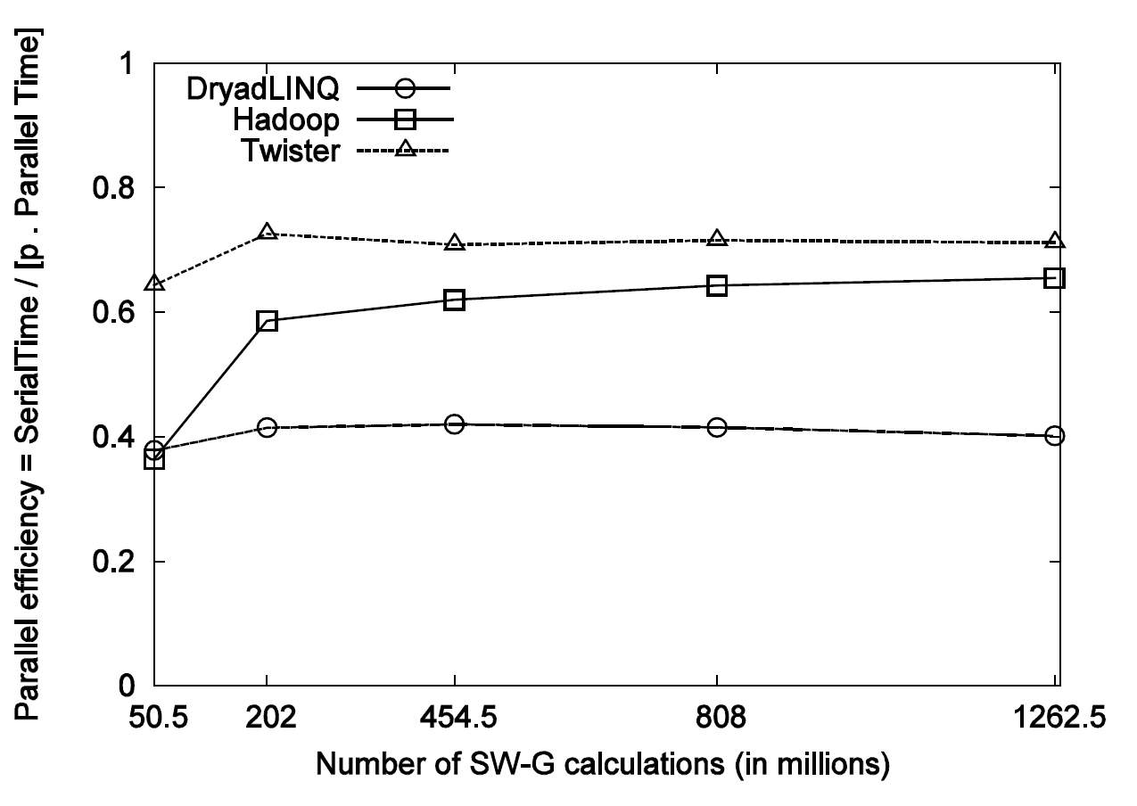
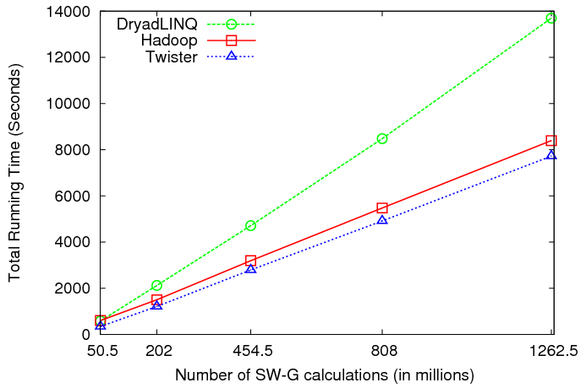
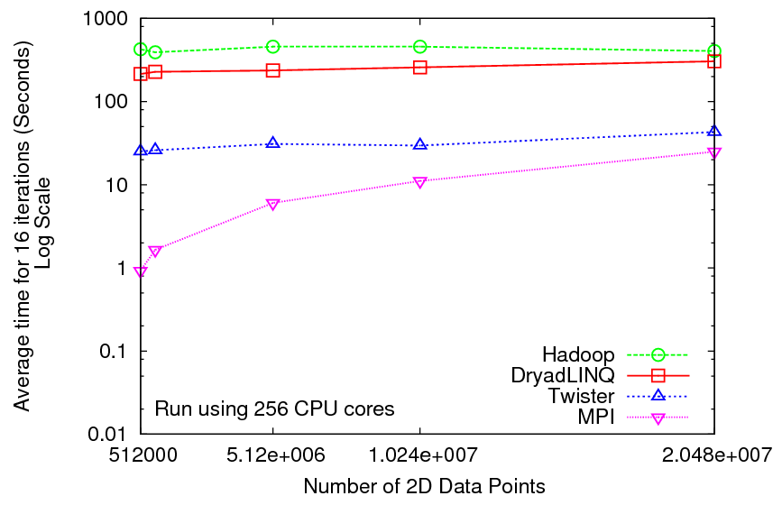
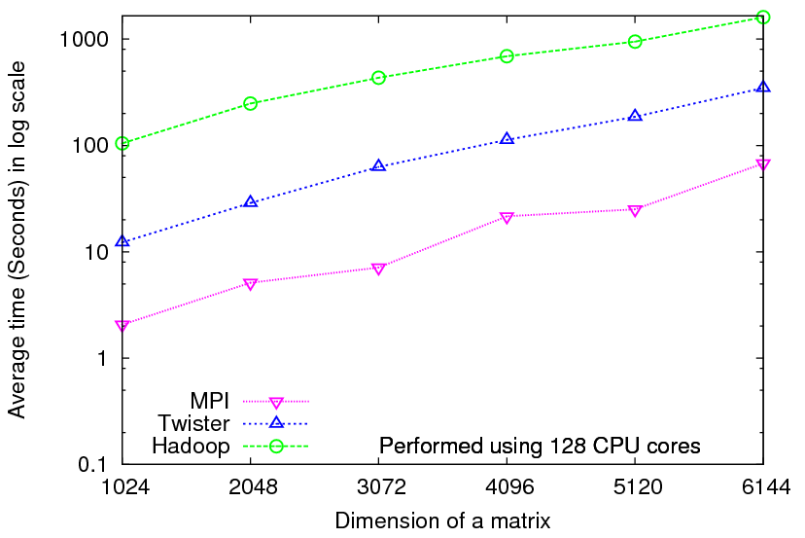
Iterative Computations
K-means
Matrix Multiplication
Smith Waterman
Performance of K-Means
Performance Matrix Multiplication

Slide 19

Performance of Pagerank using
ClueWeb Data (Time for 20 iterations)
using 32 nodes (256 CPU cores) of Crevasse

Slide 20
Cloud Issues
Security, Privacy
  Private clouds can address but cannot offer same degree of “elasticity” as smaller
Performance
  Software network interfaces
  Virtualization hurts locality (compute node to compute node for parallel computing; compute node to data for data analysis)
  Poor and costly transfer of data into cloud
Confusion in field with 3 different major offerings – Amazon, Google, Microsoft and no academic (private) software stacks with a rich feature set

Slide 21
Broad Architecture Components
Traditional Supercomputers (TeraGrid and DEISA) for large scale parallel computing – mainly simulations
  Likely to offer major GPU enhanced systems
Traditional Grids for handling distributed data – especially instruments and sensors
Clouds for “high throughput computing” including much data analysis and emerging areas such as Life Sciences using loosely coupled parallel computations
  May offer small clusters for MPI style jobs
  Certainly offer MapReduce
Integrating these needs new work on distributed file systems and high quality data transfer service
  Link Lustre WAN, Amazon/Google/Hadoop/Dryad File System
  Offer Bigtable (distributed scalable Excel)

Slide 22
Cyberinfrastructure Offers …..
Service Oriented Architecture
Distributed Data via Grids
Dynamic utility (on-demand) computing via clouds with increasing features and generality
Supercomputers for largest MPI jobs – probably not so relevant for Complex/Social systems/Bioinformatics etc.
Fine-grain disk/data parallel computing via MapReduce
  MPI and MapReduce support concurrency within services
Linkage of coarse grain functions like workflow with several systems to chose from (Taverna, Trident, Kepler …)
  Workflow supports concurrency between services
User interfaces via Gateways or Portals
Data management (metadata) without clear consensus as to approach
Unclear whether cloud computing will be funded by NSF (NIH, DoE …) at commercial clouds (which have superior features but are probably more expensive) or on TeraGrid (or equivalent for other agencies)

Slide 23
What do you want?
I didn’t hear any clear requirements for more computing, network or data resources
No complaints that TeraGrid focused on wrong problem class
  e.g. did not address data intensive computing
No complaints that clouds didn’t address security/privacy concerns of social/health informatics
No complaints that NSF has no guidelines on purchasing commercial cloud time
Should we build a Socially Coupled Informatics Platform including rich set of “Policy Tools as Services”

Slide 24

FutureGrid: a Cloud/Grid Testbed
IU Cray operational, IU IBM (iDataPlex) completed stability test May 6
UCSD IBM operational, UF IBM stability test completed June 12
Network, NID and PU HTC system operational
UC IBM stability test completed June 7; TACC Dell in acceptance tests
NID: Network Impairment Device
Private
Public
FG Network

Slide 25
FutureGrid Concepts
Support development of new applications and new middleware using Cloud, Grid and Parallel computing (Nimbus, Eucalyptus, Hadoop, Globus, Unicore, MPI, OpenMP. Linux, Windows …) looking at functionality, interoperability, performance
Put the “science” back in the computer science of grid computing by enabling replicable experiments
Open source software built around Moab/xCAT to support dynamic provisioning from Cloud to HPC environment, Linux to Windows ….. with monitoring, benchmarks and support of important existing middleware
June 2010 Initial users; September 2010 Initial hardware accepted and significant use starts; October 2011 FutureGrid allocatable via TeraGrid process

Slide 26
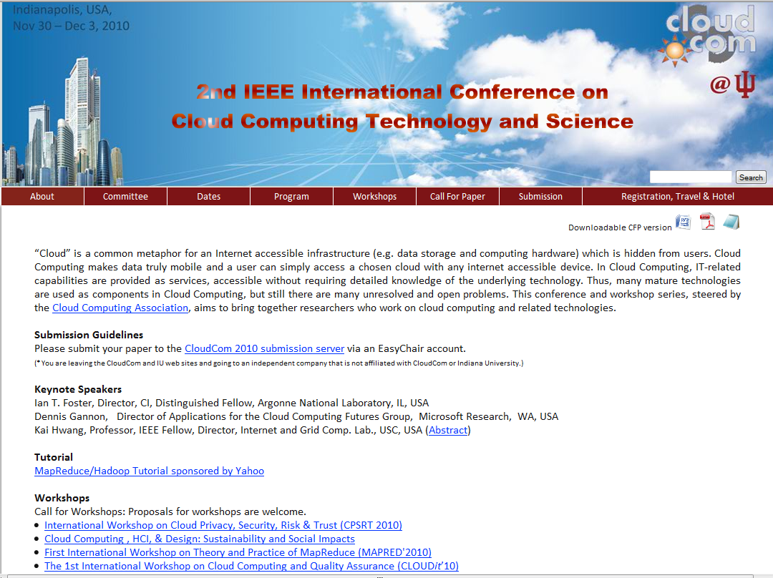
Microsoft Azure Tutorial

