Slide 1
Overview of Cyberinfrastructure and the Breadth of Its Application
South Carolina State University
Cyberinfrastructure Day
March 3 2011
Geoffrey Fox
gcf@indiana.edu
http://www.infomall.org http://www.futuregrid.org
Director, Digital Science Center, Pervasive Technology Institute
Associate Dean for Research and Graduate Studies, School of Informatics and Computing
Indiana University Bloomington
Notes:
SALSA is
Service Aggregated Linked Sequential Activities

Slide 2
What is Cyberinfrastructure
Cyberinfrastructure is (from NSF) infrastructure that supports distributed research and learning (e-Science, e-Research, e-Education)
  Links data, people, computers
Exploits Internet technology (Web2.0 and Clouds) adding (via Grid technology) management, security, supercomputers etc.
It has two aspects: parallel – low latency (microseconds) between nodes and distributed – highish latency (milliseconds) between nodes
Parallel needed to get high performance on individual large simulations, data analysis etc.; must decompose problem
Distributed aspect integrates already distinct components – especially natural for data (as in biology databases etc.)
2
Notes:
2

Slide 3
e-moreorlessanything
‘e-Science is about global collaboration in key areas of science, and the next generation of infrastructure that will enable it.’ from inventor of term John Taylor Director General of Research Councils UK, Office of Science and Technology
e-Science is about developing tools and technologies that allow scientists to do ‘faster, better or different’ research
Similarly e-Business captures the emerging view of corporations as dynamic virtual organizations linking employees, customers and stakeholders across the world.
This generalizes to e-moreorlessanything including e-DigitalLibrary, e-SocialScience, e-HavingFun and e-Education
A deluge of data of unprecedented and inevitable size must be managed and understood.
People (virtual organizations), computers, data (including sensors and instruments) must be linked via hardware and software networks
3
Notes:
3

Slide 4
Important Trends
Data Deluge in all fields of science
Multicore implies parallel computing important again
  Performance from extra cores – not extra clock speed
  GPU enhanced systems can give big power boost
Clouds – new commercially supported data center model replacing compute grids (and your general purpose computer center)
Light weight clients: Sensors, Smartphones and tablets accessing and supported by backend services in cloud
Commercial efforts moving much faster than academia in both innovation and deployment

Slide 5
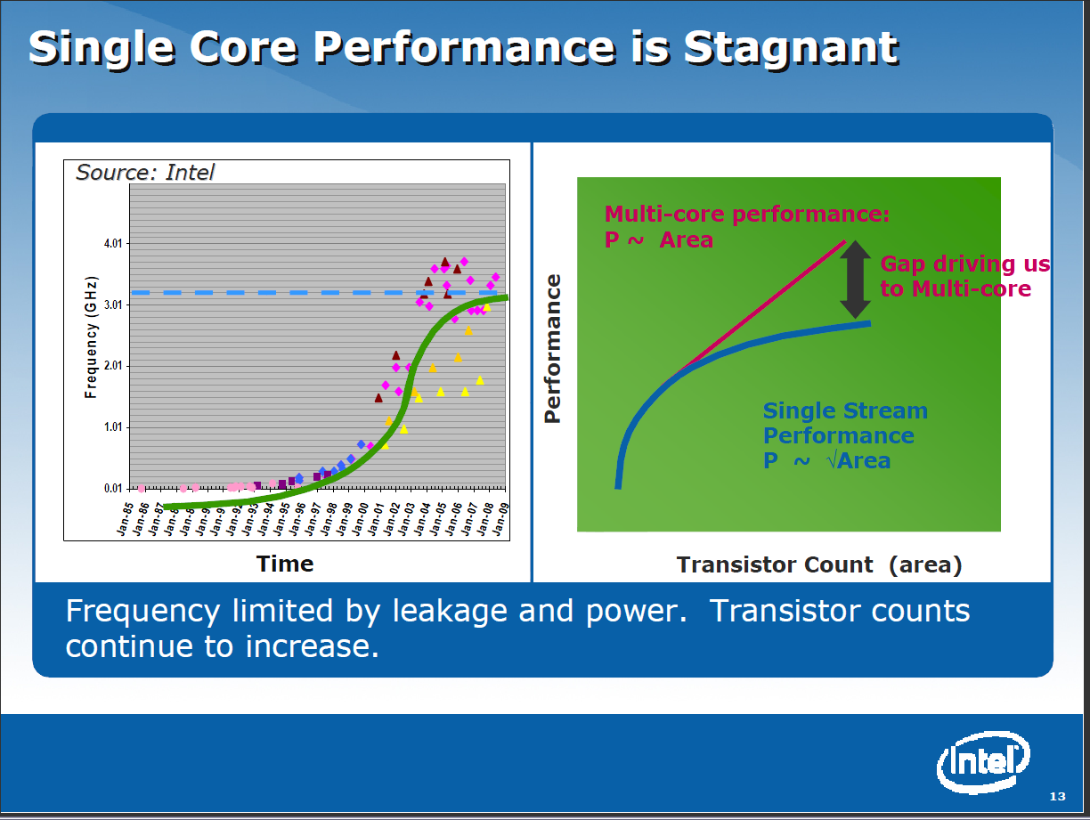

Slide 6
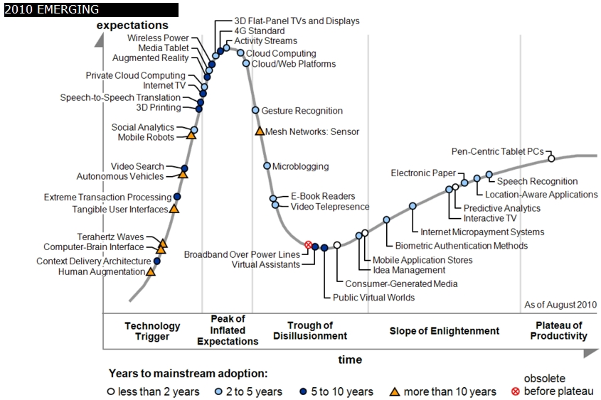
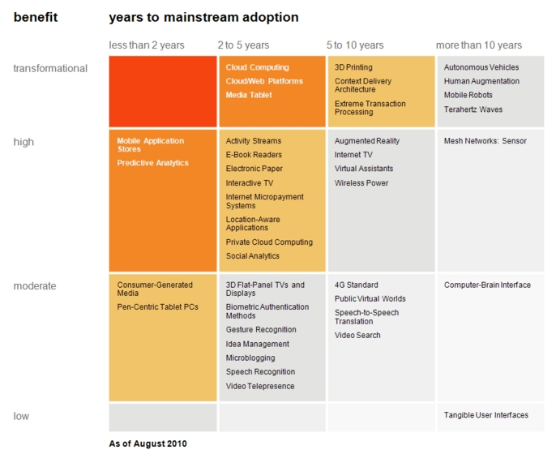

Transformational
High
Moderate
Low
Gartner 2009 Hype Curve
Clouds, Web2.0
Service Oriented Architectures
Cloud Computing
Cloud Web Platforms
Media Tablet

Slide 7



Data Centers Clouds &
Economies of Scale I
Range in size from “edge” facilities to megascale.
Economies of scale
  Approximate costs for a small size center (1K servers) and a larger, 50K server center.
2 Google warehouses of computers on the banks of the Columbia River, in The Dalles, Oregon
Such centers use 20MW-200MW
(Future) each with 150 watts per CPU
Save money from large size, positioning with cheap power and access with Internet
Technology | Cost in small-sized Data Center | Cost in Large Data Center | Ratio
Network | $95 per Mbps/ month | $13 per Mbps/ month | 7.1
Storage | $2.20 per GB/ month | $0.40 per GB/ month | 5.7
Administration | ~140 servers/ Administrator | >1000 Servers/ Administrator | 7.1
Each data center is
11.5 times
the size of a football field

Slide 8


Data Centers, Clouds
& Economies of Scale II
Builds giant data centers with 100,000’s of computers;
~ 200-1000 to a shipping container with Internet access
“Microsoft will cram between 150 and 220 shipping containers filled with data center gear into a new 500,000 square foot Chicago facility. This move marks the most significant, public use of the shipping container systems popularized by the likes of Sun Microsystems and Rackable Systems to date.”

Slide 9
















X as a Service
SaaS: Software as a Service imply software capabilities
(programs) have a service (messaging) interface
  Applying systematically reduces system complexity to being linear in number of components
  Access via messaging rather than by installing in /usr/bin
IaaS: Infrastructure as a Service or HaaS: Hardware as a Service – get your computer time with a credit card and with a Web interface
PaaS: Platform as a Service is IaaS plus core software capabilities on which you build SaaS
Cyberinfrastructure is “Research as a Service”
Other Services
Clients

Slide 10
Clouds hide Complexity
Cyberinfrastructure
Is “Research as a Service”
SaaS: Software as a Service
(e.g. CFD or Search documents/web are services)
PaaS: Platform as a Service
IaaS plus core software capabilities on which you build SaaS
(e.g. Azure is a PaaS; MapReduce is a Platform)
IaaS (HaaS): Infrastructure as a Service
(get computer time with a credit card and with a Web interface like EC2)

Slide 11
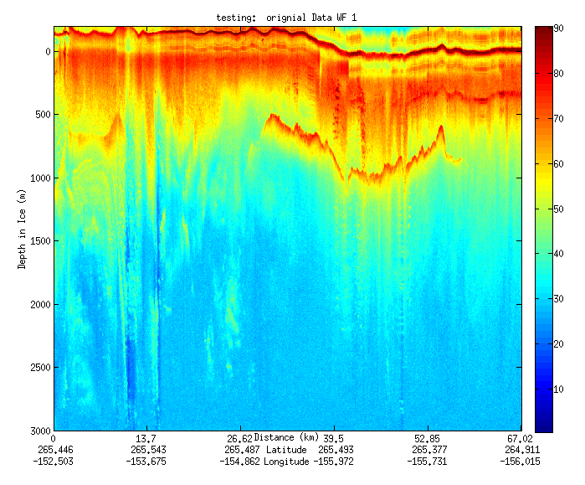
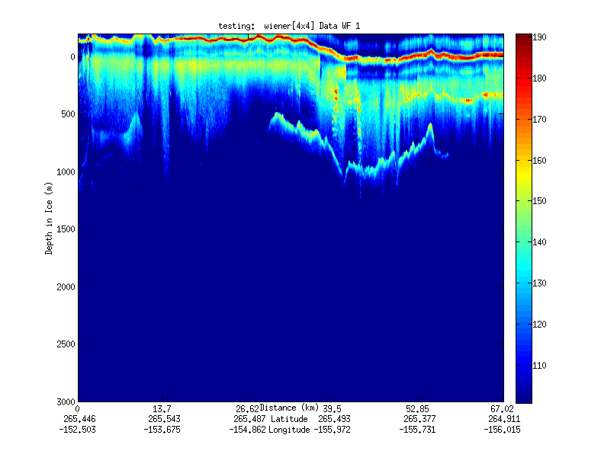
Geospatial Examples on Cloud Infrastructure
Image processing and mining
  SAR Images from Polar Grid (Matlab)
  Apply to 20 TB of data
  Can use MapReduce
Flood modeling
  Chaining flood models over a geographic area.
  Parameter fits and inversion problems.
  Deploy Services on Clouds – current models do not need parallelism
Real time GPS processing (QuakeSim)
  Services and Brokers (publish subscribe Sensor Aggregators) on clouds
  Performance issues not critical
Filter

Slide 12
Lightweight Cyberinfrastructure to support mobile Data gathering expeditions plus classic central resources (as a cloud)

Slide 13
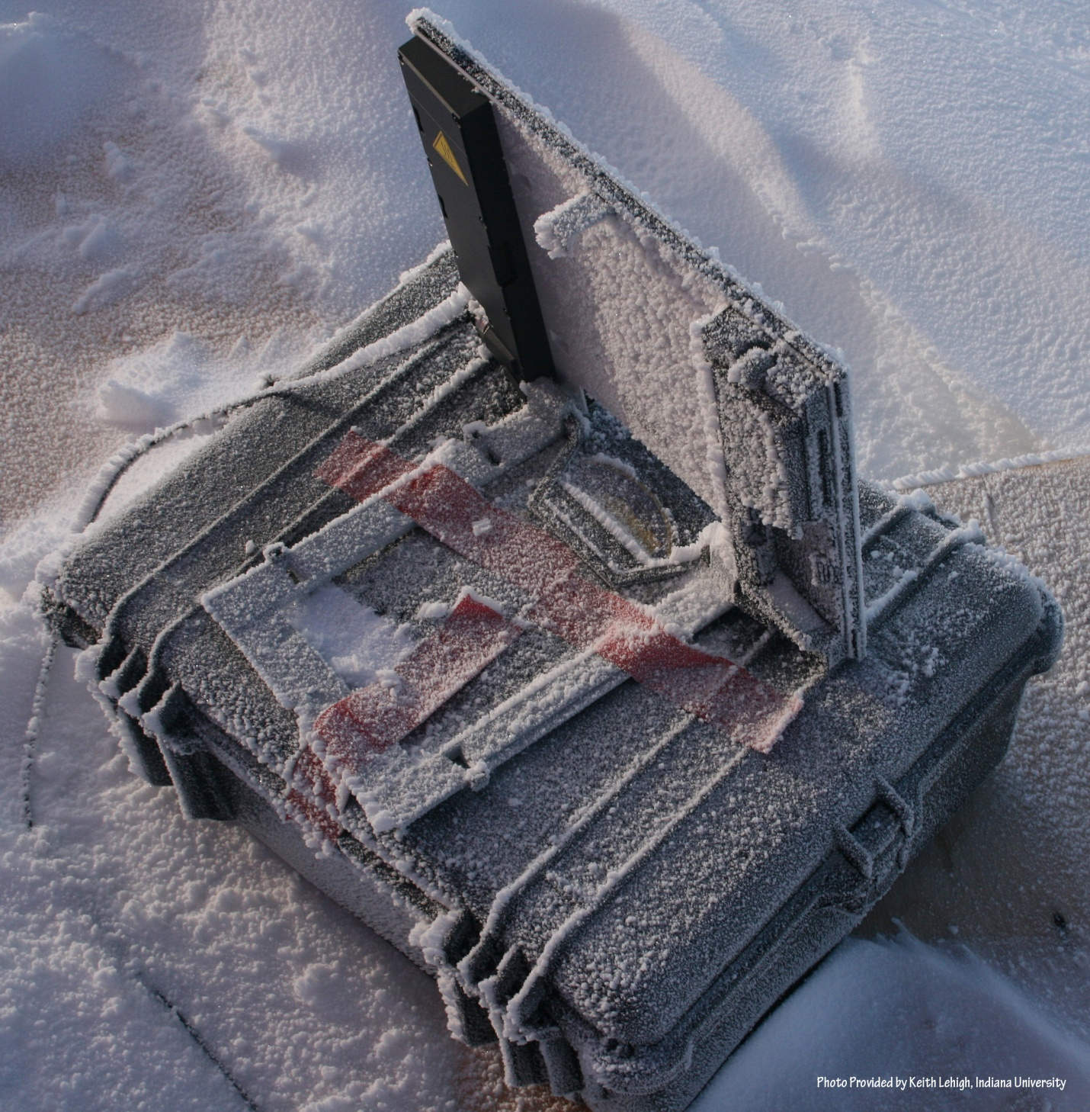
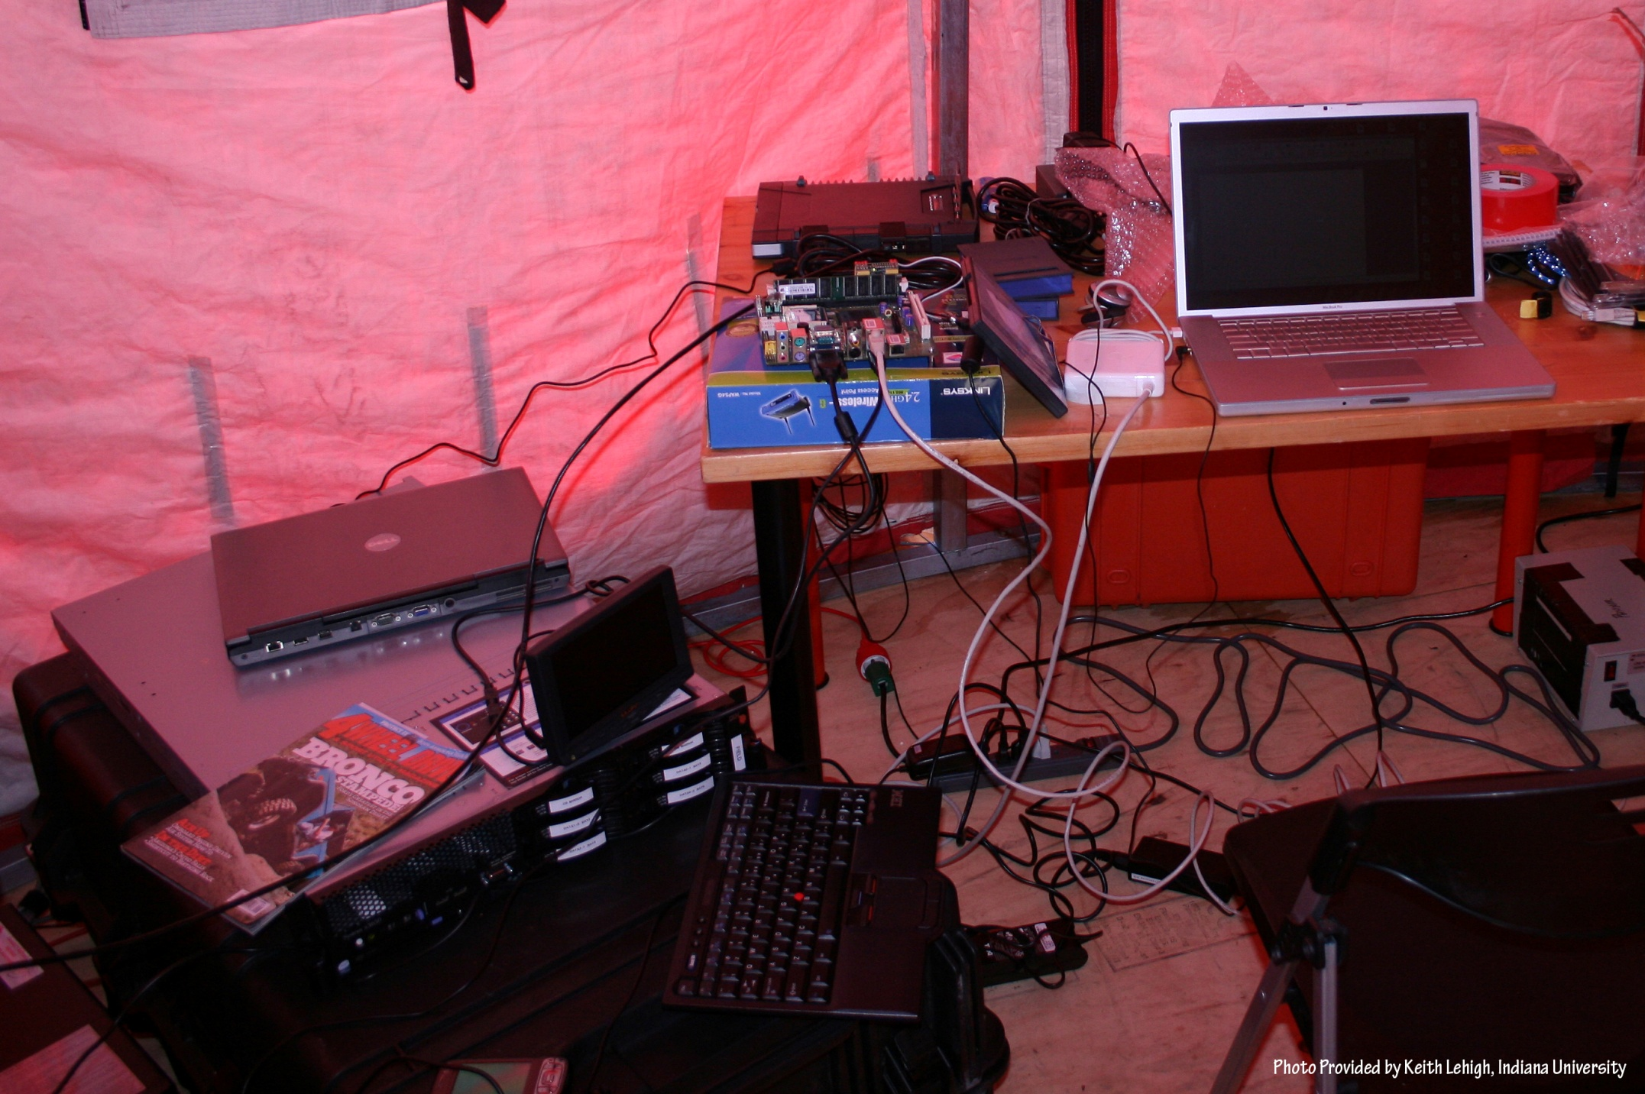
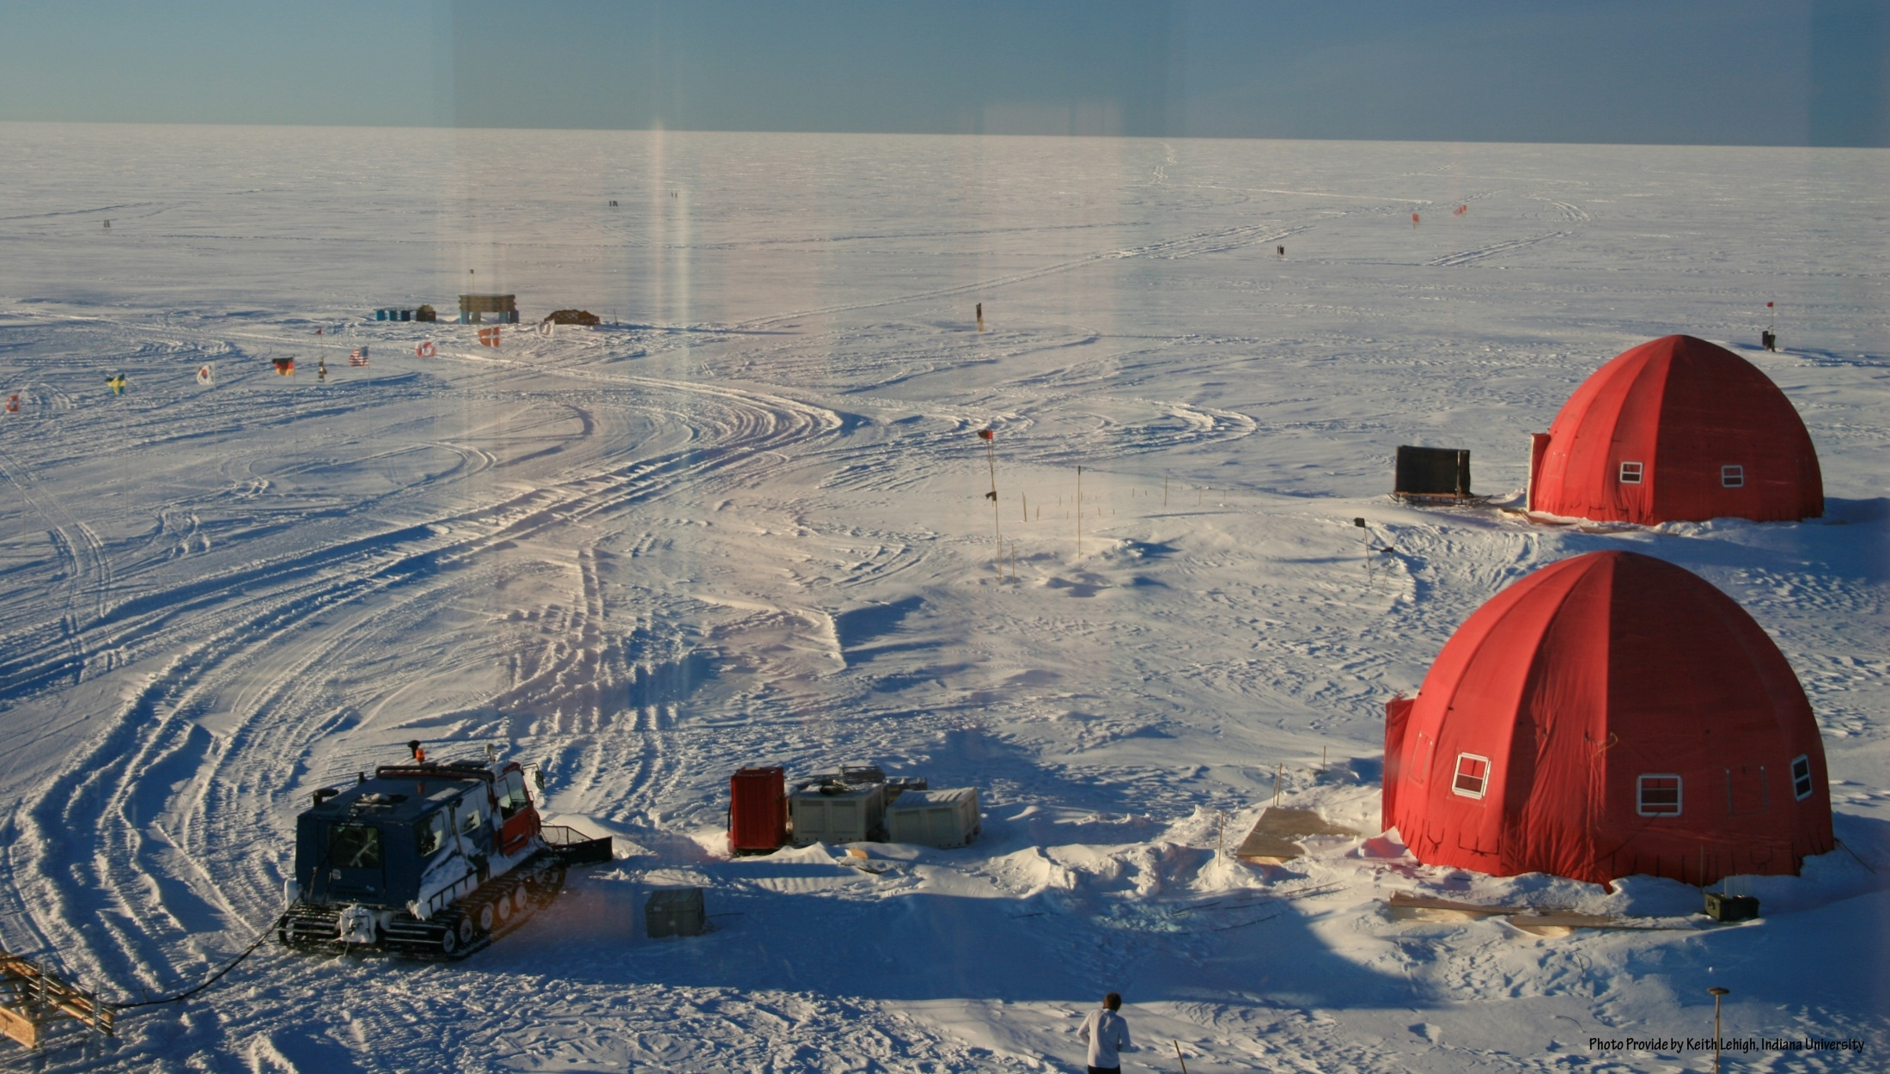
NEEM 2008 Base Station

Slide 14
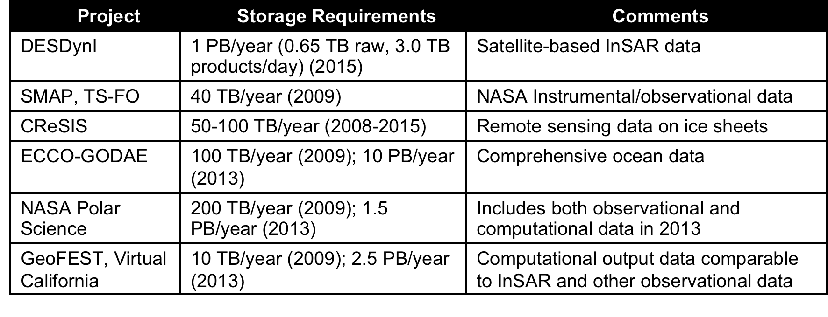
Data Sources
Common Themes of Data Sources
Focus on geospatial, environmental data sets
  Data from computation and observation.
Rapidly increasing data sizes
Data and data processing pipelines are inseparable.

Slide 15
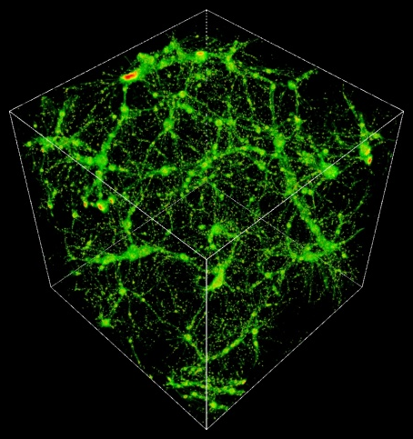
TeraGrid Example: Astrophysics
Science: MHD and star formation; cosmology at galactic scales (6-1500 Mpc) with various components: star formation, radiation diffusion, dark matter
Application: Enzo (loosely similar to: GASOLINE, etc.)
Science Users: Norman, Kritsuk (UCSD), Cen, Ostriker, Wise (Princeton), Abel (Stanford), Burns (Colorado), Bryan (Columbia), O’Shea (Michigan State), Kentucky, Germany, UK, Denmark, etc.
Notes:
The StarGate demo at SC09 combined steps 5 and 6, using 10 Gbps ESnet connection and 10 Gbps Dynamic Circuit Network (DCN) – 150 TB was moved from NICS to ANL for rendering on GPU cluster, results were streamed to OptiPortal at SC – our network tradeoffs include similar options.
The full simulation takes 3 months real time at NICS, moving data to ANL takes 3 nights – moving the data is practical, if it can be made simple and reliable.
http://www.lbl.gov/cs/Archive/news112009.html

Slide 16
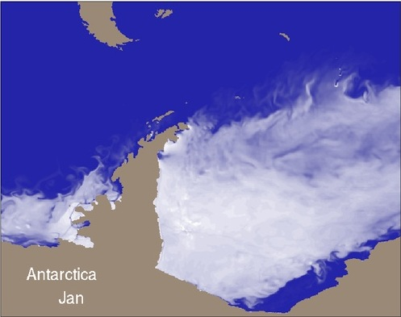
TeraGrid Example:
Petascale Climate Simulations
Science: Climate change decision support requires high-resolution, regional climate simulation capabilities, basic model improvements, larger ensemble sizes, longer runs, and new data assimilation capabilities. Opening petascale data services to a widening community of end users presents a significant infrastructural challenge.
  2008 WMS: We need faster higher resolution models to resolve important features, and better software, data management, analysis, viz, and a global VO that can develop models and evaluate outputs
Realistic Antarctic sea-ice coverage generated from century-scale high resolution coupled climate simulation performed on Kraken (John Dennis, NCAR)
Applications: many, including: CCSM (climate system, deep), NRCM (regional climate, deep), WRF (meteorology, deep), NCL/NCO (analysis tools, wide), ESG (data, wide)
Science Users: many, including both large (e.g., IPCC, WCRP) and small groups;
  ESG federation includes >17k users, 230 TB data, 500 journal papers (2 years)
Notes:
TeraGrid has had a modest impact on the advancement of climate science thus far -- XROADS plans for XD to have a much larger impact on the advancement of climate science. The XROADS team we've assembled includes individuals (Apps, tools, viz, data, AUSS including Gateways, TEOS) working at the forefront of petascale climate simulation, climate science gateways, climate workflows, analysis and visualization of climate, and global data and knowledge sharing. A solid Deep & Wide foundation for advancing climate science.
WMS – 2008 World Modeling Summit
WCRP – World Climate Research Program
WMS and community says models need to be 1 km or less resolution
Lots of users for each tool, hundreds for CCSM, WRF, tens of thousands for NCL/NCO, ESG

Slide 17


TeraGrid Example: Genomic Sciences
Science: many, ranging from de novo sequence analysis to resequencing, including: genome sequencing of a single organism; metagenomic studies of entire populations of microbes; study of single base-pair mutations in DNA
Applications: e.g. ANL’s Metagenomics RAST server catering to hundreds of groups, Indiana’s SWIFT aiming to replace BLASTX searches for many bio groups, Maryland’s CLOUDburst, BioLinux
PIs: thousands of users and developers, e.g. Meyer (ANL), White (U. Maryland), Dong (U. North Texas), Schork (Scripps), Nelson, Ye, Tang, Kim (Indiana)
Results of Smith-Waterman distance computation, deterministic annealing clustering, and Sammon’s mapping visualization pipeline for 30,000 metagenomics sequences: (a) 17 clusters for full sample; (b) 10 sub-clusters found from purple and green clusters in (a). (Nelson and Ye, Indiana)
Map sequence
clusters to 3D
Notes:
Simon Twigger (UMD) example: CloVR, a tool that can be used to build pipelines that use cloud resources: http://clovr.igs.umaryland.edu/
Porting/developing pipelines can make use of clouds; on XD, will use XROADS services, e.g., job execution, metascheduling
Sharing digital products includes supporting standard data formats: e.g., Metagenome Transport Format from Genomics Standards Consortium’s M5 working group, coming in other fields following the MTF model according to Eugene Kolker, Seattle Children’s Hospital – see “‘Omics Data Sharing,” Science 9 Oct 2009
XROADS Wide follows successful TG gateways model – build general tools that communities can use to build specific tools for their members

Slide 18
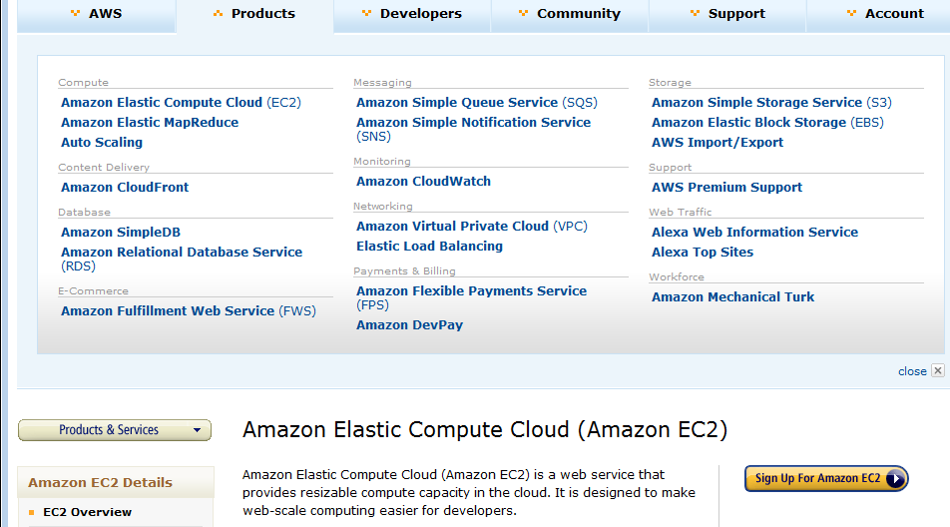
Amazon offers a lot!

Slide 19
Philosophy of Clouds and Grids
Clouds are (by definition) commercially supported approach to large scale computing
  So we should expect Clouds to replace Compute Grids
  Current Grid technology involves “non-commercial” software solutions which are hard to evolve/sustain
  Maybe Clouds ~4% IT expenditure 2008 growing to 14% in 2012 (IDC Estimate)
Public Clouds are broadly accessible resources like Amazon and Microsoft Azure – powerful but not easy to optimize and perhaps data trust/privacy issues
Private Clouds run similar software and mechanisms but on “your own computers”
Services still are correct architecture with either REST (Web 2.0) or Web Services
Clusters still critical concept

Slide 20






MapReduce “File/Data Repository” Parallelism
Map = (data parallel) computation reading and writing data
Reduce = Collective/Consolidation phase e.g. forming multiple global sums as in histogram
Instruments
Iterative MapReduce
Map Map Map Map
Reduce Reduce Reduce
Communication
Reduce
Portals
/Users
Disks
Map₁
Map₂
Map₃

Slide 21
Cloud Computing: Infrastructure and Runtimes
Cloud infrastructure: outsourcing of servers, computing, data, file space, utility computing, etc.
  Handled through Web services that control virtual machine lifecycles.
Cloud runtimes: tools (for using clouds) to do data-parallel computations.
  Apache Hadoop, Google MapReduce, Microsoft Dryad, and others
  Designed for information retrieval but are excellent for a wide range of science data analysis applications
  Can also do much traditional parallel computing for data-mining if extended to support iterative operations
  Not usually on Virtual Machines

Slide 22
MapReduce
A parallel Runtime coming from Information Retrieval
Data Partitions
Map(Key, Value)
A hash function maps the results of the map tasks to r reduce tasks
Reduce(Key, List<Value>)
Reduce Outputs
Implementations support:
  Splitting of data
  Passing the output of map functions to reduce functions
  Sorting the inputs to the reduce function based on the intermediate keys
  Quality of services

Slide 23

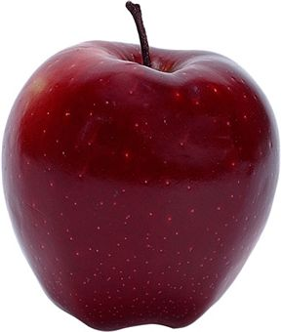
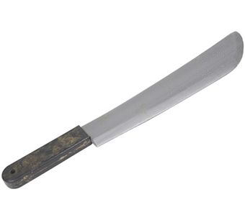
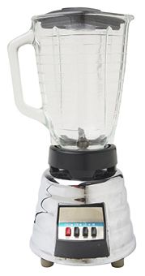


Sam’s Problem http://www.slideshare.net/esaliya/mapreduce-in-simple-terms
Sam thought of “drinking” the apple
He used a to cut the and a to make juice.

Slide 24
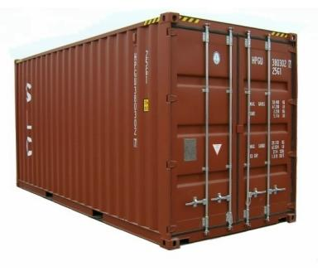
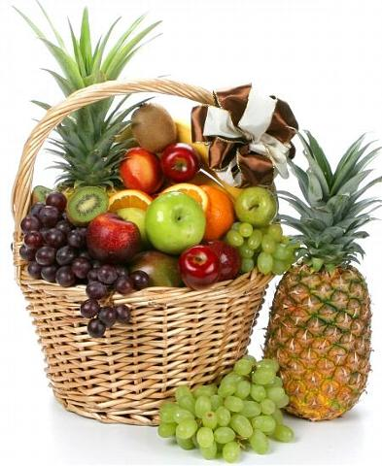

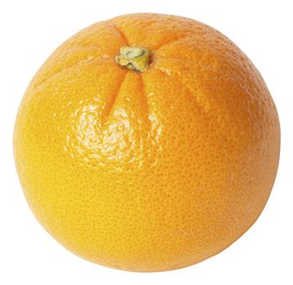


Creative Sam
Implemented a parallel version of his innovation
Fruits
Each input to a map is a list of <key, value> pairs
A list of <key, value> pairs mapped into another list of <key, value> pairs which gets grouped by the key and reduced into a list of values
(<a, > , <o, > , <p, > , …)
Each output of slice is a list of <key, value> pairs
(<a’, > , <o’, > , <p’, > )
Grouped by key
The idea of Map Reduce in Data Intensive Computing
Each input to a reduce is a <key, value-list> (possibly a list of these, depending on the grouping/hashing mechanism)
e.g. <ao, ( …)>
Reduced into a list of values

Slide 25

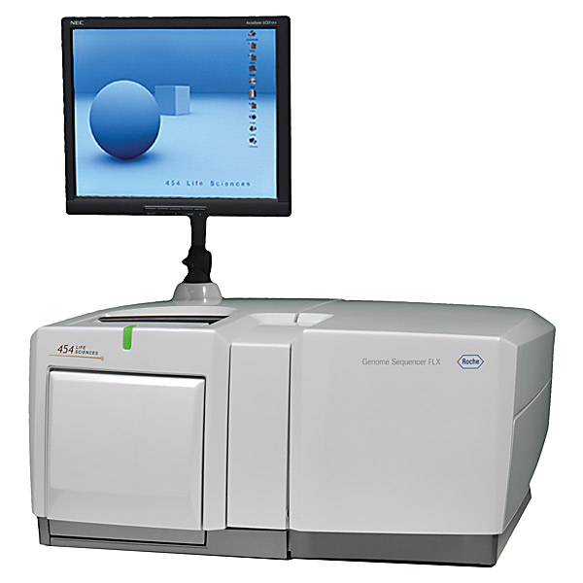
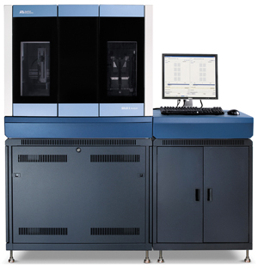
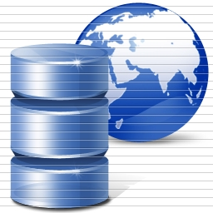
DNA Sequencing Pipeline
Illumina/Solexa Roche/454 Life Sciences Applied Biosystems/SOLiD
Internet
~300 million base pairs per day leading to
~3000 sequences per day per instrument
? 500 instruments at ~0.5M$ each
Read Alignment
Pairwise
clustering
Form block
Pairings
Sequence
alignment
Dissimilarity
Matrix
N(N-1)/2 values
Visualization
Plotviz
FASTA File
N Sequences
Blocking
MPI
MDS
MapReduce

Slide 26
Cap3 Cost
Notes:
This is just the cost for the compute instances. In addition to this, there will be minor charges for the data storage for EMR & AzureMR. Also there will be additional minor charges for the queue service and table service for AzureMR.
Cost presented here are amortized for the actual time (time/3600 * num_instances * instance_price_per_hour), assuming the remaining time of the instance hour have been put to useful work.
Note: EMR & Hadoop-EC2 requires one extra node to act as the master node (included in the cost calculation)

Slide 27
SWG Cost
Notes:
This is just the cost for the compute instances. In addition to this, there will be minor charges for the data storage for EMR & AzureMR. Also there will be additional minor charges for the queue service and table service for AzureMR.
Cost presented here are amortized for the actual time (time/3600 * num_instances * instance_price_per_hour), assuming the remaining time of the instance hour have been put to useful work.
Note: EMR & Hadoop-EC2 requires one extra node to act as the master node (included in the cost calculation)

Slide 28
Cost of Clouds
4096 Cap3 data files : 1.06 GB / 1875968 reads (458 readsX4096)..
Following is the cost to process 4096 CAP3 files..
Cost to process 4096 FASTA files (~1GB) on EC2 (58 minutes)
Amortized compute cost = 10.41 $ (0.68$ per high CPU extra large instance per hour) 10000 SQS messages = 0.01 $ Storage per 1GB per month = 0.15 $ Data transfer out per 1 GB = 0.15 $ Total = 10.72 $
Cost to process 4096 FASTA files (~1GB) on Azure (59 minutes)
Amortized compute cost = 15.10 $ (0.12$ per small instance per hour) 10000 queue messages = 0.01 $ Storage per 1GB per month = 0.15 $ Data transfer in/out per 1 GB =0.10 $ + 0.15 $ Total = 15.51 $
Amortized cost in Tempest (24 core X 32 nodes, 48 GB per node) = 9.43$
(Assume 70% utilization, write off over 3 years, include support)

Slide 29
US Cyberinfrastructure Context
There are a rich set of facilities
  Production TeraGrid facilities with distributed and shared memory
  Experimental “Track 2D” Awards
    FutureGrid: Distributed Systems experiments cf. Grid5000
    Keeneland: Powerful GPU Cluster
    Gordon: Large (distributed) Shared memory system with SSD aimed at data analysis/visualization
  Open Science Grid aimed at High Throughput computing and strong campus bridging

Slide 30
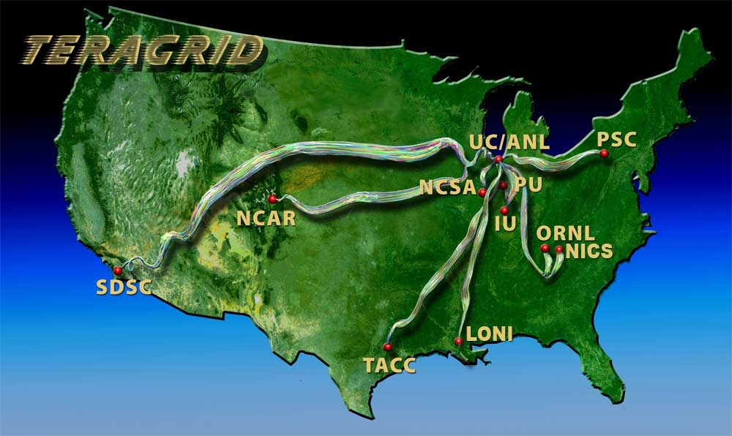
TeraGrid
~2 Petaflops; over 20 PetaBytes of storage (disk and tape), over 100 scientific data collections
UW
Grid Infrastructure Group (UChicago)
UC/ANL
PSC
NCAR
PU
NCSA
Caltech
IU
UNC/RENCI
ORNL
USC/ISI
NICS
SDSC
LONI
TACC
Resource Provider (RP)
Software Integration Partner
Network Hub

Slide 31
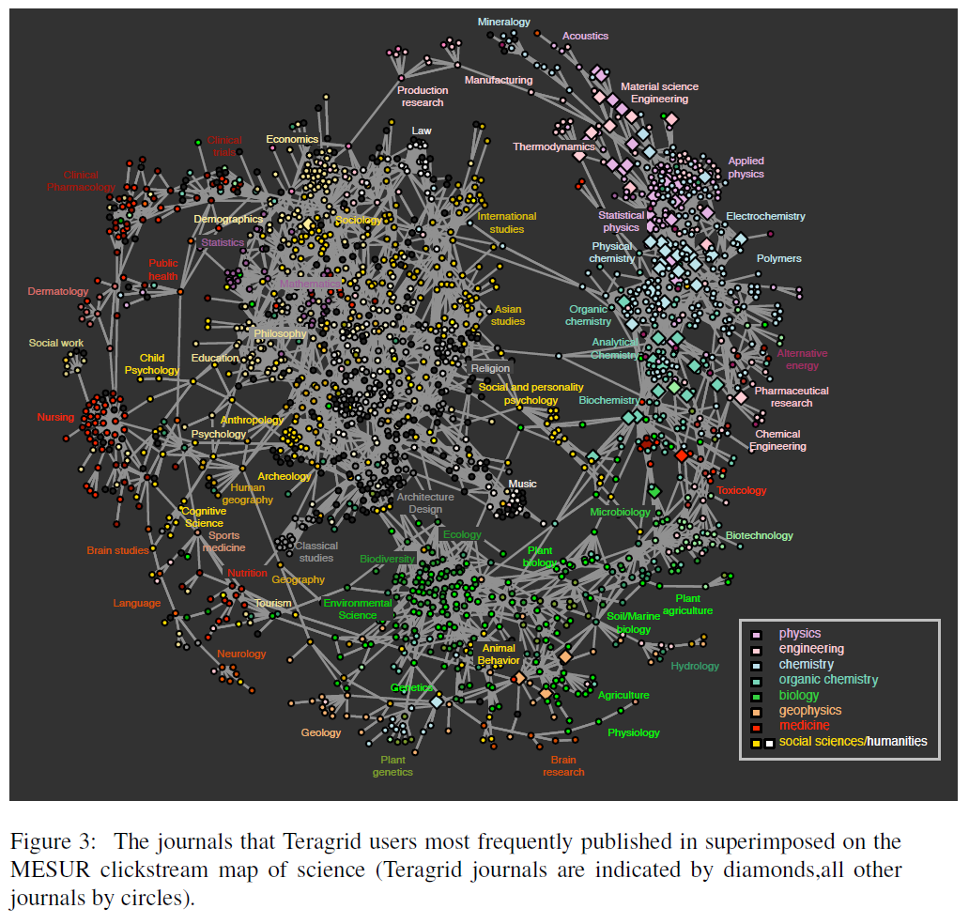
TeraGrid
User Areas

Slide 32
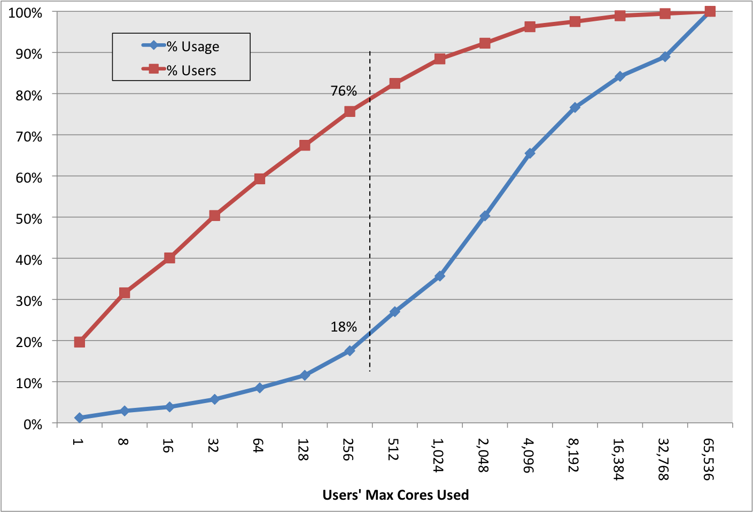
80% of Users, 20% of Computing
Nearly 80% of TeraGrid users in FY09 never ran a job larger than 256 cores.
Usage by all those users accounted for less than 20% of TeraGrid usage in the same period.
96% of users and 66% of usage needed 4,096 or fewer cores.

Slide 33
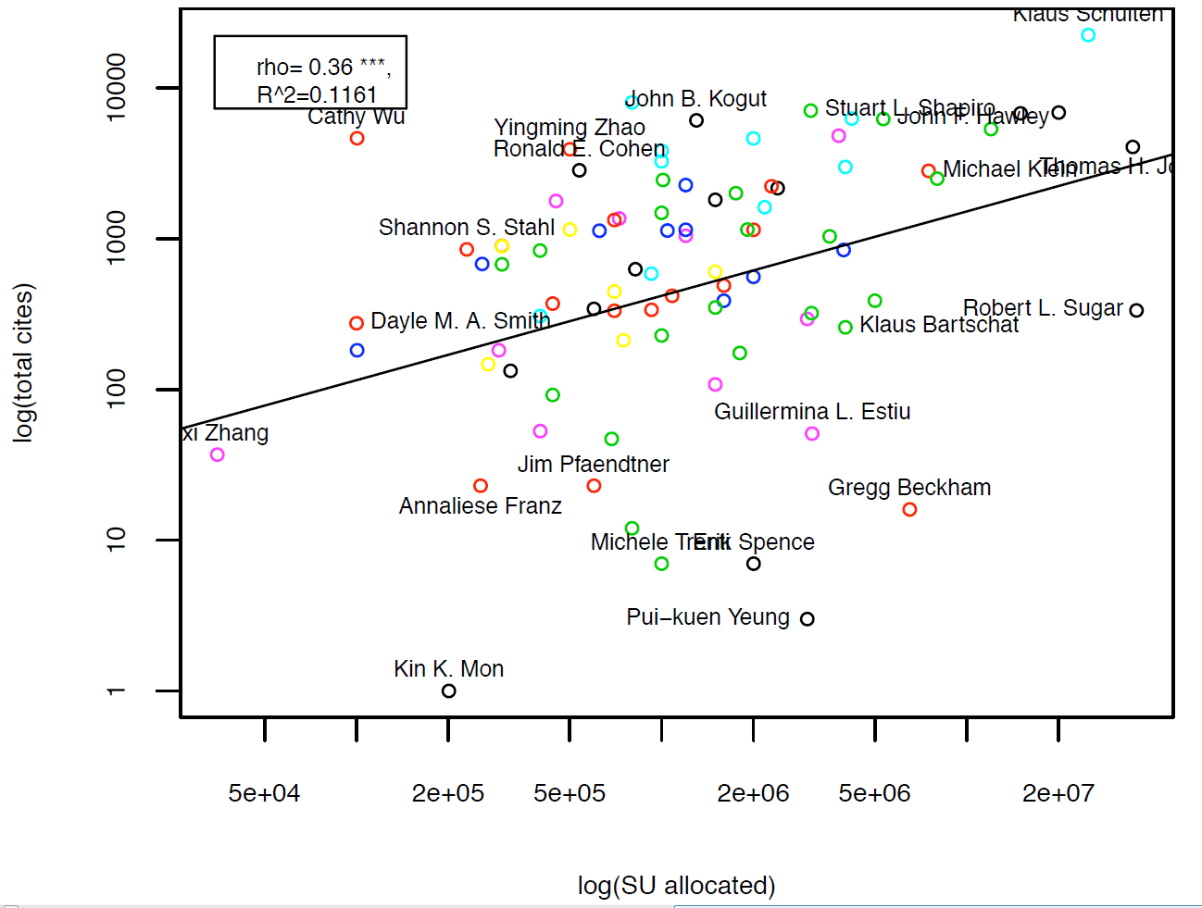
Science Impact Occurs
Throughout the Branscomb Pyramid

Slide 34
FutureGrid key Concepts I
FutureGrid is a 4 year $15M project with 7 clusters at 5 sites across country with 8 funded partners
FutureGrid is a flexible testbed supporting Computer Science and Computational Science experiments in
  Innovation and scientific understanding of distributed computing (cloud, grid) and parallel computing paradigms
  The engineering science of middleware that enables these paradigms
  The use and drivers of these paradigms by important applications
  The education of a new generation of students and workforce on the use of these paradigms and their applications
  interoperability, functionality, performance or evaluation

Slide 35

FutureGrid key Concepts II
Rather than loading images onto VM’s, FutureGrid supports Cloud, Grid and Parallel computing environments by dynamically provisioning software as needed onto “bare-metal”
  Image library for MPI, OpenMP, Hadoop, Dryad, gLite, Unicore, Globus, Xen, ScaleMP (distributed Shared Memory), Nimbus, Eucalyptus, OpenNebula, KVM, Windows …..
Growth comes from users depositing novel images in library
Each use of FutureGrid is an experiment that is reproducible
Developing novel software to support these goals which build on Grid5000 in France
Image1
Image2
…
ImageN
Choose
Load
Run

Slide 36
FutureGrid Partners
Indiana University (Architecture, core software, Support)
Purdue University (HTC Hardware)
San Diego Supercomputer Center at University of California San Diego (INCA, Monitoring)
University of Chicago/Argonne National Labs (Nimbus)
University of Florida (ViNE, Education and Outreach)
University of Southern California Information Sciences (Pegasus to manage experiments)
University of Tennessee Knoxville (Benchmarking)
University of Texas at Austin/Texas Advanced Computing Center (Portal)
University of Virginia (OGF, Advisory Board and allocation)
Center for Information Services and GWT-TUD from Technische Universtität Dresden. (VAMPIR)
Red institutions have FutureGrid hardware

Slide 37

FutureGrid: a Grid/Cloud/HPC Testbed
NID: Network Impairment Device
Private
Public
FG Network

Slide 38
5 Use Types for FutureGrid
Training Education and Outreach
  Semester and short events; promising for outreach
Interoperability test-beds
  Grids and Clouds; OGF really needed this
Domain Science applications
  Life science highlighted
Computer science
  Largest current category
Computer Systems Evaluation
  TeraGrid (TIS, TAS, XSEDE), OSG, EGI

Slide 39
Some Current FutureGrid projects I
Project | Institution | Details
Educational Projects
VSCSE Big Data | IU PTI, Michigan, NCSA and 10 sites | Over 200 students in week Long Virtual School of Computational Science and Engineering on Data Intensive Applications & Technologies
LSU Distributed Scientific Computing Class | LSU | 13 students use Eucalyptus and SAGA enhanced version of MapReduce
Topics on Systems: Cloud Computing CS Class | IU SOIC | 27 students in class using virtual machines, Twister, Hadoop and Dryad
Interoperability Projects
OGF Standards | Virginia, LSU, Poznan | Interoperability experiments between OGF standard Endpoints
Sky Computing | University of Rennes 1 | Over 1000 cores in 6 clusters across Grid’5000 & FutureGrid using ViNe and Nimbus to support Hadoop and BLAST demonstrated at OGF 29 June 2010

Slide 40
Some Current FutureGrid projects II
Domain Science Application Projects
Combustion | Cummins | Performance Analysis of codes aimed at engine efficiency and pollution
Cloud Technologies for Bioinformatics Applications | IU PTI | Performance analysis of pleasingly parallel/MapReduce applications on Linux, Windows, Hadoop, Dryad, Amazon, Azure with and without virtual machines
Computer Science Projects
Cumulus | Univ. of Chicago | Open Source Storage Cloud for Science based on Nimbus
Differentiated Leases for IaaS | University of Colorado | Deployment of always-on preemptible VMs to allow support of Condor based on demand volunteer computing
Application Energy Modeling | UCSD/SDSC | Fine-grained DC power measurements on HPC resources and power benchmark system
Evaluation and TeraGrid/OSG Support Projects
Use of VM’s in OSG | OSG, Chicago, Indiana | Develop virtual machines to run the services required for the operation of the OSG and deployment of VM based applications in OSG environments.
TeraGrid QA Test & Debugging | SDSC | Support TeraGrid software Quality Assurance working group
TeraGrid TAS/TIS | Buffalo/Texas | Support of XD Auditing and Insertion functions

Slide 41
Education & Outreach on FutureGrid
Build up tutorials on supported software
Support development of curricula requiring privileges and systems destruction capabilities that are hard on conventional TeraGrid
Offer suite of appliances (customized VM based images) supporting online laboratories
Supporting several workshops including Virtual Summer School on “Big Data” July 26-30 2010; TeraGrid ‘10 “Cloud technologies, data-intensive science and the TG” August 2010; CloudCom conference tutorials Nov 30-Dec 3 2010
Experimental class use at Indiana, Florida and LSU
Planning ADMI Summer 2011 School on Clouds and REU program for Minority Serving Institutions
Will expand with new hire

Slide 42
Software Components
Important as Software is Infrastructure …
Portals including “Support” “use FutureGrid” “Outreach”
Monitoring – INCA, Power (GreenIT)
Experiment Manager: specify/workflow
Image Generation and Repository
Intercloud Networking ViNE
  Virtual Clusters built with virtual networks
Performance library (current tools don’t work on VM’s)
Rain or Runtime Adaptable InsertioN Service for images
Security Authentication, Authorization (need to vet images)
Expect major open sources software releases this summer of RAIN (underneath VM’s) and appliance platform (above images)

Slide 43
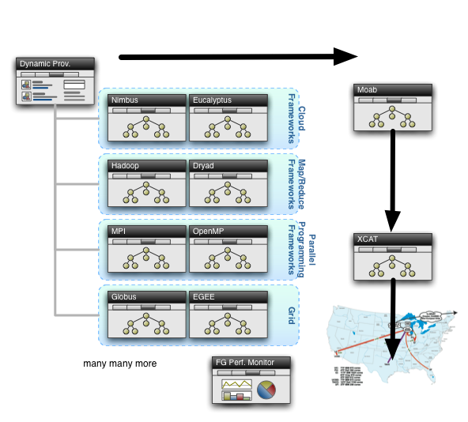
Rain in FutureGrid

Slide 44
Some critical Concepts as text I
Computational thinking is set up as e-Research and often characterized by a Data Deluge from sensors, instruments, simulation results and the Internet. Curating and managing this data involves digital library technology and possible new roles for libraries. Interdisciplinary Collaboration across continents and fields implies virtual organizations that are built using Web 2.0 technology. VO’s link people, computers and data.
Portals or Gateways provide access to computational and data set up as Cyberinfrastructure or e-Infrastructure made up of multiple Services
Intense computation on individual problems involves Parallel Computing linking computers with high performance networks that are packaged as Clusters and/or Supercomputers. Performance improvements now come from Multicore architectures implying parallel computing important for commodity applications and machines.

Slide 45
Some critical Concepts as text II
Cyberinfrastructure also involves distributed systems supporting data and people that are naturally distributed as well as pleasingly parallel computations. Grids were initial technology approach but these failed to get commercial support and in many cases being replaced by Clouds.
Clouds are highly cost-effective user friendly approaches to large (~100,000 node) data centers originally pioneered by Web 2.0 applications. They tend to use Virtualization technology and offer new MapReduce approach
These developments have implications for Education as well as Research but there is less agreement and success in using cyberinfrastructure in education as with research. Will Change!
“Appliances” allow one to package a course module (run CFD with MPI) as a download to run on a virtual machine.
Group video conferencing enables virtual organizations

