Slide 1
Big Data to Knowledge
Panel
SKG 2014
Institute of Computing Technology, Chinese Academy of Sciences, Beijing, China
August 29 2014
Geoffrey Fox
gcf@indiana.edu
http://www.infomall.org
School of Informatics and Computing
Digital Science Center
Indiana University Bloomington

Slide 2
Analytics and the DIKW Pipeline
Data goes through a pipeline
Raw data → Data → Information → Knowledge → Wisdom → Decisions
Each link enabled by a filter which is “business logic” or “analytics”
We are interested in filters that involve “sophisticated analytics” which require non trivial parallel algorithms
  Improve state of art in both algorithm quality and (parallel) performance
Design and Build SPIDAL (Scalable Parallel Interoperable Data Analytics Library)
Data
Information
Analytics
Information
Knowledge
More Analytics

Slide 3

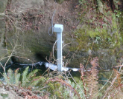
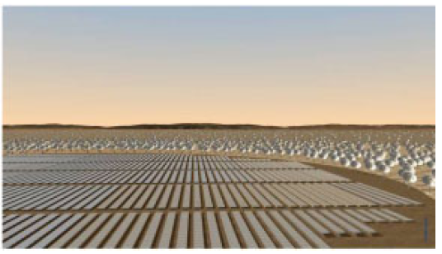
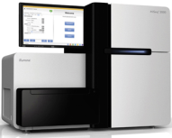






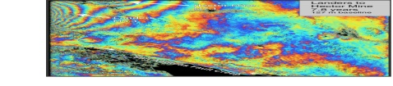
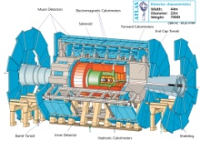
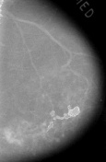



Raw Data → Data → Information → Knowledge → Wisdom → Decisions
Another
Grid
SS
SS
SS
SS
SS
SS
SS
Filter
Cloud
Discovery
Cloud
Portal
Filter
Cloud
Fusion for Discovery/Decisions
SS
Filter
Cloud
Another
Service
SS
Filter
Cloud
Filter
Cloud
Filter
Cloud
Discovery
Cloud
SS
SS: Sensor or Data
Interchange
Service
Workflow through multiple filter/discovery clouds or Services
SS
Filter
Cloud
Filter
Cloud
Filter
Cloud
Filter
Cloud
SS
Another
Cloud
SS
SS
SS
SS
SS
SS
SS
SS
SS
SS
SS
SS
SS
Compute
Cloud
Storage
Cloud
Distributed
Grid
Hadoop Cluster
Database

Slide 4
What is Big Data?
Big Data to Knowledge. We have
  Data to Information
  Information to Knowledge
  Knowledge to Wisdom
Big Data == Big Information == Big Knowledge
One can classify by properties like size but I prefer to classify by a data centric approach -- its the data that gives the answer rather than a model or theory
I see no difference between Big Data and Intelligent Big Data -- Big Data characterized by its smart transformation

Slide 5
Status of Big Data?
Obviously one needs good infrastructure
Hardware
Software
Algorithms
The basic hardware is good -- clouds or HPC both work
I suggested that algorithms and their parallel implementation needed more work.
There are key problems with data
a) Coping with distribution -- cant bring computing to data very easily in some cases (where "global machine learning" needed)
b) Getting data given privacy and proprietary issues. Web Observatory nice step

