Slide 1
Algorithms and Applications for Grids and Clouds
22nd ACM Symposium on Parallelism in Algorithms and Architectures
Santorini, Greece June 13 – 15, 2010
http://www.cs.jhu.edu/~spaa/2010/index.html
Geoffrey Fox
gcf@indiana.edu
http://www.infomall.org http://www.futuregrid.org
Director, Digital Science Center, Pervasive Technology Institute
Associate Dean for Research and Graduate Studies, School of Informatics and Computing
Indiana University Bloomington

Slide 2
Algorithms and Application for Grids and Clouds
We discuss the impact of clouds and grid technology on scientific computing using examples from a variety of fields -- especially the life sciences. We cover the impact of the growing importance of data analysis and note that it is more suitable for these modern architectures than the large simulations (particle dynamics and partial differential equation solution) that are mainstream use of large scale "massively parallel" supercomputers. The importance of grids is seen in the support of distributed data collection and archiving while clouds are and will replace grids for the large scale analysis of the data.
We discuss the structure of algorithms (and the associated applications) that will run on current clouds and use either the basic "on-demand" computing paradigm or higher level frameworks based on MapReduce and its extensions. Looking at performance of MPI (mainstay of scientific computing) and MapReduce both theoretically and experimentally shows that current MapReduce implementations run well on algorithms that are a "Map" followed by a "Reduce" but perform poorly on algorithms that iterate over many such phases. Several important algorithms including parallel linear algebra falls into latter class. One can define MapReduce extensions to accommodate iterative map and reduce but these have less fault tolerance than basic MapReduce. We discuss clustering, dimension reduction and sequence assembly and annotation as example algorithms.

Slide 3
Important Trends
Data Deluge in all fields of science
  Also throughout life e.g. web!
Multicore implies parallel computing important again
  Performance from extra cores – not extra clock speed
Clouds – new commercially supported data center model replacing compute grids
Light weight clients: Smartphones and tablets

Slide 4

Gartner 2009 Hype Curve
Clouds, Web2.0
Service Oriented Architectures

Slide 5


Clouds as Cost Effective Data Centers
Builds giant data centers with 100,000’s of computers; ~ 200
-1000 to a shipping container with Internet access
“Microsoft will cram between 150 and 220 shipping containers filled with data center gear into a new 500,000 square foot Chicago facility. This move marks the most significant, public use of the shipping container systems popularized by the likes of Sun Microsystems and Rackable Systems to date.”

Slide 6

Clouds hide Complexity
SaaS: Software as a Service
IaaS: Infrastructure as a Service or HaaS: Hardware as a Service – get your computer time with a credit card and with a Web interaface
PaaS: Platform as a Service is IaaS plus core software capabilities on which you build SaaS
Cyberinfrastructure is “Research as a Service”
SensaaS is Sensors (Instruments) as a Service
2 Google warehouses of computers on the banks of the Columbia River, in The Dalles, Oregon
Such centers use 20MW-200MW
(Future) each
150 watts per CPU
Save money from large size, positioning with cheap power and access with Internet

Slide 7


The Data Center Landscape
Range in size from “edge” facilities to megascale.
Economies of scale
  Approximate costs for a small size center (1K servers) and a larger, 50K server center.
Technology | Cost in small-sized Data Center | Cost in Large Data Center | Ratio
Network | $95 per Mbps/ month | $13 per Mbps/ month | 7.1
Storage | $2.20 per GB/ month | $0.40 per GB/ month | 5.7
Administration | ~140 servers/ Administrator | >1000 Servers/ Administrator | 7.1
Each data center is
11.5 times
the size of a football field

Slide 8
Clouds hide Complexity
Cyberinfrastructure
Is “Research as a Service”
SaaS: Software as a Service
(e.g. CFD or Search documents/web are services)
PaaS: Platform as a Service
IaaS plus core software capabilities on which you build SaaS
(e.g. Azure is a PaaS; MapReduce is a Platform)
IaaS (HaaS): Infrastructure as a Service
(get computer time with a credit card and with a Web interface like EC2)

Slide 9

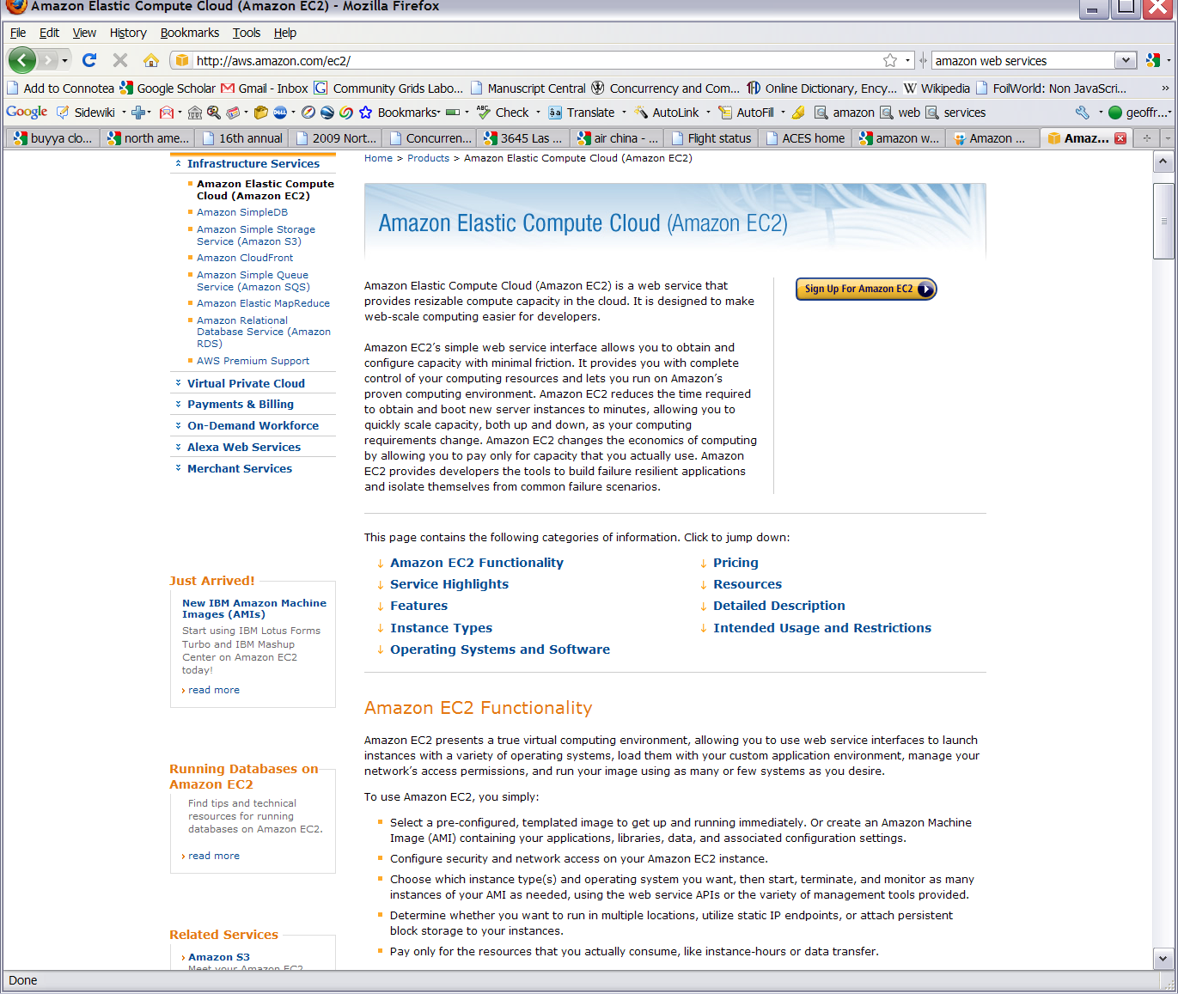






Commercial Cloud
Software

Slide 10
Philosophy of Clouds and Grids
Clouds are (by definition) commercially supported approach to large scale computing
  So we should expect Clouds to replace Compute Grids
  Current Grid technology involves “non-commercial” software solutions which are hard to evolve/sustain
  Maybe Clouds ~4% IT expenditure 2008 growing to 14% in 2012 (IDC Estimate)
Public Clouds are broadly accessible resources like Amazon and Microsoft Azure – powerful but not easy to customize and perhaps data trust/privacy issues
Private Clouds run similar software and mechanisms but on “your own computers” (not clear if still elastic)
  Platform features such as Queues, Tables, Databases limited
Services still are correct architecture with either REST (Web 2.0) or Web Services
Clusters still critical concept

Slide 11
Cloud Computing: Infrastructure and Runtimes
Cloud infrastructure: outsourcing of servers, computing, data, file space, utility computing, etc.
  Handled through Web services that control virtual machine lifecycles.
Cloud runtimes or Platform: tools (for using clouds) to do data-parallel (and other) computations.
  Apache Hadoop, Google MapReduce, Microsoft Dryad, Bigtable, Chubby and others
  MapReduce designed for information retrieval but is excellent for a wide range of science data analysis applications
  Can also do much traditional parallel computing for data-mining if extended to support iterative operations
  MapReduce not usually on Virtual Machines

Slide 12
Authentication and Authorization: Provide single sign in to both FutureGrid and Commercial Clouds linked by workflow
Workflow: Support workflows that link job components between FutureGrid and Commercial Clouds. Trident from Microsoft Research is initial candidate
Data Transport: Transport data between job components on FutureGrid and Commercial Clouds respecting custom storage patterns
Program Library: Store Images and other Program material (basic FutureGrid facility)
Blob: Basic storage concept similar to Azure Blob or Amazon S3
DPFS Data Parallel File System: Support of file systems like Google (MapReduce), HDFS (Hadoop) or Cosmos (dryad) with compute-data affinity optimized for data processing
Table: Support of Table Data structures modeled on Apache Hbase or Amazon SimpleDB/Azure Table
SQL: Relational Database
Queues: Publish Subscribe based queuing system
Worker Role: This concept is implicitly used in both Amazon and TeraGrid but was first introduced as a high level construct by Azure
MapReduce: Support MapReduce Programming model including Hadoop on Linux, Dryad on Windows HPCS and Twister on Windows and Linux
Software as a Service: This concept is shared between Clouds and Grids and can be supported without special attention
Web Role: This is used in Azure to describe important link to user and can be supported in FutureGrid with a Portal framework

Slide 13






MapReduce “File/Data Repository” Parallelism
Map = (data parallel) computation reading and writing data
Reduce = Collective/Consolidation phase e.g. forming multiple global sums as in histogram
Instruments
Iterative MapReduce
Map Map Map Map
Reduce Reduce Reduce
Communication
Reduce
Portals
/Users
Disks
Map₁
Map₂
Map₃

Slide 14
Grids and Clouds + and -
Grids are useful for managing distributed systems
  Pioneered service model for Science
  Developed importance of Workflow
  Performance issues – communication latency – intrinsic to distributed systems
Clouds can execute any job class that was good for Grids plus
  More attractive due to platform plus elasticity
  Currently have performance limitations due to poor affinity (locality) for compute-compute (MPI) and Compute-data
  These limitations are not “inevitable” and should gradually improve

Slide 15
MapReduce
Data Partitions
Map(Key, Value)
A hash function maps the results of the map tasks to reduce tasks
Reduce(Key, List<Value>)
Reduce Outputs
Implementations support:
  Splitting of data
  Passing the output of map functions to reduce functions
  Sorting the inputs to the reduce function based on the intermediate keys
  Quality of service

Slide 16
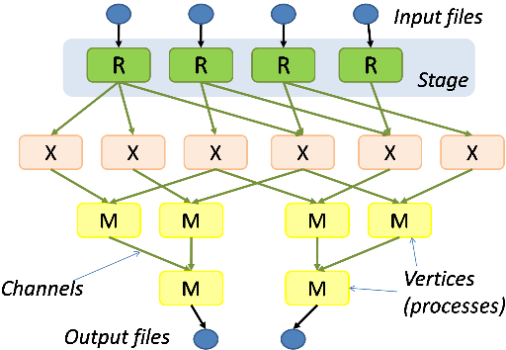
Hadoop & Dryad
Apache Hadoop
Microsoft Dryad
Master Node
Data/Compute Nodes
Job
Tracker
M
M
M
M
R
R
R
R
Name
Node
Data blocks
1
2
2
4
HDFS
3
3
Apache Implementation of Google’s MapReduce
Uses Hadoop Distributed File System (HDFS) manage data
Map/Reduce tasks are scheduled based on data locality in HDFS
Hadoop handles:
  Job Creation
  Resource management
  Fault tolerance & re-execution of failed map/reduce tasks
The computation is structured as a directed acyclic graph (DAG)
  Superset of MapReduce
Vertices – computation tasks
Edges – Communication channels
Dryad process the DAG executing vertices on compute clusters
Dryad handles:
  Job creation, Resource management
  Fault tolerance & re-execution of vertices

Slide 17

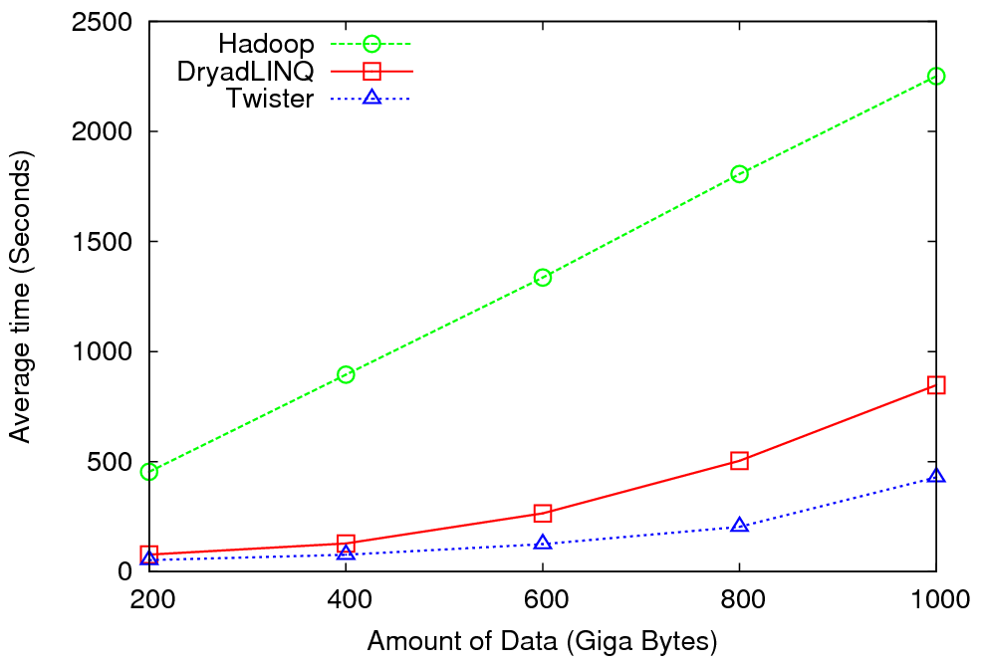
High Energy Physics Data Analysis
An application analyzing data from Large Hadron Collider (1TB but 100 Petabytes eventually)
Input to a map task: <key, value>
key = Some Id value = HEP file Name
Output of a map task: <key, value>
key = random # (0<= num<= max reduce tasks)
value = Histogram as binary data
Input to a reduce task: <key, List<value>>
key = random # (0<= num<= max reduce tasks)
value = List of histogram as binary data
Output from a reduce task: value
value = Histogram file
Combine outputs from reduce tasks to form the final histogram

Slide 18

Reduce Phase of Particle Physics
“Find the Higgs” using Dryad
Higgs in Monte Carlo
Combine Histograms produced by separate Root “Maps” (of event data to partial histograms) into a single Histogram delivered to Client

Slide 19
Broad Architecture Components
Traditional Supercomputers (TeraGrid and DEISA) for large scale parallel computing – mainly simulations
  Likely to offer major GPU enhanced systems
Traditional Grids for handling distributed data – especially instruments and sensors
Clouds for “high throughput computing” including much data analysis and emerging areas such as Life Sciences using loosely coupled parallel computations
  May offer small clusters for MPI style jobs
  Certainly offer MapReduce
Integrating these needs new work on distributed file systems and high quality data transfer service
  Link Lustre WAN, Amazon/Google/Hadoop/Dryad File System
  Offer Bigtable (distributed scalable Excel)

Slide 20

Application Classes
Old classification of Parallel software/hardware
in terms of 5 (becoming 6) “Application architecture” Structures)
1 | Synchronous | Lockstep Operation as in SIMD architectures | SIMD
2 | Loosely Synchronous | Iterative Compute-Communication stages with independent compute (map) operations for each CPU. Heart of most MPI jobs | MPP
3 | Asynchronous | Computer Chess; Combinatorial Search often supported by dynamic threads | MPP
4 | Pleasingly Parallel | Each component independent – in 1988, Fox estimated at 20% of total number of applications | Grids
5 | Metaproblems | Coarse grain (asynchronous) combinations of classes 1)-4). The preserve of workflow. | Grids
6 | MapReduce++ | It describes file(database) to file(database) operations which has subcategories including. Pleasingly Parallel Map Only Map followed by reductions Iterative “Map followed by reductions” – Extension of Current Technologies that supports much linear algebra and datamining | Clouds Hadoop/ Dryad Twister
Notes:
CGL-MapReduce is an example of MapReduce++ -- supports MapReduce model with iteration (data stays in memory and communication via streams not files)

Slide 21
Applications & Different Interconnection Patterns
Map Only | Classic MapReduce | Iterative Reductions MapReduce++ | Loosely Synchronous
CAP3 Analysis Document conversion (PDF -> HTML) Brute force searches in cryptography Parametric sweeps | High Energy Physics (HEP) Histograms SWG gene alignment Distributed search Distributed sorting Information retrieval | Expectation maximization algorithms Clustering Linear Algebra | Many MPI scientific applications utilizing wide variety of communication constructs including local interactions
- CAP3 Gene Assembly - PolarGrid Matlab data analysis | - Information Retrieval - HEP Data Analysis - Calculation of Pairwise Distances for ALU Sequences | Kmeans Deterministic Annealing Clustering - Multidimensional Scaling MDS | - Solving Differential Equations and - particle dynamics with short range forces
Input
iterations
Input
Input
map
map
map
Pij
reduce
Output
reduce
Domain of MapReduce and Iterative Extensions
MPI

Slide 22
Fault Tolerance and MapReduce
MPI does “maps” followed by “communication” including “reduce” but does this iteratively
There must (for most communication patterns of interest) be a strict synchronization at end of each communication phase
  Thus if a process fails then everything grinds to a halt
In MapReduce, all Map processes and all reduce processes are independent and stateless and read and write to disks
  As 1 or 2 (reduce+map) iterations, no difficult synchronization issues
Thus failures can easily be recovered by rerunning process without other jobs hanging around waiting
Re-examine MPI fault tolerance in light of MapReduce
  Twister will interpolate between MPI and MapReduce

Slide 23


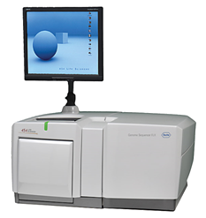
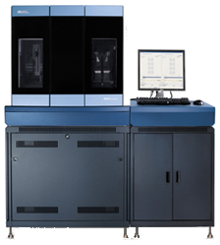
DNA Sequencing Pipeline
MapReduce
Pairwise
clustering
Sequence
alignment
Dissimilarity
Matrix
N(N-1)/2 values
Visualization
Plotviz
FASTA File
N Sequences
Blocking
block
Pairings
MPI
MDS
Read Alignment
Illumina/Solexa Roche/454 Life Sciences Applied Biosystems/SOLiD
Internet
Modern Commercial Gene Sequencers
This chart illustrate our research of a pipeline mode to provide services on demand (Software as a Service SaaS)
User submit their jobs to the pipeline. The components are services and so is the whole pipeline.

Slide 24
Alu and Metagenomics Workflow
“All pairs” problem
Data is a collection of N sequences. Need to calculate N² dissimilarities (distances) between sequnces (all pairs).
  These cannot be thought of as vectors because there are missing characters
  “Multiple Sequence Alignment” (creating vectors of characters) doesn’t seem to work if N larger than O(100), where 100’s of characters long.
Step 1: Can calculate N² dissimilarities (distances) between sequences
Step 2: Find families by clustering (using much better methods than Kmeans). As no vectors, use vector free O(N²) methods
Step 3: Map to 3D for visualization using Multidimensional Scaling (MDS) – also O(N²)
Results:
N = 50,000 runs in 10 hours (the complete pipeline above) on 768 cores
Discussions:
Need to address millions of sequences …..
Currently using a mix of MapReduce and MPI
Twister will do all steps as MDS, Clustering just need MPI Broadcast/Reduce

Slide 25


Biology MDS and Clustering Results
Alu Families
This visualizes results of Alu repeats from Chimpanzee and Human Genomes. Young families (green, yellow) are seen as tight clusters. This is projection of MDS dimension reduction to 3D of 35399 repeats – each with about 400 base pairs
Metagenomics
This visualizes results of dimension reduction to 3D of 30000 gene sequences from an environmental sample. The many different genes are classified by clustering algorithm and visualized by MDS dimension reduction

Slide 26

All-Pairs Using DryadLINQ
125 million distances
4 hours & 46 minutes
Calculate Pairwise Distances (Smith Waterman Gotoh)
Calculate pairwise distances for a collection of genes (used for clustering, MDS)
Fine grained tasks in MPI
Coarse grained tasks in DryadLINQ
Performed on 768 cores (Tempest Cluster)
Moretti, C., Bui, H., Hollingsworth, K., Rich, B., Flynn, P., & Thain, D. (2009). All-Pairs: An Abstraction for Data Intensive Computing on Campus Grids. IEEE Transactions on Parallel and Distributed Systems , 21, 21-36.

Slide 27
Hadoop/Dryad Comparison
Inhomogeneous Data I
Inhomogeneity of data does not have a significant effect when the sequence lengths are randomly distributed
Dryad with Windows HPCS compared to Hadoop with Linux RHEL on Idataplex (32 nodes)

Slide 28
Hadoop/Dryad Comparison
Inhomogeneous Data II
This shows the natural load balancing of Hadoop MR dynamic task assignment using a global pipe line in contrast to the DryadLinq static assignment
Dryad with Windows HPCS compared to Hadoop with Linux RHEL on Idataplex (32 nodes)

Slide 29
Hadoop VM Performance Degradation
Perf. Degradation = (T_{vm} – T_{baremetal})/T_{baremetal}
15.3% Degradation at largest data set size

Slide 30

Twister(MapReduce++)
Pub/Sub Broker Network
Map Worker
M
Streaming based communication
Intermediate results are directly transferred from the map tasks to the reduce tasks – eliminates local files
Cacheable map/reduce tasks
  Static data remains in memory
Combine phase to combine reductions
User Program is the composer of MapReduce computations
Extends the MapReduce model to iterative computations
Worker Nodes
R
Reduce Worker
D
D
MR
Driver
User
Program
M
M
M
M
D
MRDeamon
R
R
R
R
Data Read/Write
Communication
Data Split
File System
Iterate
Static
data
Configure()
User Program
Map(Key, Value)
δ flow
Reduce (Key, List<Value>)
Combine (Key, List<Value>)
Different synchronization and intercommunication mechanisms used by the parallel runtimes
Close()

Slide 31


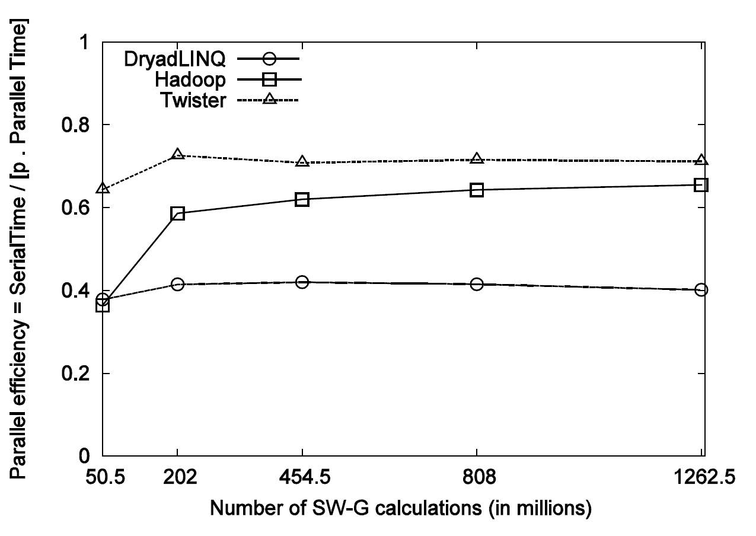
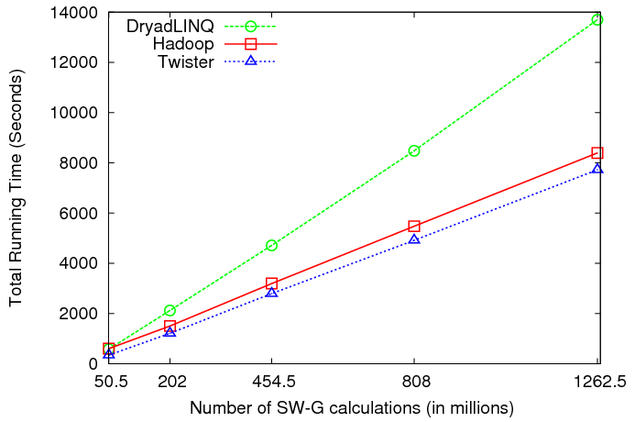
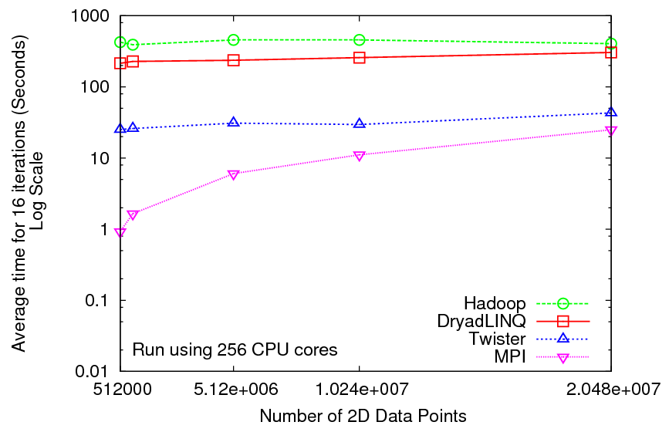
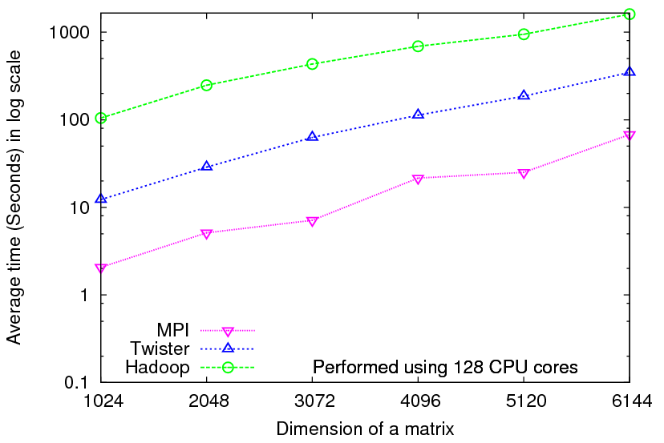
Iterative Computations
K-means
Matrix Multiplication
Smith Waterman
Performance of K-Means
Performance Matrix Multiplication

Slide 32

Performance of Pagerank using
ClueWeb Data (Time for 20 iterations)
using 32 nodes (256 CPU cores) of Crevasse

Slide 33
TwisterMPIReduce
PairwiseClustering
MPI
Multi Dimensional Scaling MPI
Generative Topographic Mapping MPI
Other …
TwisterMPIReduce
Azure Twister (C# C++)
Java Twister
Microsoft Azure
FutureGrid
Local Cluster
Amazon EC2
Runtime package supporting subset of MPI mapped to Twister
Set-up, Barrier, Broadcast, Reduce

Slide 34
2916 iterations
(384 CPUcores)
968 iterations
(384 CPUcores)
343 iterations
(768 CPU cores)

Slide 37


Sequence Assembly in the Clouds
Cap3 parallel efficiency
Cap3 – Per core per file (458 reads in each file) time to process sequences

Slide 38


Applications using Dryad & DryadLINQ
CAP3 - Expressed Sequence Tag assembly to re-construct full-length mRNA
Input files (FASTA)
DryadLINQ
CAP3
CAP3
CAP3
Output files
Perform using DryadLINQ and Apache Hadoop implementations
Single “Select” operation in DryadLINQ
“Map only” operation in Hadoop
X. Huang, A. Madan, “CAP3: A DNA Sequence Assembly Program,” Genome Research, vol. 9, no. 9, pp. 868-877, 1999.

Slide 39
Architecture of EC2 and Azure Cloud for Cap3
HDFS
Input Data Set
Data File
exe
exe
Map()
Map()
Executable
Optional
Reduce
Phase
Reduce
HDFS
Results

Slide 40
Cap3 Performance with different EC2 Instance Types
Notes:
Instance Type CPU Cores Memory Local Disk Space Cost per hour
Small 1 1.7 GB 250 GB 0.12$
Medium 2 3.5 GB 500 GB 0.24$
Large 4 7 GB 1000 GB 0.48$
Extra Large 8 15 GB 2000 GB 0.96$

Slide 41
Cost to assemble to process 4096 FASTA files
~ 1 GB / 1875968 reads (458 readsX4096)
Amazon AWS total :11.19 $
    Compute 1 hour X 16 HCXL (0.68$ * 16) = 10.88 $
    10000 SQS messages = 0.01 $
    Storage per 1GB per month = 0.15 $
    Data transfer out per 1 GB = 0.15 $
Azure total : 15.77 $
    Compute 1 hour X 128 small (0.12 $ * 128) = 15.36 $
    10000 Queue messages = 0.01 $
    Storage per 1GB per month = 0.15 $
    Data transfer in/out per 1 GB = 0.10 $ + 0.15 $
Tempest (amortized) : 9.43 $
  24 core X 32 nodes, 48 GB per node
  Assumptions : 70% utilization, write off over 3 years, include support

Slide 42
 | AWS/ Azure | Hadoop | DryadLINQ
Programming patterns | Independent job execution | MapReduce | DAG execution, MapReduce + Other patterns
Fault Tolerance | Task re-execution based on a time out | Re-execution of failed and slow tasks. | Re-execution of failed and slow tasks.
Data Storage | S3/Azure Storage. | HDFS parallel file system. | Local files
Environments | EC2/Azure, local compute resources | Linux cluster, Amazon Elastic MapReduce | Windows HPCS cluster
Ease of Programming | EC2 : ** Azure: *** | **** | ****
Ease of use | EC2 : *** Azure: ** | *** | ****
Scheduling & Load Balancing | Dynamic scheduling through a global queue, Good natural load balancing | Data locality, rack aware dynamic task scheduling through a global queue, Good natural load balancing | Data locality, network topology aware scheduling. Static task partitions at the node level, suboptimal load balancing

Slide 43
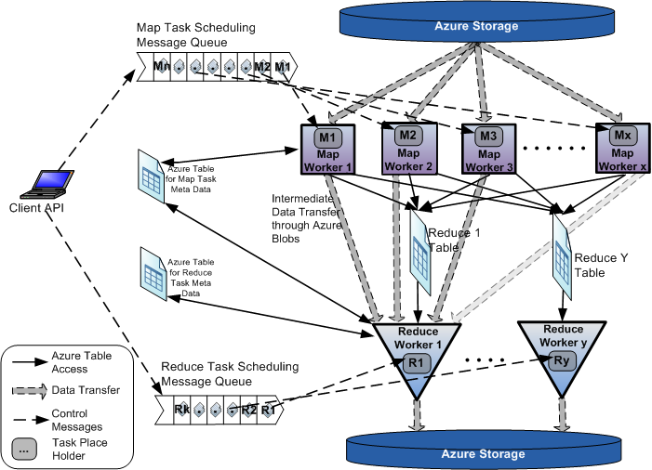
AzureMapReduce

Slide 44
Early Results with AzureMapreduce
Compare
Hadoop - 4.44 ms Hadoop VM - 5.59 ms DryadLINQ - 5.45 ms Windows MPI - 5.55 ms

Slide 45
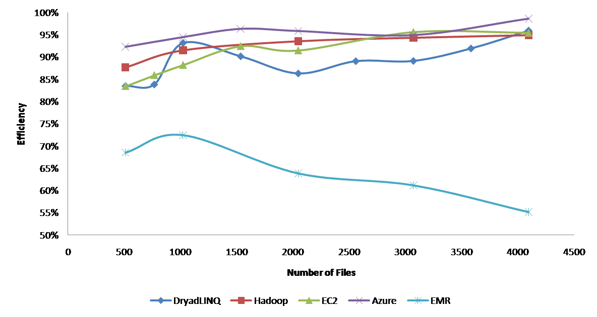
Currently we cant make Amazon Elastic MapReduce run well
Hadoop runs well on Xen FutureGrid Virtual Machines

Slide 46
Some Issues with AzureTwister and AzureMapReduce
Transporting data to Azure: Blobs (HTTP), Drives (GridFTP etc.), Fedex disks
Intermediate data Transfer: Blobs (current choice) versus Drives (should be faster but don’t seem to be)
Azure Table v Azure SQL: Handle all metadata
Messaging Queues: Use real publish-subscribe system in place of Azure Queues
Azure Affinity Groups: Could allow better data-compute and compute-compute affinity

Slide 47
 | Google MapReduce | Apache Hadoop | Microsoft Dryad | Twister | Azure Twister
Programming Model | 98 | MapReduce | DAG execution, Extensible to MapReduce and other patterns | Iterative MapReduce | MapReduce-- will extend to Iterative MapReduce
Data Handling | GFS (Google File System) | HDFS (Hadoop Distributed File System) | Shared Directories & local disks | Local disks and data management tools | Azure Blob Storage
Scheduling | Data Locality | Data Locality; Rack aware, Dynamic task scheduling through global queue | Data locality; Network topology based run time graph optimizations; Static task partitions | Data Locality; Static task partitions | Dynamic task scheduling through global queue
Failure Handling | Re-execution of failed tasks; Duplicate execution of slow tasks | Re-execution of failed tasks; Duplicate execution of slow tasks | Re-execution of failed tasks; Duplicate execution of slow tasks | Re-execution of Iterations | Re-execution of failed tasks; Duplicate execution of slow tasks
High Level Language Support | Sawzall | Pig Latin | DryadLINQ | Pregel has related features | N/A
Environment | Linux Cluster. | Linux Clusters, Amazon Elastic Map Reduce on EC2 | Windows HPCS cluster | Linux Cluster EC2 | Window Azure Compute, Windows Azure Local Development Fabric
Intermediate data transfer | File | File, Http | File, TCP pipes, shared-memory FIFOs | Publish/Subscribe messaging | Files, TCP

Slide 48
Parallel Data Analysis Algorithms on Multicore
Developing a suite of parallel data-analysis capabilities
  Clustering with deterministic annealing (DA)
  Dimension Reduction for visualization and analysis (MDS, GTM)
  Matrix algebra as needed
    Matrix Multiplication
    Equation Solving
    Eigenvector/value Calculation
Notes:
Results
Microsoft CCR supports MPI, dynamic threading
Detailed performance measurements with Speedups of 7.5 or above on 8-core systems for “large problems” using deterministic annealed (avoid local minima) algorithms for clustering, Gaussian Mixtures, GTM (dimensional reduction) etc.

Slide 49
High Performance
Dimension Reduction and Visualization
Need is pervasive
  Large and high dimensional data are everywhere: biology, physics, Internet, …
  Visualization can help data analysis
Visualization of large datasets with high performance
  Map high-dimensional data into low dimensions (2D or 3D).
  Need Parallel programming for processing large data sets
  Developing high performance dimension reduction algorithms:
    MDS(Multi-dimensional Scaling), used earlier in DNA sequencing application
    GTM(Generative Topographic Mapping)
    DA-MDS(Deterministic Annealing MDS)
    DA-GTM(Deterministic Annealing GTM)
  Interactive visualization tool PlotViz
We are supporting drug discovery by browsing 60 million compounds in PubChem database with 166 features each
Notes:
With David Wild

Slide 50
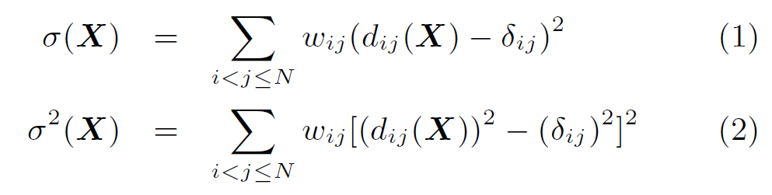

Dimension Reduction Algorithms
Multidimensional Scaling (MDS) [1]
  Given the proximity information among points.
  Optimization problem to find mapping in target dimension of the given data based on pairwise proximity information while minimize the objective function.
  Objective functions: STRESS (1) or SSTRESS (2)
  Only needs pairwise distances δ_{ij} between original points (typically not Euclidean)
  d_{ij}(X) is Euclidean distance between mapped (3D) points
Generative Topographic Mapping
(GTM) [2]
  Find optimal K-representations for the given data (in 3D), known as
  K-cluster problem (NP-hard)
  Original algorithm use EM method for optimization
  Deterministic Annealing algorithm can be used for finding a global solution
  Objective functions is to maximize log-likelihood:
[1] I. Borg and P. J. Groenen. Modern Multidimensional Scaling: Theory and Applications. Springer, New York, NY, U.S.A., 2005.
[2] C. Bishop, M. Svens´en, and C. Williams. GTM: The generative topographic mapping. Neural computation, 10(1):215–234, 1998.
Notes:
MDS implemented in C#; GTM in R and C/C++

Slide 51
GTM vs. MDS
GTM
MDS (SMACOF)
Purpose
Non-linear dimension reduction
Find an optimal configuration in a lower-dimension
Iterative optimization method
Objective
Function
Maximize Log-Likelihood
Minimize STRESS or SSTRESS
Complexity
O(KN) (K << N)
O(N²)
Optimization
Method
EM
Iterative Majorization (EM-like)
MDS also soluble by viewing as nonlinear χ² with iterative linear equation solver

Slide 52
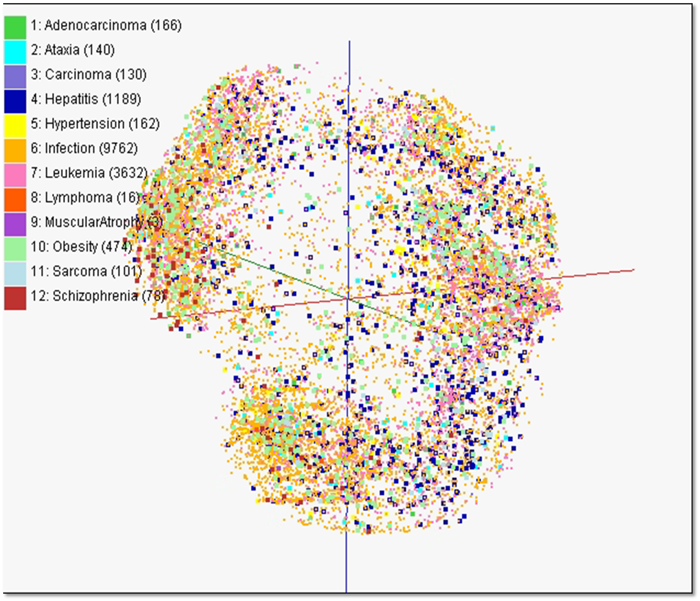
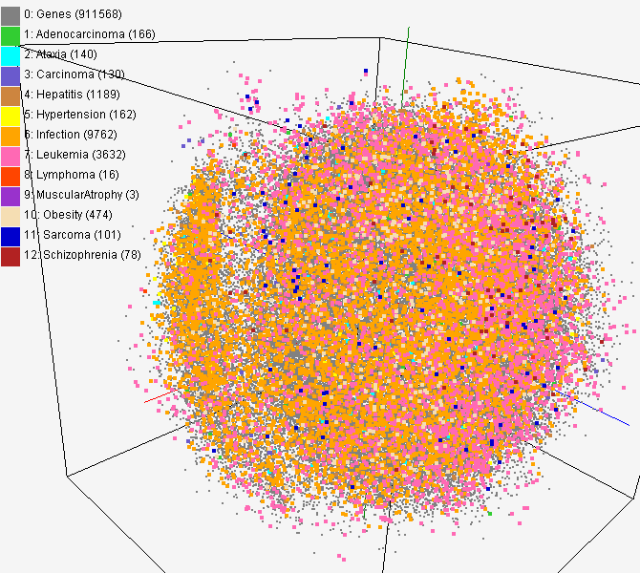
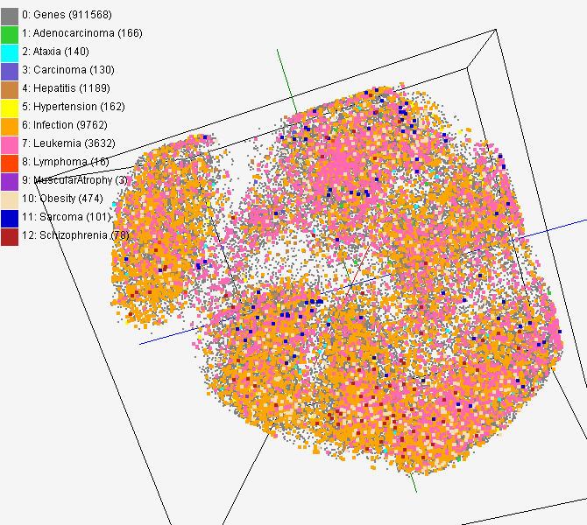
MDS and GTM Map (1)
PubChem data with CTD visualization by using MDS (left) and GTM (right)
About 930,000 chemical compounds are visualized as a point in 3D space, annotated by the related genes in Comparative Toxicogenomics Database (CTD)

Slide 53
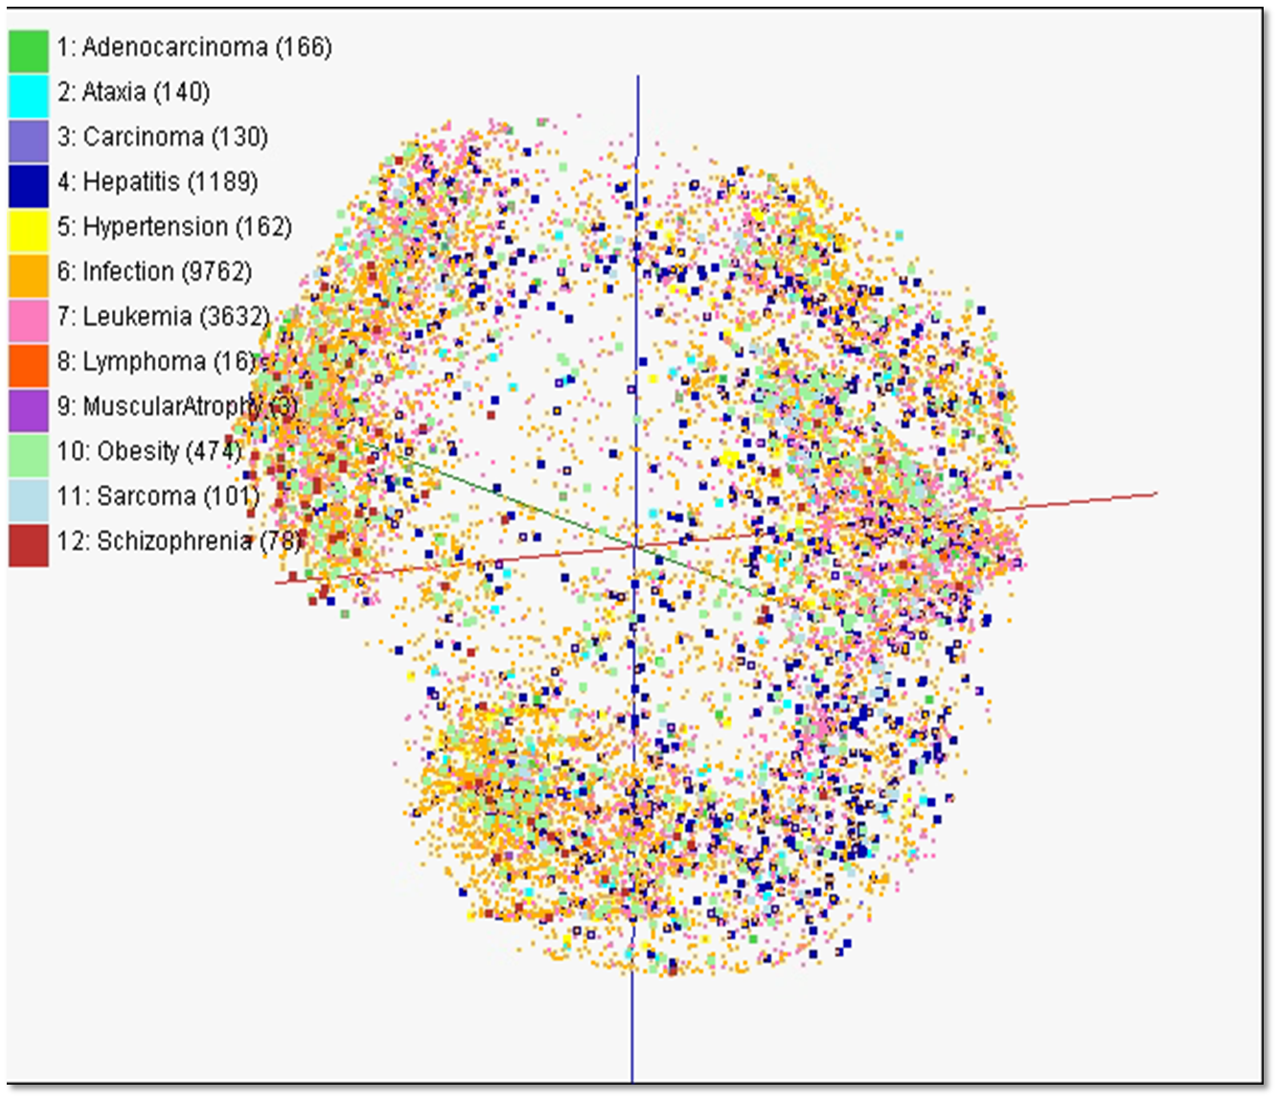

Slide 54
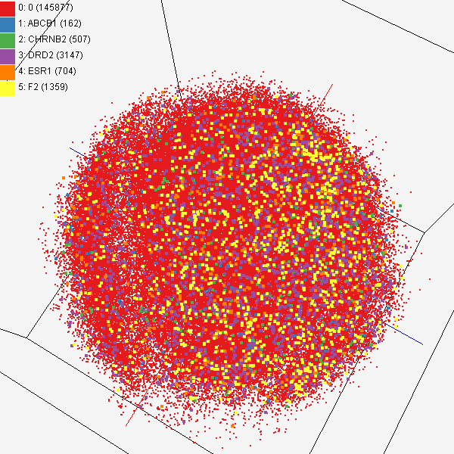
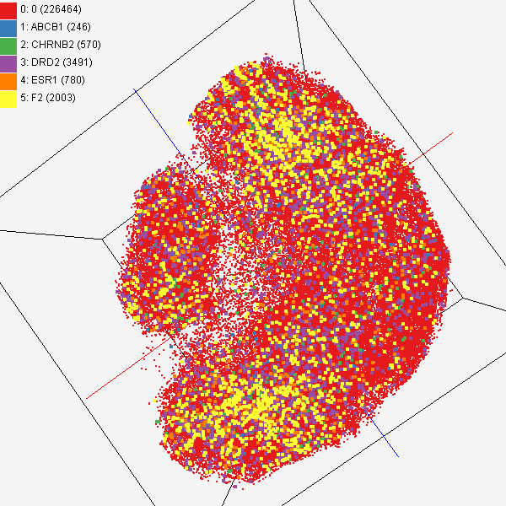
MDS and GTM Map (2)
Chemical compounds shown in literatures, visualized by MDS (left) and GTM (right)
Visualized 234,000 chemical compounds which may be related with a set of 5 genes of interest (ABCB1, CHRNB2, DRD2, ESR1, and F2) based on the dataset collected from major journal literatures which is also stored in Chem2Bio2RDF system.

Slide 55
Interpolation Method
MDS and GTM are highly memory and time consuming process for large dataset such as millions of data points
MDS requires O(N²) and GTM does O(KN) (N is the number of data points and K is the number of latent variables)
Training only for sampled data and interpolating for out-of-sample set can improve performance
Interpolation is a pleasingly parallel application suitable for MapReduce and Clouds
n
in-sample
Training
Trained data
N-n
out-of-sample
Interpolated
MDS/GTM map
Interpolation
Total N data

Slide 56
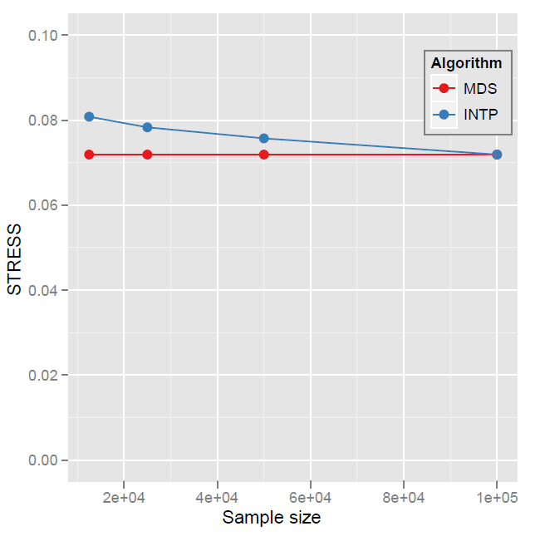
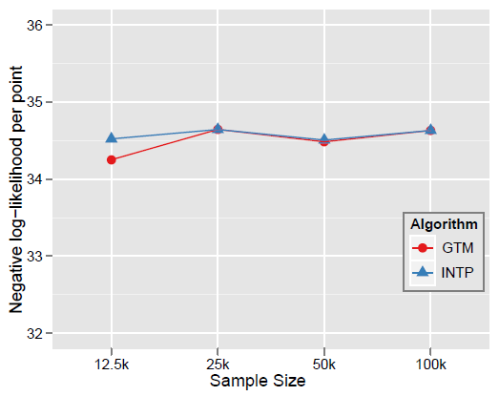

Quality Comparison
(O(N²) Full vs. Interpolation)
MDS
GTM
Quality comparison between Interpolated result upto 100k based on the sample data (12.5k, 25k, and 50k) and original MDS result w/ 100k.
STRESS:
w_{ij} = 1 / ∑δ_{ij}²
16 nodes
Interpolation result (blue) is getting close to the original (red) result as sample size is increasing.
Time = C(250 n² + nN_{I}) where sample size n and N_{I} points interpolated
Notes:
12.5K 25K 50K 100K Run on 16 nodes of Tempest
Note that we gain performance of over a factor of 100 for this data size. It would be more for larger data set.

Slide 57
FutureGrid Concepts
Support development of new applications and new middleware using Cloud, Grid and Parallel computing (Nimbus, Eucalyptus, Hadoop, Globus, Unicore, MPI, OpenMP. Linux, Windows …) looking at functionality, interoperability, performance
Put the “science” back in the computer science of grid computing by enabling replicable experiments
Open source software built around Moab/xCAT to support dynamic provisioning from Cloud to HPC environment, Linux to Windows ….. with monitoring, benchmarks and support of important existing middleware
June 2010 Initial users; September 2010 All hardware (except IU shared memory system) accepted and major use starts; October 2011 FutureGrid allocatable via TeraGrid process

Slide 58

FutureGrid: a Grid Testbed
IU Cray operational, IU IBM (iDataPlex) completed stability test May 6
UCSD IBM operational, UF IBM stability test completed June 12
Network, NID and PU HTC system operational
UC IBM stability test completed June 7; TACC Dell awaiting completion of installation
NID: Network Impairment Device
Private
Public
FG Network

Slide 59
FutureGrid Partners
Indiana University (Architecture, core software, Support)
Purdue University (HTC Hardware)
San Diego Supercomputer Center at University of California San Diego (INCA, Monitoring)
University of Chicago/Argonne National Labs (Nimbus)
University of Florida (ViNE, Education and Outreach)
University of Southern California Information Sciences (Pegasus to manage experiments)
University of Tennessee Knoxville (Benchmarking)
University of Texas at Austin/Texas Advanced Computing Center (Portal)
University of Virginia (OGF, Advisory Board and allocation)
Center for Information Services and GWT-TUD from Technische Universtität Dresden. (VAMPIR)
Blue institutions have FutureGrid hardware

Slide 60
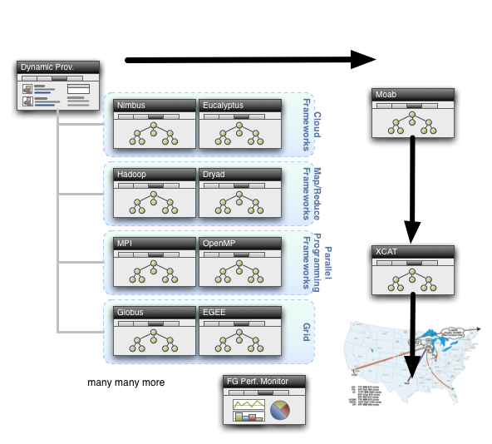
Dynamic Provisioning

Slide 61
FutureGrid Interaction with Commercial Clouds
We support experiments that link Commercial Clouds and FutureGrid experiments with one or more workflow environments and portal technology installed to link components across these platforms
We support environments on FutureGrid that are similar to Commercial Clouds and natural for performance and functionality comparisons.
  These can both be used to prepare for using Commercial Clouds and as the most likely starting point for porting to them (item c below).
  One example would be support of MapReduce-like environments on FutureGrid including Hadoop on Linux and Dryad on Windows HPCS which are already part of FutureGrid portfolio of supported software.
We develop expertise and support porting to Commercial Clouds from other Windows or Linux environments
We support comparisons between and integration of multiple commercial Cloud environments -- especially Amazon and Azure in the immediate future
We develop tutorials and expertise to help users move to Commercial Clouds from other environments.

Slide 62
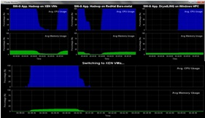
Dynamic Virtual Clusters
Dynamic Cluster Architecture
Monitoring & Control Infrastructure
Monitoring Infrastructure
Monitoring Interface
Pub/Sub Broker Network
SW-G Using Hadoop
SW-G Using Hadoop
SW-G Using DryadLINQ
Linux
Bare-system
Linux on Xen
Windows Server 2008 Bare-system
Virtual/Physical Clusters
Summarizer
XCAT Infrastructure
XCAT Infrastructure
Switcher
iDataplex Bare-metal Nodes
(32 nodes)
iDataplex Bare-metal Nodes
Switchable clusters on the same hardware (~5 minutes between different OS such as Linux+Xen to Windows+HPCS)
Support for virtual clusters
SW-G : Smith Waterman Gotoh Dissimilarity Computation as an pleasingly parallel problem suitable for MapReduce style application

Slide 64
Algorithms and Clouds I
Clouds are suitable for “Loosely coupled” data parallel applications
Quantify “loosely coupled” and define appropriate programming model
“Map Only” (really pleasingly parallel) certainly run well on clouds (subject to data affinity) with many programming paradigms
Parallel FFT and adaptive mesh PDA solver probably pretty bad on clouds but suitable for classic MPI engines
MapReduce and Twister are candidates for “appropriate programming model”
1 or 2 iterations (MapReduce) and Iterative with large messages (Twister) are “loosely coupled” applications
How important is compute-data affinity and concepts like HDFS

Slide 65
Algorithms and Clouds II
Platforms: exploit Tables as in SHARD (Scalable, High-Performance, Robust and Distributed) Triple Store based on Hadoop
  What are needed features of tables
Platforms: exploit MapReduce and its generalizations: are there other extensions that preserve its robust and dynamic structure
  How important is the loose coupling of MapReduce
  Are there other paradigms supporting important application classes
What are other platform features are useful
Are “academic” private clouds interesting as they (currently) only have a few of Platform features of commercial clouds?
Long history of search for latency tolerant algorithms for memory hierarchies
  Are there successes? Are they useful in clouds?
  In Twister, only support large complex messages
  What algorithms only need TwisterMPIReduce

Slide 66
Algorithms and Clouds III
Can cloud deployment algorithms be devised to support compute-compute and compute-data affinity
What platform primitives are needed by datamining?
  Clearer for partial differential equation solution?
Note clouds have greater impact on programming paradigms than Grids
Workflow came from Grids and will remain important
  Workflow is coupling coarse grain functionally distinct components together while MapReduce is data parallel scalable parallelism
Finding subsets of MPI and algorithms that can use them probably more important than making MPI more complicated
Note MapReduce can use multicore directly – don’t need hybrid MPI OpenMP Programming models

Slide 67
Clouds MapReduce and eScience I
Clouds are the largest scale computer centers ever constructed and so they have the capacity to be important to large scale science problems as well as those at small scale.
Clouds exploit the economies of this scale and so can be expected to be a cost effective approach to computing. Their architecture explicitly addresses the important fault tolerance issue.
Clouds are commercially supported and so one can expect reasonably robust software without the sustainability difficulties seen from the academic software systems critical to much current Cyberinfrastructure.
There are 3 major vendors of clouds (Amazon, Google, Microsoft) and many other infrastructure and software cloud technology vendors including Eucalyptus Systems that spun off UC Santa Barbara HPC research. This competition should ensure that clouds should develop in a healthy innovative fashion. Further attention is already being given to cloud standards
There are many Cloud research projects, conferences (Indianapolis December 2010) and other activities with research cloud infrastructure efforts including Nimbus, OpenNebula, Sector/Sphere and Eucalyptus.

Slide 68
Clouds MapReduce and eScience II
There are a growing number of academic and science cloud systems supporting users through NSF Programs for Google/IBM and Microsoft Azure systems. In NSF, FutureGrid will offer a Cloud testbed and Magellan is a major DoE experimental cloud system. The EU framework 7 project VENUS-C is just starting.
Clouds offer "on-demand" and interactive computing that is more attractive than batch systems to many users.
MapReduce attractive data intensive computing model supporting many data intensive applications
BUT
The centralized computing model for clouds runs counter to the concept of "bringing the computing to the data" and bringing the "data to a commercial cloud facility" may be slow and expensive.
There are many security, legal and privacy issues that often mimic those Internet which are especially problematic in areas such health informatics and where proprietary information could be exposed.
The virtualized networking currently used in the virtual machines in today’s commercial clouds and jitter from complex operating system functions increases synchronization/communication costs.
  This is especially serious in large scale parallel computing and leads to significant overheads in many MPI applications. Indeed the usual (and attractive) fault tolerance model for clouds runs counter to the tight synchronization needed in most MPI applications.

Slide 69
The term SALSA or Service Aggregated Linked Sequential Activities, is derived from Hoare’s Concurrent Sequential Processes (CSP)
SALSA Group
http://salsahpc.indiana.edu
Group Leader: Judy Qiu
Staff : Adam Hughes
CS PhD: Jaliya Ekanayake, Thilina Gunarathne, Jong Youl Choi, Seung-Hee Bae,
Yang Ruan, Hui Li, Bingjing Zhang, Saliya Ekanayake,
CS Masters: Stephen Wu
Undergraduates: Zachary Adda, Jeremy Kasting, William Bowman
http://salsahpc.indiana.edu/content/cloud-materials Cloud Tutorial Material
Notes:
describes our approach to multicore computing where we used services as modules to capture key functionalities implemented with multicore threading.
This will be expanded as a proposed approach to parallel computing where one produces libraries of parallelized components and combines them with a generalized service integration (workflow) model

