Slide 1
NSF 1443054: CIF21 DIBBs: Middleware and High Performance Analytics Libraries for Scalable Data Science
Software: MIDAS HPC-ABDS
SPIDAL Analytics Performance
February 2017

Slide 2
Performance Evaluation
K-Means Clustering
MPI Java and C – LRT-FJ and LRT-BSP
Flink K-Means
Spark K-Means
DA-MDS
MPI Java – LRT-FJ and LRT-BSP
DA-PWC
MPI Java – LRT-FJ
MDSasChisq
MPI Java – LRT-FJ
HPC Cluster
128 Intel Haswell nodes with 2.3GHz nominal frequency
96 nodes with 24 cores on 2 sockets (12 cores each)
32 nodes with 36 cores on 2 sockets (18 cores each)
128GB memory per node
40Gbps Infiniband
Software
RHEL 6.8
Java 1.8
OpenHFT JavaLang 6.7.2
Habanero Java 0.1.4
OpenMPI 1.10.1

Slide 3
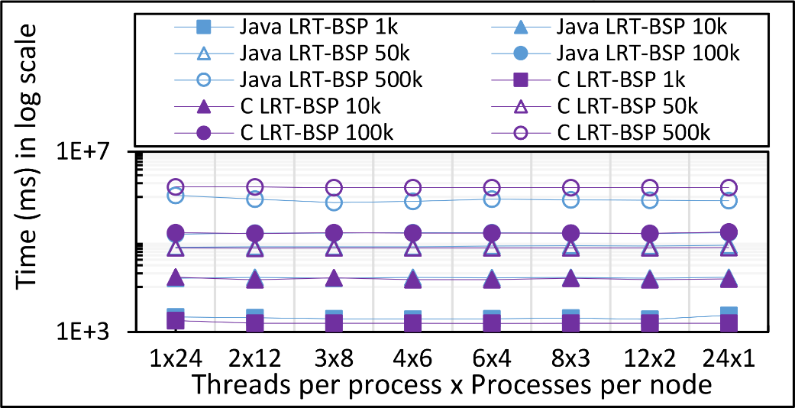
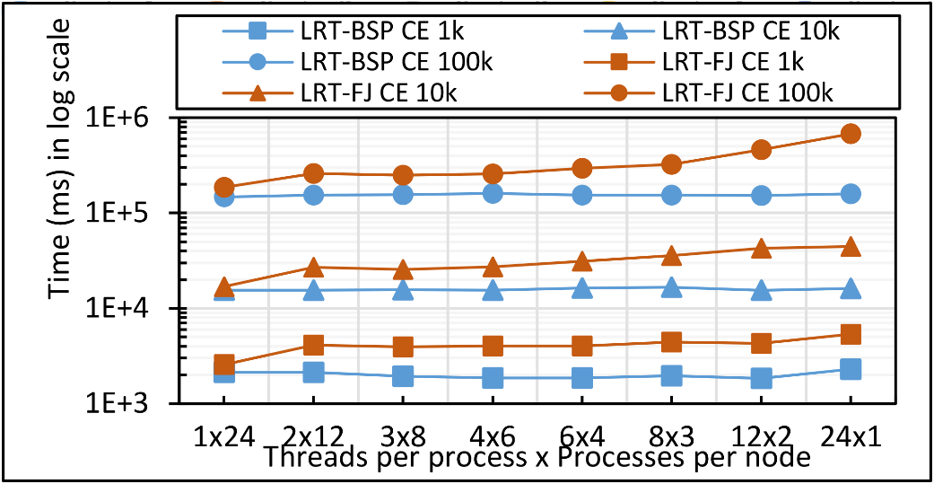
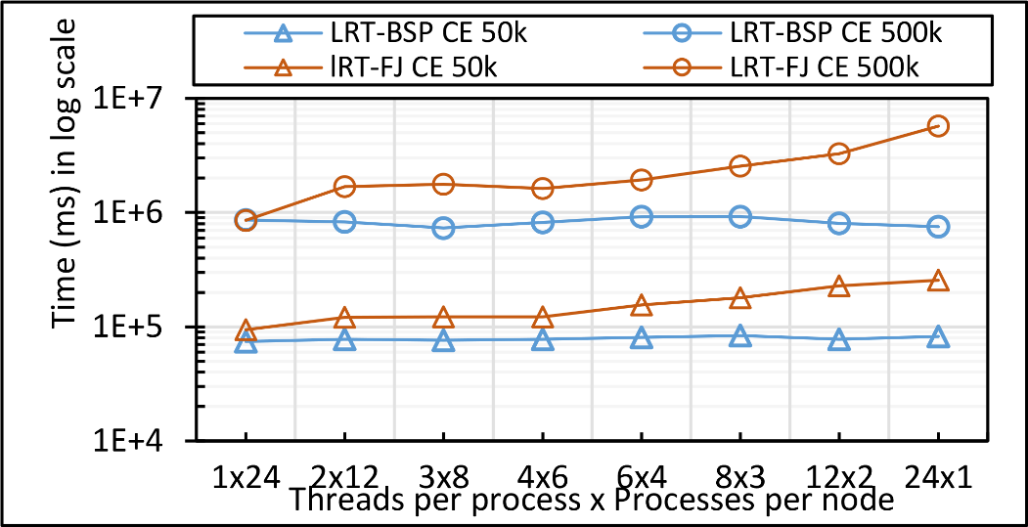
K-Means Clustering
Java K-Means LRT-BSP affinity CE vs NE performance for 1mil points with 1k,10k,50k,100k, and 500k centers on 16 nodes over varying threads and processes.
Java vs C K-Means LRT-BSP affinity CE performance for 1 mil points with 1k,10k,50k,100k, and 500k centers on 16 nodes over varying threads and processes.
Java K-Means 1 mil points with 1k,10k, and 100k centers performance on 16 nodes for LRT-FJ and LRT-BSP over varying threads and processes. The affinity pattern is CE.
Java K-Means 1 mil points with 50k, and 500k centers performance on 16 nodes for LRT-FJ and LRT-BSP over varying threads and processes. The affinity pattern is CE.
Notes:
1. The gap between different data sizes follow O(N)

Slide 4
K-Means Clustering
All-Procs.
#processes = total parallelism.
Each pinned to a separate core.
Balanced across the two sockets.
Threads internal.
1 process per node, pinned to T cores, where T = #threads.
Threads pinned to separate cores.
Threads balanced across the two sockets.
Hybrid
2 processes per node, pinned to T cores.
Total parallelism = Tx2 where T is 8 or 12.
Threads pinned to separate cores and balanced across the two sockets.
Java and C K-Means 1 mil points with 100k centers performance on 16 nodes for LRT-FJ and LRT-BSP over varying intra-node parallelisms. The affinity pattern is CE.

Slide 5
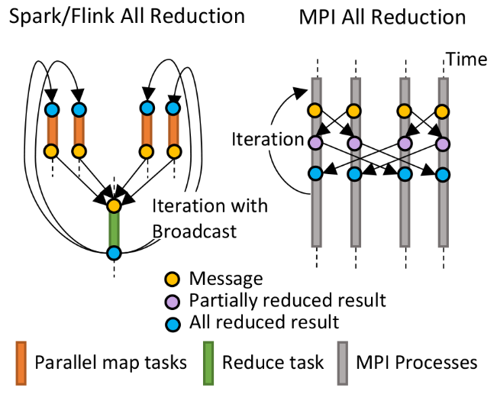
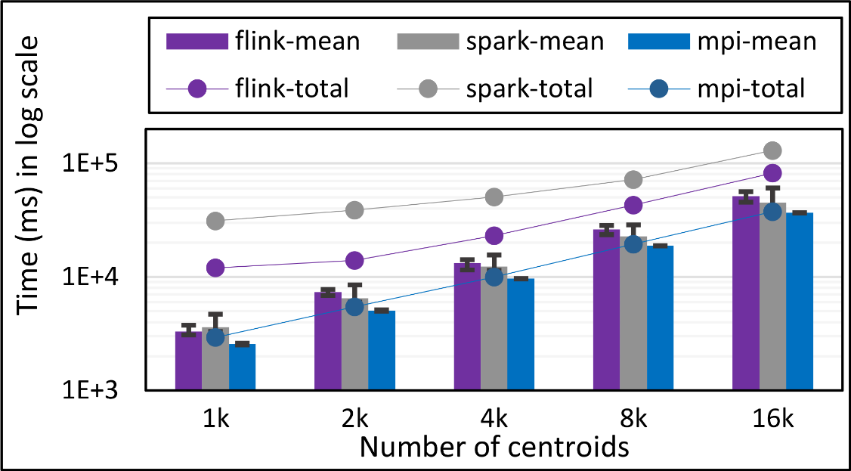
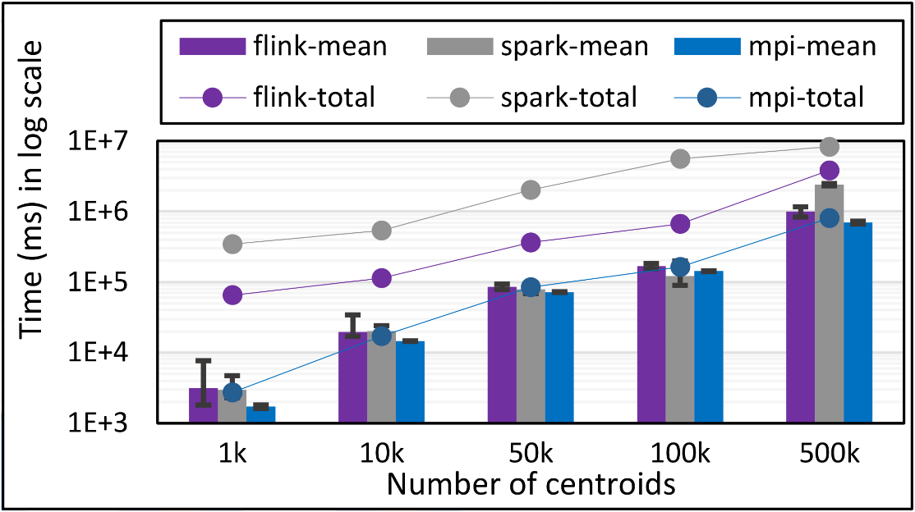
K-Means Clustering
Flink and Spark
Data Set <Points>
Data Set <Initial Centroids>
Map (nearest centroid calculation)
Reduce (update centroids)
Data Set <Updated Centroids>
Broadcast
K-Means total and compute times for 100k 2D points and
1k,2k,4k,8k, and 16k centroids for Spark, Flink, and MPI Java LRT-BSP CE. Run on 1 node as 24x1.
K-Means total and compute times for 1 million 2D points and 1k,10,50k,100k, and 500k centroids for Spark, Flink, and MPI Java LRT-BSP CE. Run on 16 nodes as 24x1.
Notes:
Note the differences in communication architectures
Note times are in log scale
Bars indicate compute only times, which is similar across these frameworks
Overhead is dominated by communications in Flink and Spark

Slide 6
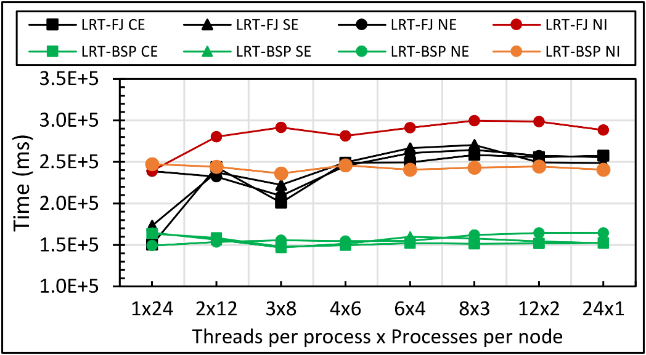
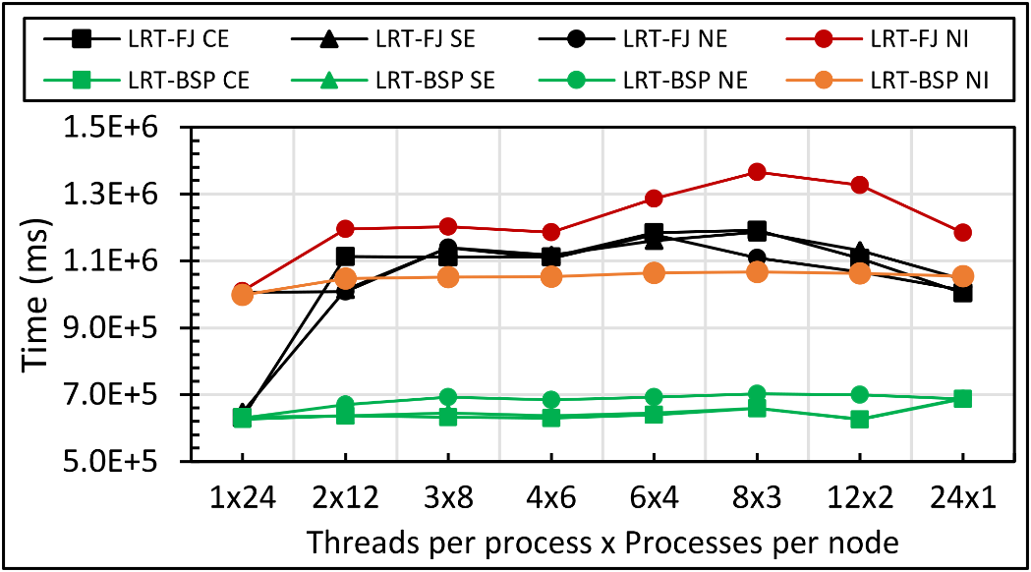
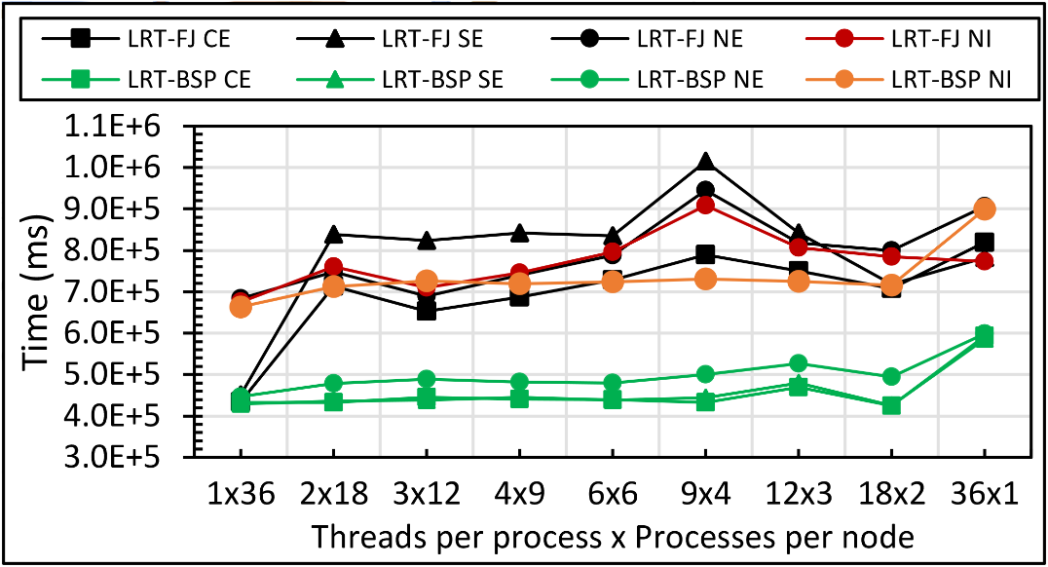
DA-MDS
Java DA-MDS 50k on 16 of 24-core nodes
Java DA-MDS 50k on 16 of 36-core nodes
Java DA-MDS 100k on 16 of 24-core nodes
Java DA-MDS 100k on 16 of 36-core nodes

Slide 7
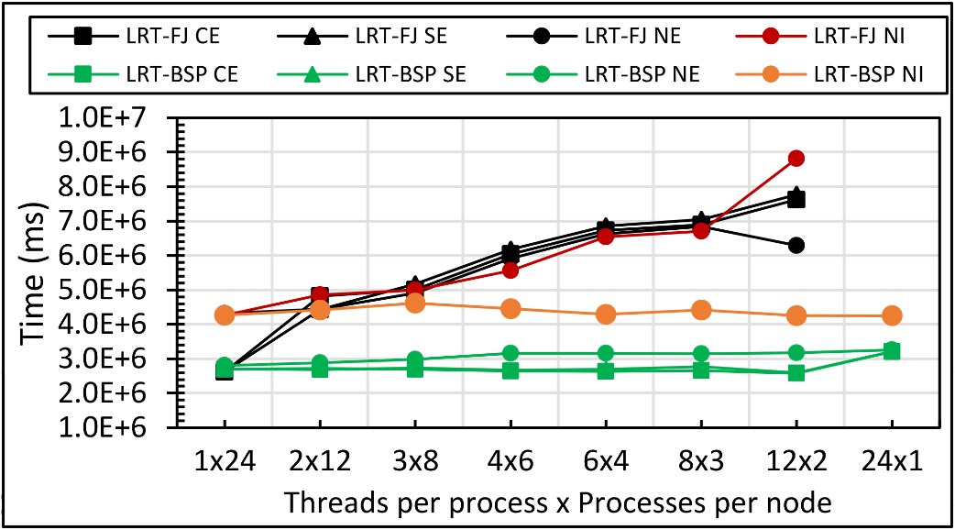
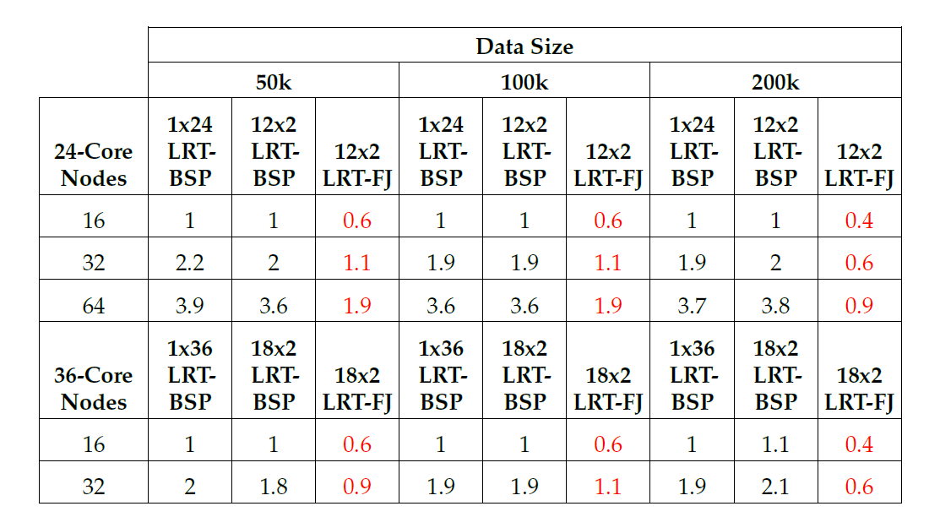
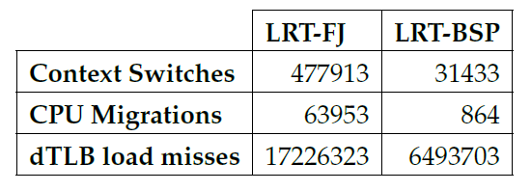
DA-MDS
Java DA-MDS 200k on 16 of 24-core nodes
Java DA-MDS 200k on 16 of 36-core nodes
15x
74x
2.6x
Linux perf statistics for DA-MDS run of 18x2 on 32 nodes. Affinity pattern is CE.
Java DA-MDS speedup comparison for LRT-FJ and LRT-BSP

Slide 8
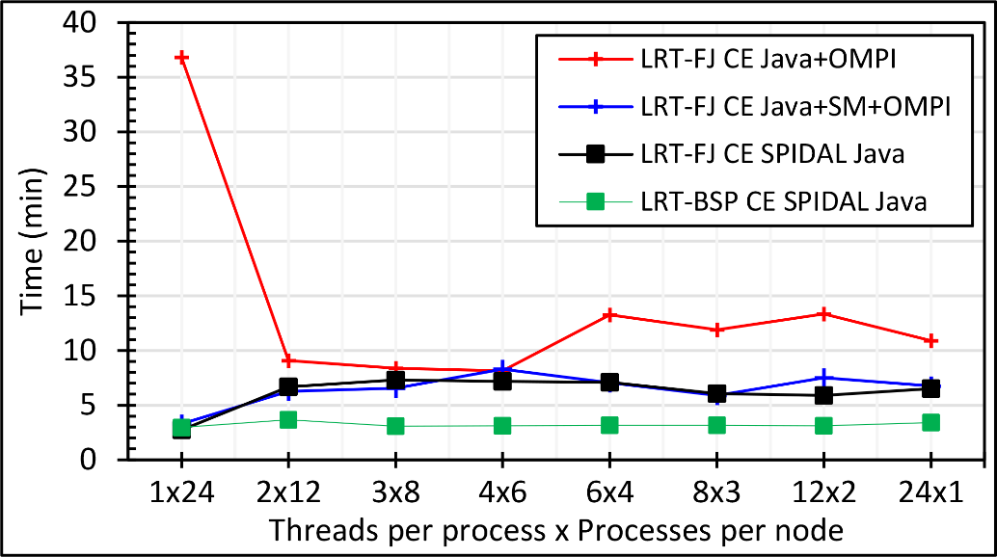
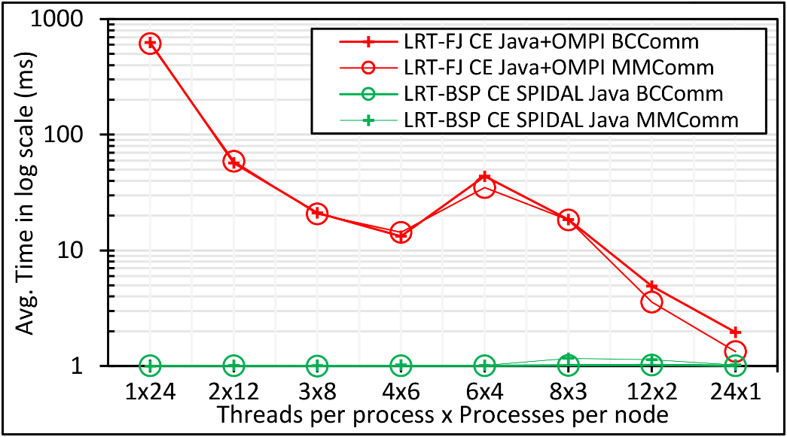
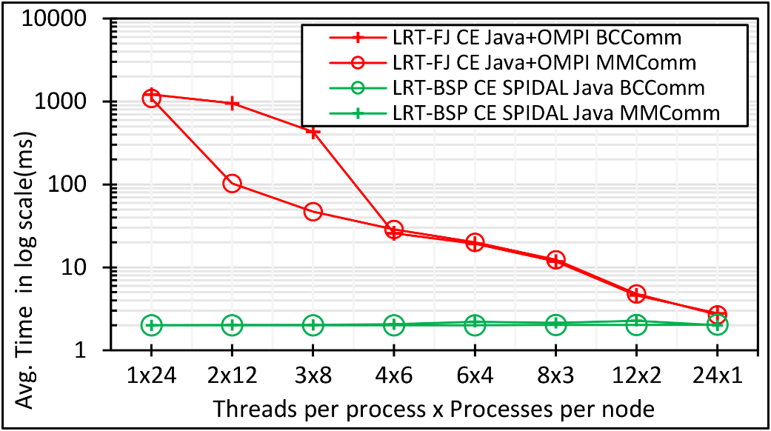
DA-MDS
Performance with and without optimizations. The bottom row is communication performance
Java DA-MDS 100k on 48 of 24-core nodes
Java DA-MDS 200k on 48 of 24-core nodes
Java DA-MDS 100k communication on 48 of 24-core nodes
Java DA-MDS 200k communication on 48 of 24-core nodes
Notes:
Note. Linear increase in communication time when going from 100k to 200k with shared memory communication.

Slide 9
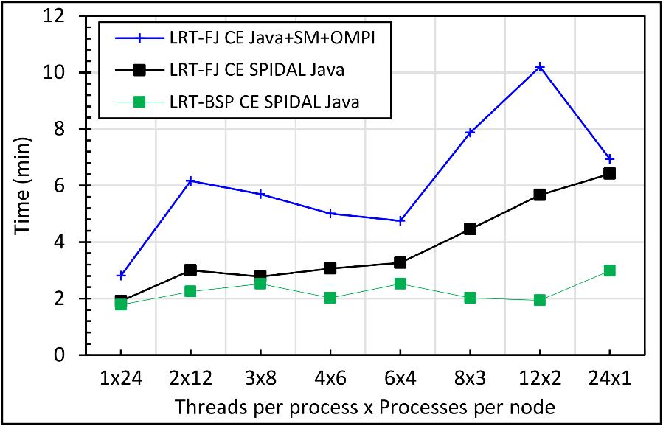
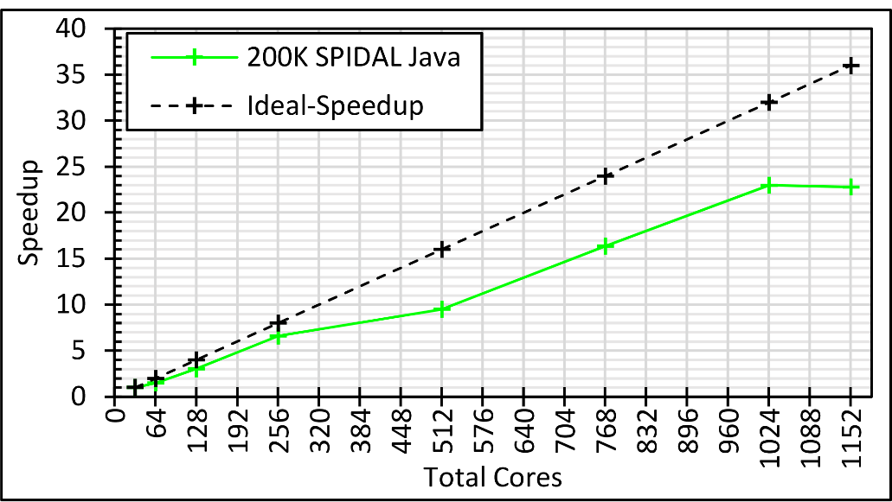
DA-MDS
Performance with and without optimizations
The best speedup with varying problem size and cores on 24-core and 36-core nodes
Java DA-MDS 400k on 48 of 24-core nodes
Java DA-MDS speedup with varying data sizes
Java DA-MDS speedup on 36-core nodes
Notes:
Note. 400K LRT-FJ CE could NOT be done due to reaching memory limits

Slide 10
DA-MDS Speedup with different optimizations
Speedup compared to 1 process per node on 48 nodes
Best MPI; inter and intra node
BSP Threads are better than FJ and at best match Java MPI
MPI; inter/intra node; Java not optimized
Best FJ Threads intra node; MPI inter node

Slide 11
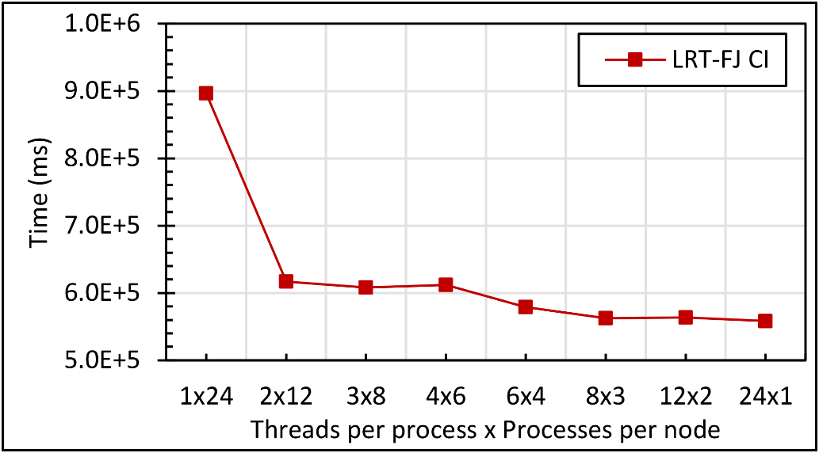
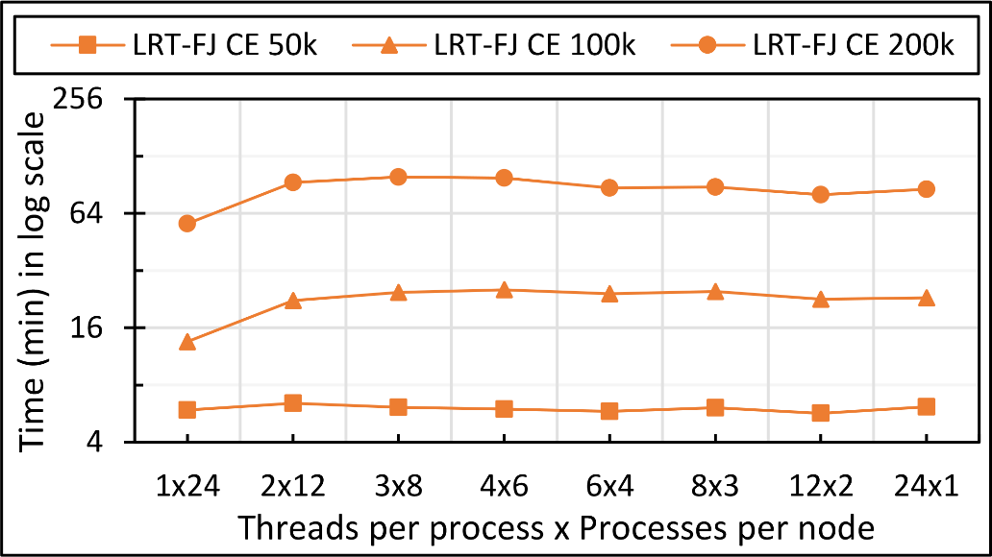
Unoptimized MDSasChisq and DA-PWC
Java MDSasChisq performance on 32 of 24-core nodes
Java MDSasChisq speedup on 32 of 24-core nodes
Java DA-PWC performance on 32 of 24-core nodes
Notes:
Note. 400K LRT-FJ CE could NOT be done due to reaching memory limits

