Slide 1





NSF 1443054: CIF21 DIBBs: Middleware and High Performance Analytics Libraries for Scalable Data Science
Software: MIDAS
HPC-ABDS
Software Defined Systems
February 2017

Slide 2
Infrastructure Nexus
Software Defined Systems enable interoperability and reproducible computing
DevOps
Cloudmesh HPCCloud 2.0

Slide 3
HPCCloud 2.0 Software Defined Systems
Significant advantages in specifying job software with scripts such as Chef, Puppet, Ansible – “Software Defined Systems” (SDS)
  Choose Ansible as Python based
Less voluminous than machine images; easier to ensure latest version; easy to recreate image on demand after crashes
In work with NIST, we looked at 87 applications from two of our “big data on cloud” classes and from NIST itself (6)
The 6 NIST use cases need 27 Ansible roles (distinct software subsystems) and full set of 87 needed 62 separate roles (average 4.75 roles per use case)
https://docs.google.com/spreadsheets/d/1e8-pzWn-7lz47-gIAra0VzCX6IkAypa8Cu5YG5MES_4
With NIST Public Big Data group, looking at mapping SDS to system architecture
Preparing Ansible specifications of many subsystems and use cases
Note many public Ansible roles (Ansible Galaxy collection) do NOT expose full functionality of software and/or have errors
Microservices, HPCCloud 3.0 and serverless computing build on SDS https://youtu.be/iNN9KAsQ3G8?t=8m Amin Vahdat (Google)
  Amazon Lambda, Google Cloud Functions, Microsoft Azure Functions,
  IBM OpenWhisk; WOSC2017 workshop June 2017

Slide 4
27 Ansible Roles and Re-use in 6 NIST use cases
ID | 6 NIST Use Cass | Hadoop | Mesos | Spark | Storm | Pig | Hive | Drill | HDFS | HBase | Mysql | MongoDB | RethinkDB | Mahout | D3, Tableau | nltk | MLlib | Lucene/Solr | OpenCV | Python | Java | maven | Ganglia | Nagios | spark supervisord | zookeeper | AlchemyAPI | R
1 | NIST Fingerprint Matching | x |  | x |  |  | x | x |  | x | x |  |  |  |  |  |  |  |  |  | x | x | x | x | x | x
2 | Human and Face Detection |  | x | x |  |  |  |  |  |  |  |  |  |  |  |  |  |  | x | x |  |  |  |  |  | x
3 | Twitter Analysis |  |  |  | x |  |  |  |  | x |  | x |  |  | x | x |  |  |  | x | x |  |  |  |  | x | x | x
4 | Analytics for Healthcare Data/Health Informatics | x |  | x |  |  |  |  |  | x |  |  |  | x | x |  | x | x |  |  | x |  |  |  |  | x
5 | Spatial Big Data/Spatial Statistics/Geographic Information Systems | x |  | x |  |  |  |  |  |  |  |  |  | x | x |  | x |  |  |  | x | x
6 | Data Warehousing and Data Mining | x |  | x |  | x | x |  |  | x |  | x |  | x | x |  | x | x |  |  | x |  |  |  |  | x
count |  | 4 | 1 | 5 | 1 | 1 | 2 | 1 | 0 | 4 | 1 | 2 | 0 | 3 | 4 | 1 | 3 | 2 | 1 | 2 | 5 | 2 | 3 | 1 | 1 | 5 | 1 | 1

Slide 5
Cloudmesh HPCCloud 2.0 DevOps Tool
Model: Define software configuration with tools like Ansible (Chef, Puppet); instantiate on a virtual cluster
Save scripts not virtual machines and let script build applications
Cloudmesh is an easy-to-use command line program/shell and portal to interface with heterogeneous infrastructures taking script as input
  It first defines virtual cluster and then instantiates script on it
  It has several common Ansible defined software built in
Supports OpenStack, AWS, Azure, SDSC Comet, virtualbox, libcloud supported clouds as well as classic HPC and Docker infrastructures
  Has an abstraction layer that makes it possible to integrate other IaaS frameworks
Managing VMs across different IaaS providers is easier
Demonstrated interaction with various cloud providers:
  FutureSystems, Chameleon Cloud, Jetstream, CloudLab, Cybera, AWS, Azure, virtualbox
Status: AWS, and Azure, VirtualBox, Docker need improvements; we focus currently on SDSC Comet and NSF resources that use OpenStack
Interoperability Layer to build HPCCloud 2.0

Slide 6
Cloudmesh Architecture
Software Engineering Process
We define a basic virtual cluster which is a set of instances with a common security context
We then add basic tools including languages Python Java etc.
Then add management tools such as Yarn, Mesos, Storm, Slurm etc …..
Then add roles for different HPC-ABDS PaaS subsystems such as Hbase, Spark
  There will be dependencies e.g. Storm role uses Zookeeper
Any one project picks some of HPC-ABDS PaaS Ansible roles and adds >=1 SaaS that are specific to their project and for example read project data and perform project analytics
E.g. there will be an OpenCV role used in Image processing applications

Slide 7
Tutorial
SDS on AWS and Azure

Slide 8
Key Lessons How to Build Roles
Understand YAML Syntax with Declarative models (desired state)
  Ansible roles for software deployment use documents in YAML format
  Desired final state is achieved no matter what current states are
Become familiar with Modules
  Ansible modules complete tasks with desired state defined in the roles toward target hosts (servers)
  927 modules are currently offered ranging from basic system management e.g. files, network, monitoring, storages to virtual systems e.g. cloud platforms – aws/azure/gce, and cluster resource manager e.g. consul, kubernetes
Construct Roles with Levels
  Top level role may contain multiple small roles to finish software deployment as a single unit
  Independent roles can be shared in other top level roles
hosts: clusters
name: example of apt-get package installation towards clusters
tasks:
- apt: name=build-essential
state=present update_cache=yes

Slide 9
Key Lessons How to Build Roles
Use Variables with Templating Language
  Ansible runs with Jinja2 templating for dynamic variables in roles
  The example below shows efficiency of writing roles by template variables
- name: required packages
apt: name=cmake state=present
- name: required packages
apt: name=git state=present
- name: required packages
apt: name=libgtk2.0-dev state=present
- name: required packages
apt: name=pkg-config state=present
- name: required packages
apt: name=libavcodec-dev state=present
- name: required packages
apt: name=libavformat-dev state=present
- name: required packages
apt: name=libswscale-dev state=present
- name: required packages
apt: name={{ item }} state=present
with_items:
- cmake
- git
- libgtk2.0-dev
- pkg-config
- libavcodec-dev
- libavformat-dev
- libswscale-dev
There are more advantages of using variables
: applying filters, plugins and tests

Slide 10
Key Lessons How to Build Roles
Re-Use existing Roles from Community
  Ansible Hub (https://galaxy.ansible.com/) provides 10,066 community developed roles
  Software installation can be completed by importing existing roles
  Multiple roles can be combined to build a large software component or a system
  Sharing roles may reduce having a duplicated code across multiple projects
  Caveats
    Some community roles may not suit for your system; authoring custom roles would be necessary to satisfy your requirements
    Broken roles exist; run a few tests to verify community roles before use in production

Slide 11
Defining Library of Ansible Roles
Software defined systems (SDS) describes applications by library of Ansible roles
SDS environment – for applications is defined by the roles, for example, NIST Pedestrian and Face Detection contains roles as in the following:
Library (compound) of the Ansible roles builds transparent, manageable, and dynamic SDS environment. Face Detection example is built with Apache Mesos, Spark and OpenCV with INRIA Person DataSet and Python Analytics code according to the defined roles.
- include: mesos.yml
- include: spark-for-mesos.yml
- include: opencv.yml
- include: inria-dataset.yml
- include: python-analytics-human-face-detection.yml

Slide 12
Provisioning Virtual Clusters
Virtual clusters is created on-demand based on the definition of roles
Preparing reasonable amount of computing capacity is doable compared to fixed number of traditional servers
Cloudmesh for virtual clusters
in command line:
Amazon EC2 provisioning
by Ansible (in YAML):
Azure provisioning by Python API
(JSON):
cm cluster create -n <number of nodes> -cloud <cloud provider>
ec2:
instance_type: "{{ instance_size }}"
image: "{{ image }}"
region: "{{ region }}"
count: “{{ number_of_nodes }}”
group: [ 'default', "{{ security_group }}" ]
key_name: "{{ keypair }}"
"copy": { "count": "[parameters('numberOfInstances')]", "name": "virtualMachine" }, "type": "Microsoft.Compute/virtualMachines", "properties": { "hardwareProfile": { "vmSize": "[variables('vmSize')]" },

Slide 13
Deploying Needed Roles
Required roles for particular applications are ready to deploy toward virtual clusters
Cloudmesh for roles
in command line:
Ansible playbook
in command line:
Python library
(Simple Azure):
cm hadoop start myHadoopCluster
ansible-playbook example-project-nist-fingerprint-matching.yml
ansible-playbook play-hadoop.yml
from simpleazure import SimpleAzure
from simpleazure.ansible_api import AnsibleAPI
saz = SimpleAzure()
ips = saz.arm.view_info()
ansible_client = AnsibleAPI(ips)
ansible_client.playbook(“https://github.com/futuresystems”+\
“/pedestrian-and-face-detection/site.yml")
ansible_client.run()

Slide 14
Example I: SDS on Amazon EC2
Overview
  The first tutorial builds Software Defined Systems (SDS) on Amazon Cloud with NIST Fingerprint Matching. Ansible roles are used to 1) create virtual clusters on EC2, 2) deploy software stacks and download dataset, and 3) terminate computing resources. Each step is explained with command instructions to run.
Schedule (Total estimated time: 17 minutes)
  Task 1: Amazon Account Registration (3 minutes)
  Task 2-0: Define Library of Ansible Roles (Use existing roles in this tutorial)
  Task 2-1: Virtual Clusters Provisioning (5 minutes)
  Task 2-2: Application Deployment using needed roles (5 minutes)
  Task 2-3: Test Run (3 minutes)
  Task 3: Lease termination (1 minute)

Slide 15
Example I: SDS on Amazon EC2
Working code & Ansible Role
  EC2 Provisioning Ansible: https://github.com/lee212/ec2-provisioning-with-ansible
  NIST Fingerprint matching: https://github.com/cloudmesh/example-project-nist-fingerprint-matching
Prerequisite
  Ansible
  Amazon account
Roles Used (software components)
  Hadoop: Resource/job scheduler role
  Spark, HBase, Drill: Data processing role
  Fingerprint Matching: Application role
  NIST Special dataset: Dataset role

Slide 16
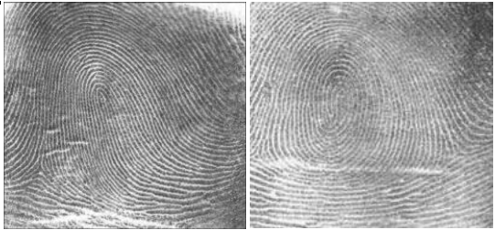
Example I: SDS on Amazon EC2
Fingerprint Matching Lifecycle on AWS
Defining Library of Ansible Roles
‘Amazon EC2 provisioning’ role
Needed Roles
‘Amazon EC2 Termination’ role
Role 1: install Hadoop
mesos.yml
spark-for-mesos.yml
opencv.yml
inria-dataset.yml
python-analytics-human-face-detection.yml
Launch EC2 Instances
Role 2: install spark
host groups (masters/workers)
- execute spark dispatcher for cluster/batch mode
Save results
- allocate IPs
- configure security groups
completed tasks in files
Terminate Instances
Role 3: install HBase, Drill
- return public IPs
- remove security groups
Replace static inventory file
Role 4: NIST Special Dataset
[masters]
10.0.0.1
10.0.0.2
10.0.0.3
[workers]
10.0.0.4
10.0.0.5
10.0.0.6
u'tag_masters_True': [u'52.23.213.103', u'54.196.41.145',u'54.209.137.235'],
u'tag_workers_True': [u'52.23.213.104', u'54.196.41.146',u'54.209.137.237'], ...
- download Dataset
- share with worker nodes
Role 5: Fingerprint Matching analytics
- Run software
Virtual Clusters on EC2

Slide 17
Example I: SDS on Amazon EC2 (Task 1/3)
Amazon Account Registration (3 minutes)
  To communicate with Amazon Cloud, EC2 credentials are required i.e. ‘Access key ID’ and ‘Secret access key’ from the AWS website. This is one-time only task for first-time user.
Instructions
  Open a web browser for http://aws.amazon.com
  Obtain Credentials
    Navigate to
    My Account > Security Credentials > Get Started with (individual) IAM Users
    Create a new user with ‘Programmatic access’ type
    Create a new group to add user with ‘AmazonEC2FullAccess’
    Complete and save
      ‘Access key ID’ (for example, AKIAIOSFODNN7EXAMPLE)
      ‘Secret access key’ (for example, wJalrXUtnFEMI/K7MDENG/bPxRfiCYEXAMPLEKEY)

Slide 18
Example I: SDS on Amazon EC2 (2/3)
Virtual Clusters on Amazon Cloud (5 minutes)
  Prepare Ansible software to run Ansible scripts (roles) for virtual clusters on EC2. NIST Fingerprint matching will be deployed once systems are ready to use.
Instructions
  Download EC2 provisioning scripts:
    $ git clone https://github.com/lee212/ec2-provisioning-with-ansible.git
    $ cd ec2-provisioning-with-ansible
  Provide AWS Credentials:
    $ nano cred
    export AWS_ACCESS_KEY=1234567890
    export AWS_SECRET_ACCESS_KEY=1234567890
    * replace 1234567890 with real keys
    $ source cred
  Start 3 Ubuntu VMs with virtual private network:
    $ ansible-playbook boot-ec2-with-vpc.yml

Slide 19
Example I: SDS on Amazon EC2 (2/3)
Ansible Cloud Module for Amazon Cloud
  In the previous slide, virtual clusters was provisioned by the Ansible script ` boot-ec2-with-vpc.yml ` which uses ‘ec2.py’ cloud module. Here is an example of code snippets to start a single EC2 instance with Ubuntu 14.04 image:
Inventory Groups by Tags
  Inventory group is used to classify servers, for example, Hadoop cluster consists of eight components including zookeeper and the instance tag is used to create inventory group dynamically. The following example shows instances with the tags for namenodes and zookeepernodes:
ec2:
key_name: albert # SSH registered key name
instance_type: t2.micro # EC2 Instance size
image: ami-2d39803a # Ubuntu 14.04 image
group: default # security group
region: us-east-1 # EC2 Region
ec2:
key_name: "{{ keypair }}"
instance_type: "{{ instance_size }}"
image: "{{ image }}"
region: "{{ region }}"
exact_count: 3
count_tag: three-nodes
group: [ 'default', "{{ security_group }}" ]
instance_tags:
namenodes: True
datanodes: False
zookeepernodes: True
historyservernodes: False
frontendnodes: False

Slide 20
Example I: SDS on Amazon EC2 (3/3)
Deployment, Run and Termination (9 minutes)
  NIST Fingerprint matching Software (MINDTCT and BOZORTH3 from NBIS) and Special Database 4 will be prepared in this step. Leased cloud resources are also stopped and returned once all jobs are completed. IPython tutorial is available here.
    MINDTCT: The NIST minutiae detector, which automatically locates and records ridge ending and bifurcations in a fingerprint image.
    BOZORTH3: A NIST fingerprint matching algorithm, which is a minutiae based fingerprint-matching algorithm. (from http://www.nist.gov/itl/iad/ig/nbis.cfm)
    Special Database 4 - NIST 8-bit Gray Scale Images of Fingerprint Image Groups
    Special Database 14 - NIST Mated Fingerprint Card Pairs 2 (from NIST Biometric Special Databases)
Instructions
  Install Software Stacks, Dataset, and Analytics (Hadoop, HBase, Spark, Drill, Fingerprint, NIST Special dataset):
    $ ansible-playbook software.yml
    $ ansible-playbook dataset.yml
  End of the lease for AWS:
    $ ansible-platybook terminate.yml

Slide 21
Example II: SDS on Microsoft Azure
Overview
  In this tutorial, virtual clusters will be provisioned on Microsoft Azure using Azure Resource Manager (ARM) Templates for NIST Pedestrian and Face detection. Python library for ARM Template, Simple Azure, is used to construct SDS on Azure virtual machines.
Schedule (total estimated time: 26 minutes)
  Task 1: Azure Account Registration (5 minutes)
  Task 2-0: Define library of Ansible roles (Use existing roles)
  Task 2: Virtual Clusters on Azure Cloud (5 minutes)
  Task 3-1: Resource Scheduler Configuration (5 minutes)
  Task 3-2: Application Deployment (5 minutes)
  Task 3-3: Test Run (3 minutes)
  Task 4: Lease termination (3 minutes)

Slide 22
Example II: SDS on Microsoft Azure
Working code & Ansible Role
  Simple Azure: https://github.com/lee212/simpleazure
  Simple Azure Docker version: docker run -i -t lee212/simpleazure
  NIST Pedestrian and Face detection: https://github.com/futuresystems/pedestrian-and-face-detection
Prerequisite
  Microsoft Azure Account
  Simple Azure
Roles Used (software components)
  Mesos: Resource/job scheduler role
  Spark: Data processing role
  Pedestrian and Face Detection: Application role
  INRIA Person Dataset: dataset role

Slide 23
Example II: SDS on Microsoft Azure (1/4)
Azure Account Registration (5 minutes)
  Microsoft Azure CLI provides an easy step to configure azure account over Azure Web Portal (https://portal.azure.com). Four key strings are required: subscription id, tenant id, client id, and client secret. The following instructions explain how to get these. This is one-time task for first-time user.
Instructions
  Run Azure CLI to authenticate:
    $ azure login
    It asks to open a web browser at https://aka.ms/devicelogin
    Provide a code number to validate from screen
    ‘login command OK’ will be displayed if succeeded
  Get Subscription ID and Tenant ID
    $ azure account show
info: Executing command account show
data: Name : Simple-Azure-Subscription
data: ID : 5s3ag2s5-2aa1-4828-xxxx-9g8sw72w5w5g # subscription id
data: State : Enabled
data: Tenant ID : 5e39a20e-c55a-53de-xxxx-2503a55et6ta # tenant id
data: Is Default : true
data: Environment : AzureCloud
data: Has Certificate : No
data: Has Access Token : Yes
data: User name : hroe.lee@gmail.com

Slide 24
Example II: SDS on Microsoft Azure (1/4)
Azure Account Registration (5 minutes)
  Azure services are accessible through a service principal (SP) which will be configured in this step. It is similar to IAM User setup with service group on Amazon EC2. IPython tutorial is available here.
Instructions
  Create a new service principal:
    $ azure ad sp create --name tutorial
  Set a secret key for SP:
    $ azure ad sp set -p $password $client_id (replace $var with actual value before execution)
    ‘info: ad sp set command OK’ is expected if it ran successfully.
  Assign a role to SP:
    $ azure role assignment create --objectId $client_id -o Owner -c /subscriptions/$subscription_id
    ‘info: role assignment create command OK’ is expected if it ran successfully.
info: Executing command ad sp create
+
+
data: Object Id: 5d79f365-26e0-4993-8fe7-7021b3fd373d
data: Display Name: tutorial
data: Service Principal Names:
data: ca66450a-2532-4e8b-81b2-31722d36d808 # client id
data: http://tutorial
info: ad sp create command OK

Slide 25
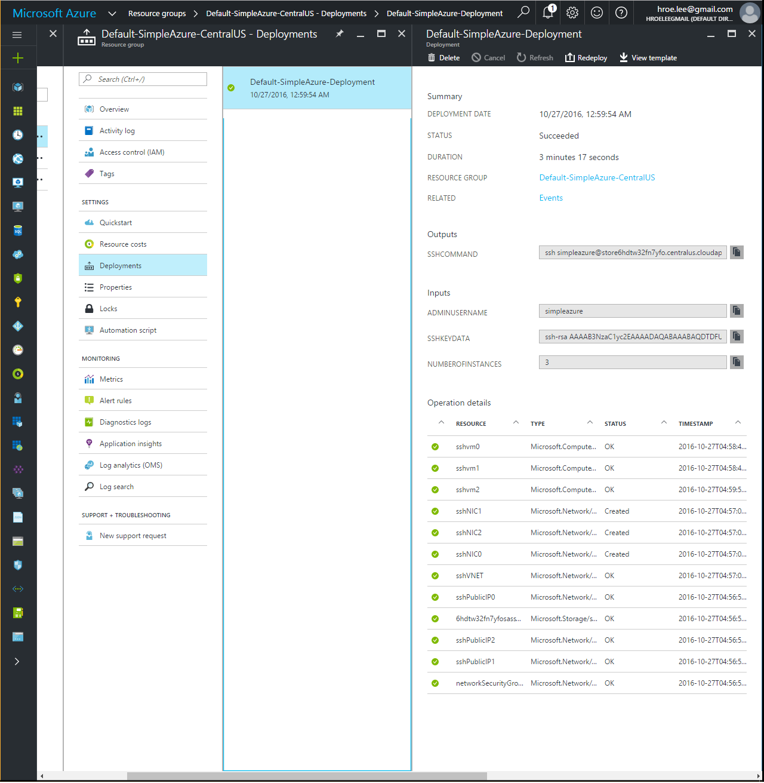
Example II: SDS on Microsoft Azure (2/4)
Virtual Clusters on Azure Cloud (5 minutes)
  Python library for Azure Template, Simple Azure, is used to provision virtual clusters from template which contains definition of infrastructure. IPython Notebook is here.
Instructions
  Import Simple Azure:
  Load pre-configured template for 3 VMs:
  Provision virtual clusters with the template:
from simpleazure import SimpleAzure
import os
os.environ['AZURE_SUBSCRIPTION_ID'] = $subscription_id
os.environ['AZURE_CLIENT_SECRET'] = $client secret
os.environ['AZURE_TENANT_ID'] = $tenant_id
os.environ['AZURE_CLIENT_ID'] = $client_id
saz_obj = SimpleAzure()
from simpleazure.template.template import Template
vclusters = Template()
vclusters.read_template("3vms.json")
saz.arm.load_template(vclusters)
saz.arm.deploy()
Screenshot of deployed virtual clusters on Azure Cloud

Slide 26
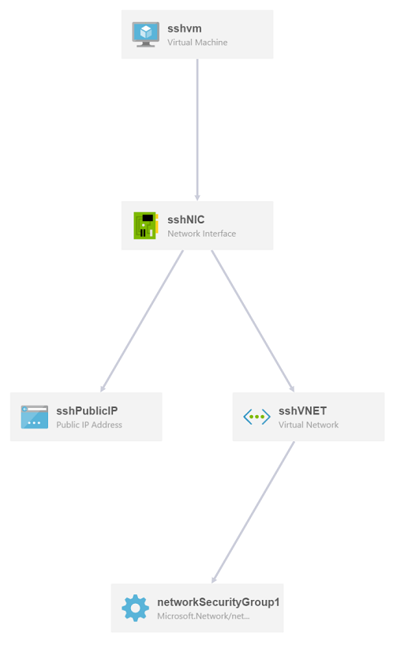
Example II: SDS on Microsoft Azure (2/4)
Virtual Machine Template in Azure Resources
  Azure defines a virtual machine (“Microsoft.Compute/virtualMachines”, see spec) with required hardware profiles in Templates. It includes storage, network, server and operating system profiles. The example in the previous slide (3vms.json) deploys three VMs with the same profiles and additional resources for ssh key properties and public IP address properties. The code snippet of a single virtual machine template is provided below, it is written in a JSON format.
Visualized 101-vm-sshkey template
{ "apiVersion": "2015-08-01",
"type": "Microsoft.Compute/virtualMachines",
"name": “tutorial",
"location": “eastus",
"properties": {
"hardwareProfile": { "vmSize": "Standard_DS2" },
"osProfile": { "computerName": “tutorial",
"adminUsername": "ubuntu",
"linuxConfiguration": { "disablePasswordAuthentication": "true", "ssh": { "publicKeys": [ { "keyData": "GEN-SSH-PUB-KEY" } ] } } },
"storageProfile": {
"imageReference": {
"publisher": "Canonical",
"offer": "UbuntuServer",
"sku": "14.04-LTS",
"version": "latest" },
"osDisk": {
"name": "osdisk",
"vhd": { "uri": "[variables('storage_uri')]" }, "createOption": "FromImage" } },
"networkProfile": {
{ "id": "[resourceId('Microsoft.Network/networkInterfaces', variables('nicName'))]" } } } }

Slide 27
Example II: SDS on Microsoft Azure (3/4)
NIST Pedestrian and Face Detection
  Histograms of Oriented Gradients (HOG) for Human Detection and Haar Cascades for Face Detection from OpenCV are used with INRIA Person Dataset. We deploy Apache Spark on Mesos clusters to train and apply detection models from OpenCV using Python API. IPython tutorial is available here.
Instructions
  Load Ansible API:
  Download Ansible Roles for NIST Pedestrian and Face Detection:
  Deploy Software, Application and Dataset by ansible:
from simpleazure import SimpleAzure
from simpleazure.ansible_api import AnsibleAPI
saz = SimpleAzure()
ips = saz.arm.view_info()
ansible_client = AnsibleAPI(ips)
from simpleazure.github_cli import GithubCLI
git_client = GithubCLI()
git_client.set_repo('https://github.com/futuresystems/pedestrian-and-face-detection')
git_client.clone()
ansible_client.playbook(git_client.path + "/site.yml")
ansible_client.run()

Slide 28
Example II: SDS on Microsoft Azure (4/4)
Termination
  Virtual clusters running on Azure use at least six resources:
    Microsoft.Compute/virtualMachines
    Microsoft.Network/networkInterfaces
    Microsoft.Network/networkSecurityGroups
    Microsoft.Network/publicIPAddresses
    Microsoft.Network/virtualNetworks
    Microsoft.Storage/storageAccounts
  Deleting a resource group where deployments are made stops all services and deletes resources in the group.
Instructions
  To delete a deployment only:
    >>> saz.arm.terminate_deployment()
  To delete a resource group:
    >>> saz.arm.remove_resource_group()
  Deployment name or resource group name can be specified as a parameter, if you want to clean up other resources as well.

Slide 29
MultiCloud and Virtual Cluster
Management with Cloudmesh Client
Gregor von Laszewski and Geoffrey C. Fox
Ass. Dir. CGL
Adj. Assoc. Professor in the
Department of Intelligent Systems Engineering
Indiana University
laszewski@gmail.com

Slide 30
MultiClouds
Previous section shows a lot of detail is needed to achieve deployment of a software stack on resources.
In the next section we show our vision on how to make that simpler for the users.
We demonstrate this on OpenStack clouds, but will be working towards the integration of AWS and Azure as part of the PhD thesis of a student
The result will be (example given for hadoop)
Start Virtual Cluster
Deploy
Stack
Run Experiment
cm cluster –n 10
cm hadoop
Run experiment on hadoop cluster
Abstracts deployment technologies:
Ansible, chef, puppet, ...
Abstracts : compute resources into a virtual cluster

Slide 31
Outlook
Our MultiCloud effort focusses on
  Abstraction for virtual clusters
    Virtual clusters on clouds
    Virtual clusters on container frameworks
    Setting up a security context between compute resources in a virtual cluster
  Abstraction for software stack deployment
    Lots of software stacks have been developed for a variety of frameworks
    Reuse of ansible, (puppet, chef) for stack deployment
      We focus on ansible at this time
  (Future) Execution Abstraction
    Execution abstraction is focused on repeatable experiments that include
    A) virtual cluster management
    B) software stack deployment
    C) repeatable experiments on data

Slide 32
Federated Clouds
Capacity Federation
Technology Federation
Azure
AWS
Azure
AWS
Multi Cloud
Future
Systems
Multi Cloud
Chameleon
Cloud
….
Open
Stack
HPC
Own
Cloud
Rackspace

Slide 33
Why Federated Clouds?
Motivation
Requirements
Price
Availability
  Fault Tolerance
Capacity
  Resource Limitations
Features within the cloud
  Hybrid Clouds
Independence:
  Avoid vender lock in
Accessible
Ease of use
Integrated
Flexible
Support multiple user community types
  Enduser
  Administrator
  Developers

Slide 34
Cloudmesh Client Architecture
Layered Architecture
  Manageable
  Expandable
  Flexible
  Focus on functionality
Access Interface
  Command shell
  Command line (integrated in shell)
  Portal (less need for that as we need scriptable environment, portals are too inflexible)
Integration
  IaaS: OpenStack – AWS – Azure
  HPC: simple experiment management

Slide 35
Cloudmesh Design Addresses
Multi Cloud Management
  Capability
  Capacity
  Heterogeneity: OpenStack, AWS, Azure, XSEDE comet, …
Delivers software-defined systems on
  Virtualized infrastructure
  Bare-metal infrastructure
Delivers Software defined Platforms
  Applications
  Systems and platform software
  Testbeds
Delivers Integrative capabilities
  Add your own cloud
  Add other clouds
  Have an abstraction for integration

Slide 36
Cloudmesh Access Interfaces
Motivation
Cloudmesh Shell
Scripting
Experiment management
Command shell
  Includes command line
  State preserving between calls
REST interface under development
Contributes to NIST Big Data WG
$ cm cloud list
+-------------------+--------+
| cloud | active |
+-------------------+--------+
| chameleon | |
| jetstream | |
| aws | |
| azure | |
| dreamhost | |
| comet | |
| futuresystems | True |
+-------------------+--------+

Slide 37
Integrated Access Interfaces
Integrated State Management across access interface components
E.g. you start a VM in the commandline, you can see it in the Web interface
Communication through database its state
Cloudmesh
Database
Cloudmesh API
Cloudmesh
Shell
Command Line
Cloudmesh
Web
Cloudmesh REST Services

Slide 38
Installation
Simple system integration
  pip install cloudmesh_client
Simple configuration
  Add new clouds by editing the ~/.cloudmesh/cloudmesh.yaml file
  Templates are provided for many clouds so you do have to only do a few things such as adding username
  Use predefined commands such as
  $ cm register remote
  which fetches the information form FutureSystems (f you have a future systems account)

Slide 39
Cloudmesh Shell
$ cm
======================================================
/ ___| | ___ _ _ __| |_ __ ___ ___ ___| |__
| | | |/ _ \| | | |/ _` | '_ ` _ \ / _ \/ __| '_ \
| |___| | (_) | |_| | (_| | | | | | | __/\__ \ | | |
\____|_|\___/ \__,_|\__,_|_| |_| |_|\___||___/_| |_|
======================================================
cm> default cloud=india
cm> flavor list
+--------+------+--------------+---------+-------+--------+----------------------+
| CLOUD | id | name | vcpus | ram | disk | cm_refresh |
|--------+------+--------------+---------+-------+--------+----------------------|
| india | 1 | m1.tiny | 1 | 512 | 0 | 2014-08-26T01-15-20Z |
| india | 3 | m1.medium | 2 | 4096 | 40 | 2014-08-26T01-15-20Z |
| india | 2 | m1.small | 1 | 2048 | 20 | 2014-08-26T01-15-20Z |
| india | 4 | m1.large | 4 | 8192 | 40 | 2014-08-26T01-15-20Z |
| india | 7 | m1.memmedium | 1 | 4096 | 20 | 2014-08-26T01-15-20Z |
| india | 6 | m1.memlarge | 1 | 8192 | 20 | 2014-08-26T01-15-20Z |
+--------+------+--------------+---------+-------+--------+----------------------+

Slide 40
Cloudmesh Shell help
cluster help
Could not execute the command.
Usage:
cluster list [--format=FORMAT]
cluster list NAME [--format=FORMAT] [--column=COLUMN]- -short]
cluster create NAME
[--count=COUNT]
[--login=USERNAME] [--cloud=CLOUD] [--image=IMAGE] [--flavor=FLAVOR] [--add]
cluster delete NAME
cluster setup NAME [--username]
cluster inventory NAME
Description:
with the help of the cluster command you can create a number
of virtual machines that are integrated in a named virtual cluster.
You will be able to login between the nodes of the virtual cluster
while using public keys.
….

Slide 41
MultiCloud interaction is simple
cm default=india
cm boot
  Boots a vm on futuresystems cloud called india
cm default=chameleon
cm boot
  Boots a vm on chameleon
cm cluster create –count=10
  Creates a virtual cluster with 10 vms
cm cluster inventory
  List the ip addresses that can be reused by ansible

Slide 42
Starting hadoop
Create a virtual cluster
Install hadoop on it
cm hadoop start myHadoopCluster
You can than interact with that cluster
Important is that this is deployed by the user.

Slide 43
Summary MultiCloud Management with Cloudmesh client
Easy to switch between clouds
Allows integration with existing DevOps frameworks (ansible)
Allows deployment of virtual clusters
Allows deployment of software stack on virtual clusters
Extensible

