Slide 1





NSF 1443054: CIF21 DIBBs: Middleware and High Performance Analytics Libraries for Scalable Data Science
Software: MIDAS
HPC-ABDS
Tutorial
February 2017

Slide 2
SPIDAL Project
Datanet: CIF21 DIBBs: Middleware and High Performance Analytics Libraries for Scalable Data Science
NSF14-43054 started October 1, 2014
Indiana University (Fox, Qiu, Crandall, von Laszewski)
Rutgers (Jha)
Virginia Tech (Marathe)
Kansas (Paden)
Stony Brook (Wang)
Arizona State (Beckstein)
Utah (Cheatham)
A co-design project: Software, algorithms, applications

Slide 3
NSF 1443054: CIF21 DIBBs: Middleware and High Performance Analytics Libraries for Scalable Data Science
INSERT
Software: MIDAS
HPC-ABDS
Tutorial Overview
February 2017

Slide 4
Rationale for HPC Big Data Convergence

Slide 5
HPC and/or Cloud 1.0 2.0 3.0
Cloud 1.0: IaaS PaaS
Cloud 2.0: DevOps
Cloud 3.0: Amin Vahdat from Google; Insight (Solution) as a Service from IBM; serverless computing
HPC 1.0 and Cloud 1.0 separate ecosystems
HPCCloud or HPC-ABDS: Take performance of HPC and functionality of Cloud (Big Data) systems
HPCCloud 2.0 Use DevOps to invoke HPC or Cloud software on VM, Docker, HPC infrastructure
HPCCloud 3.0 Automate Solution as a Service using HPC-ABDS on “correct” infrastructure

Slide 6
Why Connect (“Converge”) Big Data and HPC
Two major trends in computing systems are
  Growth in high performance computing (HPC) with an international exascale initiative (China in the lead)
  Big data phenomenon with an accompanying cloud infrastructure of well publicized dramatic and increasing size and sophistication.
Note “Big Data” largely an industry initiative although software used is often open source
  So HPC labels overlaps with “research” e.g. HPC community largely responsible for Astronomy and Accelerator (LHC, Belle, BEPC ..) data analysis
Merge HPC and Big Data to get
  More efficient sharing of large scale resources running simulations and data analytics as HPCCloud 3.0
  Higher performance Big Data algorithms
  Richer software environment for research community building on many big data tools
  Easier sustainability model for HPC – HPC does not have resources to build and maintain a full software stack

Slide 7
Convergence Points (Nexus) for
HPC-Cloud-Big Data-Simulation
Nexus 1: Applications – Divide use cases into Data and Model and compare characteristics separately in these two components with 64 Convergence Diamonds (features)
Nexus 2: Software – High Performance Computing (HPC) Enhanced Big Data Stack HPC-ABDS. 21 Layers adding high performance runtime to Apache systems (Hadoop is fast!). Establish principles to get good performance from Java or C programming languages
Nexus 3: Hardware – Use Infrastructure as a Service IaaS and DevOps (HPCCloud 2.0) to automate deployment of software defined systems on hardware designed for functionality and performance e.g. appropriate disks, interconnect, memory
Deliver Solutions (wisdom) as a Service HPCCloud 3.0

Slide 8
Some Cosmic Issues in HPC – Big Data areas and their linkage

Slide 9
Some Confusing Issues; Missing Requirements; Missing Consensus I
Different Problem Types
  Data Management v. Data Analytics
  Every problem has Data & Model; which is Big/Important?
  Streaming v Batch; Interactive v Batch
  Science Requirements v. Commercial Requirements; are they similar?; what are important problems ; how big are they and are they global or locally parallel?
Broad Execution Issues
  Pleasingly Parallel (Local Machine Learning) v. Global Machine Learning
  Fine grain v. Coarse Grain parallelism; workflow (dataflow with directed graph) v. parallel computing (tight synchronization and ~BSP))
  Threads v Processes
  Objects v files; HDFS v Lustre

Slide 10
Some confusing issues; Missing Requirements; Missing Consensus II
Qualitative Aspects of Approach
  Need for Interdisciplinary Collaboration
  Trade-off between Performance and Productivity
  What about software sustainability? Should we do all with Apache?
  Academic v. Industry; who is leading?
Many choices in all parts of System
  Virtualization: HPC v Docker v OpenStack (OpenNebula)
  Apache Beam v. Kepler for orchestration and lots of other HPC v “Apache” or “Apache v Apache” choices e.g. Beam v. Crunch v. NiFi
  What Language should be used: Python/R/Matlab, C++, Java …
  350 Software systems in HPC-ABDS collection with lots of choice
  HPC simulation stack well defined and highly optimized; user makes few choices

Slide 11
Some confusing issues; Missing Requirements; Missing Consensus III
What is the appropriate hardware?
  Depends on answers to “what are requirements” and software choices
  What is flexible cost effective hardware; at universities? In public clouds?
  HPC v. HTC (high throughput) v. Cloud
  Value of GPU’s and other innovative node hardware
Miscellaneous Issues
  Big Data Performance analysis often rudimentary (compared to HPC)
  What is the Big Data Stack?
  Trade-off between “integrated systems” versus using a collection of independent components
  What are parallelization challenges? Library of “hand optimized” code versus automatic parallelization and domain specific libraries
  Can DevOps be used more systematically to promote interoperability
  Orchestration v. Management; TOSCA v. BPEL (Heat v. Beam)

Slide 12
Some confusing issues; Missing Requirements; Missing Consensus IV
Status of field
  What problems need to be solved?
  What is pretty universally agreed?
  What is understood (by some) but not broadly agreed?
  What is not understood and needs substantial more work?
  Is there an interesting Big Data Exascale Convergence?
  Role of Data Science? Curriculum of Data Science?
  Role of Benchmarks

Slide 13
NSF 1443054: CIF21 DIBBs: Middleware and High Performance Analytics Libraries for Scalable Data Science
INSERT
Software: MIDAS
HPC-ABDS
Big Data
Use Cases February 2017

Slide 14
NSF 1443054: CIF21 DIBBs: Middleware and High Performance Analytics Libraries for Scalable Data Science
INSERT
Software: MIDAS
HPC-ABDS
Big Data
Use Case Examples February 2017

Slide 15
Examples of HPC Analytics

Slide 16
Clustering and Visualization
The SPIDAL Library includes several clustering algorithms with sophisticated features
  Deterministic Annealing
  Radius cutoff in cluster membership
  Elkans algorithm using triangle inequality
They also cover two important cases
  Points are vectors – algorithm O(N) for N points
  Points not vectors – all we know is distance δ(i, j) between each pair of points i and j. algorithm O(N²) for N points
We find visualization important to judge quality of clustering
As data typically not 2D or 3D, we use dimension reduction to project data so we can then view it
Have a browser viewer WebPlotViz that replaces an older Windows system
Clustering and Dimension Reduction are modest HPC applications
Calculating distance δ(i, j) is similar compute load but pleasingly parallel
All examples require HPC but largest size ~600 cores

Slide 17
Fungal Sequences
Input data
  ~7 million gene sequences in FASTA format.
Pre-processing
  Input data filtered to locate unique sequences that appear multiple occasions in the input data, resulting in 170K gene sequences.
  Smith–Waterman algorithm is applied to generate distance matrix for 170K gene sequences.
Clustering data with DAPWC
  Run DAPWC iteratively to produce clean clustering for the data. Initial step of DAPWC is done with 8 clusters. Resulting clusters are visualized and further clustered using DAPWC with appropriate number of clusters that are determined through visualizing in WebPlotViz.
  Resulting clusters are gathered and merged to produce the final clustering result.

Slide 18

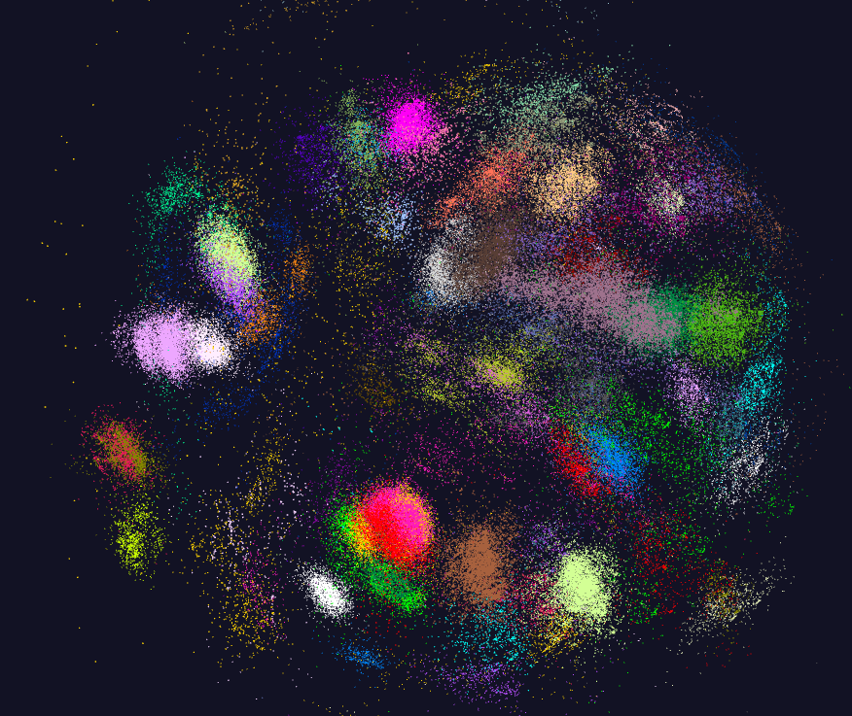

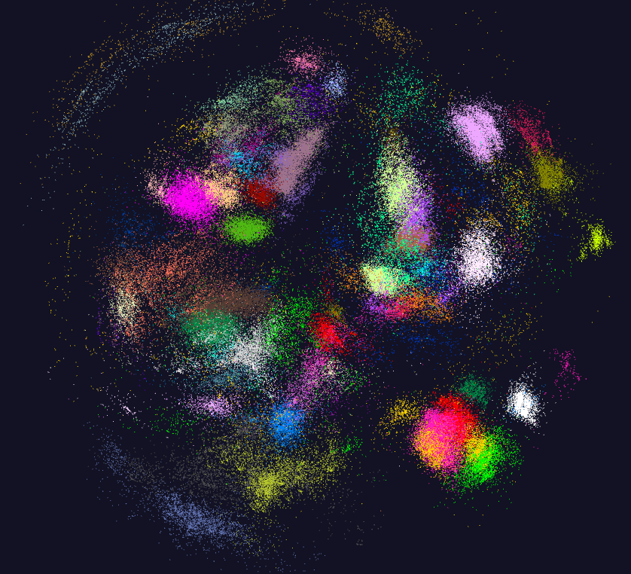
170K Fungi sequences

Slide 19
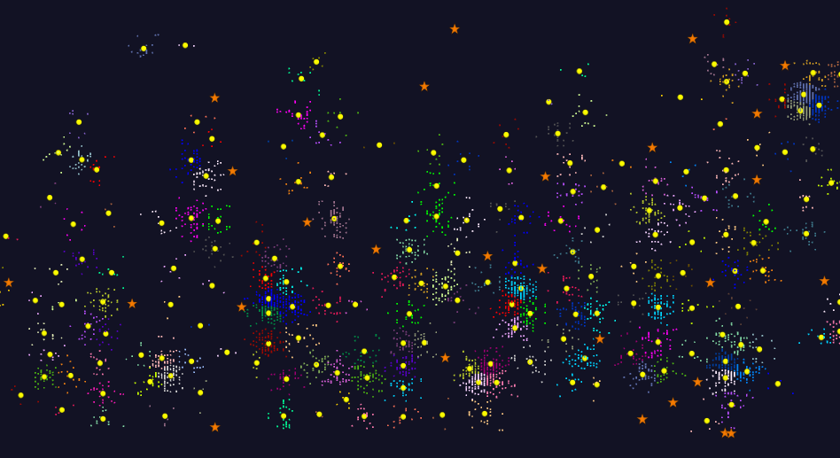
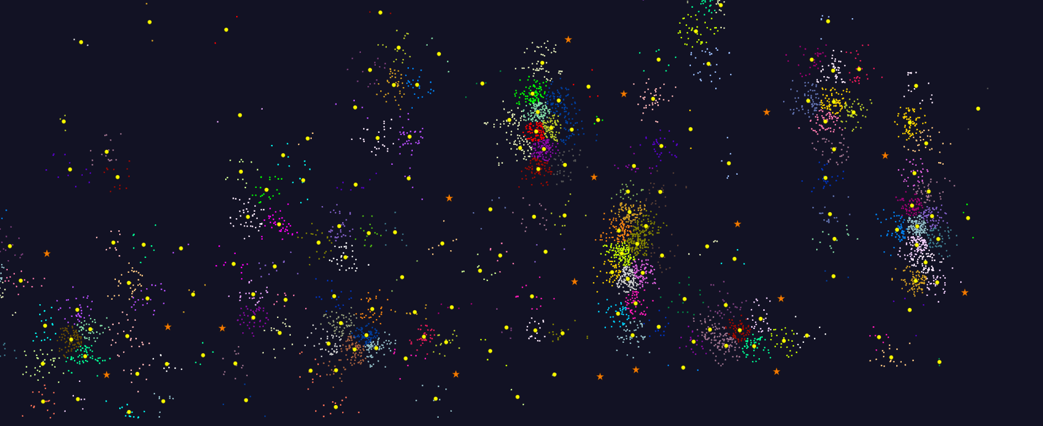
2D Vector Clustering with cutoff at 3 σ
Orange Star – outside all clusters; yellow circle cluster centers
LCMS Mass Spectrometer Peak Clustering. Charge 2 Sample with 10.9 million points and 420,000 clusters visualized in WebPlotViz

Slide 20
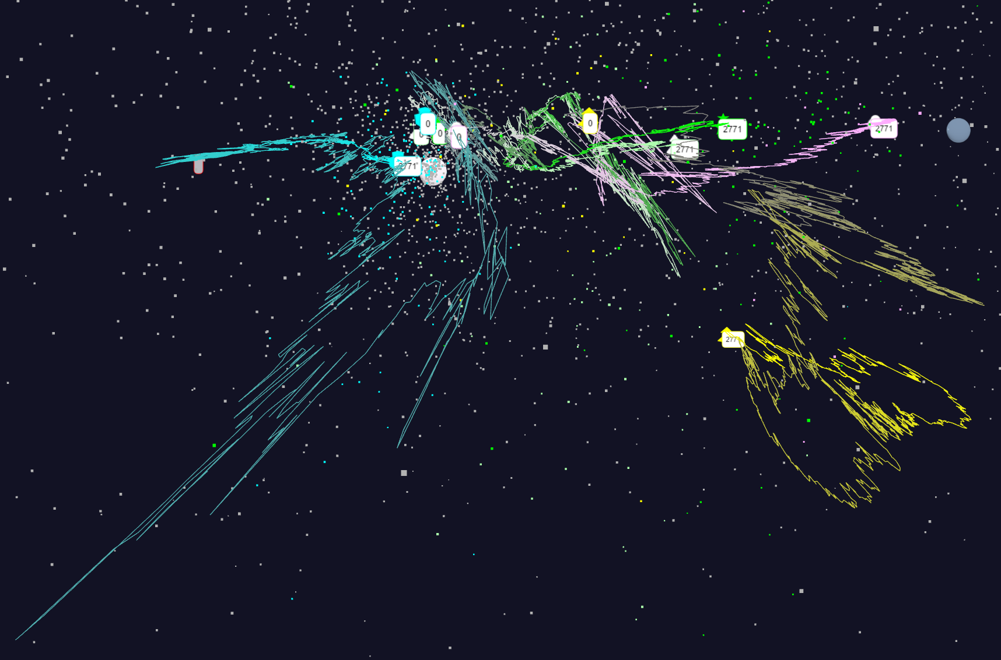
Relative Changes in Stock Values using one day values
S&P
Mid Cap
Dow Jones
+10%
Finance
Origin
0% change
Energy
1/20/2018
20

Slide 21
Pathology Image Data
Input data
  Large number of data files (~1800) that describe 11 images using 96 properties for each data point. Around 3.95 million data points in total.
Pre-processing
  Create single data files by subsampling and collating data points from data files. Data files can be created for a specific image or a collection of images.
  Calculate distance matrix using generated data files
Dimension reduction with DAMDS
  DAMDS is applied to produce 3D data points which are visualized using WebPlotViz

Slide 22
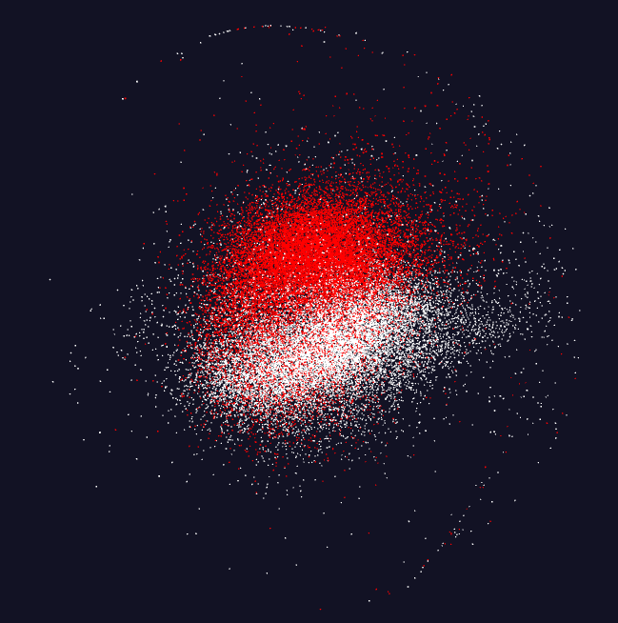
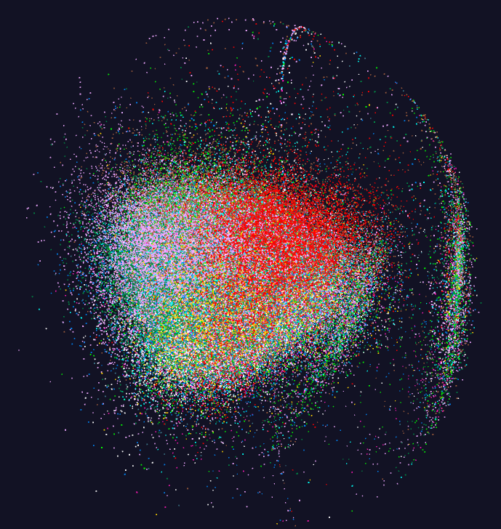
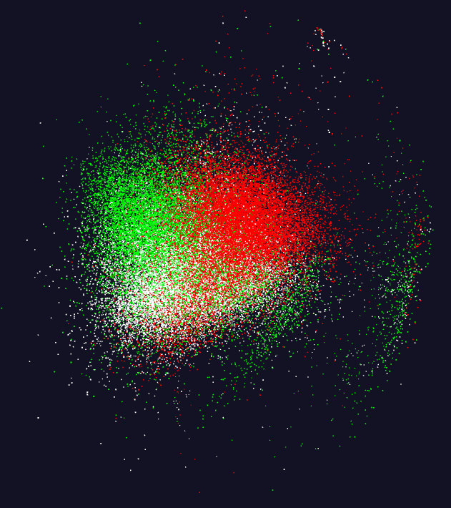
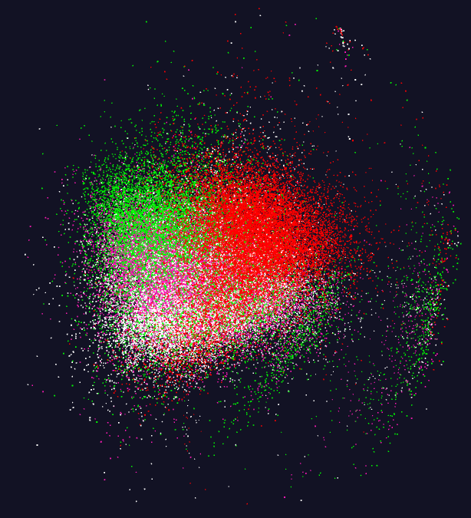
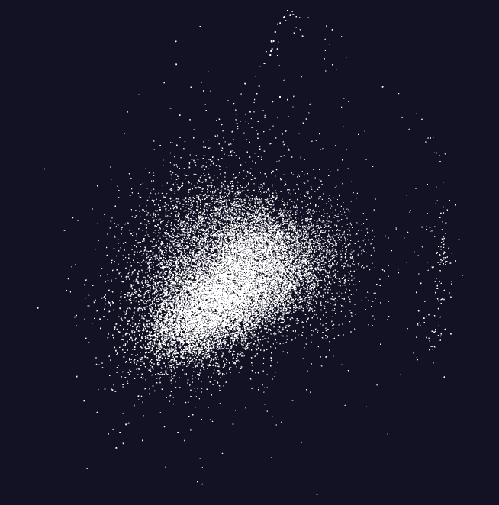
Pathology Image Features (cells)
11 Images
20,000 features per image.
96 properties per feature

Slide 23
NSF 1443054: CIF21 DIBBs: Middleware and High Performance Analytics Libraries for Scalable Data Science
INSERT
Software: MIDAS
HPC-ABDS
DA Algorithms
Analytics
February 2017

Slide 24
NSF 1443054: CIF21 DIBBs: Middleware and High Performance Analytics Libraries for Scalable Data Science
INSERT
Software: MIDAS
HPC-ABDS
WebPlotViz: February 2017

Slide 25
What’s in DSC-SPIDAL
High Performance Algorithm Implementations in Java and MPI
  DA-MDS https://github.com/DSC-SPIDAL
    Use the master-lrt-spin branch
  DA-PWC https://github.com/DSC-SPIDAL/dapwc
    Use the master branch
  DA-VS https://github.com/DSC-SPIDAL/davs
    Use the master branch
  K-Means https://github.com/DSC-SPIDAL/KMeans
    Use the lrt branch
    If you want to use a C implementation use lrt in https://github.com/DSC-SPIDAL/KMeansC
Frameworks
  Harp https://github.com/DSC-SPIDAL/Harp
Tools
  WebPviz https://spidal-gw.dsc.soic.indiana.edu
    Code https://github.com/DSC-SPIDAL/WebPViz

Slide 26
Access, Build, and Cite
All these can be accessed through Github freely.
  If you want to contribute to code, you’ll need to send either a Git pull request or send an email to add you as a contributor.
    Of course, you can fork these repositories and do changes.
All these repositories come with build instructions.
  For algorithms section you can also visit the DSC-SPIDAL cookbook
You can cite the following papers
  Algorithms DA-MDS [1] and [2]
  Frameworks Harp [3]
  Tools WebPviz [4]
See http://hpc-abds.org/kaleidoscope/ for full list of papers

Slide 27
Tutorials on using SPIDAL
DAMDS, Clustering, WebPlotviz https://dsc-spidal.github.io/tutorials/
Active WebPlotViz for clustering plus DAMDS on fungi
  https://spidal-gw.dsc.soic.indiana.edu/public/resultsets/1273112137
  https://spidal-gw.dsc.soic.indiana.edu/public/groupdashboard/Anna_GeneSeq
Active WebPlotViz for 2D Proteomics https://spidal-gw.dsc.soic.indiana.edu/public/resultsets/1657429765
Active WebPlotViz for Pathology Images https://spidal-gw.dsc.soic.indiana.edu/public/resultsets/1678860580
Harp https://github.com/DSC-SPIDAL/Harp

Slide 28
SPIDAL Tutorials - Prerequisites
Operating System
SPDIAL is extensively tested and known to work on,
  Red Hat Enterprise Linux Server release 6.7 (Santiago)
  Red Hat Enterprise Linux Server release 5.10 (Tikanga)
  Ubuntu 14.04 LTS
  This may work in Windows systems depending on the ability to setup OpenMPI properly, however, this has not been tested and we recommend choosing a Linux based operating system instead.
Java
  Download Oracle JDK 8 from http://www.oracle.com/technetwork/java/javase/downloads/index.html
  Extract the archive to a folder named jdk1.8.0
  Set the following environment variables.
    JAVA_HOME=<path-to-jdk1.8.0-directory>
    PATH=$JAVA_HOME/bin:$PATH
    export JAVA_HOME PATH
Apache Maven
Download latest Maven release from http://maven.apache.org/download.cgi
Extract it to some folder and set the following environment variables.
  MVN_HOME=<path-to-Maven-folder>
  $PATH=$MVN_HOME/bin:$PATH
  export MVN_HOME PATH
OpenMPI
We recommend using OpenMPI 1.10.1 although it work with the previous 1.8 versions. Note, if using a version other than 1.10.1 please remember to set Maven dependency appropriately in the pom.xml
https://dsc-spidal.github.io/tutorials/post/install_ompi.md/

Slide 29
SPIDAL Tutorials - Installing SPIDAL Software
Common
  SPIDAL libraries depend on the common project in DSC-SPIDAL github. We need to build it first.
  git clone https://github.com/DSC-SPIDAL/common.git
  cd common
  mvn install
DA-MDS is the deterministic annealing implementation of Multidimensional Scaling algorithm. The project can be built from the source.
  git clone https://github.com/DSC-SPIDAL/damds.git
  cd damds; mvn install
  After building it will create a Jar file inside the target directory.
DAPWC Deterministic Annealing Pairwise Clustering is a scalable and parallel clustering program that operates on non vector space points
  git clone https://github.com/DSC-SPIDAL/dapwc.git
  cd dapwc
  mvn install
After building it will create a Jar file inside the target directory.
Examples are given running on Slurm on cluster or on a local machine
The link to WebPlotViz is described
https://dsc-spidal.github.io/tutorials/post/install_spidal/

Slide 30
SPIDAL Tutorial: Visual Clustering of Sequence Data
Instructions are given for 8-step workflow
Process raw data to find Unique sequences that appear more than once ( 170K resulting sequences )
Run Smith–Waterman algorithm to generate distance matrix
Run MDS to genereate 3D data points for the data using the distance matrix
Run DAPWC with a low number of target clusters ( 8 clusters were used in this case ).
Visualize the resulting 8 clusters to estimate number of sub clusters in each one. If 2 or more of the 8 clusters seem to be more proper when merged, they can be merged before the next iteration
Run DAPWC for each of the 8 clusters separately, specifying the appropriate number of clusters for each one.
Visualize the new clusters and merge them where needed
Collect all the clusters into a single file for the final cluster result.
https://dsc-spidal.github.io/tutorials/post/fungi_gene_sequence_example/

Slide 31
SPIDAL Tutorial: Pathology Image Data
The data consist of several pathology images that are described using 96 features. There are 11 images in the dataset totaling upto around 4 million data points.
The example will only use a very small subset of the complete data set. The visualization listed below is a result of a larger run which contained ~220K data points in total. 220K data points where selected by 20K random row samples extracted from each image. The plot is clustered by image. Each of the 11 clusters correspond to a single image, With distance matrix outliers set to 3*sigma
Visualization using WebPlotViz - https://spidal-gw.dsc.soic.indiana.edu/public/resultsets/1678860580
Detailed instructions are given
https://dsc-spidal.github.io
/tutorials/post/pathology_image_data_example/

Slide 32
Software Nexus
Application Layer On
Big Data Software Components for Programming and Data Processing On
HPC for runtime On
IaaS and DevOps Hardware and Systems
HPC-ABDS
MIDAS
Java Grande

Slide 33
NSF 1443054: CIF21 DIBBs: Middleware and High Performance Analytics Libraries for Scalable Data Science
INSERT
Software: MIDAS
HPC-ABDS
General
HPC-ABDS
February 2017

Slide 34
Java Grande
Revisited on 3 data analytics codes
Clustering
Multidimensional Scaling
Latent Dirichlet Allocation all sophisticated algorithms

Slide 35
NSF 1443054: CIF21 DIBBs: Middleware and High Performance Analytics Libraries for Scalable Data Science
INSERT
Software: MIDAS
HPC-ABDS
SPIDAL Java
Optimized
February 2017

Slide 36
NSF 1443054: CIF21 DIBBs: Middleware and High Performance Analytics Libraries for Scalable Data Science
INSERT
Software: MIDAS
HPC-ABDS
Performance
Analytics
February 2017

Slide 37
HPC-ABDS
Introduction
DataFlow and In-place Runtime

Slide 38
HPC-ABDS Parallel Computing
Both simulations and data analytics use similar parallel computing ideas
Both do decomposition of both model and data
Both tend use SPMD and often use BSP Bulk Synchronous Processing
One has computing (called maps in big data terminology) and communication/reduction (more generally collective) phases
Big data thinks of problems as multiple linked queries even when queries are small and uses dataflow model
Simulation uses dataflow for multiple linked applications but small steps such as iterations are done in place
Reduction in HPC (MPIReduce) done as optimized tree or pipelined communication between same processes that did computing
Reduction in Hadoop or Flink done as separate map and reduce processes using dataflow
  This leads to 2 forms (In-Place and Flow) of Map-X mentioned in use-case (Ogres) section
Interesting Fault Tolerance issues highlighted by Hadoop-MPI comparisons – not discussed here!

Slide 39
General Reduction in Hadoop, Spark, Flink
Map Tasks
Separate Map and Reduce Tasks
MPI only has one sets of tasks for map and reduce
MPI gets efficiency by using shared memory intra-node (of 24 cores)
MPI achieves AllReduce by interleaving multiple binary trees
Switching tasks is expensive! (see later)
Reduce Tasks
Follow by Broadcast for AllReduce which is what most iterative algorithms use
Output partitioned with Key

Slide 40

HPC Runtime versus ABDS distributed Computing Model on Data Analytics
Hadoop writes to disk and is slowest; Spark and Flink spawn many processes and do not support allreduce directly; MPI does in-place combined reduce/broadcast

Slide 41
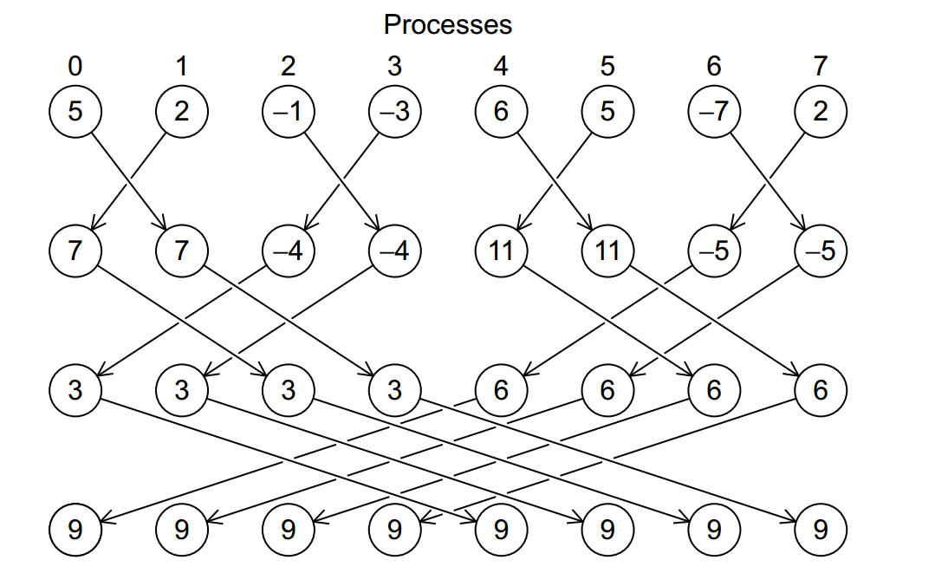
Illustration of In-Place AllReduce in MPI

Slide 42
HPC-ABDS
Spark Flink MPI Comparison

Slide 43

Flink MDS Dataflow Graph

Slide 44


MDS Results with Flink, Spark and MPI
MDS execution time on 16 nodes with 20 processes in each node with varying number of points
MDS execution time with 32000 points on varying number of nodes. Each node runs 20 parallel tasks
MDS performed poorly on Flink due to its lack of support for nested iterations. In Flink and Spark the algorithm doesn’t scale with the number of nodes.

Slide 45
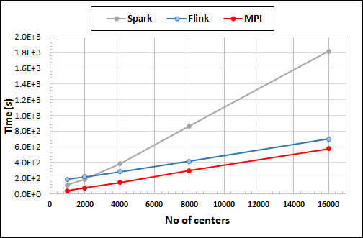
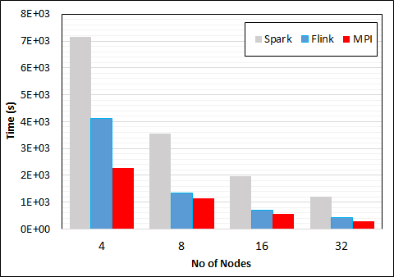
K-Means Clustering in Spark, Flink, MPI
Data Set <Points>
Dataflow for K-means
Data Set <Initial Centroids>
Map (nearest centroid calculation)
Reduce (update centroids)
Data Set <Updated Centroids>
Broadcast
K-Means execution time on 16 nodes with 20 parallel tasks in each node with 10 million points and varying number of centroids. Each point has 100 attributes.
K-Means execution time on varying number of nodes with 20 processes in each node with 10 million points and 16000 centroids. Each point has 100 attributes.
Notes:
Note the differences in communication architectures
Note times are in log scale
Bars indicate compute only times, which is similar across these frameworks
Overhead is dominated by communications in Flink and Spark

Slide 46
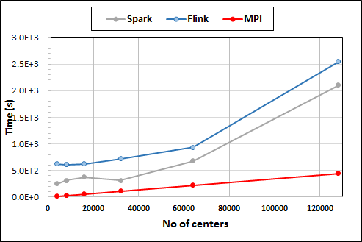
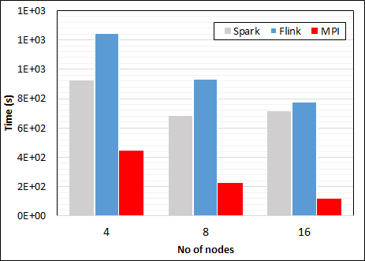
K-Means Clustering in Spark, Flink, MPI
K-Means execution time on 8 nodes with 20 processes in each node with 1 million points and varying number of centroids. Each point has 2 attributes.
K-Means execution time on varying number of nodes with 20 processes in each node with 1 million points and 64000 centroids. Each point has 2 attributes.
K-Means performed well on all three platforms when the computation time is high and communication time is low as illustrated in 10 million points and 10 iterations case. After lowering the computation and increasing the communication by setting the points to1 million and iterations to 100, the performance gap between MPI and the other two platforms increased.
Notes:
Note the differences in communication architectures
Note times are in log scale
Bars indicate compute only times, which is similar across these frameworks
Overhead is dominated by communications in Flink and Spark

Slide 47

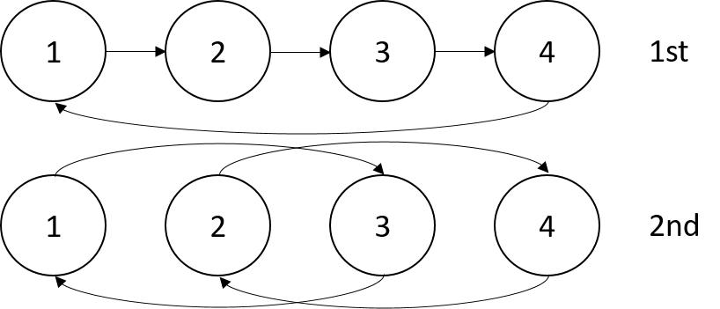

Sorting 1Tb of records
MPI Shuffling using a ring communication
Terasort flow
All three platforms worked relatively well because of the bulk nature of the data transfer.
Terasort execution time in 64 and 32 nodes. Only MPI shows the sorting time and communication time as other two frameworks doesn't provide a viable method to accurately measure them. Sorting time includes data save time. MPI-IB - MPI with Infiniband
Notes:
Note the differences in communication architectures
Note times are in log scale
Bars indicate compute only times, which is similar across these frameworks
Overhead is dominated by communications in Flink and Spark

Slide 48
HPC-ABDS
General Summary
DataFlow and In-place Runtime

Slide 49
HPC-ABDS Parallel Computing
MPI designed for fine grain case and typical of parallel computing used in large scale simulations
  Only change in model parameters are transmitted
  In-place implementation
  Synchronization important as parallel computing
Dataflow typical of distributed or Grid computing workflow paradigms
  Data sometimes and model parameters certainly transmitted
  If used in workflow, large amount of computing (>> communication) and no performance constraints from synchronization
  Caching in iterative MapReduce avoids data communication and in fact systems like TensorFlow, Spark or Flink are called dataflow but usually implement “model-parameter” flow
HPC-ABDS Plan: Add in-place implementations to ABDS when best performance keeping ABDS Interface as in next slide

Slide 50
Programming Model I
Programs are broken up into parts
  Functionally (coarse grain)
  Data/model parameter decomposition (fine grain)
Fine grain needs low latency or minimal data copying
Coarse grain has lower communication /
compute cost
MPI
Dataflow
Possible Iteration

Slide 51
Programming Model II
MPI designed for fine grain case and typical of parallel computing used in large scale simulations
  Only change in model parameters are transmitted
Dataflow typical of distributed or Grid computing paradigms
  Data sometimes and model parameters certainly transmitted
  Caching in iterative MapReduce avoids data communication and in fact systems like TensorFlow, Spark or Flink are called dataflow but usually implement “model-parameter” flow
Different Communication/Compute ratios seen in different cases with ratio (measuring overhead) larger when grain size smaller. Compare
  Intra-job reduction such as Kmeans clustering accumulation of center changes at end of each iteration and
  Inter-Job Reduction as at end of a query or word count operation

Slide 52
Programming Model Summary
Need to distinguish
  Grain size and Communication/Compute ratio (characteristic of problem or component (iteration) of problem)
  DataFlow versus “Model-parameter” Flow (characteristic of algorithm)
  In-Place versus Flow Software implementations
Inefficient to use same mechanism independent of characteristics
Classic Dataflow is approach of Spark and Flink so need to add parallel in-place computing as done by Harp for Hadoop
  TensorFlow uses In-Place technology
Note parallel machine learning (GML not LML) can benefit from HPC style interconnects and architectures as seen in GPU-based deep learning
  So commodity clouds not necessarily best

Slide 53
MIDAS
This is applied to biomolecular simulations
Harp software links are given at start with DSC-SPIDAL Github

Slide 54
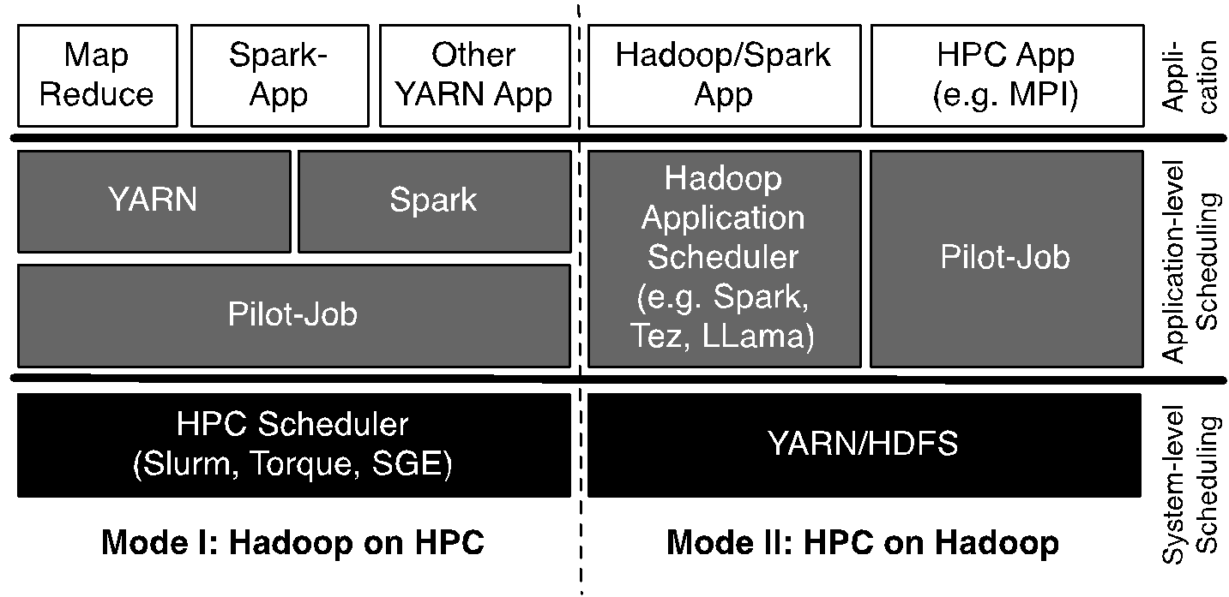
Pilot-Hadoop/Spark Architecture
HPC into Scheduling Layer
http://arxiv.org/abs/1602.00345

Slide 55
What’s in MIDAS-tutorial
Infrastructure Component to bring ABDS to HPC.
  Slides covering RADICAL-Pilot, Pilot-YARN, Pilot-Spark
  https://github.com/radical-cybertools/MIDAS-tutorial/blob/master/TutorialOverview.ipynb
  Framework
    https://github.com/radical-cybertools/radical.pilot/tree/master
Biomolecular Simulations
  Slides
  https://becksteinlab.github.io/SPIDAL-MDAnalysis-Midas-tutorial/index.html
Linked Ipython notebooks are “passive”. If you’d like to play with them on your cluster/resources please contact us.

Slide 56
Analysis of Biomolecular Simulations
Libraries
  MDAnalysis http://mdanalysis.org :
    https://github.com/MDAnalysis/mdanalysis : use the master branch for releases (develop for bleeding edge)
    Releases available as conda packages (conda-forge) and on PyPi (pip install mdanalysis)
    Documentation: http://docs.mdanalysis.org (or http://devdocs.mdanalysis.org for bleeding edge)
    Introductory tutorial: http://mdanalysis.org/MDAnalysisTutorial/
    Citations:
      R. J. Gowers, M. Linke, J. Barnoud, T. J. E. Reddy, M. N. Melo, S. L. Seyler, D. L. Dotson, J. Domanski, S. Buchoux, I. M. Kenney, and O. Beckstein. MDAnalysis: A Python package for the rapid analysis of molecular dynamics simulations. In S. Benthall and S. Rostrup, editors, Proceedings of the 15th Python in Science Conference, pages 102-109, Austin, TX, 2016. SciPy.
      N. Michaud-Agrawal, E. J. Denning, T. B. Woolf, and O. Beckstein. MDAnalysis: A Toolkit for the Analysis of Molecular Dynamics Simulations. J. Comput. Chem. 32 (2011), 2319-2327, doi:10.1002/jcc.21787.
  MDSynthesis – a logistics and persistence engine for the analysis of molecular dynamics trajectories
    https://github.com/datreant/MDSynthesis : use the master branch
    Releases available from PyPi (pip install mdsynthesis)
    Documentation: http://mdsynthesis.readthedocs.org
    Citation: D. L. Dotson, S. L. Seyler, M. Linke, R. J. Gowers, and O. Beckstein. datreant: persistent, Python trees for heterogeneous data. In S. Benthall and S. Rostrup, editors, Proceedings of the 15th Python in Science Conference, pages 51 – 56, Austin, TX, 2016.

Slide 57
NSF 1443054: CIF21 DIBBs: Middleware and High Performance Analytics Libraries for Scalable Data Science
INSERT
Software: MIDAS
HPC-ABDS
MIDAS- Molecular Dynamics Analysis Tutorial
February 2017

Slide 58
NSF 1443054: CIF21 DIBBs: Middleware and High Performance Analytics Libraries for Scalable Data Science
INSERT
Software: MIDAS
HPC-ABDS
Harp HPC for Big Data
February 2017

Slide 59
Streaming Applications and Technology

Slide 60
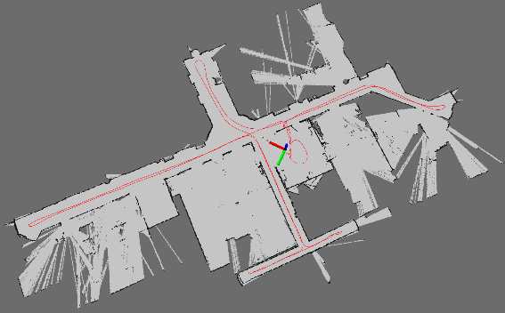
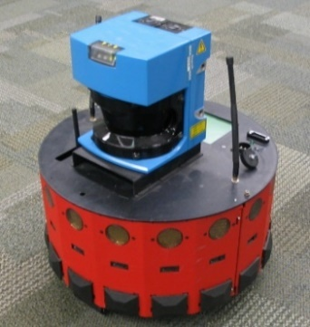
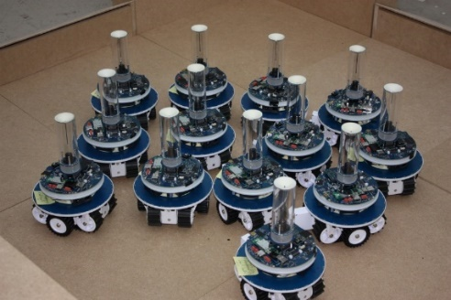
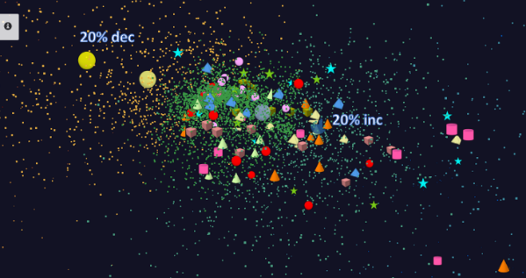
Adding HPC to Storm & Heron for Streaming
Robotics Applications
Time series data visualization in real time
Simultaneous Localization and Mapping
N-Body Collision
Avoidance
Map Built from
Robot data
Robot with a Laser Range Finder
Robots need to avoid collisions when they move
Map High dimensional data to 3D visualizer
Apply to Stock market data tracking 6000 stocks

Slide 61
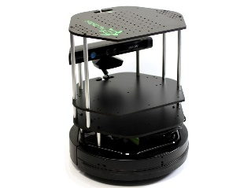
Data Pipeline
Sending to
pub-sub
Sending to
Persisting
storage
Multiple
streaming
workflows
Streaming
workflow
A stream application with some tasks running in parallel
Gateway
Message Brokers
RabbitMQ, Kafka
Streaming Workflows
Apache Heron and Storm
End to end delays without any processing is less than 10ms
Storm does not support “real parallel processing” within bolts – add optimized inter-bolt communication
Hosted on HPC and OpenStack cloud

Slide 62
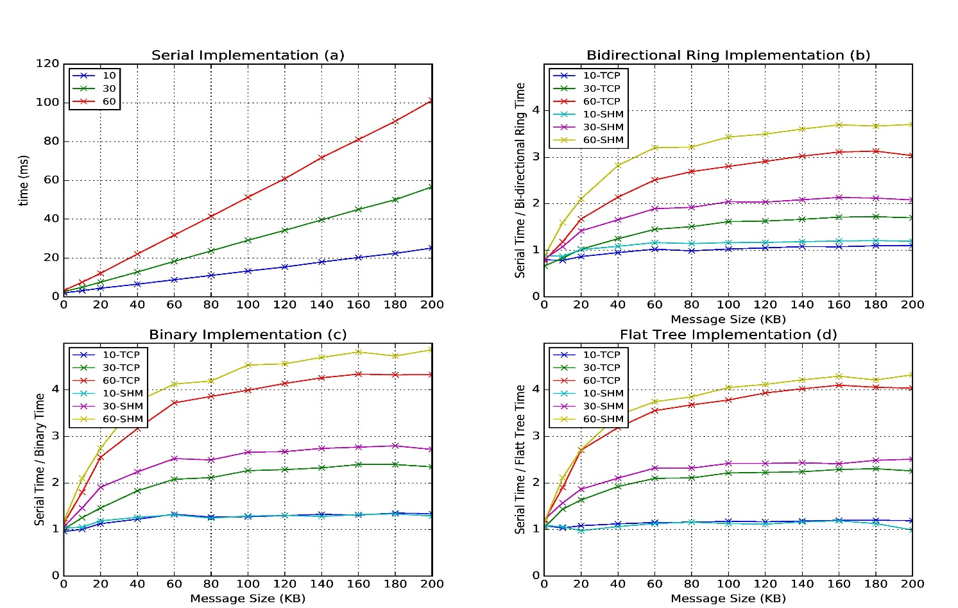
Improvement of Storm (Heron) using HPC communication algorithms
Latency of binary tree, flat tree and bi-directional ring implementations compared to serial implementation. Different lines show varying # of parallel tasks with either TCP communications and shared memory communications(SHM).
Original Time
Speedup Ring
Speedup Binary
Speedup Tree

Slide 63
SPIDAL Algorithms

Slide 64
Harp LDA on Big Red II Supercomputer (Cray)
Harp LDA Scaling Tests
Harp LDA on Juliet (Intel Haswell)
  Big Red II: tested on 25, 50, 75, 100 and 125 nodes; each node uses 32 parallel threads; Gemini interconnect
  Juliet: tested on 10, 15, 20, 25, 30 nodes; each node uses 64 parallel threads on 36 core Intel Haswell nodes (each with 2 chips); Infiniband interconnect
Corpus: 3,775,554 Wikipedia documents, Vocabulary: 1 million words;
Topics: 10k topics; alpha: 0.01; beta: 0.01; iteration: 200

Slide 65
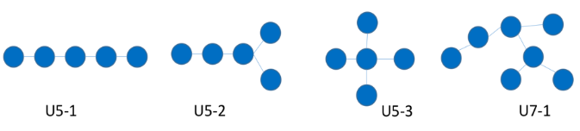
SPIDAL Algorithms – Subgraph mining
Finding patterns in graphs is very important
  Counting the number of embeddings of a given labeled/unlabeled template subgraph
  Finding the most frequent subgraphs/motifs efficiently from a given set of candidate templates
  Computing the graphlet frequency distribution.
Reworking existing parallel VT algorithm Sahad with MIDAS middleware giving HarpSahad which runs 5 (Google) to 9 (Miami) times faster than original Hadoop version
Work in progress
Templates
Datasets:
Network | No. Of Nodes (in million) | No. Of Edges (in million) | Size (MB)
Web-google | 0.9 | 4.3 | 65
Miami | 2.1 | 51.2 | 740

Slide 66
SPIDAL Algorithms – Random Graph Generation
Random graphs, important and needed with particular degree distribution and clustering coefficients.
  Preferential attachment (PA) model, Chung-Lu (CL), stochastic Kronecker, stochastic block model (SBM), and block two–level Erdos-Renyi (BTER)
  Generative algorithms for these models are mostly sequential and take a prohibitively long time to generate large-scale graphs.
SPIDAL working on developing efficient parallel algorithms for generating random graphs using different models with new DG method with low memory and high performance, almost optimal load balancing and excellent scaling.
  Algorithms are about 3-4 times faster than the previous ones.
  Generate a network with 250 billion edges in 12 seconds using 1024 processors.
Needs to be packaged for SPIDAL using MIDAS (currently MPI)

Slide 67
SPIDAL Algorithms – Triangle Counting
Triangle counting; important special case of subgraph mining and specialized programs can outperform general program
Previous work used Hadoop but MPI based PATRIC is much faster
SPIDAL version uses much more efficient decomposition (non-overlapping graph decomposition) – a factor of 25 lower memory than PATRIC
Next graph problem – Community detection
MPI version complete. Need to package for SPIDAL and add MIDAS -- Harp
SPIDAL

Slide 68
SPIDAL Algorithms – Core I
Several parallel core machine learning algorithms; need to add SPIDAL Java optimizations to complete parallel codes except MPI MDS
  https://www.gitbook.com/book/esaliya/global-machine-learning-with-dsc-spidal/details
O(N²) distance matrices calculation with Hadoop parallelism and various options (storage MongoDB vs. distributed files), normalization, packing to save memory usage, exploiting symmetry
WDA-SMACOF (DA-MDS): Multidimensional scaling MDS is optimal nonlinear dimension reduction enhanced by SMACOF, deterministic annealing and Conjugate gradient for non-uniform weights. Used in many applications
  MPI (shared memory) and MIDAS (Harp) versions
MDS Alignment to optimally align related point sets, as in MDS time series
WebPlotViz data management (MongoDB) and browser visualization for 3D point sets including time series. Available as source or SaaS
MDS as χ² using Manxcat. Alternative more general but less reliable solution of MDS. Latest version of WDA-SMACOF usually preferable
Other Dimension Reduction: SVD, PCA, GTM to do

Slide 69
SPIDAL Algorithms – Core II
Latent Dirichlet Allocation LDA for topic finding in text collections; new algorithm with MIDAS runtime outperforming current best practice
DA-PWC Deterministic Annealing Pairwise Clustering for case where points aren’t in a vector space; used extensively to cluster DNA and proteomic sequences; improved algorithm over other published. Parallelism good but needs SPIDAL Java
DAVS Deterministic Annealing Clustering for vectors; includes specification of errors and limit on cluster sizes. Gives very accurate answers for cases where distinct clustering exists. Being upgraded for new LC-MS proteomics data with one million clusters in 27 million size data set
K-means basic vector clustering: fast and adequate where clusters aren’t needed accurately
Elkan’s improved K-means vector clustering: for high dimensional spaces; uses triangle inequality to avoid expensive distance calcs
Future work – Classification: logistic regression, Random Forest, SVM, (deep learning); Collaborative Filtering, TF-IDF search and Spark MLlib algorithms
Harp-DaaL extends Intel DAAL’s local batch mode to multi-node distributed modes
  Leveraging Harp’s benefits of communication for iterative compute models

Slide 70
Image and Optimization Algorithms

Slide 71
Imaging Applications: Remote Sensing, Pathology, Spatial Systems
Both Pathology/Remote sensing working on 2D moving to 3D images
Each pathology image could have 10 billion pixels, and we may extract a million spatial objects per image and 100 million features (dozens to 100 features per object) per image. We often tile the image into 4K x 4K tiles for processing. We develop buffering-based tiling to handle boundary-crossing objects. For each typical study, we may have hundreds to thousands of pathology images
Remote sensing aimed at radar images of ice and snow sheets; as data from aircraft flying in a line, we can stack radar 2D images to get 3D
2D problems need modest parallelism “intra-image” but often need parallelism over images
3D problems need parallelism for an individual image
Use Optimization algorithms to support applications (e.g. Markov Chain, Integer Programming, Bayesian Maximum a posteriori, variational level set, Euler-Lagrange Equation)
Classification (deep learning convolution neural network, SVM, random forest, etc.) will be important

Slide 72
NSF 1443054: CIF21 DIBBs: Middleware and High Performance Analytics Libraries for Scalable Data Science
INSERT
Software: MIDAS
HPC-ABDS
Image & Model Fitting Abstractions
February 2017

Slide 73
Applications
And image algorithms

Slide 74
NSF 1443054: CIF21 DIBBs: Middleware and High Performance Analytics Libraries for Scalable Data Science
INSERT
Software: MIDAS
HPC-ABDS
Polar Science Applications
February 2017

Slide 75
Fsoftwareddddddddd
NSF 1443054: CIF21 DIBBs: Middleware and High Performance Analytics Libraries for Scalable Data Science
INSERT
Software: MIDAS
HPC-ABDS
Pathology
Spatial Analysis
February 2017

Slide 76
NSF 1443054: CIF21 DIBBs: Middleware and High Performance Analytics Libraries for Scalable Data Science
INSERT
Software: MIDAS
HPC-ABDS
Public Health
February 2017

Slide 77
Biomolecular Simulations Tutorial
Can be found combined with MIDAS tutorial earlier

Slide 78
NSF 1443054: CIF21 DIBBs: Middleware and High Performance Analytics Libraries for Scalable Data Science
INSERT
Software: MIDAS
HPC-ABDS
MDAnalysis
Biomolecular Simulations February 2017

Slide 79
Futures
Orchestration

Slide 80
NSF 1443054: CIF21 DIBBs: Middleware and High Performance Analytics Libraries for Scalable Data Science
INSERT
Software: MIDAS
HPC-ABDS
HPC Cloud
Convergence
February 2017

Slide 81
NSF 1443054: CIF21 DIBBs: Middleware and High Performance Analytics Libraries for Scalable Data Science
INSERT
Software: MIDAS
HPC-ABDS
Software Defined Systems
February 2017

Slide 82
Analytics and the DIKW Pipeline
Data goes through a pipeline (Big Data is also Big Wisdom etc.)
Raw data → Data → Information → Knowledge → Wisdom → Decisions
Each link enabled by a filter which is “business logic” or “analytics”
  All filters are Analytics
However I am most interested in filters that involve “sophisticated analytics” which require non trivial parallel algorithms
  Improve state of art in both algorithm quality and (parallel) performance
See Apache Crunch or Google Cloud Dataflow supporting pipelined analytics
  And Pegasus, Taverna, Kepler from Grid community
Data
Information
Analytics
Information
Knowledge
More Analytics

Slide 83
Cloud DIKW based on HPC-ABDS to integrate streaming and batch Big Data
System Orchestration / Dataflow / Workflow
Archival Storage – NOSQL like Hbase
Batch Processing (Iterative MapReduce)
Analytics
Raw Data
Data
Information
Knowledge
Wisdom
Decisions
Analytics
Streaming Processing (Iterative MapReduce)
Storm
Storm
Storm
Storm
Storm
Storm
Pub-Sub
Internet of Things

Slide 84
NSF 1443054: CIF21 DIBBs: Middleware and High Performance Analytics Libraries for Scalable Data Science
INSERT
Software: MIDAS
HPC-ABDS
Status and Challenges: January 2017

