Slide 1





NSF 1443054: CIF21 DIBBs: Middleware and High Performance Analytics Libraries for Scalable Data Science
Software: MIDAS
HPC-ABDS
Big Data
Use Case Examples February 2017

Slide 2
NBD-PWG (NIST Big Data Public Working Group) Subgroups & Co-Chairs
There were 5 Subgroups
  Note mainly industry
Requirements and Use Cases Sub Group
  Geoffrey Fox, Indiana U.; Joe Paiva, VA; Tsegereda Beyene, Cisco
Definitions and Taxonomies SG
  Nancy Grady, SAIC; Natasha Balac, SDSC; Eugene Luster, R2AD
Reference Architecture Sub Group
  Orit Levin, Microsoft; James Ketner, AT&T; Don Krapohl, Augmented Intelligence
Security and Privacy Sub Group
  Arnab Roy, CSA/Fujitsu Nancy Landreville, U. MD Akhil Manchanda, GE
Technology Roadmap Sub Group
  Carl Buffington, Vistronix; Dan McClary, Oracle; David Boyd, Data Tactics
See http://bigdatawg.nist.gov/usecases.php
And http://bigdatawg.nist.gov/V1_output_docs.php

Slide 3
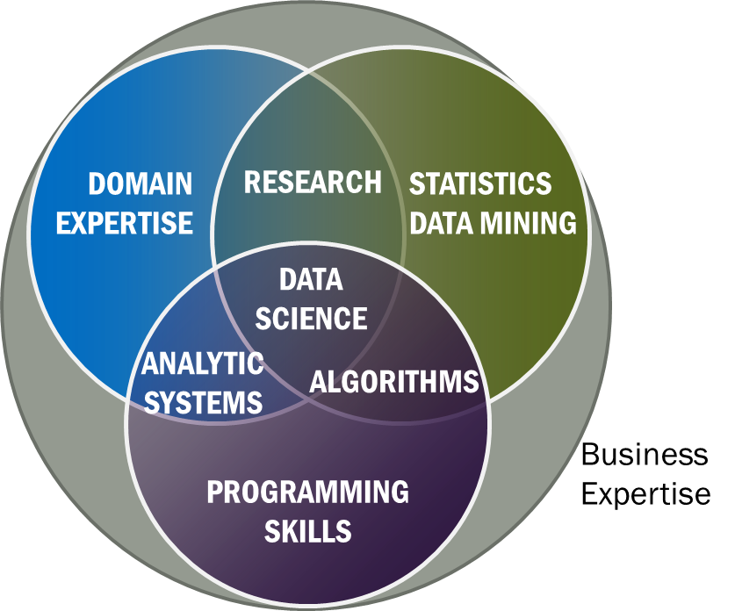
Original NIST Data Science Definition
Data Science is the extraction of actionable knowledge directly from data through a process of discovery, hypothesis, and analytical hypothesis analysis.
A Data Scientist is a practitioner who has sufficient knowledge of the overlapping regimes of expertise in business needs, domain knowledge, analytical skills and programming expertise to manage the end-to-end scientific method process through each stage in the big data lifecycle.
Notes:
Big Data refers to digital data volume, velocity and/or variety whose management requires scalability across coupled horizontal resources
Data Science is the extraction of actionable knowledge directly from data through a process of discovery, hypothesis, and analytical hypothesis analysis.
A Data Scientist is a practitioner who has sufficient knowledge of the overlapping regimes of expertise in business needs, domain knowledge, analytical skills and programming expertise to manage the end-to-end scientific method process through each stage in the big data lifecycle.

Slide 4
NIST Big Data Reference Architecture
INFORMATION VALUE CHAIN
System Orchestrator
Big Data Application Provider
Analytics
Data Provider
Curation
Visualization
Data Consumer
DATA
DATA
SW
Collection
Access
SW
DATA
SW
K E Y :
Big Data Framework Provider
Processing Frameworks (analytic tools, etc.)
IT VALUE CHAIN
Horizontally Scalable
Service Use
Vertically Scalable
Security & Privacy
DATA
Platforms (databases, etc.)
Management
Horizontally Scalable
Data Flow
Vertically Scalable
Infrastructures
SW
Horizontally Scalable (VM clusters)
Vertically Scalable
Analytics Tools Transfer
Physical and Virtual Resources (networking, computing, etc.)

Slide 5
Top 10 Security & Privacy Challenges: Classification
Infrastructure security
Secure Computations in Distributed Programming Frameworks
Security Best Practices for Non-Relational Data Stores
Data Privacy
Privacy Preserving Data Mining and Analytics
Cryptographically Enforced Data Centric Security
Granular Access Control
Data Management
Secure Data Storage and Transaction Logs
Granular Audits
Data Provenance
Integrity and Reactive Security
End-point validation and filtering
Real time Security Monitoring

Slide 6

Use Case Template
26 fields completed for 51 areas
Government Operation: 4
Commercial: 8
Defense: 3
Healthcare and Life Sciences: 10
Deep Learning and Social Media: 6
The Ecosystem for Research: 4
Astronomy and Physics: 5
Earth, Environmental and Polar Science: 10
Energy: 1

Slide 7
51 Detailed Use Cases: Contributed July-September 2013
Covers goals, data features such as 3 V’s, software, hardware
Government Operation(4): National Archives and Records Administration, Census Bureau
Commercial(8): Finance in Cloud, Cloud Backup, Mendeley (Citations), Netflix, Web Search, Digital Materials, Cargo shipping (as in UPS)
Defense(3): Sensors, Image surveillance, Situation Assessment
Healthcare and Life Sciences(10): Medical records, Graph and Probabilistic analysis, Pathology, Bioimaging, Genomics, Epidemiology, People Activity models, Biodiversity
Deep Learning and Social Media(6): Driving Car, Geolocate images/cameras, Twitter, Crowd Sourcing, Network Science, NIST benchmark datasets
The Ecosystem for Research(4): Metadata, Collaboration, Language Translation, Light source experiments
Astronomy and Physics(5): Sky Surveys including comparison to simulation, Large Hadron Collider at CERN, Belle Accelerator II in Japan
Earth, Environmental and Polar Science(10): Radar Scattering in Atmosphere, Earthquake, Ocean, Earth Observation, Ice sheet Radar scattering, Earth radar mapping, Climate simulation datasets, Atmospheric turbulence identification, Subsurface Biogeochemistry (microbes to watersheds), AmeriFlux and FLUXNET gas sensors
Energy(1): Smart grid
Published by NIST as http://nvlpubs.nist.gov/nistpubs/SpecialPublications/NIST.SP.1500-3.pdf with common set of 26 features recorded for each use-case; “Version 2” being prepared
26 Features for each use case Biased to science

Slide 8

Other Sources of Use Cases

Slide 9
Distributed Computing Practice for Large-Scale Science & Engineering
S. Jha, M. Cole, D. Katz, O. Rana, M. Parashar, and J. Weissman,
Characteristics of 6 Distributed Applications
Application Example | Execution Unit | Communication | Coordination | Execution Environment
Montage | Multiple sequential and parallel executable | Files | Dataflow (DAG) | Dynamic process creation, execution
NEKTAR | Multiple concurrent parallel executables | Stream based | Dataflow | Co-scheduling, data streaming, async. I/O
Replica-Exchange | Multiple seq. and parallel executables | Pub/sub | Dataflow and events | Decoupled coordination and messaging
Climate Prediction (generation) | Multiple seq. & parallel executables | Files and messages | Master-Worker, events | @Home (BOINC)
Climate Prediction (analysis) | Multiple seq. & parallel executables | Files and messages | Dataflow | Dynamics process creation, workflow execution
SCOOP | Multiple Executable | Files and messages | Dataflow | Preemptive scheduling, reservations
Coupled Fusion | Multiple executable | Stream-based | Dataflow | Co-scheduling, data streaming, async I/O
Note importance of Workflow(dataflow)

Slide 10
10 Security & Privacy Use Cases
Consumer Digital Media Usage
Nielsen Homescan
Web Traffic Analytics
Health Information Exchange
Personal Genetic Privacy
Pharma Clinic Trial Data Sharing
Cyber-security
Aviation Industry
Military - Unmanned Vehicle sensor data
Education - “Common Core” Student Performance Reporting

Slide 11
7 Computational Giants of
NRC Massive Data Analysis Report
G1: Basic Statistics e.g. MRStat
G2: Generalized N-Body Problems
G3: Graph-Theoretic Computations
G4: Linear Algebraic Computations
G5: Optimizations e.g. Linear Programming
G6: Integration e.g. LDA and other GML
G7: Alignment Problems e.g. BLAST

Slide 12
Examples of First Set of Features

Slide 13
Sample Features of 51 Use Cases I
PP (26) “All” Pleasingly Parallel or Map Only
MR (18) Classic MapReduce MR (add MRStat below for full count)
MRStat (7) Simple version of MR where key computations are simple reduction as found in statistical averages such as histograms and averages
MRIter (23) Iterative MapReduce or MPI (Flink, Spark, Twister)
Graph (9) Complex graph data structure needed in analysis
Fusion (11) Integrate diverse data to aid discovery/decision making; could involve sophisticated algorithms or could just be a portal
Streaming (41) Some data comes in incrementally and is processed this way

Slide 14
Category PP: Pleasingly Parallel Processing
This is a simple but incredibly important class of parallel computing problem.
Parallel computing involves organizing a set of computers to solve a given problem and one major task is organizing the separate computers so they are working together. In pleasingly parallel mode this task is at its simplest as different computers can work independently
When each user accesses a search site, they can be processed independently based on a common backend dataset that has accumulated contributions of all sites and all users
One example is the LHC particle physics analysis where several billion collision events (each of about 1.5 megabytes size for 2 largest experiments) are recorded each year. A major step in analysis is converting the raw data for each event into lists of produced particles and this takes about 10 seconds per core.
Each of the many billion computations are independent and so this problem is pleasingly parallel.
Actually there are several other correlated activities which in this case involve various global reductions such as forming averages for calibration and histograms for physics (see this section of class). We capture this as MRStat category.
Different users accessing a database or different sensors accessing cloud are other pleasing parallel use cases.

Slide 15
4 Basic Forms of MapReduce
(1) Map Only
(2) Classic MapReduce
(3) Iterative Map Reduce or Map-Collective
(4) Point to Point or Map-Communication
Input
Input
Iterations
Input
map
map
map
Local
reduce
reduce
Output
Graph
BLAST Analysis Local Machine Learning Pleasingly Parallel | High Energy Physics (HEP) Histograms Distributed search Recommender Engines | Expectation maximization Clustering e.g. K-means Linear Algebra, PageRank | Classic MPI PDE Solvers and Particle Dynamics Graph Problems
MapReduce and Iterative Extensions (Spark, Twister) |  |  | MPI, Giraph
Integrated Systems such as Hadoop + Harp with Compute and Communication model separated

Slide 16
MR, MRStat, MRIter Categories Variants of MapReduce
One can usefully classify runtime structure by 5 variants of MapReduce
  1. Pleasingly Parallel PP described earlier which is “map-only” in MapReduce
  2. Classic MapReduce MR
  2. Simple version of classic MapReduce MRStat
  3. Iterative MapReduce MRIter
  4. Graph processing Graph – See later
These categories are illustrated as runtime structure on previous slide using SPMD Single Program Multiple Data structure
Always parallelism comes from dividing up something that’s big (typically main dataset listed earlier for 51 use cases) and using lots of processes (cores) each process tackling part of problem.
The calculation done by each process is called a Map and there are various forms of communication between processes required for total answer .
No communication or Map Only is Pleasingly Parallel PP
Classic MapReduce MR has one set of Maps followed by one Reduction
MRStat is a special case of MR with simple reductions corresponding to global sums/averages needed in statistics and histograms
MRIter is seen when you use iterative algorithm as in Expectation maximization and parallel linear algebra. It has multiple waves of maps followed by reductions; efficiency of execution requires information to be stored in memory between iteration
Graph needs point to point communication as is familiar from parallel HPC computations

Slide 17
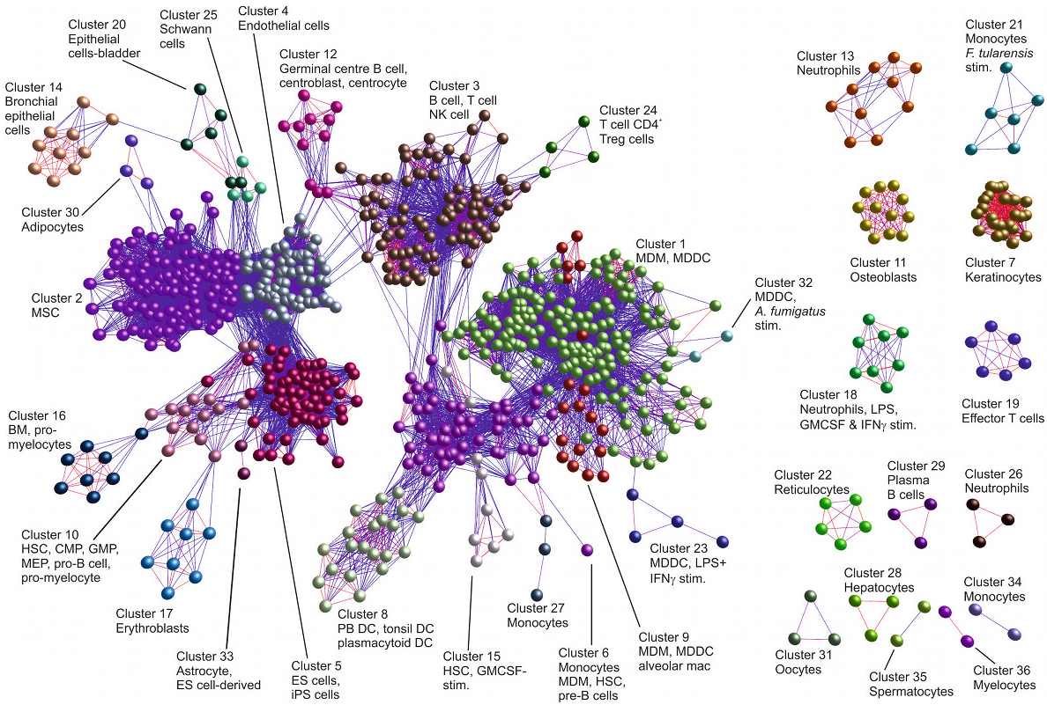
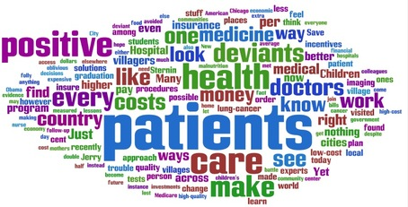
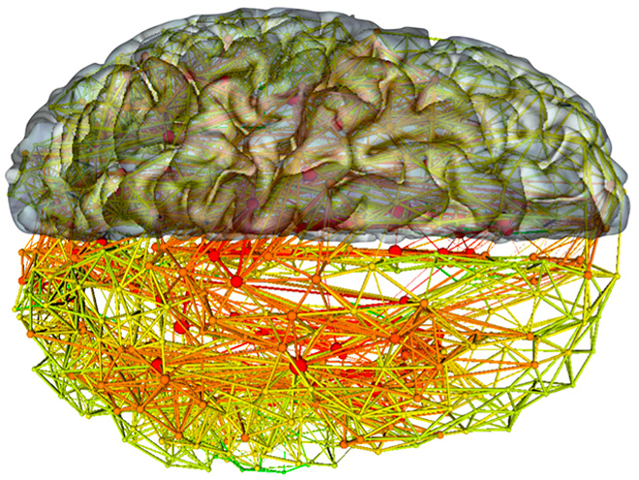
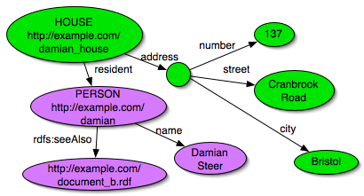
Graph Category
Many problems involve understanding a bunch of entities with complex connections (patients-drugs-doctors-hospitals, RDF Semantic graph,
neurons in brain or more general biological systems)
These require computations cognizant of the connection structure
When you decompose such problems with graph nodes spread over processors, the connections than cross processor boundaries require communication – ABDS systems Giraph and Pregel support this with is “4th form of MapReduce” – maps followed by point to point communication.
92 graph algorithms at http://en.wikipedia.org/wiki/Category:Graph_algorithms

Slide 18
Category Fusion and Workflow:
Data Fusion and Workflow
Data fusion and related areas like “knowledge management” are well used
phrases with an intuitively clear meaning but with no clear technical definition.
Almost all areas have multiple types and sources of data and integrating these together is important
  This corresponds to the “variety” feature of Big Data V’s
Raw Data → Data → Information → Knowledge → Wisdom → Decisions slide show a workflow with multiple services/clouds linked together in a data flow fashion to finally present results fused together in portal
The fusion can be as simple as placing results of analysis of different types of data in different parts of the portal so a decision maker can weigh the different results
Alternatively a clever machine learning algorithm can integrate the different pieces of information and reach a conclusion

Slide 19
First Set of Features:
Streaming Category
We return here with Internet of Things later

Slide 20

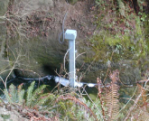
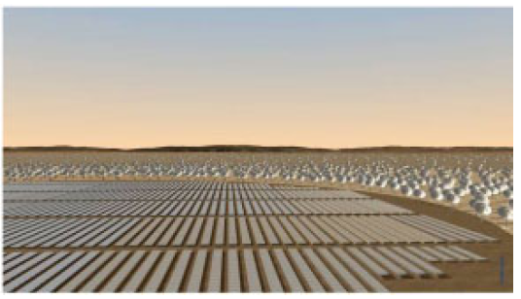
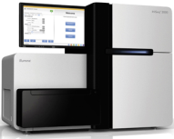
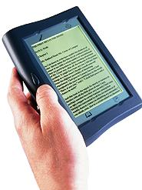





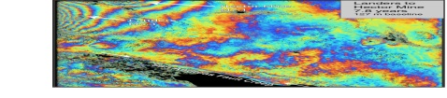
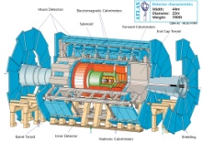
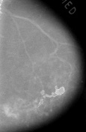

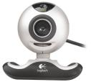

Raw Data → Data → Information → Knowledge → Wisdom → Decisions
Another
Grid
SS
SS
SS
SS
SS
SS
SS
Filter
Cloud
Discovery
Cloud
Portal
Filter
Cloud
Fusion for Discovery/Decisions
SS
Filter
Cloud
Another
Service
SS
Filter
Cloud
Filter
Cloud
Filter
Cloud
Discovery
Cloud
SS
SS
Filter
Cloud
Filter
Cloud
Filter
Cloud
Filter
Cloud
SS
SS: Sensor or Data
Interchange
Service
Workflow through multiple filter/discovery clouds or Services
Another
Cloud
SS
SS
SS
SS
SS
SS
SS
SS
SS
SS
SS
SS
SS
Compute
Cloud
Storage
Cloud
Distributed
Grid
Hadoop Cluster
Database

Slide 21
Streaming Category
We will look at several streaming examples later but most of the use cases involve this. Streaming can be seen in many ways
  There are devices – The Internet of Things and various MEMS in smartphones
  There are people tweeting or logging in to the cloud to search. These interactions are streaming
Apache Storm is critical software here to gather and integrate multiple erratic streams
Also important algorithm challenges to update quickly analyses with streamed data
http://www.kpcb.com/internet-trends

Slide 22
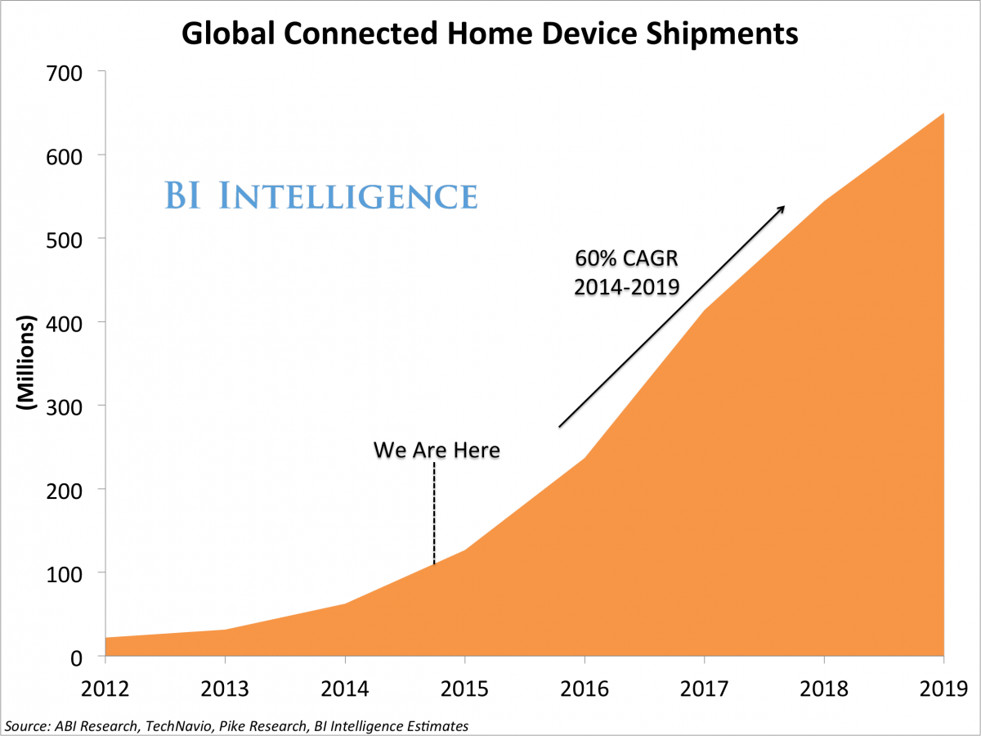
Home Devices

Slide 23
Host of Sensors processed on demand
Sensors are typically small and well served by a single virtual machine in the cloud (in fact share with many other sensors)
Cloud records data, controls and acts as a source of intelligence for sensors (perform hard calculation, access web)
It is projected that there will be 24-50 billion devices on the Internet by 2020

Slide 24
5 Classes of Streaming Applications
Set of independent small events where precise time sequencing unimportant.
  e.g. Independent search requests or tweets from users
Time series of connected small events where time ordering important.
  e.g. Streaming audio or video; robot monitoring
Set of independent large events where each event needs parallel processing with time sequencing not critical
  e.g. Processing images from telescopes or light sources with material or biological sciences.
Set of connected large events where each event needs parallel processing with time sequencing critical.
  e.g. Processing high resolution monitoring (including video) information from robots (self-driving cars) with real time response needed
Stream of connected small or large events that need to be integrated in a complex way.
  e.g. Tweets or other online data where we are using them to update old and find new clusters rather just classifying tweets based on previous clusters i.e. where we update model as well as using it to classify event.

Slide 25
Science Streaming Examples
Streaming Application |  | Details
1 | Data Assimilation | Integrate data into simulations to enhance quality. Distributed Data sources
2 | Analysis of Simulation Results | Climate, Fusion, Molecular Dynamics, Materials. Typically local or in-situ data
3 | Steering Experiments | Control of simulation or Experiment. Data could be local or distributed
4 | Astronomy, Light Sources | Outlier event detection; classification; build model, accumulate data. Distributed Data sources
5 | Environmental Sensors, Smart Grid, Transportation systems | Environmental sensor data or Internet of Things; many small events. Distributed Data sources.
6 | Robotics | Cloud control of Robots including cars. Need processing near robot when decision time < ~1 second
7 | Network Science: Online Classification | Build model and classify with online (streaming) algorithms

Slide 26
Second Set of Features

Slide 27
Features of 51 Big Data Use Cases II
S/Q/Index (12) Index, Search and Query. Important to commercial applications and suitable for MapReduce
Classify (30) Classification: divide data into categories (machine learning) with lots of different methods including clustering, SVM, learning networks, Bayesian methods, random Forests
CF (4) Collaborative Filtering for recommender engines; another key commercial application running under MapReduce; typical algorithm is k nearest neighbors
LML (36) Local Machine Learning (Independent for each parallel entity). Pleasing parallel running R or Image processing etc. on each item in parallelism.
GML (23) Global Machine Learning: Deep Learning, Clustering, LDA, PLSI, MDS,
  Large Scale Optimizations as in Variational Bayes, MCMC, Lifted Belief Propagation, Stochastic Gradient Descent, L-BFGS, Levenberg-Marquardt . Can call EGO or Exascale Global Optimization with scalable parallel algorithm

Slide 28
S/Q/Index Category
This is classic database problem with
  Very good indices for quick query response
  Fault tolerance done very well
The cloud has emphasized alternative solutions based on MapReduce and NoSQL databases
MapReduce can be viewed as exposing the parallel layer inside databases allowing systems like Hive (SQL on Hadoop) to be built which are more scalable (and so cheaper on big data) than classic databases
NoSQL systems support different data abstractions – tables with flexible schema, objects, graphs, documents
  Tools like Drill make them look like SQL stores

Slide 29
Categories Classify and CF:
Many big data use cases involve classification of data in some fashion
Search classifies documents by their nearness to your search
Recommender systems classify items by their relevance to your interests
Network science divide people and the Internet into communities of like-minded folks
Biologists classify sequences by their role and the family to which they belong
Classification is implemented by Machine Learning ML in several ways
SVM divides data into regions by planes
Clustering divides data into groups where members of each group are near each other
Clustering is “unsupervised” learning as no input as to categories
Collaborative Filtering CF is supervised as use existing rankings to predict new rankings
Collaborative Filtering CF is a well known approach for recommender systems that match current user interests with those of others to predict interesting data to investigate
  It has three distinct subclasses user-based, item-based and content-based which can be combined in hybrid fashion
Learning networks train with existing classifications to be able to predict new ones and so are typically supervised (although use case 26 has both)

Slide 30
Second Set of Features
Machine Learning

Slide 31
Categories LML GML
Local and Global Machine Learning
So far we have classified overall features of computing and applications.
Now we look at particular analysis applied to each data item i.e. to analytics
There are two important styles – Global (GML) and Local (LML) – describing if analytics is applicable to whole dataset or is applied separately to each data point.
  Pleasing Parallel applications are defined by local analytics
  MRIter, EGO and EM (Expectation Maximization) applications are global
Global analytics require non trivial parallel algorithms which are often challenging either at algorithm or implementation level.
Machine learning ML can be applied locally or globally and can be used for most analysis algorithms tackling generic issues like classification and pattern recognition
  Note use cases like 39,40,43,44 have domain specific analysis (called signal processing for radar data in 43,44) that takes raw data and converts into meaningful information – this not machine learning although it could use local machine learning components

Slide 32
Aspects of Analytics
So Expectation Maximization EM is an important class of Iterative optimization where approximate optimizations are calculated iteratively. Each iteration has two steps – E and M – each of which calculates new values for a subset of variables fixing the other subset
  This avoids difficult nonlinear optimization but it is often an active research area to find the choice of EM heuristic that gives “best answer” measured by execution time or quality of result
A particularly difficult class of optimization comes from datasets where graphs are an important data structure or more precisely complicated graphs that complicate the task of querying data to find members satisfying a particular graph structure

Slide 33
Category GML: Global Machine Learning aka EGO – Exascale Global Optimization
Typically maximum likelihood or χ² with a sum over the N data items – documents, , sequences, items to be sold, images etc. and often links (point-pairs). Usually it’s a sum of positive numbers as in least squares
Covering clustering/community detection, mixture models, topic determination, Multidimensional scaling, (Deep) Learning Networks
PageRank is “just” parallel linear algebra
Note many Mahout algorithms are sequential – partly as MapReduce limited; partly because parallelism unclear
  MLLib (Spark based) better
SVM and Hidden Markov Models do not use large scale parallelization in practice?
Detailed papers on particular parallel graph algorithms

Slide 34
Exascale Global Optimization EGO
  EGO is used to represent an artificial intelligence (AI) GML problem phrased as a giant optimization over many variables
    Name invented at Argonne-Chicago workshop
  The simplest case is χ² or similar Maximum likelihood formulations which end as minimization of a sum of terms which involve observational data and parameters to be determined
  This analytic formulation of AI is rather different from traditional rule based or expert system AI
  Its easy enough to minimize the sum of a billion terms but not so easy to reliably apply a billion rules
  One example illustrated later is Multi-dimensional scaling where for N entities (say sequences) one has N(N-1)/2 measures of similarities between pairs and one minimizes weighted sum of square of similarities minus predicted similarities from an assignment of entity to a position in some vector space.
  Information retrieval takes the world’s documents and finds best possible set of topics implied by them

Slide 35
Third Set of Features

Slide 36
Features of 51 Big Data Use Cases III
Workflow (51) Universal “orchestration” or dataflow
between different tasks in job
(Described earlier under Fusion)
GIS (16) Geographical Information System. Geotagged data and often displayed in ESRI, Microsoft Virtual Earth, Google Earth, GeoServer, Minnesota Map Server etc.
HPC (5) Classic large-scale simulation of cosmos, materials, etc. generating (visualization) data to be analyzed for turbulence, particle trajectories etc.
Agent (2) Simulations of models of data-defined macroscopic entities represented as agents. Use in simulations of cities (vehicle flow)or spread of information in complex system.

Slide 37
GIS Category Support of spatial big data
Many use cases are involved with entities that are functions of space and time; in particular use cases from defense, earth, environmental, polar science are strongly correlated to position
  Some Physics and most Astronomy use cases can also have this feature
Note use cases 43 and 44 have map-based illustrations.
Fundamental physics use case 39 is not like this – partly as quantum mechanics makes traditional pictures misleading but physics often uses non map based 3D simulations.
A GIS – Geographical Information System – is designed to display spatial (“geo-located) data with information added or available as you browse via clicking; Google Earth and maps are familiar GIS and ESRI
The Open Geospatial Consortium has set standards and methodology to allow different owners of geolocated material present their wares so can be placed on same GIS display

Slide 38
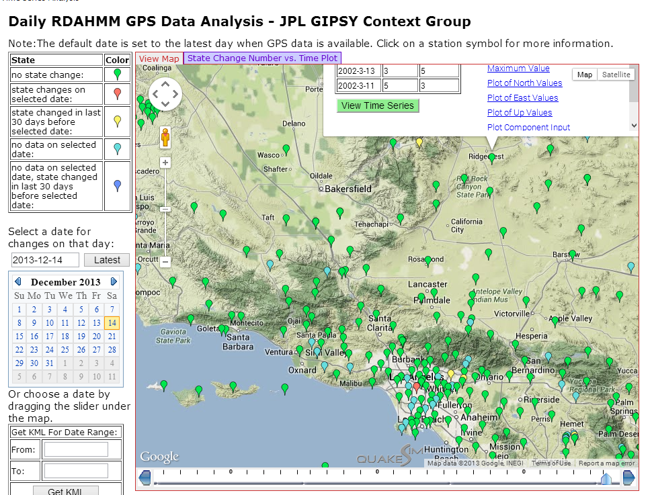
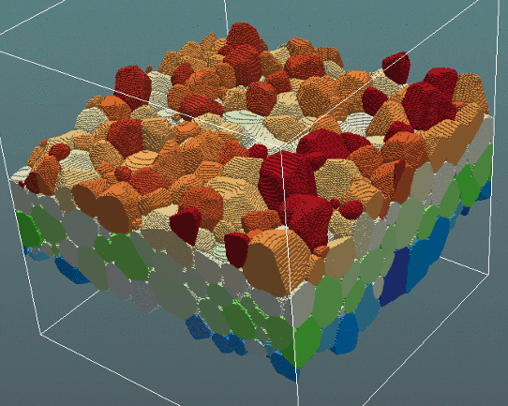
3D (4D with time) science has special displays or visualizations
3D view of a grain structure in a nanomaterial (use cases 11,12) http://www.icams.de/content/departments/stks/index.html
GIS of GPS sensors monitored at JPL http://www.quakesim.org/tools/timeseries for earthquake signatures with one GPS clicked near top right to get more information

Slide 39
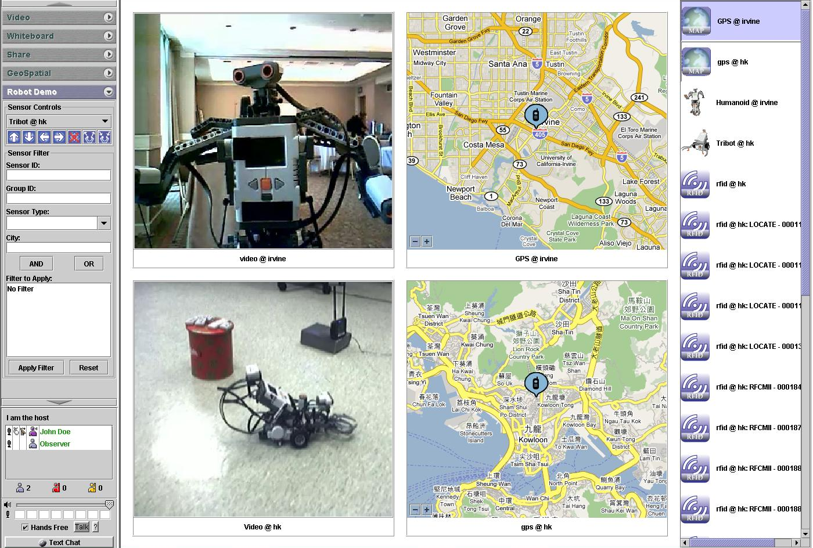
Sensor Control Interface with GIS and Information Fusion

Slide 40
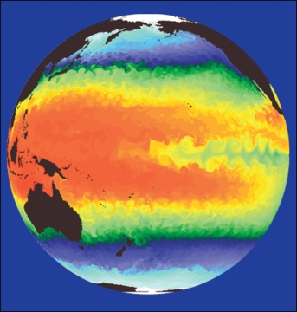
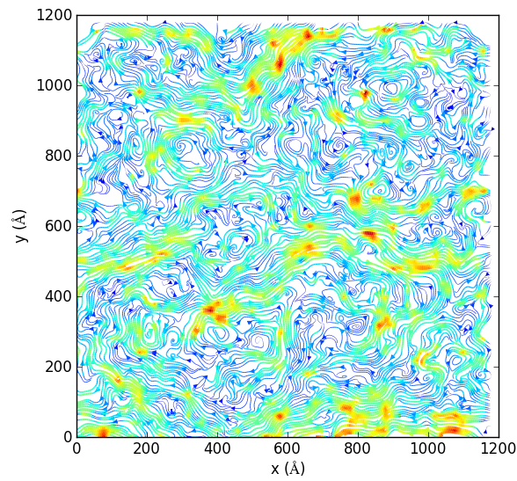
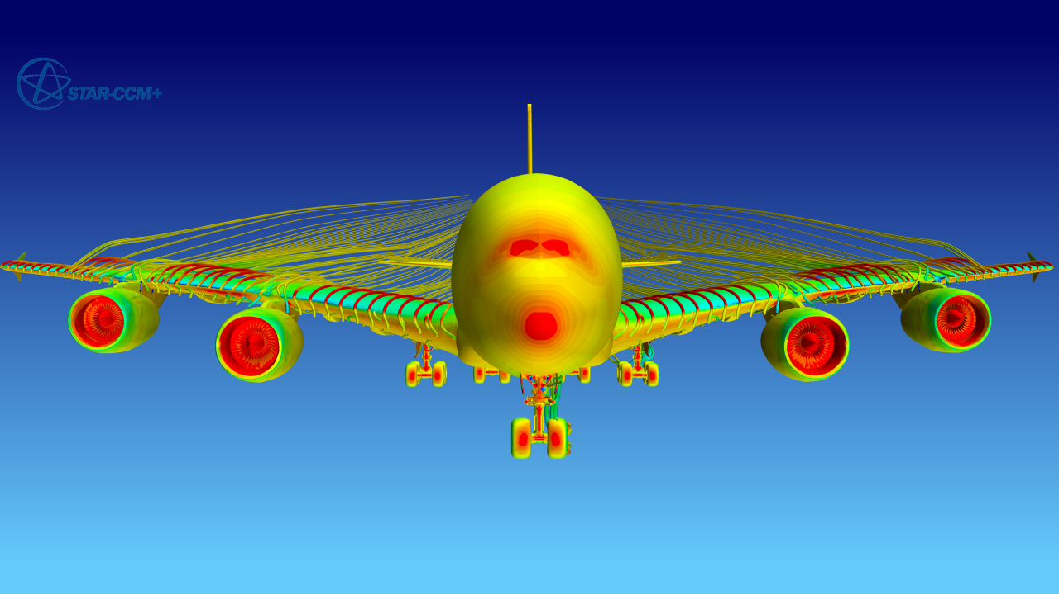
Category HPC
High Performance Computing
Large scale simulations produce output that can often be thought of as visualizations
These need to be automatically analyzed to identify key features
Here see molecular dynamics, airflow (turbulence) and climate
Petabyte/Second for an exascale supercomputer

Slide 41
Category Agent: Agent-based modelling:
When one simulates a new material one typically uses fundamental equations of matter describing atoms, electrons, molecules. However if we want to simulate the stock market, transportation systems or reaction of population to disease or shock, then the basic entities are not fundamental quantities
Rather people, cars, stocks are “macroscopic quantities” defined not by Newton’s laws but by some set of interaction or time evolution “empirical” rules. They form complex systems
One uses Agents which are black boxes with defined responses to other agents and rest of context for this type of simulation
  Agents are sometimes evolved with slow event driven simulations but the methods used in use cases 23 and 24 are much faster although agent simulations are always slower (per entity) than simple fundamental particle simulations

Slide 42
S/Q/Index Category
Classical Database

Slide 43
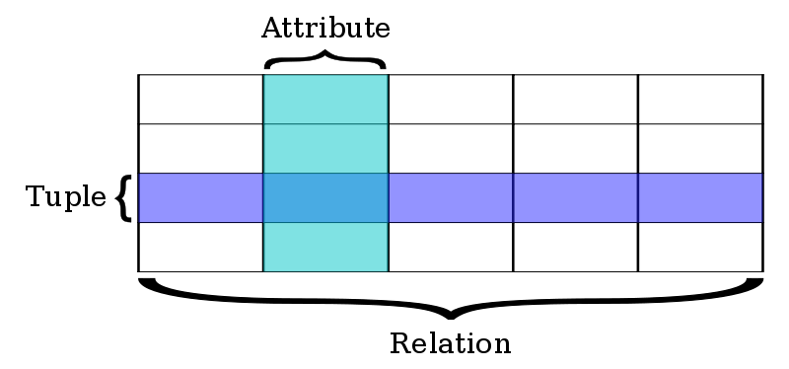
Classic Database application
Now we discuss approaches to important Search&Query and Index features
Built around predetermined table structures (“Schema-on-write”) with highly optimized queries in SQL language
OLTP Online Transaction Processing as done for bank accounts is a good example where traditional (relational) databases good.
Very good indices for quick query response
Fault tolerance done very well
This can be scaled to large systems but
parallelism is not easy – partly due to
robustness constraints.
Note bank accounts involve little computing and data is “only” large
  100 million people at ten megabytes of data (10⁵ transactions of 100 bytes) is a petabyte

Slide 44
Classic Database application
There is a vigorous debate as to which is better
  Databases or new cloud solutions typified by Hadoop for processing and NoSQL for storage?
Modern data analytics are not helped significantly by RDBMS (Relational Database management System) technologies and can run on cheaper hardware that can scale to much larger datasets than RDBMS
  SQL does not have built in clustering or recommender systems!
One can view MapReduce as exposing parallelism possible in databases and Hive+Hadoop as one example of cost effective parallel RDBMS
The RDBMS optimizations (which are great for OLTP) come at a cost so that price per terabyte per year is $1000-$2000 for a Hadoop cluster but 5-10 or more times that for a commercial RDBMS installation
  RDBMS needs more expensive servers whereas Hadoop scales on cheap commodity hardware.
  Commercial RDBMS software very expensive
ETL (Extract, Transform Load) and “Data Warehouse” are important terms in describing RDBMS approach to diverse unstructured data
  Also operational data store or ODS

Slide 45
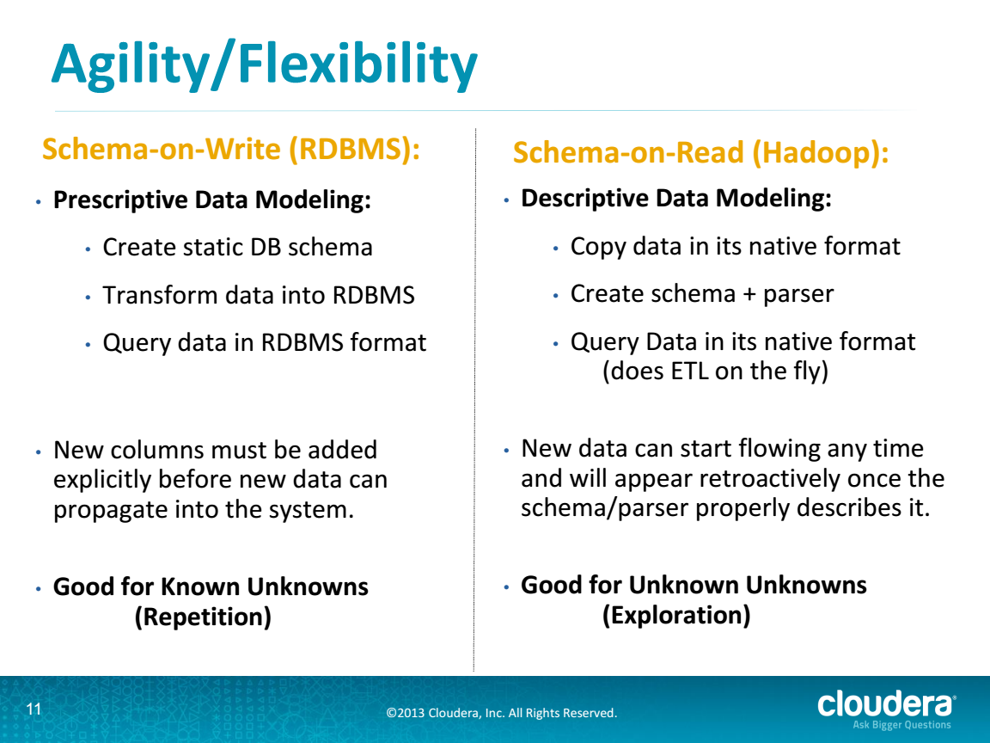
RDBMS v. Cloud from Cloudera
http://cci.drexel.edu/bigdata/bigdata2013/Apache%20Hadoop%20in%20the%20Enterprise.pdf

Slide 46
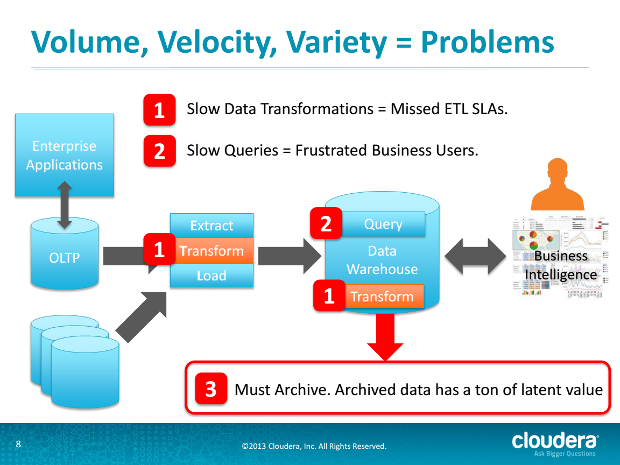
Problems in RDBMS Approach
http://cci.drexel.edu/bigdata/bigdata2013/Apache%20Hadoop%20in%20the%20Enterprise.pdf

Slide 47
Traditional Relational Database Approach
ETL = Extract, Transform, Load
20120119berkeley.pdf Jeff Hammerbacher

Slide 48
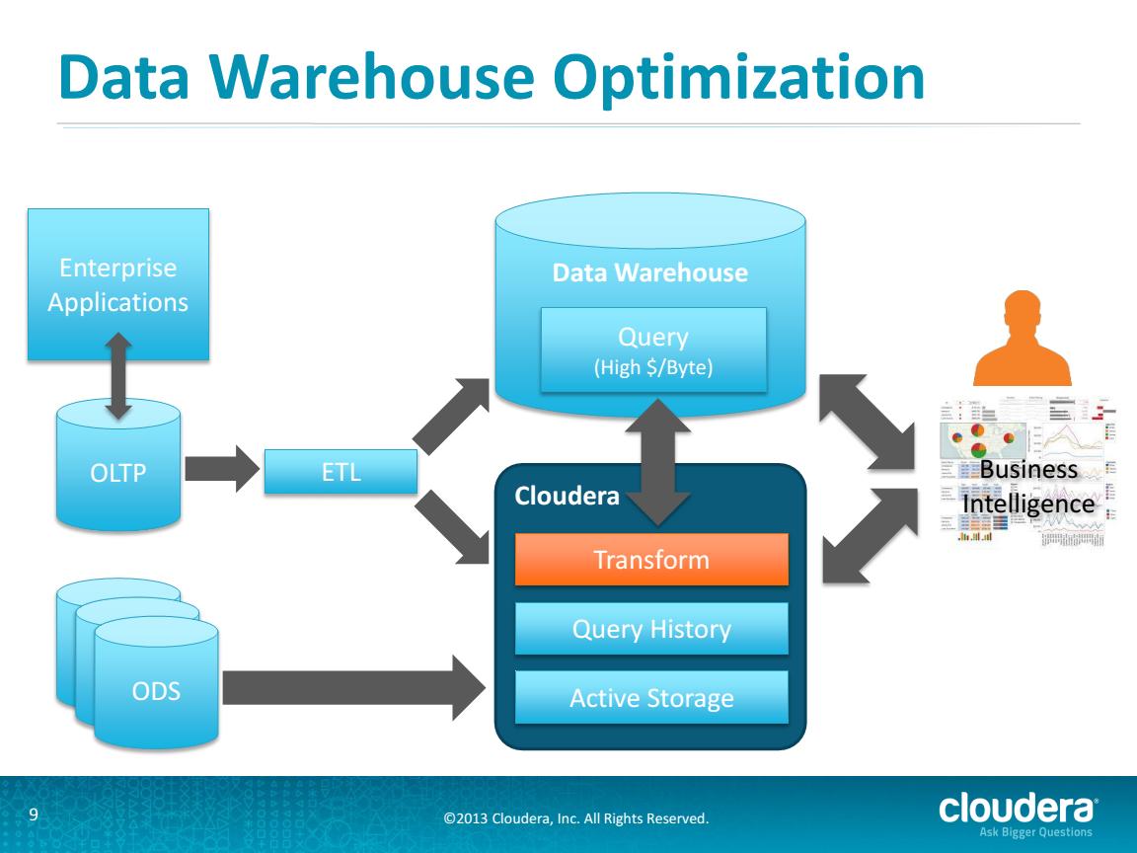
Hybrid RDBMS Cloud Solution from Cloudera
http://cci.drexel.edu/bigdata/bigdata2013/Apache%20Hadoop%20in%20the%20Enterprise.pdf

Slide 49
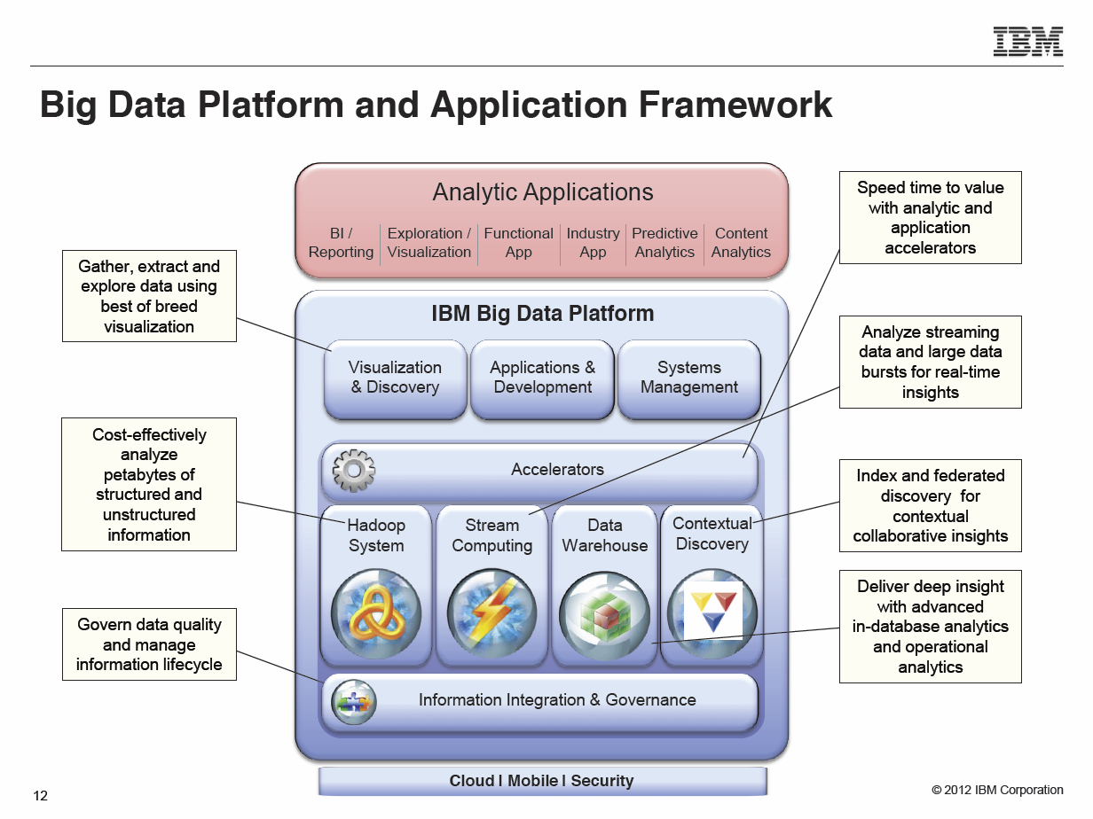
Typical Modern Do-everything Solution from IBM
Anjul Bhambhri, VP of Big Data, IBM http://fisheritcenter.haas.berkeley.edu/Big_Data/index.html

Slide 50
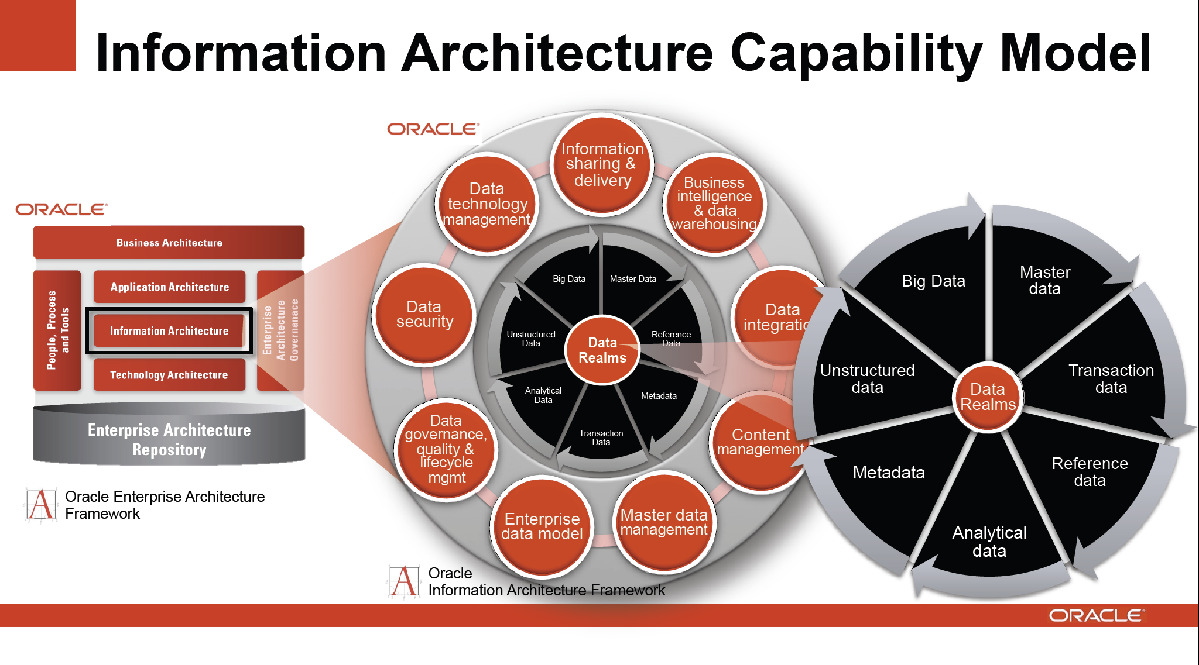
Typical Modern Do-everything Solution from Oracle
http://cs.metrostate.edu/~sbd/ Oracle

Slide 51
S/Q/Index Category
NoSQL Solutions

Slide 52
Database built on top of
NoSQL such as Hbase for media I
The “cloud” solution for databases or data systems was originally developed by the Internet companies – Google and Yahoo for search and Amazon, eBay for commerce, who needed cheaper faster solutions than relational databases.
They were driven by the commercial cloud infrastructure companies pioneered and still dominated by Amazon which made it easy for new startups (as large as Netflix) to outsource their computing flexibly
Hadoop (developed at Yahoo on MapReduce model from Google) was an important driver as MapReduce turned out to be easy to use, powerful and free.
Hadoop was developed by Apache open source process and grew many related projects forming the Apache Big Data Stack – many of them contained in Apache Bigtop project.
Cloudera was a company whose business model involves supporting and enhancing Apache big data stack

Slide 53
Database built on top of
NoSQL such as Hbase for media II
One important part of Hadoop ecosystem is Hbase which is the open source version of Bigtable which was the original Google data management system built to support distributed tables
Hbase is built on HDFS – the Hadoop File System – which correspondingly is open source version of GFS – the Google File System
  Key feature is data distributed over same nodes that do computing
  Builds in “Bring computing to the Data” Big data principle
HDFS/Hbase is equivalent of stored data in relational database
Hadoop MapReduce is equivalent of SQL processing engine although it uses Java not SQL to express processing
Hadoop runs several maps in parallel in so-called SPMD (single program multiple data) mode – each map processes a part of the data
  The Reduce step integrates the results from all maps to get full answer.

Slide 54
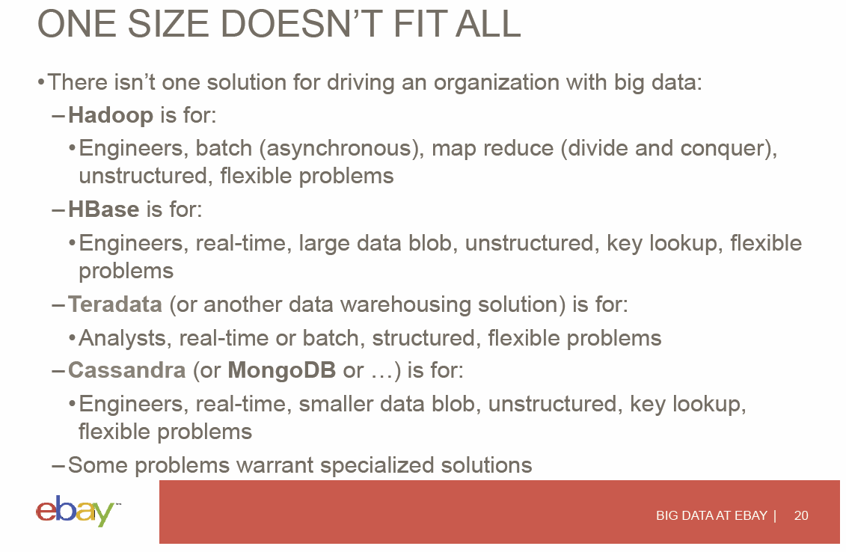
View from eBay on Trade-offs
Hugh Williams
http://fisheritcenter.haas.berkeley.edu/Big_Data/index.html

Slide 55
Examples: Especially Image based Applications

Slide 56
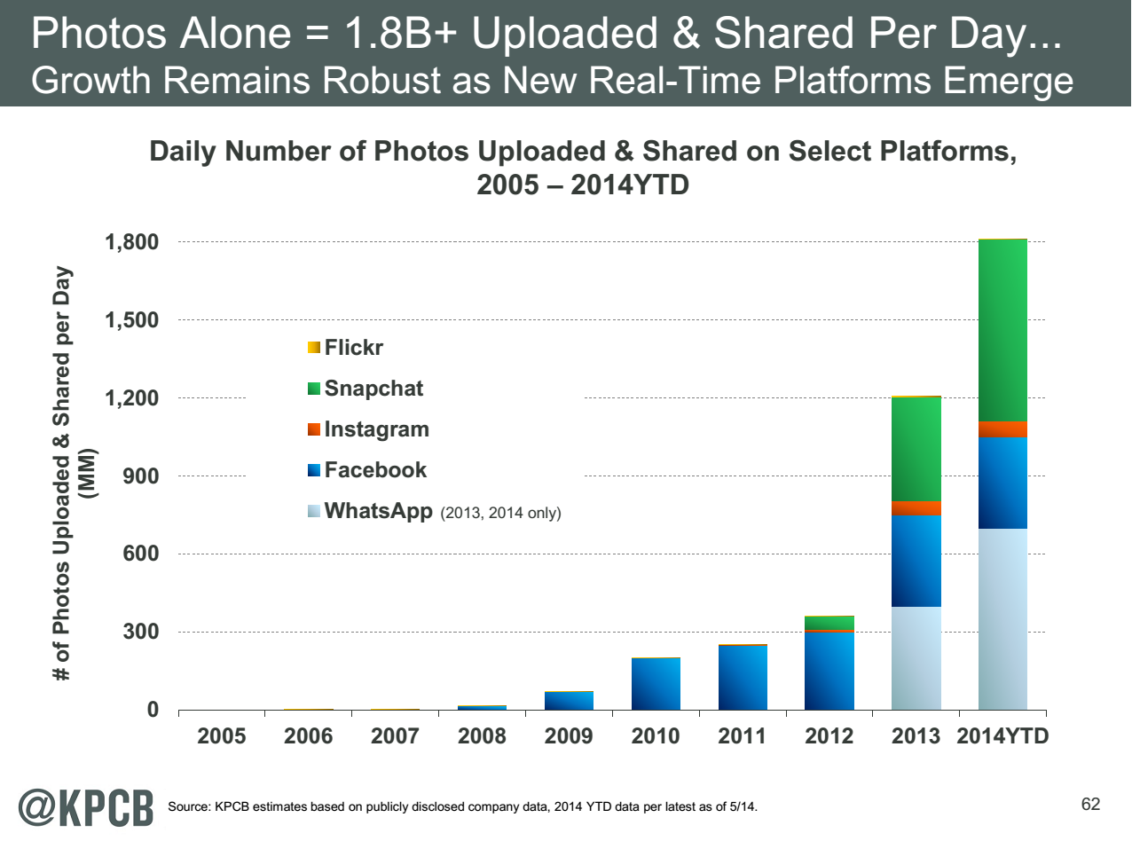
http://www.kpcb.com/internet-trends

Slide 57
Thirteen Image-based Use Cases in the 51
13-15 Military Sensor Data Analysis/ Intelligence
PP, LML, GIS, MR
7:Pathology Imaging/ Digital Pathology: PP, LML,
MR for search becoming terabyte 3D images, Global Classification
18&35: Computational Bioimaging (Light Sources): PP, LML Also materials
26: Large-scale Deep Learning: GML Stanford ran 10 million images and 11 billion parameters on a 64 GPU HPC; vision (drive car), speech, and Natural Language Processing
27: Organizing large-scale, unstructured collections of photos: GML Fit position and camera direction to assemble 3D photo ensemble
36: Catalina Real-Time Transient Synoptic Sky Survey (CRTS): PP, LML followed by classification of events (GML)
43: Radar Data Analysis for CReSIS Remote Sensing of Ice Sheets: PP, LML to identify glacier beds; GML for full ice-sheet
44: UAVSAR Data Processing, Data Product Delivery, and Data Services: PP to find slippage from radar images
45, 46: Analysis of Simulation visualizations: PP LML ?GML find paths, classify orbits, classify patterns that signal earthquakes, instabilities, climate, turbulence

Slide 58
13: Cloud Large Scale Geospatial Analysis and Visualization
Defense
Application: Need to support large scale geospatial data analysis and visualization with number of geospatially aware sensors and the number of geospatially tagged data sources rapidly increasing.
Current Approach: Traditional GIS systems are generally capable of analyzing millions of objects and easily visualizing thousands. Data types include Imagery (various formats such as NITF, GeoTiff, CADRG), and vector with various formats like shape files, KML, text streams. Object types include points, lines, areas, polylines, circles, ellipses. Data accuracy very important with image registration and sensor accuracy relevant. Analytics include closest point of approach, deviation from route, and point density over time, PCA and ICA. Software includes Server with Geospatially enabled RDBMS, Geospatial server/analysis software – ESRI ArcServer, Geoserver; Visualization by ArcMap or browser based visualization
Futures: Today’s intelligence systems often contain trillions of geospatial objects and need to be able to visualize and interact with millions of objects. Critical issues are Indexing, retrieval and distributed analysis; Visualization generation and transmission; Visualization of data at the end of low bandwidth wireless connections; Data is sensitive and must be completely secure in transit and at rest (particularly on handhelds); Geospatial data requires unique approaches to indexing and distributed analysis.
PP, GIS, Classification
Streaming
Parallelism over Sensors and people accessing data

Slide 59
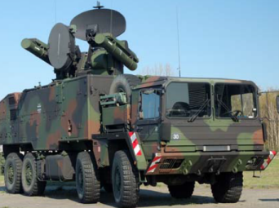
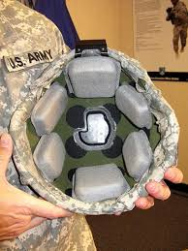
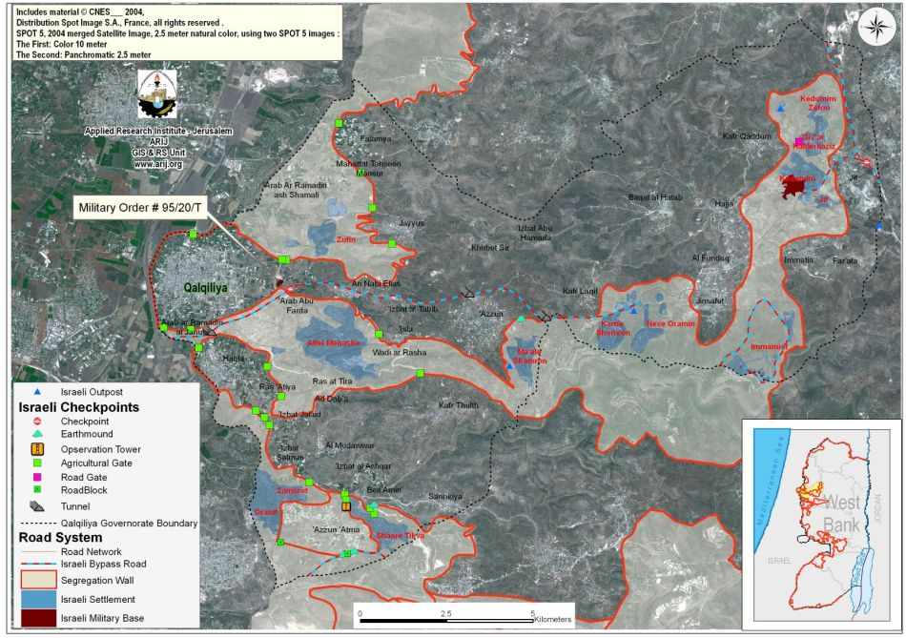
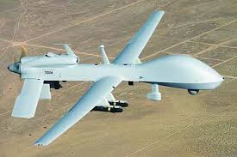
13: Cloud Large Scale Geospatial Analysis and Visualization
Defense
This introduces important concept of a Geographical Information System displaying results from sensors
GIS: Geotagged data and often displayed in ESRI, Google Earth etc.
PP, GIS, Classification
Streaming
Parallelism over Sensors and people accessing data

Slide 60
14: Object identification and tracking from Wide Area Large Format Imagery (WALF) Imagery or Full Motion Video (FMV) – Persistent Surveillance
Defense
Application: Persistent surveillance sensors can easily collect petabytes
of imagery data in the space of a few hours. The data should be reduced
to a set of geospatial object (points, tracks, etc.) which can easily be integrated with other data to form a common operational picture. Typical processing involves extracting and tracking entities (vehicles, people, packages) over time from the raw image data.
Current Approach: The data needs to be processed close to the sensor which is likely forward deployed since data is too large to be easily transmitted. Typical object extraction systems are currently small (1-20 node) GPU enhanced clusters. There are a wide range of custom software and tools including traditional RDBMS’s and display tools. Real time data obtained at FMV (Full Motion Video) – 30-60 frames per/sec at full color 1080P resolution or WALF (Wide Area Large Format) with 1-10 frames per/sec at 10Kx10K full color resolution. Visualization of extracted outputs will typically be as overlays on a geospatial (GIS) display. Analytics are basic object detection analytics and integration with sophisticated situation awareness tools with data fusion. Significant security issues to ensure the enemy is not able to know what we see.
Futures: Typical problem is integration of this processing into a large (GPU) cluster capable of processing data from several sensors in parallel and in near real time. Transmission of data from sensor to system is also a major challenge.
Streaming
PP, GIS, MR, MRIter? Classification
Parallelism over Sensors and people accessing data

Slide 61
15: Intelligence Data Processing and Analysis
Defense
Application: Allow Intelligence Analysts to a) Identify relationships
between entities (people, organizations, places, equipment) b) Spot trends in sentiment or intent for either general population or leadership group (state, non-state actors) c) Find location of and possibly timing of hostile actions (including implantation of IEDs) d) Track the location and actions of (potentially) hostile actors e) Ability to reason against and derive knowledge from diverse, disconnected, and frequently unstructured (e.g. text) data sources f) Ability to process data close to the point of collection and allow data to be shared easily to/from individual soldiers, forward deployed units, and senior leadership in garrison.
Current Approach: Software includes Hadoop, Accumulo (Big Table), Solr, Natural Language Processing, Puppet (for deployment and security) and Storm running on medium size clusters. Data size in 10s of Terabytes to 100s of Petabytes with Imagery intelligence device gathering petabyte in a few hours. Dismounted warfighters would have at most 1-100s of Gigabytes (typically handheld data storage).
Futures: Data currently exists in disparate silos which must be accessible through a semantically integrated data space. Wide variety of data types, sources, structures, and quality which will span domains and requires integrated search and reasoning. Most critical data is either unstructured or imagery/video which requires significant processing to extract entities and information. Network quality, Provenance and security essential.
GIS, MR, MRIter?, Classification, Fusion
Parallelism over Sensors and people accessing data
Streaming

Slide 62
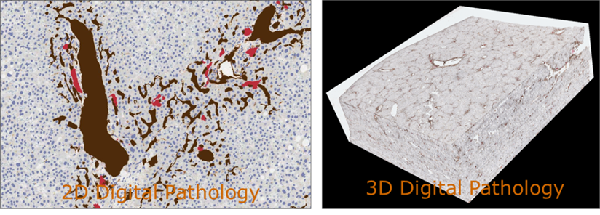
17:Pathology Imaging/Digital Pathology I
Healthcare
Life Sciences
Application: Digital pathology imaging is an emerging field
where examination of high resolution images of tissue
specimens enables novel and more effective ways for disease diagnosis. Pathology image analysis segments massive (millions per image) spatial objects such as nuclei and blood vessels, represented with their boundaries, along with many extracted image features from these objects. The derived information is used for many complex queries and analytics to support biomedical research and clinical diagnosis.
MR, MRIter, PP, Classification
Streaming
Parallelism over Images

Slide 63
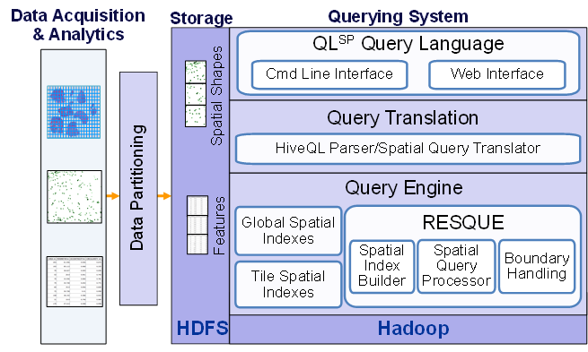
17: Pathology Imaging/ Digital Pathology II
Healthcare
Life Sciences
Current Approach: 1GB raw image data + 1.5GB analytical results per 2D image. MPI for image analysis; MapReduce + Hive with spatial extension on supercomputers and clouds. GPU’s used effectively. Figure below shows the architecture of Hadoop-GIS, a spatial data warehousing system over MapReduce to support spatial analytics for analytical pathology imaging.
Futures: Recently, 3D pathology imaging is made possible through 3D laser technologies or serially sectioning hundreds of tissue sections onto slides and scanning them into digital images. Segmenting 3D microanatomic objects from registered serial images could produce tens of millions of 3D objects from a single image. This provides a deep “map” of human tissues for next generation diagnosis. 1TB raw image data + 1TB analytical results per 3D image and 1PB data per moderated hospital per year.
Architecture of Hadoop-GIS, a spatial data warehousing system over MapReduce to support spatial analytics for analytical pathology imaging

Slide 64
26: Large-scale Deep Learning
Application: Large models (e.g., neural networks with more neurons and connections) combined with large datasets are increasingly the top performers in benchmark tasks for vision, speech, and Natural Language Processing. One needs to train a deep neural network from a large (>>1TB) corpus of data (typically imagery, video, audio, or text). Such training procedures often require customization of the neural network architecture, learning criteria, and dataset pre-processing. In addition to the computational expense demanded by the learning algorithms, the need for rapid prototyping and ease of development is extremely high.
Current Approach: The largest applications so far are to image recognition and scientific studies of unsupervised learning with 10 million images and up to 11 billion parameters on a 64 GPU HPC Infiniband cluster. Both supervised (using existing classified images) and unsupervised applications
Futures: Large datasets of 100TB or more may be necessary in order to exploit the representational power of the larger models. Training a self-driving car could take 100 million images at megapixel resolution. Deep Learning shares many characteristics with the broader field of machine learning. The paramount requirements are high computational throughput for mostly dense linear algebra operations, and extremely high productivity for researcher exploration. One needs integration of high performance libraries with high level (python) prototyping environments
Classified OUT
IN
Deep Learning, Social Networking
GML, EGO, MRIter, Classify

Slide 65
27: Organizing large-scale, unstructured collections of consumer photos I
Deep Learning
Social Networking
Application: Produce 3D reconstructions of
scenes using collections of millions to billions
of consumer images, where neither the scene structure nor the camera positions are known a priori. Use resulting 3d models to allow efficient browsing of large-scale photo collections by geographic position. Geolocate new images by matching to 3d models. Perform object recognition on each image. 3d reconstruction posed as a robust non-linear least squares optimization problem where observed relations between images are constraints and unknowns are 6-d camera pose of each image and 3-d position of each point in the scene.
Current Approach: Hadoop cluster with 480 cores processing data of initial applications. Note over 500 billion images on Facebook and over 5 billion on Flickr with over 500 million images added to social media sites each day.
EGO, GIS, MR, Classification
Parallelism over Photos

Slide 66
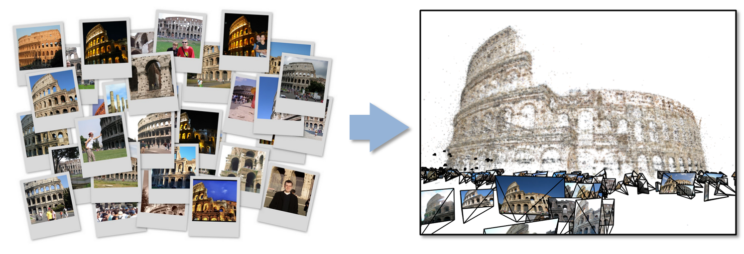
27: Organizing large-scale, unstructured collections of consumer photos II
Deep Learning
Social Networking
Futures: Need many analytics including feature extraction, feature matching, and large-scale probabilistic inference, which appear in many or most computer vision and image processing problems, including recognition, stereo resolution, and image denoising. Need to visualize large-scale 3-d reconstructions, and navigate large-scale collections of images that have been aligned to maps.

Slide 67
36: Catalina Real-Time Transient Survey (CRTS): a digital, panoramic, synoptic sky survey I
Astronomy & Physics
Application: The survey explores the variable universe in the visible
light regime, on time scales ranging from minutes to years, by searching for variable and transient sources. It discovers a broad variety of astrophysical objects and phenomena, including various types of cosmic explosions (e.g., Supernovae), variable stars, phenomena associated with accretion to massive black holes (active galactic nuclei) and their relativistic jets, high proper motion stars, etc. The data are collected from 3 telescopes (2 in Arizona and 1 in Australia), with additional ones expected in the near future (in Chile).
Current Approach: The survey generates up to ~ 0.1 TB on a clear night with a total of ~100 TB in current data holdings. The data are preprocessed at the telescope, and transferred to Univ. of Arizona and Caltech, for further analysis, distribution, and archiving. The data are processed in real time, and detected transient events are published electronically through a variety of dissemination mechanisms, with no proprietary withholding period (CRTS has a completely open data policy). Further data analysis includes classification of the detected transient events, additional observations using other telescopes, scientific interpretation, and publishing. In this process, it makes a heavy use of the archival data (several PB’s) from a wide variety of geographically distributed resources connected through the Virtual Observatory (VO) framework.
Parallelism over Images and Events: Celestial events identified in Telescope Images
PP, ML, Classification
Streaming

Slide 68
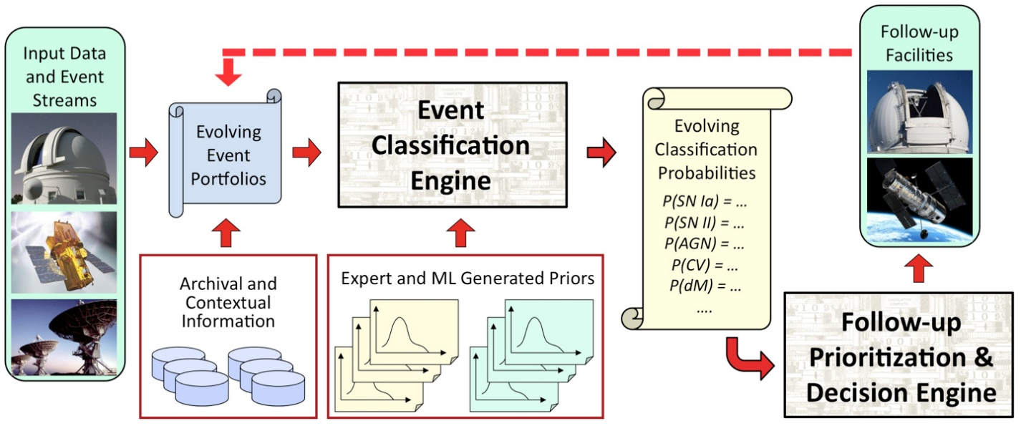
36: Catalina Real-Time Transient Survey (CRTS): a digital, panoramic, synoptic sky survey II
Astronomy & Physics
Futures: CRTS is a scientific and methodological testbed
and precursor of larger surveys to come, notably the
Large Synoptic Survey Telescope (LSST), expected to operate in 2020’s and selected as the highest-priority ground-based instrument in the 2010 Astronomy and Astrophysics Decadal Survey. LSST will gather about 30 TB per night.

Slide 69
35: Light source beamlines
Application: Samples are exposed to X-rays from light sources in a variety of configurations depending on the experiment. Detectors (essentially high-speed digital cameras) collect the data. The data are then analyzed to reconstruct a view of the sample or process being studied.
Current Approach: A variety of commercial and open source software is used for data analysis – examples including Octopus for Tomographic Reconstruction, Avizo (http://vsg3d.com) and FIJI (a distribution of ImageJ) for Visualization and Analysis. Data transfer is accomplished using physical transport of portable media (severely limits performance) or using high-performance GridFTP, managed by Globus Online or workflow systems such as SPADE.
Futures: Camera resolution is continually increasing. Data transfer to large-scale computing facilities is becoming necessary because of the computational power required to conduct the analysis on time scales useful to the experiment. Large number of beamlines (e.g. 39 at LBNL ALS) means that total data load is likely to increase significantly and require a generalized infrastructure for analyzing gigabytes per second of data from many beamline detectors at multiple facilities.
Research Ecosystem PP, LML, Streaming

Slide 70
43: Radar Data Analysis for CReSIS Remote Sensing of Ice Sheets I
Earth, Environmental and Polar Science
Application: This data feeds into intergovernmental Panel on Climate Change (IPCC) and uses custom radars to measures ice sheet bed depths and (annual) snow layers at the North and South poles and mountainous regions.
Current Approach: The initial analysis is currently Matlab signal processing that produces a set of radar images. These cannot be transported from field over Internet and are typically copied to removable few TB disks in the field and flown “home” for detailed analysis. Image understanding tools with some human oversight find the image features (layers) shown later, that are stored in a database front-ended by a Geographical Information System. The ice sheet bed depths are used in simulations of glacier flow. The data is taken in “field trips” that each currently gather 50-100 TB of data over a few week period.
Futures: An order of magnitude more data (petabyte per mission) is projected with improved instrumentation. Demands of processing increasing field data in an environment with more data but still constrained power budget, suggests low power/performance architectures such as GPU systems.
PP, GIS
Streaming
Parallelism over Radar Images

Slide 71
43: Radar Data Analysis for CReSIS Remote Sensing of Ice Sheets II
Typical CReSIS data showing aircraft taking data which shows a glacier bed at a depth of 3100 meters with multiple confusing reflections.
Earth, Environmental and Polar Science

Slide 72
43: Radar Data Analysis for CReSIS Remote Sensing of Ice Sheets III
Earth, Environmental and Polar Science
Typical flight paths of CReSIS data gathering in survey region

Slide 73
43: Radar Data Analysis for CReSIS Remote Sensing of Ice Sheets IV
Earth, Environmental and Polar Science
Typical CReSIS echogram with Detected Boundaries. The
upper (green) boundary is between air and ice layer
while the lower (red) boundary is between ice and terrain
PP, GIS
Streaming
Parallelism over Radar Images

Slide 74
44: UAVSAR Data Processing, Data Product Delivery, and Data Services I
Application: Synthetic Aperture Radar (SAR) can identify landscape changes caused by seismic activity, landslides, deforestation, vegetation
changes and flooding. This is for example used to support earthquake science (see next slide) as well as disaster management. This use case supports the storage, application of image processing and visualization of this geo-located data with angular specification.
Current Approach: Data from planes and satellites is processed on NASA computers before being stored after substantial data communication. The data is made public as soon as processed and requires significant curation due to instrumental glitches. The current data size is ~150TB
Futures: The data size would increase dramatically if Earth Radar Mission launched. Clouds are suitable hosts but are not used today in production.
Earth, Environmental and Polar Science
PP, GIS
Streaming
Parallelism over Radar Images

Slide 75
44: UAVSAR Data Processing, Data Product Delivery, and Data Services II
Combined unwrapped coseismic interferograms for flight lines 26501, 26505, and 08508 for the October 2009 – April 2010 time period. End points where slip can be seen on the Imperial, Superstition Hills, and Elmore Ranch faults are noted. GPS stations are marked by dots and are labeled.
Earth, Environmental and Polar Science
PP, GIS
Streaming
Parallelism over Radar Images

Slide 76
Examples: Especially Internet of Things based Applications
See streaming earlier

Slide 77
Internet of Things and Streaming Apps
It is projected that there will be 24 (Mobile Industry Group) to 50 (Cisco) billion devices on the Internet by 2020.
The cloud natural controller of and resource provider
for the Internet of Things.
Smart phones/watches, Wearable devices (Smart People), “Intelligent River” “Smart Homes and Grid” and “Ubiquitous Cities”, Robotics.
Majority of use cases are streaming – experimental science gathers data in a stream – sometimes batched as in a field trip. Below is sample
10: Cargo Shipping Tracking as in UPS, Fedex PP GIS LML
13: Large Scale Geospatial Analysis and Visualization PP GIS LML (in image set)
28: Truthy: Information diffusion research from Twitter Data PP MR for Search, GML for community determination
39: Particle Physics: Analysis of LHC Large Hadron Collider Data: Discovery of Higgs particle PP Local Processing Global statistics
50: DOE-BER AmeriFlux and FLUXNET Networks PP GIS LML
51: Consumption forecasting in Smart Grids PP GIS LML

Slide 78
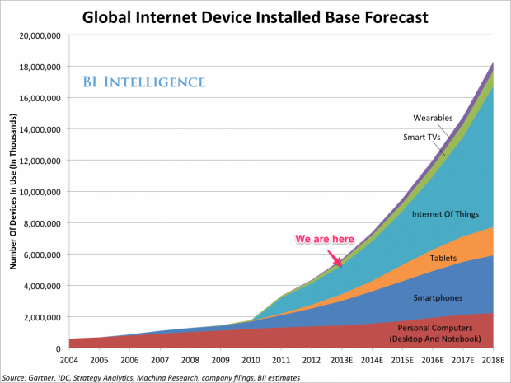

Slide 79
http://www.kpcb.com/internet-trends

Slide 80
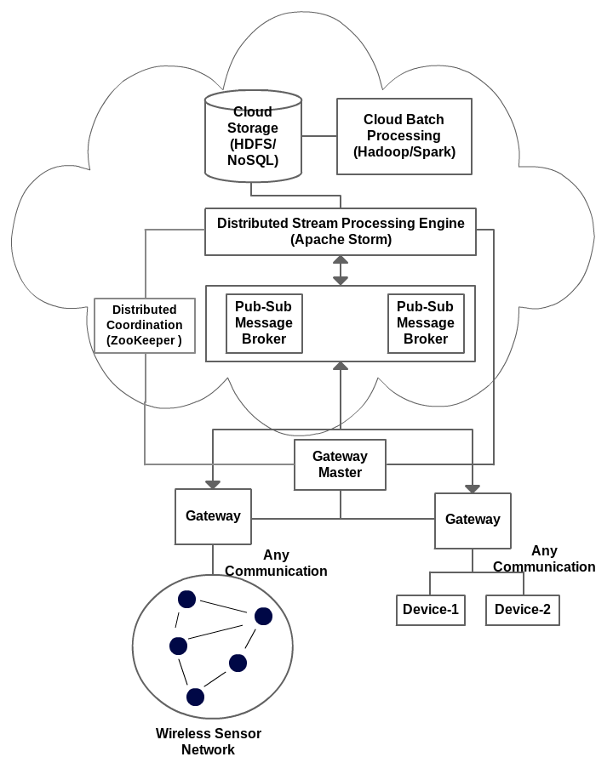
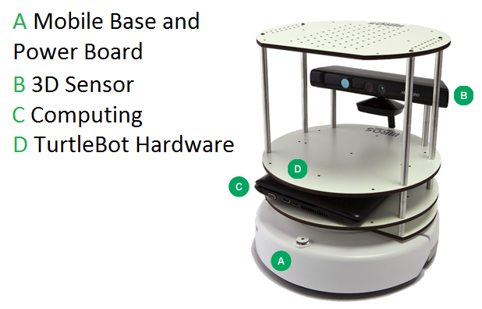
IOTCloud
Device → Pub-Sub→Storm → Datastore → Data Analysis
Apache Storm provides scalable distributed system for processing data streams coming from devices in real time.
For example Storm layer can decide to store the data in cloud storage for further analysis or to send control data back to the devices
Evaluating Pub-Sub Systems ActiveMQ, RabbitMQ, Kafka, Kestrel
Turtlebot and Kinect

Slide 81
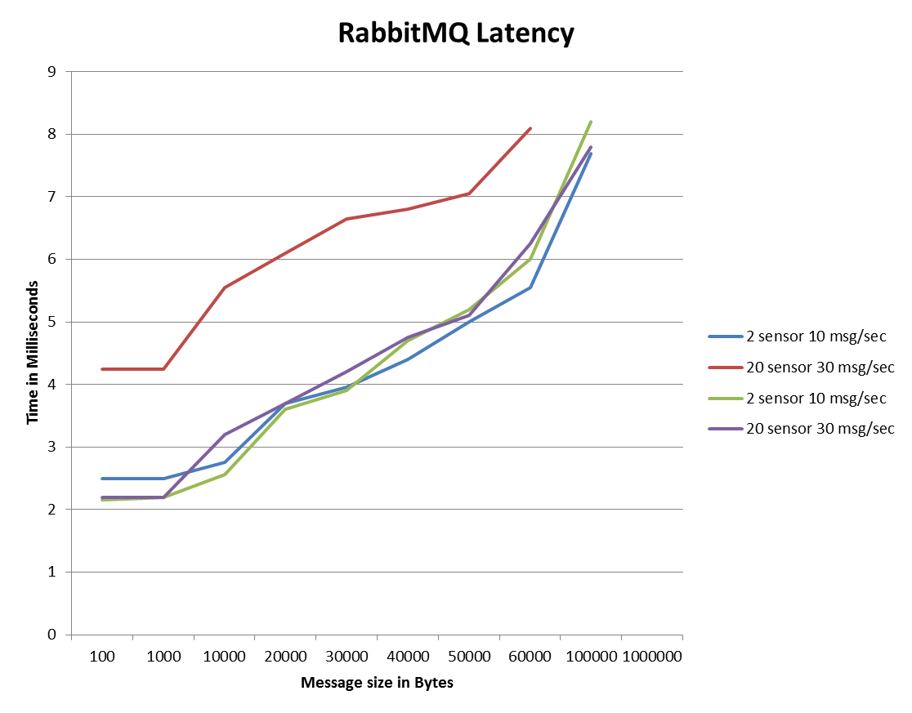
Storm Performance From Device to Cloud
6 FutureGrid India Medium OpenStack machines
1 Broker machine, RabbitMQ 1 machine hosting ZooKeeper and Storm – Nimbus (Master for Storm)
2 Sensor sites generating data
2 Storm nodes sending back the same data and we measure the unidirectional latency
Using drones and Kinects
System saturates

Slide 82
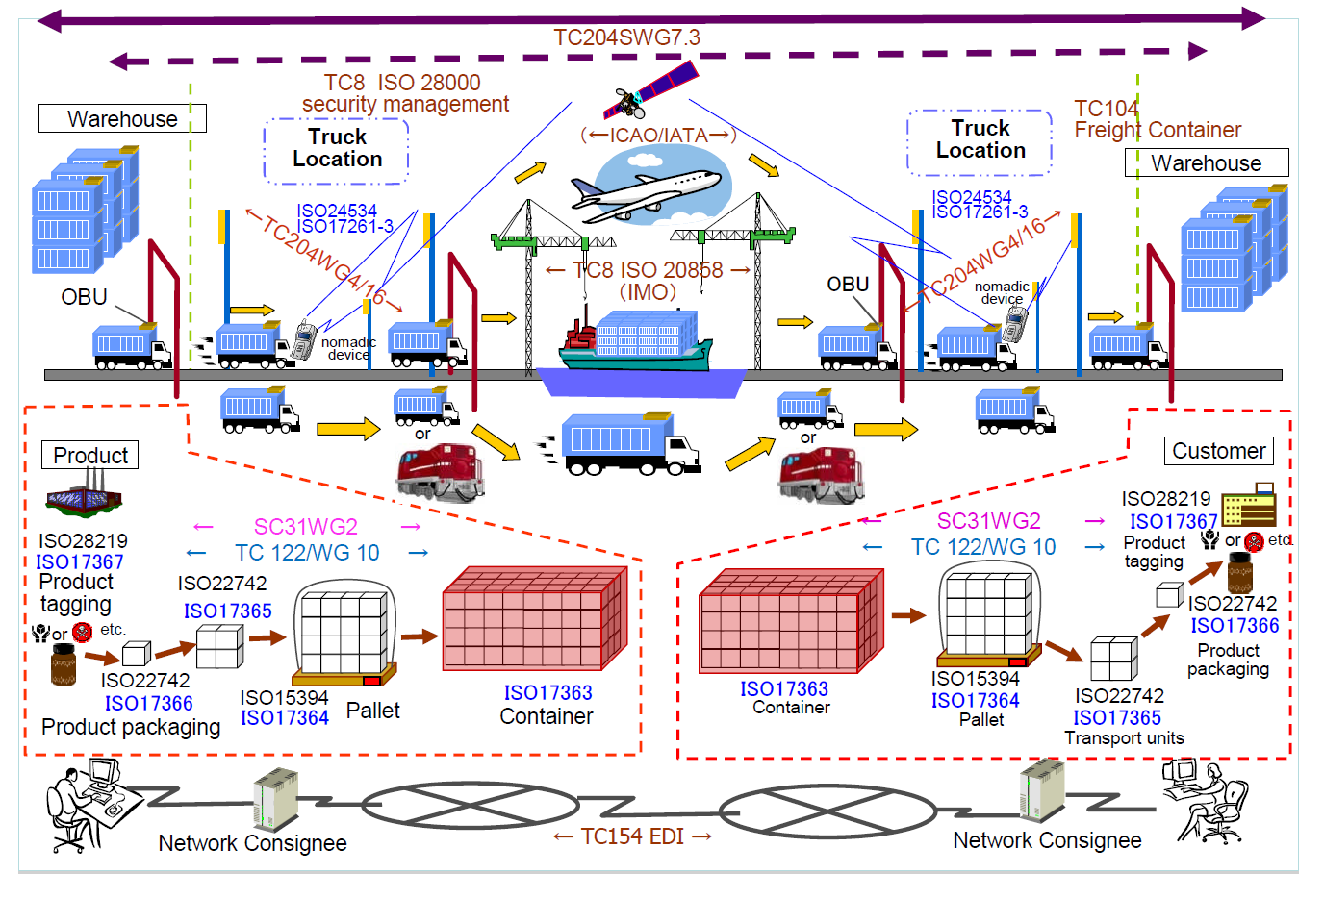
10: Cargo Shipping Architecture
Commercial
Industry Standards
Continuous Tracking
PP Streaming

Slide 83
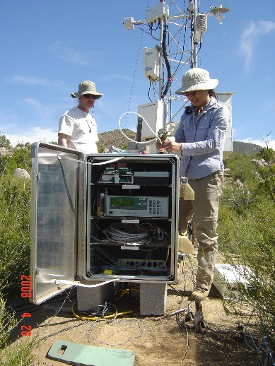
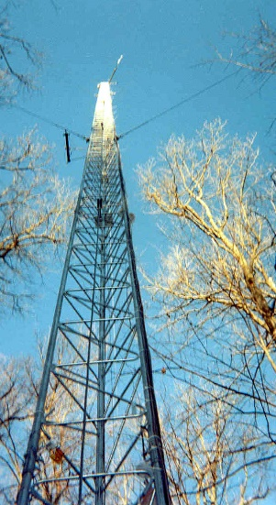
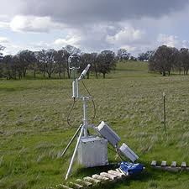
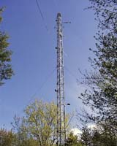
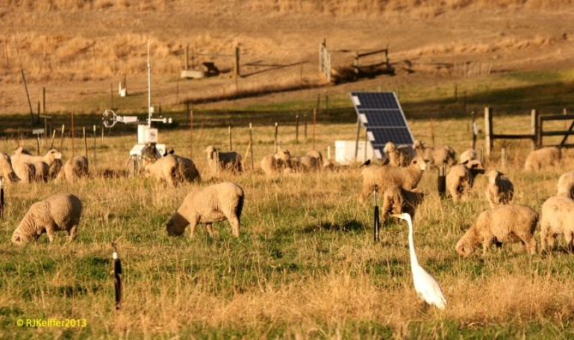
50: DOE-BER AmeriFlux and FLUXNET Networks
Application: AmeriFlux and FLUXNET are US and world collections
respectively of sensors that observe trace gas fluxes (CO₂,
water vapor) across a broad spectrum of times (hours, days,
seasons, years, and decades) and space. Moreover, such datasets provide the crucial linkages among organisms, ecosystems, and process-scale studies—at climate-relevant scales of landscapes, regions, and continents—for incorporation into biogeochemical and climate models.
Current Approach: Software includes EddyPro, Custom analysis software, R, python, neural networks, Matlab. There are ~150 towers in AmeriFlux and over 500 towers distributed globally collecting flux measurements.
Futures: Field experiment data taking would be improved by access to existing data and automated entry of new data via mobile devices. Need to support interdisciplinary study integrating diverse data sources.
Earth, Environmental and Polar Science
Fusion, PP, GIS
Streaming
Parallelism over Sensors

Slide 84
51: Consumption forecasting in Smart Grids
Application: Predict energy consumption for customers, transformers, sub-stations and the electrical grid service area using smart meters providing measurements every 15-mins at the granularity of individual consumers within the service area of smart power utilities. Combine Head-end of smart meters (distributed), Utility databases (Customer Information, Network topology; centralized), US Census data (distributed), NOAA weather data (distributed), Micro-grid building information system (centralized), Micro-grid sensor network (distributed). This generalizes to real-time data-driven analytics for time series from cyber physical systems
Current Approach: GIS based visualization. Data is around 4 TB a year for a city with 1.4M sensors in Los Angeles. Uses R/Matlab, Weka, Hadoop software. Significant privacy issues requiring anonymization by aggregation. Combine real time and historic data with machine learning for predicting consumption.
Futures: Wide spread deployment of Smart Grids with new analytics integrating diverse data and supporting curtailment requests. Mobile applications for client interactions.
Energy
Fusion, PP, MR, ML, GIS, Classification
Streaming
Parallelism over Sensors

Slide 85
28: Truthy: Information diffusion research using Twitter Data
Deep Learning
Social Networking
Application: Understanding how communication spreads on socio-technical networks. Detecting potentially harmful information spread at the early stage (e.g., deceiving messages, orchestrated campaigns, untrustworthy information, etc.)
Current Approach: 1) Acquisition and storage of a large volume (30 TB a year compressed) of continuous streaming data from Twitter (~100 million messages per day, ~500GB data/day increasing over time); (2) near real-time analysis of such data, for anomaly detection, stream clustering, signal classification and online-learning; (3) data retrieval, big data visualization, data-interactive Web interfaces, public API for data querying. Use Python/SciPy/NumPy/MPI for data analysis. Information diffusion, clustering, and dynamic network visualization capabilities already exist
Futures: Truthy plans to expand incorporating Google+ and Facebook. Need to move towards Hadoop/IndexedHBase & HDFS distributed storage. Previously used Redis as an in-memory database to be a buffer for real-time analysis. Need streaming clustering, anomaly detection and online learning.
Index, S/Q, MR, MRIter, Graph, Classification
Streaming
Parallelism over Tweets

Slide 86
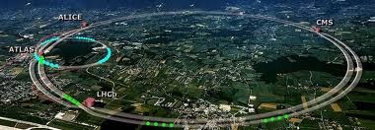
39: Particle Physics: Analysis of LHC Large Hadron Collider Data: Discovery of Higgs particle I
Astronomy & Physics
CERN LHC Accelerator Ring (27 km circumference. Up to 175m depth) at Geneva with 4 Experiment positions marked
Application: One analyses collisions at the CERN LHC (Large Hadron Collider) Accelerator and Monte Carlo producing events describing particle-apparatus interaction. Processed information defines physics properties of events (lists of particles with type and momenta). These events are analyzed to find new effects; both new particles (Higgs) and present evidence that conjectured particles (Supersymmetry) have not been detected. LHC has a few major experiments including ATLAS and CMS. These experiments have global participants (for example CMS has 3600 participants from 183 institutions in 38 countries), and so the data at all levels is transported and accessed across continents.
MRStat or PP, MC
Parallelism over observed collisions

Slide 87
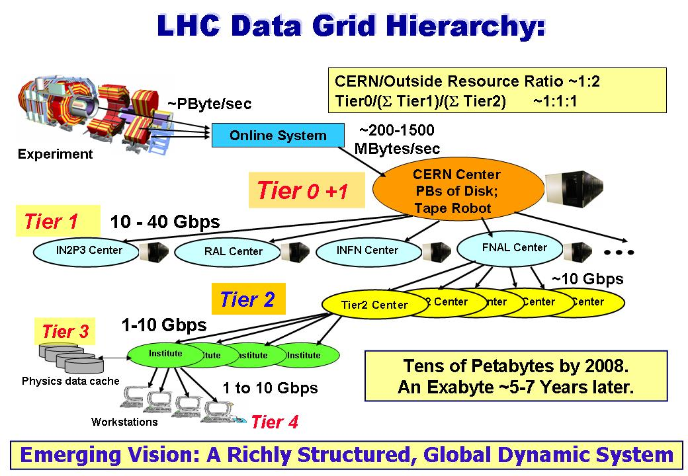
39: Particle Physics: Analysis of LHC Large Hadron Collider Data: Discovery of Higgs particle II
Current Approach: The LHC experiments are pioneers of a
distributed Big Data science infrastructure, and several aspects
of the LHC experiments’ workflow highlight issues that other disciplines will need to solve. These include automation of data distribution, high performance data transfer, and large-scale high-throughput computing. Grid analysis with 350,000 cores running “continuously” over 2 million jobs per day arranged in 3 tiers (CERN, “Continents/Countries”. “Universities”). Uses “Distributed High Throughput Computing” (Pleasing parallel) architecture with facilities integrated across the world by WLCG (LHC Computing Grid) and Open Science Grid in the US.
15 Petabytes data gathered each year from Accelerator data and Analysis with 200PB total. Specifically in 2012 ATLAS had at Brookhaven National Laboratory (BNL) 8PB Tier1 tape; BNL over 10PB Tier1 disk and US Tier2 centers 12PB disk cache. CMS has similar data sizes. Note over half resources used for Monte Carlo simulations as opposed to data analysis

