Slide 1
FutureGrid and Applications
December 18 2009
Geoffrey Fox
gcf@indiana.edu http://salsaweb.ads.iu.edu/salsa
Community Grids Laboratory
Pervasive Technology Institute
Indiana University
Notes:
SALSA is
Service Aggregated Linked Sequential Activities

Slide 2
FutureGrid
The goal of FutureGrid is to support the research on the future of distributed, grid, and cloud computing.
FutureGrid will build a robustly managed simulation environment or testbed to support the development and early use in science of new technologies at all levels of the software stack: from networking to middleware to scientific applications.
The environment will mimic TeraGrid and/or general parallel and distributed systems – FutureGrid is part of TeraGrid and one of two experimental TeraGrid systems (other is GPU)
This test-bed will succeed if it enables major advances in science and engineering through collaborative development of science applications and related software.
FutureGrid is a (small >5000 core) Science/Computer Science Cloud but it is more accurately a virtual machine based simulation environment

Slide 3
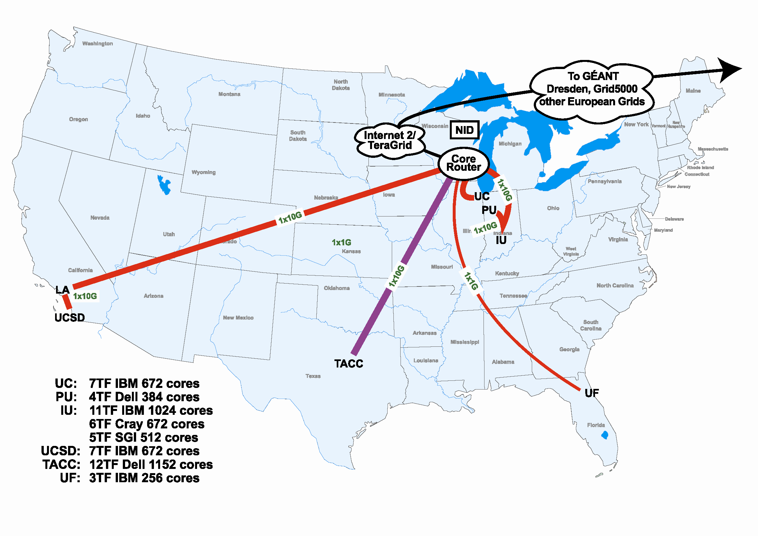
FutureGrid Hardware

Slide 4
Compute Hardware
System type | # CPUs | # Cores | TFLOPS | Total RAM (GB) | Secondary Storage (TB) | Site | Status
Dynamically configurable systems
IBM iDataPlex | 256 | 1024 | 11 | 3072 | 339* | IU | New System
Dell PowerEdge | 192 | 1152 | 8 | 1152 | 15 | TACC | New System
IBM iDataPlex | 168 | 672 | 7 | 2016 | 120 | UC | New System
IBM iDataPlex | 168 | 672 | 7 | 2688 | 72 | SDSC | Existing System
Subtotal | 784 | 3520 | 33 | 8928 | 546
Systems possibly not dynamically configurable
Cray XT5m | 168 | 672 | 6 | 1344 | 339* | IU | New System
Shared memory system TBD | 40 | 480 | 4 | 640 | 339* | IU | New System 4Q2010
Cell BE Cluster | 4 | 80 | 1 | 64 |  | IU | Existing System
IBM iDataPlex | 64 | 256 | 2 | 768 | 1 | UF | New System
High Throughput Cluster | 192 | 384 | 4 | 192 |  | PU | Existing System
Subtotal | 468 | 1872 | 17 | 3008 | 1
Total | 1252 | 5392 | 50 | 11936 | 547

Slide 5
Storage Hardware
System Type | Capacity (TB) | File System | Site | Status
DDN 9550 (Data Capacitor) | 339 | Lustre | IU | Existing System
DDN 6620 | 120 | GPFS | UC | New System
SunFire x4170 | 72 | Lustre/PVFS | SDSC | New System
Dell MD3000 | 30 | NFS | TACC | New System
FutureGrid has dedicated network (except to TACC) and a network fault and delay generator
Can isolate experiments on request; IU runs Network for NLR/Internet2
Additional partner machines could run FutureGrid software and be supported (but allocated in specialized ways)

Slide 6

Network Impairments Device
Spirent XGEM Network Impairments Simulator for jitter, errors, delay, etc
Full Bidirectional 10G w/64 byte packets
up to 15 seconds introduced delay (in 16ns increments)
0-100% introduced packet loss in .0001% increments
Packet manipulation in first 2000 bytes
up to 16k frame size
TCL for scripting, HTML for human configuration

Slide 7
FutureGrid Partners
Indiana University (Architecture, core software, Support)
Purdue University (HTC Hardware)
San Diego Supercomputer Center at University of California San Diego (INCA, Monitoring)
University of Chicago/Argonne National Labs (Nimbus)
University of Florida (ViNE, Education and Outreach)
University of Southern California Information Sciences Institute (Pegasus to manage experiments)
University of Tennessee Knoxville (Benchmarking)
University of Texas at Austin/Texas Advanced Computing Center (Portal)
University of Virginia (OGF, Advisory Board and allocation)
Center for Information Services and GWT-TUD from Technische Universtität Dresden Germany. (VAMPIR)
Blue institutions have FutureGrid hardware

Slide 8
Other Important Collaborators
NSF
Early users from an application and computer science perspective and from both research and education
Grid5000/Aladdin and D-Grid in Europe
Commercial partners such as
  Eucalyptus ….
  Microsoft (Dryad + Azure) – Note current Azure external to FutureGrid as are GPU systems
  Application partners
TeraGrid
Open Grid Forum
Possibly Open Nebula, Open Cirrus Testbed, Open Cloud Consortium, Cloud Computing Interoperability Forum. IBM-Google-NSF Cloud, and other DoE/NSF/… clouds
China, Japan, Korea, Australia, other Europe … ?

Slide 9
FutureGrid Usage Scenarios
Developers of end-user applications who want to develop new applications in cloud or grid environments, including analogs of commercial cloud environments such as Amazon or Google.
  Is a Science Cloud for me? Is my application secure?
Developers of end-user applications who want to experiment with multiple hardware environments.
Grid/Cloud middleware developers who want to evaluate new versions of middleware or new systems.
Networking researchers who want to test and compare different networking solutions in support of grid and cloud applications and middleware. (Some types of networking research will likely best be done via through the GENI program.)
Education as well as research
Interest in performance requires that bare metal important

Slide 10
Selected FutureGrid Timeline
October 1 2009 Project Starts
November 16-19 SC09 Demo/F2F Committee Meetings/Chat up collaborators
January 2010 – Significant Hardware available
March 2010 FutureGrid network complete
March 2010 FutureGrid Annual Meeting
April 2010 Many early users
September 2010 All hardware (except Track IIC lookalike) accepted
October 1 2011 FutureGrid allocatable via TeraGrid process – first two years by user/science board led by Andrew Grimshaw

Slide 11
FutureGrid Architecture

Slide 12
FutureGrid Architecture
Open Architecture allows to configure resources based on images
Managed images allows to create similar experiment environments
Experiment management allows reproducible activities
Through our modular design we allow different clouds and images to be “rained” upon hardware.
Note will be supported 24x7 at “TeraGrid Production Quality”
Will support deployment of “important” middleware including TeraGrid stack, Condor, BOINC, gLite, Unicore, Genesis II

Slide 13
RAIN: Dynamic Provisioning
Change underlying system to support current user demands
Linux, Windows, Xen, Nimbus, Eucalyptus
Stateless images
  Shorter boot times
  Easier to maintain
Stateful installs
  Windows
Use moab to trigger changes and xCAT to manage installs

Slide 14
SALSA
Dynamic Virtual Cluster Hosting
Monitoring Infrastructure
SW-G Using Hadoop
SW-G Using Hadoop
SW-G Using DryadLINQ
SW-G Using Hadoop
SW-G Using Hadoop
SW-G Using DryadLINQ
Linux
Bare-system
Linux on Xen
Windows Server 2008 Bare-system
Cluster Switching from Linux Bare-system to Xen VMs to Windows 2008 HPC
xCAT Infrastructure
iDataplex Bare-metal Nodes (32 nodes)
SW-G : Smith Waterman Gotoh Dissimilarity Computation
– A typical MapReduce style application

Slide 15
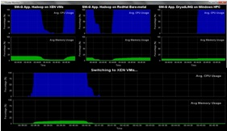
Monitoring Infrastructure
Monitoring Interface
Pub/Sub Broker Network
Virtual/Physical Clusters
Summarizer
xCAT Infrastructure
Switcher
iDataplex Bare-metal Nodes
(32 nodes)

Slide 16
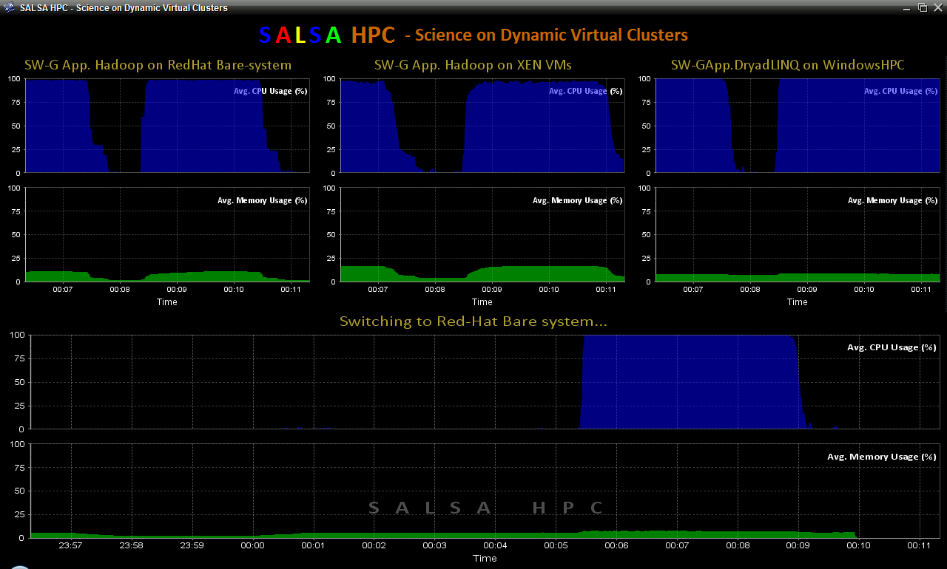
SALSA HPC Dynamic Virtual Clusters

Slide 17
Collaborators in SALSA Project
Microsoft Research
Technology Collaboration
Azure (Clouds)
Dennis Gannon
Roger Barga
Dryad (Parallel Runtime)
Christophe Poulain
CCR (Threading)
George Chrysanthakopoulos
DSS (Services)
Henrik Frystyk Nielsen
Indiana University
SALSA Technology Team
Geoffrey Fox
Judy Qiu
Scott Beason
Jaliya Ekanayake
Thilina Gunarathne
Thilina Gunarathne
Jong Youl Choi
Yang Ruan
Seung-Hee Bae
Hui Li
Saliya Ekanayake
Applications
Bioinformatics, CGB
Haixu Tang, Mina Rho,
Peter Cherbas, Qunfeng Dong
IU Medical School
Gilbert Liu
Demographics (Polis Center)
Neil Devadasan
Cheminformatics
David Wild, Qian Zhu
Physics
CMS group at Caltech (Julian Bunn)
Community Grids Lab
and UITS RT – PTI

Slide 18
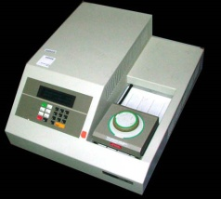
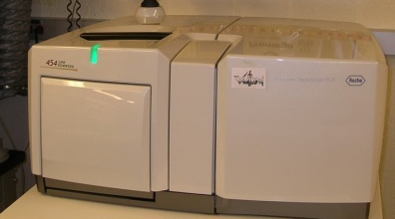
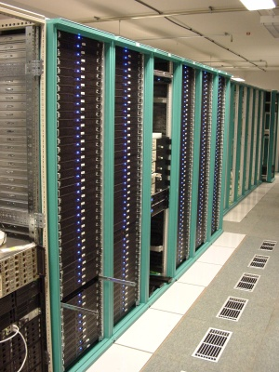
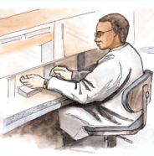


MapReduce “File/Data Repository” Parallelism
Map = (data parallel) computation reading and writing data
Reduce = Collective/Consolidation phase e.g. forming multiple global sums as in histogram
Instruments
Iterative MapReduce
Map Map Map Map
Reduce Reduce Reduce
Communication
Reduce
Portals
/Users
Disks
Map₁
Map₂
Map₃

Slide 19
Some Life Sciences Applications
EST (Expressed Sequence Tag) sequence assembly program using DNA sequence assembly program software CAP3.
Metagenomics and Alu repetition alignment using Smith Waterman dissimilarity computations followed by MPI applications for Clustering and MDS (Multi Dimensional Scaling) for dimension reduction before visualization
Correlating Childhood obesity with environmental factors by combining medical records with Geographical Information data with over 100 attributes using correlation computation, MDS and genetic algorithms for choosing optimal environmental factors.
Mapping the 26 million entries in PubChem into two or three dimensions to aid selection of related chemicals with convenient Google Earth like Browser. This uses either hierarchical MDS (which cannot be applied directly as O(N²)) or GTM (Generative Topographic Mapping).

Slide 20
Alu and Sequencing Workflow
Data is a collection of N sequences – 100’s of characters long
  These cannot be thought of as vectors because there are missing characters
  “Multiple Sequence Alignment” (creating vectors of characters) doesn’t seem to work if N larger than O(100)
Can calculate N² dissimilarities (distances) between sequences (all pairs)
Find families by clustering (much better methods than Kmeans). As no vectors, use vector free O(N²) methods
Map to 3D for visualization using Multidimensional Scaling MDS – also O(N²)
N = 50,000 runs in 10 hours (all above) on 768 cores
Our collaborators just gave us 170,000 sequences and want to look at 1.5 million – will develop new algorithms!
MapReduce++ will do all steps as MDS, Clustering just need MPI Broadcast/Reduce

Slide 21
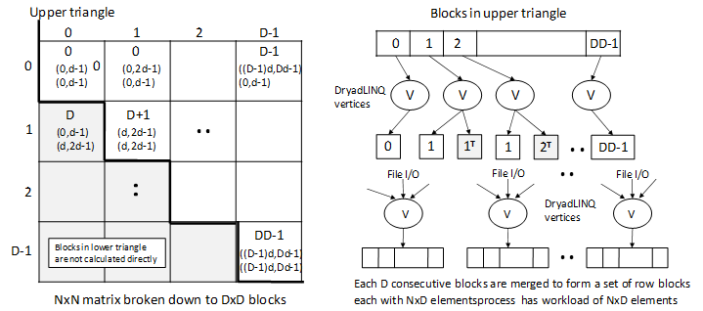
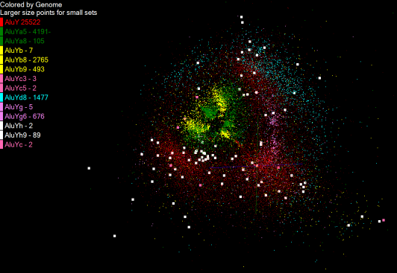
Pairwise Distances – ALU Sequences
125 million distances
4 hours & 46 minutes
Calculate pairwise distances for a collection of genes (used for clustering, MDS)
O(N^2) problem
“Doubly Data Parallel” at Dryad Stage
Performance close to MPI
Performed on 768 cores (Tempest Cluster)
Processes work better than threads when used inside vertices
100% utilization vs. 70%
Notes:
1~180 lines without threading in DryadLINQ, with threading, it is about 400 lines
MPI ~500 lines
The Alu clustering problem [27] is one of the most challenging problems for sequencing clustering because Alus represent the largest repeat families in human genome. There are about 1 million copies of Alu sequences in human genome, in which most insertions can be found in other primates and only a small fraction (~ 7000) are human-specific. This indicates that the classification of Alu repeats can be deduced solely from the 1 million human Alu elements. Notable, Alu clustering can be viewed as a classical case study for the capacity of computational infrastructures because it is not only of great intrinsic biological interests, but also a problem of a scale that will remain as the upper limit of many other clustering problem in bioinformatics for the next few years, e.g. the automated protein family classification for a few millions of proteins predicted from large metagenomics projects. In our work here we examine Alu samples of 35339 and 50,000 sequences.

Slide 22
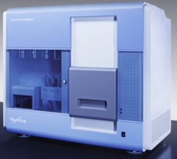
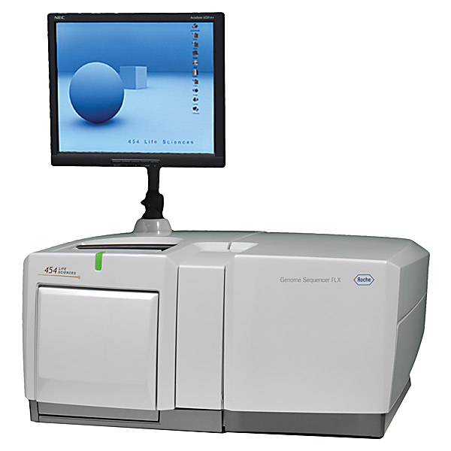
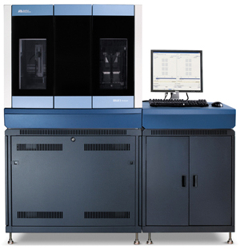
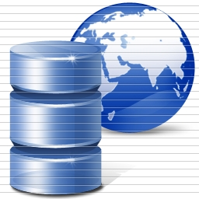
DNA Sequencing Pipeline
Illumina/Solexa Roche/454 Life Sciences Applied Biosystems/SOLiD
Internet
~300 million base pairs per day leading to
~3000 sequences per day per instrument
? 500 instruments at ~0.5M$ each
Read Alignment
Pairwise
clustering
Form block
Pairings
Sequence
alignment
Dissimilarity
Matrix
N(N-1)/2 values
Visualization
Plotviz
FASTA File
N Sequences
Blocking
MPI
MDS
MapReduce

Slide 23
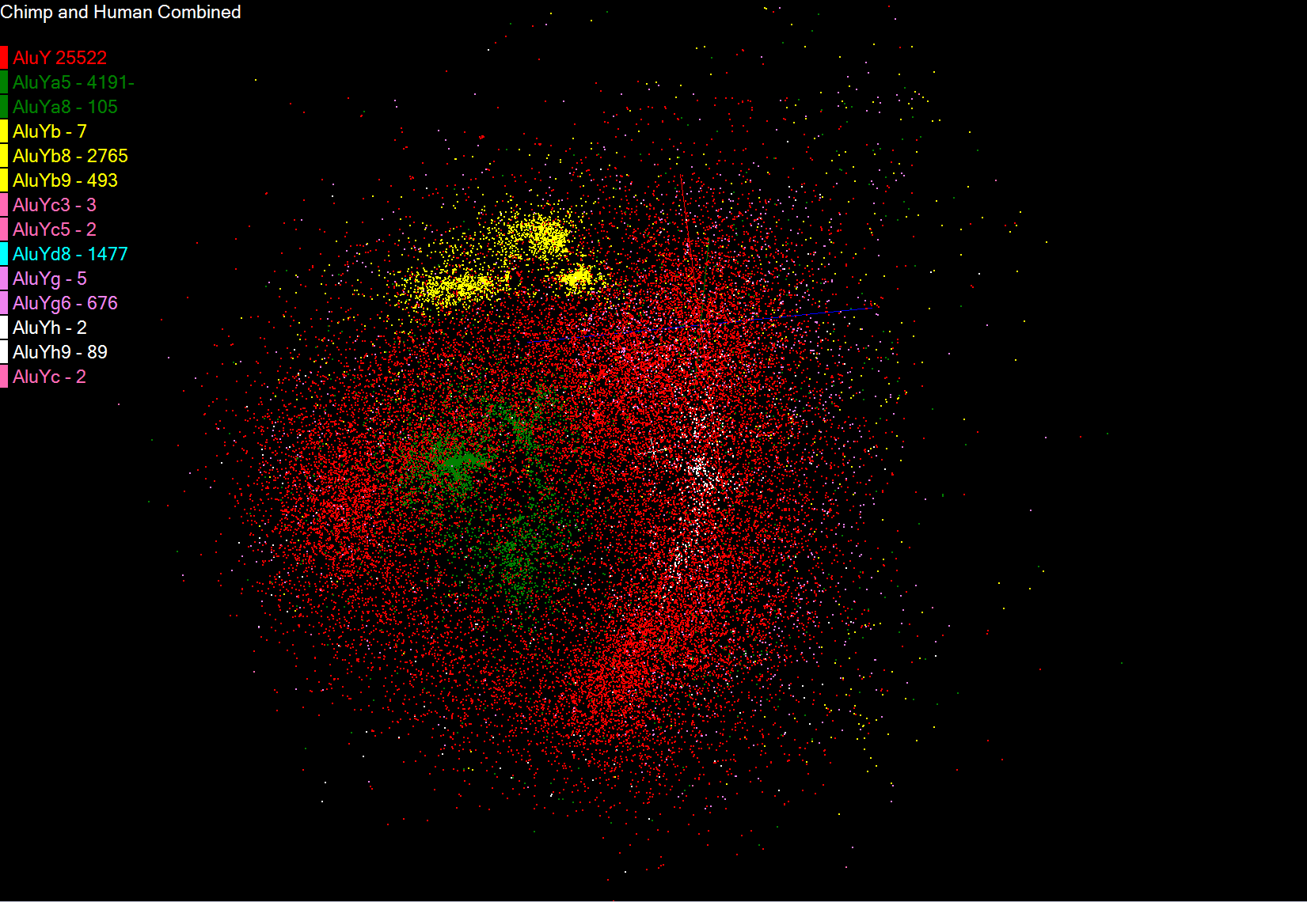

Slide 24
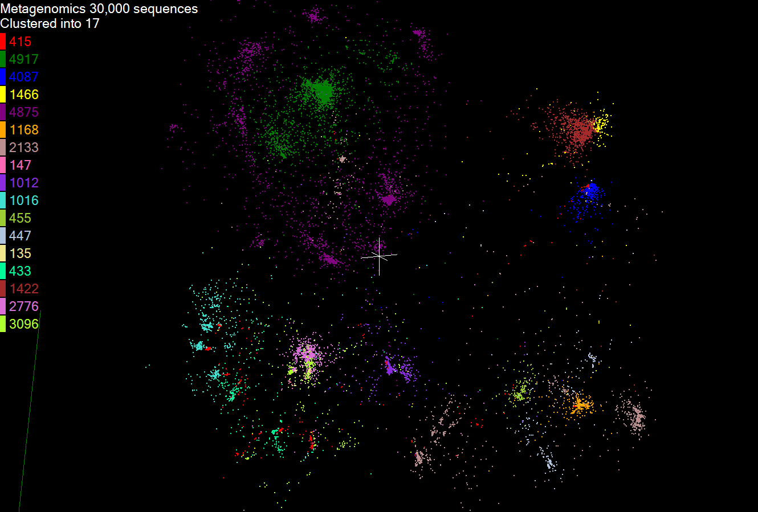

Slide 25
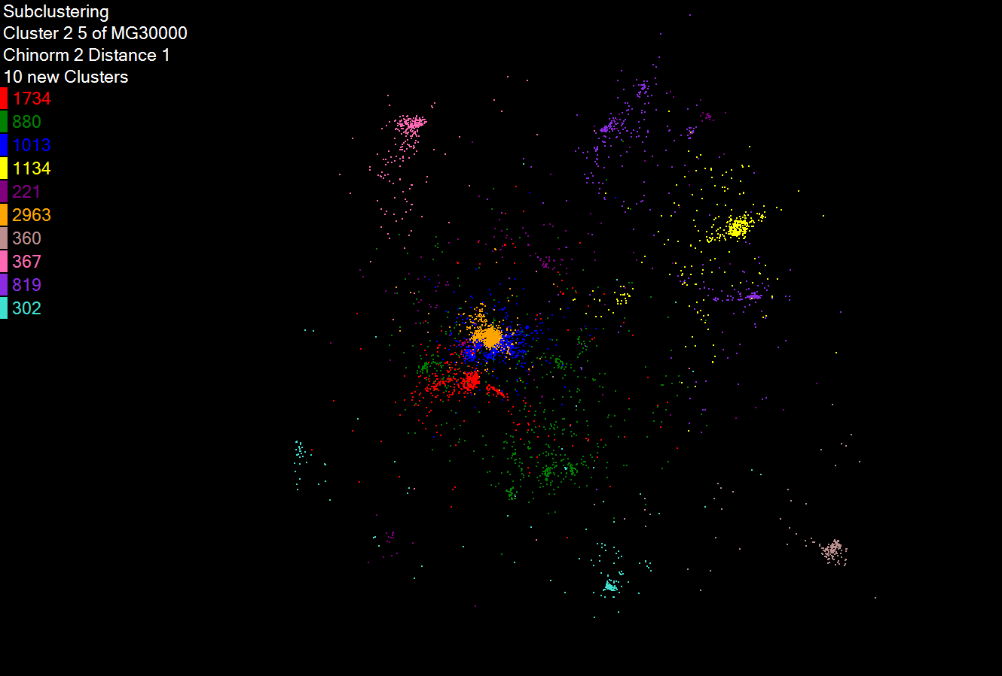
Hierarchical Subclustering

Slide 26
Pairwise Clustering
30,000 Points on Tempest

