Slide 1
Science Applications on Clouds and FutureGrid
June 14 2012
Cloud and Autonomic Computing Center Spring 2012 Workshop
Cloud Computing: from Cybersecurity to Intercloud
University of Florida Gainesville
Geoffrey Fox
gcf@indiana.edu
http://www.infomall.org https://portal.futuregrid.org
Director, Digital Science Center, Pervasive Technology Institute
Associate Dean for Research and Graduate Studies, School of Informatics and Computing
Indiana University Bloomington
(Science Clouds work with Dennis Gannon Microsoft)

Slide 2
Science Computing Environments
Large Scale Supercomputers – Multicore nodes linked by high performance low latency network
  Increasingly with GPU enhancement
  Suitable for highly parallel simulations
High Throughput Systems such as European Grid Initiative EGI or Open Science Grid OSG typically aimed at pleasingly parallel jobs
  Can use “cycle stealing”
  Classic example is LHC data analysis
Grids federate resources as in EGI/OSG or enable convenient access to multiple backend systems including supercomputers
  Portals make access convenient and
  Workflow integrates multiple processes into a single job
Specialized visualization, shared memory parallelization etc. machines

Slide 3
Some Observations
Classic HPC machines as MPI engines offer highest possible performance on closely coupled problems
Clouds offer from different points of view
    On-demand service (elastic)
    Economies of scale from sharing
    Powerful new software models such as MapReduce, which have advantages over classic HPC environments
    Plenty of jobs making it attractive for students & curricula
    Security challenges
HPC problems running well on clouds have above “cloud” advantages
Note 100% utilization of Supercomputers makes elasticity moot for capability (very large) jobs and makes capacity (many modest) use not be on-demand
Cloud-HPC Interoperability seems important

Slide 4
Clouds and Grids/HPC
Synchronization/communication Performance
Grids > Clouds > Classic HPC Systems
Clouds naturally execute effectively Grid workloads but are less clear for closely coupled HPC applications
Service Oriented Architectures and workflow appear to work similarly in both grids and clouds
May be for immediate future, science supported by a mixture of
  Clouds – some practical differences between private and public clouds – size and software
  High Throughput Systems (moving to clouds as convenient)
  Grids for distributed data and access
  Supercomputers (“MPI Engines”) going to exascale

Slide 5
What Applications work in Clouds
Pleasingly parallel applications of all sorts with roughly independent data or spawning independent simulations
  Long tail of science and integration of distributed sensors
Commercial and Science Data analytics that can use MapReduce (some of such apps) or its iterative variants (most other data analytics apps)
Which science applications are using clouds?
  Many demonstrations –Conferences, OOI, HEP ….
  Venus-C (Azure in Europe): 27 applications not using Scheduler, Workflow or MapReduce (except roll your own); use worker role
  50% of applications on FutureGrid are from Life Science but there is more computer science than total applications
  Locally Lilly corporation is major commercial cloud user (for drug discovery) but Biology department is not

Slide 6
Parallelism over Users and Usages
“Long tail of science” can be an important usage mode of clouds.
In some areas like particle physics and astronomy, i.e. “big science”, there are just a few major instruments generating now petascale data driving discovery in a coordinated fashion.
In other areas such as genomics and environmental science, there are many “individual” researchers with distributed collection and analysis of data whose total data and processing needs can match the size of big science.
Clouds can provide scaling convenient resources for this important aspect of science.
Can be map only use of MapReduce if different usages naturally linked e.g. exploring docking of multiple chemicals or alignment of multiple DNA sequences
  Collecting together or summarizing multiple “maps” is a simple Reduction

Slide 7
Internet of Things and the Cloud
It is projected that there will be 24 billion devices on the Internet by 2020. Most will be small sensors that send streams of information into the cloud where it will be processed and integrated with other streams and turned into knowledge that will help our lives in a multitude of small and big ways.
It is not unreasonable for us to believe that we will each have our own cloud-based personal agent that monitors all of the data about our life and anticipates our needs 24x7.
The cloud will become increasing important as a controller of and resource provider for the Internet of Things.
As well as today’s use for smart phone and gaming console support, “smart homes” and “ubiquitous cities” build on this vision and we could expect a growth in cloud supported/controlled robotics.
Natural parallelism over “things”

Slide 8








Sensors as a Service
Output Sensor
Sensors as a Service
Sensor Processing as a Service (could use
MapReduce)
A larger sensor ………

Slide 9
Classic Parallel Computing
HPC: Typically SPMD (Single Program Multiple Data) “maps” typically processing particles or mesh points interspersed with multitude of low latency messages supported by specialized networks such as Infiniband and technologies like MPI
  Often run large capability jobs with 100K cores on same job
  National DoE/NSF/NASA facilities run 100% utilization
  Fault fragile and cannot tolerate “outlier maps” taking longer than others
Clouds: MapReduce has asynchronous maps typically processing data points with results saved to disk. Final reduce phase integrates results from different maps
  Fault tolerant and does not require map synchronization
  Map only useful special case
HPC + Clouds: Iterative MapReduce caches results between “MapReduce” steps and supports SPMD parallel computing with large messages as seen in parallel linear algebra need in clustering and other data mining

Slide 10
4 Forms of MapReduce
(a) Map Only
(b) Classic MapReduce
(c) Iterative MapReduce
(d) Loosely Synchronous
Input
Input
Iterations
Input
map
map
map
P_{ij}
reduce
reduce
Output
BLAST Analysis
Parametric sweep
Pleasingly Parallel
High Energy Physics (HEP) Histograms
Distributed search
Expectation maximization Clustering e.g. Kmeans
Linear Algebra, Page Rank
Classic MPI
PDE Solvers and particle dynamics
Domain of MapReduce and Iterative Extensions
MPI

Slide 11

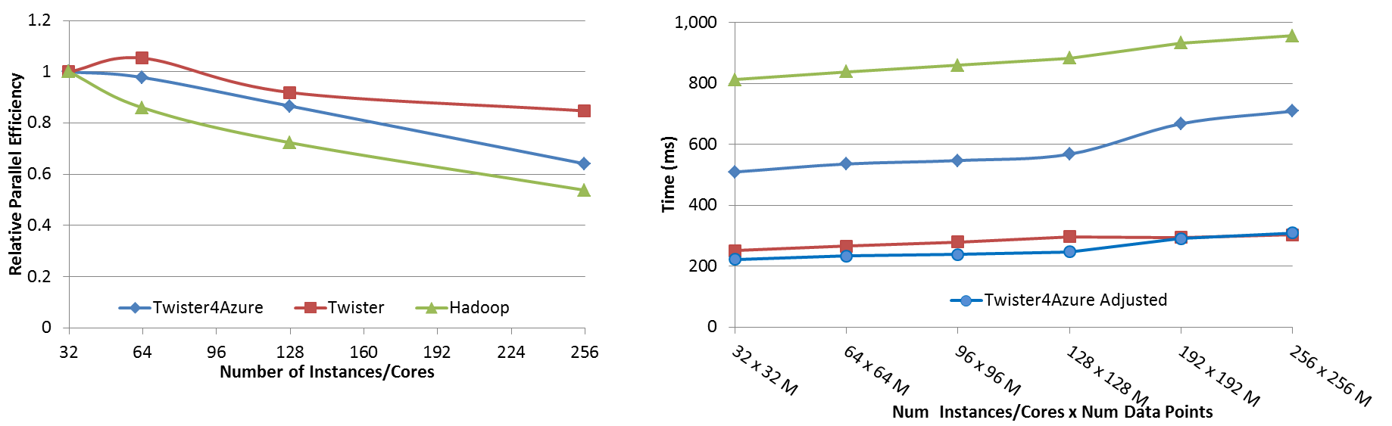
Performance – Kmeans Clustering
Overhead between iterations
First iteration performs the initial data fetch
Task Execution Time Histogram
Number of Executing Map Task Histogram
Scales better than Hadoop on bare metal
Strong Scaling with 128M Data Points
Weak Scaling
Notes:
Right(c): Twister4Azure executing Map Task histogram for 128 million data points in 128 Azure small instances
Figure 5. KMeansClustering Scalability. Left(a): Relative parallel efficiency of strong scaling using 128 million data points.
Center(b): Weak scaling. Workload per core is kept constant (ideal is a straight horizontal line).

Slide 12
Data Intensive Iterative Applications I
Important class of (Data analytics) applications
  Driven by data deluge & emerging fields
  Data mining, machine learning – often with linear algebra at core
  Expectation maximization
k ← 0;
MAX ← maximum iterations
δ^{[0]} ← initial paramwter value
while ( k< MAX_ITER || f(δ^{[k]}, δ^{[k-1]}) )
foreach datum in data
β[datum] ← process (datum, δ^{[k]})
end foreach
δ^{[k+1]} ← combine(β[])
k ← k+1
end while
Notes:
Iterative computations are at the core of the vast majority of data intensive scientific computations.
need to process massive amounts of data and the emergence of data intensive computational fields, such as bioinformatics, chemical informatics and web mining.

Slide 13
Twister for Data Intensive
Iterative Applications
Generalize to arbitrary Collective
Broadcast
Compute
Communication
Reduce/ barrier
New Iteration
Smaller Loop-Variant Data
Larger Loop-Invariant Data
(Iterative) MapReduce structure
Iterative Map-Collective is framework
Twister runs on Linux or Azure
Twister4Azure is built on top of Azure tables, queues, storage
Judy Qiu IU
Notes:
Most of these applications consists of iterative computation and communication steps where single iterations can easily be specified as MapReduce computations.
Large input data sizes which are loop-invariant and can be reused across iterations.
Loop-variant results.. Orders of magnitude smaller…
While these can be performed using traditional MapReduce frameworks, Traditional is not efficient for these types of computations. MR leaves lot of room for improvements in terms of iterative applications.

Slide 14
What to use in Clouds
HDFS style file system to collocate data and computing
Queues to manage multiple tasks
Tables to track job information
MapReduce and Iterative MapReduce to support parallelism
Services for everything
Portals as User Interface
Appliances and Roles (Venus-C approach) as customized images
Software environments/tools like Google App Engine, memcached
Workflow to link multiple services (functions)

Slide 15
What to use in Grids and Supercomputers?
Portals and Workflow as in clouds
MPI and GPU/multicore threaded parallelism
Services in Grids
Wonderful libraries supporting parallel linear algebra, particle evolution, partial differential equation solution
Parallel I/O for high performance in an application
Wide area File System (e.g. Lustre) supporting file sharing
This is a rather different style of PaaS from clouds –
should we unify?

Slide 16
How to use Clouds I
Build the application as a service. Because you are deploying one or more full virtual machines and because clouds are designed to host web services, you want your application to support multiple users or, at least, a sequence of multiple executions.
  If you are not using the application, scale down the number of servers and scale up with demand.
  Attempting to deploy 100 VMs to run a program that executes for 10 minutes is a waste of resources because the deployment may take more than 10 minutes.
  To minimize start up time one needs to have services running continuously ready to process the incoming demand.
Build on existing cloud deployments. For example use an existing MapReduce deployment such as Hadoop or existing Roles and Appliances (Images)

Slide 17
How to use Clouds II
Use PaaS if possible. For platform-as-a-service clouds like Azure use the tools that are provided such as queues, web and worker roles and blob, table and SQL storage.
  Note HPC systems don’t offer much in PaaS area
Design for failure. Applications that are services that run forever will experience failures. The cloud has mechanisms that automatically recover lost resources, but the application needs to be designed to be fault tolerant.
  In particular, environments like MapReduce (Hadoop, Daytona, Twister4Azure) will automatically recover many explicit failures and adopt scheduling strategies that recover performance "failures" from for example delayed tasks.
  One expects an increasing number of such Platform features to be offered by clouds and users will still need to program in a fashion that allows task failures but be rewarded by environments that transparently cope with these failures. (Need to build more such robust environments)

Slide 18
How to use Clouds III
Use as a Service where possible. Capabilities such as SQLaaS (database as a service or a database appliance) provide a friendlier approach than the traditional non-cloud approach exemplified by installing MySQL on the local disk.
  Suggest that many prepackaged aaS capabilities such as Workflow as a Service for eScience will be developed and simplify the development of sophisticated applications.
Moving Data is a challenge. The general rule is that one should move computation to the data, but if the only computational resource available is a the cloud, you are stuck if the data is not also there.
  Persuade Cloud Vendor to host your data free in cloud
  Persuade Internet2 to provide good link to Cloud
  Decide on Object Store v. HDFS style (or v. Lustre WAFS on HPC)

Slide 19
Architecture of Data Repositories?
Traditionally governments set up repositories for data associated with particular missions
  For example EOSDIS (Earth Observation), GenBank (Genomics), NSIDC (Polar science), IPAC (Infrared astronomy)
  LHC/OSG computing grids for particle physics
This is complicated by volume of data deluge, distributed instruments as in gene sequencers (maybe centralize?) and need for intense computing like Blast
  i.e. repositories need lots of computing?

Slide 20
Clouds as Support for Data Repositories?
The data deluge needs cost effective computing
  Clouds are by definition cheapest
  Need data and computing co-located
Shared resources essential (to be cost effective and large)
  Can’t have every scientists downloading petabytes to personal cluster
Need to reconcile distributed (initial source of ) data with shared analysis
  Can move data to (discipline specific) clouds
  How do you deal with multi-disciplinary studies
Data repositories of future will have cheap data and elastic cloud analysis support?
  Hosted free if data can be used commercially?

Slide 21
Using Science Clouds in a Nutshell
High Throughput Computing; pleasingly parallel; grid applications
Multiple users (long tail of science) and usages (parameter searches)
Internet of Things (Sensor nets) as in cloud support of smart phones
(Iterative) MapReduce including “most” data analysis
Exploiting elasticity and platforms (HDFS, Queues ..)
Use worker roles, services, portals (gateways) and workflow
Good Strategies:
  Build the application as a service;
  Build on existing cloud deployments such as Hadoop;
  Use PaaS if possible;
  Design for failure;
  Use as a Service (e.g. SQLaaS) where possible;
  Address Challenge of Moving Data

Slide 22
FutureGrid key Concepts I
FutureGrid is an international testbed modeled on Grid5000
Supporting international Computer Science and Computational Science research in cloud, grid and parallel computing (HPC)
  Industry and Academia
The FutureGrid testbed provides to its users:
  A flexible development and testing platform for middleware and application users looking at interoperability, functionality, performance or evaluation
  Each use of FutureGrid is an experiment that is reproducible
  A rich education and teaching platform for advanced cyberinfrastructure (computer science) classes

Slide 23
FutureGrid key Concepts II
FutureGrid has a complementary focus to both the Open Science Grid and the other parts of XSEDE (TeraGrid).
  FutureGrid is user-customizable, accessed interactively and supports Grid, Cloud and HPC software with and without virtualization.
  FutureGrid is an experimental platform where computer science applications can explore many facets of distributed systems
  and where domain sciences can explore various deployment scenarios and tuning parameters and in the future possibly migrate to the large-scale national Cyberinfrastructure.
  FutureGrid supports Interoperability Testbeds (see OGF)
Note much of current use Education, Computer Science Systems and Biology/Bioinformatics

Slide 24

FutureGrid key Concepts III
Rather than loading images onto VM’s, FutureGrid supports Cloud, Grid and Parallel computing environments by provisioning software as needed onto “bare-metal” using Moab/xCAT
  Image library for MPI, OpenMP, MapReduce (Hadoop, Dryad, Twister), gLite, Unicore, Globus, Xen, ScaleMP (distributed Shared Memory), Nimbus, Eucalyptus, OpenNebula, KVM, Windows …..
  Either statically or dynamically
Growth comes from users depositing novel images in library
FutureGrid has ~4500 distributed cores with a dedicated network and a Spirent XGEM network fault and delay generator
Image1
Image2
…
ImageN
Choose
Load
Run

Slide 25
FutureGrid Partners
Indiana University (Architecture, core software, Support)
San Diego Supercomputer Center at University of California San Diego (INCA, Monitoring)
University of Chicago/Argonne National Labs (Nimbus)
University of Florida (ViNE, Education and Outreach, Operations)
University of Southern California Information Sciences (Pegasus for workflow and to manage experiments)
University of Tennessee Knoxville (Benchmarking)
University of Texas at Austin/Texas Advanced Computing Center (Portal)
University of Virginia (OGF, XSEDE)
Center for Information Services and GWT-TUD from Technische Universtität Dresden. (VAMPIR)
Red institutions have FutureGrid hardware

Slide 26

FutureGrid: a Grid/Cloud/HPC Testbed
NID: Network Impairment Device
Private
Public
FG Network

Slide 27
Compute Hardware
Name | System type | # CPUs | # Cores | TFLOPS | Total RAM (GB) | Secondary Storage (TB) | Site | Status
india | IBM iDataPlex | 256 | 1024 | 11 | 3072 | 339 + 16 | IU | Operational
alamo | Dell PowerEdge | 192 | 768 | 8 | 1152 | 30 | TACC | Operational
hotel | IBM iDataPlex | 168 | 672 | 7 | 2016 | 120 | UC | Operational
sierra | IBM iDataPlex | 168 | 672 | 7 | 2688 | 96 | SDSC | Operational
xray | Cray XT5m | 168 | 672 | 6 | 1344 | 339 | IU | Operational
foxtrot | IBM iDataPlex | 64 | 256 | 2 | 768 | 24 | UF | Operational
Bravo | Large Disk & memory | 32 | 128 | 1.5 | 3072 (192GB per node) | 144 (12 TB per Server) | IU | Operational
Delta | Large Disk & memory With Tesla GPU’s | 32 32 GPU’s | 192+ 14336 GPU | ? 6 | 1536 (192GB per node) | 96 (12 TB per Server) | IU | Operational
 |  |  | TOTAL Cores 4384

Slide 28
Storage Hardware
System Type | Capacity (TB) | File System | Site | Status
Xanadu 360 | 180 | NFS | IU | New System
DDN 6620 | 120 | GPFS | UC | New System
SunFire x4170 | 96 | ZFS | SDSC | New System
Dell MD3000 | 30 | NFS | TACC | New System
IBM | 24 | NFS | UF | New System
Substantial back up storage at IU: Data Capacitor and HPSS

Slide 29
Network Impairment Device
  Spirent XGEM Network Impairments Simulator for jitter, errors, delay, etc
  Full Bidirectional 10G w/64 byte packets
  up to 15 seconds introduced delay (in 16ns increments)
  0-100% introduced packet loss in .0001% increments
  Packet manipulation in first 2000 bytes
  up to 16k frame size
  TCL for scripting, HTML for manual configuration

Slide 30
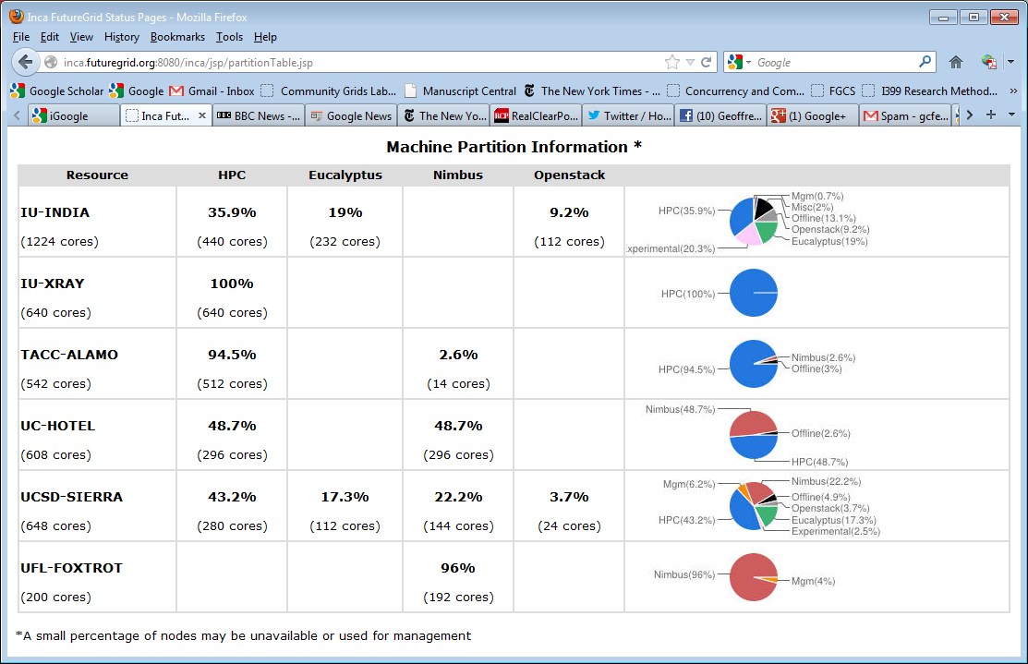
FutureGrid: Inca Monitoring

Slide 31
5 Use Types for FutureGrid
218 approved projects June 13 2012
  https://portal.futuregrid.org/projects
Training Education and Outreach (8%)
  Semester and short events; promising for small universities
Interoperability test-beds (3%)
  Grids and Clouds; Standards; from Open Grid Forum OGF
Domain Science applications (31%)
  Life science highlighted (18%), Non Life Science (13%)
Computer science (47%)
  Largest current category
Computer Systems Evaluation (27%)
  XSEDE (TIS, TAS), OSG, EGI
Clouds are meant to need less support than other models; FutureGrid needs more user support …….

Slide 32
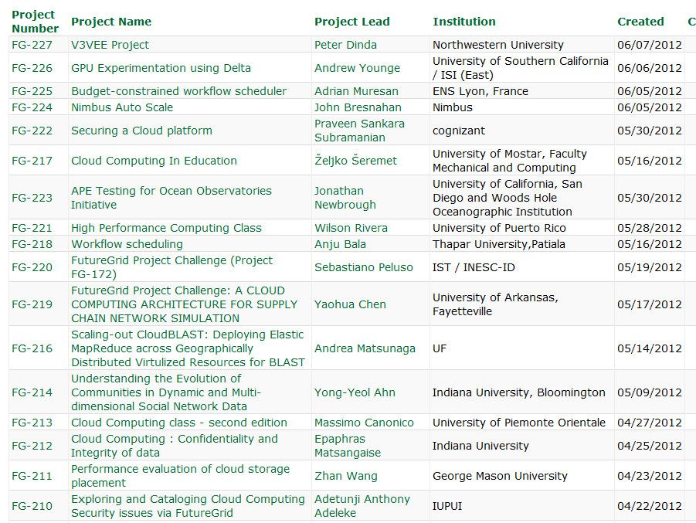
  https://portal.futuregrid.org/projects

Slide 33
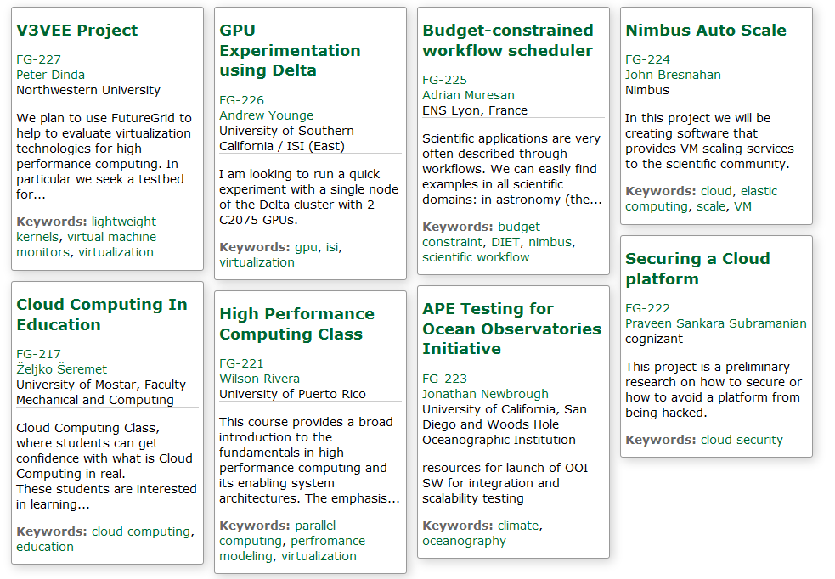
Recent Projects

Slide 34
Distribution of FutureGrid Technologies and Areas
220 Projects

Slide 35
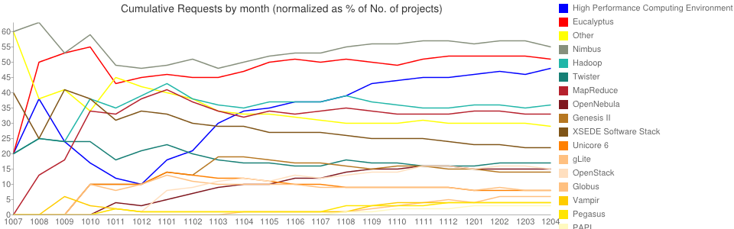
Environments Chosen Fractions v Time
High Performance Computing Environment: 103(47.2%)
Eucalyptus: 109(50%)
Nimbus: 118(54.1%)
Hadoop: 75(34.4%)
Twister: 34(15.6%)
MapReduce: 69(31.7%)
OpenNebula: 32(14.7%)
OpenStack: 36(16.5%)
Genesis II: 29(13.3%)
XSEDE Software Stack: 44(20.2%)
Unicore 6: 16(7.3%)
gLite: 17(7.8%)
Vampir: 10(4.6%)
Globus: 13(6%)
Pegasus: 10(4.6%)
PAPI: 8(3.7%)
CUDA(GPU Software)): 1(0.5%)

Slide 36
FutureGrid Tutorials
Cloud Provisioning Platforms
Using Nimbus on FutureGrid [novice]
Nimbus One-click Cluster Guide
Using OpenStack Nova on FutureGrid Using Eucalyptus on FutureGrid [novice]
Connecting private network VMs across Nimbus clusters using ViNe [novice]
Using the Grid Appliance to run FutureGrid Cloud Clients [novice]
Cloud Run-time Platforms
Running Hadoop as a batch job using MyHadoop [novice]
Running SalsaHadoop (one-click Hadoop) on HPC environment [beginner]
Running Twister on HPC environment
Running SalsaHadoop on Eucalyptus
Running FG-Twister on Eucalyptus
Running One-click Hadoop WordCount on Eucalyptus [beginner]
Running One-click Twister K-means on Eucalyptus
Image Management and Rain
Using Image Management and Rain [novice]
Storage
Using HPSS from FutureGrid [novice]
Educational Grid Virtual Appliances
Running a Grid Appliance on your desktop
Running a Grid Appliance on FutureGrid
Running an OpenStack virtual appliance on FutureGrid
Running Condor tasks on the Grid Appliance
Running MPI tasks on the Grid Appliance
Running Hadoop tasks on the Grid Appliance
Deploying virtual private Grid Appliance clusters using Nimbus
Building an educational appliance from Ubuntu 10.04
Customizing and registering Grid Appliance images using Eucalyptus
High Performance Computing
Basic High Performance Computing
Running Hadoop as a batch job using MyHadoop
Performance Analysis with Vampir
Instrumentation and tracing with VampirTrace
Experiment Management
Running interactive experiments [novice]
Running workflow experiments using Pegasus
Pegasus 4.0 on FutureGrid Walkthrough [novice]
Pegasus 4.0 on FutureGrid Tutorial [intermediary]
Pegasus 4.0 on FutureGrid Virtual Cluster [advanced]

Slide 37
Software Components
Portals including “Support” “use FutureGrid” “Outreach”
Monitoring – INCA, Power (GreenIT)
Experiment Manager: specify/workflow
Image Generation and Repository
Intercloud Networking ViNE
Virtual Clusters built with virtual networks
Performance library
Rain or Runtime Adaptable InsertioN Service for images
Security Authentication, Authorization,
Note Software integrated across institutions and between middleware and systems Management (Google docs, Jira, Mediawiki)
Note many software groups are also FG users
“Research”
Above and below
Nimbus OpenStack Eucalyptus

Slide 38
Motivation: Image Management and Rain on FutureGrid
Allow users to take control of installing the OS on a system on bare metal (without the administrator)
By providing users with the ability to create their own environments to run their projects (OS, packages, software)
Users can deploy their environments in both bare-metal and virtualized infrastructures
Security is obviously important
RAIN manages tools to dynamically provide custom HPC environment, Cloud environment, or virtual networks on-demand

Slide 39
Architecture

Slide 40
Create Image from Scratch
CentOS
Takes Up to 69%
Ubuntu
Takes Up to 83%
Notes:
Need to optimize the CentOS golden image, used by OpenNebula, because the booting process takes longer than the Ubuntu one
Orange section shows the time needed to create the images, which is the most time consuming part of the whole process
-Up to a 69% for CentOS and a 83% for Ubuntu is spent to create the base image

Slide 41
Create Image from Base Image
Reduces 55-67%
CentOS
Ubuntu
Reduces 62-80%
Notes:
We have reduced the time time to create an image in a … 55-67% and 62-80% respectively

Slide 42
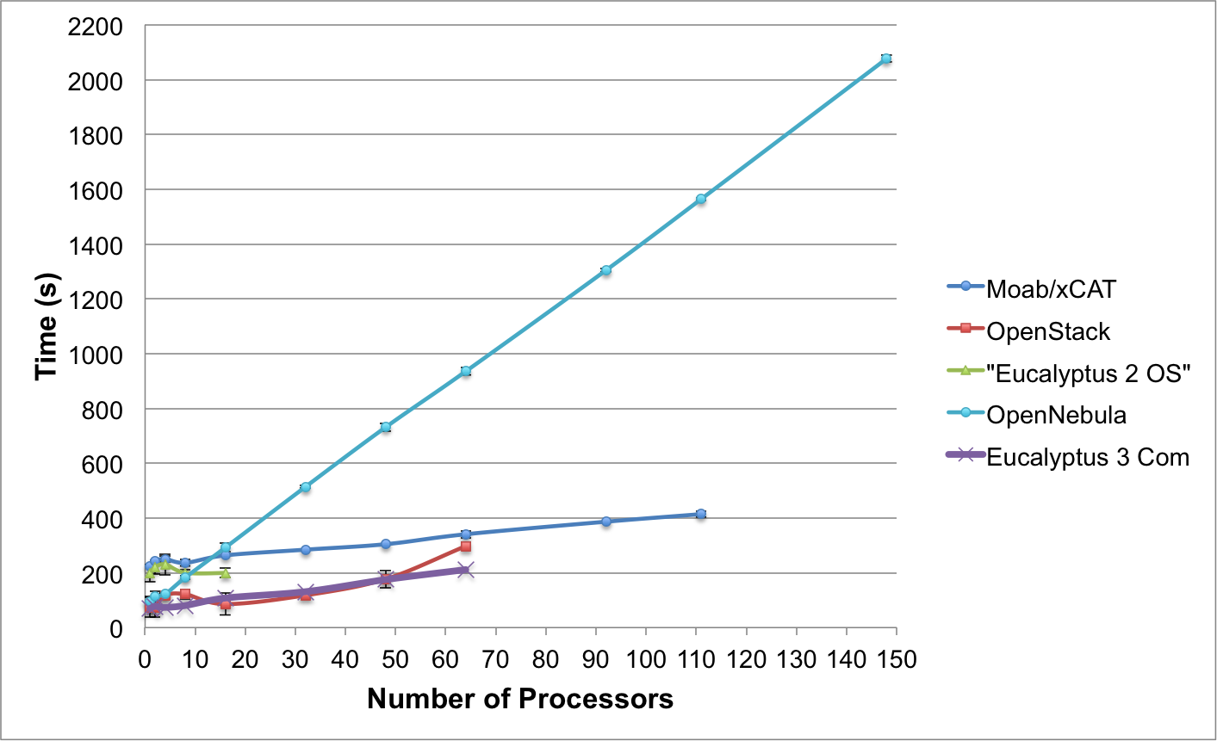
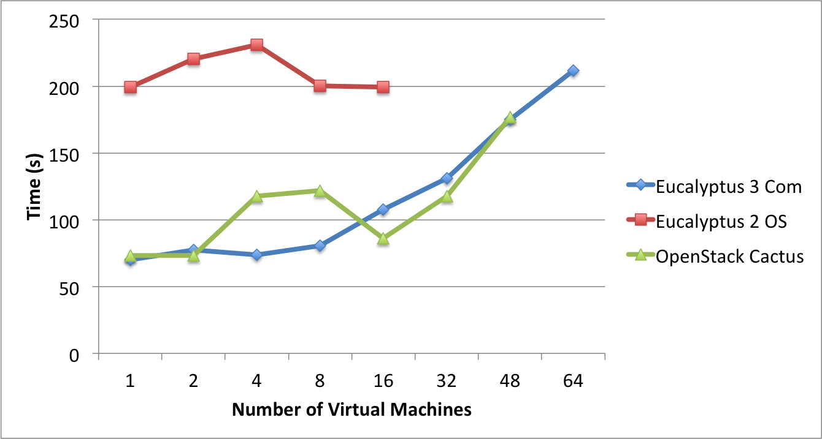
Templated Dynamic Provisioning
Abstract Specification of image mapped to various HPC and Cloud environments
OpenNebula
Parallel provisioning now supported
Moab/xCAT HPC – high as need reboot before use
Essex replaces Cactus
Current Eucalyptus 3 commercial while version 2 Open Source

Slide 43
What is FutureGrid?
The FutureGrid project mission is to enable experimental work that advances:
  Innovation and scientific understanding of distributed computing and parallel computing paradigms,
  The engineering science of middleware that enables these paradigms,
  The use and drivers of these paradigms by important applications, and,
  The education of a new generation of
  students and workforce on the use of
  these paradigms and their applications.
The implementation of mission includes
  Distributed flexible hardware
  with supported use
  Identified IaaS and PaaS “core” software
  with supported use
  Outreach
~4500 cores in 5 major
sites
FutureGrid Usage

