Slide 1
Scalable Algorithms in the Cloud III
Microsoft Summer School
Doing Research in the Cloud
Moscow State University
August 5 2014
Geoffrey Fox
gcf@indiana.edu
http://www.infomall.org
School of Informatics and Computing
Digital Science Center
Indiana University Bloomington

Slide 2
A Reminder
HPC-ABDS
Integrating High Performance Computing with Apache Big Data Stack
Shantenu Jha, Judy Qiu, Andre Luckow
http://hpc-abds.org/kaleidoscope/

Slide 3
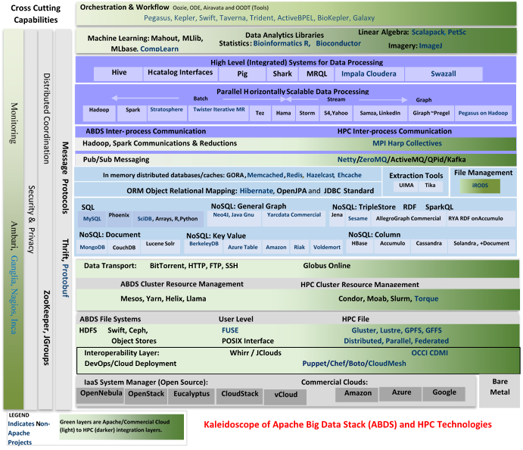
HPC-ABDS
~120 Capabilities
>40 Apache
Green layers have strong HPC Integration opportunities
Goal
Functionality of ABDS
Performance of HPC

Slide 5
Maybe a Big Data Initiative would include
IaaS: Amazon, Azure, OpenStack, Libcloud
Slurm
Yarn
Hbase, MongoDB
MySQL
iRods
Memcached
Kafka, RabbitMQ
Harp
Hadoop, Giraph, Spark
Storm
Hive
Pig
Mahout – lots of different analytics
R -– lots of different analytics
Kepler, Pegasus
Zookeeper
Ganglia, Nagios, Inca
HDFS, Lustre

Slide 6







HPC ABDS SYSTEM (Middleware)
120 Software Projects
System Abstraction/Standards
Data Format and Storage
HPC Yarn for Resource management
Horizontally scalable parallel
programming model
Collective and Point to Point Communication
Support for iteration (in memory processing)
HPC ABDS
Hourglass
Application Abstractions/Standards
Graphs, Networks, Images, Geospatial ..
Scalable Parallel Interoperable Data Analytics Library (SPIDAL)
High performance Mahout, R, Matlab …..
High Performance Applications

Slide 7
SPIDAL (Scalable Parallel Interoperable Data Analytics Library)
Getting High Performance on Data Analytics
On the systems side, we have two principles:
  The Apache Big Data Stack with ~120 projects has important broad functionality with a vital large support organization
  HPC including MPI has striking success in delivering high performance,
  however with a fragile sustainability model
There are key systems abstractions which are levels in HPC-ABDS software stack where Apache approach needs careful integration with HPC
  Resource management
  Storage
  Programming model -- horizontal scaling parallelism
  Collective and Point-to-Point communication
  Support of iteration
Data interface (not just key-value) but system also supports other important application abstractions
  Graphs/network
  Geospatial
  Genes
  Images, etc.

Slide 8
Lets discuss
Building a Big Data Ecosystem that is broadly deployable

Slide 9
Using Lots of Services
To enable Big data processing, we need to support those processing data, those developing new tools and those managing big data infrastructure
Need Software, CPU’s, Storage, Networks delivered as Software-Defined Distributed System as a Service or SDDSaaS
  SDDSaaS integrates component services from lower levels of Kaleidoscope up to different Mahout or R components and the workflow services that integrate them
Given richness and rapid evolution of field, we need to enable easy use of the Kaleidoscope (and other) software.
Make a list of basic software services needed
Then define them as Puppet/Chef Puppies/recipes
Compose them with SDDSL Language (later)
Specify infrastructures
Administrators, developers run Cloudmesh to deploy on demand
Application users directly access Data Analytics as Software as a Service created by Cloudmesh

Slide 10
Software-Defined Distributed
System (SDDS) as a Service includes
FutureGrid uses
SDDS-aaS Tools
Provisioning
Image Management
IaaS Interoperability
NaaS, IaaS tools
Expt management
Dynamic IaaS NaaS
DevOps
CS Research Use e.g. test new compiler or storage model
Class Usages e.g. run GPU & multicore
Applications
Software
(Application
Or Usage) SaaS
CloudMesh is a SDDSaaS tool that uses Dynamic Provisioning and Image Management to provide custom environments for general target systems
Involves (1) creating,
(2) deploying, and
(3) provisioning
of one or more images in a set of machines on demand http://cloudmesh.futuregrid.org/
Cloud e.g. MapReduce
HPC e.g. PETSc, SAGA
Computer Science e.g. Compiler tools, Sensor nets, Monitors
Platform
PaaS
Infra
structure
IaaS
Software Defined Computing (virtual Clusters)
Hypervisor, Bare Metal
Operating System
Network
NaaS
Software Defined Networks
OpenFlow GENI

Slide 11
CloudMesh Architecture
Cloudmesh is a SDDSaaS toolkit to support
  A software-defined distributed system encompassing virtualized and bare-metal infrastructure, networks, application, systems and platform software with a unifying goal of providing Computing as a Service.
  The creation of a tightly integrated mesh of services targeting multiple IaaS frameworks
  The ability to federate a number of resources from academia and industry. This includes existing FutureGrid infrastructure, Amazon Web Services, Azure, HP Cloud, Karlsruhe using several IaaS frameworks
  The creation of an environment in which it becomes easier to experiment with platforms and software services while assisting with their deployment.
  The exposure of information to guide the efficient utilization of resources. (Monitoring)
  Support reproducible computing environments
  IPython-based workflow as an interoperable onramp
Cloudmesh exposes both hypervisor-based and bare-metal provisioning to users and administrators
Access through command line, API, and Web interfaces.

Slide 12
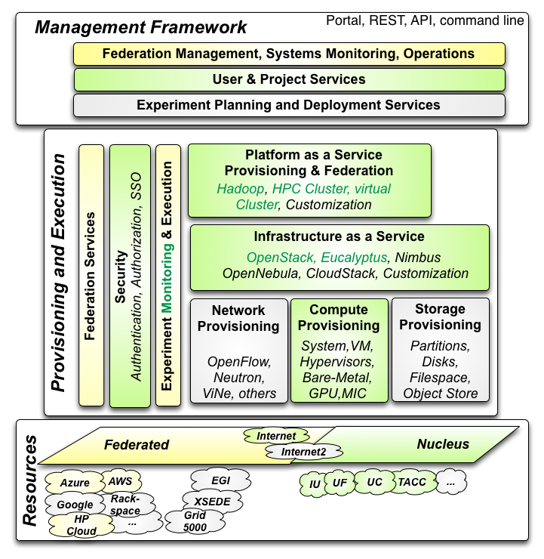

Cloudmesh Architecture
Cloudmesh Management Framework for monitoring and operations, user and project management, experiment planning and deployment of services needed by an experiment
Provisioning and execution environments to be deployed on resources to (or interfaced with) enable experiment management.
Resources.
FutureGrid, SDSC Comet, IU Juliet

Slide 13
Cloudmesh Functionality
Notes:
Due to its integrated services Cloudmesh provides the ability to be an onramp for other clouds.
It provides information services to various system level sensors to give access to sensor and utilization data. Internally, it can be used to optimize the system usage.
The provisioning experience from FutureGrid has taught us that we need to provide
the creation of new clouds (rain)
the repartitioning of resources between services (cloud shifting)
and the integration of external cloud resources in case of over provisioning (cloud bursting)
As we deal with many IaaS frameworks, we need an abstraction layer on top of the IaaS framework.
Experiment management is conducted with workflows controlled in shells, Python/iPython, as well as systems such as OpenStack's Heat.
Accounting is supported through additional services such as user management and charge rate management.
Not all features are yet implemented. Figure shows the main functionality that we target at this time to implement.

Slide 14
Building Blocks of Cloudmesh
Uses internally Libcloud and Cobbler
Celery Task/Query manager (AMQP - RabbitMQ)
MongoDB
Accesses via abstractions external systems/standards
OpenPBS, Chef
OpenStack (including tools like Heat), AWS EC2, Eucalyptus, Azure
Xsede user management (Amie) via Futuregrid
Implementing Docker, Slurm, OCCI, Ansible, Puppet
Evaluating Razor, Juju, Xcat (Original Rain used this), Foreman

Slide 15
Cloudmesh Components I
Cobbler: Python based provisioning of bare-metal or hypervisor-based systems
Apache Libcloud: Python library for interacting with many of the popular cloud service providers using a unified API. (One Interface To Rule Them All)
Celery is an asynchronous task queue/job queue environment based on RabbitMQ or equivalent and written in Python
OpenStack Heat is a Python orchestration engine for common cloud environments managing the entire lifecycle of infrastructure and applications.
Docker (written in Go) is a tool to package an application and its dependencies in a virtual Linux container
OCCI is an Open Grid Forum cloud instance standard
Slurm is an open source C based job scheduler from HPC community with similar functionalities to OpenPBS

Slide 16
Cloudmesh Components II
Chef Ansible Puppet Salt are system configuration managers. Scripts are used to define system
Razor cloud bare metal provisioning from EMC/puppet
Juju from Ubuntu orchestrates services and their provisioning defined by charms across multiple clouds
Xcat (Originally we used this) is a rather specialized (IBM) dynamic provisioning system
Foreman written in Ruby/Javascript is an open source project that helps system administrators manage servers throughout their lifecycle, from provisioning and configuration to orchestration and monitoring. Builds on Puppet or Chef

Slide 17
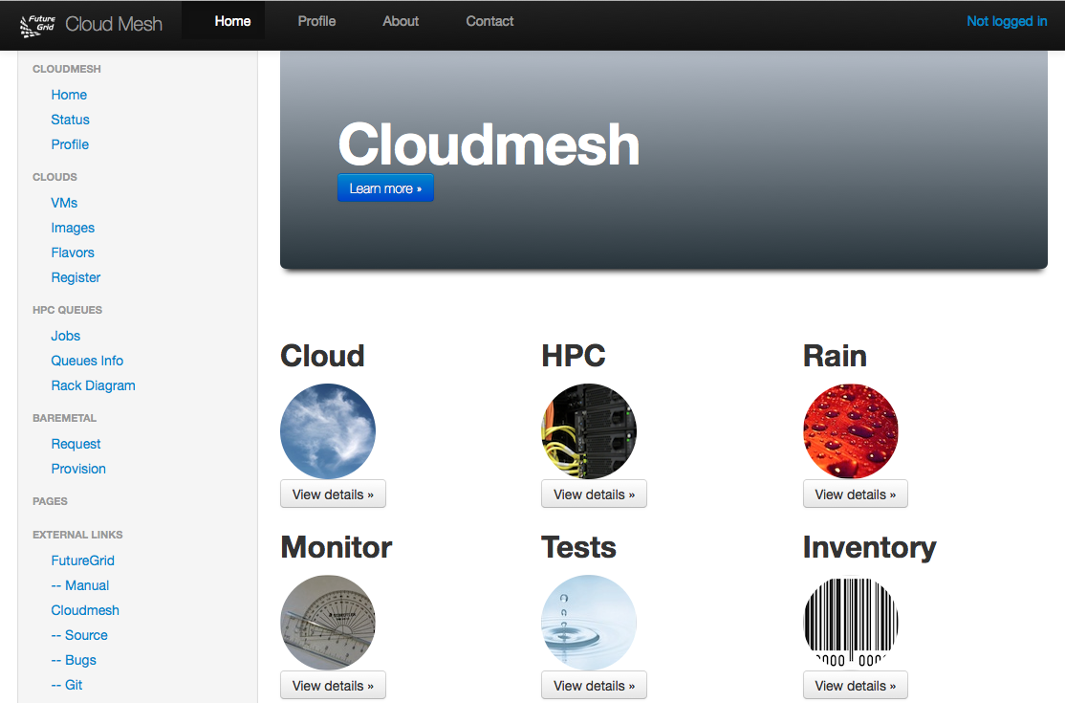
Cloudmesh User Interface
Notes:
A starting window allows to chose from the different functionality

Slide 18
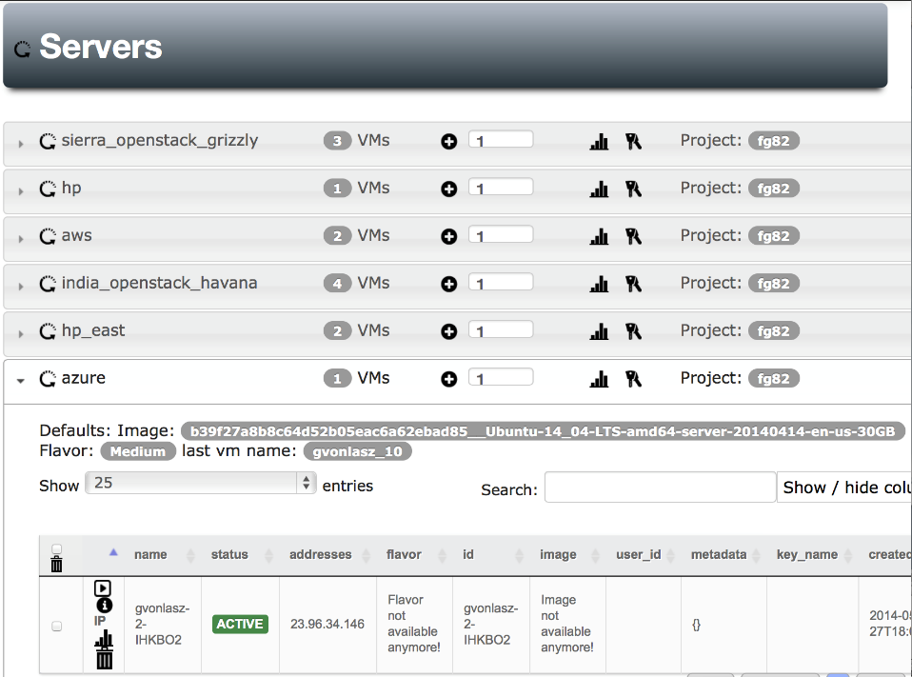
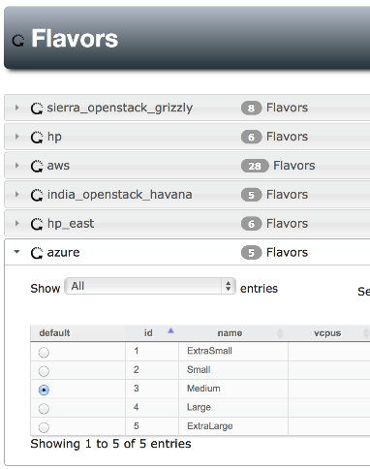
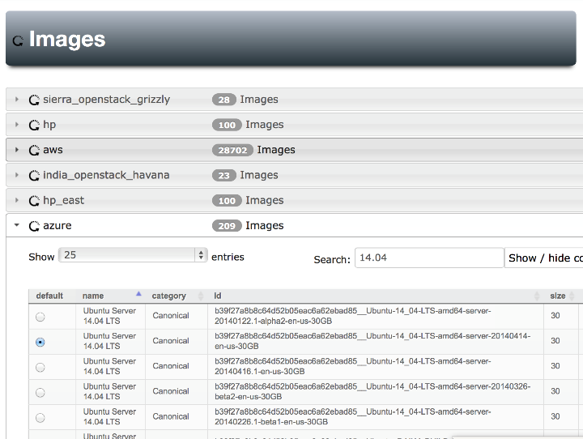
Notes:
Yes Azure is also there, Our gui can easily handle searching for images , we can set defaults for each cloud (images & flavors), pressing the + button will give us a new server with the specified defaults

Slide 19
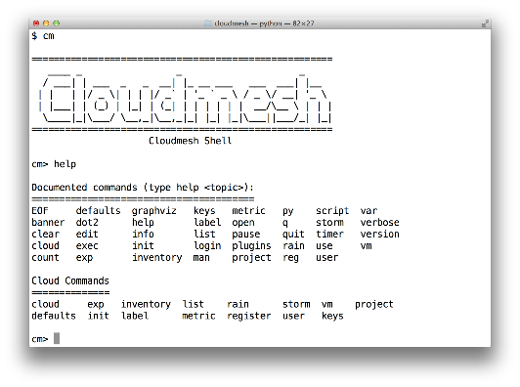
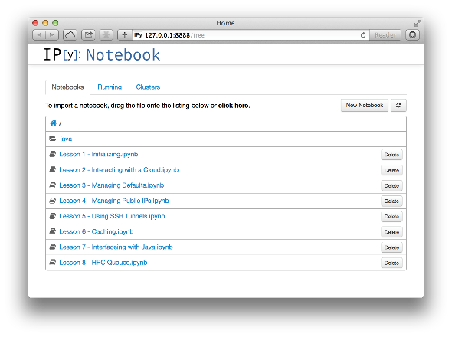
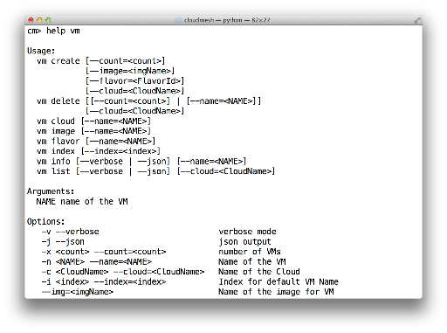
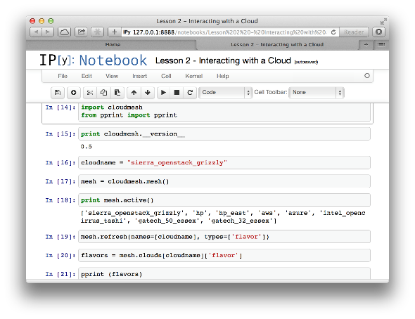
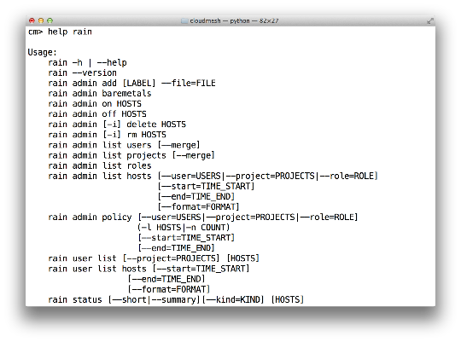
Cloudmesh Shell & bash & IPython
Notes:
Cloudmesh provides more than shell commands it has an integrated shell

Slide 20
SDDS Software Defined Distributed Systems
Cloudmesh builds infrastructure as SDDS consisting of one or more virtual clusters or slices with extensive built-in monitoring
These slices are instantiated on infrastructures with various owners
Controlled by roles/rules of Project, User, infrastructure
One needs general hypervisor and bare-metal slices to support research
The experiment management system is intended to integrates ISI Precip, FG Cloudmesh and tools latter invokes
Enables reproducibility in experiments.
User in Project
Request
Execution in Project
Python or REST API
Repository
SDDSL
Results
Request
SDDS
CMMon
CMPlan
User Roles
CMExec
Infrastructure (Cluster, Storage, Network, CPS)
Select
Plan
Requested SDDS as federated Virtual Infrastructures
CMProv
#1Virtual infra.
Instance Type
Current State
Management Structure
Provisioning Rules
Usage Rules (depends on user roles)
Linux
Image and Template Library
#2 Virtual infra.
#3Virtual infra.
Windows
Linux
#4 Virtual infra.
User role and infrastructure rule dependent security checks
Mac OS X

Slide 21
What is SDDSL?
There is an OASIS standard activity TOSCA (Topology and Orchestration Specification for Cloud Applications)
But this is similar to mash-ups or workflow (Taverna, Kepler, Pegasus, Swift ..) and we know that workflow itself is very successful but workflow standards are not
  OASIS WS-BPEL (Business Process Execution Language) didn’t catch on
As basic tools (Cloudmesh) use Python and Python is a popular scripting language for workflow, we suggest that Python is SDDSL
  IPython Notebooks are natural log of execution provenance

Slide 22
Cloudmesh as an On-Ramp
As an On-Ramp, CloudMesh deploys recipes on multiple platforms so you can test in one place and do production on others
Its multi-host support implies it is effective at distributed systems
It will support traditional workflow functions such as
  Specification of an execution dataflow
  Customization of Recipe
  Specification of program parameters
Workflow quite well explored in Python https://wiki.openstack.org/wiki/NovaOrchestration/WorkflowEngines
IPython notebook preserves provenance of activity

Slide 23
CloudMesh Administrative View of SDDS aaS
CM-BMPaaS (Bare Metal Provisioning aaS) is a systems view and allows Cloudmesh to dynamically generate anything and assign it as permitted by user role and resource policy
  FutureGrid machines India, Bravo, Delta, Sierra, Foxtrot are like this
  Note this only implies user level bare metal access if given user is authorized and this is done on a per machine basis
  It does imply dynamic retargeting of nodes to typically safe modes of operation (approved machine images) such as switching back and forth between OpenStack, OpenNebula, HPC on Bare metal, Hadoop etc.
CM-HPaaS (Hypervisor based Provisioning aaS) allows Cloudmesh to generate "anything" on the hypervisor allowed for a particular user
  Platform determined by images available to user
  Amazon, Azure, HPCloud, Google Compute Engine
CM-PaaS (Platform as a Service) makes available an essentially fixed Platform with configuration differences
  XSEDE with MPI HPC nodes could be like this as is Google App Engine and Amazon HPC Cluster. Echo at IU (ScaleMP) is like this
  In such a case a system administrator can statically change base system but the dynamic provisioner cannot

Slide 24
CloudMesh User View of SDDS aaS
Note we always consider virtual clusters or slices with nodes that may or may not have hypervisors
Well defined user and project management assigning roles
BM-IaaS: Bare Metal (root access) Infrastructure as a service with variants e.g. can change firmware or not
H-IaaS: Hypervisor based Infrastructure (Machine) as a Service. User provided a collection of hypervisors to build system on.
  Classic Commercial cloud view
PSaaS Physical or Platformed System as a Service where user provided a configured image on either Bare Metal or a Hypervisor
  User could request a deployment of Apache Storm and Kafka to control a set of devices (e.g. smartphones)

Slide 25
Cloudmesh Infrastructure Types
Nucleus Infrastructure:
  Persistent Cloudmesh Infrastructure with defined provisioning rules and characteristics and managed by CloudMesh
Federated Infrastructure:
  Outside infrastructure that can be used by special arrangement such as commercial clouds or XSEDE
  Typically persistent and often batch scheduled
  CloudMesh can use within prescribed provisioning rules and users restricted to those with permitted access; interoperable templates allow common images to nucleus
Contributed Infrastructure
  Outside contributions to a particular Cloudmesh project managed by Cloudmesh in this project
  Typically strong user role restrictions – users must belong to a particular project
  Can implement a Planetlab like environment by contributing hardware that can be generally used with bare-metal provisioning

Slide 28



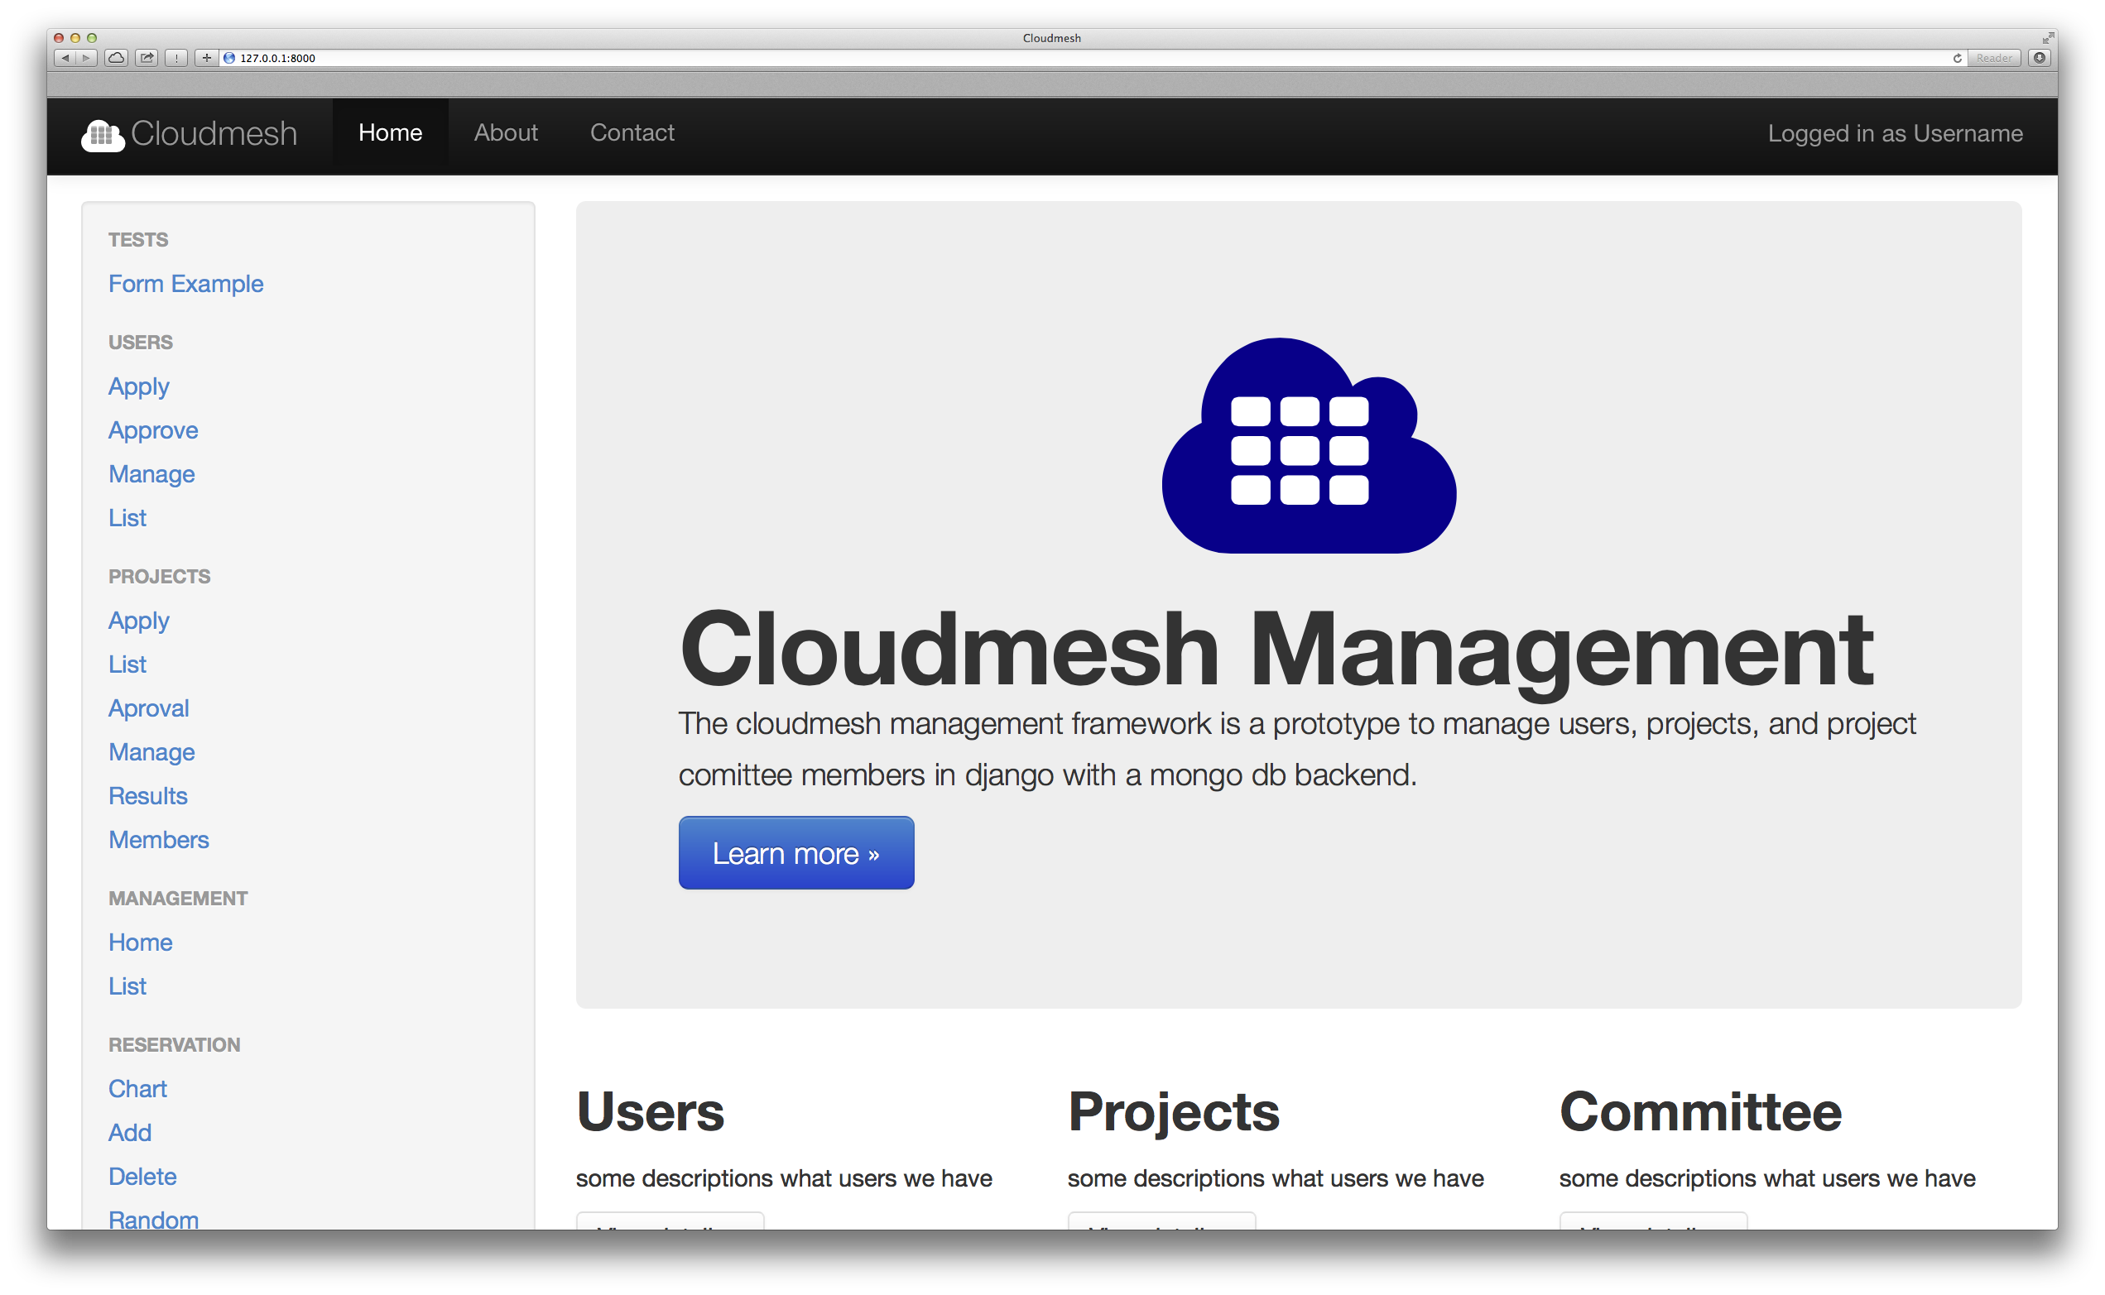
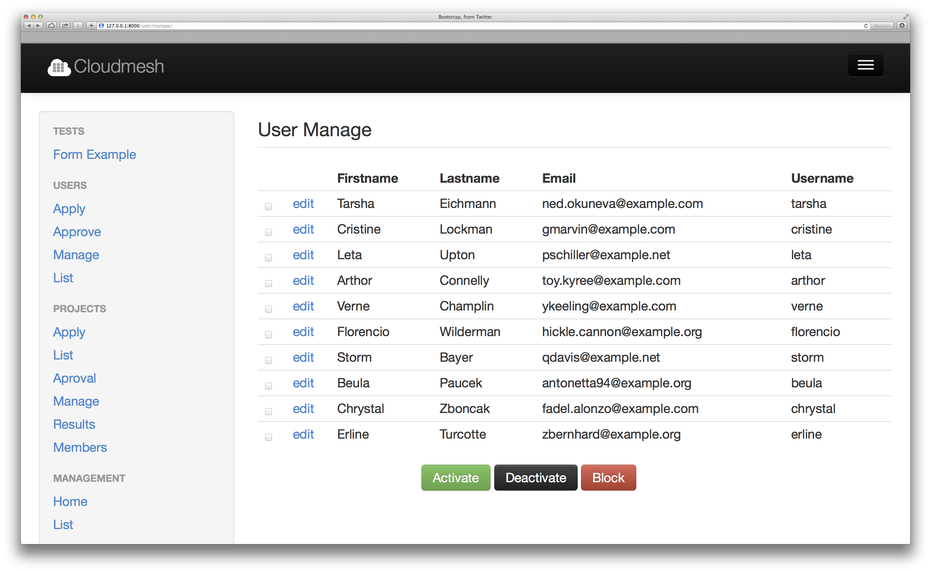
A Project Management Framework for Cloud and HPC Resource Providers
Jefferson Ridgeway², Ifeanyi Rowland Onyenweaku³, Gregor von Laszewski^{1*}, Fugang Wang¹
^{1*} Indiana University, Bloomington, IN 47408, U.S.A., laszewski@gmail.com, kevinwangfg@gmail.com
² Elizabeth City State University, jdridgeway4@gmail.com
³ Mississippi Valley State University, rowlandifeanyi17@gmail.com
Abstract
Screenshots and Diagrams
Implementation
Cloudmesh is a project that allows the management of virtual machines in a federated fashion. It can be run in two modes. One is a standalone mode where the users run cloudmesh on the local machines. The second mode is a hosted mode where multiple users share a web server through which the virtual machines are managed. One of the important functions for cloudmesh is to provide a sophisticated user management. This user management is currently conducted in drupal through the FutureGrid portal via an integration to the FutureGrid LDAP server. However, as the rest of cloudmesh is developed in python, hence in order to increase sustainability, we benefit from transitioning the user management also to python. This will also allow us to add more advanced user and project management functionality into cloudmesh.
The implementation leverages a data model design provided in python via mongoengine to represent users projects and project committees that approve projects. As part of the management functionality, we need to implement a queue in which users are queued for approval, and a project queue whereby projects are queued and approved by a committee. An Application Interface written in python will support this task and provide an abstraction that is outside the web interface.
Cloudmesh Management is implemented with frameworks such as python Django and MongoDB (with access through mongoengine).
Using the frameworks mentioned above, an API that performs the addition of users and projects to the database was implemented. In this API, the user is added to the database after being verified. We were able to display all the users and projects that has been created, and perform certain functions like activate, deactivate, block, find, delete a user and many more with the database. In the creation of the web Framework of Cloudmesh Management, we used classes that contains attributes that represents fields in the database, to connect with mongodb using the form API to display the forms on the django development framework.
Status
Introduction
Figure 1: User Management Framework
Figure 2: Project and Committee Framework
We have developed a prototype web service for the User Interface displaying links to management, administration, cloudmesh and projects via the django web devlopment framework on the browser. Currently, we are working on the approval mechanism and a mixed database model in order to connect the mongoDB database with the Django web framework to display users, projects, committees, and approvals/disapprovals.
Future work to improve the Cloudmesh management framework includes finishing the implementation of the approval mechanism for both users and projects registration through web interface, completion of the functions of the committee roles, authentication and authorization framework, improving workflows of management and to display reservation data and list virtual machines on various clouds accessing the cloudmesh database.
Ever since the inception of clouds and their functionality in maintaining data, the field of cloud computing has grown immensely. An important academic project is FutureGrid lead by Indiana University. FutureGrid provides an experimental testbed for clouds, HPC, and Grids. It enables researchers to experiment in difficult research challenges in the computer science field that are related to the applicability of grids and clouds [1]. The testbed aids virtual machine based environments, and native operating systems for experiments aimed at minimizing overhead and maximizing performance [1]. This testbed has been the motivating driver for Cloudmesh. Cloudmesh allows for federated resource management of virtual machines , bare metal provisioning, and access to a rich set of interfaces including REST, shell, and a python api of its services. The goal is to provide a Software Defined Distributed System (SDDSaas)[2]. Currently, Cloudmesh uses flask, a web development framework. While there is no issue with using flask as the main web development framework, the cloud computing community uses django as web development framework. Django operates in a similar fashion as flask, such as displaying views, using certain templates, and other components, but mainly it is more widely used and accepted within the community.
The goals of Cloudmesh include to develop a role based user, a project management framework, and to evaluate if Django can be used instead of flask as the web development framework for accessing Cloudmesh databases and much of the logic in Cloudmesh can be easily moved from flask to django. All the while, developing sample use cases for using certain django features, so that the transition form flask to django an be facilitated easily. This will include creating proper and appropriate documentation on how to install and manage a Django server. An additional goal to this research is to see if we can reuse the MongoDB that we used as part of the flask based framework within the django based framework [3].
Acknowledgments
We like to thank Dr. Geoffrey Fox for his support, We also would like to thank the School of Informatics at Indiana University Bloomington and the IU-SROC director Dr. Lamara Warren. This material is based upon work supported in part by the National Science Foundation under Grant No. 0910812.
References
von Laszewski, G., Cloudmesh:Overiew, Cloudmesh. Retrieved June 28, 2014, from Indiana University, Bloomington, 2013: http://cloudmesh.futuregrid.org/cloudmesh/about.html
von Laszewski, G.; Fox, G. C.; Wang, F.; Younge, A. J.; Kulshrestha; Pike, G. G.; Smith, W.; Voeckler, J.; Figueiredo, R. J.; Fortes, J.; Keahey, K. & Deelman, E. Design of the FutureGrid Experiment Management Framework, Proceedings of Gateway Computing Environments 2010 (GCE2010) at SC10, IEEE, 2010
Design
Users and project information must be verified before they can be activated. The user is verified by validation of the information entered. Include the username, email, institution, country, and much more
Figure 3: Web interface for the Cloudmesh Management
*Corresponding Contact
Gregor von Laszewski, Indiana University, laszewski@gmail.com

Slide 29
Comparing Data Intensive and Simulation Problems

Slide 30
Useful Set of Analytics Architectures
Pleasingly Parallel: including local machine learning as in parallel over images and apply image processing to each image
- Hadoop could be used but many other HTC, Many task tools
Search: including collaborative filtering and motif finding implemented using classic MapReduce (Hadoop); Alignment
Map-Collective or Iterative MapReduce using Collective Communication (clustering) – Hadoop with Harp, Spark …..
Map-Communication or Iterative Giraph: (MapReduce) with point-to-point communication (most graph algorithms such as maximum clique, connected component, finding diameter, community detection)
  Vary in difficulty of finding partitioning (classic parallel load balancing)
Large and Shared memory: thread-based (event driven) graph algorithms (shortest path, Betweenness centrality) and Large memory applications
Ideas like workflow are “orthogonal” to this

Slide 31
4 Forms of MapReduce
(1) Map Only
(2) Classic MapReduce
(3) Iterative Map Reduce or Map-Collective
(4) Point to Point or Map-Communication
Input
Input
Iterations
Input
map
map
map
Local
reduce
reduce
Output
Graph
BLAST Analysis Local Machine Learning Pleasingly Parallel | High Energy Physics (HEP) Histograms Distributed search Recommender Engines | Expectation maximization Clustering e.g. K-means Linear Algebra, PageRank | Classic MPI PDE Solvers and Particle Dynamics Graph Problems
MapReduce and Iterative Extensions (Spark, Twister) |  |  | MPI, Giraph
Integrated Systems such as Hadoop + Harp with Compute and Communication model separated
Correspond to first 4 of Identified Architectures

Slide 32
Comparison of Data Analytics with Simulation I
Pleasingly parallel often important in both
Both are often SPMD and BSP
  Streaming event style important in Big Data; only see in simulations for “parameter sweep” simulations
  Non-iterative MapReduce is major big data paradigm
  not a common simulation paradigm except where “Reduce” summarizes pleasingly parallel execution
Big Data often has large collective communication
  Classic simulation has a lot of smallish point-to-point messages
Simulation dominantly sparse (nearest neighbor) data structures
  “Bag of words (users, rankings, images..)” algorithms are sparse, as is PageRank
  Important data analytics involves full matrix algorithms

Slide 33
Comparison of Data Analytics with Simulation II
There are similarities between some graph problems and particle simulations with a strange cutoff force.
  Both Map-Communication
Note many big data problems are “long range force” as all points are linked.
  Easiest to parallelize. Often full matrix algorithms
  e.g. in DNA sequence studies, distance δ(i, j) defined by BLAST, Smith-Waterman, etc., between all sequences i, j.
  Opportunity for “fast multipole” ideas in big data.
In image-based deep learning, neural network weights are block sparse (corresponding to links to pixel blocks) but can be formulated as full matrix operations on GPUs and MPI in blocks.
In HPC benchmarking, Linpack being challenged by a new sparse conjugate gradient benchmark HPCG, while I am diligently using non- sparse conjugate gradient solvers in clustering and Multi-dimensional scaling.

Slide 34


“Force Diagrams” for macromolecules and Facebook

Slide 35
Iterative MapReduce
Implementing HPC-ABDS
Judy Qiu, Bingjing Zhang, Dennis Gannon, Thilina Gunarathne

Slide 36
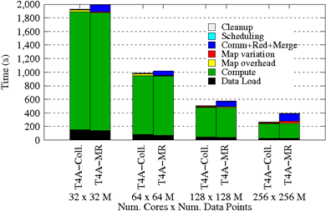
Using Optimal “Collective” Operations
Twister4Azure Iterative MapReduce with enhanced collectives
  Map-AllReduce primitive and MapReduce-MergeBroadcast
Strong Scaling on K-means for up to 256 cores on Azure

Slide 37
Kmeans and (Iterative) MapReduce
Shaded areas are computing only where Hadoop on HPC cluster is fastest
Areas above shading are overheads where T4A smallest and T4A with AllReduce collective have lowest overhead
Note even on Azure Java (Orange) faster than T4A C# for compute

Slide 38
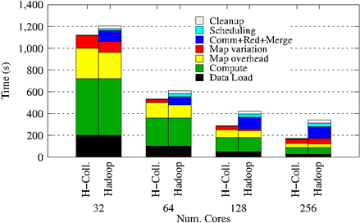
Collectives improve traditional MapReduce
Poly-algorithms choose the best collective implementation for machine and collective at hand
This is K-means running within basic Hadoop but with optimal AllReduce collective operations
Running on Infiniband Linux Cluster

Slide 39
Harp Design
Parallelism Model
Architecture
MapReduce Model
Map-Collective or Map-Communication Model
M
M
M
M
MapReduce Applications
Map-Collective
or Map-Communication Applications
M
M
M
M
Application
Shuffle
Harp
Optimal Communication
MapReduce V2
R
R
Framework
Resource Manager
YARN

Slide 40
Features of Harp Hadoop Plugin
Hadoop Plugin (on Hadoop 1.2.1 and Hadoop 2.2.0)
Hierarchical data abstraction on arrays, key-values and graphs for easy programming expressiveness.
Collective communication model to support various communication operations on the data abstractions (will extend to Point to Point)
Caching with buffer management for memory allocation required from computation and communication
BSP style parallelism
Fault tolerance with checkpointing

Slide 41
WDA SMACOF MDS (Multidimensional Scaling) using Harp on IU Big Red 2
Parallel Efficiency: on 100-300K sequences
Best available MDS (much better than that in R)
Java
Harp (Hadoop plugin)
Cores =32 #nodes
Conjugate Gradient (dominant time) and Matrix Multiplication

Slide 42
Increasing Communication
Identical Computation
Mahout and Hadoop MR – Slow due to MapReduce
Python slow as Scripting; MPI fastest
Spark Iterative MapReduce, non optimal communication
Harp Hadoop plug in with ~MPI collectives

Slide 43
Java Grande

Slide 44
Java Grande
We once tried to encourage use of Java in HPC with Java Grande Forum but Fortran, C and C++ remain central HPC languages.
  Not helped by .com and Sun collapse in 2000-2005
The pure Java CartaBlanca, a 2005 R&D100 award-winning project, was an early successful example of HPC use of Java in a simulation tool for non-linear physics on unstructured grids.
Of course Java is a major language in ABDS and as data analysis and simulation are naturally linked, should consider broader use of Java
Using Habanero Java (from Rice University) for Threads and mpiJava or FastMPJ for MPI, gathering collection of high performance parallel Java analytics
  Converted from C# and sequential Java faster than sequential C#
So will have either Hadoop+Harp or classic Threads/MPI versions in Java Grande version of Mahout

Slide 45
Performance of MPI Kernel Operations
Pure Java as in FastMPJ slower than Java interfacing to C version of MPI

Slide 46
Java Grande and C# on 40K point DAPWC Clustering
Very sensitive to threads v MPI
C# Hardware 0.7 performance Java Hardware
C#
Java
64 Way parallel
128 Way parallel
256 Way
parallel
TXP
Nodes
Total

Slide 47
Java and C# on 12.6K point DAPWC Clustering
Time hours
Java
C#
#Threads x #Processes per node
# Nodes
Total Parallelism
C# Hardware 0.7 performance Java Hardware
#Threads x #Processes per node
1x1
1x2
2x1
1x4
2x2
4x1
1x8
2x4
4x2
8x1

Slide 48
Lessons / Insights
Integrate (don’t compete) HPC with “Commodity Big data” (Azure to Amazon to Enterprise Data Analytics)
  i.e. improve Mahout; don’t compete with it
  Use Hadoop plug-ins rather than replacing Hadoop
Enhanced Apache Big Data Stack HPC-ABDS has ~120 members
Need to develop needed services at all levels of stack from users of Mahout to those developing better run time and programming environments
Need to capture capabilities as dynamic services – developing a HPC-Cloud interoperability environment
Scripts defining SDDSaaS can also help experiment management and provisioning

