Slide 1
FutureGrid Summary
TG’10 Pittsburgh
BOF on New Compute Systems in the TeraGrid Pipeline August 3 2010
Geoffrey Fox
gcf@indiana.edu
http://www.infomall.org http://www.futuregrid.org
Director, Digital Science Center, Pervasive Technology Institute
Associate Dean for Research and Graduate Studies, School of Informatics and Computing
Indiana University Bloomington

Slide 2
FutureGrid key Concepts I
FutureGrid provides a testbed with a wide variety of computing services to its users
Supporting users developing new applications and new middleware using Cloud, Grid and Parallel computing (Hypervisors – Xen, KVM, ScaleMP, Linux, Windows, Nimbus, Eucalyptus, Hadoop, Globus, Unicore, MPI, OpenMP …)
Software supported by FutureGrid or users
~5000 dedicated cores distributed across country
The FutureGrid testbed provides to its users:
A rich development and testing platform for middleware and application users looking at interoperability, functionality and performance
Each use of FutureGrid is an experiment that is reproducible
A rich education and teaching platform for advanced cyberinfrastructure classes
Ability to collaborate with the US industry on research projects

Slide 3
FutureGrid key Concepts II
Cloud infrastructure supports loading of general images on Hypervisors like Xen; FutureGrid dynamically provisions software as needed onto “bare-metal” using Moab/xCAT based environment
Key early user oriented milestones:
June 2010 Initial users
October 2010-January 2011 Increasing not so early users allocated by FutureGrid
October 2011 FutureGrid allocatable via TeraGrid process
To apply for FutureGrid access or get help, go to homepage www.futuregrid.org. Alternatively for help send email to help@futuregrid.org. You should receive an automated reply to email within minutes, and contact clearly from a live human no later than next (U.S.) business day after sending an email message. Please send email to PI gcf@indiana.edu if problems

Slide 4
FutureGrid Partners
Indiana University (Architecture, core software, Support)
Collaboration between research and infrastructure groups
Purdue University (HTC Hardware)
San Diego Supercomputer Center at University of California San Diego (INCA, Monitoring)
University of Chicago/Argonne National Labs (Nimbus)
University of Florida (ViNE, Education and Outreach)
University of Southern California Information Sciences (Pegasus to manage experiments)
University of Tennessee Knoxville (Benchmarking)
University of Texas at Austin/Texas Advanced Computing Center (Portal)
University of Virginia (OGF, Advisory Board and allocation)
Center for Information Services and GWT-TUD from Technische Universtität Dresden. (VAMPIR)
Red institutions have FutureGrid hardware

Slide 5
Compute Hardware
System type | # CPUs | # Cores | TFLOPS | Total RAM (GB) | Secondary Storage (TB) | Site | Status
Dynamically configurable systems
IBM iDataPlex | 256 | 1024 | 11 | 3072 | 339* | IU | Operational
Dell PowerEdge | 192 | 768 | 8 | 1152 | 30 | TACC | Being installed
IBM iDataPlex | 168 | 672 | 7 | 2016 | 120 | UC | Operational
IBM iDataPlex | 168 | 672 | 7 | 2688 | 96 | SDSC | Operational
Subtotal | 784 | 3136 | 33 | 8928 | 585
Systems not dynamically configurable
Cray XT5m | 168 | 672 | 6 | 1344 | 339* | IU | Operational
Shared memory system TBD | 40 | 480 | 4 | 640 | 339* | IU | New System TBD
IBM iDataPlex | 64 | 256 | 2 | 768 | 1 | UF | Operational
High Throughput Cluster | 192 | 384 | 4 | 192 |  | PU | Not yet integrated
Subtotal | 464 | 1792 | 16 | 2944 | 1
Total | 1248 | 4928 | 49 | 11872 | 586

Slide 6
Storage Hardware
System Type | Capacity (TB) | File System | Site | Status
DDN 9550 (Data Capacitor) | 339 | Lustre | IU | Existing System
DDN 6620 | 120 | GPFS | UC | New System
SunFire x4170 | 96 | ZFS | SDSC | New System
Dell MD3000 | 30 | NFS | TACC | New System

Slide 7
Network & Internal Interconnects
FutureGrid has dedicated network (except to TACC) and a network fault and delay generator
Can isolate experiments on request; IU runs Network for NLR/Internet2
(Many) additional partner machines will run FutureGrid software and be supported (but allocated in specialized ways)
Machine | Name | Internal Network
IU Cray | xray | Cray 2D Torus SeaStar
IU iDataPlex | india | DDR IB, QLogic switch with Mellanox ConnectX adapters Blade Network Technologies & Force10 Ethernet switches
SDSC iDataPlex | sierra | DDR IB, Cisco switch with Mellanox ConnectX adapters Juniper Ethernet switches
UC iDataPlex | hotel | DDR IB, QLogic switch with Mellanox ConnectX adapters Blade Network Technologies & Juniper switches
UF iDataPlex | foxtrot | Gigabit Ethernet only (Blade Network Technologies; Force10 switches)
TACC Dell | alamo | QDR IB, Mellanox switches and adapters Dell Ethernet switches

Slide 8
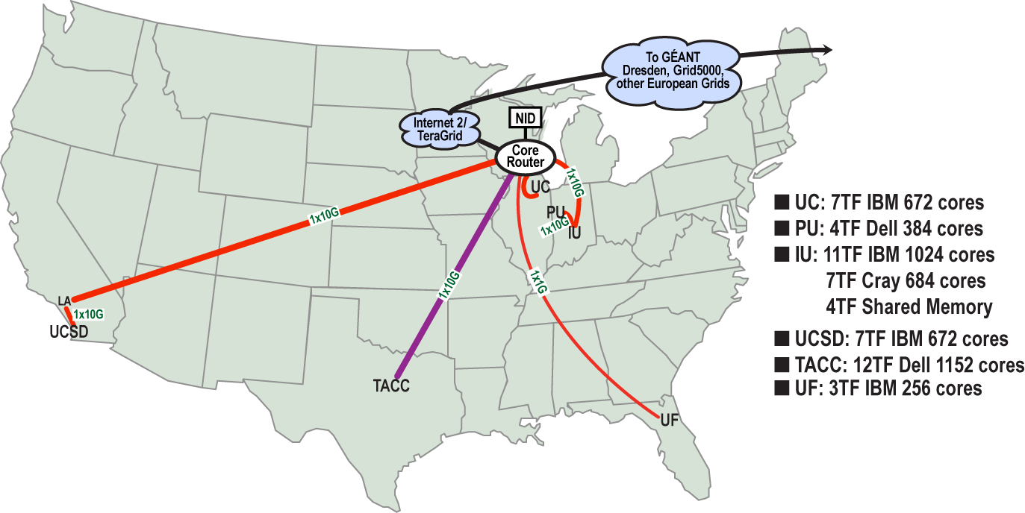
FutureGrid: a Grid/Cloud Testbed
Operational: IU Cray operational; IU , UCSD, UF & UC IBM iDataPlex operational
Network, NID operational
TACC Dell running acceptance tests – ready ~September 1
NID: Network Impairment Device
Private Public
FG Network

Slide 9
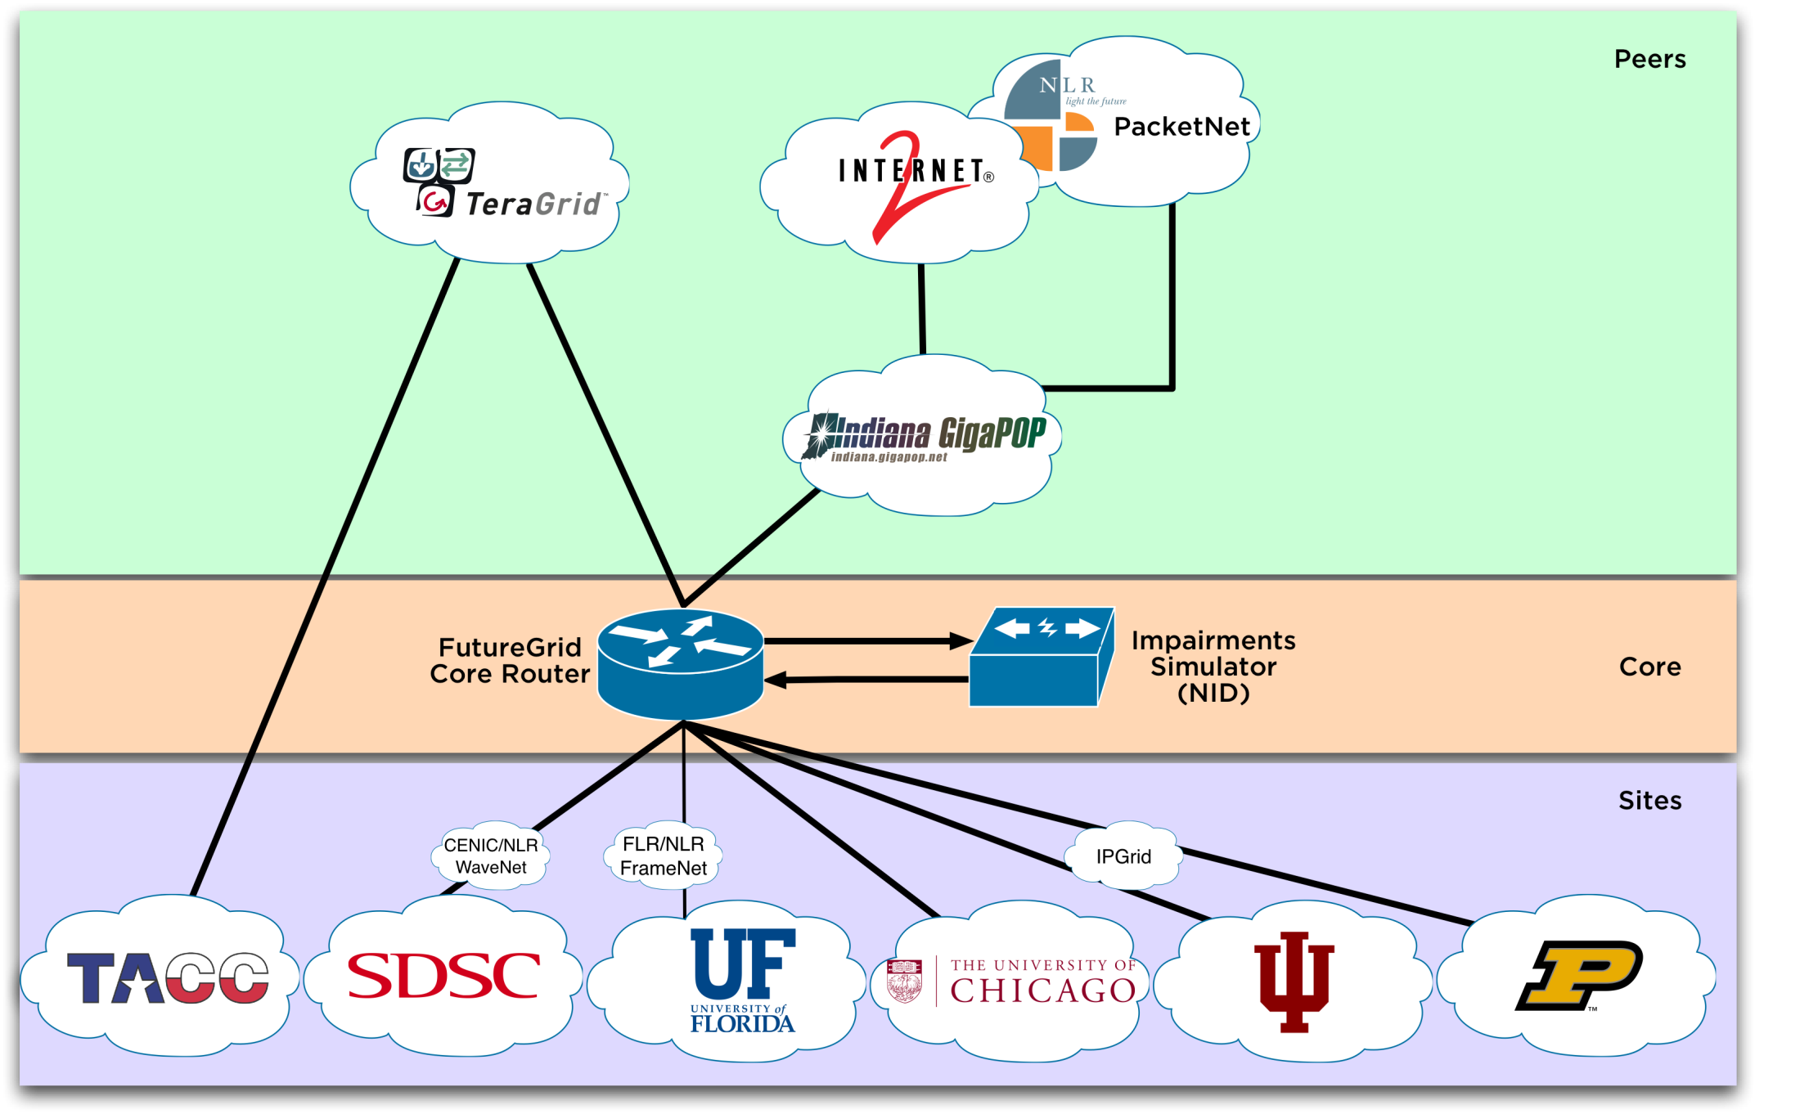
Logical Diagram

Slide 10
Network Impairment Device
Spirent XGEM Network Impairments Simulator for jitter, errors, delay, etc
Full Bidirectional 10G w/64 byte packets
up to 15 seconds introduced delay (in 16ns increments)
0-100% introduced packet loss in .0001% increments
Packet manipulation in first 2000 bytes
up to 16k frame size
TCL for scripting, HTML for manual configuration
Need more proposals to use (have one from University of Delaware)

Slide 11
FutureGrid Usage Model
The goal of FutureGrid is to support the research on the future of distributed, grid, and cloud computing
FutureGrid will build a robustly managed simulation environment and test-bed to support the development and early use in science of new technologies at all levels of the software stack: from networking to middleware to scientific applications
The environment will mimic TeraGrid and/or general parallel and distributed systems – FutureGrid is part of TeraGrid (but not part of formal TeraGrid process for first two years)
Supports Grids, Clouds, and classic HPC
It will mimic commercial clouds (initially IaaS not PaaS)
Expect FutureGrid PaaS to grow in importance
FutureGrid can be considered as a (small ~5000 core) Science/Computer Science Cloud but it is more accurately a virtual machine or bare-metal based simulation environment
This test-bed will succeed if it enables major advances in science and engineering through collaborative development of science applications and related software

Slide 12
Some Current FutureGrid early uses
Investigate metascheduling approaches on Cray and iDataPlex
Deploy Genesis II and Unicore end points on Cray and iDataPlex clusters
Develop new Nimbus cloud capabilities
Prototype applications (BLAST) across multiple FutureGrid clusters and Grid’5000
Compare Amazon, Azure with FutureGrid hardware running Linux, Linux on Xen or Windows for data intensive applications
Test ScaleMP software shared memory for genome assembly
Develop Genetic algorithms on Hadoop for optimization
Attach power monitoring equipment to iDataPlex nodes to study power use versus use characteristics
Industry (Columbus IN) running CFD codes to study combustion strategies to maximize energy efficiency
Support evaluation needed by XD TIS and TAS services
Investigate performance of Kepler workflow engine
Study scalability of SAGA in difference latency scenarios
Test and evaluate new algorithms for phylogenetics/systematics research in CIPRES portal
Investigate performance overheads of clouds in parallel and distributed environments
Support tutorials and classes in cloud, grid and parallel computing (IU, Florida, LSU)
~12 active/finished users out of ~32 early user applicants

Slide 13
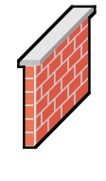
OGF’10 Demo
SDSC
Rennes
Grid’5000 firewall
UF
Lille
UC
Sophia
ViNe provided the necessary inter-cloud connectivity to deploy CloudBLAST across 5 Nimbus sites, with a mix of public and private subnets.

Slide 14
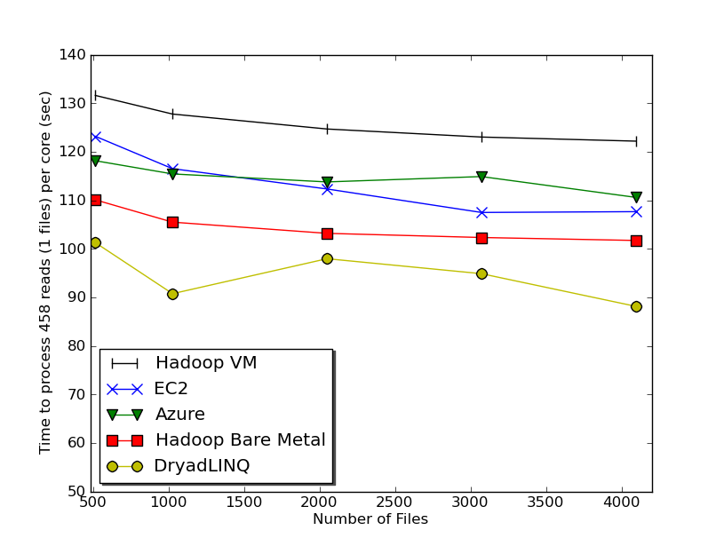
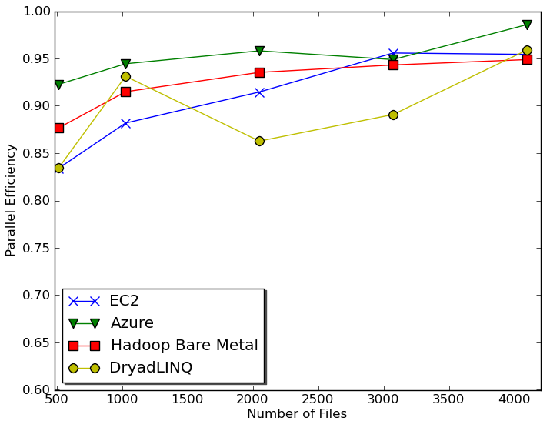
Sequence Assembly in the Clouds
Cap3 parallel efficiency
Cap3 – Per core per file (458 reads in each file) time to process sequences

Slide 15
Education on FutureGrid
Build up tutorials on supported software
Support development of curricula requiring privileges and systems destruction capabilities that are hard to grant on conventional TeraGrid
Offer suite of appliances (customized VM based images) supporting online laboratories
Supporting ~200 students in Virtual Summer School on “Big Data” July 26-30 with set of certified images – first offering of FutureGrid 101 Class; TeraGrid ‘10 “Cloud technologies, data-intensive science and the TG”; CloudCom conference tutorials Nov 30-Dec 3 2010
Experimental class use fall semester at Indiana, Florida and LSU

Slide 16
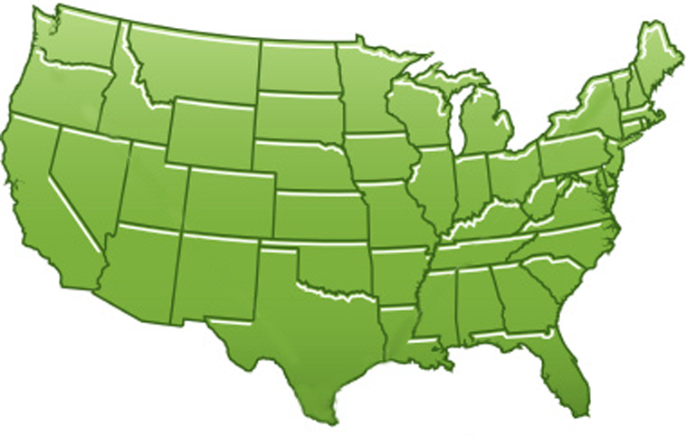
300+ Students learning about Twister & Hadoop
MapReduce technologies, supported by FutureGrid.
July 26-30, 2010 NCSA Summer School Workshop
http://salsahpc.indiana.edu/tutorial
Washington
University
University of
Minnesota
Michigan
State
Johns
Hopkins
Univ.Illinois
at Chicago
Iowa
State
Penn
State
IBM Almaden
Research Center
Notre
Dame
University of
California at
Los Angeles
Indiana
University
San Diego
Supercomputer
Center
University of
Texas at El Paso
University of
Arkansas
University
of Florida

Slide 17
Software Components
Portals including “Support” “use FutureGrid” “Outreach”
Monitoring – INCA, Power (GreenIT)
Experiment Manager: specify/workflow
Image Generation and Repository
Intercloud Networking ViNE
Virtual Clusters built with virtual networks
Performance library
Rain or Runtime Adaptable InsertioN Service: Schedule and Deploy images
Security (including use of isolated network), Authentication, Authorization,

Slide 18
FutureGrid Software Architecture
Flexible Architecture allows one to configure resources based on images
Managed images allows to create similar experiment environments
Experiment management allows reproducible activities
Through our modular design we allow different clouds and images to be “rained” upon hardware.
Note will eventually be supported at “TeraGrid Production Quality”
Will support deployment of “important” middleware including TeraGrid stack, Condor, BOINC, gLite, Unicore, Genesis II, MapReduce, Bigtable …..
Will accumulate more supported software as system used!
Will support links to external clouds, GPU clusters etc.
Grid5000 initial highlight with OGF29 Hadoop deployment over Grid5000 and FutureGrid
Interested in more external system collaborators!

Slide 19
Dynamic provisioning Examples
Need to provision
Linux or Windows O/S
Linux or (Windows O/S) on Hypervisors (KVM, Xen, ScaleMP)
Appliances – O/S plus application/middleware on bare-metal or hypervisors
Give me a virtual cluster with 30 nodes based on Xen
Give me 15 KVM nodes each in Chicago and Texas linked to Azure and Grid5000
Give me a Eucalyptus environment with 10 nodes
Give 32 MPI nodes running on first Linux and then Windows with Cray iDataPlex Dell comparisons
Give me a Hadoop or Dryad environment with 160 nodes
Compare with Amazon and Azure
Give me a 1000 BLAST instances linked to Grid5000
Give me two 8 node (64 core) ScaleMP instances on Alamo and India

Slide 20
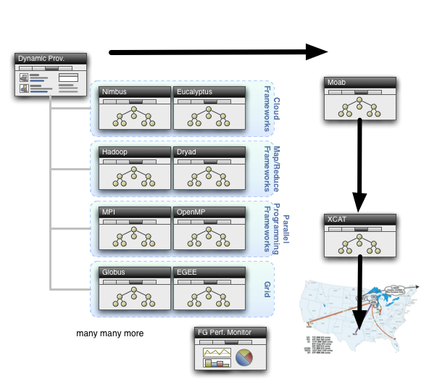
Dynamic Provisioning

Slide 21
Security Issues
Need to provide dynamic flexible usability and preserve system security
Still evolving process but initial approach involves
Encouraging use of “as a Service” approach e.g. “Database as a Software” not “Database in your image”; clearly possible for some cases as in “Hadoop as a Service”
Commercial clouds use aaS for database, queues, tables, storage …..
Makes complexity linear in #features rather than exponential if need to support all images with or without all features
Have a suite of vetted images (here images includes customized appliances) that can be used by users with suitable roles
Typically do not allow root access; can be VM or not VM based
Can create images and requested that they be vetted
“Privileged images” (e.g. allow root access) use VM’s and network isolation

Slide 22
FutureGrid Interaction with Commercial Clouds
We support experiments that link Commercial Clouds and FutureGrid with one or more workflow environments and portal technology installed to link components across these platforms
We support environments on FutureGrid that are similar to Commercial Clouds and natural for performance and functionality comparisons
These can both be used to prepare for using Commercial Clouds and as the most likely starting point for porting to them
One example would be support of MapReduce-like environments on FutureGrid including Hadoop on Linux and Dryad on Windows HPCS which are already part of FutureGrid portfolio of supported software
We develop expertise and support porting to Commercial Clouds from other Windows or Linux environments
We support comparisons between and integration of multiple commercial Cloud environments – especially Amazon and Azure in the immediate future
We develop tutorials and expertise to help users move to Commercial Clouds from other environments

