Slide 1
Challenges in Big Data,
Big Simulations, Clouds and HPC
IEEE Cloud and Big Data Computing
Toulouse France July 18-21
http://cbdcom2016.sciencesconf.org/
Geoffrey Fox
July 19, 2016
gcf@indiana.edu
http://www.dsc.soic.indiana.edu/, http://spidal.org/ http://hpc-abds.org/kaleidoscope/
Department of Intelligent Systems Engineering
School of Informatics and Computing, Digital Science Center
Indiana University Bloomington
Notes:
`

Slide 2
Abstract
We review several questions at the intersection of Big Data, Big Simulations, Clouds and HPC. We consider broad topics:
  Application Requirements
  Software (including language)
  System (hardware)
  Focus on Parallel processing in applications
We consider these in context of a Big Data - Big Simulation convergence and propose a simple approach which we are pursuing although it is certainly not agreed

Slide 3
What are the application and user requirements?
e.g. is the data streaming, how similar are commercial and scientific requirements?
NIST Big Data Initiative
Use Cases and Properties

Slide 4
51 Detailed Use Cases: Contributed July-September 2013
Covers goals, data features such as 3 V’s, software, hardware
Government Operation(4): National Archives and Records Administration, Census Bureau
Commercial(8): Finance in Cloud, Cloud Backup, Mendeley (Citations), Netflix, Web Search, Digital Materials, Cargo shipping (as in UPS)
Defense(3): Sensors, Image surveillance, Situation Assessment
Healthcare and Life Sciences(10): Medical records, Graph and Probabilistic analysis, Pathology, Bioimaging, Genomics, Epidemiology, People Activity models, Biodiversity
Deep Learning and Social Media(6): Driving Car, Geolocate images/cameras, Twitter, Crowd Sourcing, Network Science, NIST benchmark datasets
The Ecosystem for Research(4): Metadata, Collaboration, Language Translation, Light source experiments
Astronomy and Physics(5): Sky Surveys including comparison to simulation, Large Hadron Collider at CERN, Belle Accelerator II in Japan
Earth, Environmental and Polar Science(10): Radar Scattering in Atmosphere, Earthquake, Ocean, Earth Observation, Ice sheet Radar scattering, Earth radar mapping, Climate simulation datasets, Atmospheric turbulence identification, Subsurface Biogeochemistry (microbes to watersheds), AmeriFlux and FLUXNET gas sensors
Energy(1): Smart grid
Published by NIST as http://nvlpubs.nist.gov/nistpubs/SpecialPublications/NIST.SP.1500-3.pdf
“Version 2” being prepared
26 Features for each use case Biased to science

Slide 5
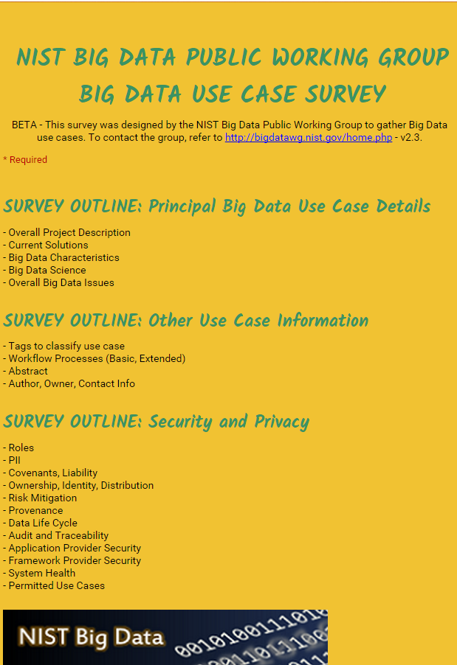
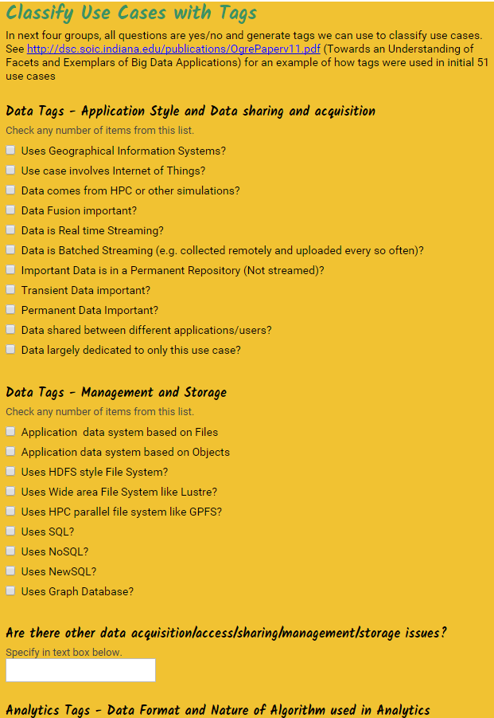
http://hpc-abds.org/kaleidoscope/survey/
Online Use Case Form

Slide 6
Sample Features of 51 Use Cases I
PP (26) “All” Pleasingly Parallel or Map Only
MR (18) Classic MapReduce MR (add MRStat below for full count)
MRStat (7) Simple version of MR where key computations are simple reduction as found in statistical averages such as histograms and averages
MRIter (23) Iterative MapReduce or MPI (Flink, Spark, Twister)
Graph (9) Complex graph data structure needed in analysis
Fusion (11) Integrate diverse data to aid discovery/decision making; could involve sophisticated algorithms or could just be a portal
Streaming (41) Some data comes in incrementally and is processed this way
Classify (30) Classification: divide data into categories
S/Q (12) Index, Search and Query

Slide 7
Sample Features of 51 Use Cases II
CF (4) Collaborative Filtering for recommender engines
LML (36) Local Machine Learning (Independent for each parallel entity) – application could have GML as well
GML (23) Global Machine Learning: Deep Learning, Clustering, LDA, PLSI, MDS,
  Large Scale Optimizations as in Variational Bayes, MCMC, Lifted Belief Propagation, Stochastic Gradient Descent, L-BFGS, Levenberg-Marquardt . Can call EGO or Exascale Global Optimization with scalable parallel algorithm
Workflow (51) Universal
GIS (16) Geotagged data and often displayed in ESRI, Microsoft Virtual Earth, Google Earth, GeoServer etc.
HPC (5) Classic large-scale simulation of cosmos, materials, etc. generating (visualization) data
Agent (2) Simulations of models of data-defined macroscopic entities represented as agents

Slide 8
Data and Model in Big Data and Simulations
Need to discuss Data and Model as problems combine them, but we can get insight by separating which allows better understanding of Big Data - Big Simulation “convergence” (or differences!)
Big Data implies Data is large but Model varies
  e.g. LDA with many topics or deep learning has large model
  Clustering or Dimension reduction can be quite small in model size
Simulations can also be considered as Data and Model
  Model is solving particle dynamics or partial differential equations
  Data could be small when just boundary conditions
  Data large with data assimilation (weather forecasting) or when data visualizations are produced by simulation
Data often static between iterations (unless streaming); Model varies between iterations

Slide 9
Classifying Use Cases
Take 51 NIST and other use cases → derive multiple specific features
Generalize and systematize with features termed “facets”
50 Facets (Big Data) termed Ogres divided into 4 sets or views where each view has “similar” facets
Add simulations and look separately at Data and Model gives 64 Facets describing Big Simulation and Data termed Convergence Diamonds looking at either data or model or their combination
Allows one to study coverage of benchmark sets and architectures

Slide 10
64 Features in 4 views for Unified Classification of Big Data and Simulation Applications
Both
Simulations
Analytics
(Model for Big Data)
(Nearly all Data)
(All Model)
(Mix of Data and Model)
(Nearly all Data+Model)

Slide 11
Convergence Diamonds and their 4 Views I
One view is the overall problem architecture or macropatterns which is naturally related to the machine architecture needed to support application.
  Unchanged from Ogres and describes properties of problem such as “Pleasing Parallel” or “Uses Collective Communication”
The execution (computational) features or micropatterns view, describes issues such as I/O versus compute rates, iterative nature and regularity of computation and the classic V’s of Big Data: defining problem size, rate of change, etc.
  Significant changes from ogres to separate Data and Model and add characteristics of Simulation models. e.g. both model and data have “V’s”; Data Volume, Model Size
  e.g. O(N²) Algorithm relevant to big data or big simulation model

Slide 12
Convergence Diamonds and their 4 Views II
The data source & style view includes facets specifying how the data is collected, stored and accessed. Has classic database characteristics
  Simulations can have facets here to describe input or output data
  Examples: Streaming, files versus objects, HDFS v. Lustre
Processing view has model (not data) facets which describe types of processing steps including nature of algorithms and kernels by model e.g. Linear Programming, Learning, Maximum Likelihood, Spectral methods, Mesh type,
  mix of Big Data Processing View and Big Simulation Processing View and includes some facets like “uses linear algebra” needed in both: has specifics of key simulation kernels and in particular includes facets seen in NAS Parallel Benchmarks and Berkeley Dwarfs
Instances of Diamonds are particular problems and a set of Diamond instances that cover enough of the facets could form a comprehensive benchmark/mini-app set
Diamonds and their instances can be atomic or composite

Slide 13
DISCUSSION
What are the application and user requirements?
e.g. is the data streaming, how similar are commercial and scientific requirements?
NIST Big Data Initiative
Use Cases and Properties

Slide 14
Structure of Applications
Real-time (streaming) data is increasingly common in scientific and engineering research, and it is ubiquitous in commercial Big Data (e.g., social network analysis, recommender systems and consumer behavior classification)
  So far little use of commercial and Apache technology in analysis of scientific streaming data
Pleasingly parallel applications important in science (long tail) and data communities
Commercial-Science application differences: Search and recommender engines have different structure to deep learning, clustering, topic models, graph analyses such as subgraph mining
  Latter very sensitive to communication and can be hard to parallelize
  Search typically not as important in Science as in commercial use as search volume scales by number of users
Should discuss data and model separately
  Term data often used rather sloppily and often refers to model

Slide 15
What is structure of problems and what does this imply?
  e.g. do big data requirements imply clouds or HPC machines or both
  e.g. difference between big data and big simulation problem structure
  The Big Data Ogres and Convergence Diamonds
  6 Forms of MapReduce
  2 Forms of Communication/Flow

Slide 16
Problem Architecture View (Meta or MacroPatterns)
Pleasingly Parallel – as in BLAST, Protein docking, some (bio-)imagery including Local Analytics or Machine Learning – ML or filtering pleasingly parallel, as in bio-imagery, radar images (pleasingly parallel but sophisticated local analytics)
Classic MapReduce: Search, Index and Query and Classification algorithms like collaborative filtering (G1 for MRStat in Features, G7)
Map-Collective: Iterative maps + communication dominated by “collective” operations as in reduction, broadcast, gather, scatter. Common datamining pattern
Map-Point to Point: Iterative maps + communication dominated by many small point to point messages as in graph algorithms
Map-Streaming: Describes streaming, steering and assimilation problems
Shared Memory: Some problems are asynchronous and are easier to parallelize on shared rather than distributed memory – see some graph algorithms
SPMD: Single Program Multiple Data, common parallel programming feature
BSP or Bulk Synchronous Processing: well-defined compute-communication phases
Fusion: Knowledge discovery often involves fusion of multiple methods.
Dataflow: Important application features often occurring in composite Ogres
Use Agents: as in epidemiology (swarm approaches) This is Model only
Workflow: All applications often involve orchestration (workflow) of multiple components
Most (11 of total 12) are properties of Data+Model
Notes:
Big dwarfs are Ogres
Implement Ogres in ABDS+

Slide 17
Local and Global Machine Learning
Many applications use LML or Local machine Learning where machine learning (often from R or Python or Matlab) is run separately on every data item such as on every image
But others are GML Global Machine Learning where machine learning is a basic algorithm run over all data items (over all nodes in computer)
  maximum likelihood or χ² with a sum over the N data items – documents, sequences, items to be sold, images etc. and often links (point-pairs).
  GML includes Graph analytics, clustering/community detection, mixture models, topic determination, Multidimensional scaling, (Deep) Learning Networks
Note Facebook may need lots of small graphs (one per person and ~LML) rather than one giant graph of connected people (GML)

Slide 18
6 Forms of MapReduce
Describes Architecture of
- Problem (Model reflecting data)
- Machine
- Software
2 important variants (software) of Iterative MapReduce and Map-Streaming a) “In-place” HPC b) Flow for model and data

Slide 19
Relation of Problem and Machine Architecture
Problem is Model plus Data
In my old papers (especially book Parallel Computing Works!), I discussed computing as multiple complex systems mapped into each other
Problem → Numerical formulation → Software → Hardware
Each of these 4 systems has an architecture that can be described in similar language
One gets an easy programming model if architecture of problem matches that of Software
One gets good performance if architecture of hardware matches that of software and problem
So “MapReduce” can be used as architecture of software (programming model) or “Numerical formulation of problem”

Slide 20
Comparison of Data Analytics with Simulation I
Simulations (models) produce big data as visualization of results – they are data source
  Or consume often smallish data to define a simulation problem
  HPC simulation in (weather) data assimilation is data + model
Pleasingly parallel often important in both
Both are often SPMD and BSP
  Non-iterative MapReduce is major big data paradigm
  not a common simulation paradigm except where “Reduce” summarizes pleasingly parallel execution as in some Monte Carlos
Big Data often has large collective communication
  Classic simulation has a lot of smallish point-to-point messages
  Motivates Map-Collective model
Simulations characterized often by difference or differential operators leading to nearest neighbor sparsity
Some important data analytics can be sparse as in PageRank and “Bag of words” algorithms but many involve full matrix algorithm

Slide 21


“Force Diagrams” for macromolecules and Facebook

Slide 22
Comparison of Data Analytics with Simulation II
There are similarities between some graph problems and particle simulations with a strange cutoff force.
  Both Map-Communication
Note many big data problems are “long range force” (as in gravitational simulations) as all points are linked.
  Easiest to parallelize. Often full matrix algorithms
  e.g. in DNA sequence studies, distance δ(i, j) defined by BLAST, Smith-Waterman, etc., between all sequences i, j.
  Opportunity for “fast multipole” ideas in big data. See NRC report
Current Ogres/Diamonds do not have facets to designate underlying hardware: GPU v. Many-core (Xeon Phi) v. Multi-core as these define how maps processed; they keep map-X structure fixed; maybe should change as ability to exploit vector or SIMD parallelism could be a model facet.
In image-based deep learning, neural network weights are block sparse (corresponding to links to pixel blocks) but can be formulated as full matrix operations on GPUs and MPI in blocks.
In HPC benchmarking, Linpack being challenged by a new sparse conjugate gradient benchmark HPCG, while I am diligently using non- sparse conjugate gradient solvers in clustering and Multi-dimensional scaling.

Slide 23
What about the many choices for infrastructure and middleware?
  Should we use classic HPC cluster, Docker or OpenStack (OpenNebula)?
  Do we need dataflow or more like MPI and SPMD, Bulk Synchronous Processing?
  Should we use threads or processes?
  Where are Big Data (Apache) approaches superior/inferior to those familiar from Grid and HPC work?
  Software Functionality and Performance
  HPC-ABDS
  High performance Computing Enhanced Apache Big Data Stack
  Clouds v. HPC clusters
  Flink, Spark, HPC(MPI) Tradeoffs

Slide 24
HPC-ABDS

Slide 25
Functionality of 21 HPC-ABDS Layers
Message Protocols:
Distributed Coordination:
Security & Privacy:
Monitoring:
IaaS Management from HPC to hypervisors:
DevOps:
Interoperability:
File systems:
Cluster Resource Management:
Data Transport:
A) File management
B) NoSQL
C) SQL
In-memory databases & caches / Object-relational mapping / Extraction Tools
Inter process communication Collectives, point-to-point, publish-subscribe, MPI:
A) Basic Programming model and runtime, SPMD, MapReduce:
B) Streaming:
A) High level Programming:
B) Frameworks
Application and Analytics:
Workflow-Orchestration:

Slide 26
Parallel Computing Approaches
Both simulations and data analytics use similar parallel computing ideas
Both do decomposition of both model and data
Both tend use SPMD and often use BSP Bulk Synchronous Processing
One has computing (called maps in big data terminology) and communication/reduction (more generally collective) phases
Big data thinks of problems as multiple linked queries even when queries are small and uses dataflow model
Simulation uses dataflow for multiple linked applications but small steps just as iterations are done in place
Reduction in HPC (MPIReduce) done as optimized tree or pipelined communication between same processes that did computing
Reduction in Hadoop or Flink done as separate processes using dataflow
  This leads to 2 forms (In-Place and Flow) of Map-X described earlier
Interesting Fault Tolerance issues highlighted by Hadoop-MPI comparisons – not discussed here!

Slide 27
Programming Model I
Programs are broken up into parts
  Functionally (coarse grain)
  Data/model parameter decomposition (fine grain)
Fine grain needs low latency or minimal data copying
Coarse grain has lower communication /
compute cost
MPI
Dataflow
Possible Iteration

Slide 28
Programming Model II
MPI designed for fine grain case and typical of parallel computing used in large scale simulations
  Only change in model parameters are transmitted
Dataflow typical of distributed or Grid computing paradigms
  Data sometimes and model parameters certainly transmitted
  Caching in iterative MapReduce avoids data communication and in fact systems like TensorFlow, Spark or Flink are called dataflow but usually implement “model-parameter” flow
Different Communication/Compute ratios seen in different cases with ratio (measuring overhead) larger when grain size smaller. Compare
  Intra-job reduction such as Kmeans clustering accumulation of center changes at end of each iteration and
  Inter-Job Reduction as at end of a query or word count operation

Slide 29
Programming Model III
Need to distinguish
  Grain size and Communication/Compute ratio (characteristic of problem or component (iteration) of problem)
  DataFlow versus “Model-parameter” Flow (characteristic of algorithm)
  In-Place versus Flow Software implementations
Inefficient to use same mechanism independent of characteristics
Classic Dataflow is approach of Spark and Flink so need to add parallel in-place computing as done by Harp for Hadoop
  TensorFlow uses In-Place technology
Note parallel machine learning (GML not LML) can benefit from HPC style interconnects and architectures as seen in GPU-based deep learning
  So commodity clouds not necessarily best

Slide 30
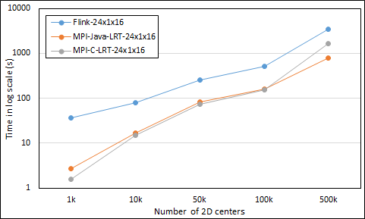
Kmeans Clustering Flink and MPI one million points fixed; various # centers
24 cores on 16 nodes
Flink
Java
C
MPI

Slide 31
Harp (Hadoop Plugin) brings HPC to ABDS
Basic Harp: Iterative HPC communication; scientific data abstractions
Careful support of distributed data AND distributed model
Avoids parameter server approach but distributes model over worker nodes and supports collective communication to bring global model to each node
Applied first to Latent Dirichlet Allocation LDA with large model and data
MapReduce Model
MapCollective Model
MapReduce Applications
MapCollective Applications
M
M
M
M
M
M
M
M
MapReduce V2
Harp
Shuffle
Collective Communication
R
R
YARN

Slide 32
Automatic parallelization
Database community looks at big data job as a dataflow of (SQL) queries and filters
Apache projects like Pig, MRQL and Flink aim at automatic query optimization by dynamic integration of queries and filters including iteration and different data analytics functions
Going back to ~1993, High Performance Fortran HPF compilers optimized set of array and loop operations for large scale parallel execution of optimized vector and matrix operations
HPF worked fine for initial simple regular applications but ran into trouble for cases where parallelism hard (irregular, dynamic)
Will same happen in Big Data world?
Straightforward to parallelize k-means clustering but sophisticated algorithms like Elkans method (use triangle inequality) and fuzzy clustering are much harder (but not used much NOW)
Will Big Data technology run into HPF-style trouble with growing use of sophisticated data analytics?

Slide 33
The choice of language for Big Data and Big Simulation?
  C++, Java, Scala, Python, R highlights performance v. productivity trade-offs.
  What is actual performance of Big Data implementations and what are good benchmarks?
  Need more Performance evaluation

Slide 34
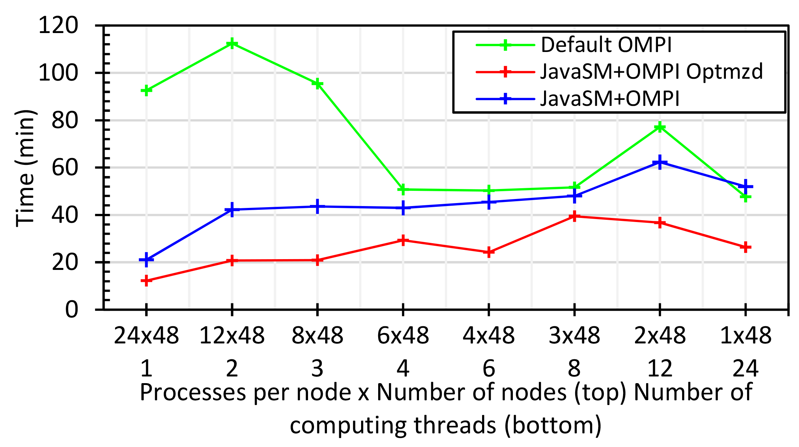
Java MPI performs better than FJ Threads I
48 24 core Haswell nodes 200K DA-MDS Dataset size
Default MPI much worse than threads
Optimized MPI using shared memory node-based messaging is much better than threads (default OMPI does not support SM for needed collectives)
All MPI
All Threads

Slide 35

Java MPI performs better than FJ Threads II
128 24 core Haswell nodes on SPIDAL DA-MDS Code
Speedup compared to 1 process per node on 48 nodes
Best MPI; inter and intra node
MPI; inter/intra node; Java not optimized
Best FJ Threads intra node; MPI inter node

Slide 36
MPI, Fork-Join and Long Running Threads
K-Means 1 million 2D points and 1k centers
Case 0: FJ threads
  Proc bound to T cores using MPI
  Threads inherit the same binding
Case 1: LRT threads
  Procs and threads are both unbound
Case 2: LRT threads
  Similar to Case 0 with LRT threads
Case 3: LRT threads
  Proc bound to all cores (= non bound)
  Each worker thread is bound to a core
P0,P1..,P7
C0
C1
C2
C3
C4
C5
C6
C7
Socket 0
Socket 1
All Threads
All MPI
Fork Join
LRT
Differ in helper threads

Slide 37
DISCUSSION
Is software sustainability important?
  Is the Apache model a good approach to this?
  How useful is DevOps to specify software systems?
  Some but not dramatic pressure on HPC community
  DevOps promising but not mature

Slide 38
“Software Engineering”
Fixed Stacks or a “sea of components”? There are ongoing trade-offs between “integrated” systems and those involving collections of components. Funding availability important here
  Commercial big data tends to use the latter with the component of choice changing rapidly (e.g., as seen in Hadoop replaced by Spark and now Spark being challenged by Flink).
  Conversely, the HPC community remains committed to much of the 1990s tool base.
  Performance focus suggest fixed stacks to HPC
Implications of HPC Isolation: The fraction of students learning traditional HPC languages and tools is declining rapidly. If the HPC developer base is to be sustained, HPC must embrace more widely used tools

Slide 39
Performance, Productivity, Sustainability
Performance-Productivity: The Big Data community emphasizes rapid development and human productivity, even at the expense of execution efficiency. The HPC community has long discussed productivity but has not yet embraced it as a metric of success.
Performance Focus of HPC: The earlier “Grid computing” emphasis of HPC computing did not have same performance emphasis seen in big simulation work today (i.e. it was nearer Big Data in philosophy).
Sustainability: The economic sustainability model for Big Data software seems more robust than that for big simulation, given the relative sizes of the communities and the rapid growth of data analytics.

Slide 40
Big Data - Big Simulation
Convergence?
HPC-Clouds convergence?
Where are differences in approach, opinion?
Convergence Diamonds
HPC-ABDS Software on differently optimized hardware infrastructure

Slide 41
Components in Big Data HPC Convergence
Applications, Benchmarks and Libraries
  51 NIST Big Data Use Cases, 7 Computational Giants of the NRC Massive Data Analysis, 13 Berkeley dwarfs, 7 NAS parallel benchmarks
  Unified discussion by separately discussing data & model for each application;
  64 facets– Convergence Diamonds -- characterize applications
  Characterization identifies hardware and software features for each application across big data, simulation; “complete” set of benchmarks (NIST)
Software Architecture and its implementation
  HPC-ABDS: Cloud-HPC interoperable software: performance of HPC (High Performance Computing) and the rich functionality of the Apache Big Data Stack.
  Added HPC to Hadoop, Storm, Heron, Spark; will add to Beam and Flink
  Work in Apache model contributing code
Run same HPC-ABDS across all platforms but “data management” nodes have different balance in I/O, Network and Compute from “model” nodes
  Optimize to data and model functions as specified by convergence diamonds
  Do not optimize for simulation and big data
Convergence Language: Make C++, Java, Scala, Python … perform well

Slide 42
Typical Convergence Architecture
Running same HPC-ABDS software across all platforms but data management machine has different balance in I/O, Network and Compute from “model” machine
Model has similar issues whether from Big Data or Big Simulation.
Data Management Model for Big Data
and Big Simulation

Slide 43
DISCUSSION
Big Data - Big Simulation
Convergence?
HPC-Clouds convergence?
Where are differences in approach, opinion?
Convergence Diamonds
HPC-ABDS Software on differently optimized hardware infrastructure

Slide 44
What do we mean by convergence?
Commercial v. Science Data: Big Data reasonably clearly defined but covers the major commercial activities as well as scientific data analysis; the commercial activity is much the largest and we typically refer to that in discussing convergence. However analyzing scientific big data is very important and must be considered
Super large v Typical HPC Clusters: HPC spans both "leadership class supercomputers" and general HPC clusters from departmental size and above. Most deep learning for Big Data operates (today) on medium scale hardware. Hence, the current HPC synergy is mostly on departmental/university scale machines. Starting with leadership class systems is a much harder problem (culturally and technically), as it is equivalent to seeking convergence between commercial data centers and leadership class machines.
  Note possible relevance of capacity versus capability distinction with most observational data analysis on HPC clusters using machine in capacity mode.

Slide 45
Socio-Technical Issues in Convergence I
Change is Hard I: A lot of scientific data analysis (e.g. astronomy and particle physics) started a long time ago and established processes before many recent Big Data developments occurred.
Change is Hard II: SQL Databases have been around a long but many aspects of a modern Big Data stack (Hadoop, R, NoSQL, machine learning) are very recent
Interdisciplinary collaboration is critical to make progress; users and technologists, industry, academic and government.
  In some areas it still needs to be improved – see below!
HPC & Database Communities: Big Data arose from the database and computer science communities; HPC and scientific computing arose from the science and engineering community. They are distinct cultures.
Expertise: It could be helpful to fold in discussion of data science and education/training. Some choices today may be impacted by lack of broad expertise of computing staff in some Big Data issues.

Slide 46
Socio-Technical Issues II
HPC would benefit from convergence: The HPC community could learn about different performance, usability, interactivity, economics and sustainability trade-offs/choices from Big Data community.
  HPC could benefit from the areas -- databases, streaming, machine learning -- where Big Data a leader
Commodity-based HPC. The HPC community has always ridden the commodity technology curve, which is driven by volume markets. If HPC embraced convergence, it could benefit from cheaper hardware (not as fully optimized) and richer software driven by needs of Big Data community.
  This benefit could cover both simulation and data analysis for science.
  This important question has not been properly addressed within HPC

Slide 47
Socio-Technical Issues III
Big Data would benefit from convergence: Performance is becoming increasingly important to the Big Data community, as data volumes continue to grow; HPC techniques could lead to a significant (factor of 10) performance increases in large scale machine learning
  Expertise in parallel computing from HPC could benefit the Big Data community by improving the parallel performance of machine learning, both on GPUs and on clusters. Furthermore, there are interesting synergies between query optimization in Big Data and automatic compilation in scientific computing, as query languages are domain-specific approaches, just as are parallel languages.
Both HPC and Big Data would benefit from convergence: There are mutually beneficial activities such as parallelizing R and Python

