Slide 1
Classical and Iterative
MapReduce on Azure
Cloud Futures Workshop
Microsoft Conference Center Building 33, Redmond, Washington
June 2 2011
Geoffrey Fox
gcf@indiana.edu
http://www.infomall.org http://www.salsahpc.org
Director, Digital Science Center, Pervasive Technology Institute
Associate Dean for Research and Graduate Studies, School of Informatics and Computing
Indiana University Bloomington
Work with Thilina Gunarathne, Judy Qiu
Twister introduced in Jaliya Ekanayake’s PhD Thesis

Slide 2
Simple Assumptions
Clouds may not be suitable for everything but they are suitable for majority of data intensive applications
  Solving partial differential equations on 100,000 cores probably needs classic MPI engines
Cost effectiveness, elasticity and quality programming model will drive use of clouds in many areas such as genomics
Need to solve issues of
  Security-privacy-trust for sensitive data
  How to store data – “data parallel file systems” (HDFS) or classic HPC approach with shared file systems with Lustre etc.
Programming model which is likely to be MapReduce based initially
  Look at high level languages
  Compare with databases (SciDB?)
  Must support iteration for many problems

Slide 3
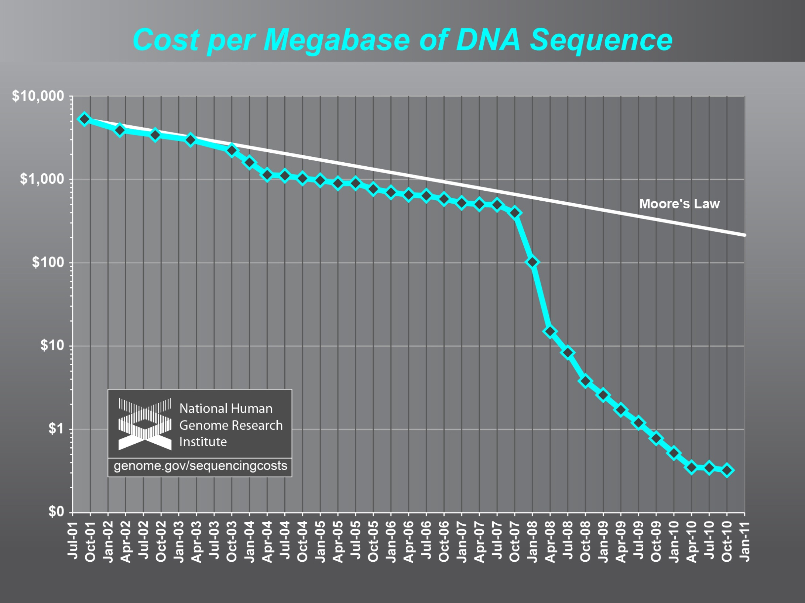
Why need cost effective
Computing!
(Note Public Clouds not allowed for human genomes)

Slide 4
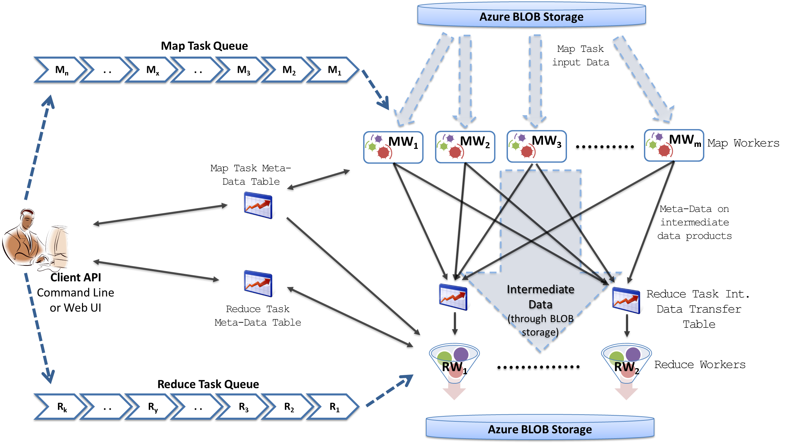
MapReduceRoles4Azure Architecture
Azure Queues for scheduling, Tables to store meta-data and monitoring data, Blobs for input/output/intermediate data storage.
Notes:
We use Azure Queues for scheduling, Tables to store meta-data and monitoring data, Blobs for input/output/intermediate data storage.

Slide 5
MapReduceRoles4Azure
Use distributed, highly scalable and highly available cloud services as the building blocks.
  Azure Queues for task scheduling.
  Azure Blob storage for input, output and intermediate data storage.
  Azure Tables for meta-data storage and monitoring
Utilize eventually-consistent , high-latency cloud services effectively to deliver performance comparable to traditional MapReduce runtimes.
Minimal management and maintenance overhead
Supports dynamically scaling up and down of the compute resources.
MapReduce fault tolerance
http://salsahpc.indiana.edu/mapreduceroles4azure/

Slide 6
MapReduceRoles4Azure Performance
Parallel efficiency
AzureMapReduce
  Azure small instances – Single Core (1.7 GB memory)
Hadoop Bare Metal -IBM iDataplex cluster
  Two quad-core CPUs (Xeon 2.33GHz),16 GB memory, Gigabit Ethernet per node
EMR & Hadoop on EC2
  Cap3 – HighCPU Extra Large instances (8 Cores, 20 CU, 7GB memory per instance)
  SWG – Extra Large Instances (4 Cores, 8 CU, 15GB memory per instance)
Notes:
Idataplex - Two quad-core CPUs (Intel Xeon CPU E5410 2.33GHz) 16 GB memory, Gigabit Ethernet network interface

Slide 7
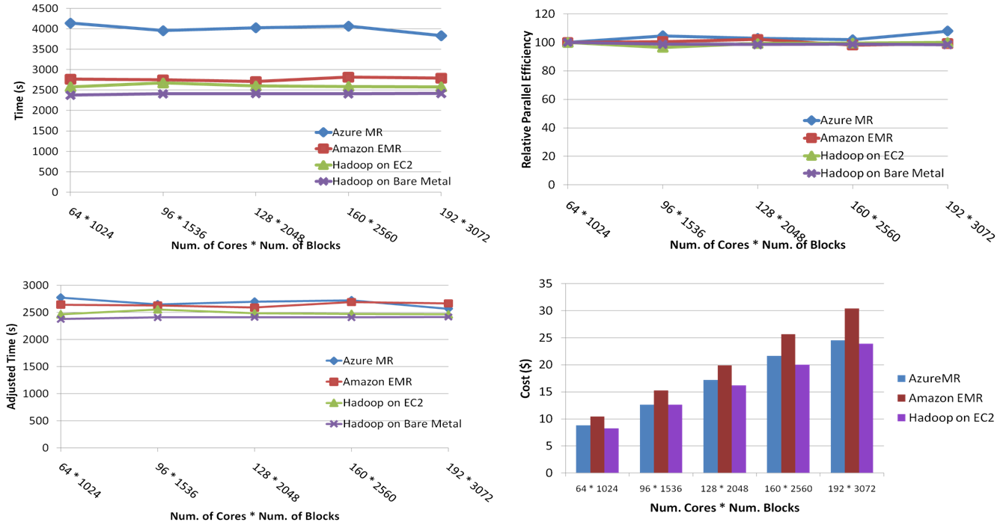
SWG Sequence Alignment Performance
Smith-Waterman-GOTOH to calculate all-pairs dissimilarity
Notes:
~123 million sequence alignments, for under 30$ with zero up front hardware cost,

Slide 8
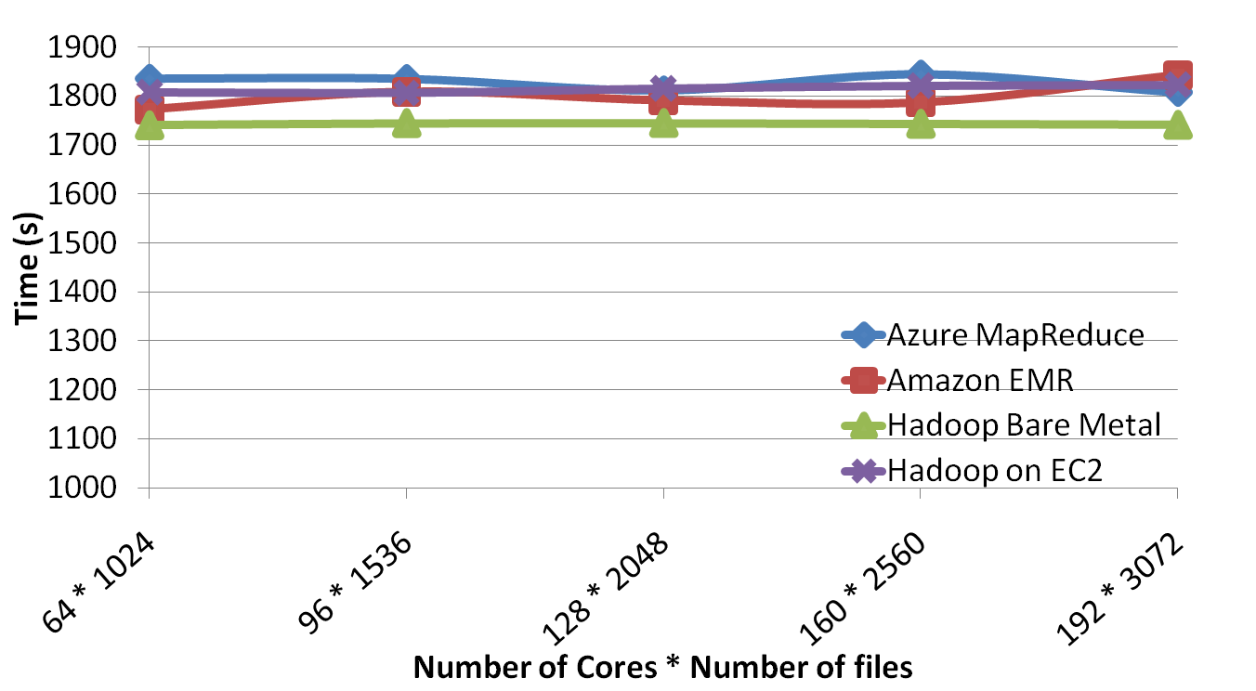
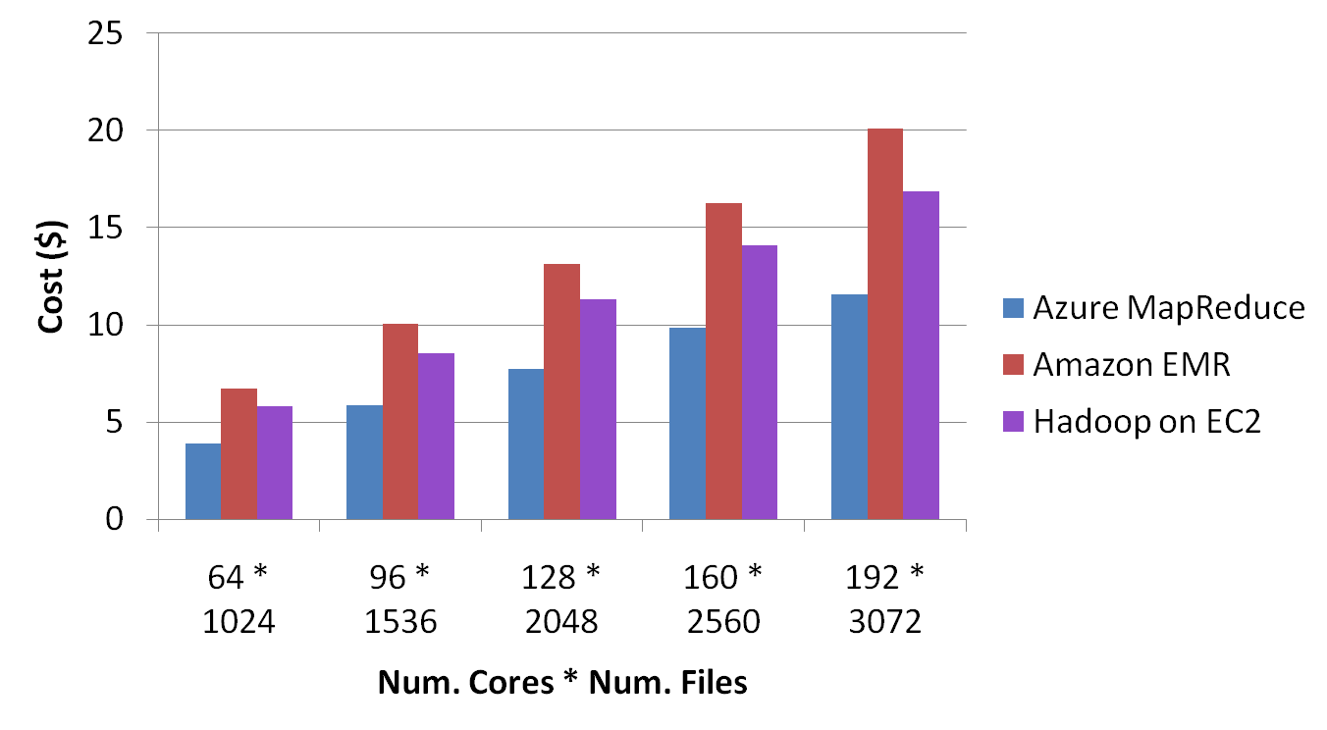
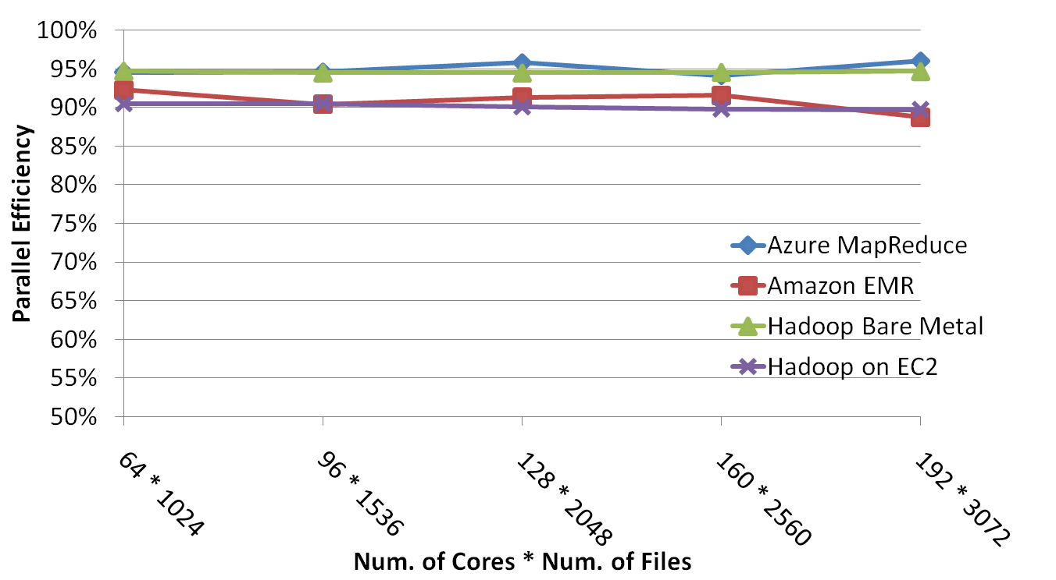
CAP3 Sequence Assembly Performance

Slide 9

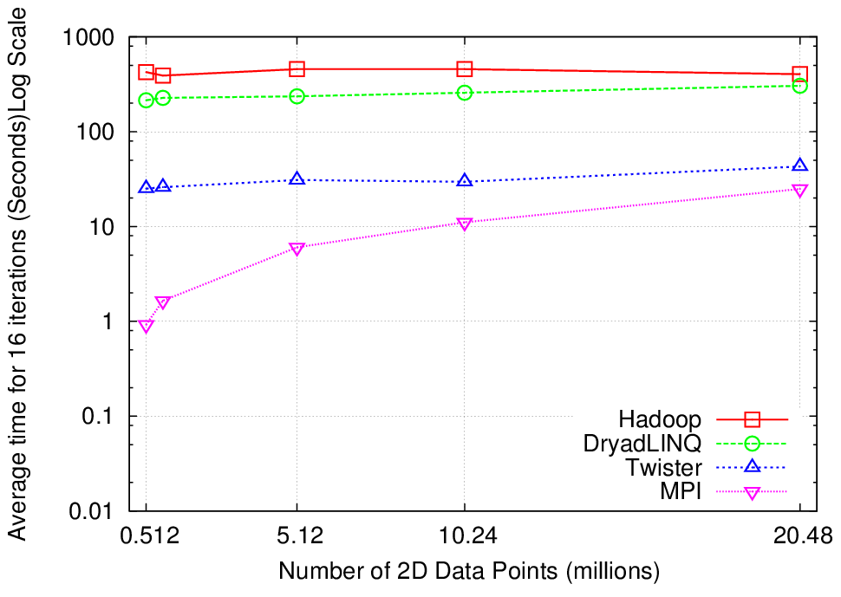
Why Iterative MapReduce? K-Means Clustering
http://www.iterativemapreduce.org/
Compute the distance to each data point from each cluster center and assign points to cluster centers
map
map
Time for 20 iterations
reduce
Compute new cluster
centers
User program
Compute new cluster centers
Iteratively refining operation
Typical MapReduce runtimes incur extremely high overheads
  New maps/reducers/vertices in every iteration
  File system based communication
Long running tasks and faster communication in Twister enables it to perform close to MPI

Slide 10

Performance of Pagerank using ClueWeb Data (Time for 20 iterations) using 32 nodes (256 CPU cores)
Iterate Matrix Vector Multiplication
(Power method for Eigenvector)

Slide 11
High Level Flow Twister4Azure
Map
Combine
Job Start
Map
Reduce
Combine
Merge
Add Iteration?
Job Finish
Reduce
No
Map
Combine
Yes
Data Cache
Hybrid scheduling of the new iteration
Merge Step
In-Memory Caching of static data
Cache aware hybrid scheduling using Queues as well as using a bulletin board (special table)
Notes:
In our current work, we extend MR4Azure to support iterative mapreduce computations. We added an additional merge step to the programming model, where the computations decides whether to go for a new iteration or not. We also support in-memory caching of static data between iterations and we developed a hybrid scheduling strategy to perform cache aware scheduling.

Slide 12
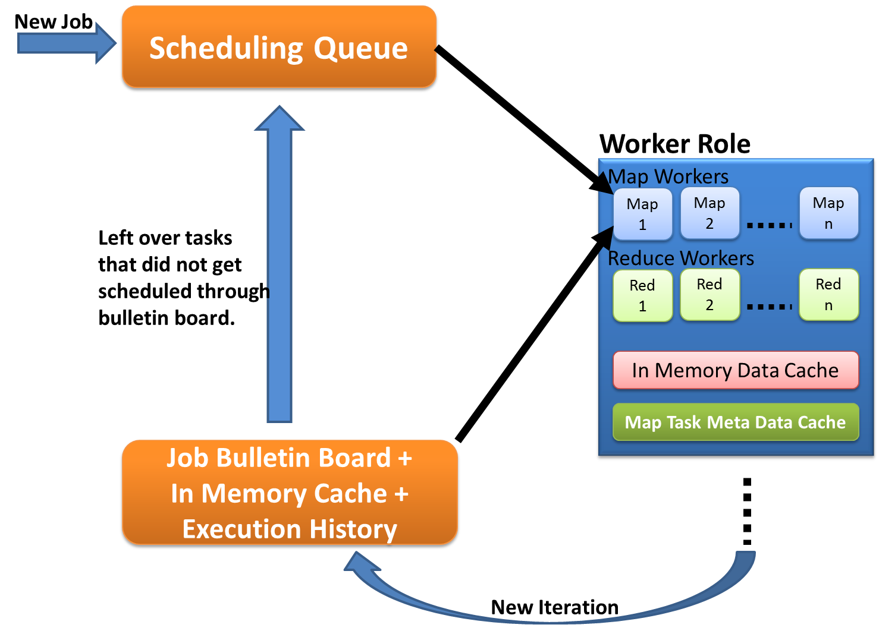
Cache aware scheduling
New Job (1st iteration)
  Through queues
New iteration
  Publish entry to Job Bulletin Board
  Workers pick tasks based on in-memory data cache and execution history (MapTask Meta-Data cache)
  Any tasks that do not get scheduled through the bulletin board will be added to the queue.

Slide 13
Twister4Azure Performance Comparisons
BLAST Sequence Search
Smith Waterman Sequence Alignment
Cap3 Sequence Assembly

Slide 14



Twister4Azure Performance – Kmeans Clustering
Speedup gained using data cache
Performance with/without data caching.
Increasing number of iterations
Scaled speedup
Notes:
KMeans iterative MapReduce performance. 16 Azure Small instances, 6 iterations, 8 to 48 million 20-D data points.
Left: Performance with and without data caching.
Right: Speedup obtained from using the data cache
Left: Scaling speedup with increasing number of instances (Azure Small) & data for 10 iterations.
Right: Increasing number of iterations using 16 million data points with caching using 16 Azure Small instances.

Slide 15
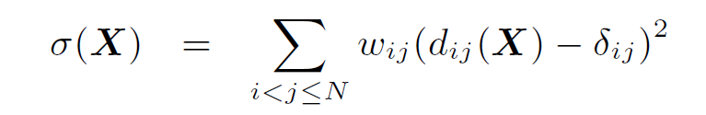
Visualizing Metagenomics
Multidimensional Scaling MDS natural way to map sequences to 3D so you can visualize
Minimize Stress
Improve with deterministic annealing (gives lower stress with less variation between random starts)
Need to iterate Expectation Maximization
N² dissimilarities (Needleman-Wunsch) δ_{i j}
Communicate N positions X between steps

Slide 16
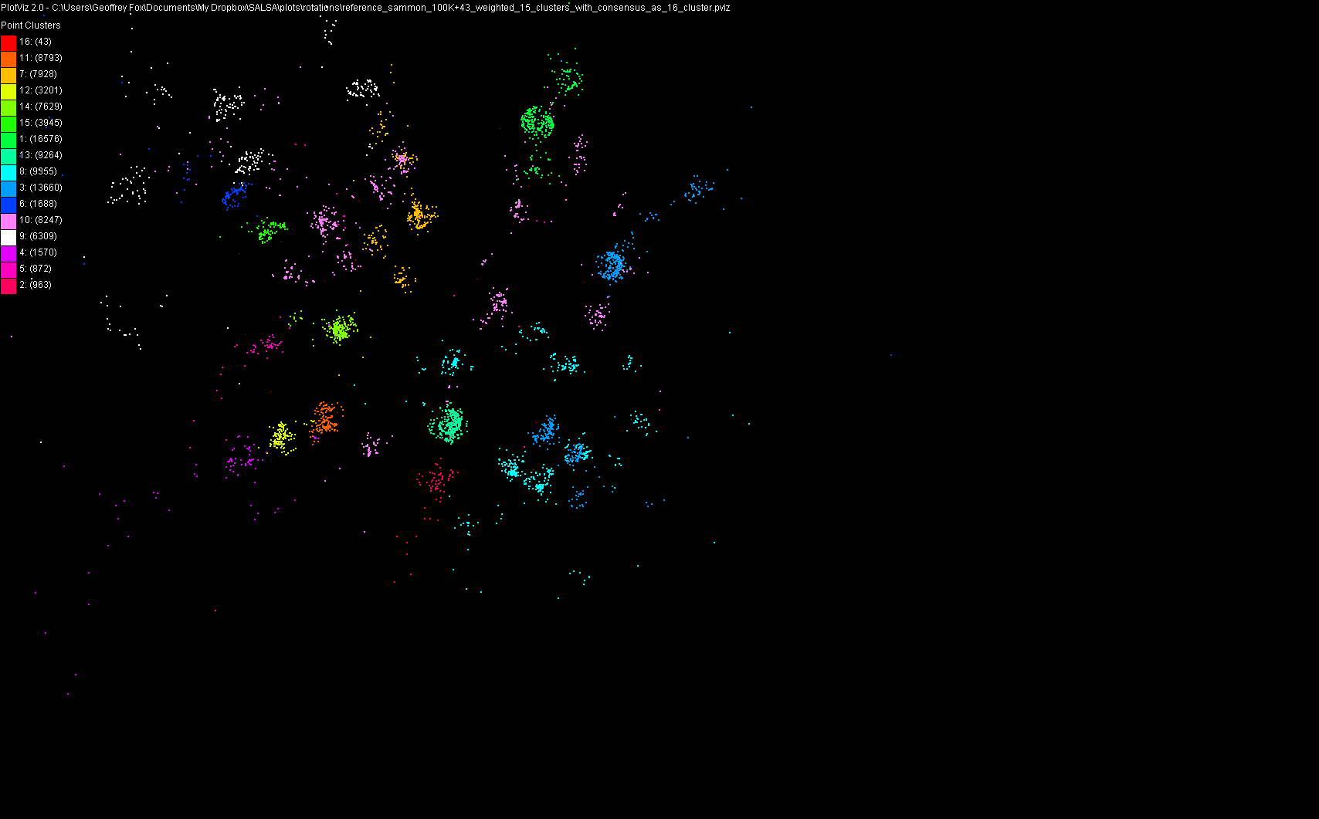
100,043 Metagenomics Sequences
Aim to do 10 million by end of Summer

Slide 17
Multi-Dimensional-Scaling
Many iterations
Memory & Data intensive
3 Map Reduce jobs per iteration
X_{k} = invV * B(X_{(k-1)}) * X_{(k-1)}
2 matrix vector multiplications termed BC and X
BC: Calculate BX
X: Calculate invV (BX)
Calculate Stress
Map
Reduce
Merge
Map
Reduce
Merge
Map
Reduce
Merge
New Iteration

Slide 18
MDS Execution Time Histogram
10 iterations, 30000 * 30000 data points, 15 Azure Instances

Slide 19
MDS Executing Task Histogram
10 iterations, 30000 * 30000 data points, 15 Azure Instances

Slide 20
MDS Performance
# Instances | Speedup
6 | 6
12 | 16.4
24 | 35.3
48 | 52.8
Probably super linear as used small instances
30,000*30,000 Data points, 15 instances, 3 MR steps per iteration
30 Map tasks per application

Slide 21
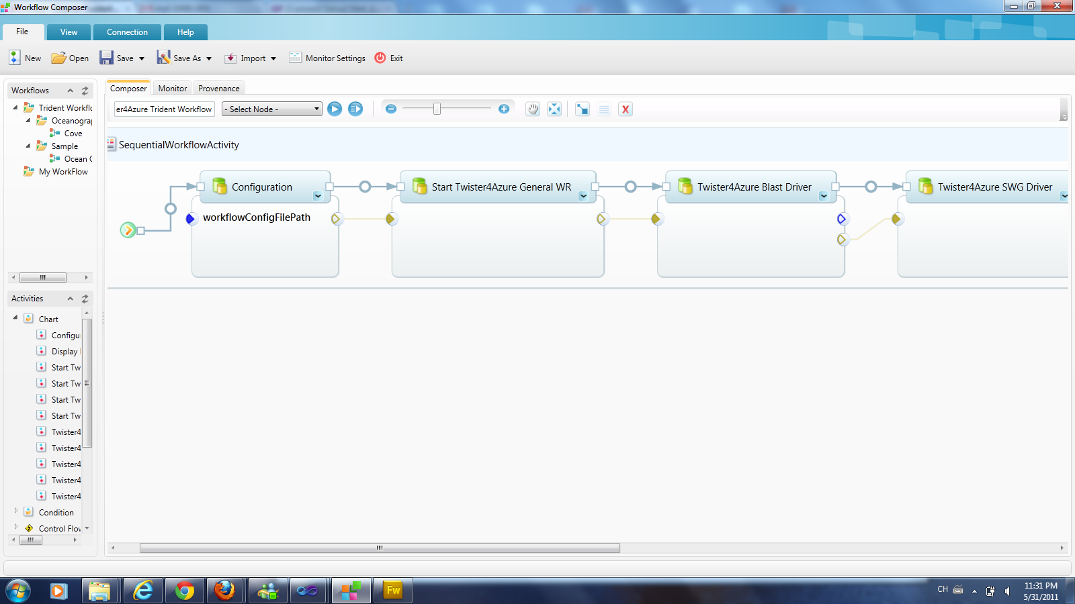
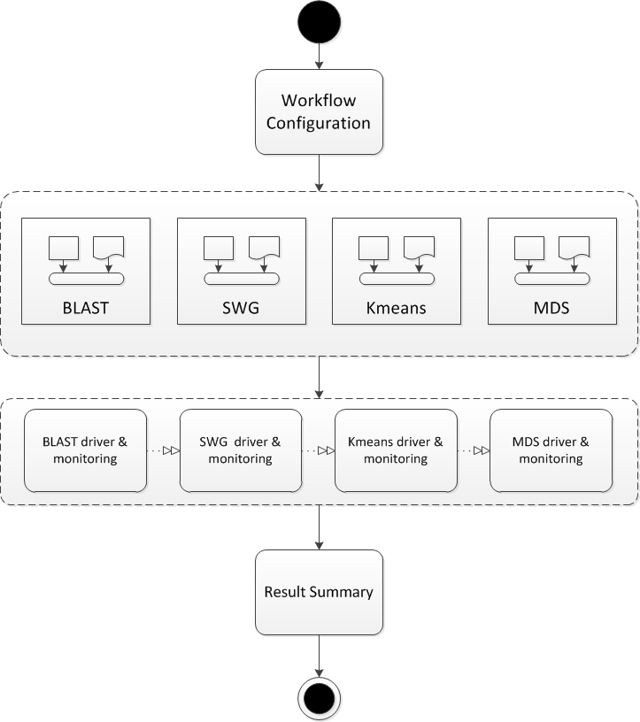
Trident Integration

Slide 22
Types of Data
Loop invariant data (static data) – traditional MR key-value pairs
  Comparatively larger sized data
  Cached between iterations
Loop variant data (dynamic data) – broadcast to all the map tasks in beginning of the iteration
  Comparatively smaller sized data
Can be specified even for non-iterative MR jobs

Slide 23
In-Memory Data Cache
Caches the loop-invariant (static) data across iterations
  Data that are reused in subsequent iterations
Avoids the data download, loading and parsing cost between iterations
  Significant speedups for some data-intensive iterative MapReduce applications
Cached data can be reused by any MR application within the job

Slide 24
Cache Aware Scheduling
Map tasks need to be scheduled with cache awareness
  Map task which process data ‘X’ needs to be scheduled to the worker with ‘X’ in the Cache
Nobody has global view of the data products cached in workers
  Decentralized architecture
  Impossible to do cache aware assigning of tasks to workers
Solution: workers pick tasks based on the data they have in the cache
  Job Bulletin Board : advertise the new iterations

Slide 25
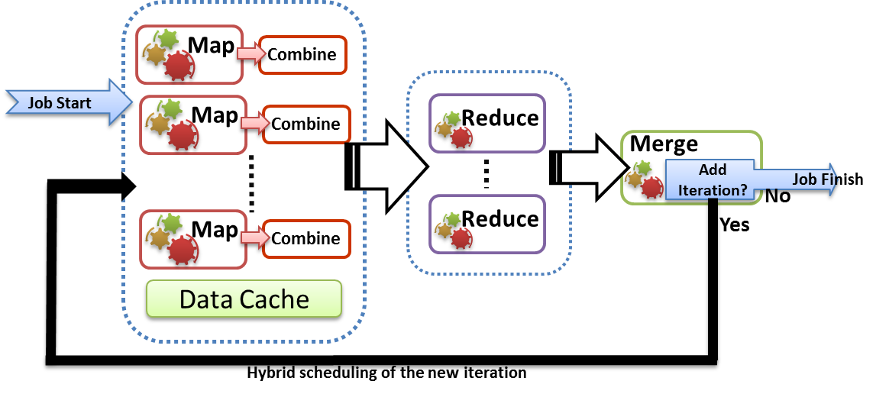
Merge Step
Extension to the MapReduce programming model to support iterative applications
  Map -> Combine -> Shuffle -> Sort -> Reduce -> Merge
Receives all the Reduce outputs and the broadcast data for the current iteration
User can add a new iteration or schedule a new MR job from the Merge task.
  Serve as the “loop-test” in the decentralized architecture
    Number of iterations
    Comparison of result from previous iteration and current iteration
  Possible to make the output of merge the broadcast data of the next iteration

Slide 26
Multiple Applications per Deployment
Ability to deploy multiple Map Reduce applications in a single deployment
Possible to invoke different MR applications in a single job
Support for many application invocations in a workflow without redeployment

Slide 27
Conclusions
Twister4Azure enables users to easily and efficiently perform large scale iterative data analysis and scientific computations on Azure cloud.
  Supports classic and iterative MapReduce
Utilizes a hybrid scheduling mechanism to provide the caching of static data across iterations.
Can integrate with Trident (or other workflow)
Plenty of testing and improvements to come!
Open source: Please use http://salsahpc.indiana.edu/twister4azure
Is it useful to make available as a Service?

