Slide 1
FutureGrid: A Distributed High Performance Test-bed for Clouds
Andrew J. Younge
Indiana University
http://futuregrid.org

Slide 2
# whoami
PhD Student at Indiana University
Been at IU since early 2010
Computer Science, Bioinformatics
Advisor: Dr. Geoffrey C. Fox
Previously at Rochester Institute of Technology
B.S. & M.S. in Computer Science in 2008, 2010
> dozen publications
Involved in Distributed Systems since 2006 (UMD)
Visiting Researcher at USC/ISI !
http://ajyounge.com

Slide 3
Part 1 – Futuregrid Project
Grid, Cloud, HPC test-bed for science
Notes:
NOTE: FutureGrid is an effort by MANY! Not just me!

Slide 4
FutureGrid
FutureGrid is an international testbed modeled on Grid5000
Supporting international Computer Science and Computational Science research in cloud, grid and parallel computing (HPC)
Industry and Academia
The FutureGrid testbed provides to its users:
A flexible development and testing platform for middleware and application users looking at interoperability, functionality, performance or evaluation
Each use of FutureGrid is an experiment that is reproducible
A rich education and teaching platform for advanced cyberinfrastructure (computer science) classes

Slide 5
FutureGrid
FutureGrid has a complementary focus to both the Open Science Grid and the other parts of XSEDE (TeraGrid).
User-customizable, accessed interactively and supports Grid, Cloud and HPC software with and without virtualization.
An experimental platform
Where computer science applications can explore many facets of distributed systems
Where domain sciences can explore various deployment scenarios and tuning parameters and in the future possibly migrate to the large-scale national Cyberinfrastructure.
Much of current use is in Computer Science Systems, Biology/Bioinformatics, and Education

Slide 6
Distribution of FutureGrid Technologies and Areas
Over 200 Projects

Slide 7
FutureGrid Partners
Indiana University (Architecture, Software, Support)
Purdue University (HTC Hardware)
San Diego Supercomputer Center at University of California San Diego (INCA, Monitoring)
University of Chicago/Argonne National Labs (Nimbus)
University of Florida (ViNE, Education and Outreach)
University of Southern California / Information Sciences Institute (Pegasus experiment management)
University of Tennessee Knoxville (Benchmarking)
University of Texas at Austin/Texas Advanced Computing Center (Portal)
University of Virginia (OGF, Advisory Board and allocation)
Center for Information Services and GWT-TUD from Technische Universtität Dresden. (VAMPIR)
Notes:
Red indicates Hardware resources

Slide 8
FutureGrid Services
Notes:
Clients – Browser
Saas – Google Docs
PaaS – Microsoft Azure, Google App Engine
IaaS – Amazon Elastic Compute Cloud

Slide 9
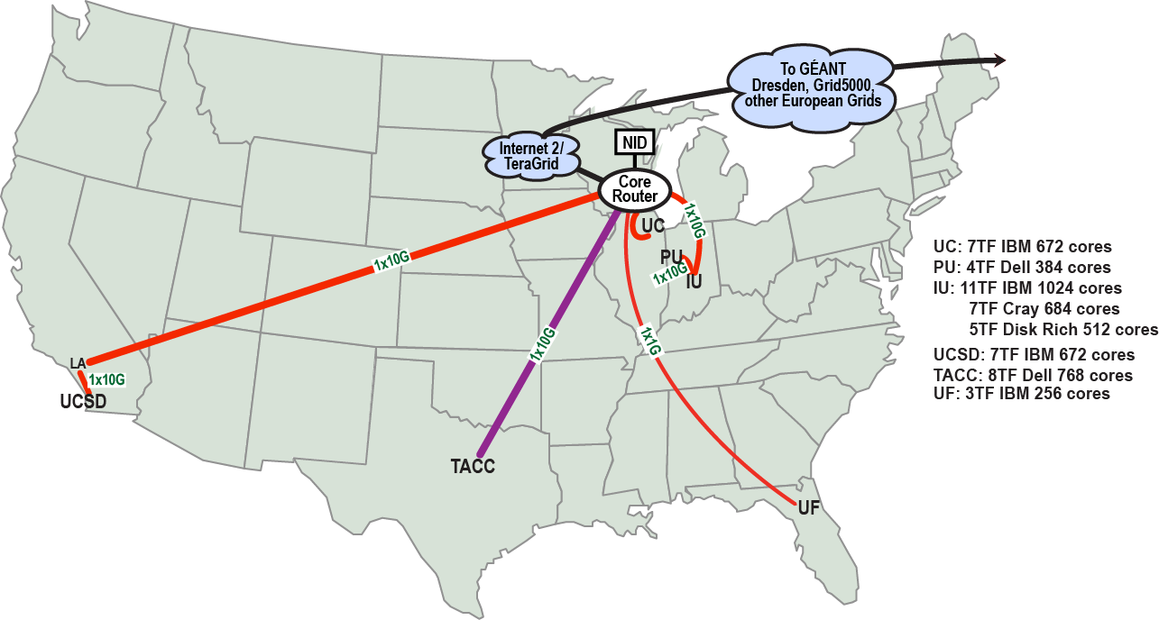
FutureGrid: a Distributed Testbed
NID: Network Impairment Device
Private Public
FG Network

Slide 10
Compute Hardware
Name | System type | # CPUs | # Cores | TFLOPS | Total RAM (GB) | Secondary Storage (TB) | Site | Status
india | IBM iDataPlex | 256 | 1024 | 11 | 3072 | 339 + 16 | IU | Operational
alamo | Dell PowerEdge | 192 | 768 | 8 | 1152 | 30 | TACC | Operational
hotel | IBM iDataPlex | 168 | 672 | 7 | 2016 | 120 | UC | Operational
sierra | IBM iDataPlex | 168 | 672 | 7 | 2688 | 96 | SDSC | Operational
xray | Cray XT5m | 168 | 672 | 6 | 1344 | 339 | IU | Operational
foxtrot | IBM iDataPlex | 64 | 256 | 2 | 768 | 24 | UF | Operational
bravo | Large Memory | 32 | 128 | 1.5 | 3072 | 144 | IU | Operational
delta | Tesla GPUs | 32 + 32 GPUs | 192 | ? | 3072 | 96 | IU | Testing / Operational

Slide 11
Storage Hardware
System Type | Capacity (TB) | File System | Site | Status
DDN 9550 (Data Capacitor)* | 339 shared with IU + 16 TB dedicated | Lustre | IU | Existing System
DDN 6620 | 120 | GPFS | UC | Online
SunFire x4170 | 96 | ZFS | SDSC | Online
Dell MD3000 | 30 | NFS | TACC | Online
IBM | 24 | NFS | UF | Online
RAID Array | 100 | NFS | IU | New System
* Being upgraded

Slide 12
FutureGrid Services
Notes:
Clients – Browser
Saas – Google Docs
PaaS – Microsoft Azure, Google App Engine
IaaS – Amazon Elastic Compute Cloud

Slide 13
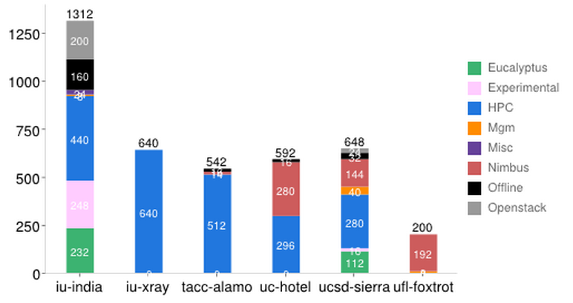
FutureGrid: Inca Monitoring

Slide 14
Detailed Software Architecture

Slide 15
RAIN Architecture

Slide 16
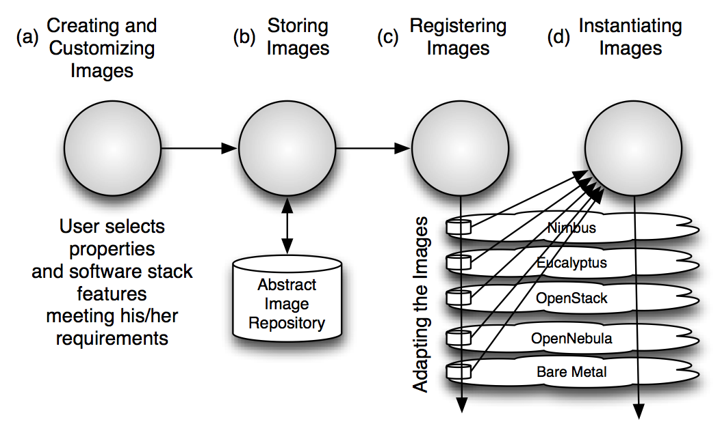
VM Image Management Process

Slide 17
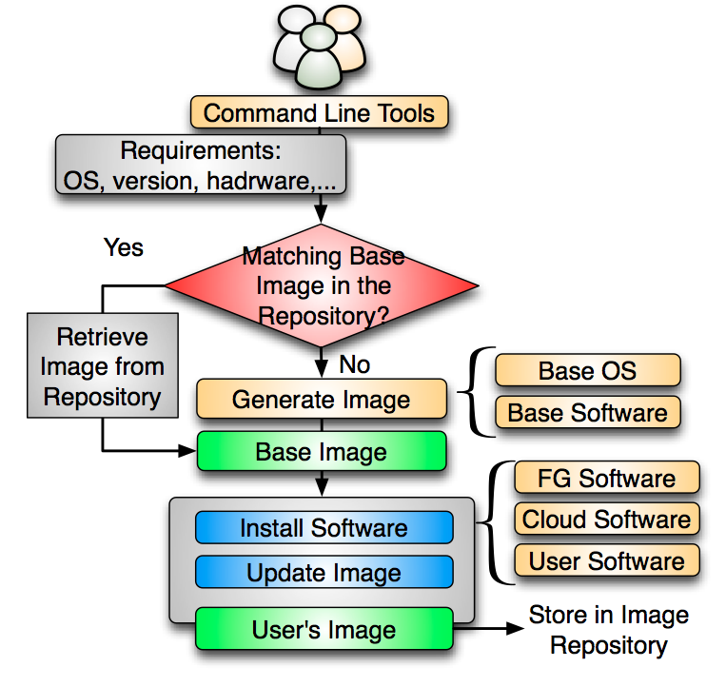
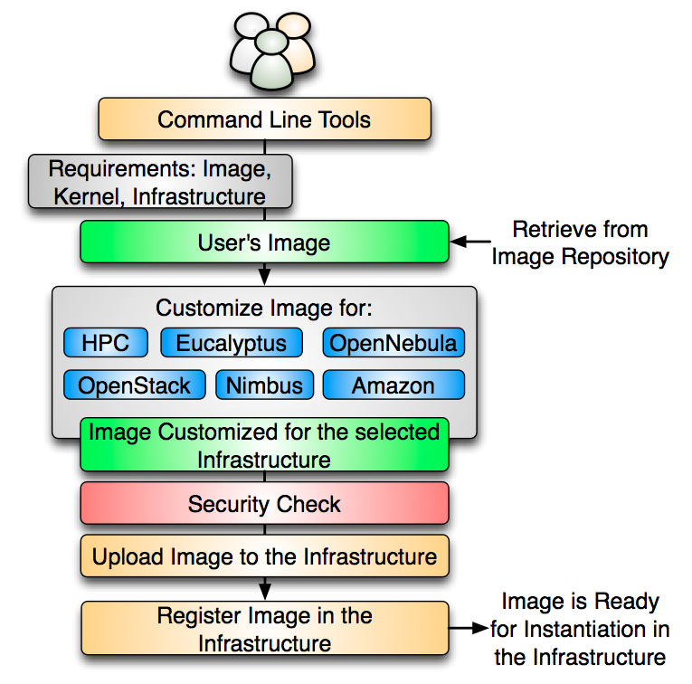
VM Image Management

Slide 18
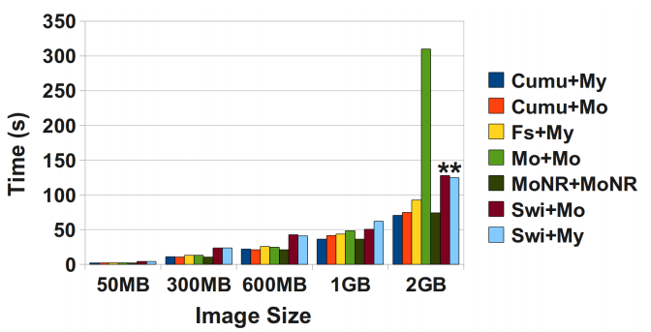
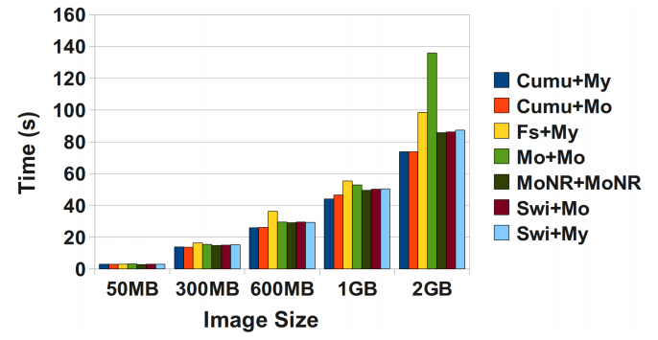
Image Repository Experiments
Uploading VM Images to the Repository
Retrieving Images from the Repository
Notes:
Asterisks mean that those tests were done using the command line tool instead of the Python API.

Slide 19
FutureGrid Services
Notes:
Clients – Browser
Saas – Google Docs
PaaS – Microsoft Azure, Google App Engine
IaaS – Amazon Elastic Compute Cloud

Slide 20
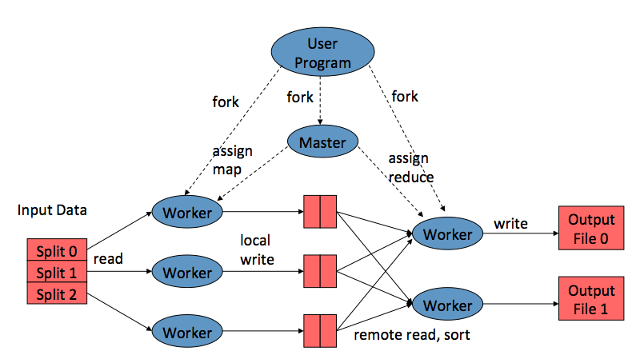
MapReduce Model
Map: produce a list of (key, value) pairs from the input structured as a (key value) pair of a different type (k1,v1) → list (k2, v2)
Reduce: produce a list of values from an input that consists of a key and a list of values associated with that key (k2, list(v2)) → list(v2)

Slide 21
4 Forms of MapReduce
(a) Map Only
(b) Classic MapReduce
(c) Iterative MapReduce
(d) Loosely Synchronous
Input
Input
Iterations
Input
map
map
map
P_{ij}
reduce
reduce
Output
BLAST Analysis
Parametric sweep
Pleasingly Parallel
High Energy Physics (HEP) Histograms
Distributed search
Expectation maximization Clustering e.g. Kmeans
Linear Algebra, Page Rank
Classic MPI
PDE Solvers and particle dynamics
Domain of MapReduce and Iterative Extensions
MPI
Notes:
Work from my colleagues in the IU SALSA group.

Slide 22
Created by IU SALSA group
Idea: Iterative Map Reduce
Synchronously loop between Mapper and Reducer tasks
Ideal for data-driven scientific applications
Fits many classic HPC applications
K-Means Clustering
Matrix Multiplication
WordCount
PageRank
Graph Searching
HEP Data Analysis

Slide 23
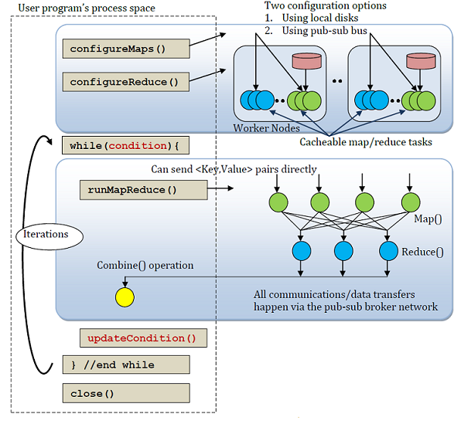
Twister

Slide 24
Performance – Kmeans Clustering
Task Execution Time Histogram
Number of Executing Map Task Histogram
Strong Scaling with 128M Data Points
Weak Scaling
Notes:
Right(c): Twister4Azure executing Map Task histogram for 128 million data points in 128 Azure small instances
Figure 5. KMeansClustering Scalability.
Left(a): Relative parallel efficiency of strong scaling using 128 million data points. Center(b): Weak scaling. Workload per core is kept constant (ideal is a straight horizontal line).

Slide 25
FutureGrid Services
Notes:
Clients – Browser
Saas – Google Docs
PaaS – Microsoft Azure, Google App Engine
IaaS – Amazon Elastic Compute Cloud

Slide 26
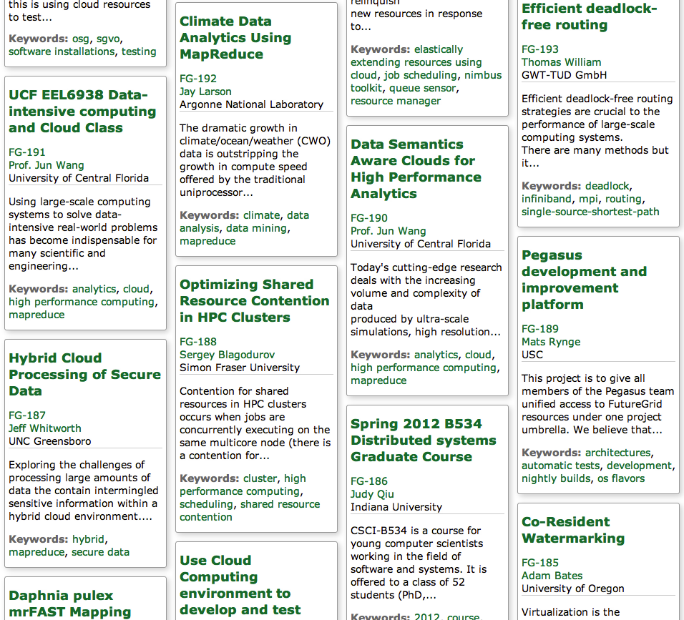

Slide 27
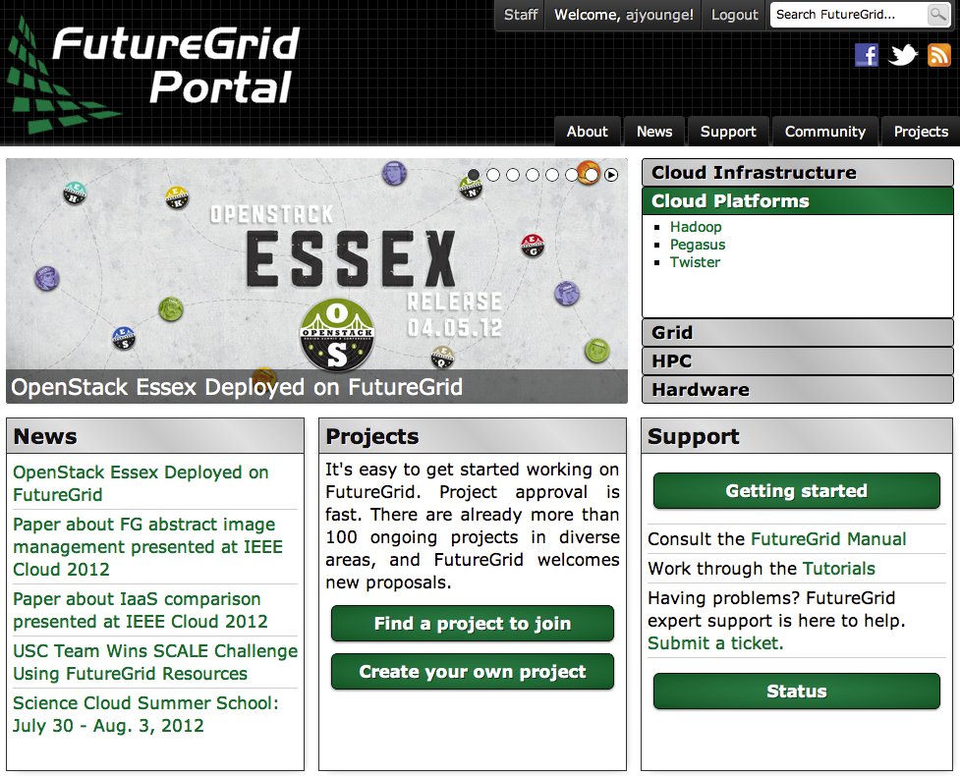

Slide 28
Part 2 – Moving Forward
Addressing the intersection between HPC and Clouds

Slide 29
Where are we?
Distributed Systems is very broad
Grid computing spans most areas and is becoming more mature.
Clouds are an emerging technology, providing many of the same features as Grids without many of the potential pitfalls.
From “Cloud Computing and Grid Computing 360-Degree Compared”

Slide 30
HPC + Cloud?
HPC
Cloud
Fast, tightly coupled systems
Performance is paramount
Massively parallel applications
MPI applications for distributed memory computation
Built on commodity PC components
User experience is paramount
Scalability and concurrency are key to success
Big Data applications to handle the Data Deluge
4th Paradigm
Challenge: Leverage performance of HPC with usability of Clouds

Slide 31
Virtualization
 | Xen | KVM | VirtualBox | VMWare
Paravirtualization | Yes | No | No | No
Full Virtualization | Yes | Yes | Yes | Yes
Host CPU | X86, X86_64, IA64 | X86, X86_64, IA64, PPC | X86, X86_64 | X86, X86_64
Guest CPU | X86, X86_64, IA64 | X86, X86_64, IA64, PPC | X86, X86_64 | X86, X86_64
Host OS | Linux, Unix | Linux | Windows, Linux, Unix | Proprietary Unix
Guest OS | Linux, Windows, Unix | Linux, Windows, Unix | Linux, Windows, Unix | Linux, Windows, Unix
VT-x / AMD-v | Opt | Req | Opt | Opt
Supported Cores | 128 | 16* | 32 | 8
Supported Memory | 4TB | 4TB | 16GB | 64GB
3D Acceleration | Xen-GL | VMGL | Open-GL | Open-GL, DirectX
Licensing | GPL | GPL | GPL/Proprietary | Proprietary

Slide 32
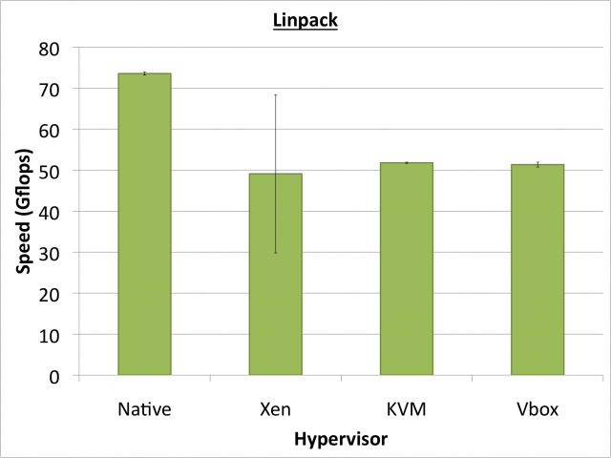
Hypervisor Performance
HPCC Linpack – Nothing quite as good as native (note: its now not as bad)
SPEC OpenMP – KVM at native performance
Notes:
HPL measures the floating point execution rate for solving a system of linear equations.
Hypervisor performance in Linpack reaches roughly 70% of native performance during our tests, with Xen showing a high degree of variation.

Slide 33
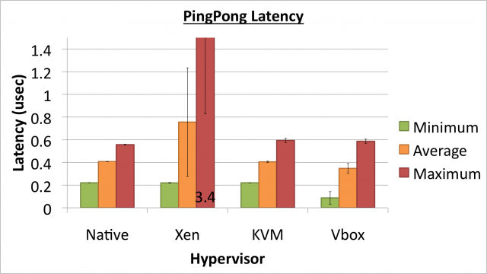
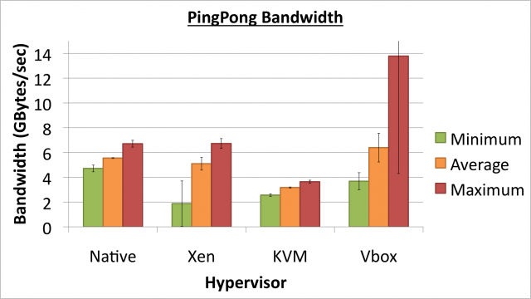
Performance Matters

Slide 34
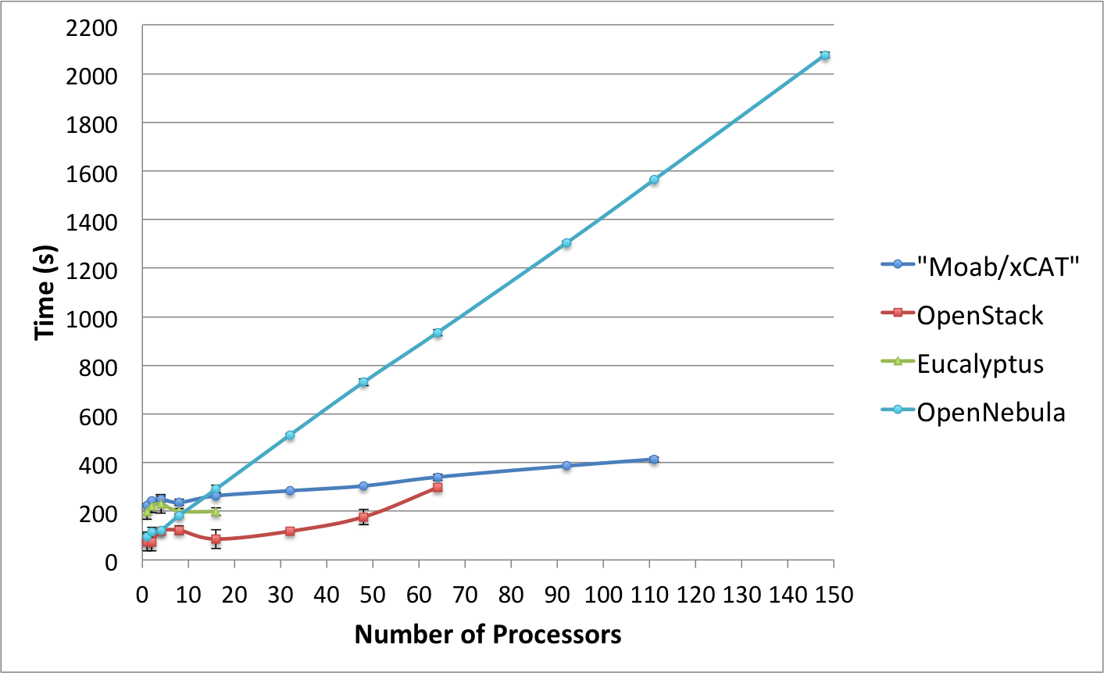
IaaS Scalability Is an Issue
From “Comparison of Multiple Cloud Frameworks"

Slide 35
Heterogeneity
Monolithic MPP Supercomputers are typical
But not all scientific applications are homogenous
Grid technologies showed the power & utility of distributed, heterogeneous resources
Ex: Open Science Grid, LHC, and BOINC
Apply federated resource capabilities from Grids to HPC Clouds
SKY Computing? (Nimbus term)

Slide 36
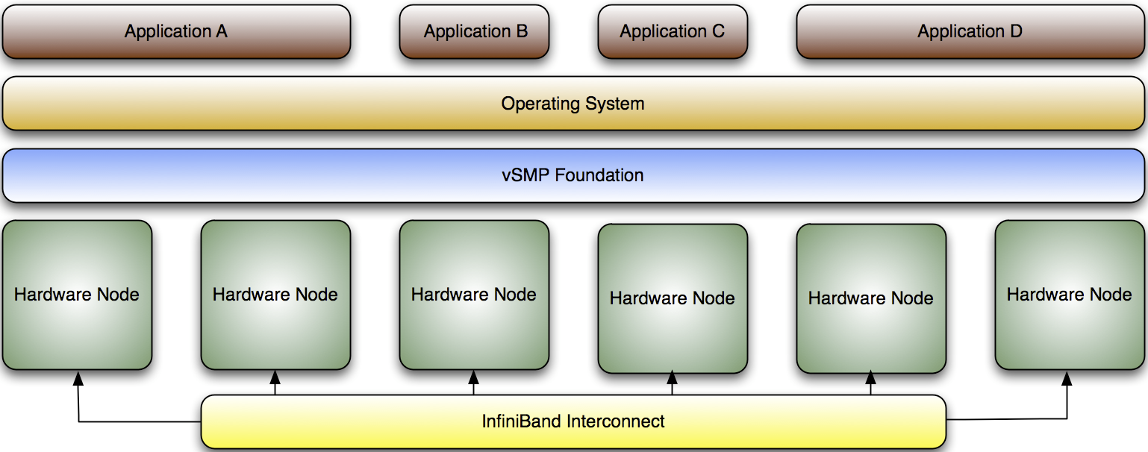
ScaleMP vSMP
vSMP Foundation is a virtualization software that creates a single virtual machine over multiple x86-based systems.
Provides large memory and compute SMP virtually to users by using commodity MPP hardware.
Allows for the use of MPI, OpenMP, Pthreads, Java threads, and serial jobs on a single unified OS.

Slide 37
vSMP Performance
Benchmark with HPCC, SPEC, & 3rd Party Apps
Compare vSMP Performance to Native
(Future) Compare vSMP to SGI Altix UV

Slide 38
GPUs in the Cloud
Orders of magnitude more compute performance
GPUs at Petascale today
Considered in path towards Exascale
Great Flops per Watt, when power is a premium
How to do we enable CUDA in the Cloud?
Notes:
Some offerings already exist Y axis – flops. I need to remember X axis.

Slide 39
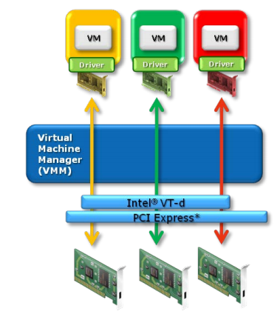
Xen PCI Passthrough
CUDA
CUDA
CUDA
Pass through the PCI-E GPU device to DomU
Use Nvidia Tesla & CUDA programming model
NEW R&D – it works!
Intel VT-d or AMD IOMMU extensions
Xen pci-back
GPU1
GPU2
GPU3

Slide 40
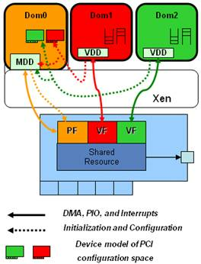
InfiniBand VM Support
PCI Passthrough does not share device with multiple VMs
Can use SR-IOV for InfiniBand & 10GbE
Reduce host CPU utilization
Maximize Bandwidth
“Near native” performance
Available in Q2 2012 OFED
From “SR-IOV Networking in Xen: Architecture, Design and Implementation”

Slide 41
OpenStack Goal
Federate Cloud deployments across Distributed Resources using Multi-zones
Incorporate heterogeneous HPC resources
GPUs with Xen and OpenStack
Bare metal / dynamic provisioning (when needed)
Virtualized SMP for Shared Memory
Leverage Hypervisor best-practices for near-native performance
Build rich set of images to enable new PaaS

Slide 42
aaS versus Roles/Appliances
If you package a capability X as XaaS, it runs on a separate VM and you interact with messages
SQLaaS offers databases via messages similar to old JDBC model
If you build a role or appliance with X, then X built into VM and you just need to add your own code and run
Generalized worker role builds in I/O and scheduling
Lets take all capabilities – MPI, MapReduce, Workflow .. – and offer as roles or aaS (or both)
Perhaps workflow has a controller aaS with graphical design tool while runtime packaged in a role?
Need to think through packaging of parallelism

Slide 43
Why Clouds for HPC?
Already-known Cloud advantages
Leverage economies of scale
Customized user environment
Leverage new programming paradigms for big data
But there’s more to be realized when moving to exascale
Leverage heterogeneous hardware
Runtime scheduling to avoid synchronization barriers
Check-pointing, snapshotting, live migration enable fault tolerance
Targeting usable exascale, not stunt-machine excascale

Slide 44
FutureGrid’s Future
NSF XSEDE Integration
Slated to incorporate some FG services to XSEDE next year
Contribute novel architectures from test-bed to production
Idea: Deploy Federated Heterogeneous Cloud
Target service oriented science
IaaS framework with HPC performance
Use DODCS OpenStack fork?

Slide 45
Questions?
More Information:
http://ajyounge.com
http://futuregrid.org

Slide 46
Acknowledgement
NSF Grant No. 0910812 to Indiana University for FutureGrid: An Experimental, High-Performance Grid Test-bed
PI: Geoffrey C. Fox
USC / ISI APEX DODCS Group
JP Walters, Steve Crago, many others
FutureGrid Software Team
FutureGrid Systems Team
IU SALSA Team

