Slide 1
Collaborative Framework for High-Performance P2P-based Data Transfer in Scientific Computing
Ali Kaplan
alikapla@cs.indiana.edu
Advisor: Prof. Geoffrey C. Fox

Slide 2
Outline
Introduction
Background
Motivation and Research Issues
GridTorrent Framework Architecture
Measurements and Analysis
Contributions and Future Work

Slide 3
Data, Data, more Data
Computational science is changing to be data intensive
Scientists are faced with mountains of data that stem from three sources[1]:
New scientific instruments data generation is monotonic
Simulations generates flood of data
The Internet and computational Grid allow the replication, creation, and recreation of more data[2]

Slide 4
^{Data, Data, more Data (cont.)}
Scientific discovery increasingly driven by data collection[3]
Computationally intensive analyses
Massive data collections
Data distributed across networks of varying capability
Internationally distributed collaborations
Data Intensive Science: 2000-2020 [4]
Dominant factor: data growth (1 Petabyte = 1000 TB)
2000 ~0.5 Petabyte
2007 ~10 Petabytes
2013 ~100 Petabytes
2020 ~1000 Petabytes?

Slide 5
^{Scientific Application} ^{Examples}
Scientific applications that generates petabytes of data are very diverse.
Fusion power
Climate modeling
Astronomy
High-energy physics
Bioinformatics
Earthquake engineering

Slide 6
Scientific Application Examples (cont.)
Some examples
Climate modeling
Community Climate System Model and other simulation applications generates 1.5 petabytes/year
Bioinformatics
The Pacific Northwest National Laboratory is building new Confocal microscopes which will be generating 5 petabytes/year
High-energy physics
The Large Hadron Collider (LHC) project at CERN will create 100 petabytes/year

Slide 7
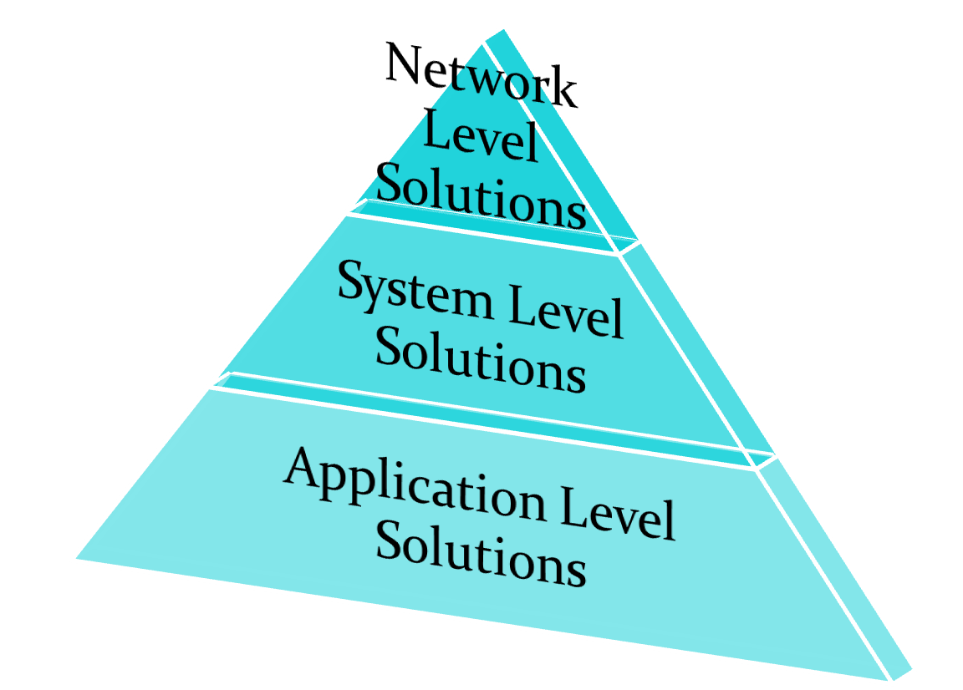
Background
Cost
Systems for transferring bulk data
Network level solutions
System level solutions
Application level solutions
Prevalence

Slide 8
Network Level Solutions
Network Attached Storage (NAS)
File-level storage system attached to traditional network
Use higher-level protocols
Does not allow direct access to individual storage
Simpler and more economical solution than SAN
Storage Area Network (SAN)
Storage devices attached directly to LAN
Utilize low-level network protocols (Fiber Channels)
Handle large data transfers
Provide better performance

Slide 9
System Level Solutions
-Require modifications to
the operating systems of the machine
The network apparatus
Or both
+ Yield very good performance
- Expensive solutions
- Not applicable to every system
Enhanced TCP-based solution

Slide 10
Application Level Solutions
+Use parallel streaming to improve performance
+Tweak TCP buffer size to improve performance
+Require no modifications to underlying systems
+Inexpensive
+Prevalent use
+-May require auxiliary component for data management
-May not be as fast as Network/System level solutions
Type of application solutions
TCP based solution
UDP based solutions

Slide 11
TCP-Based Solutions
+Harness the good features of TCP
+Reliability
+-Built-in congestion control mechanism (TCP Window)
+Require no changes on existing system
+Easy to implement
+Prevalent use
-Not suitable for real-time applications
GridFTP, GridHTTP, bbFTP and bbcp
Use mainly FTP or HTTP as base protocol

Slide 12
UDP-Based Solutions
+Small segment head overhead (8 vs. 20 bytes)
-Unreliable
+-Require additional mechanism for reliability and congestion control (at application level)
+May overcome existing problems of TCP
+May make UDP faster
-Integration with existing systems require some changes and efforts
SABUL, UDT, FOBS, RBUDP, Tsunami, and UFTP
Utilized mainly rate-based control mechanism

Slide 13
Motivation and Research Issues
Problems of existing solutions
Built-on client/server model
Why not P2P?
Utilize mainly FTP/HTTP type of protocols
Suffer from drawbacks of FTP/HTTP
Modification is difficult well established standard
Focus on the performance only between the server and client, but not between the clients
Use existing system resources inefficiently

Slide 14
Motivation and Research Issues (cont.)
If a P2P model can be solution
Which P2P can be the right model?
What additional features does it require?
Is it scalable?
How is the performance?
What is the overhead?
How flexible and extensible is it?

Slide 15
Motivation and Research Issues (cont.)
A P2P model can be solution
BitTorrent can be the right model
Designed as pure P2P file sharing protocol
Separating data transfer layer from data discovery and peer communication layer
Required additional features
Collaborative Framework
P2P client communication hub
Adequate security
Parallel streaming support
We did some performance testing to observe its performance and overhead

Slide 16
Comparison of BitTorrent and GridTorrent’s Architecture
BitTorrent | GridTorrent | Reason
P2P data-sharing protocol | P2P data-sharing protocol | No change
Simple HTTP Client | SOA-based Tracker Client | To enable advanced operations exchange with WS-Tracker
- | Task Manager | To enable execution of advanced operations in Client such as remote sharing and ACL
Web Server based Tracker | Advanced SOA-based Tracker | To allow the system to build and to handle complex actions required by scientific community
- | Security Manager | To provide authentication and authorization mechanism
- | Collaboration and Content Manager | To empower users to control access rights to their content and to start remote sharing, downloading processes and permit interactions between them
- | Parallel Streaming support | To improve further data transmission performance

Slide 17
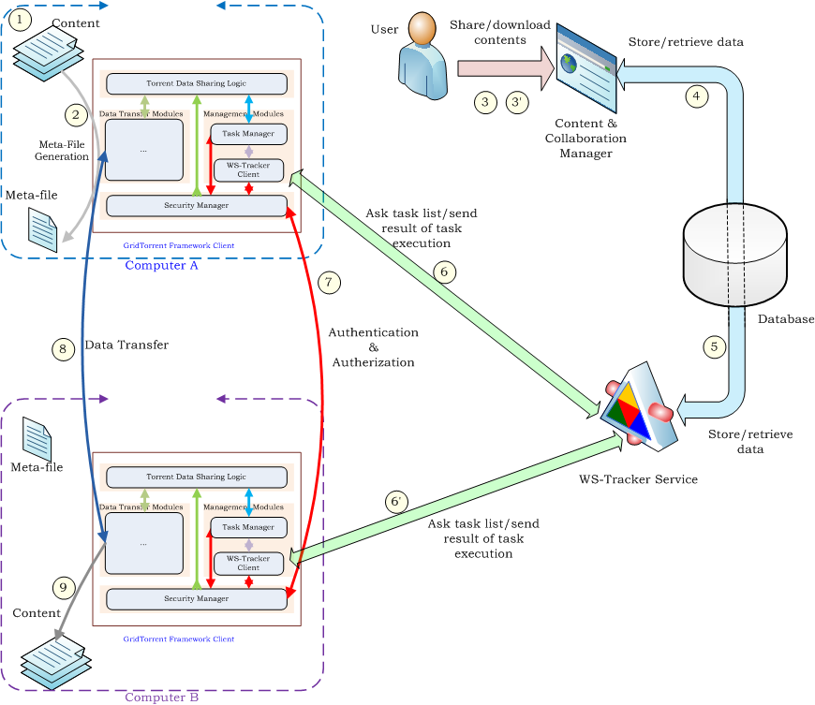

Slide 18
Collaboration and Content Manager
An Interface between users and the system
Capabilities:
Share content
Browse content
Download content
Add/remove group
Add/remove users for a particular content (Access Right Controls)
Add/remove users for a particular group (Access Right Controls)
Everything is metadata

Slide 19
WS-Tracker
The communication hub of the system
Loosely-coupled, flexible and extensible
Deliver tasks to GridTorrent clients
Update tasks status in database
Store and serve .torrent files
Database
GridTorrent
Client
Get Available
Tasks
Update Records
Deliver .torrent file
Ask for tasks
Deliver Task
WS-Tracker

Slide 20
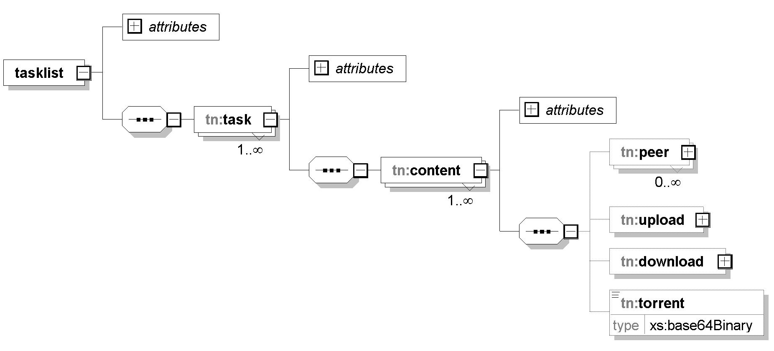
Task
A task is simply metadata (wrapped actions)
Request
Response
Periodic
Non-periodic
Instructs a GridTorrent client what to do with whom
Created by users or GridTorrent clients
Exchanged between WS-Tracker and GridTorrent client

Slide 21
Tasks overview
No | Task Name | Creator | Source | Destination | Category
1 | Task List Request | GTFC | GTFC | WS-Tracker | request, periodic
2 | Share Content Request | User | WS-Tracker | GTFC | request, nonperiodic
3 | Share Content Response | GTFC | GTFC | WS-Tracker | Response, nonperiodic
4 | Download Content Request | User | WS-Tracker | GTFC | Request, nonperiodic
5 | Download Content Response | GTFC | GTFC | WS-Tracker | response, periodic
6 | ACL Request | GTFC | GTFC | WS-Tracker | request, periodic
7 | ACL Response | User | WS-Tracker | GTFC | response
8 | Update Status | GTFC | GTFC | WS-Tracker | periodic

Slide 22
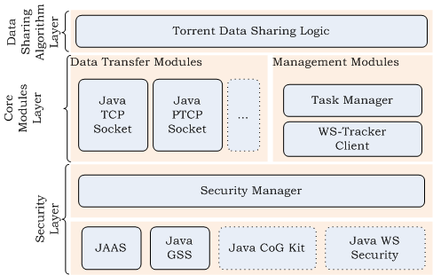
GridTorrent Client
Modular architecture
Provides extensibility and flexibility
Built-on P2P file sharing protocol
Enables to utilize idle resources efficiently
Provides adequate security
Authentication
Authorization
Data integrity
Supports parallel streaming

Slide 23
Security in GridTorrent Client

Slide 24
Security in GridTorrent Client
PeerA’s
Security Module
PeerB’s Security Module
PeerB handles PeerA’s request
PeerA starts authentication process
Yes
No
Authorization successful?
Yes
PeerA in ACL?
No
PeerB gives PeerA data port number, secret-key and pass-phrase, also save pass-phrase for further use
Reject
Connection
PeerA’s
Data Sharing Module
PeerA’s Data Sharing Module
Pass-phrase
verification
No
Yes
PeerA connects received data port and sends pass-phrase to start download process
Reject
Connection
PeerB starts data transferring process and encrypts data with secret-key if secure transmission is required

Slide 25
Security in GridTorrent Client
Only security port number on which Security Manager listens is publicly known to other peers
Each peer has to be authenticated and authorized (A&A) before starting download process
After a successful A&A, they receive data port number, secret key and pass-phrase
Peers use pass-phrase for second verification just before download process
If everything is valid and successful, actual data downloading is started
If secure data transmission is needed, secret key used for data encryption-decryption

Slide 26
Measurements and Analysis
The set of benchmarks
Performance
Overhead
Utilized PTCP transferring method for comparison
Parallel streaming is one of the major performance improvement methods
It has similar structure with GridTorrent
Observe the performance of GridTorrent for one server, multiple client case
Performed test-bed in these benchmarks
LAN (Bloomington, IN-Bloomington, IN)
WAN (Bloomington, IN-Baton Rouge, LA)

Slide 27
LAN Test Setup
PTCP
GridTorrent

Slide 28
Theoretical and Practical Limits
RTT = 0.34 ms
alikapla@Quarry: ~> traceroute gf13.ucs.indiana.edu
traceroute to gridfarm013.ucs.indiana.edu (156.56.104.93), 30 hops max, 46 byte packets
1 149.165.230.254 (149.165.230.254) 6.755 ms 0.254 ms 0.252 ms
2 tge-9-1.950.cr.hper.net.uits.iu.edu (149.166.5.113) 1.448 ms 1.329 ms 1.308 ms
3 gridfarm013.ucs.indiana.edu (156.56.104.93) 0.379 ms 0.333 ms 0.341 ms
Theoretical Bandwidth = 1000 Mbps
Maximum TCP Bandwidth = .9493*1000=949 Mbps
Measured Bandwidth with Iperf = 885 Mbps
Disk Read/Write Speed ≈ 450/350 Mbps

Slide 29
LAN Test Result (RTT = 0.34 ms)

Slide 30
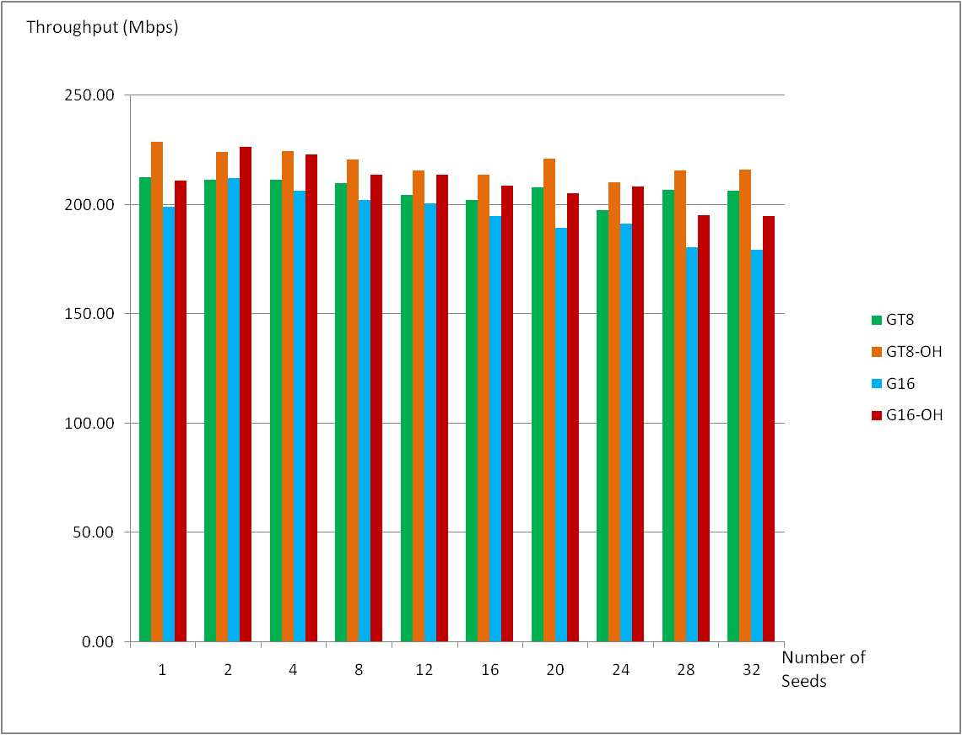
GridTorrent with 8 and 16 streams

Slide 31
WAN Test Setup
PTCP
GridTorrent

Slide 32
Theoretical and Practical Limits
RTT = 45 ms
alikapla@Quarry: ~> traceroute queenbee.loni-lsu.teragrid.org
traceroute to queenbee.loni-lsu.teragrid.org (208.100.92.21), 30 hops max, 46 byte packets
1 149.165.230.254 (149.165.230.254) 3.373 ms 0.282 ms 0.250 ms
2 if10-bf10.iu.teragrid.org (149.165.227.2) 1.421 ms 1.206 ms 13.663 ms
3 ge-0-2-0.2011.rtr.ictc.indiana.gigapop.net (149.165.183.41) 1.265 ms 1.414 ms 1.277 ms
4 66.162.116.137 (66.162.116.137) 31.242 ms 5.464 ms 2.257 ms
5 chcg-peer-02.twtelecom.net (66.192.254.70) 18.202 ms 8.712 ms 14.921 ms
6 loni.chcgil01.transitrail.net (137.164.131.122) 45.385 ms 44.892 ms 44.963 ms
7 10.240.18.130 (10.240.18.130) 45.156 ms 44.979 ms 45.173 ms
8 qb1.loni.org (208.100.92.21) 45.070 ms 45.151 ms 45.140 ms
Theoretical Bandwidth = 1000 Mbps
Maximum TCP Bandwidth = .9493*1000=949 Mbps
Measured Bandwidth with Iperf = 560 Mbps
Disk Read/Write Speed ≈ 450/350 Mbps

Slide 33
WAN Test Result (RTT = 45 ms)

Slide 34
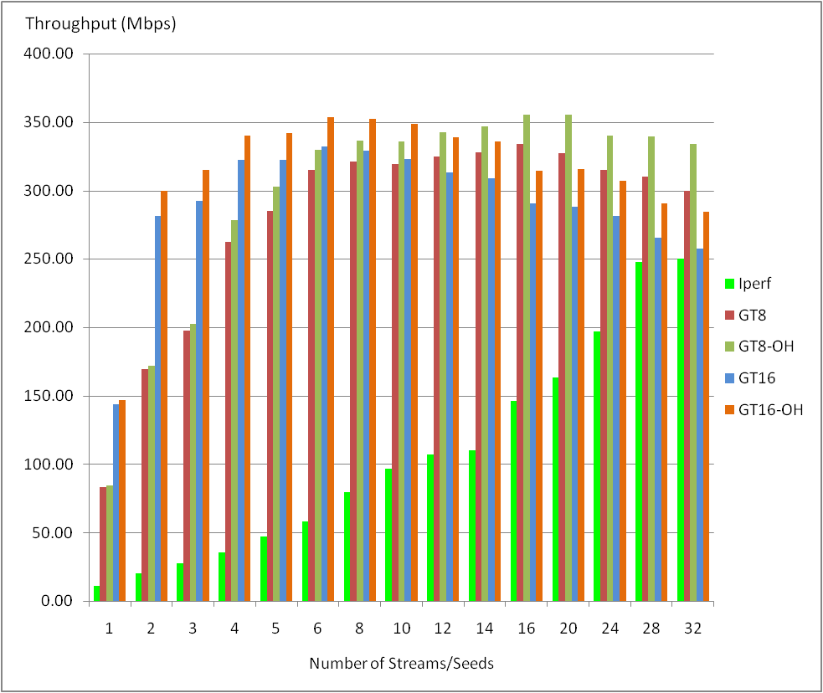
GridTorrent with 8 and 16 streams

Slide 35
Evaluation of Test Results
GridTorrent provides better or same performance on WAN
PTCP reaches maximum data transfer speed at 150-200 streams
Utilizing parallel streaming in GridTorrent yields higher data transfer rate
GridTorrent provides better performance replica systems with one server multiple clients
On WAN, for disk-to-disk transfer, disk transfer capacity is the performance limiting factor
Scalability is not an issue due to bulk data transfer characteristic

Slide 36
Characteristics of Participation in Scientific Community
Number of participator is scale of 10,100, 1000s
Fully distributed
Team work
CERN: The European Organization for Nuclear Research
The world's largest particle physics laboratory
Supported by twenty European member states
Currently the workplace of approximately 2,600 full-time employees
Some 7,931 scientists and engineers
representing 580 universities and research facilities
80 nationalities

Slide 37
Aggregated Bandwidth

Slide 39
Transmission sequence matrix of PTCP
PTCP
GridTorrent
Time (sec) | S-C1 | S-C2 | S-C3 | C1 | C2 | C3
1 | N1 |  |  | N1
2 | N2 |  |  | N1,N2
3 | N3 |  |  | N1,N2,N3
4 |  | N1 |  |  | N1
5 |  | N2 |  |  | N1,N2
6 |  | N3 |  |  | N1,N2,N3
7 |  |  | N1 |  |  | N1
8 |  |  | N2 |  |  | N1,N2
9 |  |  | N3 |  |  | N1,N2,N3
Time (sec) | S-C1 | S-C2 | S-C3 | C1-C2 | C2-C3 | C1-C3 | C1 | C2 | C3
1 | N1 |  |  |  |  |  | N1
2 |  | N2 |  |  |  | N1 | N1 | N2 | N1
3 |  |  | N3 | N1 |  |  | N1 | N1,N2 | N1,N3
4 | N2 |  |  |  | N2 |  | N1,N2 | N1,N2 | N1,N2,N3
5 |  | N3 |  |  |  | N3 | N1,N2,N3 | N1,N2,N3

Slide 40
Aggregated Bandwidth On LAN and WAN

Slide 41
Advantages of GridTorrent
More peers, more available services
Unlike client/server model, mitigate loads on server with more peers
Optimal resources usage
Computing power
Storage space
Bandwidth
Very efficient for replica systems
P2P networks are more scalable than client/server model
Reliable file transfer
Resume capability when data transfer interrupted
Third-party transfer
Disk allocation before actual data transfer

Slide 42
Contributions
System research
A Collaborative framework with P2P based data moving technique
Efficient, scalable and modular
Integrating with SOA to increase modularity, flexibility and extensibility
Strategies for increasing performance and scalability
Unification of many useful techniques such as reliable file transfer, parallel streaming support, third-party transfer and disk allocation in a simple but efficient way
Benchmarks to evaluate the GridTorrent performance
System software
Designing and implementing a infrastructure consists of GridTorrent client, WS-Tracker, and Collaborative framework

Slide 43
Potential Future Work
Utilizing other high-performance low-level TCP or UDP based data transfer protocols in data layer
Improving existing P2P technique
Adapting existing system to support dynamic (real-time) content
Developing and deploying Intelligent source selection algorithm into WS-Tracker
Additional Security
Security framework for WS-Tracker if necessary
Transforming Collaborative framework into portlets for reusability

Slide 44
References
Petascale computational systems, Bell, G.; Gray, J.; Szalay, A. Computer Volume 39, Issue 1, Jan. 2006 Page(s): 110 – 112
Getting Up To Speed, The Future of Supercomputing, Graham, S.L. Snir, M., Patterson, C.A., (eds), NAE Press, 2004, ISBN 0-309-09502-6
Overview of Grid Computing, Ian Foster, http://www-fp.mcs.anl.gov/~foster/Talks/ResearchLibraryGroupGridsApril2002.ppt, last seen 2007
Science-Driven Network Requirements for Esnet, http:// www.es.net/ESnet4/Case-Study-Requirements-Update-With-Exec-Sum-v5.doc, last seen 2007

