Slide 1
Parallel Multidimensional Scaling Performance on Multicore Systems
Community Grids Lab.
Indiana University, Bloomington
Seung-Hee Bae

Slide 2
Contents
Multidimensional Scaling (MDS)
Scaling by MAjorizing a COmplicated Function (SMACOF)
Parallelization of SMACOF
Performance Analysis
Conclusions & Future Works

Slide 3
Multidimensional Scaling (MDS)
Techniques to configure data points in high-dimensional space Into low-dimensional space based on proximity (dissimilarity) info.
e.g.) N-dimension → 3-dimension (viewable)
Dissimilarity Matrix [ Δ = (δ_{ij}) ]
Symmetric
Non-negative
Zero-diagonal elements
MDS can be used for visualization of high-dimensional scientific data
E.g.) chemical data, biological data

Slide 4
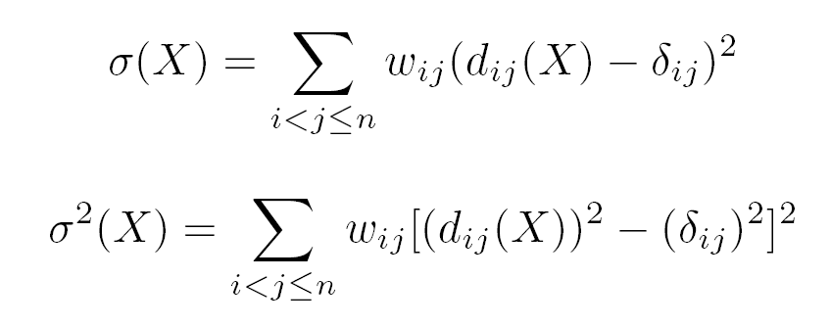
MDS (2)
Can be seen as an optimization problem.
minimization of the objective function.
Objective Function
STRESS [σ(X)] – weighted squared error btwn dist.
SSTRESS [σ²(X)] – btwn squared dist.
Where, d_{ij}(X) = | x_{i} – x_{j}|, x_{i} & x_{j} are mapping results.

Slide 5
SMACOF
Scaling by MAjorizing a COmplicated Function
Iterative EM-like algorithm
A variant of gradient descent approach
Likely to have local minima
Guarantee monotonic decreasing the objective criterion.

Slide 6
SMACOF (2)
Notes:
X^{[0]} – initial mapping. It can be random.
sigma^{[k]} = STRESS value of X^{[k]}.
Delta_sigma(X^{[k]}) = sigma(X^{[k-1]}) – sigma(X^{[k]})
inv_V, B(X) – N * N matrices, where N is the number of data (points).
X^{[k]} – N * D matrix, where D is target dimension.

Slide 7
Parallel SMACOF
Dominant time consuming part
Iterative matrix multiplication. O(k * N³)
Parallel MM on Multicore machine
Shared memory parallelism.
Only need to distribute computation but not data.
Block decomposition and mapping decomposed submatrix to each thread based on thread ID.
Only need to know starting and end position (i, j) instead of actually dividing the matrix into P submatrix, like MPI style.

Slide 8
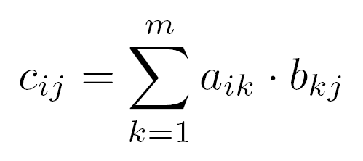
Parallel SMACOF (2)
Parallel matrix multiplication
n
n
n
b
b
b
b
b
b_{1j}
b
…
n
a_{i1}
…
a_{ij}
…
a_{im}
X
n
b_{ij}
=
n
c_{ij}
…
b_{mj}
A
B
C

Slide 9
Experiments
Test Environments
 | Intel8a | Intel8b
CPU | Intel Xeon E5320 | Intel Xeon x5355
CPU clock | 1.86 GHz | 2.66 GHz
Core | 4-core x 2 | 4-core x 2
L2 Cache | 8 MB | 8 MB
Memory | 8 GB | 4 GB
OS | XP pro 64 bit | Vista Ultimate 64 bit
Language | C# | C#

Slide 10
Experiments (2)
Benchmark Data
4D Gaussian Distribution data set (8 centers)
(2,0,4,1)
(0,2,4,1)
(2,2,1,0)
(0,0,1,0)
(0,2,0,1)
(2,2,0,1)
(0,0,0,0)
(2,0,0,0)
Notes:
The screen shot is the result of MDS for GD_4D_1024 data.

Slide 11
Experiments (3)
Design
Different number of block size
Cache line effect
Different number of threads and data points
Scalability of the parallelism
Jagged 2D Array vs. Rectangular 2D array
C# language specific issue.
Known that Jagged array performs better than multidimensional array.
Notes:
One dimensional arrays have specific instructions in the CIL that allow them to be optimized for performance.
Rectangular arrays do not have these instructions, and are not optimized to the same level.
Jagged 2D arrays can be optimized since it use a number of one-dimensional array.
* CIL – Common Intermediate Language

Slide 12
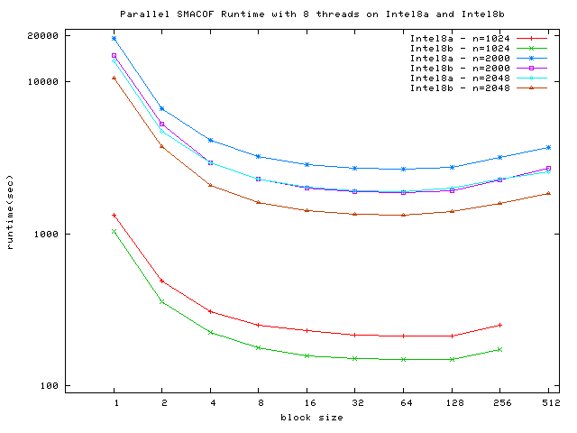
Experimental Results (1)
Different block size (Cache effect)
Notes:
When block size = 64, the cache line might be used in the best efficiency.
The reason that running time of 2000 points are longer than the running time of 2048 points is that the iteration numbers are different.
k_2000 = 80 k_2048 = 53

Slide 13
Experimental Results (2)
Different Block Size (using 1 thread)
Intel8a |  |  |  | Intel8b
#points | blkSize | Time(sec) | speedup | #points | blkSize | Time(sec) | speedup
512 | 32 | 228.39 | 1.10 | 512 | 32 | 160.17 | 1.10
512 | 64 | 226.70 | 1.11 | 512 | 64 | 159.02 | 1.11
512 | 512 | 250.52 |  | 512 | 512 | 176.12
1024 | 32 | 1597.93 | 1.50 | 1024 | 32 | 1121.96 | 1.61
1024 | 64 | 1592.96 | 1.50 | 1024 | 64 | 1111.27 | 1.62
1024 | 1024 | 2390.87 |  | 1024 | 1024 | 1801.21
2048 | 32 | 14657.47 | 1.61 | 2048 | 32 | 10300.82 | 1.71
2048 | 64 | 14601.83 | 1.61 | 2048 | 64 | 10249.28 | 1.72
2048 | 2048 | 23542.70 |  | 2048 | 2048 | 17632.51

Slide 14
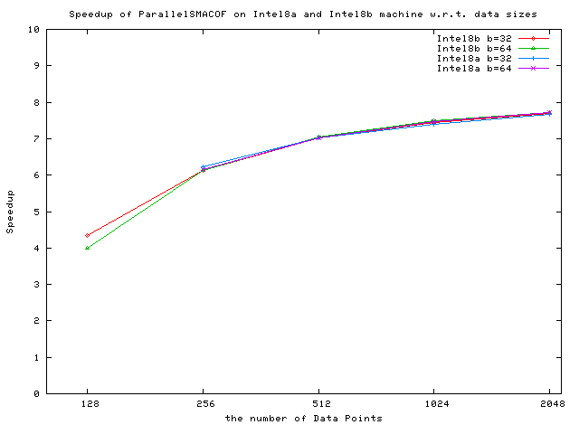
Experimental Results (3)
Different Data Size
Speedup ≈ 7.7
Overhead ≈ 0.03
Notes:
For the two small data set, i.e. 128 and 256 points data, the overhead ratio would be relatively high due to the short running time.
However, for the 512 points and bigger data set, the speedup ratio is more than 7.0.
Note that the speedup ratio for the 2048 points data is around 7.7.
parallel overhead is around 0.03 for both Intel8a and Intel8b machines.

Slide 15
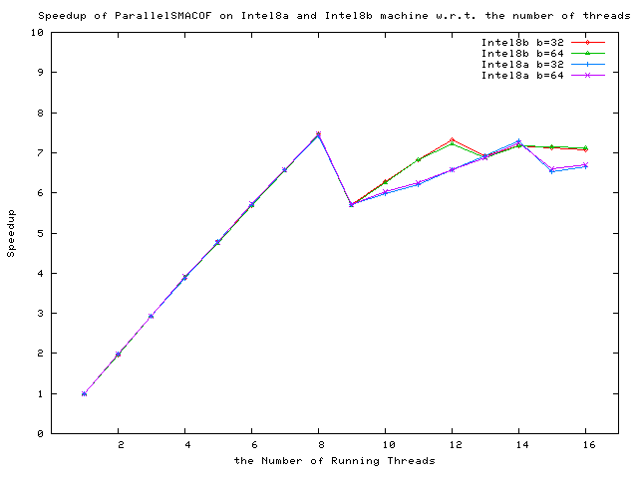
Experimental Results (4)
Different number of Threads
1024 data points
Notes:
As we expected, the speedup increases almost linearly during TH <= 8, which is the number of cores.
Then, when TH = 9, the speedup factor suddenly decreases on both machines.
That might be dependent on context switch and thread scheduling algorithms of the operating system.

Slide 16
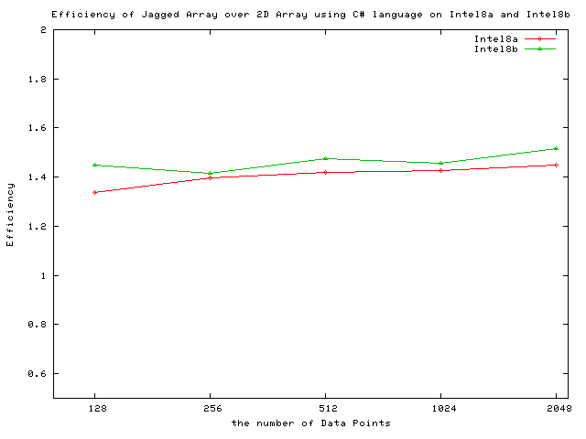
Experimental Results (5)
Jagged Array vs. 2D array
1024 data points w/ 8 threads
Notes:
As shown in Figure 7, the efficiency is about 1.5 on Intel8b
and 1.4 on Intel8a for all the test data set, 128, 256,
512, . . . , 2048 points data. In other words, jagged array data
structure is more than 40% faster than two-dimensional array
structure in C# language.

Slide 17
MDS Example: Biological Sequence Data
4500 Points : Pairwise Aligned
4500 Points : ClustalW MSA

Slide 18
Obesity Patient ~ 20 dimensional data
4000 records 8 Clusters
2000 records 6 Clusters

Slide 19
Conclusion & Future Works
Parallel SMACOF shows
High efficiency (> 0.94) and speedup (> 7.5 / 8-core), for larger data, i.e. 1024 or 2048 points.
Cache effect: b=64 is most fitted block size for the block matrix multiplication for the tested machines.
Jagged array is at least 1.4 times faster than 2D array for the parallel SMACOF.
Future Works
Distributed memory version of SMACOF

Slide 20
Acknowledgement
Prof. Geoffrey Fox
Dr. Xiaohong Qiu
SALSA project group of CGL at IUB

Slide 21
Questions? Thanks!

