Slide 1
Learning Everywhere: Machine (actually Deep) Learning Delivers HPC
Geoffrey Fox, Shantenu Jha, September 26, 2019 Learning Everywhere: Impact on HPC/eScience
eScience 2019 September 24 – 27, 2019 San Diego, California, USA
gcf@indiana.edu, http://www.dsc.soic.indiana.edu/, http://spidal.org/

Slide 2
HPCforML and MLforHPC
Technical aspects of converging HPC and Machine Learning
HPCforML (Not discussed)
Parallel high performance ML algorithms
High Performance Spark, Hadoop, Storm
8 scenarios for MLforHPC
Illustrate a few scenarios
Research Issues

Slide 3
Dean at NeurIPS
DECEMBER 2017
ML for optimizing parallel computing (load balancing)
Learned Index Structure
ML for Data-center Efficiency
ML to replace heuristics and user choices (Autotuning)

Slide 4
Implications of Machine Deep Learning for Systems and Systems for Machine Deep Learning
We could replace “Systems” by “Cyberinfrastructure” or by “HPC” or even “eScience”
I use HPC as we are aiming at systems that support big data or big simulations and almost by (my) definition could naturally involve HPC.
So we get ML for HPC and HPC for ML
HPC for ML is very important but has been quite well studied and understood
It makes data analytics run much faster
ML for HPC is transformative both as a technology and for application progress enabled
If it is ML for HPC running ML, then we have the creepy situation of the AI supercomputer improving itself
ML operationally DL at the moment!

Slide 5
MLforHPC (ML for Systems) in detail
MLforHPC can be further subdivided into several categories:
MLafterHPC: ML analyzing results of HPC as in trajectory analysis and structure identification in biomolecular simulations. Well established and successful
MLControl: Using simulations (with HPC) and ML in control of experiments and in objective driven computational campaigns. Here simulation surrogates are very valuable to allow real-time predictions. Very Promising
MLAutotuning: Using ML to configure (autotune) ML or HPC simulations.
MLaroundHPC: Using ML to learn from simulations and produce learned surrogates for the simulations or parts of simulations. The same ML wrapper can also learn configurations as well as results. Most Important.

Slide 6
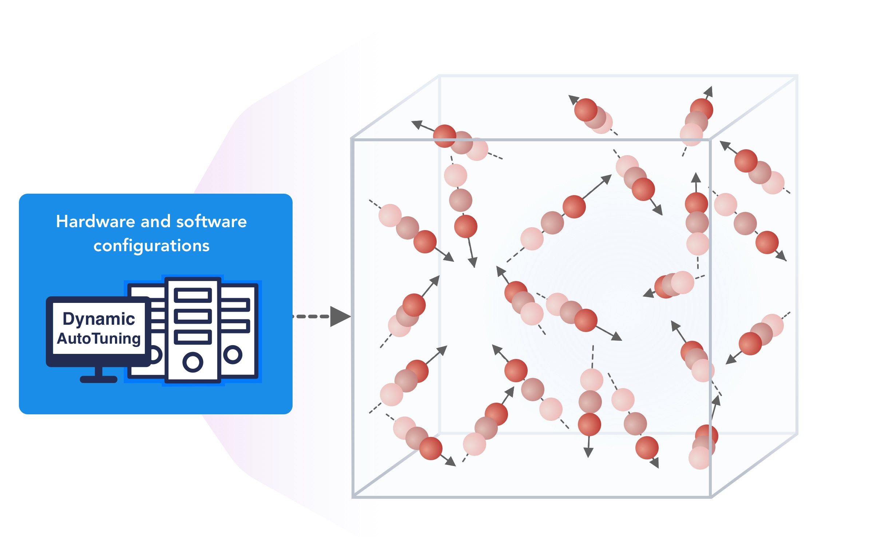
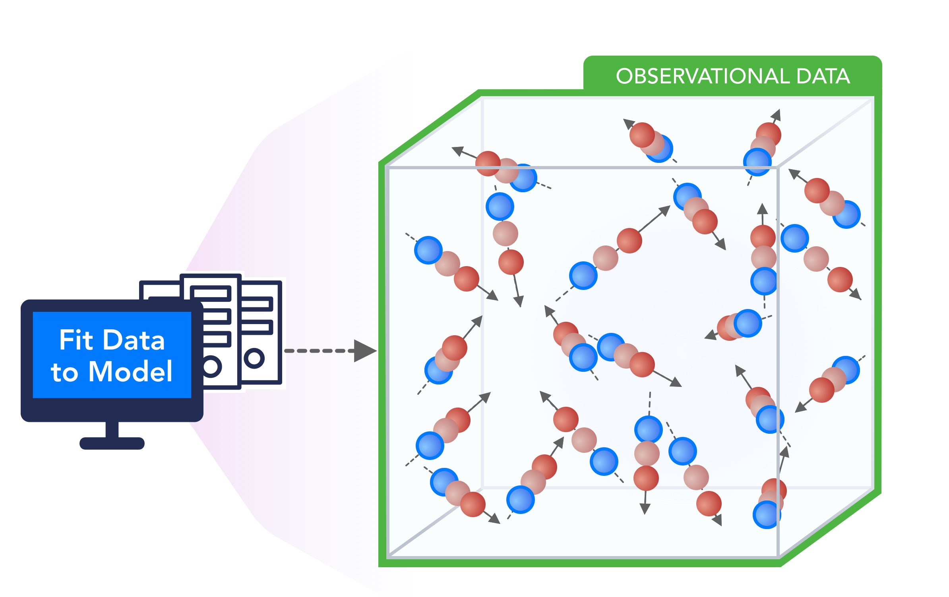
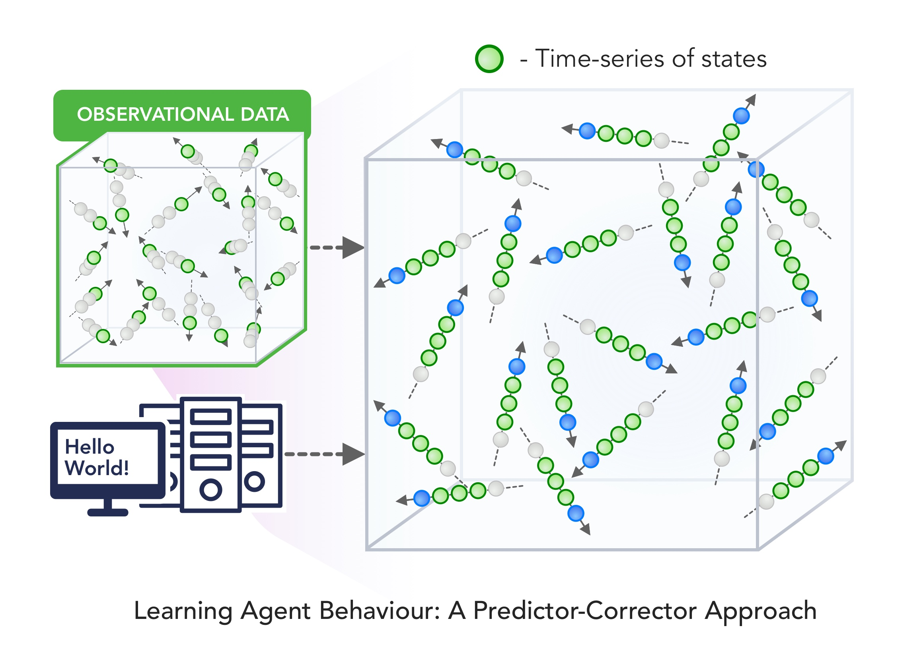
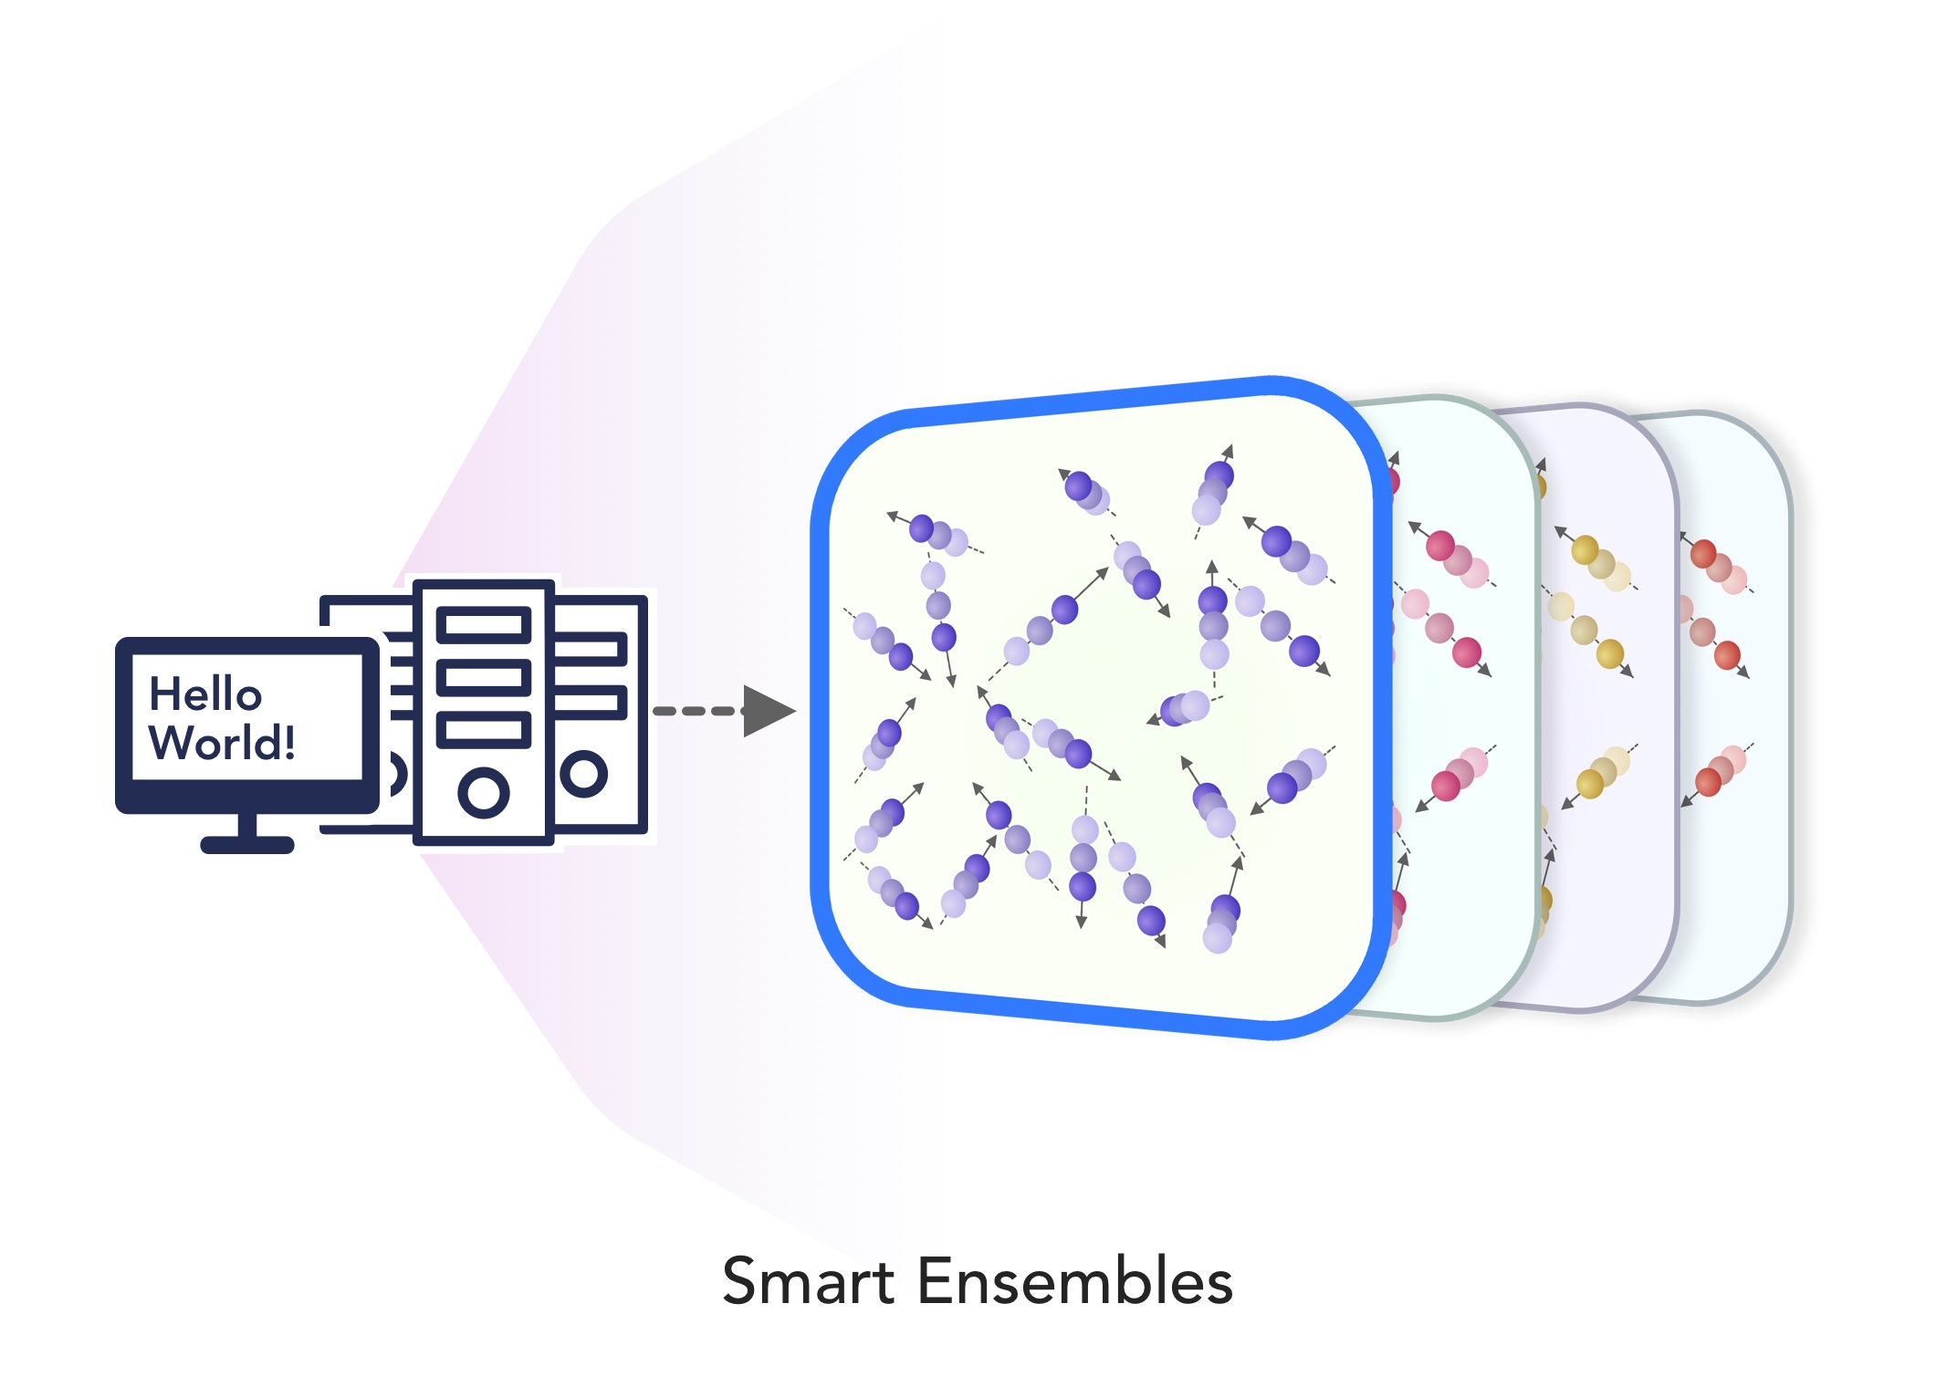
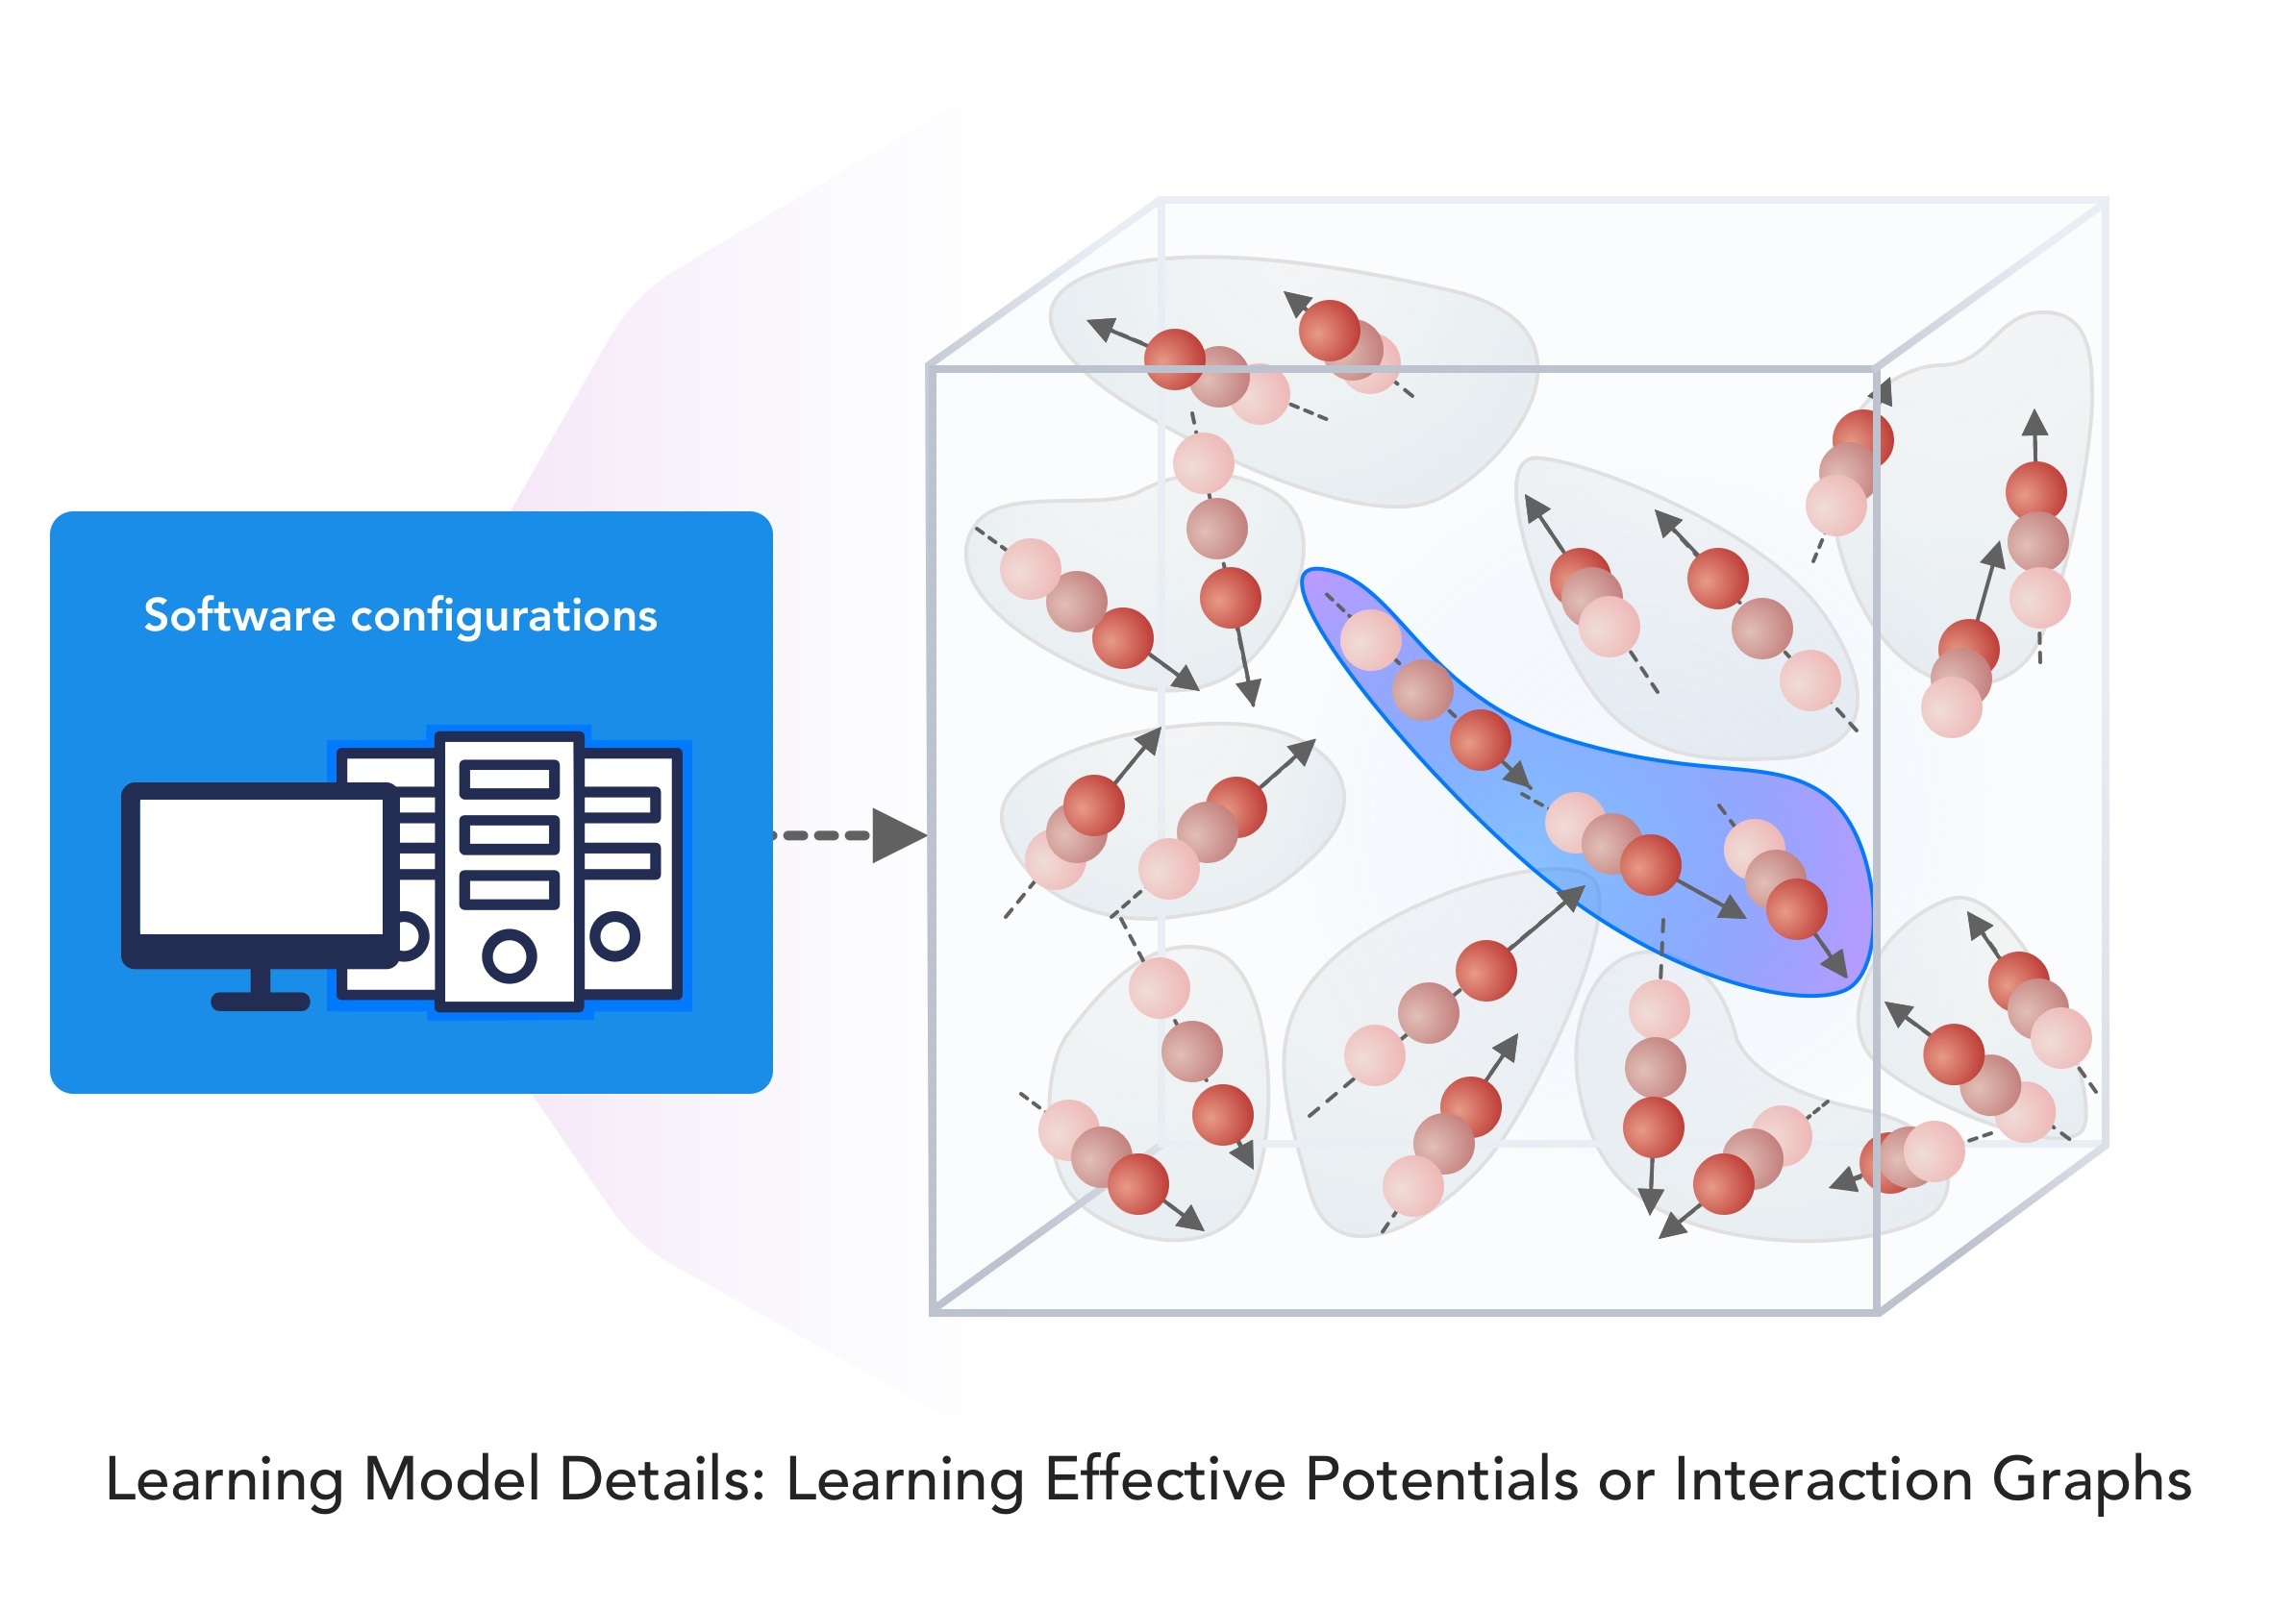
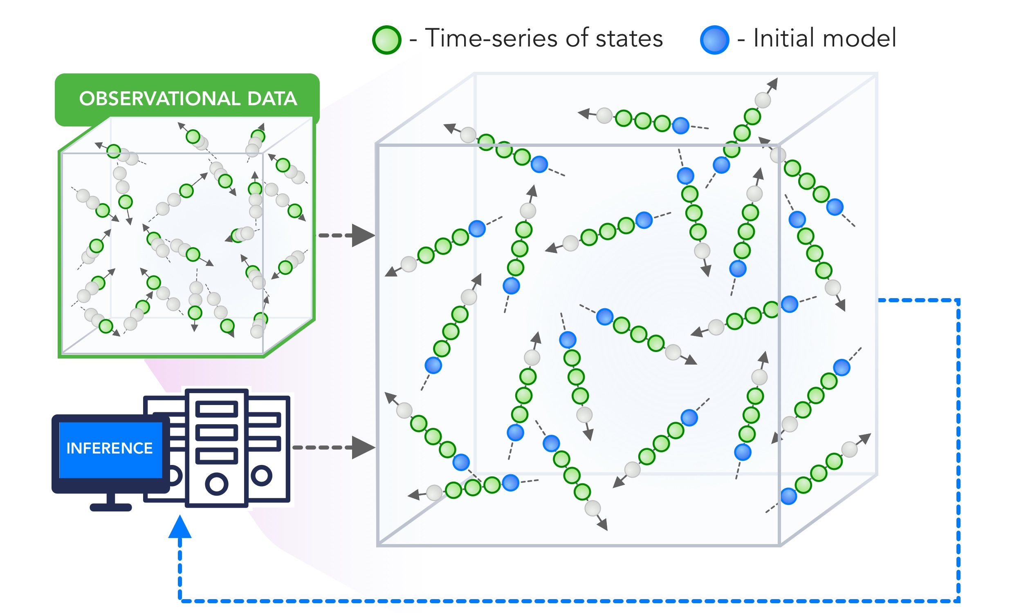
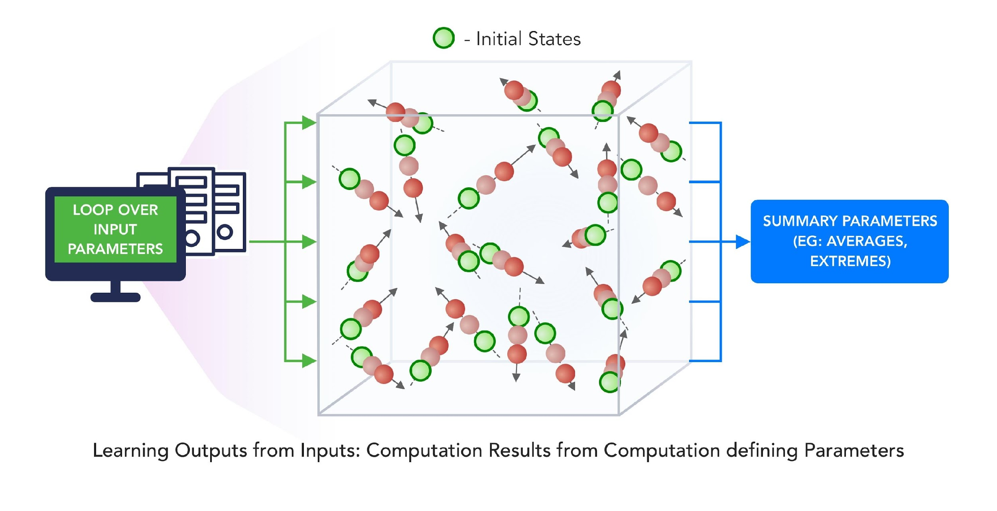
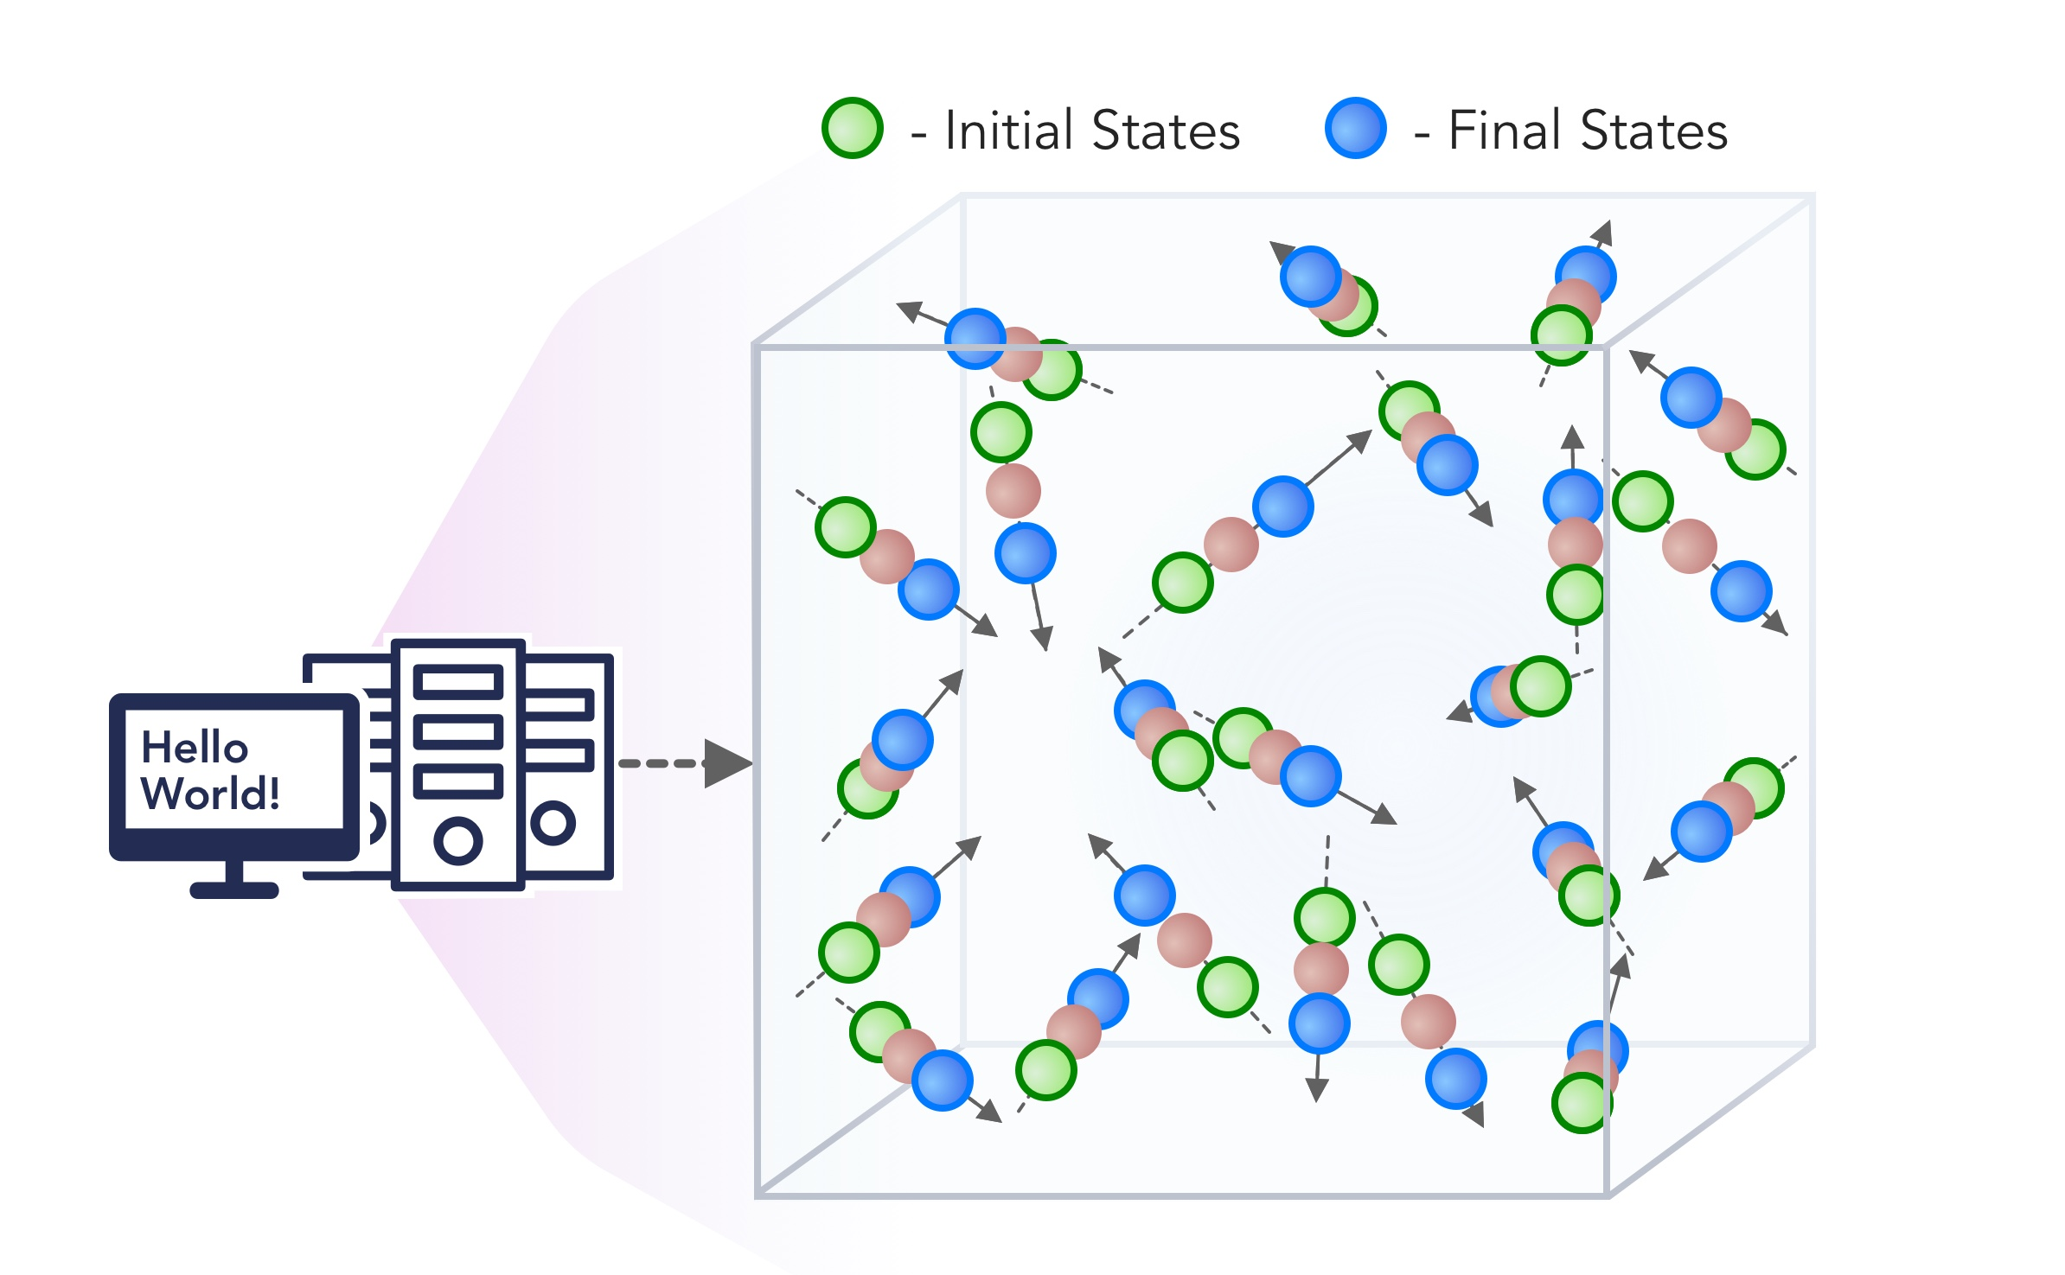
1. Improving Simulation with Configurations and Integration of Data
1.1 MLAutotuningHPC – Learn configurations
1.2 MLAutotuningHPC – Learn models from data
1.3 MLaroundHPC: Learning Model Details (ML based data assimilation)
2. Learn Structure, Theory and Model for Simulation
2.1 MLAutotuningHPC – Smart ensembles
2.2 MLaroundHPC: Learning Model Details (coarse graining, effective potentials)
2.3 MLaroundHPC: Improve Model or Theory
3. Learn Surrogates for Simulation
3.1 MLaroundHPC: Learning Outputs from Inputs (parameters)
3.2 MLaroundHPC: Learning Outputs from Inputs (fields)
INPUT
OUTPUT

Slide 7
3. MLforHPC Learn Surrogates for Simulation 3.1 MLaroundHPC: Learning Outputs from Inputs:
a) Computation Results from Computation defining Parameters
Here one just feeds in a modest number of meta-parameters that the define the problem and learn a modest number of calculated answers.
This presumably requires fewer training samples than “fields from fields” and is main use of MLaroundHPC so far
Can mix simulations and observations
Operationally same as SimulationTrainedML but with a different goal: In SimulationTrainedML the simulations are performed to directly train an AI system rather than the AI system being added to learn a simulation.

Slide 8
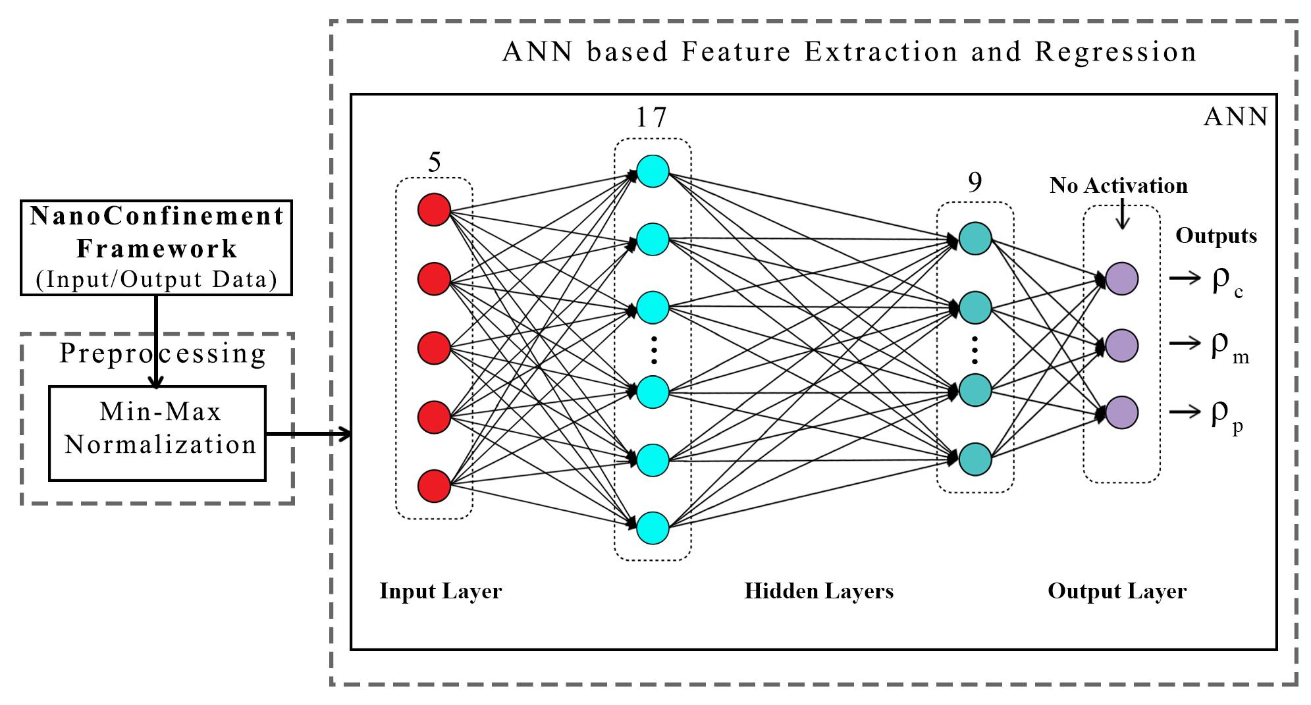
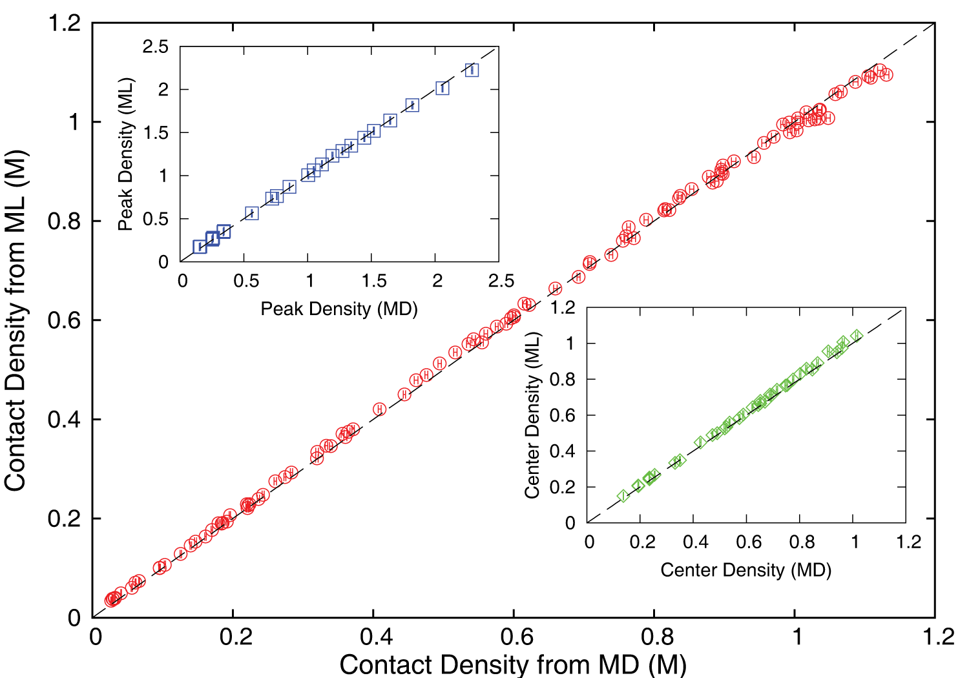
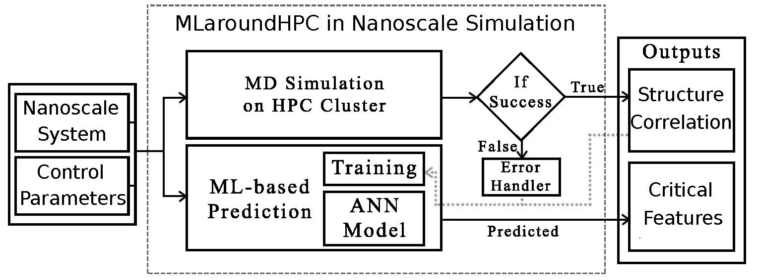
MLaroundHPC: Machine learning for performance enhancement with Surrogates of molecular dynamics simulations
Work with Jadhao and Kadupitiya at Indiana University
Employed to extract the ionic structure in electrolyte solutions confined by planar and spherical surfaces.
Written with C++ and accelerated with hybrid MPI-OpenMP.
MLaroundHPC successfully learns desired features associated with the output ionic density that are in excellent agreement with the results from explicit molecular dynamics simulations.
Speed up 10⁵
ML-Based Simulation Prediction ANN Model
Training
Inference

Slide 9
Speedup of MLaroundHPC
T_{seq} is sequential time
T_{train} time for a (parallel) simulation used in training ML
T_{learn} is time per point to run machine learning
T_{lookup} is time to run inference per instance
N_{train} number of training samples
N_{lookup} number of results looked up
Becomes T_{seq}/T_{train} if ML not used
Becomes T_{seq}/T_{lookup} (10⁵ in our case) if inference dominates (will overcome end of Moore’s law and win the race to zettascale)
Another factor as inferences uses one core; parallel simulation 128 cores
Speedup is strong (not weak with problem size increasing to improve performance) scaling as size fixed
N_{train} is 7K to 16K in our work

Slide 10
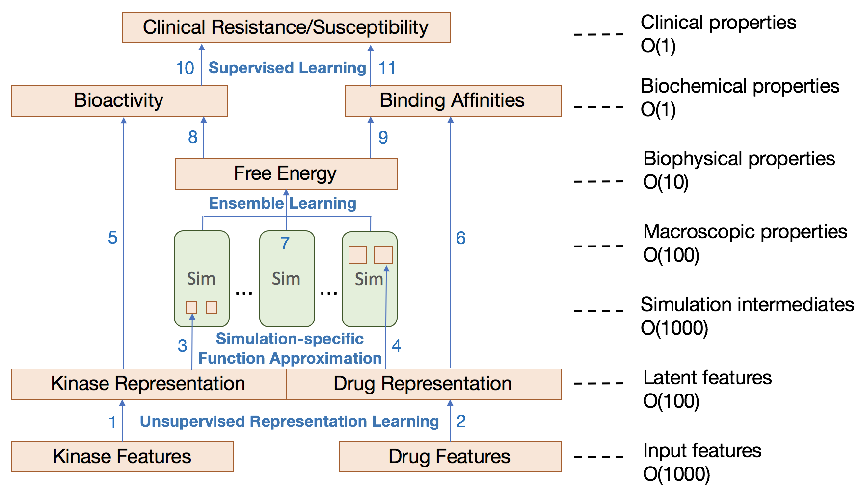
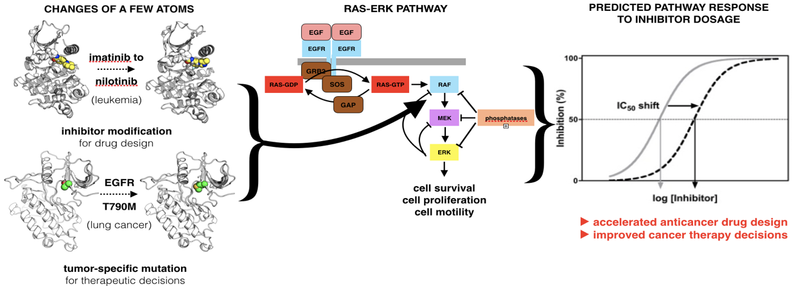
Examination of the therapeutic effectiveness of Kinase ML at multiple levels and points in the discovery process
CANDLE-INSPIRE
Kinase effectiveness workflow with number of features of relevance at each stage
Ensemble simulations and DL training samples

Slide 11
INSILICO MEDICINE USED CREATIVE AI TO DESIGN POTENTIAL DRUGS IN JUST 21 DAYS
September 4 2019 News Item
Map Drug (Material) Structure to Drug (Material) Properties
Hong Kong-based Insilico Medicine sent shockwaves through the pharma industry after publishing research in Nature Biotechnology that proves its AI-powered drug discovery system was capable of producing at least one potential treatment for fibrosis in less than a month's time.
The system bucks the standard brute-force approach for AI drug development, which involves screening millions of potential molecular structures looking for a viable fit, in favor of a Deep Reinforcement Learning algorithm that can imagine potential protein structures based on existing research and certain preprogrammed design criteria.
Insilico's system initially produced 30,000 possible designs, which the research team whittled down to six that were synthesized in the lab, with one design eventually tested on mice to promising results.
Insilico's AI-powered research process could offer a massive push forward for the pharmaceutical industry, which faces increasingly high drug development costs. In just a handful of weeks and for approximately $150,000, Insilico delivered what typically takes pharmaceutical companies $2.6 billion over seven years.

Slide 12
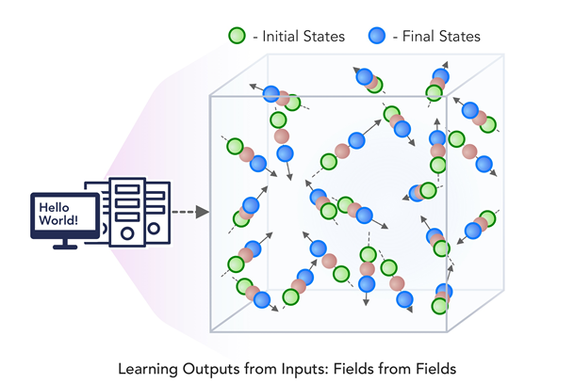
3. MLforHPC Learn Surrogates for Simulation 3.2 MLaroundHPC: Learning Outputs from Inputs:
b) Fields from Fields
Here one feeds in initial conditions and the neural network learns the result where initial and final results are fields
In simple cases, it is shown that you can learn Newton’s laws and their numerical approximation
Unclear how far but probably generalizes

Slide 13
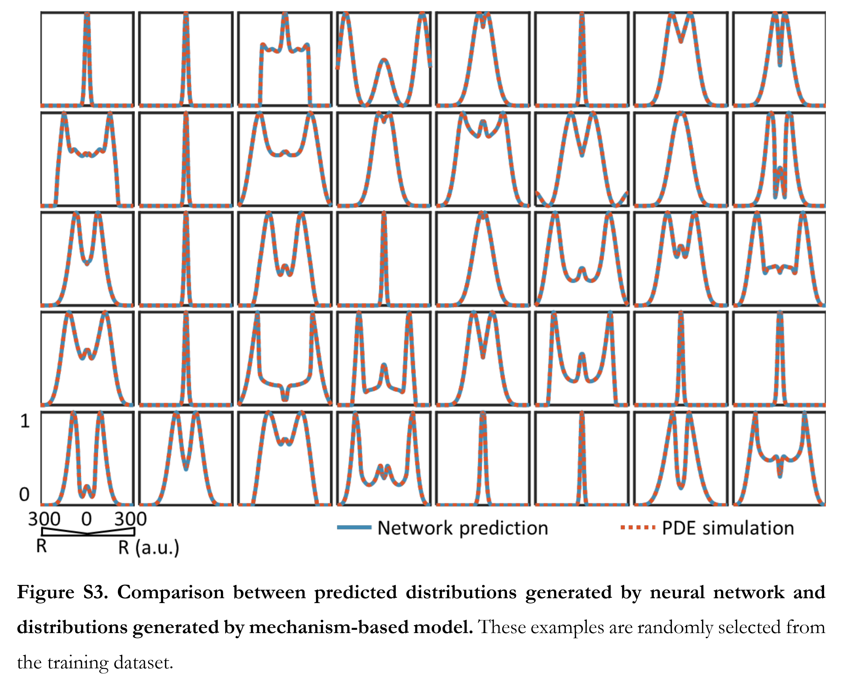
Fields from Parameters Recent paper “Massive computational acceleration by using neural networks to emulate mechanism based biological models” uses 501 LSTM units to represent a one-dimensional grid of values which is output of a two-dimensional gene circuit simulation which only depends on radius.

Slide 14
One way to think about this
We are solving PDE’s or sets of coupled ODE’s
Typically we solve iteratively New Values = (Operator) Previous Values
Classic applied math tells you nifty difference equations and spectral methods to represent Operator numerically
Deep Learning learns the operator from classic numerics or observational data or their combination
Inference is New Values = (DL Operator) Previous Values
This new nonlinear trained DL operator can allow much larger time steps, incorporate variations in parameters etc.
DL Operator is the new theory (Newton’s laws) of science
High order approximations used to be very sensitive to noise and one was taught to avoid but ANN are the opposite – very robust
Our DL operator for Simple Harmonic Oscillator has 116,610 parameters in two LSTM layers!
Newton’s laws for SHO have 2-4 parameters

Slide 15
2. Learn Structure, Theory and Model for Simulation 2.1 MLAutoTuningHPC: Smart Ensembles
Here we choose the best set of collective coordinates to achieve some computation goal
Such as exploring special states – proteins are folding
Or providing the most efficient training set with defining parameters spread well over the relevant phase space.
Deep Learning (e.g. autoencoders) replacing other machine learning approaches to find collective coordinates

Slide 16
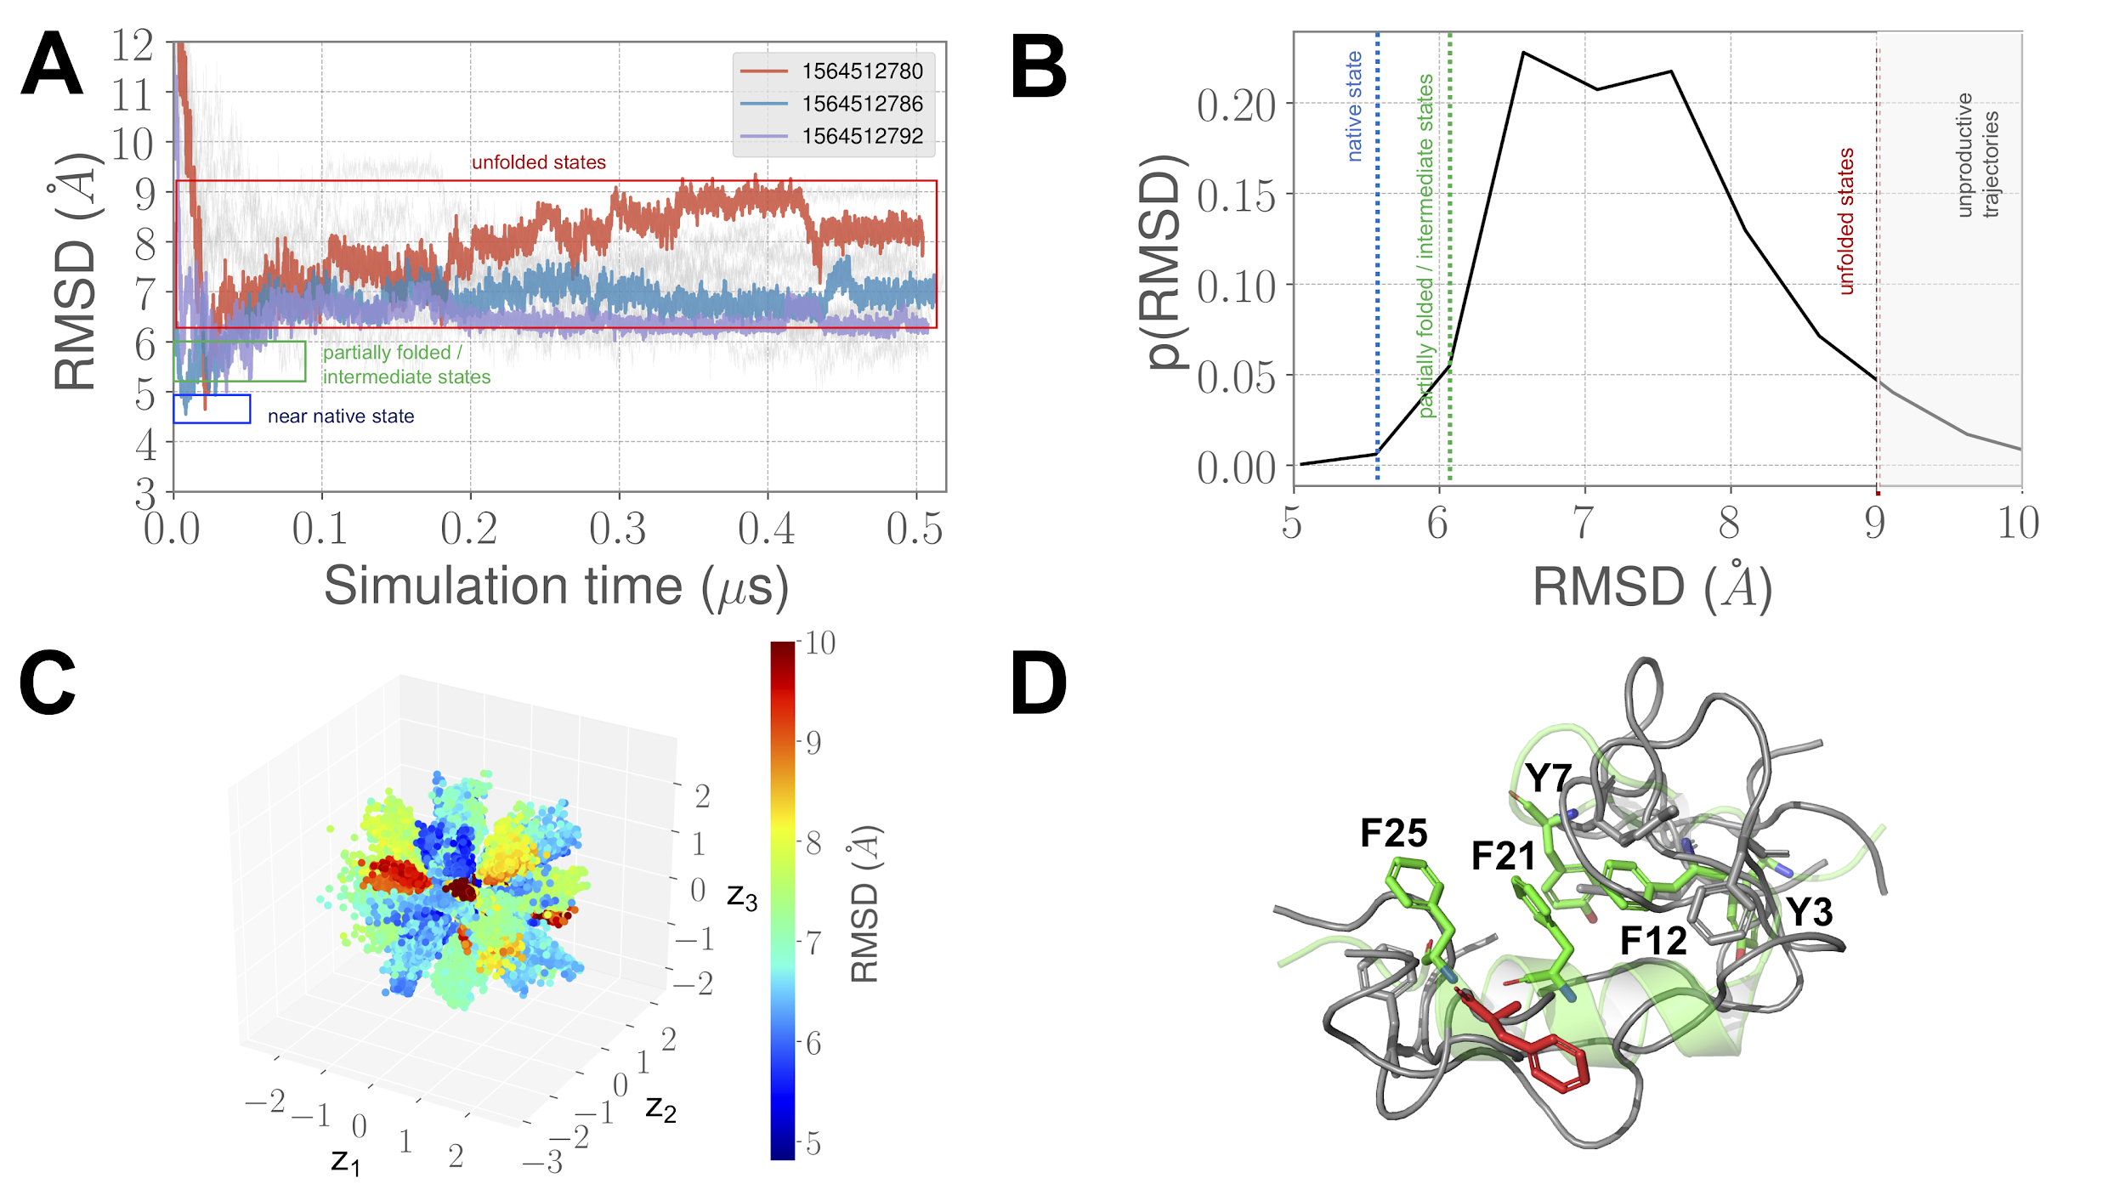
CVAE Convolutional Variational Autoencoder driven Ensemble-MD
For BBA: 20X improvement
Collaboration with ANL: see https://arxiv.org/pdf/1908.00496.pdf

Slide 17
1. Improving Simulation with Configurations and Integration of Data 1.3 MLaroundHPC: Learning Model Details (ML for Data Assimilation)
a) Learning Agent Behavior One has a a set of cells as agents modeling a virtual tissue and use ML to learn both parameters and dynamics of cells replacing detailed computations by ML surrogates. As there can be millions to billions of such agents the performance gain can be huge as each agent uses same learned model.
b) Predictor-Corrector approach Take the case where data is a video or high dimensional (spatial extent) time series. Now one time steps models and at each step optimize the parameters to minimize divergence between simulation and ground truth data. E.g. produce a generic model organism such as an embryo. Take this generic model as a template and learn the different adjustments for particular individual organisms.
Current state of the art (Ride Hailing!!) expresses spatial structure as a convolutional neural net and time dependence as recurrent neural net (LSTM)

Slide 18
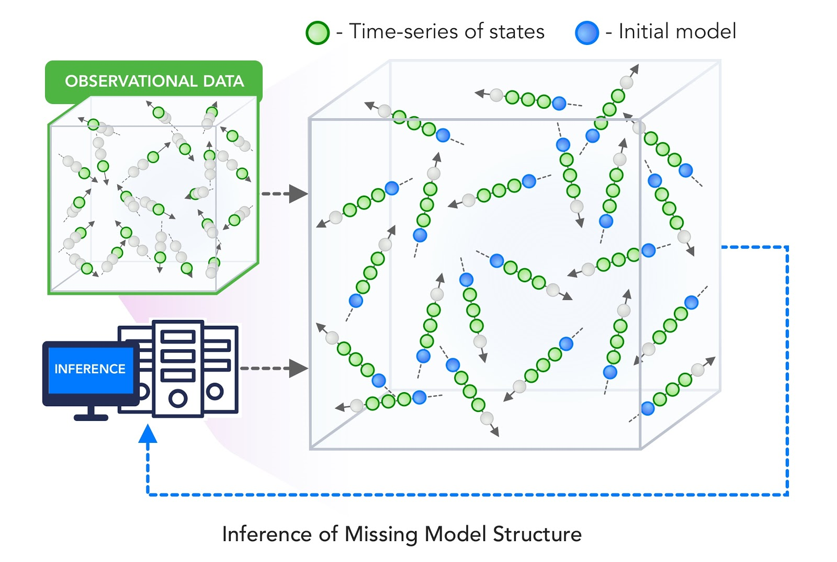
2. Learn Structure, Theory and Model for Simulation 2.3 MLaroundHPC: Learning Model Details - Inference of Missing Model Structure
This imagines a future where AI will essentially be able to derive theories from data, or more practically a mix of data and models.
This is especially promising in agent based models which often contain phenomenological approaches such as the predictor-corrector method of 1.3. We expect that will take the results of such assimilation and effective potentials and interactions and use them as the master model or theory for future research.

Slide 19
Putting it all Together Simulating Biological Organisms (with James Glazier @IU)
Learning Model (Agent) Behavior Replace components by learned surrogates (Reaction Kinetics Coupled ODE’s)
All steps use MLAutotuning
Smart Ensembles
Predictor-Corrector

Slide 20
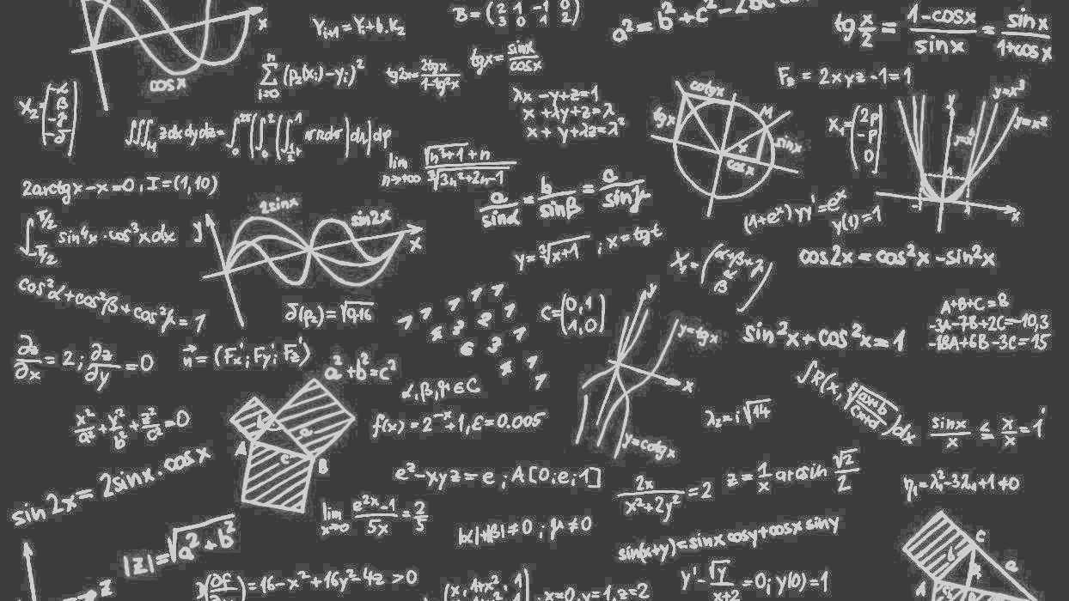
Complete Systems HPCforML
Parallel Big Data Analytics in some ways like parallel Big Simulation
Twister2 Implements HPCforML as HPC-ABDS and supports MLforHPC

Slide 21
Next Generation of Cyberinfrastructure: Application Requirements
Four clear classes of applications are
Classic simulations which are addressed excellently by DoE exascale program and although our focus is Big Data, one should consider this application area as we need to integrate simulations with data analytics and ML (Machine Learning) -- item d) below
Classic Big Data Analytics as in the analysis of LHC data, SKA, Light sources, health, and environmental data.
Cloud-Edge applications which certainly overlap with b) as data in many fields comes from the edge
Integration of ML and Data analytics with simulations. “learning everywhere”,

Slide 22
Next Generation of Cyberinfrastructure: Remarks on Deep Learning
We expect growing use of deep learning (DL) replacing older machine learning methods and DL will appear in many different forms such as Perceptrons, Convolutional NN's, Recurrent NN's, Graph Representational NN's, Autoencoders, Variational Autoencoder, Transformers, Generative Adversarial Networks, and Deep Reinforcement Learning.
For industry, growth in reinforcement learning is increasing the computational requirements of systems. However, it is hard to predict the computational complexity, parallelizability, and algorithm structure for DL even just 3 years out.
Note we always have the training and inference phases for DL and these have very different system needs.
Training will give large often parallel jobs; Inference will need a lot of small tasks.
GPU’s and perhaps TPU’s are both AI and simulation accelerators; new generation of AI accelerators may be useless for simulations?
Note in parallel DL, one MUST change both batch size and # training epochs as one scales to larger systems (in fixed problem size case) and this is implicit in MLPerf results; this may change with more model parallelism
Parallel Computing Failed again!!

Slide 23
Next Generation of Cyberinfrastructure: Compute and Data patterns
The application classes a) to d) will all have needs in the four capabilities
Parallel simulations;
Data Management;
Data analytics;
Streaming
but the proportion of these will differ in the four classes and d) is particularly hard as it intermixes all of them in a dynamic heterogeneous fashion.
A system for class d) will be able to run the other classes as it will have “everything” but a “d” system may not be the most cost-effective for a pure class a) or b) application.
The growing complexity of work implies that dynamic heterogeneity will characterize all major problems of each class.
In the absence of consensus application requirements and software systems to support ML driven HPC, it is unclear whether scaled up machines should be the same design but larger or have a radically different design and performance point.
Classic Simulations
Classic Big Data
Cloud-Edge
HPCforML. MLforHPC

Slide 24
Computer Science Issues
What computations can be assisted by what ML in which of 8 scenarios
Not known how large training set needs to be.
What is performance of different DL (ML) choices in compute time and capability
Little or no study of either predicting errors or in fact of getting floating point numbers from deep learning.
What can we do with zettascale computing?
Redesign all algorithms so they can be DL-assisted
There ought to be important analogies between time series and this area (as simulations are 4D time series?)
Dynamic interplay (of data and control) between simulations and ML seems likely but not clear at present
Interesting load balancing issues if in parallel case some points learnt using surrogates and some points calculated from scratch

