Slide 1
2010 FutureGrid User Advisory Meeting Architecture Roadmap Long term vision 10:00-10:45, Monday, August 2, 2010 Pittsburgh, PA
Gregor von Laszewski
Representing the Software Architecture Committee
http://futuregrid.svn.sourceforge.net/viewvc/futuregrid/presentations/software/tg2010/ fg-tg2010-arch-longterm.pptx

Slide 2
This presentation contains selected features of the overall architecture that are important for users

Slide 3
FutureGrid Architecture
FG open architecture allows to configure it’s resources
FG allows different clouds and images to be provisioned
FG allows access to cloud and Grid services
FG image and experiment management allows to create similar experiment environments while enabling reproducible activities
FG will be supported 24x7
FG will support deployment of important middleware including:
TeraGrid stack, Condor, BOINC, gLite, Unicore, Genesis II

Slide 4
Future Grid Users
Application/Scientific users
System administrators
Software developers
Testbed users
Performance modelers
Educators
Students
Supported by
FutureGrid
Infrastructure & Software offerings

Slide 5
Usecases
Use cases related to IaaS
Provide a Linux VM
Provision an operating syste on hardware
Provision a Microsoft Windows Operating System on hardware
Provide High Priority Preemptable Access to FG Resources (Managed by Moab)
Provide Time Window based VM Provsioning (Manged by Moab)
Reserve and Provision Resources based on Resource Properties
Create Private Testbed by Adding specific machines to the futuregrid network (via VPN for example)
Support Advance Reservation on the FG resources(for example next Saturday for 4 hours)
Provide an IPv6 Testing Environment
Use cases related to PaaS
Testing grid or cloud, particularly end-user applications
Creating a cloud front end linked to a grid and its resources to enable scientific applications and gateways
Developing data-intensive applications
Testing optimization of different layers of parallelism via grid, cloud, and many-core programming models
Testing new authentication or authorization mechanism
Hardening of middleware or science application
Provide testbed to evaluate Grid technologies of all sorts
Provision MPI System
Provision Hadoop System
Provision Nimbus System
Provision Eucalyptus System
Provision System that Supports Bioinformatics Research

Slide 6
Usecases
Use cases related to SaaS
Testing new networking protocols or topology, application layer overlays, and peer-to-peer networks
HCI researchers testing end-to-end productivity of grid computing systems
Comparing grid middleware implementations and standards compliance
Executing Experiment Workflows (Pegasus, …)
Use cases related to Training, Education and Outreach Services (TEOS)
Provide a FutureGrid Sandbox for Outreach activities
Provide VM Resources to Educator to be used by students
Provide FutureGrid services to Educator to be used by students
Provide FutureGrid services to Educator to be used by students for low-level OS activities
Train users on FutureGrid Capabilities

Slide 7
Usecases
Andrew’s Interests:
(Y1) Testing Genesis II in various environments
(Y2) Combining cloud and grid dynamically
(Y1, Now) Also interested in PBS + virtualization in the cluster.
(Y1) Specifically would like FutureGrid to include persistent endpoints for Unicore 6, GLite, Globus, etc.
Andre’s Interests:
(Y2) Grid or (Y1) cloud APIs. Globus, EC2, and clusters.
(Y1) Application scalability in different systems is important, combining several systems at the same time for the same application.
(Y2) Investigating storage + compute collocation. In that area the latency configurability would be helpful.
(Y1) Resources of 8-32 nodes per service would be sufficient.
JP’s Interests:
(Y3) Software integration for Teragrid.
(Y1) Use FutureGrid as a testing pipeline for Teragrid software and applications.
(Y1) Scalability & reliability testing for ANL.
(Y1) Need to provide and intantiate a set of VMs.
(Y1/2) Persistence required? Yes, and no. Long term testbed for Teragrid implies persistence of resources. But, release testing for newest application version would not require persistence. So both modes of operation are useful.
Steven’s Interests:
(Y1/2) Interoperability testing with multiple middleware, similar to Andrew’s requirement.
(Y1/2) Testing various cloud solutions from Europe.
(Y1) Testing at scale, in general.
Zach’s Interests:
(Y1) Testing applications on multiple cloud infrastructures (both IaaS and PaaS)
(Y1/2) Want the ability to get below the cloud API to see the middleware at work and install modified versions etc.
(Y1) Run-time management of applications on multiple clouds (i.e. completely separate installations)
(Y2) Dom0 access on the hardware would be ideal to interact with hypervisors and VMs at a low level. Networking is also an issue in this regard.
Ian’s Interests:
(Y1/2) Testing applications on multiple infrastructures (IaaS clouds) with different APIs
(Y1) Nimbus patches etc,
EC2,
OpenNebula (Y2),
look at application scalability on each (Y1/2)
(Y1)Diversity of VM environments for applications is good.

Slide 8
Dynamic provisioning Examples
Give me a virtual cluster with 30 nodes
Give me a Eucalyptus environment with 10 nodes
Give me a hadoop environment with x nodes
Run my application on hadoop, dryad, … and compare the performance
Use common Grid infrastructures: Unicore, Genesis II on provisioned FG services.

Slide 9
Dynamic Provisioning
Dynamic OS Provisioning (Linux, …, Windows)
Dynamic Image Provisioning (put an image on a resource)
This supports dynamic aspects of FG
FG Dynamic Resource Assignment
Resources in a cluster may be reassigned based on the anticipated user requirements, e.g. a server may be participating as part of an HPC application on the machine, but at a later time the server is removed from the HPC resource pool and included through dynamic provisioning into a Eucalyptus Cloud. Resources that are not used are in a "unused resource pool"
Execution-based Dynamic User Requested Resource Assignment
At the time of the job execution, a system is provisioned that fulfills the user's need at runtime.
Queue-based Dynamic User Requested Resource Assignment
Since the provisioning of images is time consuming, it is often possible to queue such jobs with the same image requirement in a queue and instantiate the provisioning before all jobs are executed which are belong to the queue.
However software is needed to support these aspects and make them seamlessly usable to the users.
Existing systems xcat/Moab, …. are not enough
The term dynamic provisioning is sometimes only used for VMs not so in FG.

Slide 10
Objectives: Software
Extensions to existing software
Existing open-source software
Open-source, integrated suite of software to
instantiate and execute grid and cloud experiments.
perform an experiment
collect the results
tools for instantiating a test environment,
Torque, MOAB, xCAT, bcfg, and Pegasus, Inca, ViNE, a number of other tools from our partners and the open source community
Portal to interact
Benchmarking

Slide 11
Development Phases
Phase 0: Get Hardware to run
Phase I: Get early users to use the system
Phase II: Deploy dynamic provisioning
Phase III: Integrate with TeraGrid

Slide 12
FutureGrid Architecture

Slide 13
FG Stratosphere
Objective
Higher than a particular cloud
Provides all mechanisms to provision a cloud on a given FG hardware
Allows the management of reproducible experiments
Allows monitoring of the environment and the results
Risks
Lots of software
Possible multiple path to do the same thing
Good news
We know about different solutions and have identified a very good plan with risk mitigation plans

Slide 14
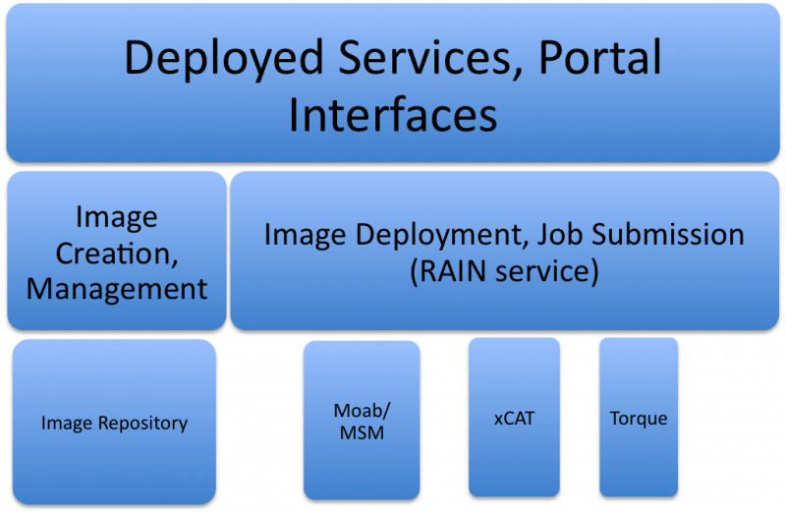
Deployment View (Layered Approach)

Slide 15
FG RAIN
Runtime Adaptable Insertion Configurator (Service)
A service that allows dynamic provisioning within FG.
As already pointed out in the Software Section, multiple mechanisms exist to dynamically provision resources for the users need.
RAIN will provide a comprehensive set of components to satisfy the different provisioning scenarios.
Is controlled via command line, will have an API
Access through scripting languages

Slide 16
FG RAIN Command
fg-rain –h hostfile –iaas nimbus –image img
fg-rain –h hostfile –paas hadoop …
fg-rain –h hostfile –paas dryad …
fg-rain –h hostfile –gaas gLite …
fg-rain –h hostfile –image img
Authorization is required to use fg-rain without virtualization.

Slide 17
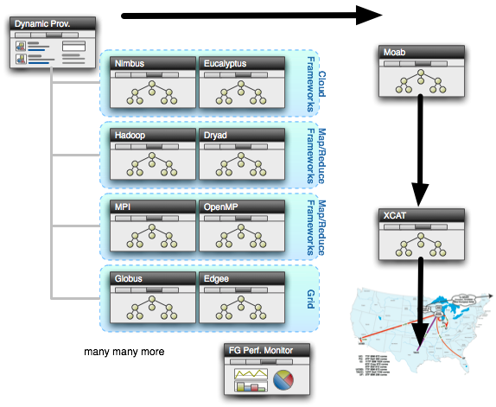
Dynamic Provisioning

Slide 18
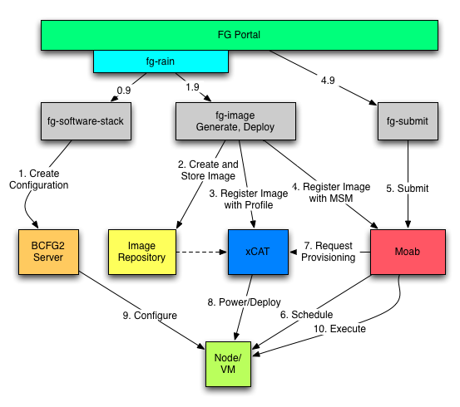
Process View: fg-rain

Slide 19
xCAT and Moab
xCAT
uses installation infrastructure to perform installs
creates stateless Linux images
changes the boot configuration of the nodes
remote power control and console (IPMI)
Moab
meta-schedules over resource managers
TORQUE and Windows HPC
control nodes through xCAT
changing the OS
remote power control

Slide 20
Image Management

Slide 21
Requirements
User Requirements:
Be able to create new virtual machines upon request.
Can specify an OS from a list of possible supported OSs.
Can specify individual software packages to include within the image.
Generation of images should not take more than a few minutes.
Simplified command line tools and/or unified portal to help create new images.
Easy image "blessing" process.
Allow for the sharing of images between users, both deployed and in specification.
Administrator Requirements:
Add, modify, delete base OS options with ease.
Build in pre-configured software for administering VMs, such as BCFG2.
Build in performance monitoring tools within VMs
Explicitly defined vetting or "blessing" process for VMs.
Simple tools or CLI interface to modify images.

Slide 22
Requirements
Infrastructure Requirements:
Have resulting images be lightweight and portable.
Have predefined kernels supported at all FG sites.
Be able to store newly generated images in the Image Repository.
Be able to updates images with Image Repository.
Continuity at virtualization layer across all FG sites.
Security & Maintenance Requirements:
Be able to automatically update VMs with security packages and new kernel updates.
Provide vetting process to probe and detect vulnerabilities within images
Have a method to update all images within the repository, deployed or not.
Have a method to update all currently running images in realtime.
Have an accurate identity management and accounting procedure to ensure data integrity.

Slide 23
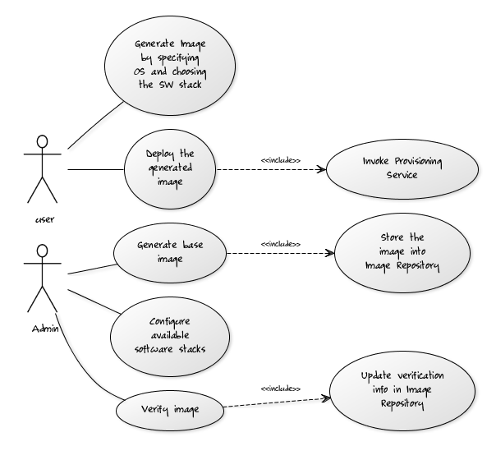
Use-Case View
The user initiates the image generation process by supplying the desired operating system and the desired software packages for the image to be created.
The OS selection is mapped to a set of preconfigured base images which are supplied by the FG administrators in advance.
The desired software stack supported by the administrators is loaded onto the base image and packages for deployment within the FG resources in an image repository.
The administrators/or an automated process will verify the images periodically, and the data would be stored into the Image Repository for the Performance/Monitoring subsystem to fetch and publish.

Slide 24
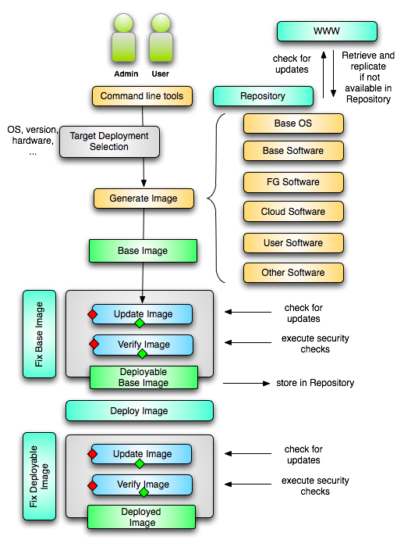
Process View
Image Generation
User starts with the CLI and selects Base OS, software stack, and the image is generated with his request.
The image is linked to BCFG2 and Inca, and submitted to be updated and verified.
If the image passes the security checks, it is stored in the repository
If the image fails, a detailed message is returned to the user.
Cleared or “verified” images within the Image repository can later be deployed onto FG infrastructure upon request.

Slide 25
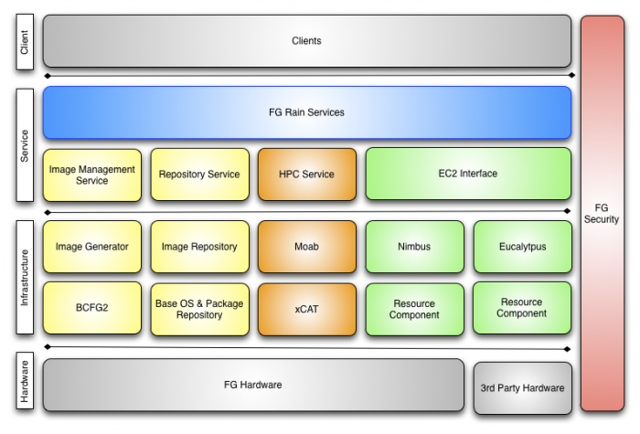
Logical View
Notes:
We will be concentrating on the YELLOW components as they make up the entire Image Management service suite.

Slide 26
Image Generator
The Image Generator is the central component of the overall management system.
Responsible for taking in user requirements about image size, type, and kind, and formatting a new image.
It will start with a base image that is selected by the user.
This image is specifically crafted by FG administrators to guarantee security and integration with the rest of FG.
It is also designed to be the smallest file footprint possible
This image is next mounted and the software stack selected is deployed onto the system, along with any other files specified.
Additional Inca monitoring and performance tools are integrated into the image already and activated upon generation.
The image generator then links the new image to the FG BCFG2 server and submits it to the image repository.

Slide 27
Image Management Service
To provide access to the Image Management system, two tools are utilized, a command line interface and a web services layer.
Such an abstraction set is absolutely necessary to provide a comprehensive service for users to generate and maintain images.
The command line interface will be implemented among the first development iteration to provide a simple interface for early users.
A more sophisticated web service will be derived to be later utilized by the FG web portal.
Furthermore, special interfaces will be developed for the system administrators to maintain the Base images and BCFG2 system.

Slide 28
Image Repository
The Image Repository is yet another fundamental and auxiliary component of the entire image management system.
The image repository is a simple abstraction that will provide a service to query, store, and update images within a central location to FG.
Once the Image Generator has finished, it will automatically preserve the new image within the image repository.
From there, the user can extract and deploy the image on any FG resource desired by the user.
Security mechanisms can occasionally extract an image and test its security using various scanning mechanisms to ensure each VM has the least possible threat level.

Slide 29
Base OS & Packages
There are a number of base images that are supported within FutureGrid.
These UNIX-based images represent the minimal installation possible within the OS itself.
There is no need to add extra packages and bloat to images
Minimize network traffic and deployment wait time.
The base OS is created as a separate .img file by FG administrators with the necessary BCFG2 client preinstalled along with any other monitoring software deemed fit by the FG Performance group.
Localized OS package repositories can be hosted within FG to minimize external network traffic and speed up system patch times.

Slide 30
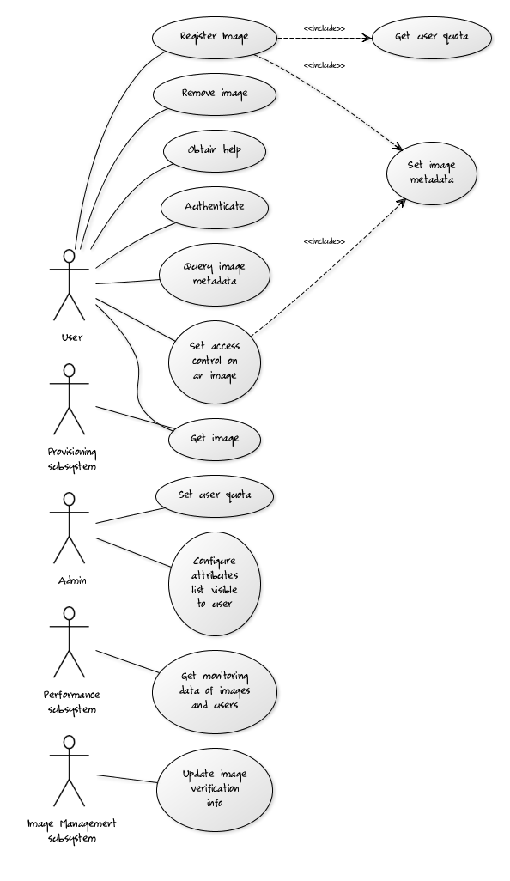
Use Case
Authenticate
Obtain help
Get list of images – metadata
Get image
Register image
Remove image
Set access control of an image
Get user quota
Set image metadata
Set user quota
Configure attributes list visible to user
Get usage data of images and users

Slide 31
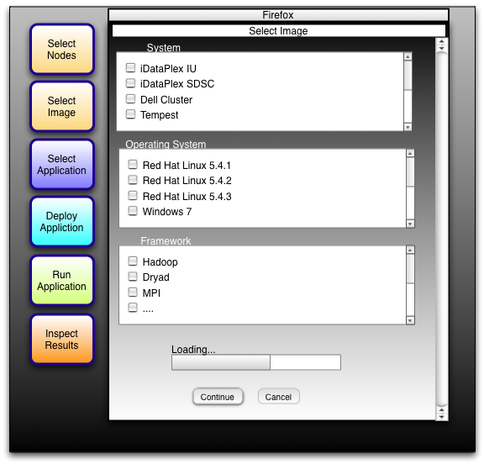
Future Grid Testbed (Dynamic Provisioning)
Text

Slide 32
FG Security Overview

Slide 33
Design Goals
Easy accounting process
User account request
Account management – update, auditing, revocation
External federated IdP
Single Sign-On on all FG resources
FG operational resources(Jira, wiki, portal…)
FG computation resources; FG services
Role based authorization
FG User, PI User, FG Developer, FG Admin, etc
Ensuring system security
OS images, running instances, networks

Slide 34
Problems
Challenges on SSO
Various systems may require different credentials.
How the credentials are used varies across different use cases. SSH key; X.509 cert for Nimbus; RESTful services
Lacking of a unique trusted CA for Eucalyptus, Nimbus. How to get one X.509 cert works on both.
Uid and group name unique across all FG sites.

Slide 35
Technologies - Accounting
LDAP
Federated IdP and services
InCommon
OpenID
CILogon
Supports InCommon and OpenID, generating proxy certificate.
If carefully configured, could replace a CA.

Slide 36
Performance Architecture
Functional Monitoring Service - Detects functional problems on FutureGrid and collects basic information about components
Performance Monitoring Service - Detects performance problems on FutureGrid by actively and passively measuring the performance of FutureGrid components.
Performance Tools - Tools provided in the user's runtime environment to help them optimize application performance.
Notes:
Three main components of the perf architecture

Slide 37
Sample Use Cases
Can users access the web portal? Fetch a VM image? Startup an experiment? …
How long does it take to generate a new VM image?
How long does it take to startup a user experiment?
What is the most commonly used VM image?
What is the performance of my application on different machines?
Notes:
Three main components of the perf architecture

Slide 38
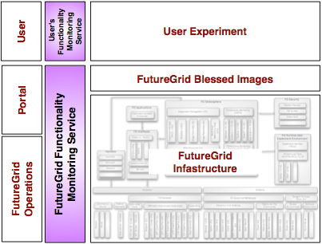
Functional Monitoring Service
Utilizes Inca (SDSC) to provide:
Automated monitoring of FutureGrid services (deployed)
Automated monitoring of FutureGrid VM images (planned)
User experiment monitoring (planned)

Slide 39
User Portal

Slide 40
FG Information Portal

Slide 41
Experiment Management
Execute Performance comparisons experiments
Repeat the experiment at a later time
Integrate workflow activities into experiments

Slide 42
Integration within TeraGrid / TeraGrid XD
Allocation: separate from TG processes for two years
It is a very exciting project, it will teak effort
TG may change, good that we can wait
We are looking for early adopters!

Slide 43
Sumary

Slide 44
FutureGrid Architecture
Fox
Later

