Slide 1
Comparison of Multiple Cloud Frameworks
Gregor von Laszewski*, Javier Diaz, Fugang Wang, Geoffrey C. Fox
Indiana University
Bloomington, IN 47408, U.S.A.
* laszewski@gmail.com

Slide 2
Workshop on Cloud Services, Federation, and the
8th Open Cirrus Summit http://fedcloud.cyberaide.org/
21 September 2012, San Jose
Deadlines
Papers Due: July 14, 2012
Author Notification: July 31, 2012
Final Papers due: August 14, 2012
Workshop: September 21, 2012

Slide 3
Bio
Gregor von Laszewski was exposed to parallel computers since 1982. Currently, he is the Assistant Director for Cloud Computing at the Community Grids Lab at Indiana University and the Software Architect of FutureGrid. He holds a PhD in Computer Science from Syracuse University. He was affiliated the past with GMD (Germany), NASA, and Argonne National Laboratory (1996-2009).
His current projects in Cloud Computing include dynamic provisioning with fg-rain and fg-move.

Slide 4
FutureGrid
Sponsored by NSF
FG provides resources
  Totaling about >3000 compute cores.
FG provides services
Research and industry is welcome
Participants
  Indiana University (Lead)
  University of Chicago
  University of Florida
  San Diego Supercomputing Center
  Texas Advanced Computing Center
  University of Virginia
  University of Tennessee
  University of Southern California
  University of Dresden
  Grid 5000.

Slide 5

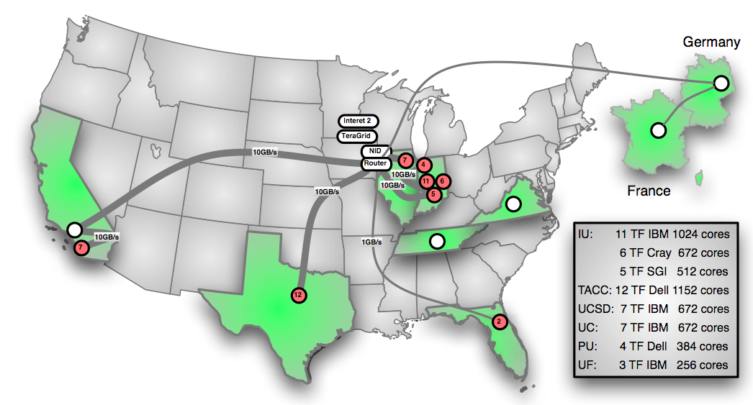
FutureGrid: a Grid/Cloud/HPC Testbed
NID: Network Impairment Device
Private
Public
FG Network

Slide 6

Selected List of Services Offered
FutureGrid
User
IaaS
Nimbus
PaaS
Hadoop
Twister
(Sphere/Sector)
MPI
Others
FG RAIN
Portal
Inca
Eucalyptus
OpenStack
OpenNebula
ViNE
HPCC
Ganglia
Exper. Manag./Pegasus
OpenMP
ScaleMP
(XD Stack)
Grid
Globus
Unicore
SAGA
Genesis II

Slide 7
Detailed Software Architecture

Slide 8
Services Offered
 | India | Sierra | Hotel | Foxtrot | Alamo | Xray | Bravo | Delta | Echo
myHadoop | ✔ | ✔ |  |  | ✔
Nimbus |  | ✔ | ✔ | ✔ | ✔
OpenStack | ✔ |  |  |  |  |  |  | ✔
Eucalyptus | ✔ | ✔
ViNe¹ | ☑ | ✔ | ☑ | ✔ | ☑
Genesis II | ✔ | ✔ |  |  | ✔ | ✔
Unicore | ✔ | ✔ |  |  |  | ✔
MPI | ✔ | ✔ | ✔ | ✔ | ✔ | ✔ | ✔
OpenMP |  |  |  |  |  | ✔
ScaleMP | ✔
Ganglia | ✔ |  | ✔
Pegasus³ | ☑ | ☑ | ☑ | ☑ | ☑
Inca | ✔ | ✔ | ✔ | ✔ | ✔ | ✔
Portal² | ☒ | ☒ | ☒ | ☒ | ☒ | ☒
PAPI |  |  |  |  |  | ✔
Vampir
ViNe can be installed on the
other resources via Nimbus ☑
Access to the resource is requested through the portal ☒
Pegasus available via Nimbus and Eucalyptus images

Slide 9
Rain in FutureGrid
http://futuregrid.org

Slide 10
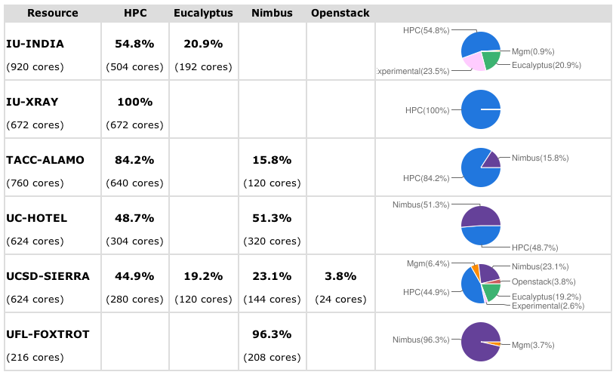
Snapshot of a Configuration

Slide 11
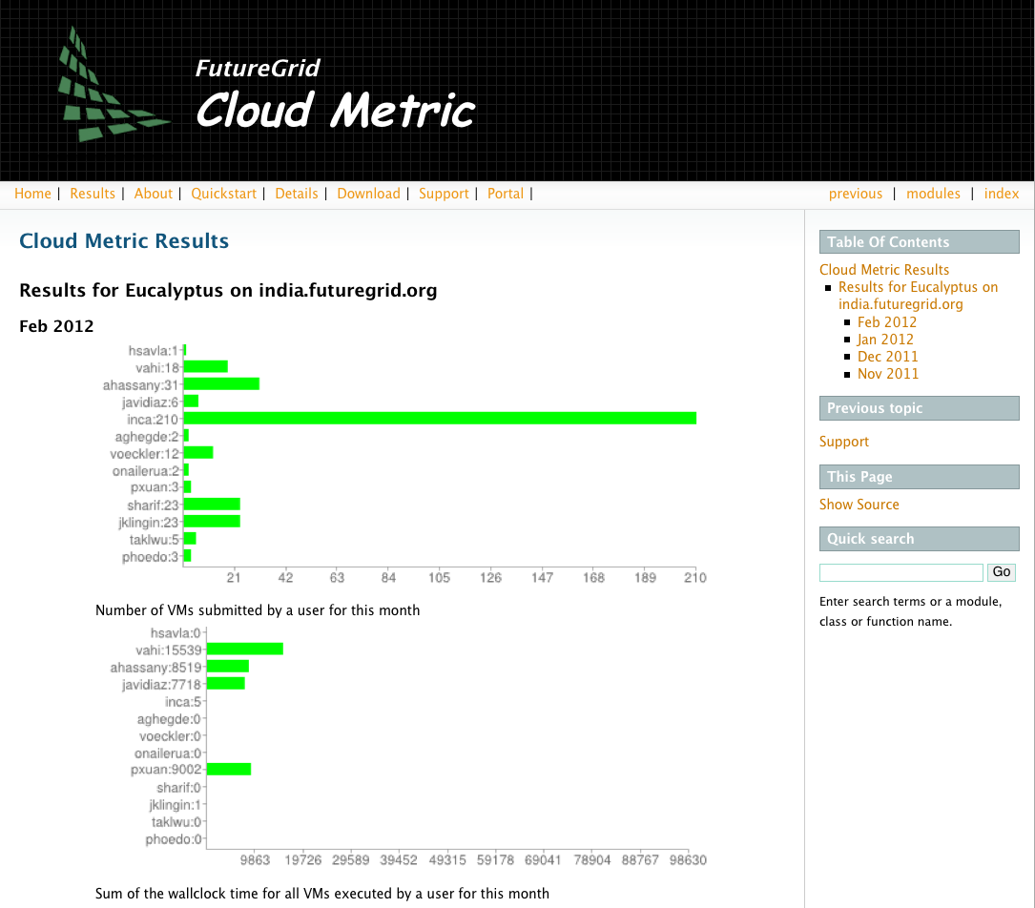
Cloud Metric

Slide 12
Selected Use Cases from Scientific Computing
Based on scale:
  virtual machines used
  computational tasksa
  number of users
  large number of concurrent resources
    to conduct actual calculations and analyses of data.
Based on robustness:
  few images, run them for a long period of time with guarantees on high-availability.

Slide 13
Questions
Resource Provider:
  Does a user need access to more than one IaaS framework?
  Which frameworks should we offer?
User
  Which IaaS framework is most suited for me?
  How can I compare these frameworks not just between each other, but also to bare-metal?
  How can I make best use of Clouds to port my applications to it?

Slide 14
User Demand Influences Deployment Requests by Projects
Values gathered during registration process
Note: We will improve the way we gather statistics in order to avoid inaccuracy during the information gathering at project and user registration time.

Slide 15
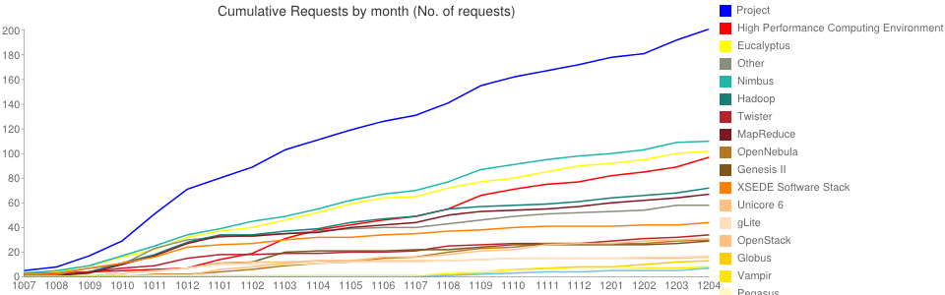
FutureGrid Technology and Project Requests
>920 Users
>220 Projects

Slide 16
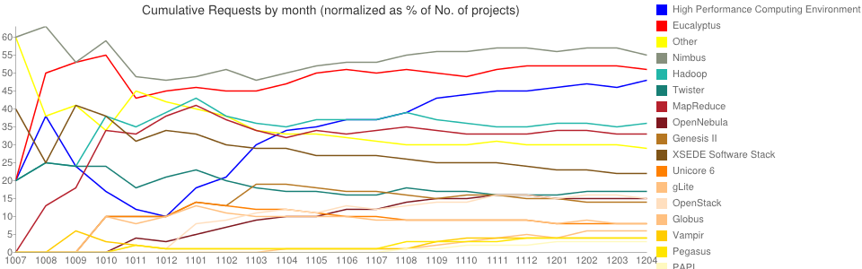
Normalized Project and Technology Requests in % of total projects

Slide 17
User Demand Influences Deployment Requests (cont.)
Note: We need to take more information than just registration information
Eucalyptus, OpenNebula have more tutorial hits than Nimbus
Not even
installed

Slide 18
Overview of Cloud IaaS Frameworks
Eucalyptus
Nimbus
OpenStack
(OpenNebula)

Slide 19
Nimbus Project
Nimbus Infrastructure:
  Open source EC2/S3-compatible Infrastructure-as-a-Service
  Focus on scientific community:
    proxy credentials, batch schedulers, best-effort allocations and others.
Nimbus Platform:
  additional tools to simplify the management
  facilitate the integration with other existing clouds (OpenStack and Amazon).
    cloudinit.d coordinates launching, controlling, and monitoring cloud applications,
    context broker service that coordinates large virtual cluster launches automatically and repeatedly

Slide 20
OpenNebula
Open source, modular
  integration with different storage and network infrastructure configurations, and hypervisor technologies
Services can deal with:
  changing re­source needs, resource additions, live migration, snapshotting, and failure of physical resources, cloud federation
Access interfaces:
  REST-based interfaces, OGF OCCI, cloud API standard, AWS EC2 API standard.
Authorization:
  passwords, ssh rsa keypairs, X.509 certificates or LDAP, fine-grained role –based ACLs
Storage:
  non-shared file systems, ssh image transfer, shared file systems (NFS, GlusterFS, Lustre) or LVM with CoW (copy-on-write)

Slide 21
OpenStack
Lots of interest by the community!
Collection of open source components
  Compute (called Nova)
  Object Storage (called Swift)
  Image Service (called Glance)
  Keystone (authorization)

Slide 22
Eucalyptus
On-premise private clouds compatible with Amazon EC2 and Amazon S3.
Cloud Controller (CLC)
  that manages the virtualized resources;
Cluster Controller (CC)
  controls the execution of VMs;
Walrus is the storage system Storage Controller (SC)
  provides block-level network storage including support for Amazon Elastic Block Storage (EBS) semantics;
  Node Controller (NC)
    installed in each compute node to control VM activities

Slide 23
Qualitative Feature Comparison of the IaaS Frameworks
Please help us to complete and work on our comparison
Send e-mail to
  laszewski@gmail.com
I am sure we have made mistakes or focused on goals different from yours that may influence the result.

Slide 24
Interfaces
✓ | OpenStack (Cactus) | EC2 and S3, Rest Interface
✓✓ | OpenStack (Essex) | EC2 and S3, Rest Interface, OCCI
✓ | Eucalyptus (2.0) | EC2 and S3, Rest Interface
✓✓ | Eucalyptus (3.1) | EC2 and S3, Rest Interface, OCCI
✓ | Nimbus | EC2 and S3, Rest Interface
✓✓✓ | OpenNebula | Native XML/RPC, EC2 and S3, OCCI, Rest Interface

Slide 25
Hypervisor
✓✓✓ | OpenStack | KVM, XEN, VMware Vsphere, LXC, UML and MS HyperV
✓✓ | Eucalyptus | KVM and XEN. VMWare in the enterprise edition.
✓ | Nimbus | KVM and XEN
✓✓ | OpenNebula | KVM, XEN and VMWare

Slide 26
Networking
✓✓✓ | OpenStack | - Two modes: (a) Flat networking (b) VLAN networking -Creates Bridges automatically -Uses IP forwarding for public IP -VMs only have private IPs
✓✓✓ | Eucalyptus | - Four modes: (a) managed; (b) managed-noLAN; (c) system; and (d) static - In (a) & (b) bridges are created automatically - IP forwarding for public IP -VMs only have private IPs
✓✓ | Nimbus | - IP assigned using a DHCP server that can be configured in two ways. Bridges must exists in the compute nodes
✓✓✓ | OpenNebula | - Networks can be defined to support Ebtable, Open vSwitch and 802.1Q tagging -Bridges must exists in the compute nodes -IP are setup inside VM

Slide 27
Software Deployment
✓ | OpenStack | - Software is composed by component that can be placed in different machines. - Compute nodes need to install OpenStack software
✓ | Eucalyptus | - Software is composed by component that can be placed in different machines. - Compute nodes need to install Eucalyptus software
✓✓ | Nimbus | Software is installed in frontend and compute nodes
✓✓✓ | OpenNebula | Software is installed in frontend

Slide 28
DevOps Deployment
✓✓✓ | OpenStack | Chef, Crowbar, (Puppet), juju
✓ | Eucalyptus | Chef*, Puppet* (*according to vendor)
 | Nimbus | no
✓✓ | OpenNebula | Chef, Puppet

Slide 29
Storage (Image Transference)
✓ | OpenStack | - Swift (http/s) - Unix filesystem (ssh)
✓ | Eucalyptus | Walrus (http/s)
✓ | Nimbus | Cumulus (http/https)
✓ | OpenNebula | Unix Filesystem (ssh, shared filesystem or LVM with CoW)

Slide 30
Authentication
✓✓✓ | OpenStack (Cactus) | X509 credentials, LDAP
✓✓ | OpenStack (Essex) | X509 credentials, (LDAP)
✓ | Eucalyptus 2.0 | X509 credentials
✓✓✓ | Eucalyptus 3.1 | X509 credentials, LDAP
✓✓ | Nimbus | X509 credentials, Grids
✓✓✓ | OpenNebula | X509 credential, ssh rsa keypair, password, LDAP

Slide 31
Avg. Release Frequency
 | OpenStack | <4month
✓ | Eucalyptus | >4 month
 | Nimbus | <4 month
✓ | OpenNebula | >6 month

Slide 32
License
✓ ✓ | OpenStack | OpenSource - Apache
 | Eucalyptus 2.0 | OpenSource ≠ Commercial (3.0)
✓ | Eucalyptus 3.1 | OpenSource, (Commercial add ons)
✓ ✓ | Nimbus | OpenSource Apache
✓ ✓ | OpenNebula | OpenSource Apache

Slide 33
Scalability Study
instantiate as many virtual machines (VM) at the same time as possible (success if all the machines have ssh access)
Our results is the time that takes to have access to all the VMs
Performance of Eucalyptus 2, OpenStack, OpenNebula and HPC
  Tests performed on India
  We had 111 physical machines for HPC
  We had up to 80 physical machines for Cloud
We used FG India cluster (and Sierra for Eucalyptus 3)
  128 Intel Xeon X5570 with 24GB of memory, a single drive of 500GB with 7200RPMm 3Gb/s and an interconnection network of 1Gbps Ethernet.
  Sierra is slower.

Slide 34
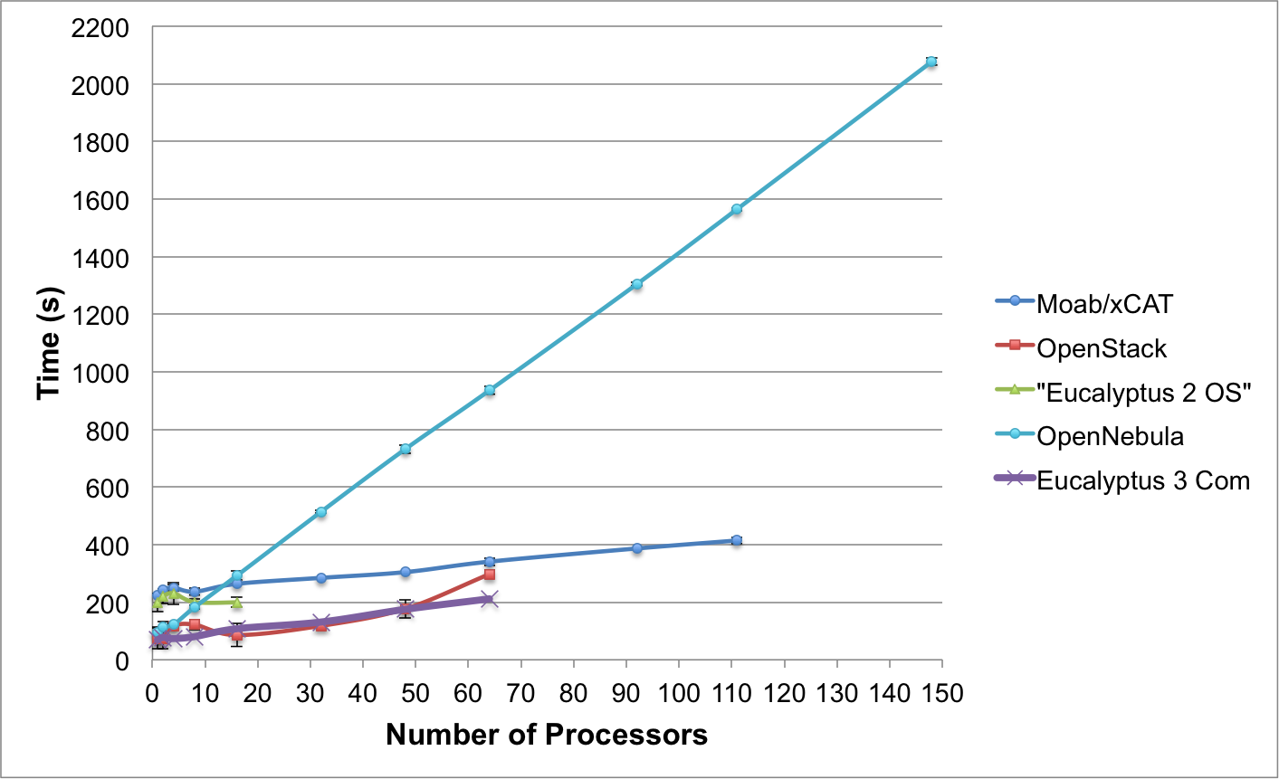
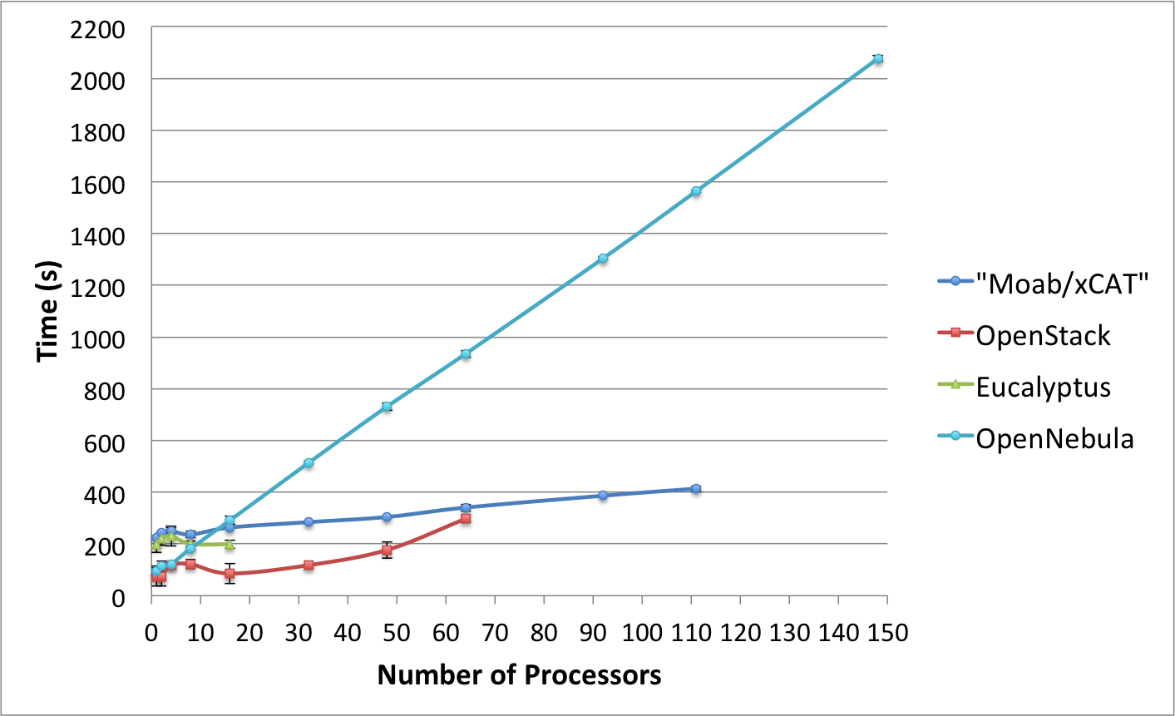
Rain Performance

Slide 35
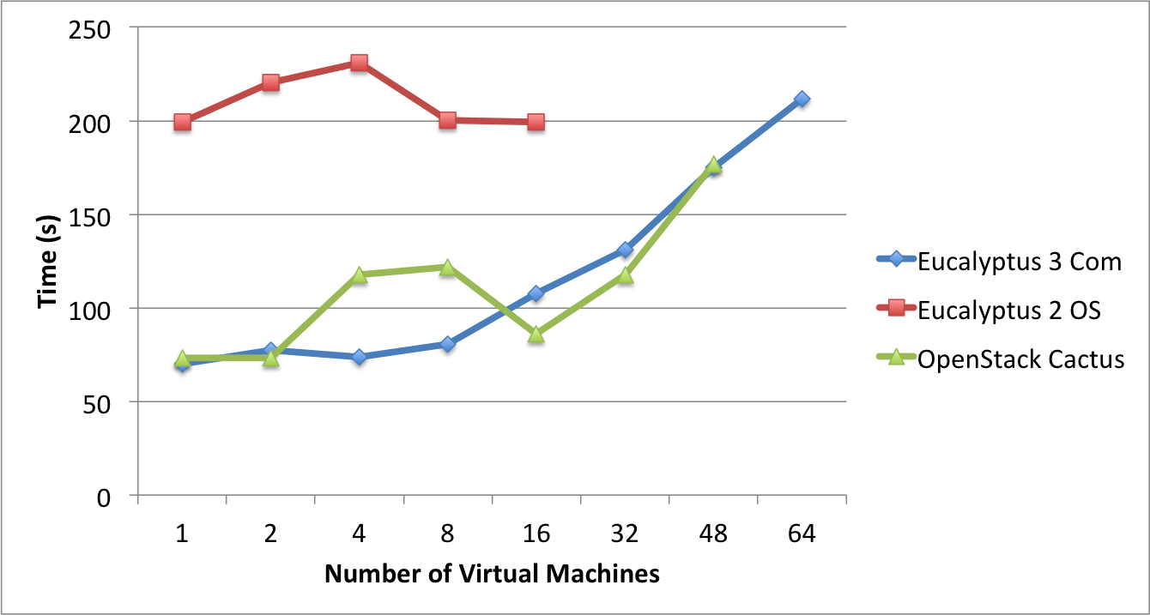
Results Eucalyptus 3, Eucalyptus 2 and OpenStack Cactus

Slide 36
OpenStack (Cactus)
Caching
  Best to cache images in the computes nodes
  If images are not cached scalability limited
  Placing images into cache was difficult due to 50% failure rate for more than 16 VMs
Scalability issues by provisioning higher number of VMs:
  Run VMs in batches of 10.
High failure rate without batch scaling
  50% above 16VMs
Network failure,
  bridges, the iptables entries or both were not created properly.
  Missing automatic assignments of public IPs

Slide 37
OpenStack (Essex)
Installation was more problematic than we anticipated
Hardware issue on our network switches
  We need tagged VLAN and PXE boot, our network switches did not support this according to our network team at IU
  We buy now new switches

Slide 38
Eucalyptus
2.03 of Eucalyptus
  Like in OpenStack, we observed similar issues with Eucalyptus while requesting larger numbers of VMs.
  Introduction of batched VM placement solves it but with a delay of 6 seconds between each of them
  Scalability issues after 16 VMs
  Issues with assigning public IP addresses
Eucalyptus 2 -> Eucalyptus 3
  Behaves much better

Slide 39
OpenNebula 3.0.0
By default does not cache images
We used SSH filetransfer
We were able to instantiate 148 VMs at the same time with almost a 100% of success.
  Very slow
  Could be improved by introducing caching

Slide 40
Conclusion (cont.)
Which IaaS question should one use?
  No clear winners
  Answer dependent on users requirements.
    Easier install: OpenNebula and Nimbus
      OpenStack and Eucalyptus have considerably improved recently on this
    Reliability: Nimbus has turned out to be very reliable,
    Popularity: OpenStack and Eucalyptus
  Rain to avoid resource starvation, dynamically add resources.

Slide 41
Next steps for you?
Apply for an account on FG and conduct your project
  projects: https://portal.futuregrid.org
Contact
  Gregor von Laszewski
  laszewski@gmail.com
Have your students/staff work with us on joined projects

