Slide 1
CReSIS Data Processing and Analysis
Jerome E. Mitchell
Indiana University - Bloomington

Slide 2
Data Processing & Analysis
CReSIS is part of BIG data revolution – will reach PB of data
Develop innovative computer vision algorithms to automate layers from radar data
Support data processing efforts
REUs involved in research from ADMI

Slide 3
Overview
Introduction
Applications
Near Surface Internal Layers
Surface and Bedrock Layers
Conclusion
What’s Next

Slide 4
Introduction
Problem
Identifying Layers requires dense hand selection
Understanding Layers in the radar images:
helps compute the ice thickness and accumulation rate maps
help studies relating to the ice sheets, their volume, and how they contribute to climate change.
Develop an automated tool for tracing Layers in radar imagery

Slide 5
Estimating Near Surface Internal Layers

Slide 6
Algorithm for Estimating Near Surface Internal Layers
Identify Ice Surface
Classify Curve Points
Active Contours (Snakes)

Slide 7
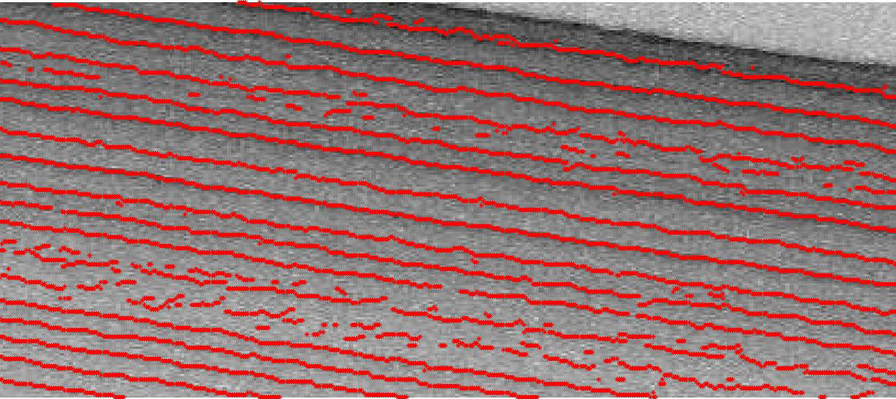
Algorithm for Estimating Near Surface Internal Layers
Identify Ice Surface
Classify Curve Points
Active Contours (Snakes)

Slide 8
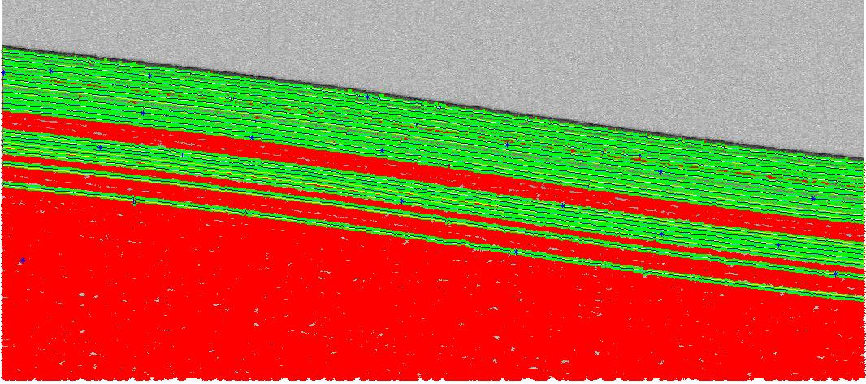
Algorithm for Estimating Near Surface Internal Layers
Identify Ice Surface
Classify Curve Points
Active Contours (Snakes)

Slide 9
Algorithm for Estimating Near Surface Internal Layers
Identify Ice Surface
Classify Curve Points
Active Contours (Snakes)

Slide 10
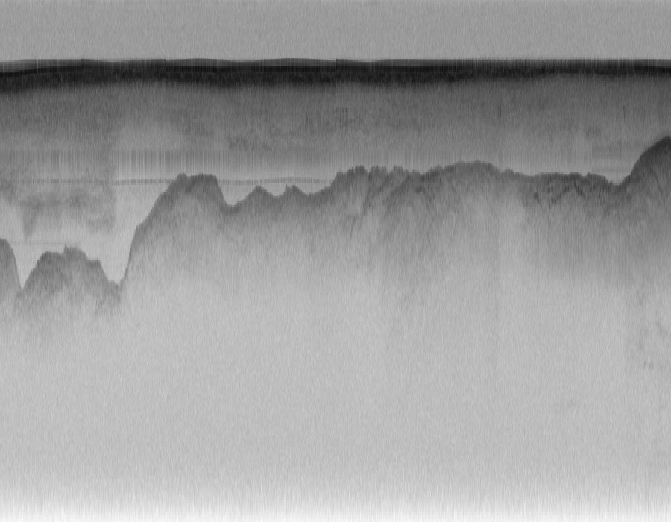
Estimating Surface and Bedrock Layers

Slide 11
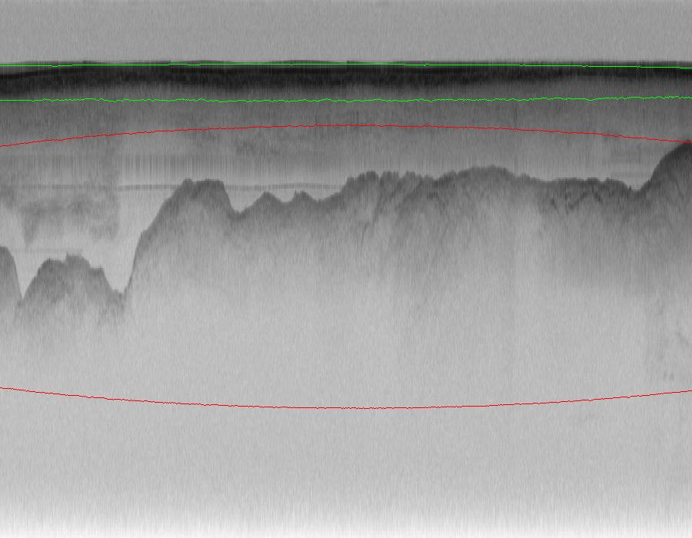
Algorithm for Estimating Surface and Bedrock
Identify an Ellipse
Active Contours (Level Sets)

Slide 12
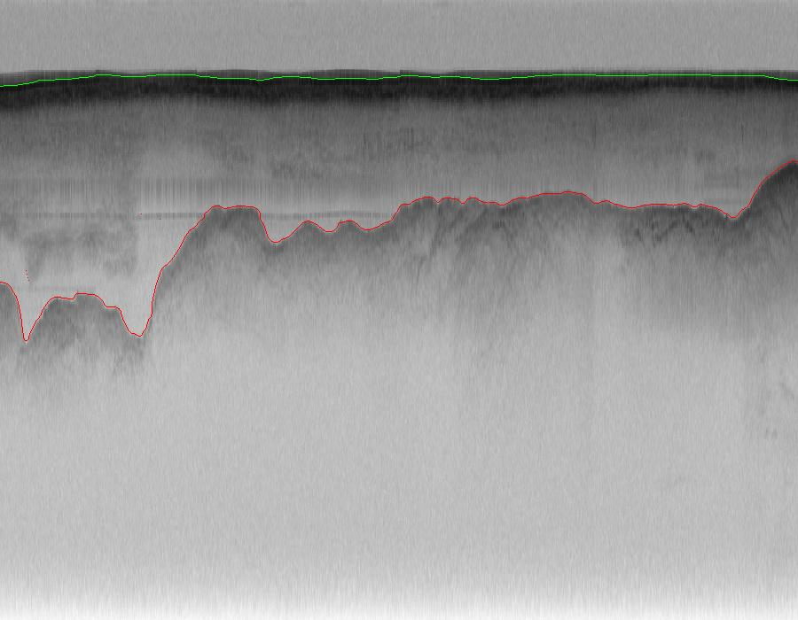
Algorithm for Estimating Surface and Bedrock
Identify an Ellipse
Active Contours (Level Sets)

Slide 13
Conclusion
Identified Near Surface Internal Layers
Snow Radar Data
Identified Surface and Bedrock Layers
Multichannel Coherent Radar Depth Sounder Data

Slide 14
What’s Next
Improve internal, surface, and bedrock detection algorithms for more data products
Learning algorithms
Incorporate meta data
Identify non layers
CReSIS Data Processing
Amazon [EC2 & S3 and Glacier] and Mathworks

