Slide 1
Using SWARM service to run a Grid based EST Sequence Assembly
Karthik Narayan
Primary Advisor : Dr. Geoffrey Fox

Slide 2
Outline
Objective
EST Sequence Assembly
The Problem
SWARM
Tools
Results
Future Work

Slide 3
Objective
Use the SWARM service and leverage the High Performance clusters for EST Sequence Assembly.

Slide 4
EST Sequence Assembly
ESTs are a collection of random cDNA sequences, sequenced from a cDNA library.
The ESTs are clustered and assembled to form contigs.
The contigs are then used to identify potential unknown genes, by Blasting against a known protein database.

Slide 5
The Problem
The input is typically large, of the order of 1 million sequences.
Memory intensive
Time consuming
Involves multiple programs

Slide 6
SWARM
A high-level job scheduling Web service framework, developed by the Pervasive Technology Institute – Indiana University.
Can submit millions of jobs to several high performance clusters and monitor their status.
extensible, lightweight, and easily installable on a desktop or small server.

Slide 7
Tools
Task | Tools
Cleaning sequence reads | Repeat Masker
Clustering sequence reads | PaCE
Assemble reads | Cap3
Similarity search | Blast

Slide 8
Repeat Masker
Developed by Institute of Systems Biology
Screens sequences for interspersed repeats and low complexity regions.
Sequence comparisons done by cross_match
Splitting of input to buckets
Post processing step

Slide 9
CAP3
Developed by Department of Computer Science, Michigan Technological University.
CAP3 is very memory intensive and cannot be run on small servers.

Slide 10
PaCE
Developed by Department of Computer Science, Iowa State University.
Clusters ESTs on parallel computers
Post-Processing step

Slide 11
CAP3
Since the clustering step is done, the load for CAP3 is considerably less, but not trivial.
No. of Sequences | No. of Clusters by PaCE
10000 | 974
20000 | 2412
150000 | 12544

Slide 12
PaCE Clusters

Slide 13
CAP3
Sort the input files, and submit the Cap3 jobs both ways.

Slide 14
CAP3
Set a threshold, and submit the files with number of sequences less than the threshold to the local machine and the others to GRID.

Slide 15
CAP3
CAP3 Job Distribution after clustering of clusters for 2 million sequences

Slide 16
BLAST
NCBI BLAST for homology search
Splitting of input to buckets
If Complete, update the status for the pipeline in the database, zip the output files and email to the User.

Slide 17
Workflow
Login and select the programs one wants to run from the list of available programs.

Slide 18
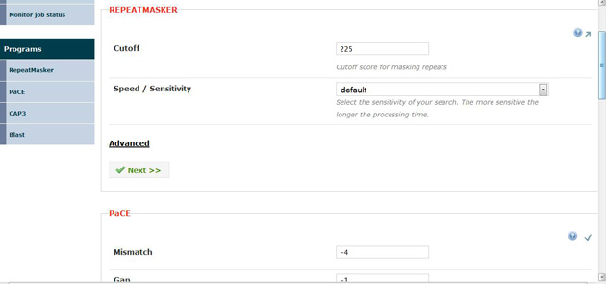
Workflow
Enter the parameters for the selected programs.

Slide 19
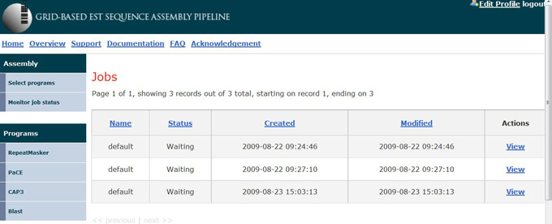
Workflow
Upload the required files, if any.
The job is then submitted to the Swarm service and a status message is displayed.
An email is sent to the user, once the job is completed.

Slide 20
Results
Assembly results for 2million sequences
No. of Sequences | Runtime for PaCE | No. of Clusters by PaCE | No. of jobs for CAP3 | Runtime for CAP3 | Total Runtime
2000000 | 01:22 hours | 75460 | 4073 | 25:44 hours | 27:06 hours

Slide 21
Results
Runtime for the entire pipeline for 2 million sequences
Program | No. Of Jobs | Run time
Repeat Masker | 1000 | 11:56
PaCE | 1 | 01:22
CAP3 | 4073 | 25:44
BLAST | 893 | 49:00

Slide 22
Validation
The Assembly results for Daphnia pulex, assembled using Swarm was compared to the assembly results of EST Piper.
Comparison of Blast results with hits greater than e value of 2 are as follows :
No. | Name | EST Piper | Swarm
1 | Number Of Contigs | 17465 | 20803
2 | Number of hits | 13216 | 15747
3 | No. of unique top hit genes | 9221 | 10329

Slide 23
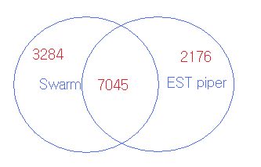
Validation
Number of genes commonly identified were 7045. That is, Swarm predicted 76.4% of the genes predicted by assembly using EST Piper.
There were 3284 genes identified by Swarm but not EST Piper.

Slide 24
Future Work
Implement assembly programs like MIRA for next-gen sequences.
Try different job scheduling strategies.
Use cloud computing resources.

