Slide 1
IEEE Cloud 2011 Panel:
Opportunities of Services Business in Cloud Age
Fundamental Research Challenges for Cloud-based Service Delivery
Gregor von Laszewski
laszewski@gmail.com
Indiana University

Slide 2
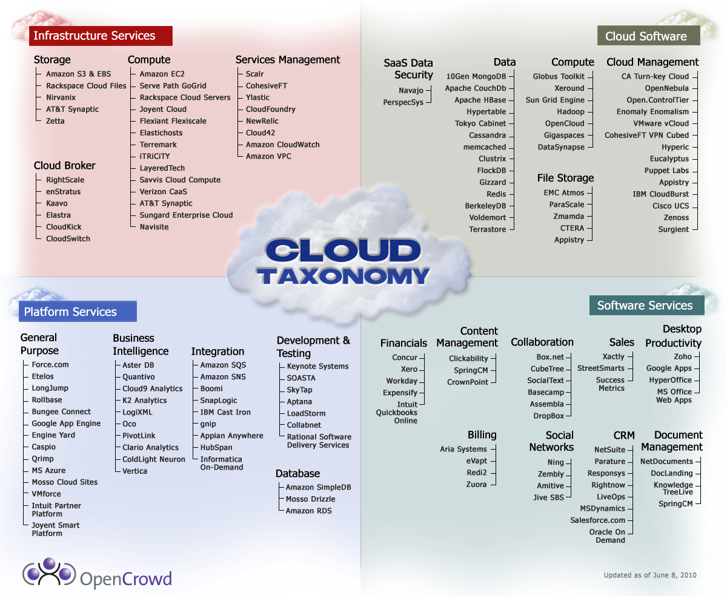

Slide 3




Challange:
Persistent Cloud Service Offerings
Cloud
Service
A
Cloud
Service
B
Cloud
Service
C

Slide 4
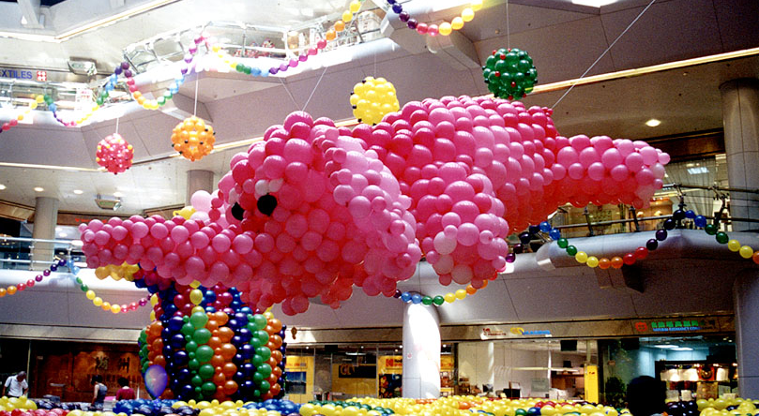
When will my SLA be compromised?

Slide 5
Example: Consumer Service Death
Google stops health service (2011)
Google stops home power meter (2011)
Microsoft stops Hohm (2011)
Why:
  No Appeal to the masses
  Privacy concerns
Can I as user risk to commit to a service?
Can I as developer commit to reusing a service?

Slide 6
Challenge: Services may not disappear but change
Facebook
Google Docs
Data cloud offereings
Development is costly
  Open Standards, Open source
  Only use proven services with enough customer base (but even that may nt protect you)

Slide 7
How do I chose which services to use for my development?
One approach for some IaaS & PaaS services:
FutureGrid
  Testbed for HPC, Grid, Cloud (11 partners)
  Provide users with the ability to compare different software stacks, cloud offerings
  Provide easy entry to cloud services
  Provide different IaaS & PaaS services
  Allow reproducible experiments
Commercial: AWS, …

Slide 8
FutureGrid Partners and Resources
  HW Resources at: Indiana University, SDSC, UC/ANL, TACC, University of Florida, Purdue,
  Software Partners: USC ISI, University of Tennessee Knoxville, University of Virginia, Technische Universtität Dresden
  However, users of FG do not have to be from these partner organizations. Furthermore, we hope that new organizations in academia and industry can partner with the project in the future.
http://futuregrid.org

Slide 9
Software Architecture

Slide 10
Cyber Ecosystem
HPC: Dedicated machines for specialized low latency high bandwidth applications
  Services expose seamless access
Grids / Clouds: Services that enable to build collaborative organizations sharing distributed resources
Clouds: Abstract resourced through efficient services that tolerate higher latency, possibly lower bandwidth

Slide 11
Some Research Issues
Standards, Interoperability
Accounting, Auditing
SLA guarantees
“Raining” proper environments on the cyberinfrastructure fabric
Data access and efficient management
Security (…. SSO …)

Slide 12

We love the cloud …

Slide 13
END

Slide 14
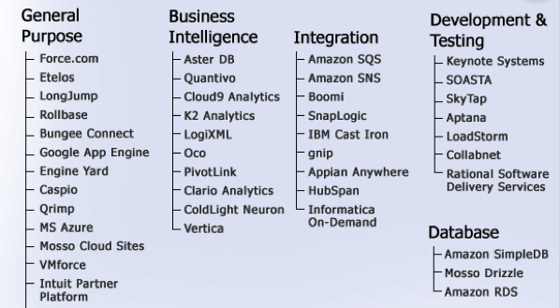

Slide 15
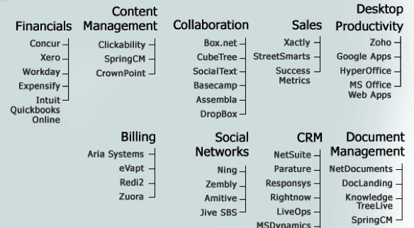

Slide 16
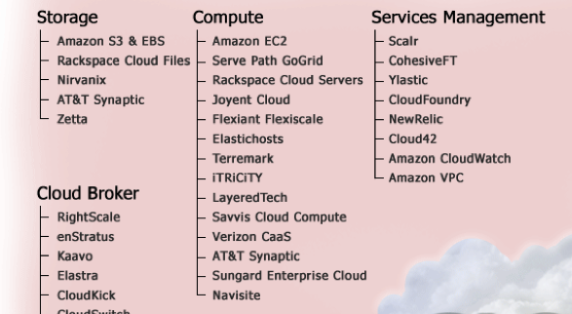

Slide 17
