Slide 1
Developing Cyberinfrastructure to Support Computational Chemistry Workflows
Marlon Pierce (IU), Suresh Marru (IU), Sudhakar Pamidighantam (NCSA) Sashikiran Challa (IU), Ye Fan (NCSA/IU), Patanachai Tangchaisin (IU)

Slide 2
Part 1: Reusable Middleware for OREChem
Services and workflows for OREChem

Slide 3
Microsoft Research’s ORECHEM Project
“A collaboration between chemistry scholars and information scientists to develop and deploy the infrastructure, services, and applications to enable new models for research and dissemination of scholarly materials in the chemistry community.”
http://research.microsoft.com/en-us/projects/orechem/

Slide 4
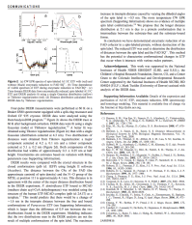
Bibliographic metadata
Citations
Figures
Tables
Chunks
NMR Spectra and Structural Data
Experiment data
PSU
Southampton
Reactions
Molecular Compounds
Cambridge
Workflows, TeraGrid
services
Indiana
Triplestore
On Azure Cloud
A not particularly accurate summary of OREChem

Slide 5
IU’s Objective
To build a pipeline to:
Fetch ORE ATOM feeds
Transform ATOM feeds into triples and store them into a triple store ( Using GRDDL/Saxon HE)
Extract crystallographically obtained 3D coordinates information
Submit compute intensive electronic structure calculations, geometry optimization tasks to tools like Gaussian09 on TeraGrid supercomputing resources.
Transform the Gaussian output into triples and store them into a triple store

Slide 6
OREChem-Computation Workflow
Convert CML to Gaussian Input format
Extract Moiety feeds in CML format
Gaussian on
TeraGrid
Moiety files
ATOM Feeds from eCrystals or CrystalEye
Gaussian Output to RDF triples
N3 files or RDF/XML
Triplestore

Slide 7
ORECHEM REST Services
Web service | Description | Input | Output
InChIExtractor | Extracts InChIs by parsing the ATOM Feed entries | ATOM feed URL | String of InChI’s
InChIto3D | Generates 3D coordinates of an InChI. (Open Babel) | InChI string | 3D coordniates in CML format
CML2Gauss | Generates Gaussian input file. (Jumbo Converters) | 3D coordinates (CML) | Gaussian input file URL
ATOM2RDF | ATOM to RDF/XML SAXON-XSLT (or GRDDL transformation) | ATOM feed URL | RDF/XML triples file URL
RDFIntoVirtuoso | Put the triples into Triple Store. (Jack-rabbit WEBDAV Client) | POST RDF/XML triples file URL | GRAPH IRI for SPARQL queries

Slide 8
ORECHEM REST Services
Web service | Description | Input | Output
FeedsHarvester | Fetch the moiety feeds from Crystal Eye. (crystal-eye harvester) | harvester name, number of feeds to be fetched | URLs of the cml.xml files
CML2GaussianSemCompChem | Generate Gaussian Input file. (Semantic Comp Chem) | POST cml.xml file URL | URL of the Gaussian Input file
http://gf18.ucs.indiana.edu:8146/FeedsHarvester/cml3d/csv?harvester=moiety&numofentries=5
http://gf18.ucs.indiana.edu:8146/CML2GaussianSemCompChem/gauss/inputgenerator

Slide 9
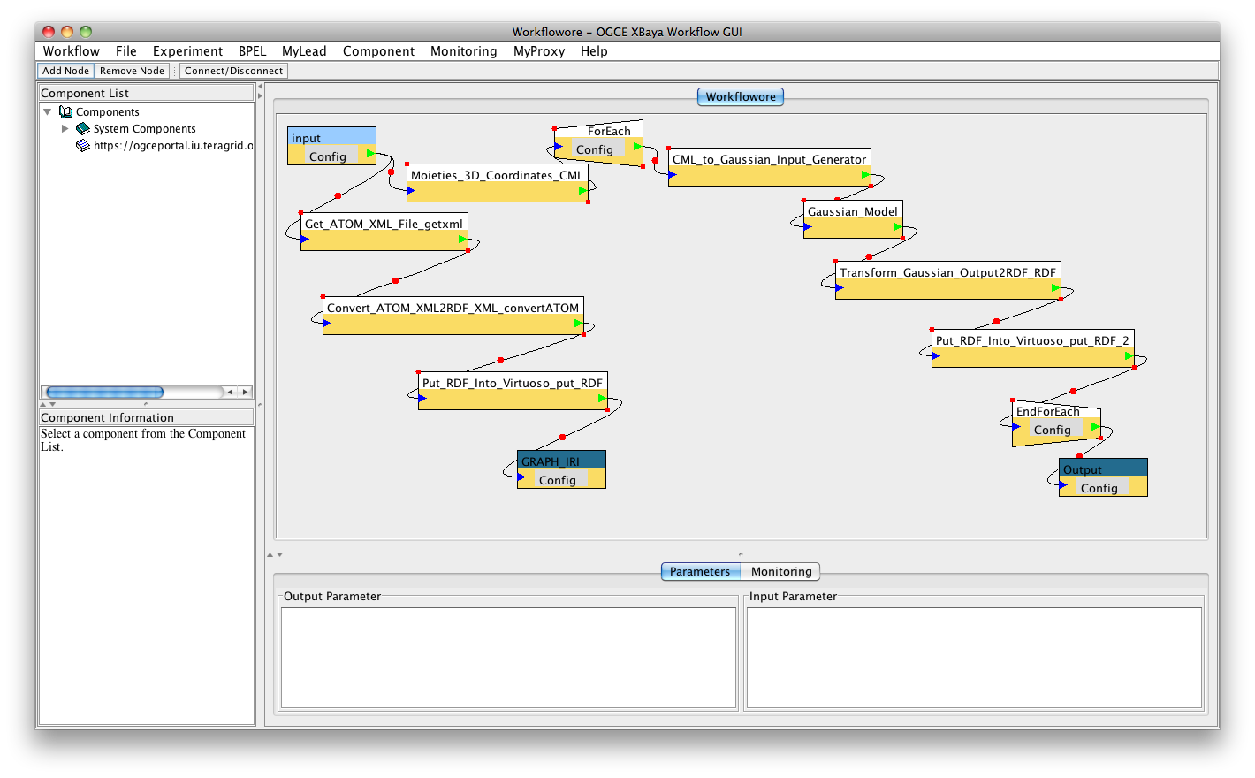
OREChem Workflow in XBaya

Slide 10
Part 2: Computational Chemistry Middleware
Reusing software from the Open Gateway Computing Environments (OGCE) Project

Slide 11
What Is a Science Gateway?
User Interface and supporting Web services to scientific applications, data sets, and resources running on cyberinfrastructure.
Science portals, Grid Computing Environments, …
Broaden and simplify usage
Cyberinfrastructure: Distributed computing resources and overlaying middleware for scientific computing.
Prominent examples include TeraGrid, Open Science Grid
Middleware includes Globus, Condor, iRods/SRB, …
Some of these approaches being pushed by scientific cloud computing
That is another topic

Slide 12
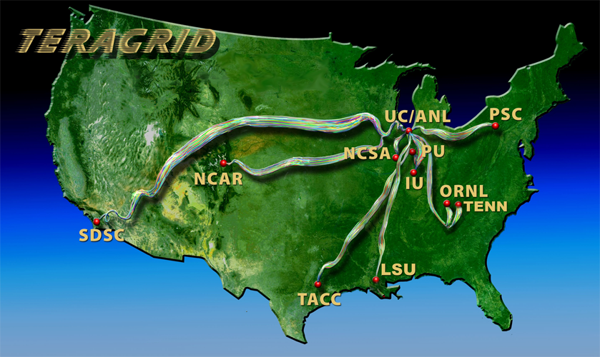
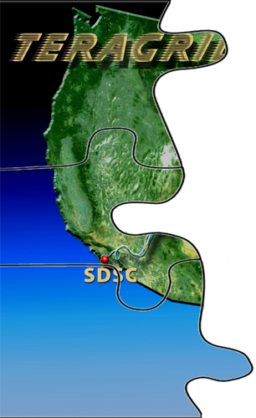
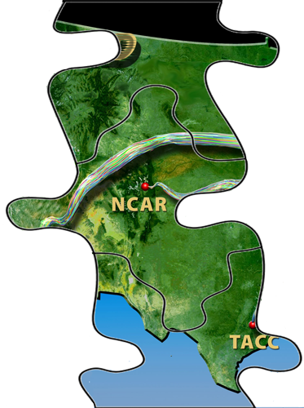
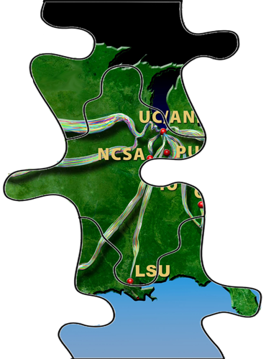
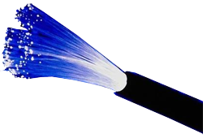
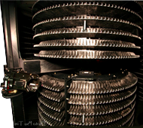
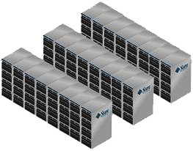
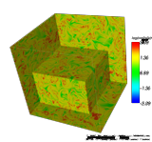
TeraGrid is one of the largest investments in shared CI from NSF’s Office of Cyberinfrastructure Soon to become TeraGrid/XD
Dedicated high-speed, cross—country network
Staff & Advanced Support
20 Petabytes Storage
2 PetaFLOPS
Computation
Visualization

Slide 13
Computational Chemistry Grid
Has a long history (S. Pamidighantam)
Started in 1998 as Quantum Chemistry Workbench
Evolved into ChemViz in NCSA Expedition Era
A pioneer of the TeraGrid Science Gateway and Community Account concepts
Manages software installations and licensing as well as middleware
Currently in two incarnations
GridChem - Science Gateway for Molecular Sciences
Production gateway
ParamChem – Automatic Parameterization of Molecular Mechanics
Infrastructure research built on GridChem

Slide 14
GridChem Science Gateway
Supported Applications
Gaussian, CHARMM, NWChem, GAMESS, Molpro, QMCPack, MD Amber, ACES, NAMD, Wien2K, Gromacs, Castep
Usage Statistics (December 2010)
431 Distinct Users
37,500 Computational jobs’ metadata in DB
Over 2,000,000 Service Units consumed
Tracked over 50 peer reviewed publications
Reportable metrics are an important issue

Slide 15
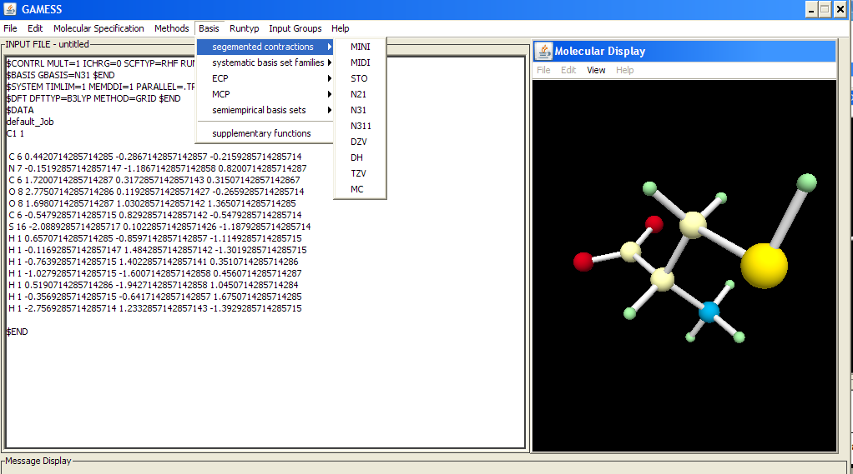
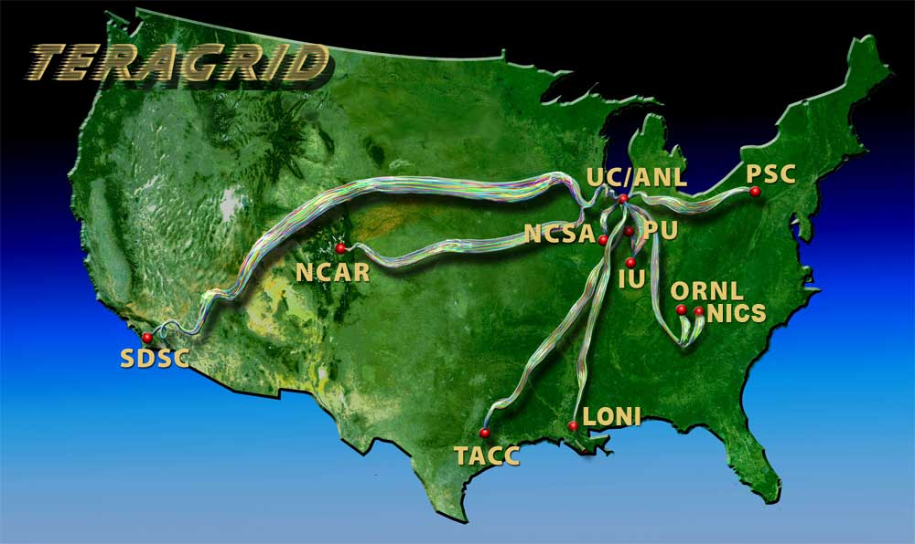
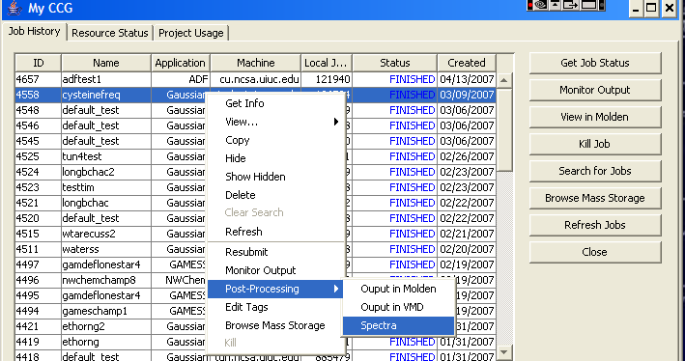
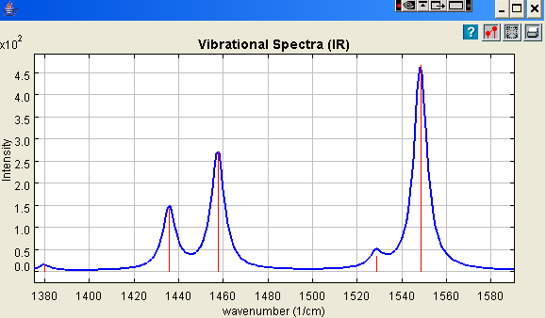
Simplified GridChem Architecture
Gaussian, GAMES & Other Molecular Editors &
Input Generators
Configure Inputs
Gaussian, CHARMM, NWChem, GAMESS, NAMD, Amber …
GridChem Client
OGCE/GridChem Middleware
Monitor
Resources
Manage Jobs
Job Managers
& Data Movement Interfaces
Submit & Monitor Jobs
Download Output
Output Analysis & Visualization

Slide 16
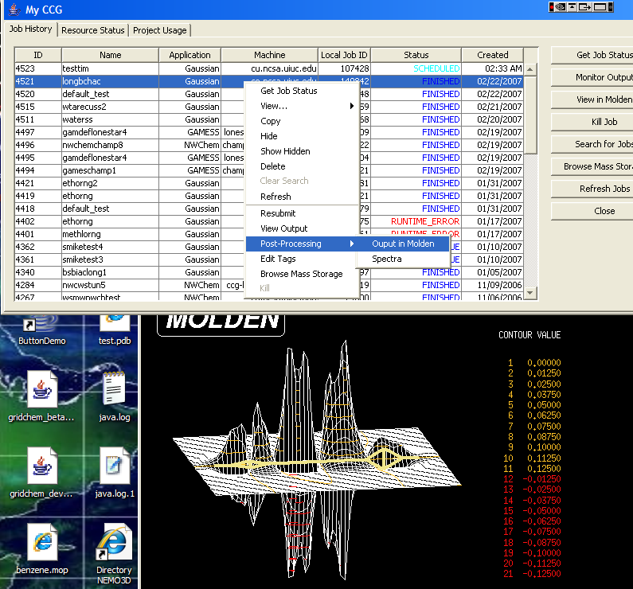
Sample GridChem Post Processing

Slide 17
Collaborations with Open Gateway Computing Environments
The OGCE has several general purpose tools that are being phased into GridChem’s production middleware.
XBaya: Graphical composition and execution of sequence of tasks.
Workflow Interpreter Service and GFAC
Supports long running executions and asynchronous invocations.
Stop, rewind, and replay executions.
Support parametric sweeps of workflows.
Integrate human interactions into workflow executions.

Slide 18
OGCE-Generalized GridChem Infrastructure
Java CoG
Abstraction
TeraGrid/XD
Globus
Molecular Editors & Input Generators
Campus Resources
DRMAA & SSH Utilities
Condor, SSH, (SLURM)
GridChem Client
OGCE Workflow & Job Management
Cloud API’s
Amazon, Eucalyptus
EC2 Interface
Other Grid Middleware
European Grids
Output Analysis and Visualization
Unicore, Open Nebula
(Requirements Driven)

Slide 19
ParamChem Overview
Collaboration between University of Maryland, NCSA, University of Kentucky, University of Florida
Goal: automate the process of parameterization for classical molecular mechanics and semi-empirical methods
These are realized as parameter sweeps of workflows.
Results disseminated through GridChem data management tools
Coupled execution of Quantum Chemistry and Molecular Mechanics.
OGCE partners with ParamChem through the NSF SDCI program to provide workflow and job management middleware.
Dynamics applications with optimization algorithms are being constructed as workflow chains.
Workflow chains are submitted as part of parametric sweeps
In progress

Slide 20
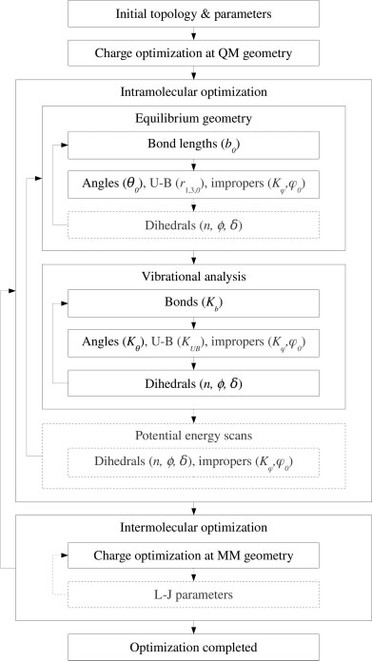
Empirical ForceFields Parameterization Need Process
Lack of Accurate Force Fields Produce Erroneous Property Estimation
Vanommeslaeghe et al.
J. Comp.Chem 2010, 31, 671-690

Slide 21
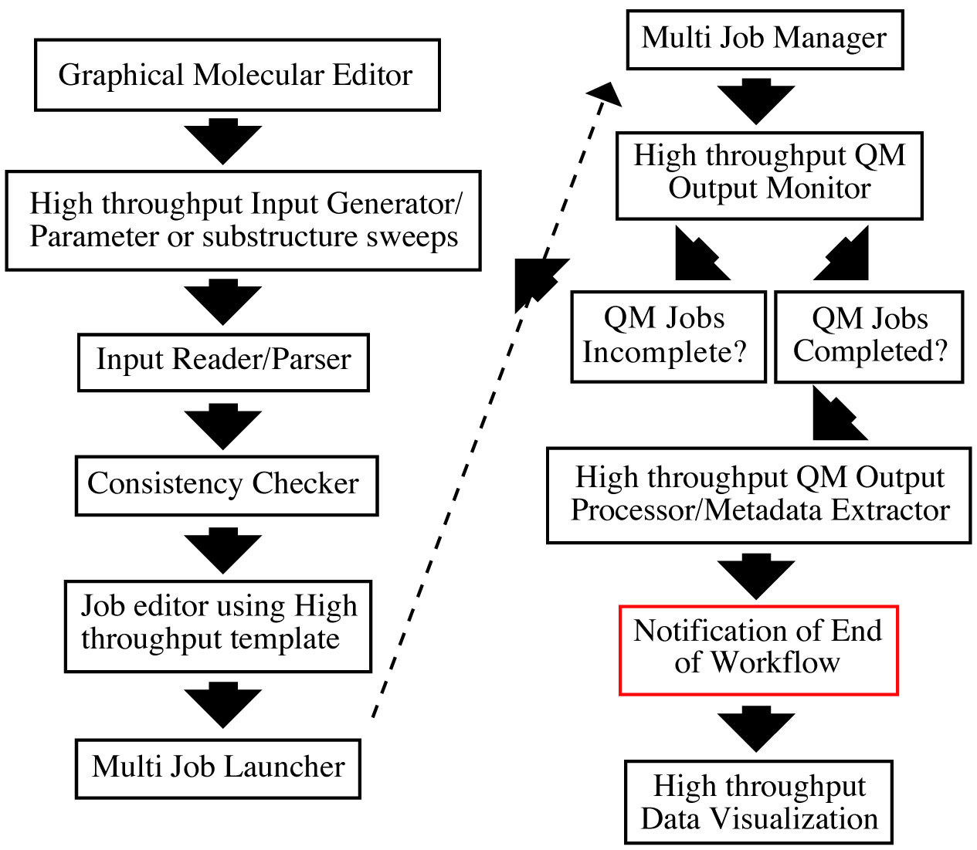
ParamChem Workflows
Initial Structure
Optimized Structure

Slide 22
ParamChem Workflow

Slide 23
Part 3: Developing Sustainable Science Gateway Software
The Open Gateway Computing Environments Project and Apache Software Foundation

Slide 24
OGCE Software
Name | Description
OGCE Gadget Container | An OpenSocial and Google gadget-compatible Web container for running Web gadgets.
GFAC | A Web service for generating, securely invoking, and managing the lifecycle of scientific applications on Grids and Clouds
Workflow Tools | Composer (XBaya), interpreter (enactment) engine, event system, and service registry to support scientific workflows on Grids and Clouds.
Gadgets and Gadget Building Tools | Tools for building secure Google-gadget based Science Gateways.
We try very hard to keep software scope under control. We don’t build data management systems, for example. We collaborate with groups who do.

Slide 25
OGCE Funds Software Lifecycle
Obvious but new of NSF as it becomes more interested in sustaining its research investments.

Slide 26
Apache Incubators
Joining Apache is our software sustainability strategy
Open source licensing, meritocracy, visibility
Apache’s community development model is our experiment
More important than simply being open source.
Need to go beyond SourceForge
Distributed control, distributed credit.
Airavata: tools for science gateway services and workflows
XBaya, GFAC, Messenger, XRegistry
Collaboration with WS02/LSF, IBM
Builds on Apache Axis2, Apache ODE, (Apache Hadoop)
Rave: OpenSocial gadget manager, general purpose gadgets
Collaboration with Hippo, Mitre, SURFnet
Builds on Apache Shindig

Slide 27
More Information
OGCE Web Site: http://www.collab-ogce.org
News Feed/Blog: http://collab-ogce.blogspot.com
Contact us:
ogce-discuss@googlegroups.com
http://groups.google.com/group/ogce-discuss/
Software Downloads: Software is available via SVN from our SourceForge project.
http://sourceforge.net/projects/ogce/
See http://www.collab-ogce.org/ogce/index.php/Portal_download

