Slide 1
Versatile HPC: Comet Virtual Clusters for the Long Tail of Science SC17 Denver Colorado
Comet Virtualization Team: Trevor Cooper, Dmitry Mishin, Christopher Irving, Gregor von Laszewski (IU) Fugang Wang (IU), Geoffrey C. Fox (IU), Phil Papadopoulos

Slide 2
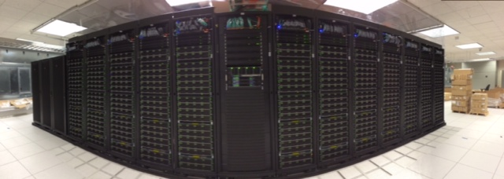
Overview
Motivation
Comet System
Virtual Cluster Design – layout, software
Benchmarks: MPI, Applications
Open Science Grid Production Usage
NSF Award# 1341698, Gateways to Discovery: Cyberinfrastructure for the Long Tail of Science
PI: Michael Norman
Co-PIs: Shawn Strande, Philip Papadopoulos, Robert Sinkovits, Nancy Wilkins-Diehr
SDSC Project in Collaboration with Indiana University (led by Geoffrey Fox)

Slide 3
Motivation for Virtual Clusters
OS and software requirements are diversifying. Growing number of user communities that can’t work in traditional HPC software environment.
Communities that have expertise and ability to utilize large clusters but need hardware.
Institutions that have bursty or intermittent need for computational resources.
Goal: Provide near bare metal HPC performance and management experience for groups that can manage their own clusters.

Slide 4
Overview of Virtual Clusters on Comet
Projects have persistent VM for cluster management
Modest: single core, 1-2 GB of RAM
Standard compute nodes will be scheduled as containers via batch system
One virtual compute node per container
Virtual disk images stored as ZFS datasets
Migrated to and from containers at job start and end
VM use allocated and tracked like regular computing

Slide 5
Enabling Technologies
KVM—Lets us run virtual machines (all processor features)
SR-IOV—Makes MPI go fast on VMs
Rocks—Systems management
ZFS—Disk image management
VLANs—Isolate virtual cluster management network
pkeys—Isolate virtual cluster IB network
Nucleus* —Coordination engine (scheduling, provisioning, status, etc.)
Client* – Cloudmesh
* Developed by our partner Indiana University

Slide 6
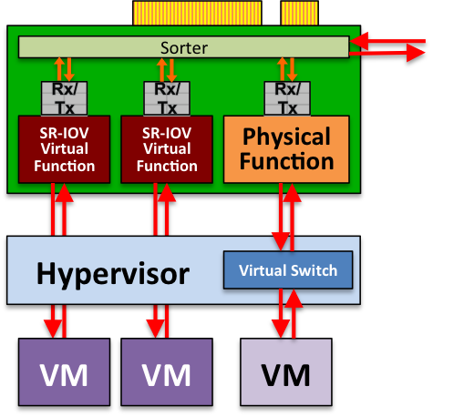
Key for Performance: Single Root I/O Virtualization (SR-IOV)
Problem: Virtualization generally has resulted in significant I/O performance degradation (e.g., excessive DMA interrupts)
Solution: SR-IOV and Mellanox ConnectX-3 InfiniBand host channel adapters
One physical function → multiple virtual functions, each light weight but with its own DMA streams, memory space, interrupts
Allows DMA to bypass hypervisor to VMs
SRIOV enables virtual HPC cluster w/ near-native InfiniBand latency/bandwidth and minimal overhead
Notes:
Virtualization → flexibility to run compute appliances:
run complex workflows with very specific application environments
tightly integrated, custom combinations of software: OS, libraries, and applications code/versions
Performance loss due to virtualized environments has been the major barrier
Virtualizing IO (DMAs) can cause excessive CPU interrupts
High-performance interconnect (InfiniBand) performance suffers
Solution: Single Root I/O Virtualization (SR-IOV) within Mellanox ConnectX-3 InfiniBand HCAs
provides technology for low-overhead DMA to virtual machines
non-proprietary industry standard: provides virtual functions for PCIe devices

Slide 7
User-Customized HPC 1:1 physical-to-virtual compute node
public network
physical
virtual
virtual
Virtual Frontend
Hosting
Frontend
Disk Image Vault
Virtual
Frontend
Virtual
Frontend
private
private
private
Compute
Compute
Compute
Virtual
Compute
Compute
Compute
Compute
Virtual
Compute
Virtual
Compute
Virtual
Compute
Compute
Compute
Compute
Virtual
Compute
Virtual
Compute

Slide 8
High Performance Virtual Cluster Characteristics
Comet: Providing
Virtualized HPC for XSEDE
Infiniband
Virtual
Frontend
Infiniband Virtualization
8% latency overhead.
Nominal bandwidth overhead
private
Ethernet
All nodes have
Private Ethernet
Infiniband
Local Disk Storage
Virtual Compute Nodes can Network boot (PXE) from its virtual frontend
All Disks retain state
keep user configuration between boots
Virtual
Compute
Virtual
Compute
Virtual
Compute

Slide 9
Data Storage/Filesystems
Local SSD storage on each compute node
Limited number of large SSD nodes (1.4TB) for large VM images
Local (SDSC) network access same as compute nodes
Modest (TB) storage available via NFS now
Future: Secure access to Lustre?

Slide 10
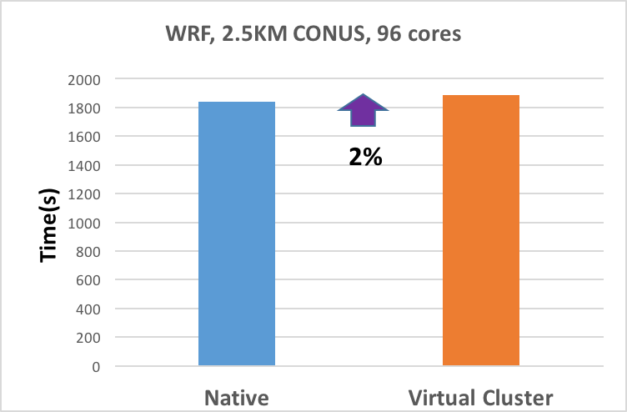
WRF Weather Modeling
96-core (4-node) calculation
Nearest-neighbor communication
Test Case: 3hr Forecast, 2.5km resolution of Continental US (CONUS).
Scalable algorithms
2% slower w/ SR-IOV vs native IB.
WRF 3.4.1 – 3hr forecast
Notes:
WRF is a mesoscale numerical weather prediction system used for both research and operational purposes
Predominantly nearest-neighbor communication
96 cores (6 nodes)
Simulate 3 hr forecast
WRF CONUS-12km benchmark. The domain is 12 KM horizontal resolution on a 425 by 300 grid with 35 vertical levels, with a time step of 72 seconds.
Run using six nodes (96 cores) over QDR4X InfiniBand virtualized with SR-IOV.
SR-IOV test cluster has 2.2 GHz Intel(R) Xeon E5-2660 processors.
Amazon instances were using 2.6 GHz Intel(R) Xeon E5-2670 processors.

Slide 11
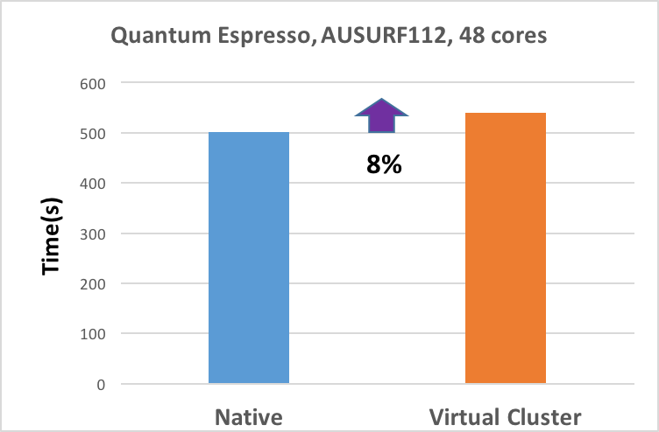
Quantum ESPRESSO
48-core (3 node) calculation
CG matrix inversion - irregular communication
3D FFT matrix transposes (all-to-all communication)
Test Case: DEISA AUSURF 112 benchmark.
8% slower w/ SR-IOV vs native IB.
Notes:
Open-source electronic-structure (DFT) calculation code
DEISA's AUSURF112 benchmark (3 nodes, 48 cores)
112 Au atoms, ultrasoft pseudo-potential, plane wave basis sets
Lots of matrix diagonalization, FFTs
Semi-local, all-to-all communication
DEISA AUSURF 112 benchmark w/ Quantum ESPRESSO.
Matrix diagonalization done with conjugate gradient algorithm. Communication overhead larger than WRF.
3D Fourier transforms stress the interconnect because they perform multiple matrix transpose operations where every MPI rank needs to send and receive all of its data to every other MPI rank.
These global collectives cause interconnect congestion, and efficient 3D FFTs are limited by the bisection bandwidth of the entire fabric connecting all of the compute nodes.

Slide 12
User Perspective User is a system administrator –we give them their own HPC cluster
Active virtual compute nodes
Scheduling
Storage management
Coordinating network changes
VM launch & shutdown
Attached and synchronized
Nucleus
Disk images
API
Request nodes
Console & power
Persistent virtual front end
Idle disk images

Slide 13
Cloudmesh Developed by IU collaborators
Cloudmesh client enables access to multiple cloud environments from a command shell and command line.
We leverage this easy to use CLI, allowing the use of Comet as infrastructure for virtual cluster management.
Cloudmesh has more functionality with ability to access hybrid clouds OpenStack, (EC2, AWS, Azure); possible to extend to other systems like Jetstream, Bridges etc.
Plans for customizable launchers available through command line or browser – can target specific application user communities.
Reference: https://github.com/cloudmesh/client

Slide 14
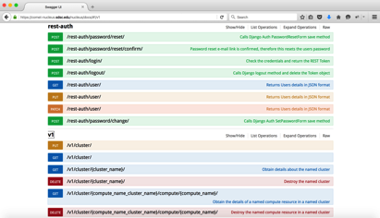
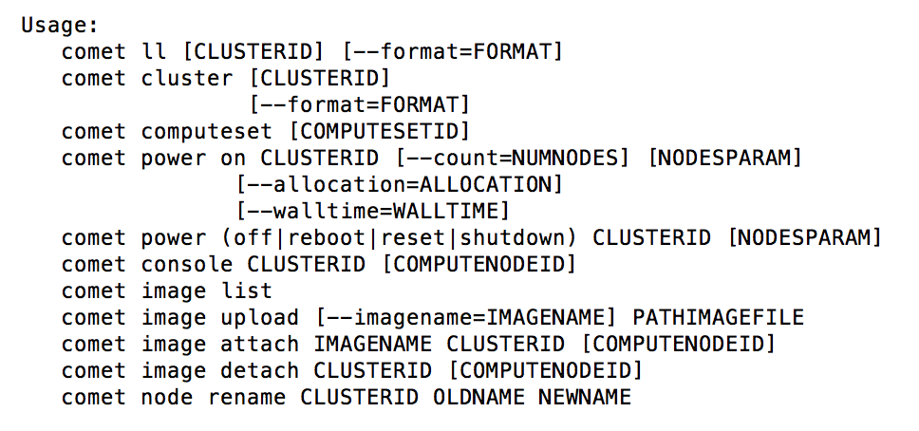
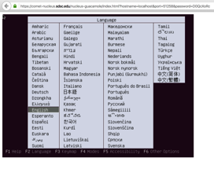
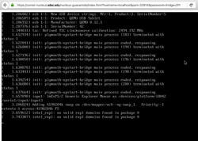
Accessing Virtual Cluster Capabilities
REST API
Command line interface
Command shell for scripting
Console Access
(Portal)
User does NOT see: Rocks, Slurm, etc.

Slide 15
Cloudmesh supports Continuous Improvement

Slide 16
Layered Architecture

Slide 17
Cloudmesh Architecture
Extensible
Layered
Useful abstractions

Slide 18
Cloudmesh – virtual cluster
$ cm default cloud=$CLOUDNAME $ cm cluster create --count 4
$ cm stack compose create
$ cm stack compose add hadoop
$ cm stack compose add spark --deployer ansible
$ cm stack deploy

Slide 19
Cloudmesh supports NIST Big Data Architecture
IaaS support
PaaS support
Integration of a variety of technologies through stacks
No vendor lock in

Slide 20
Virtual Cluster projects
Open Science Grid: University of California, San Diego, Frank Wuerthwein (in production)
Virtual cluster for PRAGMA/GLEON lake expedition - University of Florida, Renato Figueiredo
Deploying the Lifemapper species modeling Platform with Virtual Clusters on Comet: University of Kansas, James Beach
Adolescent Brain Cognitive Development Study: NIH funded, 19 institutions.

Slide 21
Production use of Comet Virtual Clusters via the Open Science Grid (OSG) Slides Credit: Frank Würthwein OSG Executive Director UCSD/SDSC

Slide 22
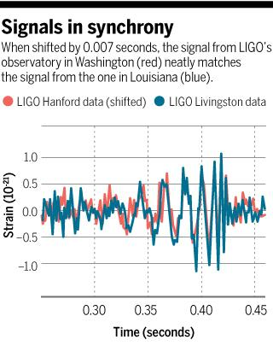
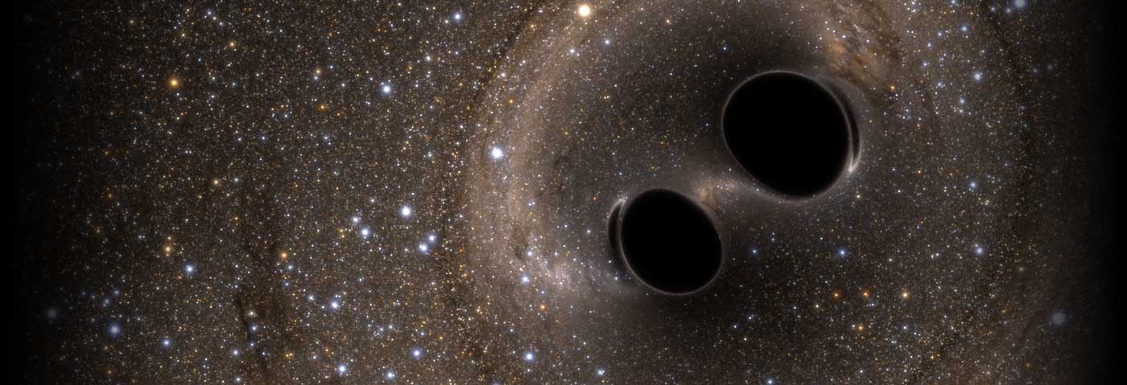
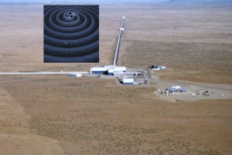
Comet’s Virtual Cluster Used to Confirm Gravitational Wave Discovery
COMET delivered 700,000 core-hours to LIGO

Slide 23
OSG supports computing across different types of resources
Local Cluster
National Supercomputer
Allocation
Collaborator’s Cluster
OSG
Metascheduling
Service
Access Point
sharing
Nationally Shared Clusters
OSG creates a uniform environment across a heterogeneous set of resources that is distributed globally
Submit locally – Run Globally
purchasing
Commercial Cloud

Slide 24
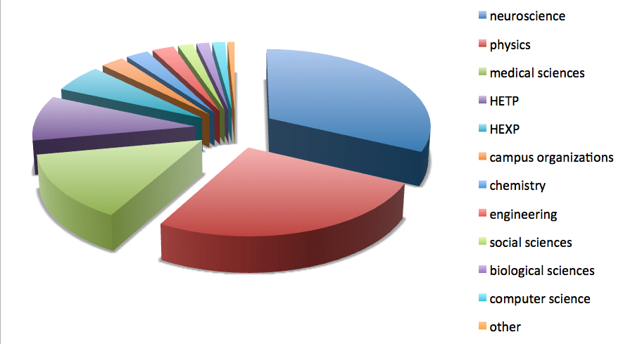
OSG on Comet
62 projects with PIs from 31 institutions
consumed a total of 3.5 Million hours in 3 months

Slide 25
OSG Comments on the VC Interface
The VC interface is a very powerful tool for experts.
Working with it requires system administration skills
Makes sense if you have an environment that you want to make available to your community
Was very easy for OSG to use the VC interface.
a day or two and we were running close to the full diversity of science on the VC onramp environment.
Having access to a virtual cluster on Comet that can be customized opens the door for a whole new set of applications we were never able to support before.
MPI, SPARK, large memory, …

Slide 26
Backup

Slide 27
Comet Network Architecture InfiniBand compute, Ethernet Storage
Management
Gateway Hosts
Login
Data Mover
Home File Systems VM Image Repository
Node-Local
Storage
320 GB
72 HSWL
18
Internet 2
27 racks
4
Core InfiniBand
(2 x 108-port)
FDR 36p
320 GB
72 HSWL
FDR
18
switches
FDR
72
2*36
FDR
Juniper
100 Gbps
FDR 36p
72
IB-Ethernet Bridges (4 x 18-port each)
Research and Education Network Access
Data Movers
36 GPU
Mid-tier
InfiniBand
4
Arista
40GbE (2x)
4 Large-Memory
4*18
40GbE
Arista
40GbE
(2x)
Data Mover Nodes
64
40GbE
128
10GbE
72 HSWL
18
Additional Support Components (not shown for clarity)
Ethernet Mgt Network (10 GbE)
7x 36-port FDR in each rack wired as full fat-tree. 4:1 over subscription between racks.
Performance Storage
7.7 PB, 200 GB/s
32 storage servers
Durable Storage
6 PB, 100 GB/s
64 storage servers

Slide 28
Comet: System Characteristics
Total peak flops ~2.1 PF
Dell primary integrator
Intel Haswell processors w/ AVX2
Mellanox FDR InfiniBand
1,944 standard compute nodes (46,656 cores)
Dual CPUs, each 12-core, 2.5 GHz
128 GB DDR4 2133 MHz DRAM
2*160GB GB SSDs (local disk)
36 GPU nodes
Same as standard nodes plus
Two NVIDIA K80 cards, each with dual Kepler3 GPUs
4 large-memory nodes
1.5 TB DDR4 1866 MHz DRAM
Four Haswell processors/node
64 cores/node
Hybrid fat-tree topology
FDR (56 Gbps) InfiniBand
Rack-level (72 nodes, 1,728 cores) full bisection bandwidth
4:1 oversubscription cross-rack
Performance Storage (Aeon)
7.6 PB, 200 GB/s; Lustre
Scratch & Persistent Storage segments
Durable Storage (Aeon)
6 PB, 100 GB/s; Lustre
Automatic backups of critical data
Home directory storage
Gateway hosting nodes
Virtual image repository
100 Gbps external connectivity to Internet2 & ESNet

Slide 29
Comet Cloudmesh Client (selected commands)
cm comet cluster ID
Show the cluster details
cm comet power on ID vm-ID -[0-3] --walltime=6h
Power 3 nodes on for 6 hours
cm comet image attach image.iso ID vm-ID-0
Attach an image
cm comet boot ID vm-ID-0
Boot node 0
cm comet console vc4
Console

Slide 30
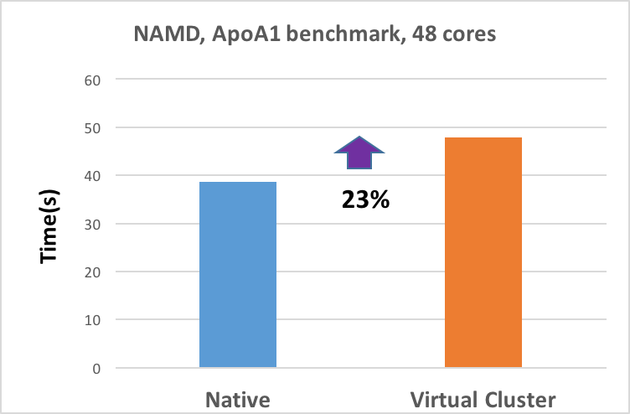
NAMD: Molecular Dynamics, ApoA1 Benchmark
48-core (2 node) calculation
Test Case: ApoA1 benchmark.
92,224 atoms, periodic, PME.
Binary used: NAMD 2.11, ibverbs, SMP.
Directly used prebuilt binary which uses ibverbs for multi-node runs.
23% slower w/ SR-IOV vs native IB.
Notes:
Open-source electronic-structure (DFT) calculation code
DEISA's AUSURF112 benchmark (3 nodes, 48 cores)
112 Au atoms, ultrasoft pseudo-potential, plane wave basis sets
Lots of matrix diagonalization, FFTs
Semi-local, all-to-all communication
DEISA AUSURF 112 benchmark w/ Quantum ESPRESSO.
Matrix diagonalization done with conjugate gradient algorithm. Communication overhead larger than WRF.
3D Fourier transforms stress the interconnect because they perform multiple matrix transpose operations where every MPI rank needs to send and receive all of its data to every other MPI rank.
These global collectives cause interconnect congestion, and efficient 3D FFTs are limited by the bisection bandwidth of the entire fabric connecting all of the compute nodes.

Slide 31
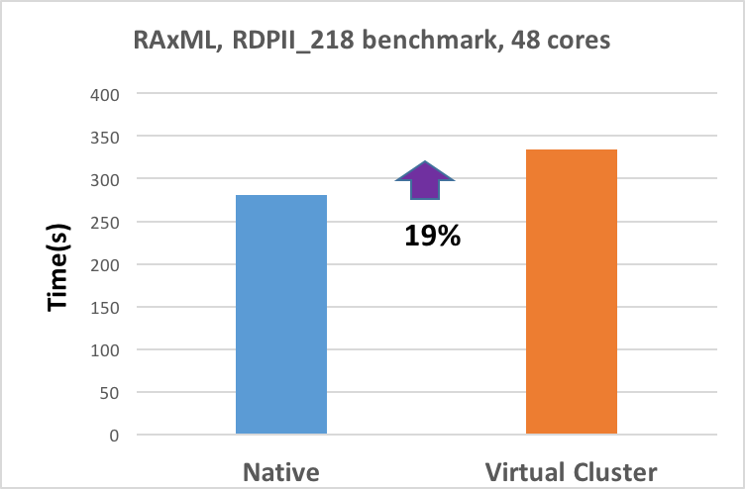
RAxML: Code for Maximum Likelihood-based inference of large phylogenetic trees.
Widely used, including by CIPRES gateway.
48-core (2 node) calculation
Hybrid MPI/Pthreads Code.
12 MPI tasks, 4 threads per task.
Compilers: gcc + mvapich2 v2.2, AVX options.
Test Case: Comprehensive analysis, 218 taxa, 2,294 characters, 1,846 patterns, 100 bootstraps specified.
19% slower w/ SR-IOV vs native IB.
Notes:
Open-source electronic-structure (DFT) calculation code
DEISA's AUSURF112 benchmark (3 nodes, 48 cores)
112 Au atoms, ultrasoft pseudo-potential, plane wave basis sets
Lots of matrix diagonalization, FFTs
Semi-local, all-to-all communication
DEISA AUSURF 112 benchmark w/ Quantum ESPRESSO.
Matrix diagonalization done with conjugate gradient algorithm. Communication overhead larger than WRF.
3D Fourier transforms stress the interconnect because they perform multiple matrix transpose operations where every MPI rank needs to send and receive all of its data to every other MPI rank.
These global collectives cause interconnect congestion, and efficient 3D FFTs are limited by the bisection bandwidth of the entire fabric connecting all of the compute nodes.

Slide 32
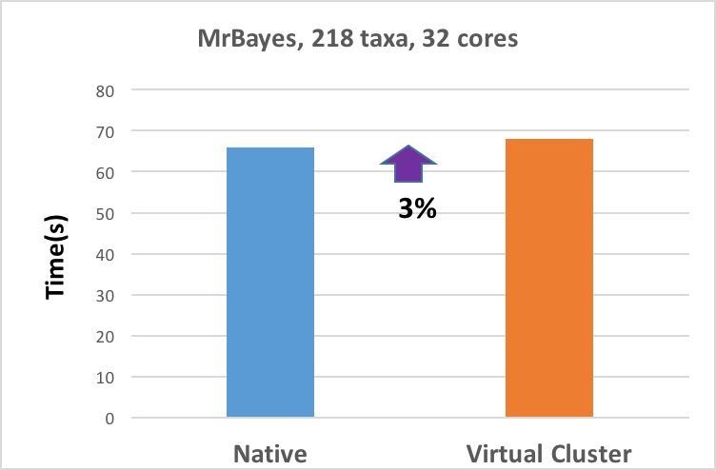
MrBayes: Software for Bayesian inference of phylogeny.
Widely used, including by CIPRES gateway.
32-core (2 node) calculation
Hybrid MPI/OpenMP Code.
8 MPI tasks, 4 OpenMP threads per task.
Compilers: gcc + mvapich2 v2.2, AVX options.
Test Case: 218 taxa, 10,000 generations.
3% slower with SR-IOV vs native IB.
Notes:
Open-source electronic-structure (DFT) calculation code
DEISA's AUSURF112 benchmark (3 nodes, 48 cores)
112 Au atoms, ultrasoft pseudo-potential, plane wave basis sets
Lots of matrix diagonalization, FFTs
Semi-local, all-to-all communication
DEISA AUSURF 112 benchmark w/ Quantum ESPRESSO.
Matrix diagonalization done with conjugate gradient algorithm. Communication overhead larger than WRF.
3D Fourier transforms stress the interconnect because they perform multiple matrix transpose operations where every MPI rank needs to send and receive all of its data to every other MPI rank.
These global collectives cause interconnect congestion, and efficient 3D FFTs are limited by the bisection bandwidth of the entire fabric connecting all of the compute nodes.

Slide 33
Cloudmesh, Comet and Virtual Clusters
CCvC
Gregor von Laszewski
laszewski@gmail.com
https://github.com/cloudmesh/client

Slide 34
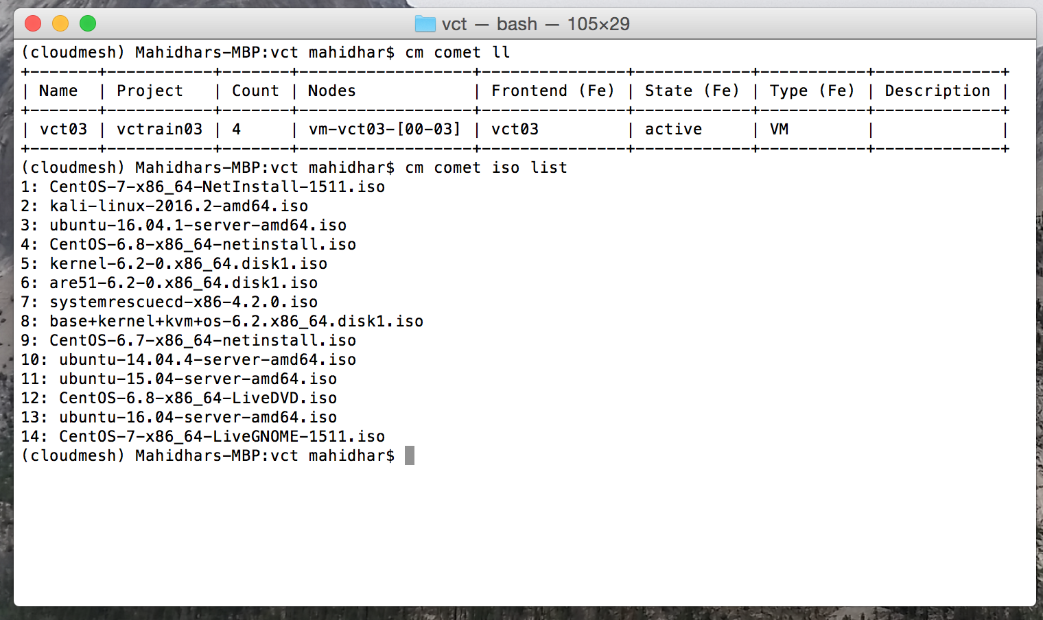
Comet Cloudmesh Usage Examples

Slide 35
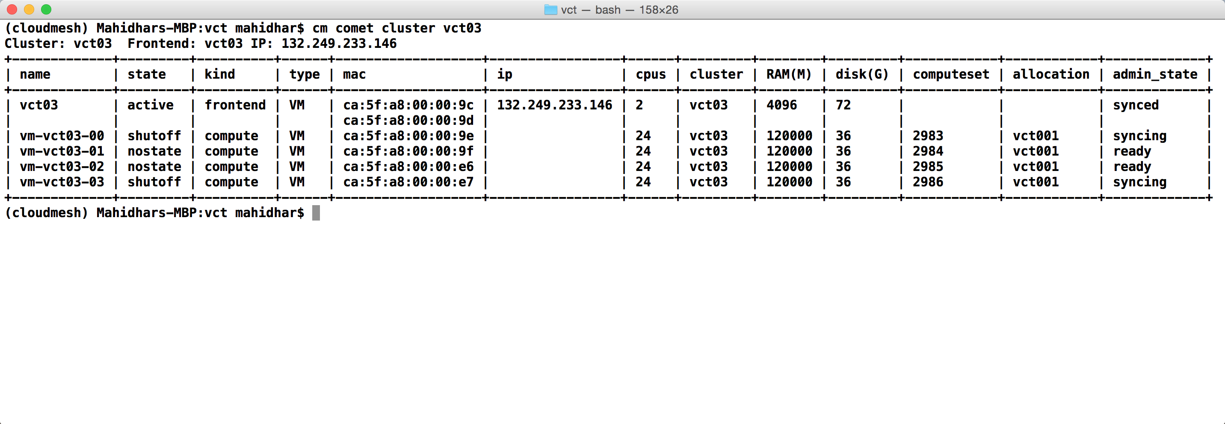
Comet Cloudmesh Usage Examples

Slide 36
Summary
Virtual clusters on Comet provide an opportunity for communities to set up custom OS and software stack.
Command line and web based interface to manage clusters. Console access is available.
Preserves performance of HPC infrastructure while opening up virtualization options. Confirmed by application benchmarks.
Significant production use on Comet by Open Science Grid (OSG).
Additional projects in the pipeline

Slide 37
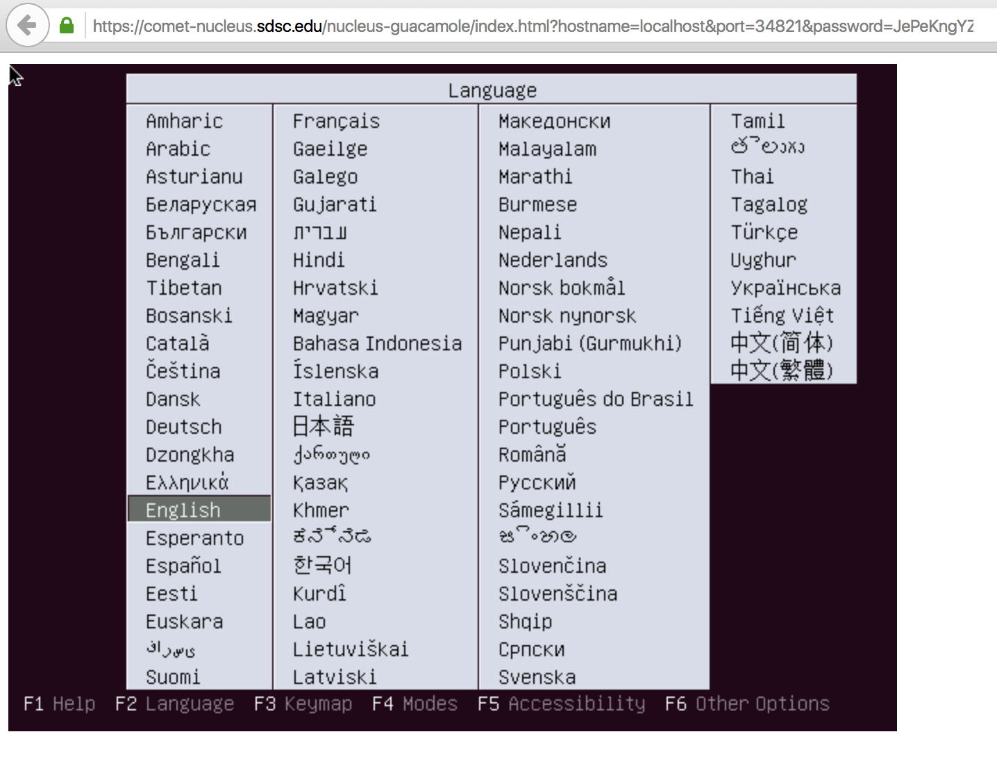
Comet Cloudmesh Client : Console access
(COMET)host:client$ cm comet console vc4 vm-vc4-0

Slide 38
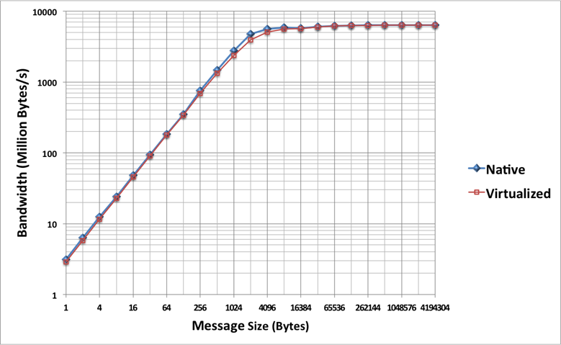
MPI bandwidth slowdown from SR-IOV is at most 1.21 for medium-sized messages & negligible for small & large ones

Slide 39
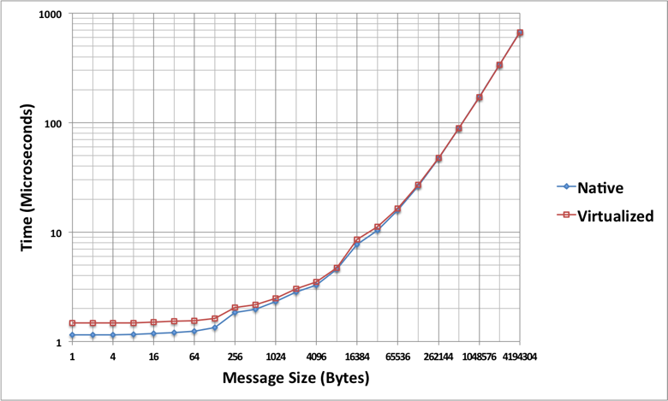
MPI latency slowdown from SR-IOV is at most 1.32 for small messages & negligible for large ones

