Slide 1
Scalable High Performance
Dimension Reduction
Thesis Defense, Jan. 17, 2012
Student: Seung-Hee Bae
Advisor: Dr. Geoffrey C. Fox
School of Informatics and Computing
Pervasive Technology Institute
Indiana University

Slide 2
Outline
Motivation & Issues
Multidimensional Scaling (MDS)
Parallel MDS
Interpolation of MDS
DA-SMACOF
Conclusion & Future Works
References

Slide 3
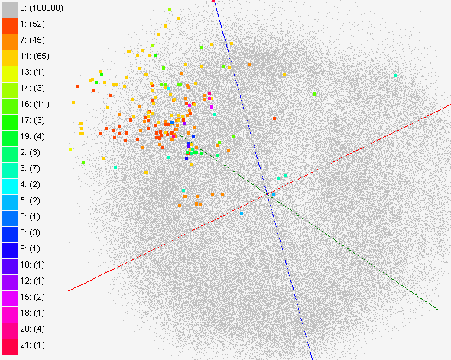
Data Visualization
Visualize high-dimensional data as points in 2D or 3D by dimension reduction.
Distances in target dimension approximate to the distances in the original HD space.
Interactively browse data
Easy to recognize clusters or groups
  An example of Solvent data
  MDS Visualization of 215 solvent data (colored) with 100k PubChem dataset (gray) to navigate chemical space.

Slide 4
Motivation
Data deluge era
  Biological sequence, Chemical compound data, Web, …
  Large-scale data analysis and mining are getting important.
High-dimensional data
  Dimension reduction alg. helps people to investigate distribution of the data in high dimension.
  For some dataset, it is hard to represent with feature vectors but proximity information.
    PCA and GTM require feature vectors
Multidimensional Scaling (MDS)
  Find a mapping in the target dimension w.r.t. the proximity (dissimilarity) information.
  Non-linear optimization problem.
  Require O(N²) memory and computation.

Slide 5
Issues
How to deal with large high-dimensional scientific data for data visualization?
  Parallelization
  Interpolation (Out-of-Sample approach)
How to find better solution of MDS output?
  Deterministic Annealing

Slide 6
Outline
Motivation & Issues
Multidimensional Scaling (MDS)
Parallel MDS
Interpolation of MDS
DA-SMACOF
Conclusion & Future Works
References

Slide 7
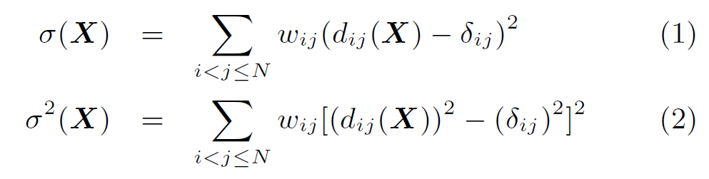
Multidimensional Scaling
Given the proximity information [Δ] among points.
Optimization problem to find mapping in target dimension.
Objective functions: STRESS (1) or SSTRESS (2)
Only needs pairwise dissimilarities δ_{ij} between original points
  (not necessary to be Euclidean distance)
d_{ij}(X) is Euclidean distance between mapped (3D) points
Various MDS algorithms are proposed:
  Classical MDS, SMACOF, force-based algorithms, …

Slide 8
SMACOF
  Scaling by MAjorizing a COmplicated Function. (SMACOF) [1]
  Iterative majorizing algorithm to solve MDS problem.
  Decrease STRESS value monotonically.
  Tend to be trapped in local optima.
  Computational complexity and memory requirement is O(N²).
[1] I. Borg and P. J. Groenen. Modern Multidimensional Scaling: Theory and Applications. Springer, New York, NY, U.S.A., 2005.

Slide 9
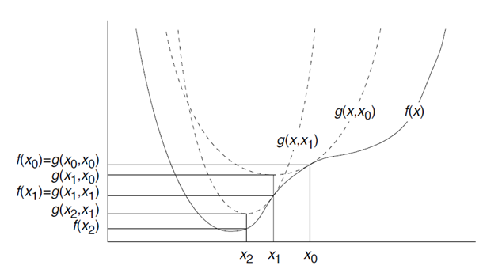
Iterative Majorizing
- Auxiliary function g(x, x₀)
- x₀: supporting point
- x₁: minimum of auxiliary function g(x, x₀)
- Auxiliary function g(x, x₁)
f(x) ≤ g(x, x_{i})
[1] I. Borg and P. J. Groenen. Modern Multidimensional Scaling: Theory and Applications. Springer, New York, NY, U.S.A., 2005.

Slide 10
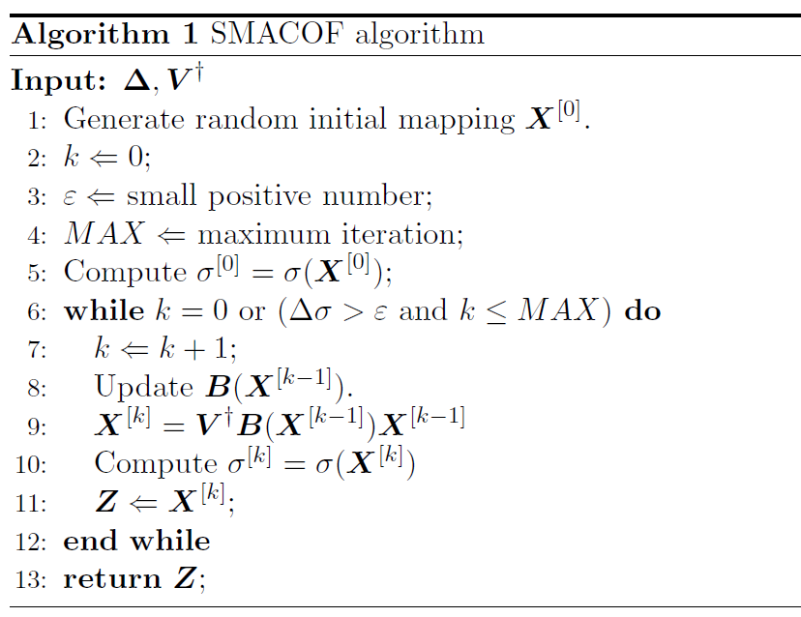
SMACOF (2)

Slide 11
Outline
Motivation & Issues
Multidimensional Scaling (MDS)
Parallel MDS
Interpolation of MDS
DA-SMACOF
Conclusion & Future Works
References

Slide 12
MPI-SMACOF
Why do we need to parallelize MDS algorithm?
  For the large data set, a data mining alg. is
    not only cpu-bounded but memory-bounded.
  For instance, SMACOF algorithm requires at least 480 GB of memory for 100k data points.
  So, we have to utilize distributed system.
Main issue of parallelization is load balance and efficiency.
  How to decompose a matrix to blocks?
  m by n block decomposition, where m * n = p.

Slide 13
SMACOF Algorithm

Slide 14
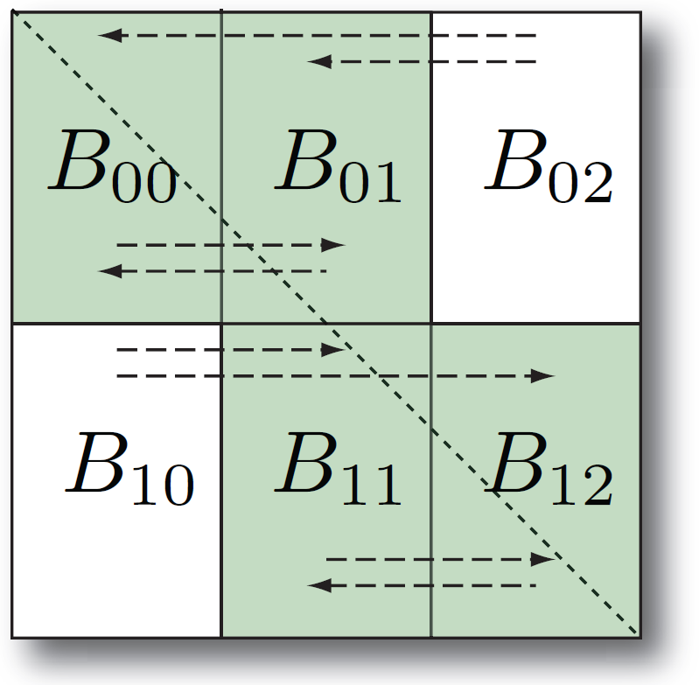
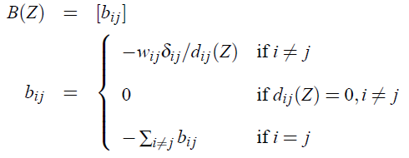
MPI-SMACOF (2)
Parallelize followings:
  Computing STRESS, updating B(X) and matrix multiplication [X_{k+1} = V⁺B(X_{k})X_{k}].

Slide 15
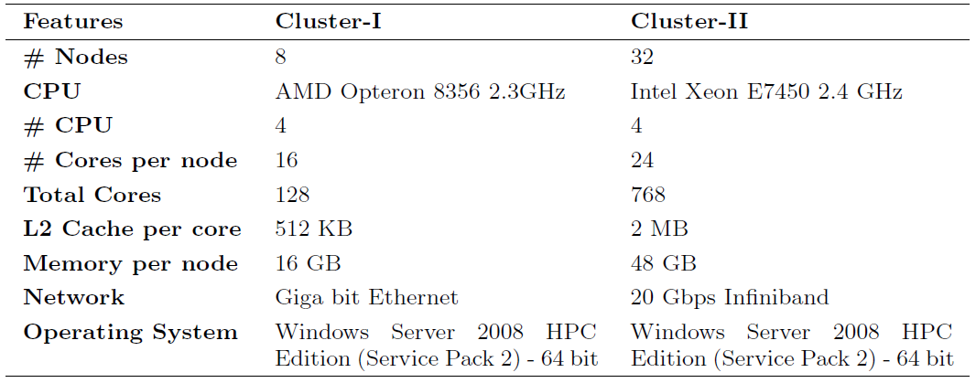
Parallel Performance
Experimental Environments

Slide 16
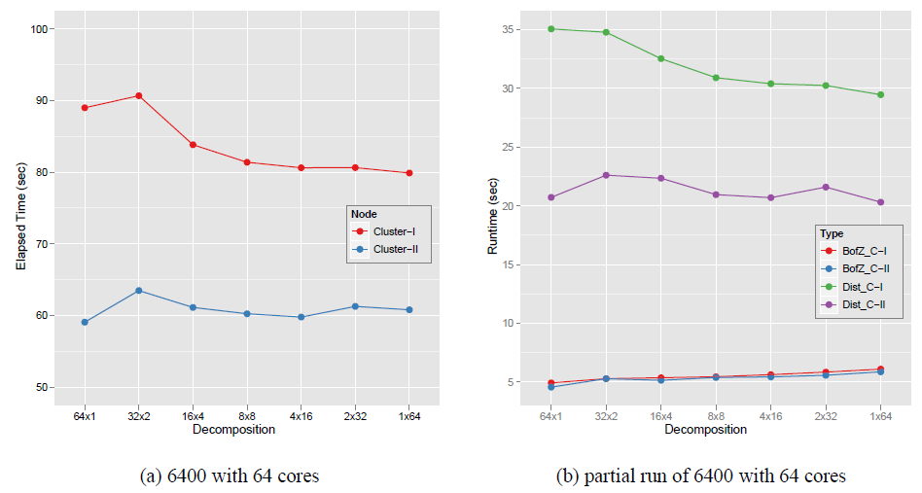
Parallel Performance (2)
Performance comparison w.r.t. how to decompose

Slide 17
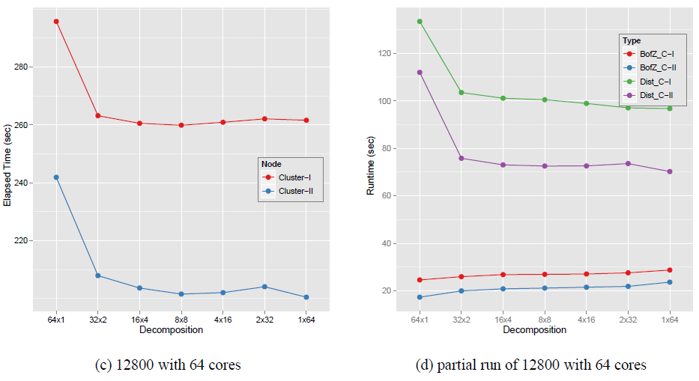
Parallel Performance (2)
Performance comparison w.r.t. how to decompose

Slide 18
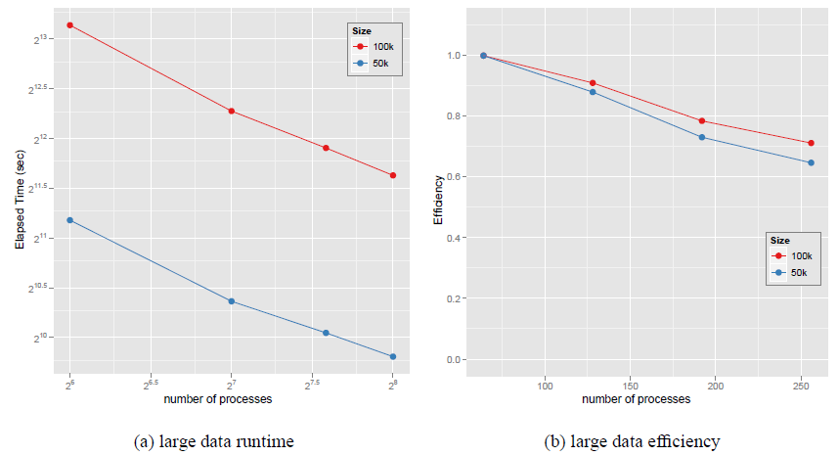
Parallel Performance (3)
Scalability Analysis

Slide 19
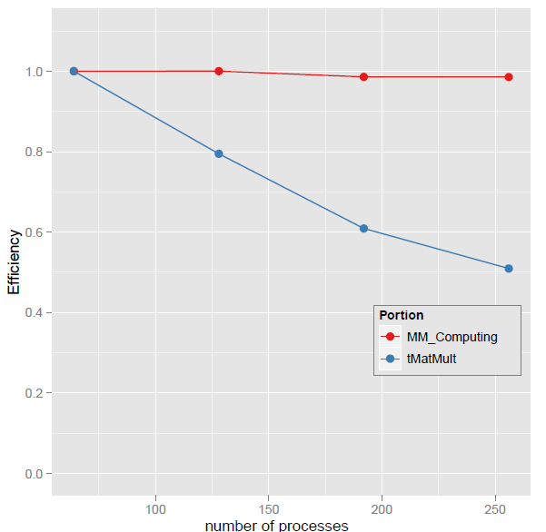
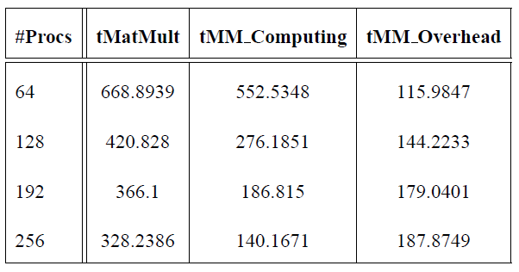
Parallel Performance (4)
Why is Efficiency getting lower?

Slide 20
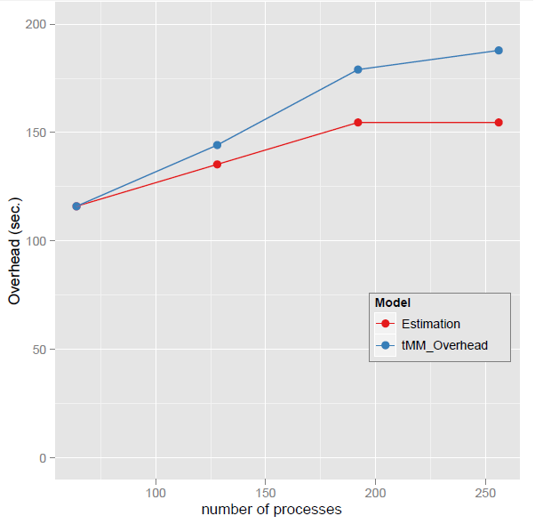
Parallel Performance (4)
Why is Efficiency getting lower?

Slide 21
Outline
Motivation & Issues
Multidimensional Scaling (MDS)
Parallel MDS
Interpolation of MDS
DA-SMACOF
Conclusion & Future Works
References

Slide 22
Interpolation of MDS
Why do we need interpolation?
  MDS requires O(N²) memory and computation.
  For SMACOF, six N * N matrices are necessary.
    N = 100,000 → 480 GB of main memory required
    N = 200,000 → 1.92 TB ( > 1.536 TB) of memory required
  Data deluge era
    PubChem database contains millions chemical compounds
    Biology sequence data are also produced very fast.
How to construct a mapping in a target dimension with millions of points by MDS?

Slide 23
Interpolation Approach
Two-step procedure
  A dimension reduction alg. constructs a mapping of n sample data (among total N data) in target dimension.
  Remaining (N-n) out-of-samples are mapped in target dimension w.r.t. the constructed mapping of the n sample data w/o moving sample mappings.
n
In-sample
Training
Prior Mapping
N-n
Out-of-sample
Interpolated map
Interpolation
Total N data

Slide 24
Majorizing Interpolation of MDS
Out-of-samples (N-n) are interpolated based on the mappings of n sample points.
  Find k-NN of the new point among n sample data.
    Landmark points → (Keep the positions)
  Based on the mappings of k-NN, find a position for a new point by the proposed iterative majorizing approach.
    Note that it is NOT acceptable to run normal MDS algorithm with (k+1) points directly, due to batch property of MDS.
  Computational Complexity – O(Mn), M = N-n

Slide 25
Parallel MDS Interpolation
Though MDS Interpolation (O(Mn)) is much faster than SMACOF algorithm (O(N²)), it still needs to be parallelize since it deals with millions of points.
MDS Interpolation is pleasingly parallel, since interpolated points (out-of-sample points) are totally independent each other.

Slide 26
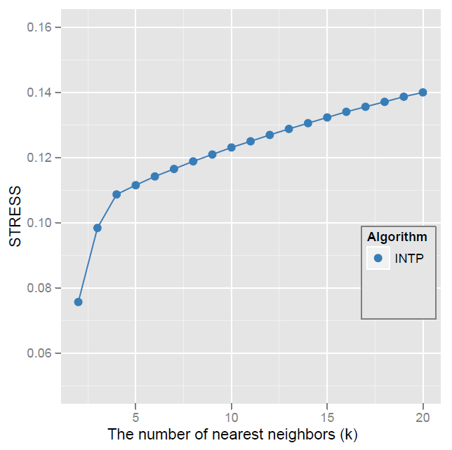
k-NN analysis

Slide 27
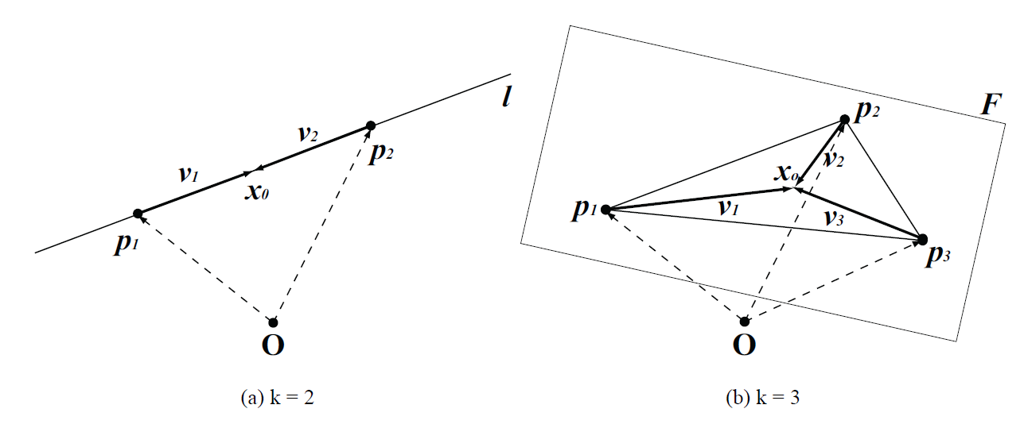
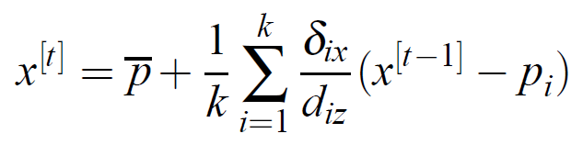
Isn’t it ambiguous with 2NN?

Slide 28
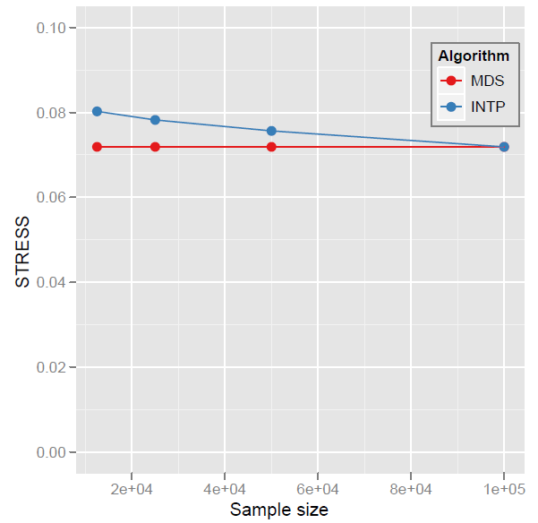
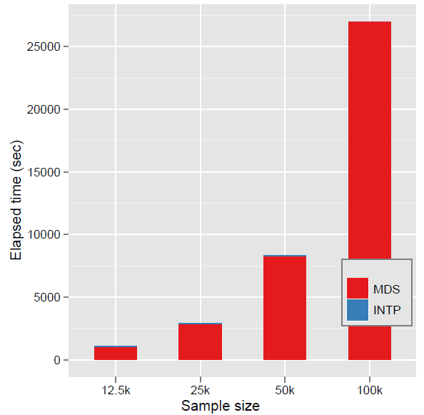
MDS Interpolation Performance
N = 100k points

Slide 29
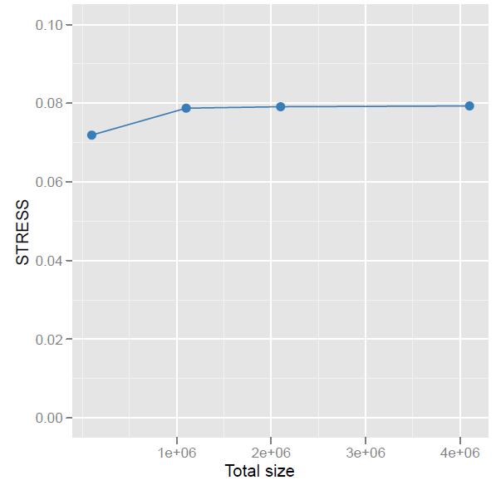
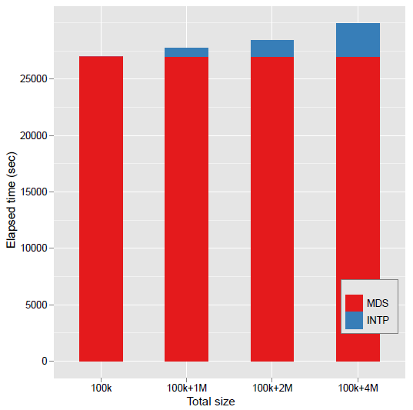
MDS Interpolation Performance (2)

Slide 30
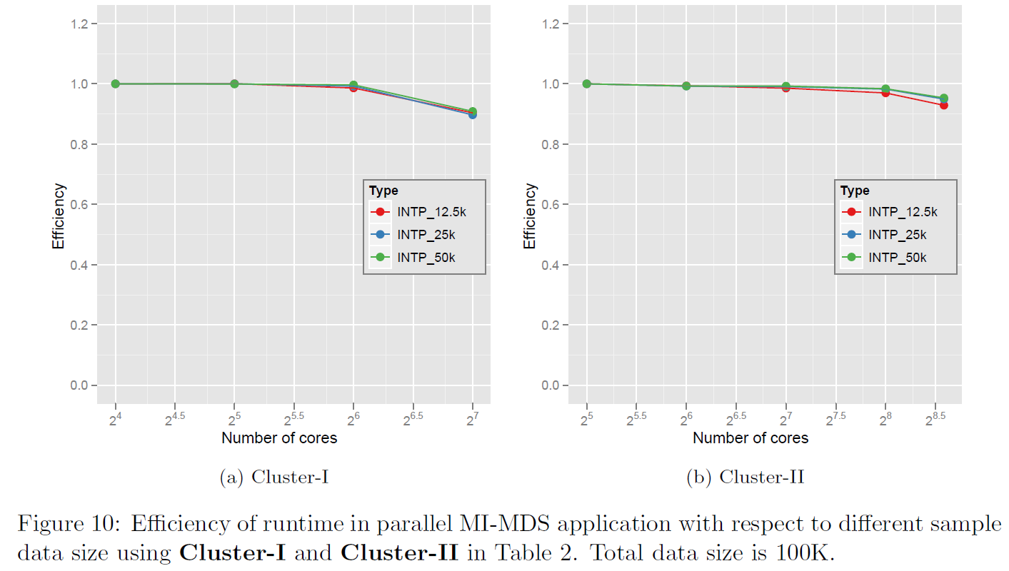
MDS Interpolation Performance (3)

Slide 31
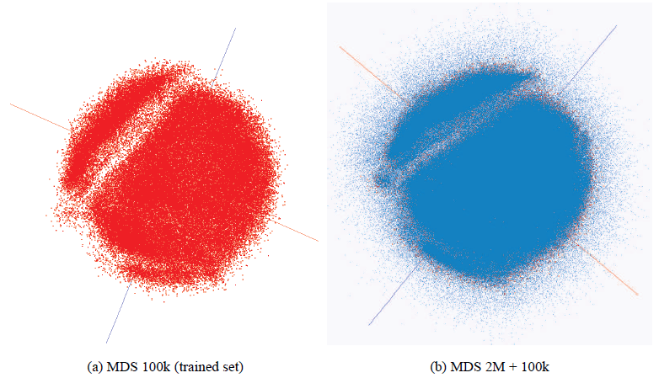
MDS Interpolation Map
PubChem data visualization by using MDS (100k) and Interpolation (2M+100k).

Slide 32
Outline
Motivation & Issues
Multidimensional Scaling (MDS)
Parallel MDS
Interpolation of MDS
DA-SMACOF
Conclusion & Future Works
References

Slide 33
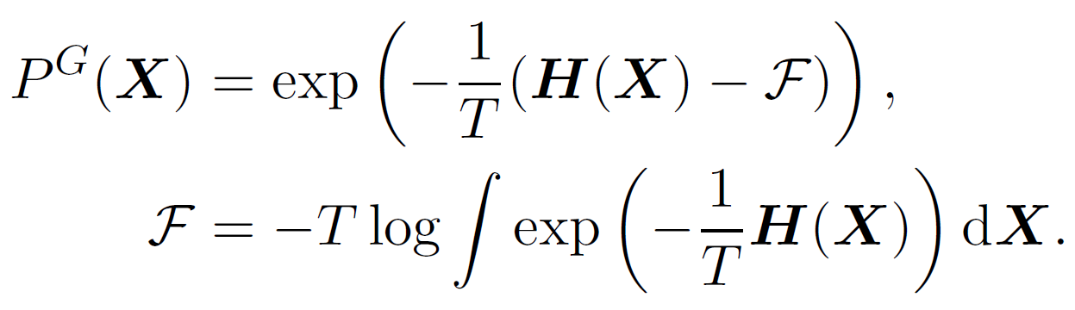
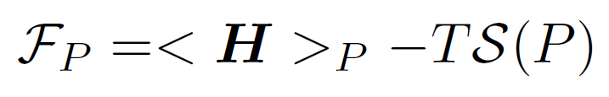
Deterministic Annealing (DA)
Simulated Annealing (SA) applies Metropolis algorithm to minimize F by random walk.
Gibbs Distribution at T (computational temperature).
Minimize Free Energy (F)
As T decreases, more structure of problem space is getting revealed.
DA tries to avoid local optima w/o random walking.
DA finds the expected solution which minimize F by calculating exactly or approximately.
DA applied to clustering, GTM, Gaussian Mixtures etc.

Slide 34
DA-SMACOF
The MDS problem space could be smoother with higher T than with the lower T.
  T represents the portion of entropy to the free energy F.
Generally DA approach starts with very high T, but if T₀ is too high, then all points are mapped at the origin.
  We need to find appropriate T₀ which makes at least one of the points is not mapped at the origin.

Slide 35
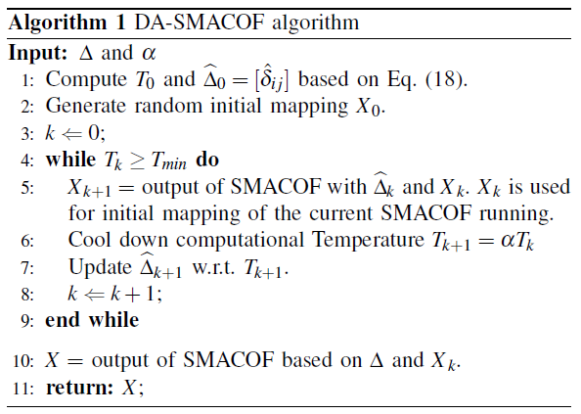
DA-SMACOF (2)

Slide 36
Experimental Analysis
Data
  iris (150)
    UCI ML Repository
  Compounds (333)
    Chemical compounds
  Metagenomics (30000)
    SW-G local alignment
  16sRNA (50000)
    NW global alignment
Algorithms
  SMACOF (EM)
  Distance Smoothing (DS)
  Proposed DA-SMACOF (DA)
Compare the avg. of 50 (10 for seq. data) random initial runs.

Slide 37
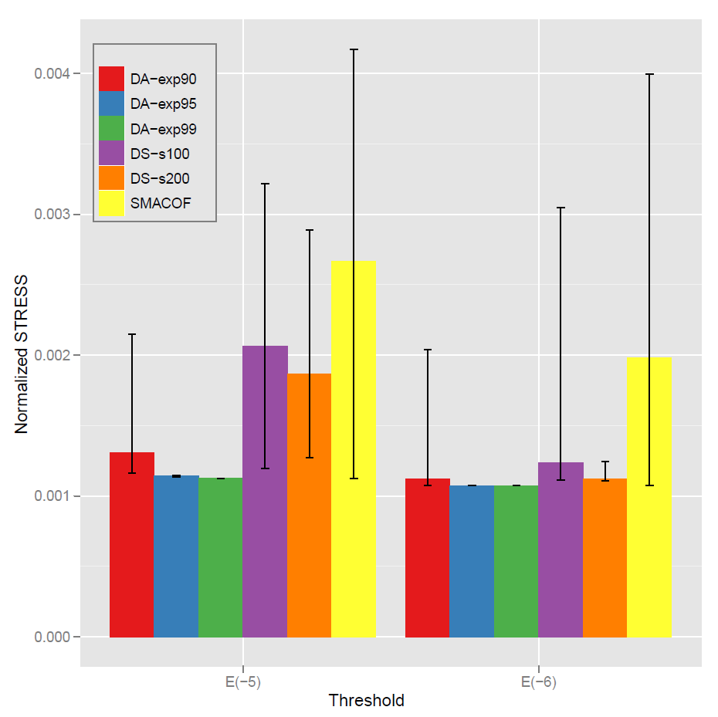
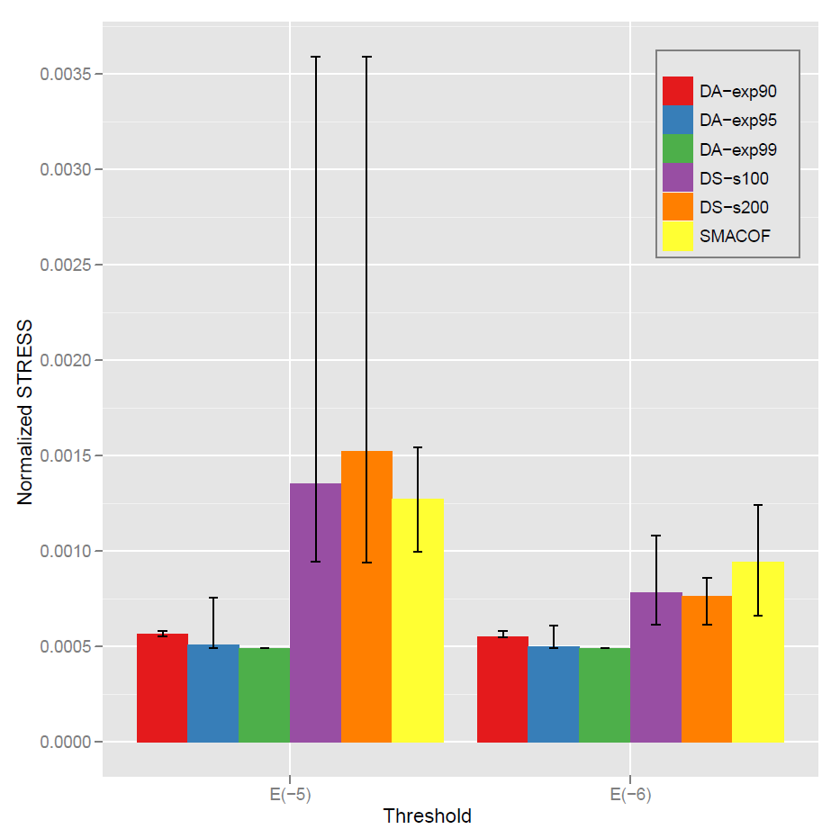
Mapping Quality (iris & Compound)
iris
compound

Slide 38
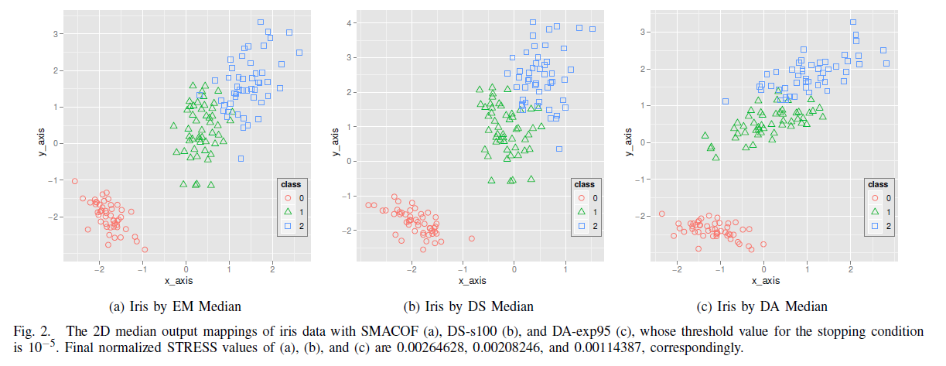
Mapping Examples

Slide 39
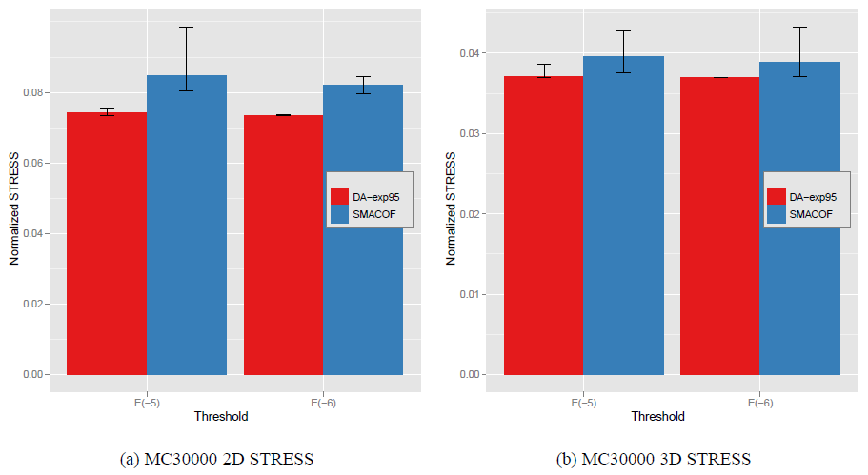
Mapping Quality (MC 30000)

Slide 40
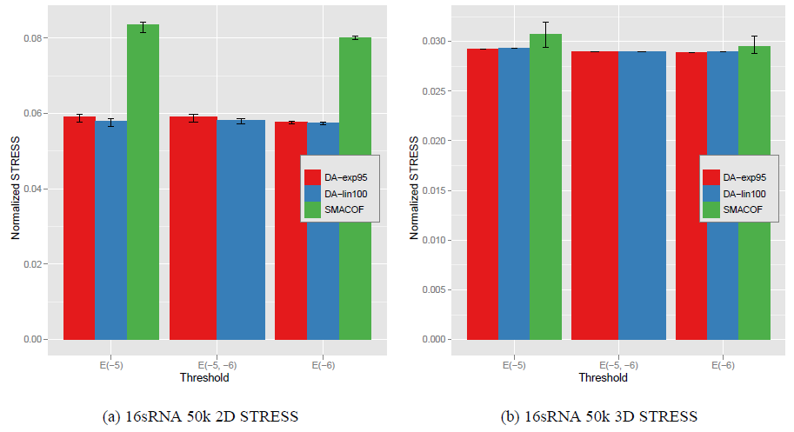
Mapping Quality (16sRNA 50000)

Slide 41
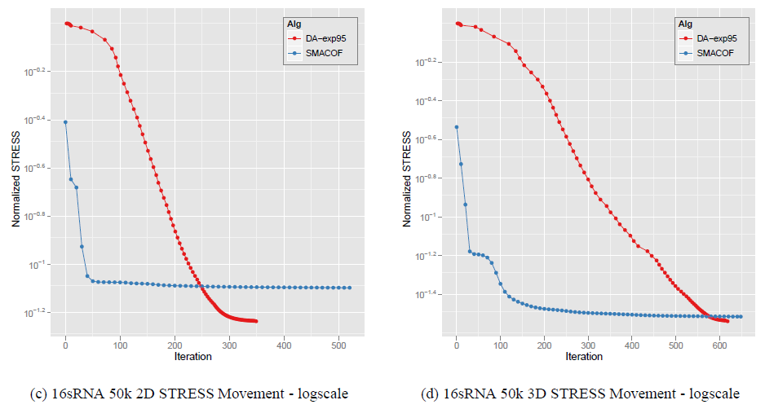
STRESS movement comparison

Slide 42
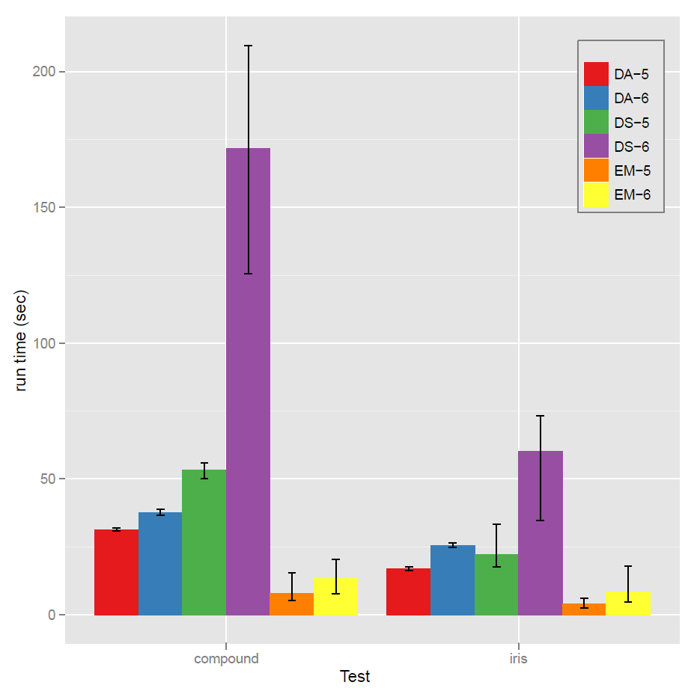
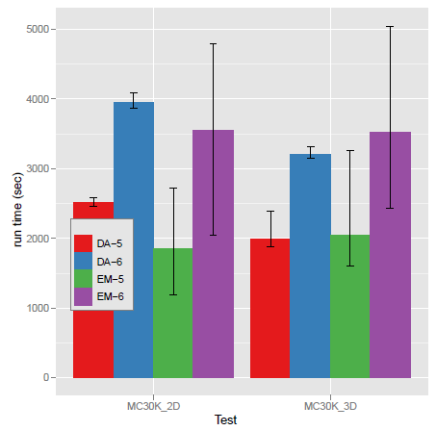
Runtime Comparison

Slide 43
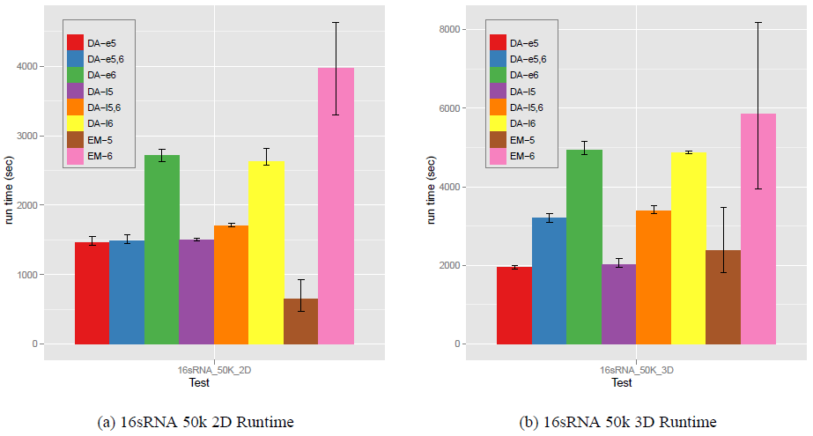
Runtime Comparison

Slide 44
Outline
Motivation & Issues
Multidimensional Scaling (MDS)
Parallel MDS
Interpolation of MDS
DA-SMACOF
Conclusion & Future Works
References

Slide 45
Conclusion
Main Goal: construct low dimensional mapping of the given large high-dimensional data as good as possible and as many as possible.
  Apply DA approach to MDS problem to prevent trapping local optima.
    The proposed DA-SMACOF outperforms SMACOF in quality and shows consistent result.
  Parallelize both SMACOF and DA-SMACOF via MPI model.
  Propose interpolation algorithm based on iterative majorizing method, called MI-MDS.
    To deal with even more points, like millions of data, which is not eligible to run normal MDS algorithm in cluster systems.

Slide 46
Future Works
Hybrid Parallel MDS
  MPI-Thread parallel model for MDS parallelizm.
Interpolation of MDS
  Improve mapping quality of MI-MDS
  Hierarchical Interpolation
DA-SMACOF
  Adaptive Cooling Scheme
  DA-MDS with weighted case

Slide 47
References
Seung-Hee Bae, Judy Qiu, and Geoffrey C. Fox, Multidimensional Scaling by Deterministic Annealing with Iterative Majorization Algorithm, in Proceedings of 6th IEEE e-Science Conference, Brisbane, Australia, Dec. 2010.
Seung-Hee Bae, Jong Youl Choi, Judy Qiu, Geoffrey Fox. Dimension Reduction Visualization of Large High-dimensional Data via Interpolation. in the Proceedings of The ACM International Symposium on High Performance Distributed Computing (HPDC), Chicago, IL, June 20-25 2010.
Jong Youl Choi, Seung-Hee Bae, Xiaohong Qiu and Geoffrey Fox. High Performance Dimension Reduction and Visualization for Large High-dimensional Data Analysis. in the Proceedings of the The 10th IEEE/ACM International Symposium on Cluster, Cloud and Grid Computing (CCGrid 2010), Melbourne, Australia, May 17-20 2010.
Geoffrey C. Fox, Seung-Hee Bae, Jaliya Ekanayake, Xiaohong Qiu, and Huapeng Yuan, Parallel data mining from multicore to cloudy grids, in Proceedings of HPC 2008 High Performance Computing and Grids workshop, Cetraro, Italy, July 2008.
Seung-Hee Bae, Parallel multidimensional scaling performance on multicore systems, in Proceedings of the Advances in High-Performance E-Science Middleware and Applications workshop (AHEMA) of Fourth IEEE International Conference on eScience, pages 695–702, Indianapolis, Indiana, Dec. 2008. IEEE Computer Society.

Slide 48
Acknowledgement
My Advisor: Prof. Geoffrey C. Fox
My Committee members
PTI SALSA Group

Slide 49
Thanks!
Questions?

