Slide 1
Towards Green Aware Computing
Gregor von Laszewski
laszewski@gmail.com
Indiana University

Slide 2
What is Green IT?
Green IT also referred as Green computing is a study and practice of using computing resources in an efficient manner such that its impact on the environment is as less hazardous as possible.
least amount of hazardous materials are used
computing resources are used efficiently in terms of energy and to promote recyclability
http://en.wikipedia.org/wiki/Green_computing

Slide 3
Motivation
Cost:
A supercomputer with 360-Tflops with conventional processors requires 20 MW to operate, which is approximately equal to the sum of 22,000 US households power consumption
Servers consume 0.5 percent of the world’s total electricity usage
Energy usage will quadruple by 2020
The total estimated energy bill for data centers in 2010 is $11.5 billion
Reliability:
Every 10C increase of temperature leads to a doubling of the system failure rate
Environment:
A typical desktop computer consumes 200-300W of power
This results in emission of about 220Kg of CO2/annum
Data Centers produce 170 million metric tons of CO2 worldwide currently per year
670 million metric tons of CO2 are expected to be emitted by data centers worldwide annually by 2020
Utilization
32 percent of all servers are running at or below 3 percent peak and average utilizations, wasting energy spinning and cooling, and doing virtually no work.

Slide 4
A Typical Google Search
Google spends about 0.0003 kWh per search
1 kilo-watt-hour (kWh) of electricity = 7.12 x 10-4 metric tons CO2 = 0.712 kg or 712g of CO2
=> 213mg CO2 emitted
The number of Google searches worldwide amounts to 200-500 million per day.
total carbon emitted per day:
= 500 million x 0.000213 kg per search = 106500kg or 106.5 metric ton
Source: http://prsmruti.rediffiland.com/blogs/2009/01/19/How-much-cabondioxide-CO2-emitted.html
Notes:
ref:
http://www.globus.org/grid_software/security/voms.php – globus alliance ... basic definition
http://vdt.cs.wisc.edu/components/voms.html – virtual data toolkit (osg) – grid middleware
http://edg-wp2.web.cern.ch/edg-wp2/security/voms/voms.html – (datagrid)

Slide 5
So what can we do?

Slide 6
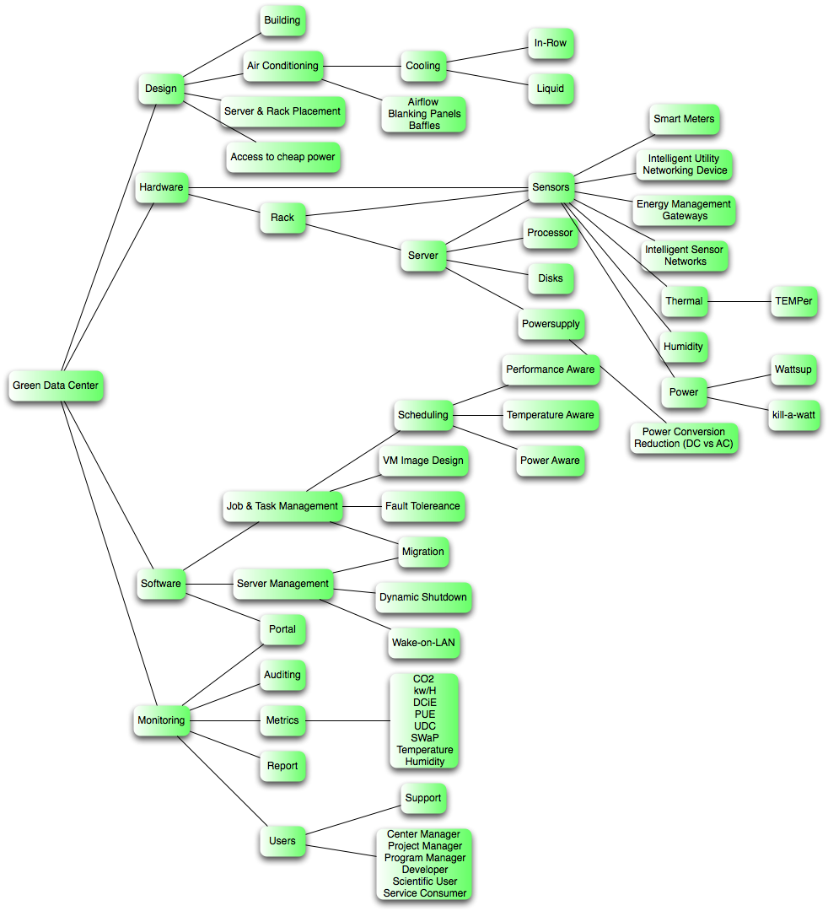
GreenIT Taxonomy
We are actively developing a Taxonomy
Helps assessing where to focus research activities
Will be resulting in
What to Monitor?
What Software?
Which Services?
What to Optimize?
At what cost ($,CO2,perf)?

Slide 7
Green Aware Computing

Slide 8
Green Aware Computing
Metrics
Power, Temperature, CO2, …
Computing system
Many-cores, Clusters, GPGPU
Algorithms and models
task scheduling, CFD model, …
Middleware
auditing & insertion service, green resource management service, virtualization, Grids and Clouds, …

Slide 9
Green Aware Computing

Slide 10
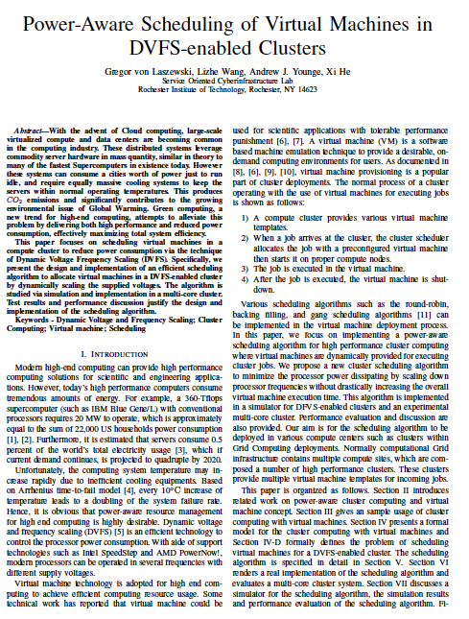
Green Aware DVFS Scheduling for VMs
How to reduce energy consumption?
Many ways exist …
Can we use dynamic voltages to reduce energy consumption
Objective: dynamically scale voltages for virtual machines in a cluster
Dynamic Voltage Frequency Scheduling (DVFS)
Cluster Aug. 2009

Slide 11
Results
For compute intense calculations on a quad core machine
Although you get slower speed with more cores, the overall throughput is more efficient
While the performance of each individual VM is only approximately 67% as fast when using 8 VMs instead of 4, there are twice as many VMs to contribute to an overall performance improvement of 34%
Put as much on the machine as you can

Slide 12
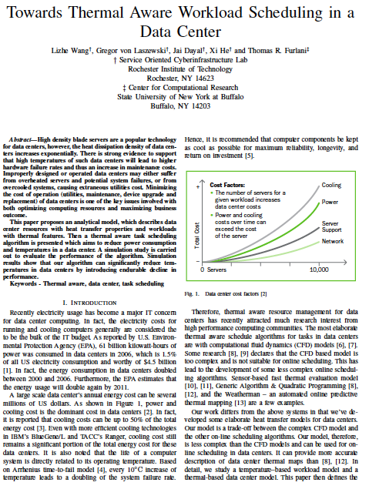
Thermal aware workload scheduling in data centers
Job-temperature model
Data center resource model
Thermal aware scheduling algorithm
Thermal aware workload scheduling framework
Simulation
To be submitted

Slide 13
Simulation Result (1)
Reduce max temperature: 6 F
Reduce average temperature: 15 F
Reduce power consumption 4000 kW/h
Reduce CO2 emission 19 000 kg/h

Slide 14
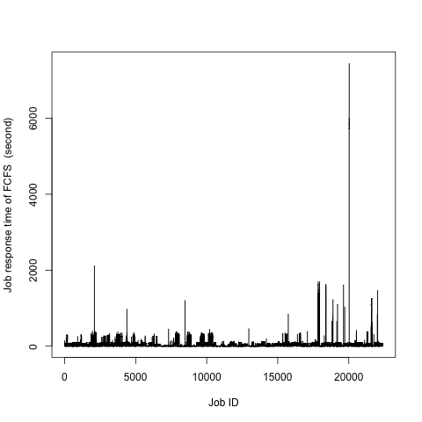
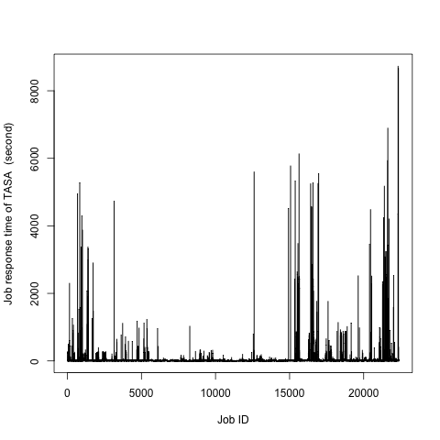
Simulation Result (2)
Response time increase 13%

Slide 15
Green Aware Computing

Slide 16
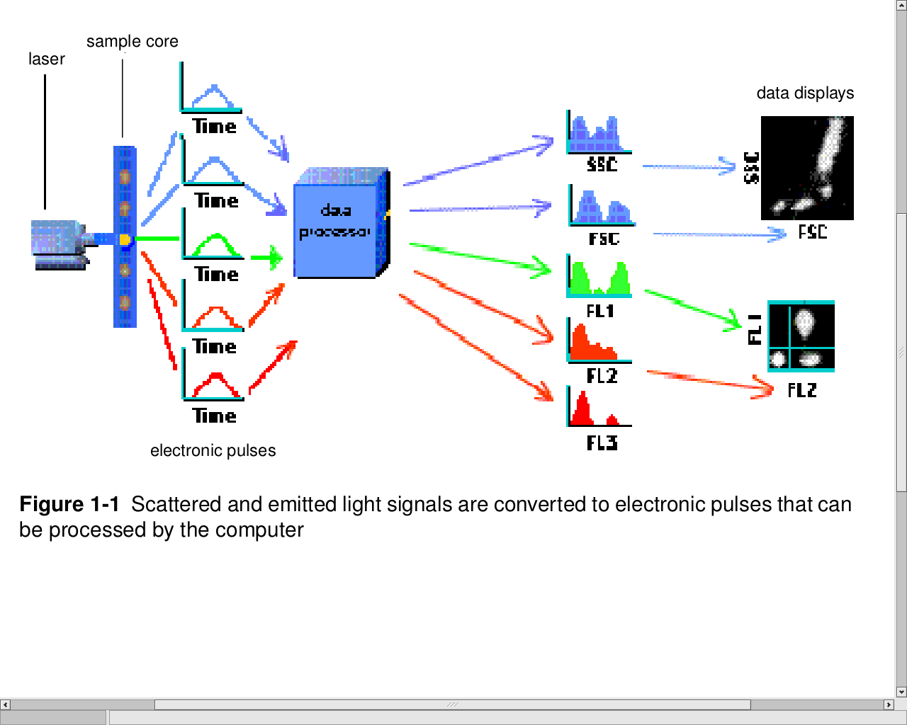
Clustering in flow cytometry
Flow cytometry (FC) is a technology in which optical measurements on fluorescently labeled cells are rapidly acquired (~ 10⁴ s⁻¹), giving datasets in ~20 dimensions and millions of events.
The dimensionality of the data is expected to continue to increase.
Current analysis methods commonly include manual sequential bivariate gating to narrow down populations of interest. This is unsatisfactory for many reasons.
From Introduction to Flow Cytometry:
A Learning Guide, BD Biosciences, 2004

Slide 17
Speedup

Slide 18
Evaluation
A speedup of 40-70 will naturally be significant in reducing power and CO2
E.g. one server with CUDA cards vs.
70 single processors
Current work:
Energy consumption
Multi/many core systems vs. CUDA

Slide 19
Green Aware Computing

Slide 20
Changing Behavior
Making you aware of issues
Provide easy monitoring and comparison tools
Provide supporting tools to make it easy to not only do computing based on
Performance vs. environmental impact

Slide 21
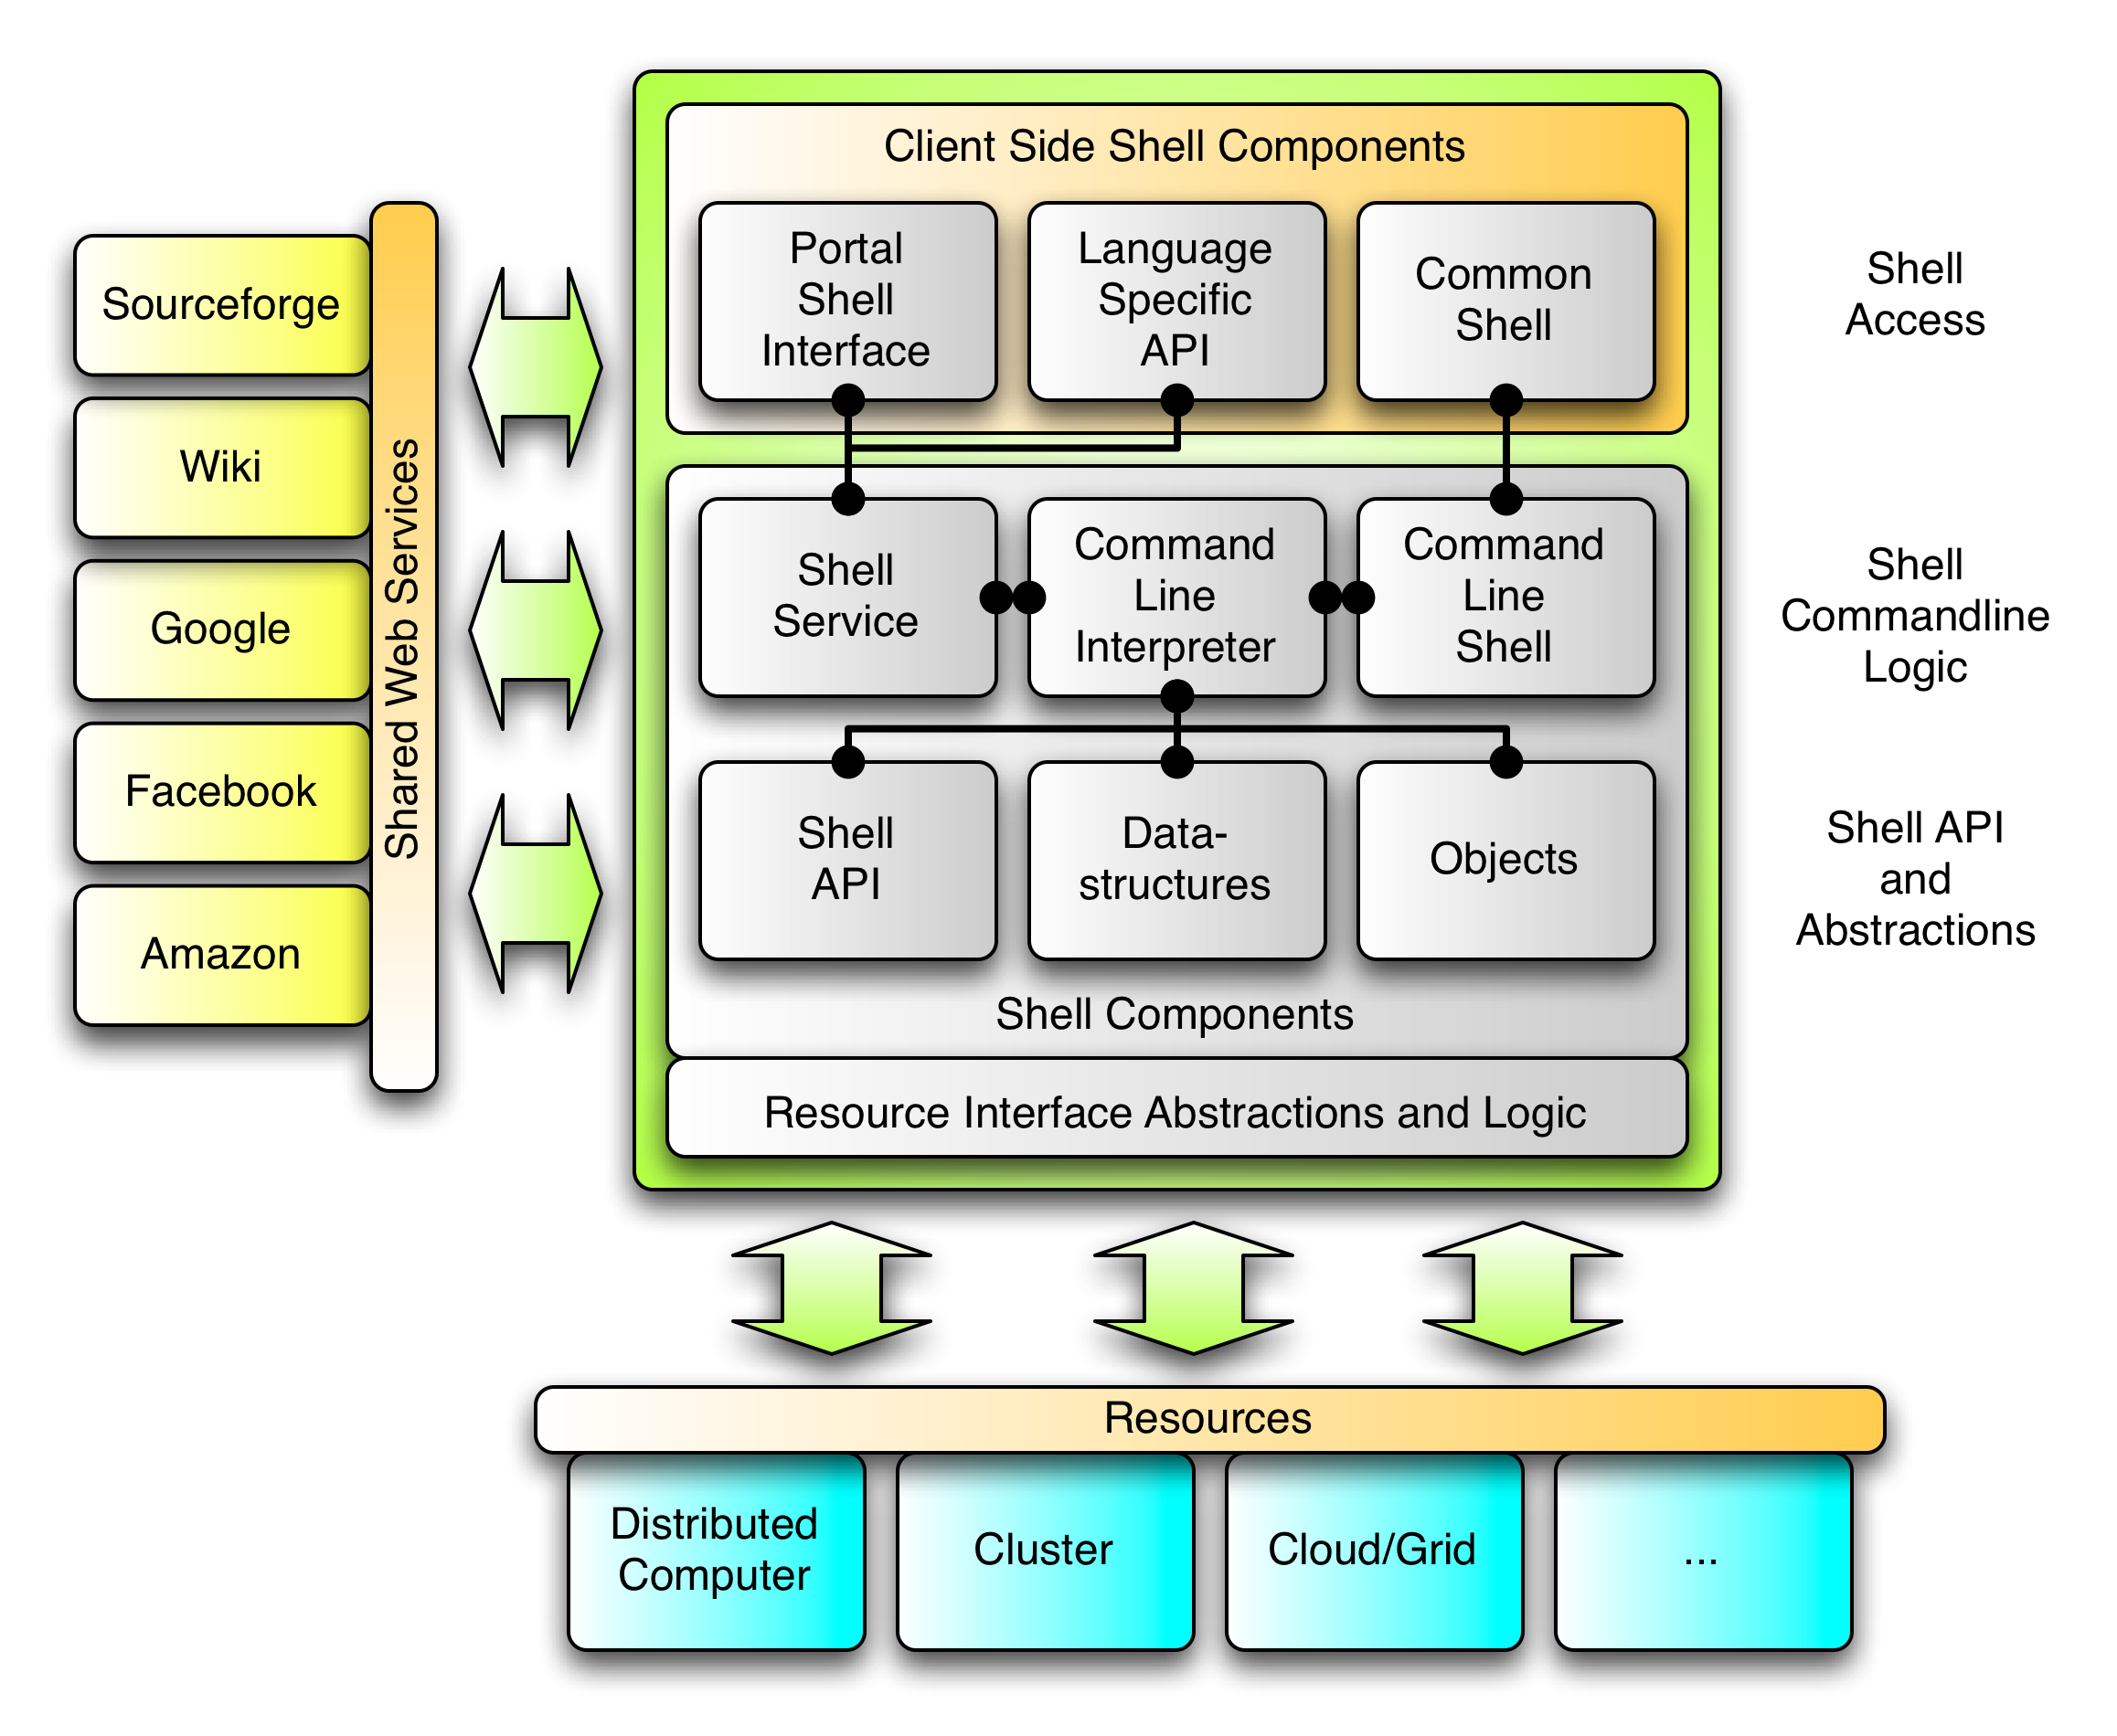
Cyberaide.org

