Slide 1
Building Big Data Processing Systems based on Scale-Out Computing Models
Xiaodong Zhang
Ohio State University
In collaborations with
Hive Development Community
Hortonworks Inc.
Facebook Data Infrastructure Team
Microsoft
Emery University
Institute of Computing Technology

Slide 2
Evolution of Computer Systems
Computers as “computers” (1930s -1990s)
  Computer architecture (CPU chips, cache, DRAM, and storage)
  Operating systems (both open sources and commercial)
  Compilers (execution optimizations)
  Databases (both commercial and open sources)
  Standard scientific computing software
Computers as “networks” (1990s – 2010s)
  Internet capacity change
    281 PB (1986), 471 PB (1993, +68%), 2.2 EB (2000, +3.67 times), 65 EB (2007, 29 times), 667 EB (2013, 9 times)
    Wireless infrastructure
Computers as “data centers” (starting 21st century)
  Everything is digitized and saved in daily life and all other applications
  Time/space creates big data: short latency and unlimited storage space.
  Data-driven decisions and actions

Slide 3
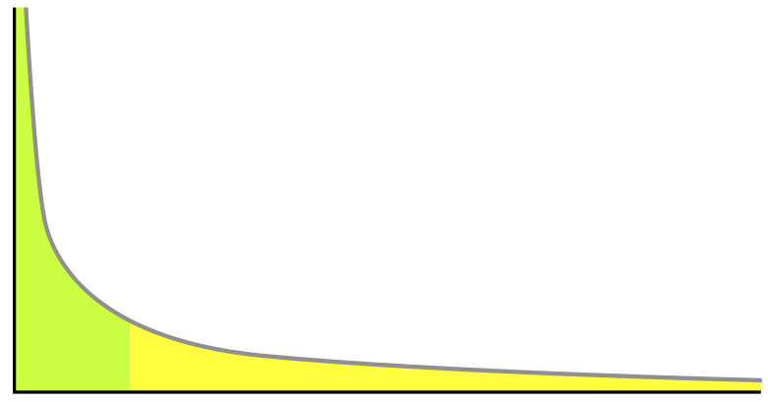
Data Access Patterns and Power Law
# of hits to
each data object
Popularity ranks
for each data object
To the rights (the yellow region) is the long tail of lower 80% objects; to the left are the few that dominate (the top 20% objects). With limited space to store objects and limited search ability to a large volume of objects, most attentions and hits have to be in the top 20% objects, ignoring the long tail.

Slide 4
Small Data: Locality of References
Principle of Locality
  A small set of data that are frequently accessed temporally and spatially
  Keeping it close to the processing unit is critical for performance
  One of limited principles/laws in computer science
Where can we get locality?
  Everywhere in computing: architecture, software systems, applications
Foundations of exploiting locality
  Locality-aware architecture
  Locality-aware systems
  Locality prediction from access patterns

Slide 5
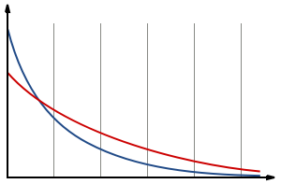
The Change of Time (short search latency) and Space (unlimited storage capacity) for Big Data Creates Different Data Access Distributions
Traditional long tail distribution
Flattered distribution after the long tail can be easily accessed
The head is lowered and the tail is dropped more and more slowly
If the flattered distribution is not power law anymore, what is it?

Slide 6
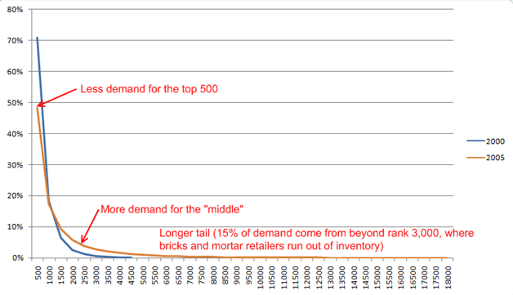
Distribution Changes in DVD rentals from Netflix 2000 to 2011
2011 predicted
The growth of Netflix selections
  2000: 4,500 DVDs
  2005:18,000 DVDs
  2011: over 100,000 DVDs (the long tail would be dropped even more slowly for more demands)
  Note: “breaks and mortar retailers”: face-to-face sell shops.

Slide 7
How to handle increasingly large volume data?
A new paradigm (from Ivy League to Land Grant model)
  150 years ago, Europe ended the industrial revolution
  But US was a backward agriculture country
  Higher education is the foundation to become a strong industrial country
    Extending the Ivy Leagues to massively accept students?
    A new higher education model?
Land grant university model: at low cost and scalable
  Lincoln singed the “Land Grant University Bill” in 1862
  To give federal land to many States to build public universities
  The mission is to build low cost universities and open to masses
The success of land grant universities
  Although the model is low cost and less selective in admissions, the excellence of education remain the same
  Many world class universities were born from this model: Cornel, MIT, Indiana, Ohio State, Purdue, Texas A&M, UC Berkeley, UIUC, …

Slide 8
Major Issues of Big Data
8
Access patterns are unpredictable
  data analytics can be in various formats
Locality is not a major concern
  Every piece of data is important
Major concerns
  Scale out: throughput increases as the number of nodes increases
  Fault tolerant
  Low cost processing for increasingly large volumes

Slide 9
Apache Hive: A big data warehouse
Major users: Baidu, eBay, Facebook, LinkedIn, Spotify, Netflix, Taobao, Tencent, Yahoo!
  Plus major software venders: IBM, Microsoft, TeraData, …
Active open source development community
  ~1500 tickets resolved by 50+ developers last year over 3 releases
Notes:
Then, introduce current status.
User
Development

Slide 10
Hive Works as a Relational DB
Operator tree
Stage 3
GBY
Query
SELECT t1.key1,
t1.key2,
COUNT(t2.value)
FROM t1 JOIN t2
ON (t1.key1 = t2.key1)
GROUP BY t1.key2;
SEL
Stage 2
JOIN
SEL
SEL
Stage 1
t1
t2
Notes:
To process a query, Hive first generates an operator tree based on the operations in the query.
Then, Hive breaks the operator tree to multiple stage based on when data needs to be repartitioned. In this example, JOIN and GBY need to repartition their input datasets. So, we have three stages for this query.

Slide 11
But Execution engine is MR
Stage 3
GBY
Job 1
tmp
SEL
SEL
Job 2
Stage 2
JOIN
GBY
JOIN
SEL
SEL
SEL
SEL
t1
t2
tmp
Stage 1
Two MR jobs
t1
t2
Notes:
After breaking the operator tree to multiple stages, Hive generates jobs based on those stages. For MapReduce, because an MR job can only shuffle data once, we may generate multiple MR jobs for a query. In this example, we have 2 MR jobs. For Tez, Hive only generates a single Tez job which have three stages.

Slide 12
Critical Issue: Data Processing must match the underlying model
High efficiency in both storage and networks
  Data placement under MapReduce model
MapReduce-based query optimization
  query planning under the new computing model
High performance and high throughput
  Best utilization of advanced architecture

Slide 13
Three Critical Components under HDFS
GBY
Query engine:
Execution model for operators
Runtime efficiency
SEL
JOIN
Query planner:
The efficiency of query plans
- Minimizing data movements
SEL
SEL
File format:
Storage/network efficiency
Data reading efficiency
HDFS
Notes:
Let’s take a look at what are performance critical components in Hive.
For a query, its input datasets are stored on HDFS as files. The file format of those files determines how those datasets are physically stored. Thus, the file format is crucial to the storage efficiency and the efficiency of reading data from HDFS.
The query plan of a query is generated by query planner. The query planner determines the efficiency of query plans and when data will be moved (repartitioned).
At runtime, the query plan is executed by those operators. Implementations of those operators determine the execution model and the runtime efficiency.
In the following of this talk, we will introduce major improvements of these three components.

Slide 14
File Format: Distributed Data Placement
GBY
SEL
JOIN
SEL
SEL
File format:
Storage/networ efficiency
Data reading efficiency
HDFS
Notes:
File format
Not easy to achieve both simultaneously.

Slide 15
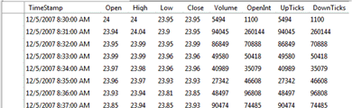
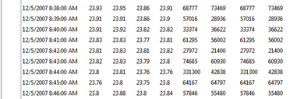
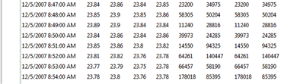

Data Format: how to place a table to a cluster
How to store a table over a cluster of servers ?
answer = table placement method
Server 1
Server 2
Server 3
Notes:
narrow down the scope
big data analytics -> sql-like
big data -> 2-dimensional table in relational db (arbitrary # rows, fixed # columns)
the storage end consists of a cluster of servers
question -> how should we divide and distribute the data to each server, and how we organize them on each local disk
we call each answer to this question, a table placement method

Slide 16
Existing Data Placement Methods
Row-Store: partitioning a table by rows to store
  Merit 1: fast data loading
  Merit 2: all columns in a row are in one HDFS block
  Limit 1: not all columns to be used (unnecessary I/O)
  Limit 2: row-based data compression may not be efficient
Column-Store: partitioning a table by columns to store
  Merit 1: only read the useful columns (I/O efficient)
  Merit 2: Efficient compression under the same data type
  Limit 1: Column grouping need intra-network communication
  Limit 2: Column partitioning operations can be an overhead

Slide 17

Data Placement under HDFS
HDFS Blocks
NameNode
(A part of the Master node)
Store Block 1
Store Block 2
Store Block 3
DataNode 1
DataNode 2
DataNode 3
HDFS (Hadoop Distributed File System) blocks are distributed
A limited ability to specify for users to define a data placement policy
  e.g. to specify which blocks should be co-located
Goals of data placement:
  Minimizing I/O operations in local disks and intra network communication

Slide 18
RCFile (Record Columnar File) in Hive
Eliminate unnecessary I/Os like Column-store
  Only read needed columns from disks
Eliminate network communication costs like Row-store
  Minimizing column grouping operations
Keep the fast data loading speed of Row-store
Efficient data compression like Column-store
Goal: to eliminate all the limits of Row-store and Column-store under HDFS
Notes:
Needs hints to take advantage of row-stores, column stores, and compression.

Slide 19
RCFile: Partition Table into Row Groups
A HDFS block consists of one
or multiple row groups
Table
A
…
B
…
C
…
D
…
HDFS Blocks
Store Block 1
Store Block 2
Store Block 3
Store Block 4
…
A Row Group
101
102
103
104
105
201
202
203
204
205
301
302
303
304
305
401
402
403
404
405
…
…
…
…
Notes:
Consistent format to the previous presentations of row-store and column-store

Slide 20
RCFile: Distributed Row-Groups among Nodes
For example, each HDFS block has three row groups
HDFS Blocks
NameNode
Store Block 1
Store Block 2
Store Block 3
Row Group 1-3
Row Group 4-6
Row Group 7-9
DataNode 1
DataNode 2
DataNode 3
Notes:
So far it looks as same as the row-store
Now I will show you the difference

Slide 21

Inside each Row Group
Metadata
Store Block 1
101
102
103
104
105
201
202
203
204
205
301
302
303
304
305
401
402
403
404
405
Notes:
No duplication

Slide 22
Inside a Row Group
Metadata
101
102
103
104
105
201
202
203
204
205
301
302
303
304
305
401
402
403
404
405
Notes:
No duplication

Slide 23
RCFile: Inside each Row Group
Compressed Metadata
Compressed Column A
Compressed Column B
Compressed Column C
Compressed Column D
101
102
103
104
105
101 | 102 | 103 | 104 | 105
201
202
203
204
205
301
302
303
304
305
201 | 202 | 203 | 204 | 205
401
402
403
404
405
301 | 302 | 303 | 304 | 305
401 | 402 | 403 | 404 | 405
Notes:
No duplication

Slide 24
Benefits of RCFile
Minimize unnecessary I/O operations
  In a row group, table is partitioned by columns
  Only read needed columns from disks
Minimize network costs in row construction
  All columns of a row are located in same HDFS block
Comparable data loading speed to Row-Store
  Only adding a vertical-partitioning operation in the data loading procedure of Row-Store
Applying efficient data compression algorithms
  Can use compression schemes used in Column-store

Slide 25
An optimization spot can be determined by balancing row-store and column-store
Unnecessary I/O transfers
(MBytes)
Row-store
RCFile: Combined row-stores and column-store
Column-store
Unnecessary network transfers
(MBytes)
The function curve depends on the ways of table partitioning in rows and columns, and access patterns of workloads.
Notes:
http://www.dbms2.com/2009/05/11/facebook-hadoop-and-hive/

Slide 26
Optimization Space for RCFile
RCFile (ICDE11) has been widely adopted: e.g., Hive, Pig (Yahoo!), and Impala (Cloudera)
But, it has space for further optimization:
  Optimal row group size?
  Column group arrangement?
  Lacks indices
  Need more support of data statistics
  Position pointers
  Other search acceleration techniques

Slide 27
Optimized Record Columnar File (ORC File, VLDB 2013)
ORC remain the same data structure of RCFile
Row group size (stripe) is sufficiently large
No specific column organization arrangement
Well utilize sequential disk bandwidth in column read
All other limits of RCFIle are addressed
  Reordering of tables as a preprocessing
  Indexes and pointers for fast searching
  Efficient compression
ORC has been merged into Hive

Slide 28



RCFile in Facebook
The interface to 1 billion+ users
…
Web Servers
Large amount of log data
600TB data per day
…
Data Loaders
Capacity:
21PB in May, 2010
at 300PB+ today
ORC/RCFile
…
Warehouse
Picture source: Visualizing Friendships, http://www.facebook.com/notes/facebook-engineering/visualizing-friendships/469716398919
Notes:
was well used in facebook

Slide 29
Query Planner in Hive
GBY
SEL
JOIN
Query planner:
The efficiency of query plans
Data movements
SEL
SEL
HDFS

Slide 30
MR programming is not that “simple”!
public static class Reduce extends Reducer<IntWritable,Text,IntWritable,Text> {
private Text result = new Text();
public void reduce(IntWritable key, Iterable<Text> values,
Context context
) throws IOException, InterruptedException {
double sumQuantity = 0.0;
IntWritable newKey = new IntWritable();
boolean isDiscard = true;
String thisValue = new String();
int thisKey = 0;
for (Text val : values) {
String[] tokens = val.toString().split("\\|");
if (tokens[tokens.length - 1].compareTo("l") == 0){
sumQuantity += Double.parseDouble(tokens[0]);
}
else if (tokens[tokens.length - 1].compareTo("o") == 0){
thisKey = Integer.valueOf(tokens[0]);
thisValue = key.toString() + "|" + tokens[1]+"|"+tokens[2];
}
else
continue;
}
if (sumQuantity > 314){
isDiscard = false;
}
if (!isDiscard){
thisValue = thisValue + "|" + sumQuantity;
newKey.set(thisKey);
result.set(thisValue);
context.write(newKey, result);
}
}
}
public int run(String[] args) throws Exception {
Configuration conf = new Configuration();
String[] otherArgs = new GenericOptionsParser(conf, args).getRemainingArgs();
if (otherArgs.length != 3) {
System.err.println("Usage: Q18Job1 <orders> <lineitem> <out>");
System.exit(2);
}
Job job = new Job(conf, "TPC-H Q18 Job1");
job.setJarByClass(Q18Job1.class);
job.setMapperClass(Map.class);
job.setMapOutputKeyClass(IntWritable.class);
job.setMapOutputValueClass(Text.class);
job.setReducerClass(Reduce.class);
job.setOutputKeyClass(IntWritable.class);
job.setOutputValueClass(Text.class);
FileInputFormat.addInputPath(job, new Path(otherArgs[0]));
FileInputFormat.addInputPath(job, new Path(otherArgs[1]));
FileOutputFormat.setOutputPath(job, new Path(otherArgs[2]));
return (job.waitForCompletion(true) ? 0 : 1);
}
public static void main(String[] args) throws Exception {
int res = ToolRunner.run(new Configuration(), new Q18Job1(), args);
System.exit(res);
}
}
package tpch;
import java.io.IOException;
import java.util.ArrayList;
import org.apache.hadoop.conf.Configuration;
import org.apache.hadoop.conf.Configured;
import org.apache.hadoop.fs.Path;
import org.apache.hadoop.io.DoubleWritable;
import org.apache.hadoop.io.IntWritable;
import org.apache.hadoop.io.Text;
import org.apache.hadoop.mapreduce.Job;
import org.apache.hadoop.mapreduce.Mapper;
import org.apache.hadoop.mapreduce.Reducer;
import org.apache.hadoop.mapreduce.Mapper.Context;
import org.apache.hadoop.mapreduce.lib.input.FileInputFormat;
import org.apache.hadoop.mapreduce.lib.input.FileSplit;
import org.apache.hadoop.mapreduce.lib.output.FileOutputFormat;
import org.apache.hadoop.util.GenericOptionsParser;
import org.apache.hadoop.util.Tool;
import org.apache.hadoop.util.ToolRunner;
public class Q18Job1 extends Configured implements Tool{
public static class Map extends Mapper<Object, Text, IntWritable, Text>{
private final static Text value = new Text();
private IntWritable word = new IntWritable();
private String inputFile;
private boolean isLineitem = false;
@Override
protected void setup(Context context
) throws IOException, InterruptedException {
inputFile = ((FileSplit)context.getInputSplit()).getPath().getName();
if (inputFile.compareTo("lineitem.tbl") == 0){
isLineitem = true;
}
System.out.println("isLineitem:" + isLineitem + " inputFile:" + inputFile);
}
public void map(Object key, Text line, Context context
) throws IOException, InterruptedException {
String[] tokens = (line.toString()).split("\\|");
if (isLineitem){
word.set(Integer.valueOf(tokens[0]));
value.set(tokens[4] + "|l");
context.write(word, value);
}
else{
word.set(Integer.valueOf(tokens[0]));
value.set(tokens[1] + "|" + tokens[4]+"|"+tokens[3]+"|o");
context.write(word, value);
}
}
}
This complex code is for a simple MR job
Low Productivity!
We all want to simply write:
“SELECT * FROM Book WHERE price > 100.00”?
Notes:
Although MR model provide a much easier environment for parallel programming. But the programming work is not that easy. You can easily write a lots of codes even for a simple MR job. Thus, the productivity of MR programming is actually quite low. To enhance the productivity, High-level languages, such as SQL-like declarative languages, on top of MapReduce is desired.

Slide 31





Query Planner: generating optimized MR tasks
A job description in SQL-like declarative language
SQL-to-MapReduce Translator
Query planner does this in automation
Write MR programs (jobs)
MR programs (jobs)
Workers
Hadoop Distributed File System (HDFS)
Notes:
With SQL-like declarative languages, users do not need to write MR jobs or even know how to write MR jobs. They can quickly use SQL-like languages to describe their data processing procedure in a few lines of query. Then, a SQL-to-MapReduce translator will translate these SQL-like queries to one or multiple MR jobs. Then, the MR framework will execute these jobs. Right now, Hive and Pig are two representative translators on top of hadoop.

Slide 32
An Example: TPC-H Q21
One of the most complex and time-consuming queries in the TPC-H benchmark for data warehousing performance
Optimized MR Jobs vs. Hive in a Facebook production cluster
3.7x
What’s wrong?

Slide 33
The Execution Plan of TPC-H Q21
The only difference:
Hive handle this sub-tree in a different way with the optimized MR jobs
SORT
AGG3
It’s the dominated part on time
(~90% of execution time)
Join4
Left-outer-Join
Join3
Join2
supplier
nation
Join1
AGG1
AGG2
lineitem
orders
lineitem
lineitem

Slide 34
A JOIN MR Job
However, inter-job correlations exist.
Let’s look at the Partition Key
An AGG MR Job
Key: l_orderkey
J5
A Table
A Composite MR Job
Key: l_orderkey
J3
Key: l_orderkey
Key: l_orderkey
Key: l_orderkey
J4
J1
J2
lineitem
orders
lineitem
lineitem
lineitem
orders
J1, J2 and J4 all need the input table ‘lineitem’
J1 to J5 all use the same partition key ‘l_orderkey’
What’s wrong with existing SQL-to-MR translators?
Existing translators are correlation-unaware
Ignore common data input
Ignore common data transition
Notes:
Corollary: Generate more unnecessary MR jobs, which significantly hurt the performance

Slide 35
Ysmart: a MapReduce based query planner
Correlation-aware
SQL-to-MR translator
MR Jobs for best performance
SQL-like queries
Primitive
MR Jobs
Identify Correlations
Merge Correlated MR jobs
1: Correlation possibilities and detection
3: Implement high-performance and low-overhead MR jobs
2: Rules for automatically exploiting correlations

Slide 36
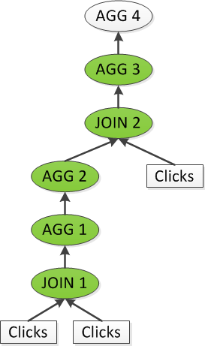
Exp2: Clickstream Analysis
A typical query in production clicks-tream analysis: “what is the average number of pages a user visits between a page in category ‘X’ and a page in category ‘Y’?”
In YSmart JOIN1, AGG1, AGG2, JOIN2 and AGG3 are executed in a single MR job
8.4x
4.8x

Slide 37
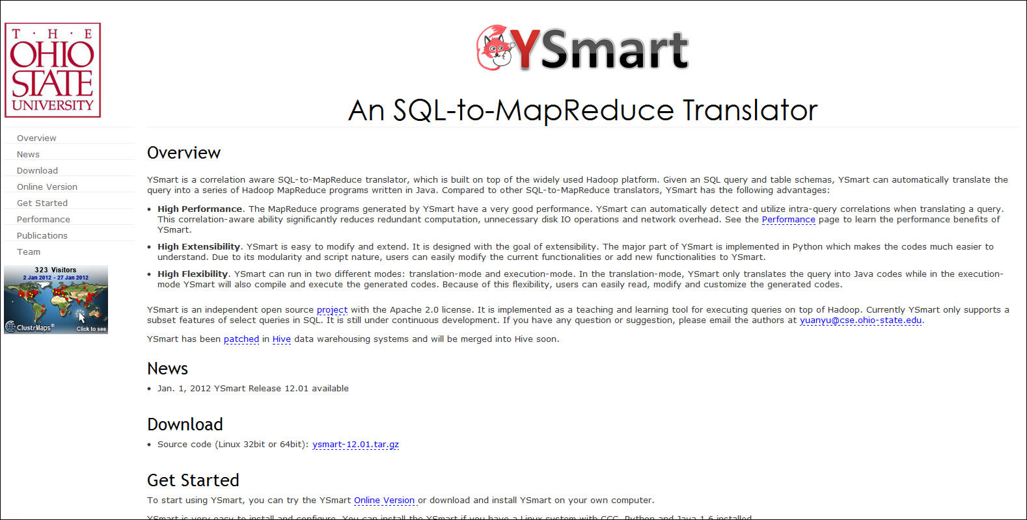
YSmart (ICDCS’11): an open source software http://ysmart.cse.ohio-state.edu

Slide 38
Ysmart has been merged in Hive
  merged patch HIVE-2206 at apache.org
YSmart
Hive + YSmart
Hadoop Distributed File System (HDFS)
Notes:
With SQL-like declarative languages, users do not need to write MR jobs or even know how to write MR jobs. They can quickly use SQL-like languages to describe their data processing procedure in a few lines of query. Then, a SQL-to-MapReduce translator will translate these SQL-like queries to one or multiple MR jobs. Then, the MR framework will execute these jobs. Right now, Hive and Pig are two representative translators on top of hadoop.

Slide 39
An Example of Query Planner in Hive
Correlation optimizer:
  Merge multiple MR jobs into a single one based on the idea of YSmart [ICDCS11]
3 jobs
JOIN2
SELECT p.c1, q.c2, q.cnt
FROM (SELECT x.c1 AS c1
FROM t1 x
JOIN t2 y ON (x.c1=y.c1)) p
JOIN (SELECT z.c1 AS c1,
count(*) AS cnt
FROM t1 z
GROUP BY z.c1) q
ON (p.c1=q.c1)
JOIN1
GBY
t1 as x
t2 as y
t1 as z

Slide 40
Query Planner
Correlation optimizer:
  Merge multiple MR jobs into a single one based on the idea of YSmart [ICDCS11]
1 job
JOIN2
SELECT p.c1, q.c2, q.cnt
FROM (SELECT x.c1 AS c1
FROM t1 x
JOIN t2 y ON (x.c1=y.c1)) p
JOIN (SELECT z.c1 AS c1,
count(*) AS cnt
FROM t1 z
GROUP BY z.c1) q
ON (p.c1=q.c1)
JOIN1
GBY
t2 as y
t1 as x, z

Slide 41
Query Execution in Hive
GBY
Query Execution
Execution model
Runtime efficiency
SEL
JOIN
SEL
SEL
HDFS

Slide 42
Original Operator Implementation in Hive
Deserialization
c1
c2
c3
De-serialized to Java objects
Virtual function calls
Take one row at a time
Serialized rows in binary format
Notes:
When Hive processes a table, it first loads serialized rows from files storing this table. Then, it takes a row and deserializes it to java objects. In the process of deserialization, Hive’s original implementation introduces several virtual function calls (https://en.wikipedia.org/wiki/Virtual_function) to deserialize a row. There is overhead to find the right implementation of a virtual function.

Slide 43
Slow and Sequential Column Element Processing
Does not exploit rich parallelism in CPUs
c1
c2
c3
Expression evaluator
Example: c1 > 10
Comparing Int?
c1>10
Comparing Byte?
Comparing …?
Branches
Notes:
To evaluate an expression, Hive passes the deserialized rows to expression evaluator (usually in a SELECT operator or a FILTER operator). The evaluator evaluates rows in a one-row-at-a-time fashion. In this example, because Hive uses generic functions to evaluate a function for different data types, it needs to look up the data type for every value. Looking up the right data type introduces branches in the row processing pipeline. With branch instructions used to process every row, it is hard to well utilize CPU parallelism.

Slide 44
Poor Cache Performance
Does not well exploit cache locality
c1
c2
c3
The size of the column element is not large enough to utilize cache.
Cache misses
Serialized rows
Notes:
Because Hive deserializes one row at a time, it cannot well utilize CPU cache.

Slide 45
Limits of Hive Operator Engine
Process one row at a time
  Function call overhead due to fine grain process
  Pipelining and parallelism in CPU are not utilized
  Poor cache performance

Slide 46
Vectorized Execution Model
Inspired by MonetDB/X100 [CIDR05]
Rows are organized into row batches
c1
c2
c3
Row batch
Serialized rows

Slide 47
Vectorized Execution Model
Each operator processes a row batch at a time
Expressions are evaluated by generated code from templates
  e.g. A class for evaluating “>” for two Int columns and another class for evaluating “>” for two Double columns
  Branching is minimized
  Looping through primitive arrays improves CPU cache performance
Notes:
Taking “c1 > 10” as an example, different classes will be used for different types of c1 (for example, long and double).

Slide 48
Summary
Research on small data for locality of references
  Principle of locality is a foundation of computer science
  Access patterns of small data are largely predictable: many research efforts
  System infrastructure must be locality aware for high performance
  Research on small data continues, but many major problems have been solved
Research on big data for wisdom of crowds
  Principle has not been established yet
  Access patterns are largely non-predictable
  Scalability, fault tolerance, and affordability are the foundation in systems design
  The R&D has just started, and will have a lot of new problems
Computer Ecosystems
  Commonly used computer systems in the format of both commercial and open sources
  An ecosystem must have a sufficient size of user group
  Creating new ecosystems or/and contributing to existing ecosystems are major our tasks

Slide 49
Basic Research lays a foundation for Hive
The original RCFile paper, ICDE 2011
The basic structure of table placement in clusters, where ORC is a case study. VLDB 2013
  It is being adopted in other systems, Pig, Cloudera, …
Ysmart, query optimization in Hive, ICDCS 2011
  It is being adopted in Spark
Query execution engine (a MonetDB-based optimization, CIDR 2005)
Major technical advancement of Hive, SIGMOD’14
  An academic and industry R&D team: Ohio State and Hortonworks

Slide 50
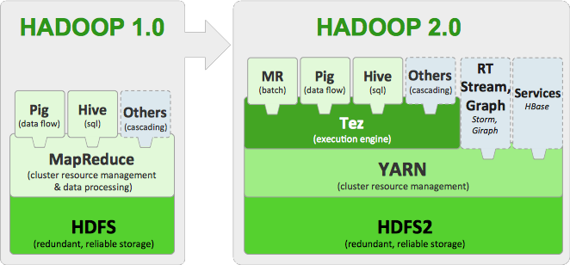
Evolution of Hadoop Ecosystem

Slide 51
Next Steps
Yarn separates computing and resource management, MR and others data processing only
A new runtime called Tez (alternative to MapReduce) is under development
  Next Hive release will make use of Tez.
  HDFS will start to cache data in next release
  Hive will make use of this in next release.
  A new cost-based optimizer is under development.
  Hive will make use of this in next release.
We are working with the Spark group to implement Ysmart optimizer and memory optimization methods

Slide 52
Thank You!

Slide 53
User interfaces
CLI
HiveServer2
Driver
Metastore
Parser
Planner
Execution
RDBMS
Data Processing Framework
(e.g. MapReduce)
SerDe
File Format
(e.g. ORC File)
Storage Handler
Other Storage Systems
(e.g. HBase)
HDFS
Notes:
The architecture of Hive.
Yin: Seems this page is not necessary.

Slide 54
Hive on Tez
Stage 3
GBY
GBY
SEL
SEL
Stage 2
JOIN
JOIN
SEL
SEL
t1
t2
SEL
SEL
Stage 1
t1
t2
Notes:
After breaking the operator tree to multiple stages, Hive generates jobs based on those stages. For MapReduce, because an MR job can only shuffle data once, we may generate multiple MR jobs for a query. In this example, we have 2 MR jobs. For Tez, Hive only generates a single Tez job which have three stages.

Slide 55
Apache Hive
A data warehouse system for Hadoop
SQL Queries
Hive
Data Processing Frameworks
(MapReduce, Tez)
Hadoop Distributed Filesystem (HDFS)
Notes:
Apache Hive is a data warehouse system for Apache Hadoop.
Has its own dialect of SQL
Queries are compiled to jobs of underlying data processing frameworks
MapReduce for a long time
Plus Apache Tez starting from Hive 0.13
Data managed by Hive is stored in HDFS and other Hadoop-based systems, e.g. HBase
A data warehouse system for Hadoop
Sep. 2010: Hive became a top level Apache project
A little bit history about Hive.
Subproject of Hadoop on Sep. 2008
TLP on Sep. 2020
A primary gateway to manipulate, retrieve, and process data stored and managed in Hadoop and its supported systems

Slide 56
1st bar
Job 8
AGG1
Job 7
JOIN7 (SEMI)
Job 6
Job 3
(Map-only)
JOIN3
(Map)
JOIN6
Job 4
Job 5
date_dim
JOIN2
(Map)
JOIN4
web_returns
JOIN5
web_site
JOIN1
(Map)
Job 2
(Map-only)
Job 1
(Map-only)
customer_address
web_sales
web_sales
web_sales

Slide 57
2nd bar
Job 5
AGG1
Job 4
JOIN7 (SEMI)
Job 3
(Map-only)
JOIN3
(Map)
JOIN6
date_dim
JOIN2
(Map)
JOIN4
web_returns
JOIN5
web_site
JOIN1
(Map)
Job 2
(Map-only)
Job 1
(Map-only)
customer_address
web_sales
web_sales

Slide 58
3rd bar
Job 2
AGG1
Job 1
JOIN7 (SEMI)
JOIN3
(Map)
JOIN6
date_dim
JOIN2
(Map)
JOIN4
web_returns
JOIN5
web_site
JOIN1
(Map)
customer_address
web_sales
web_sales

