Slide 1
Comparing Big Data and Simulation Applications and Implications for Software Environments
eScience in the Cloud 2014
Redmond WA
April 30 2014
Geoffrey Fox
gcf@indiana.edu
http://www.infomall.org
School of Informatics and Computing
Digital Science Center
Indiana University Bloomington

Slide 2
Abstract
There is perhaps a broad consensus as to important issues in practical parallel computing as applied to large scale simulations; this is reflected in supercomputer architectures, algorithms, libraries, languages, compilers and best practice for application development.
However the same is not so true for data intensive, even though commercially clouds devote much more resources to data analytics than supercomputers devote to simulations.
We look at a sample of over 50 big data applications to identify characteristics of data intensive applications and to deduce needed runtime and architectures.
We suggest a big data version of the famous Berkeley dwarfs and NAS parallel benchmarks.
Our analysis builds on combining HPC and the Apache software stack that is well used in modern cloud computing.
Initial results on Azure and HPC Clusters are presented
One suggestion from this work is value of a high performance Java (Grande) runtime that supports simulations and big data

Slide 3
NIST Big Data Use Cases
Chaitin Baru, Bob Marcus, Wo Chang co-leaders

Slide 4
Use Case Template
26 fields completed for 51 areas
Government Operation: 4
Commercial: 8
Defense: 3
Healthcare and Life Sciences: 10
Deep Learning and Social Media: 6
The Ecosystem for Research: 4
Astronomy and Physics: 5
Earth, Environmental and Polar Science: 10
Energy: 1

Slide 5
51 Detailed Use Cases: Contributed July-September 2013 Covers goals, data features such as 3 V’s, software, hardware
26 Features for each use case
Biased to science
http://bigdatawg.nist.gov/usecases.php
https://bigdatacoursespring2014.appspot.com/course (Section 5)
Government Operation(4): National Archives and Records Administration, Census Bureau
Commercial(8): Finance in Cloud, Cloud Backup, Mendeley (Citations), Netflix, Web Search, Digital Materials, Cargo shipping (as in UPS)
Defense(3): Sensors, Image surveillance, Situation Assessment
Healthcare and Life Sciences(10): Medical records, Graph and Probabilistic analysis, Pathology, Bioimaging, Genomics, Epidemiology, People Activity models, Biodiversity
Deep Learning and Social Media(6): Driving Car, Geolocate images/cameras, Twitter, Crowd Sourcing, Network Science, NIST benchmark datasets
The Ecosystem for Research(4): Metadata, Collaboration, Language Translation, Light source experiments
Astronomy and Physics(5): Sky Surveys including comparison to simulation, Large Hadron Collider at CERN, Belle Accelerator II in Japan
Earth, Environmental and Polar Science(10): Radar Scattering in Atmosphere, Earthquake, Ocean, Earth Observation, Ice sheet Radar scattering, Earth radar mapping, Climate simulation datasets, Atmospheric turbulence identification, Subsurface Biogeochemistry (microbes to watersheds), AmeriFlux and FLUXNET gas sensors
Energy(1): Smart grid

Slide 6
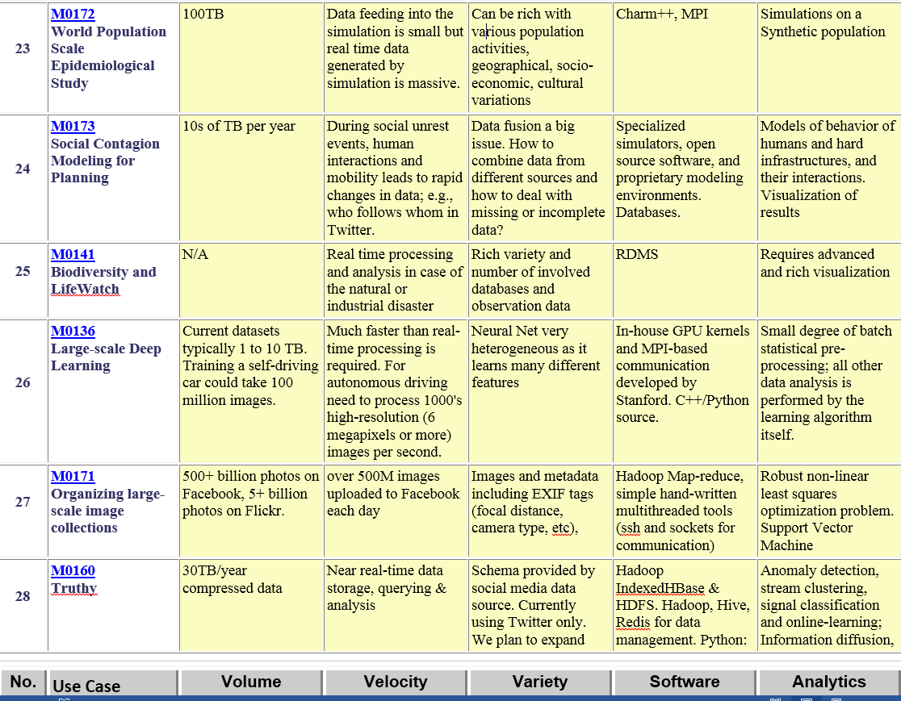
Part of Property Summary Table

Slide 7
10 Suggested Generic Use Cases
Multiple users performing interactive queries and updates on a database with basic availability and eventual consistency (BASE)
Perform real time analytics on data source streams and notify users when specified events occur
Move data from external data sources into a highly horizontally scalable data store, transform it using highly horizontally scalable processing (e.g. Map-Reduce), and return it to the horizontally scalable data store (ELT)
Perform batch analytics on the data in a highly horizontally scalable data store using highly horizontally scalable processing (e.g MapReduce) with a user-friendly interface (e.g. SQL-like)
Perform interactive analytics on data in analytics-optimized database
Visualize data extracted from horizontally scalable Big Data score
Move data from a highly horizontally scalable data store into a traditional Enterprise Data Warehouse
Extract, process, and move data from data stores to archives
Combine data from Cloud databases and on premise data stores for analytics, data mining, and/or machine learning
Orchestrate multiple sequential and parallel data transformations and/or analytic processing using a workflow manager

Slide 8
10 Security & Privacy Use Cases
Consumer Digital Media Usage
Nielsen Homescan
Web Traffic Analytics
Health Information Exchange
Personal Genetic Privacy
Pharma Clinic Trial Data Sharing
Cyber-security
Aviation Industry
Military - Unmanned Vehicle sensor data
Education - “Common Core” Student Performance Reporting
Need to integrate 10 “generic” and 10 “security & privacy” with 51 “full use cases”

Slide 9
Big Data Patterns – the Ogres

Slide 10
Would like to capture “essence of these use cases”
“small” kernels, mini-apps
Or Classify applications into patterns
Do it from HPC background not database viewpoint
e.g. focus on cases with detailed analytics
Section 5 of my class https://bigdatacoursespring2014.appspot.com/preview classifies 51 use cases with ogre facets

Slide 11
What are “mini-Applications”
Use for benchmarks of computers and software (is my parallel compiler any good?)
In parallel computing, this is well established
Linpack for measuring performance to rank machines in Top500 (changing?)
NAS Parallel Benchmarks (originally a pencil and paper specification to allow optimal implementations; then MPI library)
Other specialized Benchmark sets keep changing and used to guide procurements
Last 2 NSF hardware solicitations had NO preset benchmarks – perhaps as no agreement on key applications for clouds and data intensive applications
Berkeley dwarfs capture different structures that any approach to parallel computing must address
Templates used to capture parallel computing patterns
Also database benchmarks like TPC

Slide 12
HPC Benchmark Classics
Linpack or HPL: Parallel LU factorization for solution of linear equations
NPB version 1: Mainly classic HPC solver kernels
MG: Multigrid
CG: Conjugate Gradient
FT: Fast Fourier Transform
IS: Integer sort
EP: Embarrassingly Parallel
BT: Block Tridiagonal
SP: Scalar Pentadiagonal
LU: Lower-Upper symmetric Gauss Seidel

Slide 13
13 Berkeley Dwarfs
Dense Linear Algebra
Sparse Linear Algebra
Spectral Methods
N-Body Methods
Structured Grids
Unstructured Grids
MapReduce
Combinational Logic
Graph Traversal
Dynamic Programming
Backtrack and Branch-and-Bound
Graphical Models
Finite State Machines
First 6 of these correspond to Colella’s original.
Monte Carlo dropped.
N-body methods are a subset of Particle in Colella.
Note a little inconsistent in that MapReduce is a programming model and spectral method is a numerical method.
Need multiple facets!

Slide 14
51 Use Cases: What is Parallelism Over?
People: either the users (but see below) or subjects of application and often both
Decision makers like researchers or doctors (users of application)
Items such as Images, EMR, Sequences below; observations or contents of online store
Images or “Electronic Information nuggets”
EMR: Electronic Medical Records (often similar to people parallelism)
Protein or Gene Sequences;
Material properties, Manufactured Object specifications, etc., in custom dataset
Modelled entities like vehicles and people
Sensors – Internet of Things
Events such as detected anomalies in telescope or credit card data or atmosphere
(Complex) Nodes in RDF Graph
Simple nodes as in a learning network
Tweets, Blogs, Documents, Web Pages, etc.
And characters/words in them
Files or data to be backed up, moved or assigned metadata
Particles/cells/mesh points as in parallel simulations

Slide 15
51 Use Cases: Low-Level (Run-time) Computational Types
PP(26): Pleasingly Parallel or Map Only
MR(18 +7 MRStat): Classic MapReduce
MRStat(7): Simple version of MR where key computations are simple reduction as coming in statistical averages
MRIter(23): Iterative MapReduce
Graph(9): complex graph data structure needed in analysis
Fusion(11): Integrate diverse data to aid discovery/decision making; could involve sophisticated algorithms or could just be a portal
Streaming(41): some data comes in incrementally and is processed this way
(Count) out of 51

Slide 16
51 Use Cases: Higher-Level Computational Types or Features
Classification(30): divide data into categories
S/Q/Index(12): Search and Query
CF(4): Collaborative Filtering
Local ML(36): Local Machine Learning
Global ML(23): Deep Learning, Clustering, LDA, PLSI, MDS, Large Scale Optimizations as in Variational Bayes, Lifted Belief Propagation, Stochastic Gradient Descent, L-BFGS, Levenberg-Marquardt
GIS(16): Geotagged data and often displayed in ESRI, Microsoft Virtual Earth, Google Earth, GeoServer etc.
HPC(5): Classic large-scale simulation of cosmos, materials, etc. generates big data
Agent(2): Simulations of models of data-defined macroscopic entities represented as agents

Slide 17
18: Computational Bioimaging
Healthcare
Life Sciences
Application: Data delivered from bioimaging is increasingly automated, higher resolution, and multi-modal. This has created a data analysis bottleneck that, if resolved, can advance the biosciences discovery through Big Data techniques.
Current Approach: The current piecemeal analysis approach does not scale to situation where a single scan on emerging machines is 32 TB and medical diagnostic imaging is annually around 70 PB even excluding cardiology. One needs a web-based one-stop-shop for high performance, high throughput image processing for producers and consumers of models built on bio-imaging data.
Futures: Goal is to solve that bottleneck with extreme scale computing with community-focused science gateways to support the application of massive data analysis toward massive imaging data sets. Workflow components include data acquisition, storage, enhancement, minimizing noise, segmentation of regions of interest, crowd-based selection and extraction of features, and object classification, organization, and search. Use ImageJ, OMERO, VolRover, advanced segmentation and feature detection software.
Largely Local Machine Learning and Pleasingly Parallel

Slide 18
27: Organizing large-scale, unstructured collections of consumer photos I
Application: Produce 3D reconstructions of scenes using collections of millions to billions of consumer images, where neither the scene structure nor the camera positions are known a priori. Use resulting 3D models to allow efficient browsing of large-scale photo collections by geographic position. Geolocate new images by matching to 3D models. Perform object recognition on each image. 3D reconstruction posed as a robust non-linear least squares optimization problem where observed relations between images are constraints and unknowns are 6-D camera pose of each image and 3D position of each point in the scene.
Current Approach: Hadoop cluster with 480 cores processing data of initial applications. Note over 500 billion images on Facebook and over 5 billion on Flickr with over 500 million images added to social media sites each day.
Deep Learning
Social Networking
Global Machine Learning after Initial Local steps

Slide 19
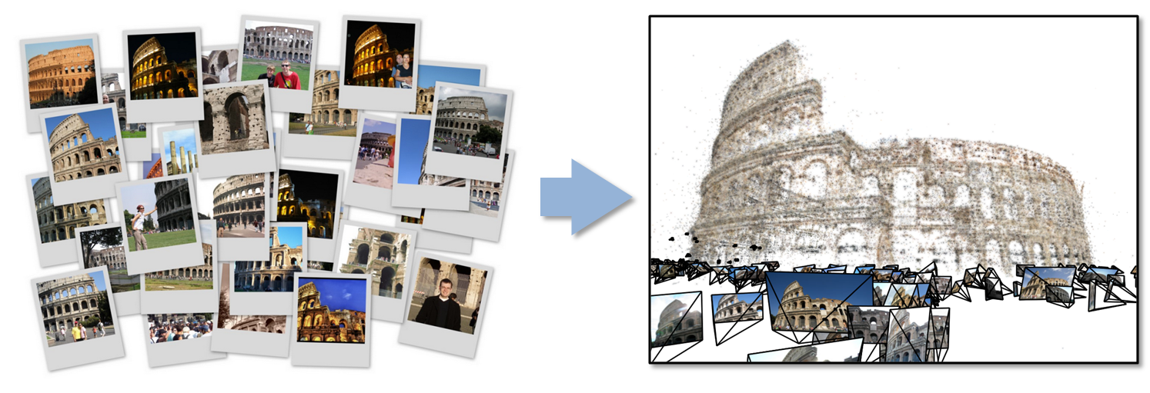
27: Organizing large-scale, unstructured collections of consumer photos II
Futures: Need many analytics, including feature extraction, feature matching, and large-scale probabilistic inference, which appear in many or most computer vision and image processing problems, including recognition, stereo resolution, and image denoising. Need to visualize large-scale 3D reconstructions, and navigate large-scale collections of images that have been aligned to maps.
Deep Learning
Social Networking
Global Machine Learning after Initial Local ML pleasingly parallel steps

Slide 20
One Facet of Ogres has Computational Features
Flops per byte;
Communication Interconnect requirements;
Is application (graph) constant or dynamic?
Most applications consist of a set of interconnected entities; is this regular as a set of pixels or is it a complicated irregular graph?
Is communication BSP or Asynchronous? In latter case shared memory may be attractive;
Are algorithms Iterative or not?
Data Abstraction: key-value, pixel, graph
Core libraries needed: matrix-matrix/vector algebra, conjugate gradient, reduction, broadcast

Slide 21
Data Source and Style Facet of Ogres
(i) SQL
(ii) NOSQL based
(iii) Other Enterprise data systems (10 examples from Bob Marcus)
(iv) Set of Files (as managed in iRODS)
(v) Internet of Things
(vi) Streaming and
(vii) HPC simulations
(viii) Involve GIS (Geographical Information Systems)
Before data gets to compute system, there is often an initial data gathering phase which is characterized by a block size and timing. Block size varies from month (Remote Sensing, Seismic) to day (genomic) to seconds or lower (Real time control, streaming)
There are storage/compute system styles: Shared, Dedicated, Permanent, Transient
Other characteristics are needed for permanent auxiliary/comparison datasets and these could be interdisciplinary, implying nontrivial data movement/replication
Notes:
Big dwarfs are Ogres
Implement Ogres in ABDS+

Slide 22
Major Analytics Architectures in Use Cases
Pleasingly Parallel: including local machine learning as in parallel over images and apply image processing to each image
- Hadoop could be used but many other HTC, Many task tools
Search: including collaborative filtering and motif finding implemented using classic MapReduce (Hadoop)
Map-Collective or Iterative MapReduce using Collective Communication (clustering) – Hadoop with Harp, Spark …..
Map-Communication or Iterative Giraph: (MapReduce) with point-to-point communication (most graph algorithms such as maximum clique, connected component, finding diameter, community detection)
Vary in difficulty of finding partitioning (classic parallel load balancing)
Shared memory: thread-based (event driven) graph algorithms (shortest path, Betweenness centrality)

Slide 23
4 Forms of MapReduce (Users and Abusers)
(a) Map Only
(b) Classic MapReduce
(c) Iterative Map Reduce or Map-Collective
(d) Point to Point
Input
Input
Iterations
Input
map
map
map
P_{ij}
reduce
reduce
Output
BLAST Analysis
Local Machine Learning
Pleasingly Parallel
High Energy Physics (HEP) Histograms
Distributed search
Expectation maximization Clustering e.g. K-means
Linear Algebra, PageRank
Classic MPI
PDE Solvers and particle dynamics
Domain of MapReduce and Iterative Extensions
MPI
Giraph
All of them are Map-Communication?

Slide 24
Core Analytics Facet of Ogres (microPattern) I
Choose from Examples given here
Map-Only
Pleasingly parallel - Local Machine Learning
MapReduce
Search/Query
Summarizing statistics as in LHC Data analysis (histograms)
Recommender Systems (Collaborative Filtering)
Linear Classifiers (Bayes, Random Forests)
Map-Collective I (need to improve/extend Mahout, MLlib)
Outlier Detection, Clustering (many methods),
LDA (Latent Dirichlet Allocation), PLSI (Probabilistic Latent Semantic Indexing)

Slide 25
Core Analytics Facet of Ogres (microPattern) II
Map-Collective II
Use matrix-matrix,-vector operations, solvers (conjugate gradient)
SVM and Logistic Regression
PageRank, (find leading eigenvector of sparse matrix)
SVD (Singular Value Decomposition)
MDS (Multidimensional Scaling)
Hidden Markov Models
Learning Neural Networks (Deep Learning)
Map-Communication
Graph Structure (Communities, subgraphs/motifs, diameter, maximal cliques, connected components)
Network Dynamics - Graph simulation Algorithms (epidemiology)
Asynchronous Shared Memory
Graph Structure (Betweenness centrality, shortest path)

Slide 26
Comparison of Data Analytics with Simulation I
Pleasingly parallel often important in both
Both are often SPMD and BSP
Non-iterative MapReduce is major big data paradigm
not a common simulation paradigm except where “Reduce” summarizes pleasingly parallel execution
Big Data often has large collective communication
Classic simulation has a lot of smallish point-to-point messages
Simulation dominantly sparse (nearest neighbor) data structures
“Bag of words (users, rankings, images..)” algorithms are sparse, as is PageRank
Important data analytics involves full matrix algorithms

Slide 27
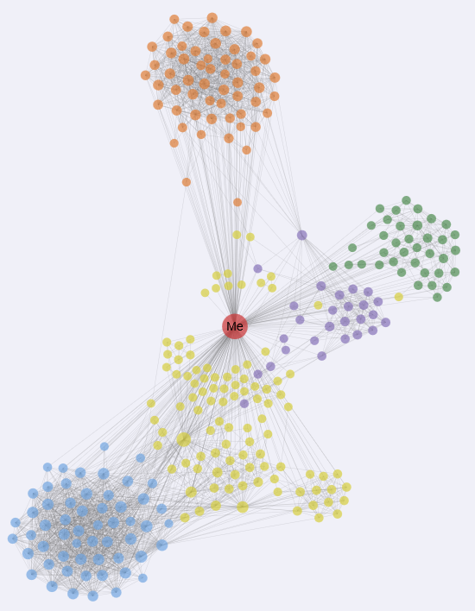
“Force Diagrams” for macromolecules and Facebook

Slide 28
Comparison of Data Analytics with Simulation II
There are similarities between some graph problems and particle simulations with a strange cutoff force.
Both Map-Communication
Note many big data problems are “long range force” as all points are linked.
Easiest to parallelize. Often full matrix algorithms
e.g. in DNA sequence studies, distance δ(i, j) defined by BLAST, Smith-Waterman, etc., between all sequences i, j.
Opportunity for “fast multipole” ideas in big data.
In image-based deep learning, neural network weights are block sparse (corresponding to links to pixel blocks) but can be formulated as full matrix operations on GPUs and MPI in blocks.
In HPC benchmarking, Linpack being challenged by a new sparse conjugate gradient benchmark HPCG, while I am diligently using non- sparse conjugate gradient solvers in clustering and Multi-dimensional scaling.

Slide 29
HPC-ABDS
Integrating High Performance Computing with Apache Big Data Stack
Shantenu Jha, Judy Qiu, Andre Luckow

Slide 30
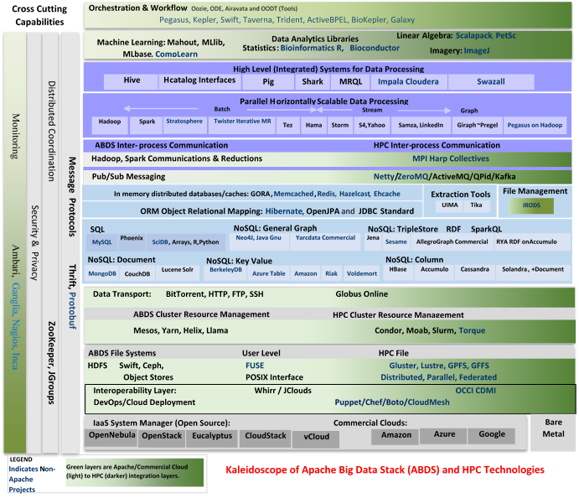

Slide 31
HPC-ABDS
~120 Capabilities
>40 Apache
Green layers have strong HPC Integration opportunities
Goal
Functionality of ABDS
Performance of HPC

Slide 32
Broad Layers in HPC-ABDS
Workflow-Orchestration
Application and Analytics: Mahout, MLlib, R…
High level Programming
Basic Programming model and runtime
SPMD, Streaming, MapReduce, MPI
Inter process communication
Collectives, point-to-point, publish-subscribe
In-memory databases/caches
Object-relational mapping
SQL and NoSQL, File management
Data Transport
Cluster Resource Management (Yarn, Slurm, SGE)
File systems(HDFS, Lustre …)
DevOps (Puppet, Chef …)
IaaS Management from HPC to hypervisors (OpenStack)
Cross Cutting
Message Protocols
Distributed Coordination
Security & Privacy
Monitoring

Slide 33
Getting High Performance on Data Analytics (e.g. Mahout, R…)
On the systems side, we have two principles:
The Apache Big Data Stack with ~120 projects has important broad functionality with a vital large support organization
HPC including MPI has striking success in delivering high performance,
however with a fragile sustainability model
There are key systems abstractions which are levels in HPC-ABDS software stack where Apache approach needs careful integration with HPC
Resource management
Storage
Programming model -- horizontal scaling parallelism
Collective and Point-to-Point communication
Support of iteration
Data interface (not just key-value)
In application areas, we define application abstractions to support:
Graphs/network
Geospatial
Genes
Images, etc.

Slide 34
HPC-ABDS Hourglass
HPC ABDS
System (Middleware)
120 Software Projects
System Abstractions/standards
Data format
Storage
HPC Yarn for Resource management
Horizontally scalable parallel programming model
Collective and Point-to-Point communication
Support of iteration (in memory databases)
Application Abstractions/standards
Graphs, Networks, Images, Geospatial ….
SPIDAL (Scalable Parallel Interoperable Data Analytics Library) or High performance Mahout, R, Matlab…
High performance
Applications

Slide 35
Iterative MapReduce Implementing HPC-ABDS
Judy Qiu, Bingjing Zhang, Dennis Gannon, Thilina Gunarathne

Slide 36
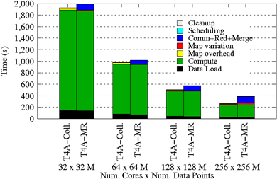
Using Optimal “Collective” Operations
Twister4Azure Iterative MapReduce with enhanced collectives
Map-AllReduce primitive and MapReduce-MergeBroadcast
Strong Scaling on K-means for up to 256 cores on Azure

Slide 37
Kmeans and (Iterative) MapReduce
Shaded areas are computing only where Hadoop on HPC cluster is fastest
Areas above shading are overheads where T4A smallest and T4A with AllReduce collective have lowest overhead
Note even on Azure Java (Orange) faster than T4A C# for compute

Slide 38
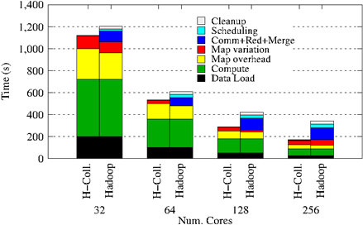
Collectives improve traditional MapReduce
Poly-algorithms choose the best collective implementation for machine and collective at hand
This is K-means running within basic Hadoop but with optimal AllReduce collective operations
Running on Infiniband Linux Cluster

Slide 39
Harp Design
Parallelism Model
Architecture
MapReduce Model
Map-Collective Model
MapReduce Applications
Map-Collective Applications
M
M
M
M
Application
M
M
M
M
MapReduce V2
Harp
Shuffle
Framework
R
R
Collective Communication
Resource Manager
YARN

Slide 40
Features of Harp Hadoop Plugin
Hadoop Plugin (on Hadoop 1.2.1 and Hadoop 2.2.0)
Hierarchical data abstraction on arrays, key-values and graphs for easy programming expressiveness.
Collective communication model to support various communication operations on the data abstractions
Caching with buffer management for memory allocation required from computation and communication
BSP style parallelism
Fault tolerance with checkpointing

Slide 41
WDA SMACOF MDS (Multidimensional Scaling) using Harp on Big Red 2 Parallel Efficiency: on 100-400K sequences next move to Azure
Conjugate Gradient (largest) and Matrix Multiplication

Slide 42
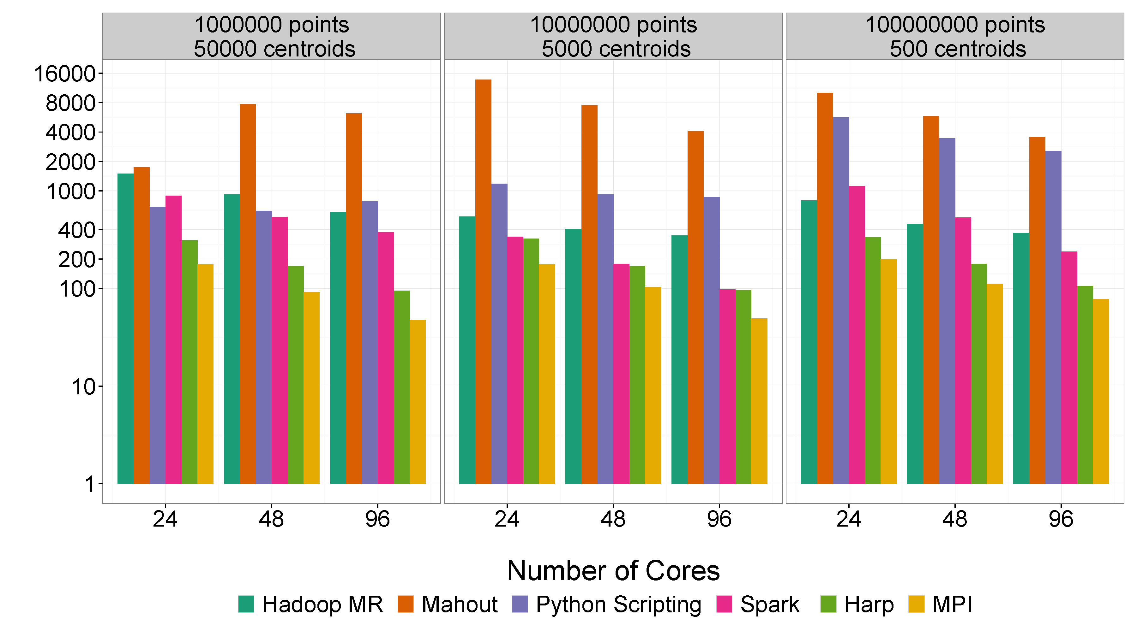
Mahout and Hadoop MR – Slow due to MapReduce Python slow as Scripting Spark Iterative MapReduce, non-optimal communication Harp Hadoop plug in with ~MPI collectives MPI fast as C, not Java
Increasing Communication
Identical Computation

Slide 43
Spare Slides

Slide 44
Application Class Facet of Ogres
Source of Problem
Search and query
Maximum Likelihood or χ² minimizations
Expectation Maximization (often Steepest descent)
Global Optimization (such as Learning Networks, Variational Bayes and Gibbs Sampling)
Do they Use Agents, as in epidemiology (swarm approaches)?
Core Algorithmic Structure
Basic Machine Learning (classification)
Stochastic Gradient Descent SGD
(L-)BFGS approximation to Newton’s Method
Levenberg-Marquardt solvers
Are data points in metric or non-metric spaces?

Slide 45
Problem Architecture Facet of Ogres (Meta or MacroPattern)
Pleasingly Parallel – as in BLAST, Protein docking, some (bio-)imagery including Local Analytics or Machine Learning – ML or filtering pleasingly parallel, as in bio-imagery, radar images (pleasingly parallel but sophisticated local analytics)
Classic MapReduce for Search and Query
Global Analytics or Machine Learning seen in LDA, Clustering, etc., with parallel ML over nodes of system
SPMD (Single Program Multiple Data)
Bulk Synchronous Processing: well-defined compute-communication phases
Fusion: Knowledge discovery often involves fusion of multiple methods.
Workflow (often used in fusion)
Notes:
Big dwarfs are Ogres
Implement Ogres in ABDS+

Slide 46
Performance on Madrid Cluster (8 nodes)
Increasing Communication
Identical Computation
Note compute same in each case as product of centers times points is identical

