Slide 1
The Future Of Digital: 2013
BI Intelligence

Slide 2






Henry Blodget
CEO & Editor-in-Chief, Business Insider
Marcelo Ballvé, Editorial Director
Tony Danova, Research Analyst
Cooper Smith, Research Analyst
John Heggestuen, Research Analyst
BI Intelligence is a new subscription service from Business Insider
that provides in-depth insight, data, and analysis of the mobile industry.
More info at intelligence.businessinsider.com

Slide 3
The medium is ~25 years old

Slide 4
So how are we doing?

Slide 5
Nearly 3 billion people online

Slide 6
About half left to go!

Slide 7
(But most of the money is already online)

Slide 8
“New media” dwarfs “old media” in market value
**Market cap the week of October 14

Slide 9
Value (and power) are still very concentrated
$1081 Market Value
**Market cap the week of October 14

Slide 10
The most important trend…

Slide 11
Multiple devices and screens.

Slide 12
PCs are now small share of connected devices…

Slide 13
Smartphone sales are still booming…

Slide 14
Tablets are cannibalizing PCs…

Slide 15
“Phablets” are filling in the gap…

Slide 16
Connected TVs on verge of going mainstream…

Slide 17
Wearables are beginning to take off…

Slide 18
Cars are increasingly connected

Slide 19
PC vendors, meanwhile, are getting smoked

Slide 20
Screen fragmentation is creating big challenges and opportunities.

Slide 21
~60% of online devices are now smartphones or tablets

Slide 22
People spend 1 hour a day on their smartphones

Slide 23
They spend ½ hour on tablet each time they use it

Slide 24
Mobile is the only media time that is growing

Slide 25
Mobile is enabling new forms of entertainment, communication, media, and commerce.

Slide 26
11 billion WhatsApp messages sent each day

Slide 27
758 million pictures shared each day

Slide 28
350 million Snapchat pictures sent a day

Slide 29
1/5th of Internet traffic is now from mobile

Slide 30
Mobile video is booming…

Slide 31
Social and music are now mostly mobile

Slide 32
~38 million US Facebook users visit only on mobile

Slide 33
Mobile is driving all of Facebook’s revenue growth

Slide 34
Mobile is now ~20% of e-commerce traffic…

Slide 35
…And 11% of e-commerce sales

Slide 36
Retailers are seeing huge mobile audience gains …

Slide 37
PayPal powers $20 billion in mobile transactions

Slide 38
Mobile has extended digital day to 18/7
Source: Google Analytcs, Business Insider

Slide 39
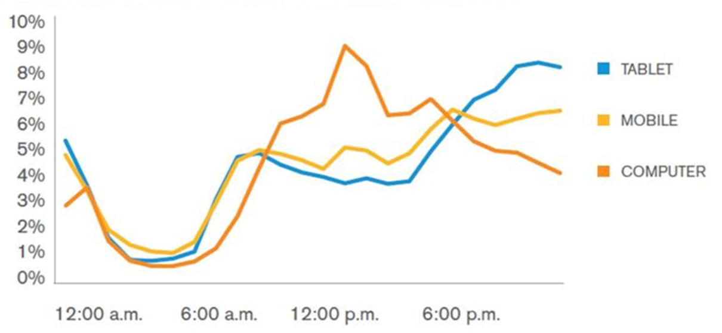
Each device has a different “prime time”
Share Of Device Page Traffic Over A Day:
Source: comScore, Telefonica, Macquarie Capital (USA), December 2011

Slide 40
Where are we in the mobile device cycle?

Slide 41
Smartphones are about halfway there.

Slide 42
Smartphone sales have overtaken “dumb phones”

Slide 43
Prices are dropping fast

Slide 44
Developed markets are already in late innings.

Slide 45
US smartphone growth is slowing

Slide 46
Fastest growth is now in emerging markets

Slide 47
China is already twice the size of the US market

Slide 48
Samsung and local manufacturers own China
Others

Slide 49
iPhone sales growth slowing

Slide 50
Tablet market a few years behind and still doubling

Slide 51
~250 million tablets will be shipped in 2013

Slide 52
iPad sales growth has nose-dived

Slide 53
What about the platform war?

Slide 54
We have a winner!

Slide 55
~80% of smartphones run Android

Slide 56
~60% of tablets run Android

Slide 57
~60% of all new computing devices run Android

Slide 58
Android used to lag Apple badly with app developers.

Slide 59
Not anymore.

Slide 60
Android now as popular with global developers as iOS

Slide 61
Most new app projects are now Android

Slide 62
Android has nearly caught iOS in developer revenue

Slide 63
Android now neck-and-neck in app downloads

Slide 64
Android is overcoming (some of) its weaknesses.

Slide 65
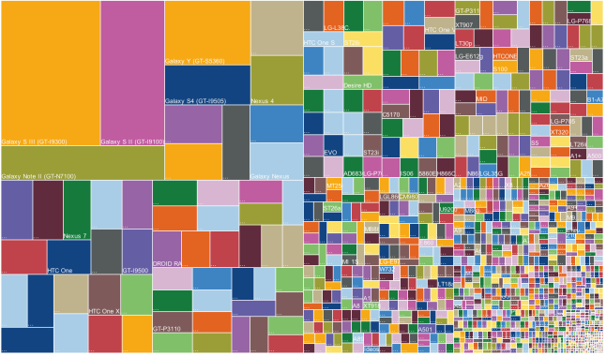
Android “fragmentation” is big but improving
Reprinted With Permission From OpenSignal, “Android Fragmentation Visualized”

Slide 66
45% of users now on latest version of Android

Slide 67
Up from only 10% early this year.

Slide 68
Apple is very strong in US — but weaker globally

Slide 69
In US, Apple still has an edge in ad revenue

Slide 70
And a big edge in eCommerce traffic…

Slide 71
Should you be “mobile only?”

Slide 72
No!

Slide 73
The world is now “multi-screen”

Slide 74
You should be “mobile, too.”

Slide 75
THE NEW MEDIA BUSINESS

Slide 76
There’s only one thing you need to remember about media…

Slide 77
“Attention is monetizable.”

Slide 78
Money follows eyeballs.

Slide 79
Eyeballs are moving to digital, especially mobile

Slide 80
And the money is following…
20%
average annual growth 2002-2012

Slide 81
Digital now accounts for ¼ of total ad spend

Slide 82
43% of ad revenue at 20 biggest companies is digital…

Slide 83
Digital is now bigger than TV

Slide 84
Print ads have fallen off cliff

Slide 85
Google now bigger than all newspapers, magazines

Slide 86
TV may be next.

Slide 87
Ratings are falling…

Slide 88
Pay TV subscriptions are dropping…
Source: Bernstein Research

Slide 89
Paid streaming usage is climbing fast…

Slide 90
People are paying directly for digital content …

Slide 91
“Over-the-top” video revenue is growing fast

Slide 92
YouTube is now bigger than AMC network

Slide 93
iTunes And Netflix already dwarf AMC

Slide 94
Facebook reaches more young people than free TV

Slide 95
“Broadcast” networks now available on digital

Slide 96
Even live sports are now being streamed

Slide 97
“I think cable is a complete waste of money. I’m not ever watching TV shows. I’m just watching on demand. I don’t have time, and I hate commercials.”
— Teen panelist at Ignition 2013

Slide 98
TV must also now share eyeballs with digital…

Slide 99
People use phones while they watch TV

Slide 100
They do email, read, social-network, play games…

Slide 101
So, eyeballs are leaving TV

Slide 102
But, so far, TV money is hanging in there

Slide 103
TV still massive, digital video still a blip

Slide 104
(Bigger they come, harder they fall?)

Slide 105
Eyeballs and money are also moving within digital…

Slide 106
People are spending less time on Internet portals

Slide 107
And more time on Google, Facebook, Twitter…

Slide 108
New sites and services are eating portals’ lunch

Slide 109
Search, display, video, and social ads are all growing

Slide 110
Traditional ‘display’ ad growth still respectable

Slide 111
Video and social ad spending is booming
We are here

Slide 112
And Google is now absurdly dominant

Slide 113
The big attention and money shift is to mobile…

Slide 114
Mobile ad spending still lags time spent

Slide 115
US mobile ads per sub growing fast but still low

Slide 116
Mobile ad prices are still much lower than desktop

Slide 117
But certain formats are improving

Slide 118
Mobile is still dominated by paid search ads

Slide 119
And Google owns almost all of it

Slide 120
Have Google, Facebook, Twitter won?

Slide 121
Not necessarily.

Slide 122
Money follows eyeballs.

Slide 123
“I hate Facebook. It’s just so boring.”
— Teen panelist at Ignition 2013 (now an Instagram user)

Slide 124
“I used to scroll down Facebook and read every single status. Now I just love Vine.”
— Teen panelist at Ignition 2013

Slide 125
So massive growth for the new new things…

Slide 126
So, what’s next?

Slide 127
Wearables!

Slide 128
Health devices are the most popular

Slide 129
Interest in glasses and headgear is only modest

Slide 130
Watches and fitness bands will be most of market

Slide 131
“Internet Of Things”

Slide 132

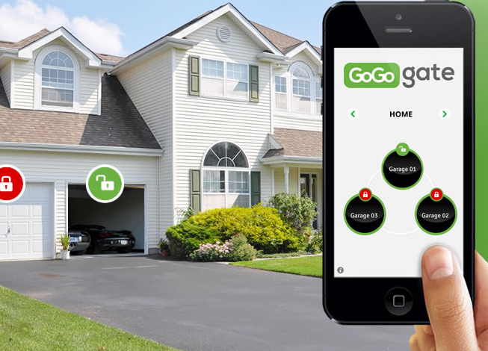
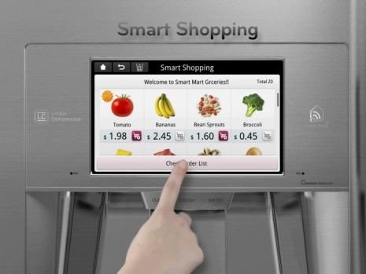
Networked houses and remote-control lives…

Slide 133
75 Billion Connected Devices By 2020
31% Average Annual Growth

Slide 134
Thank you!

