Slide 1

The
Berkeley Data Analytics Stack:
Present and Future
Michael Franklin
IEEE Big Data Conference
October 7, 2013
UC BERKELEY

Slide 2

The Big Data Problem - Nutshelled
Something’s
gotta
give:
Time
Quality
Money
Massive Diverse and Growing
Data

Slide 3
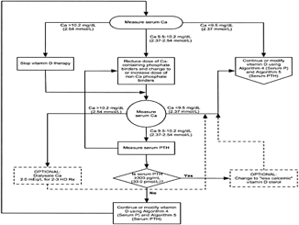


AMPLab: Integrating Three Key Resources
Algorithms
Machine Learning, Statistical Methods
Prediction, Business Intelligence
Machines
Clusters and Clouds
Warehouse Scale Computing
People
Crowdsourcing, Human Computation
Data Scientists, Analysts

Slide 4



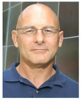























The Berkeley AMPLab
Collaborative Big Data Research
Launched: January 2011
Scheduled Conclusion: December 2016
Personnel: Approx. 60 Students, Postdocs, Faculty and Staff

Slide 5
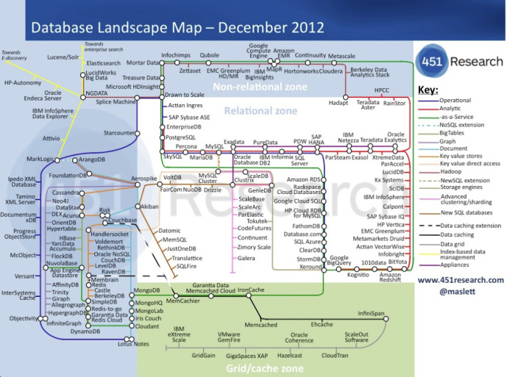
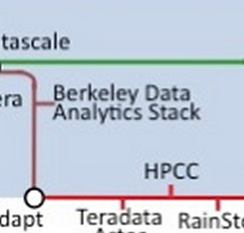
Big Data Landscape – Our Corner

Slide 6
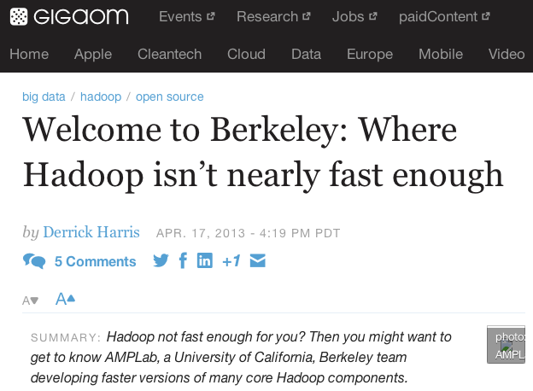
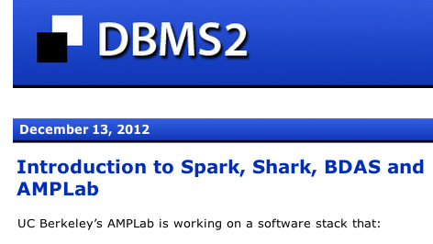
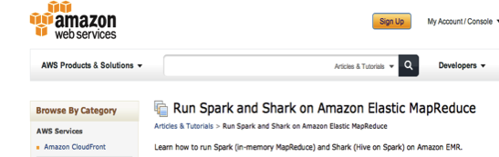


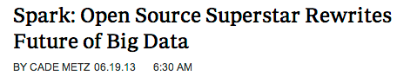
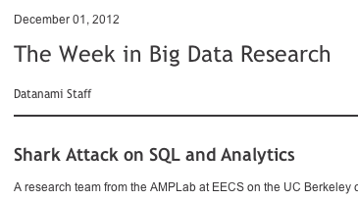
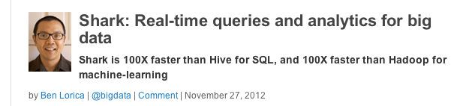

BDAS in the News

Slide 7
Berkeley Data Analytics Stack
Spark
Streaming
Graph
X
MLbase
BlinkDB
Pig
HIVE
Storm
MPI
ML-Lib
Shark
Data
Processing
Apache Spark
Hadoop MR
HDFS Storage
Tachyon
Data
Mgmt.
Apache Mesos
YARN Resource Mgr
Resource
Mgmt.
Released (BDAS)
In development (AMP)
(Developer/Alpha releases)
3rd party open source
AMP BDAS Components being released under BSD or Apache Open Source License

Slide 8

Introducing
Batch
Fast, MapReduce-like engine
  In-memory storage abstraction for iterative/interactive queries
  General execution graphs
  Up to 100x faster than Hadoop MR (2-10x even for on-disk)
Compatible with Hadoop’s storage APIs
  Can access HDFS, HBase, S3, SequenceFiles, etc
Great example of ML/Systems (and eventually DB) collaboration
Spark
Interactive
Streaming

Slide 9
Queries and ML in Hadoop
HDFS
read
query 1
result 1
query 2
result 2
query 3
result 3
Input
. . .
HDFS
read
HDFS
write
HDFS
read
HDFS
write
iter. 1
iter. 2
. . .
Input

Slide 10
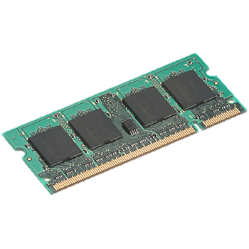
In-Memory Data Sharing
query 1
one-time
processing
query 2
query 3
Input
Distributed
memory
. . .
iter. 1
iter. 2
. . .
Input

Slide 11
Challenge
How to design a distributed memory abstraction that is both fault-tolerant and efficient?
Traditional in-memory storage systems replicate data or update logs across nodes -> slow!
  Network write is 10-100× slower than memory

Slide 12
Resilient Distributed Datasets
RDDs provide an interface for coarse-grained transformations (map, group-by, join, …) on immutable collections
Efficient fault recovery using lineage
  Log one operation to apply to many elements
  Recompute lost partitions of RDD on failure
  No cost if nothing fails
Rich enough to capture many models:
  Data flow models: MapReduce, Dryad, SQL, …
  Specialized models: Pregel, Hama, …
M. Zaharia, et al, Resilient Distributed Datasets: A fault-tolerant abstraction for in-memory cluster computing, NSDI 2012. Best Paper Award

Slide 13

Example: Log Mining
Load error messages from a log into memory, then interactively search for various patterns
Base RDD
Transformed RDD
Cache 1
lines = spark.textFile(“hdfs://...”)
errors = lines.filter(_.startsWith(“ERROR”))
messages = errors.map(_.split(‘\t’)(2))
cachedMsgs = messages.cache()
Worker
results
tasks
Block 1
Driver
Action
cachedMsgs.filter(_.contains(“foo”)).count
cachedMsgs.filter(_.contains(“bar”)).count
Cache 2
Worker
Cache 3
Result: scaled to 1 TB data in 5-7 sec
(vs 170 sec for on-disk data)
Result: full-text search of Wikipedia in <1 sec (vs 20 sec for on-disk data)
Worker
Block 2
Block 3
Notes:
Add “variables” to the “functions” in functional programming

Slide 14
Fault Tolerance with RDDs
RDDs track the series of transformations used to build them (their lineage)
Enables per-node recomputation of lost data
messages = textFile(...).filter(_.contains(“error”))
.map(_.split(‘\t’)(2))
HadoopRDD
path = hdfs://…
FilteredRDD
func = _.contains(...)
MappedRDD
func = _.split(…)

Slide 15
Example: Logistic Regression
Goal: find best line separating two sets of points
random initial line
+
+
+
+
+
–
+
–
+
+
–
–
+
+
–
–
–
–
–
–
target
Notes:
Note that dataset is reused on each gradient computation

Slide 16
Example: Logistic Regression
Load data in memory once
val data = spark.textFile(...).map(readPoint).cache()
var w = Vector.random(D)
for (i <- 1 to ITERATIONS) {
val gradient = data.map(p =>
(1 / (1 + exp(-p.y*(w dot p.x))) - 1) * p.y * p.x
).reduce(_ + _)
w -= gradient
}
println("Final w: " + w)
Initial parameter vector
Repeated MapReduce steps
to do gradient descent
Notes:
Key idea: add “variables” to the “functions” in functional programming

Slide 17
Logistic Regression Performance
110 s / iteration
first iteration 80 s
further iterations 1 s
29 GB dataset on 20 EC2 m1.xlarge machines (4 cores each)
Notes:
This is for a 29 GB dataset on 20 EC2 m1.xlarge machines (4 cores each)

Slide 18

Spark Status
Current release (0.8) includes Java and Python APIs
  Now in Apache Incubator
  Includes: mini-batch streaming option, MLlib, YARN integration, EC2
  20 Companies contributed code in latest release
  Spark Bay Area Meetup Group (1250 members) – new groups forming
Sample Use cases:
  In-memory analytics on Hive data (Conviva)
  Interactive queries on data streams (Quantifind)
  Business intelligence (Yahoo!)
  Traffic estimation w/ GPS data (Mobile Millennium)
  DNA sequence analysis (SNAP)

Slide 19
Berkeley Data Analytics Stack
Spark
Streaming
Graph
X
MLbase
BlinkDB
Pig
HIVE
Storm
MPI
ML-Lib
Shark
Data
Processing
Apache Spark
Hadoop MR
HDFS Storage
Tachyon
Data
Mgmt.
Apache Mesos
YARN Resource Mgr
Resource
Mgmt.
Released (BDAS)
In development (AMP)
(Developer/Alpha releases)
3rd party open source
AMP BDAS Components being released under BSD or Apache Open Source License

Slide 20
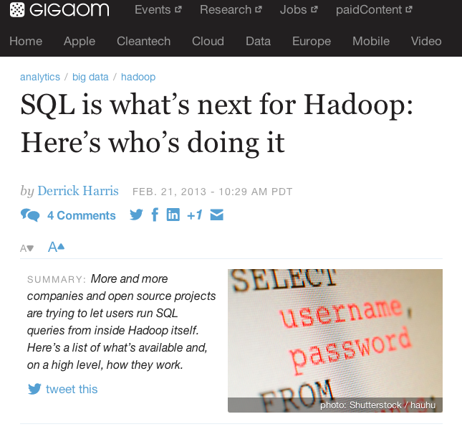
“NoSQL” Irony

Slide 21
What’s good about MapReduce?
Scales out to thousands of nodes in a fault-tolerant manner
Great for analyzing semi-structured data and complex analytics
Elasticity (cloud computing)
Multi-tenancy resource sharing

Slide 22
What Makes MR-based systems slow?
Disk-based intermediate outputs.
Inferior data format and layout (e.g., no control of data co-partitioning).
Execution strategies (lack of optimization based on data statistics).
Task scheduling and launch overhead!
None of these should be fundamental!

Slide 23
Shark = Spark + Hive
Uses Spark’s in-memory RDD caching and language
  Result reuse and low latency
  Scalable, fault-tolerant, fast
Query Compatible with Hive
  Run HiveQL queries (w/ UDFs, UDAs…) without modifications
  Convert logical query plan generated from Hive into Spark execution graph
Data Compatible with Hive
  Use existing HDFS data and Hive metadata, without modifications
C. Engle, et al, Shark: Fast Data Analysis Using Coarse-grained Distributed Memory, SIGMOD 2012 (system demonstration). Best Demo Award
R. Xin et al., Shark: SQL and Rich Analytics at Scale, SIGMOD 2013.

Slide 24

Hive Architecture
Meta store
Client
CLI
JDBC
Driver
SQL Parser
Query Optimizer
Physical Plan
Execution
MapReduce
HDFS

Slide 25
Shark Architecture
Meta store
Client
CLI
JDBC
Cache Mgr.
Driver
SQL Parser
Query Optimizer
Physical Plan
Execution
Spark
HDFS

Slide 26
Column-Oriented Storage
Caching Hive records as Java objects is inefficient
Instead, use arrays of primitive types for columns
  Similar size to serialized form, but 5x faster to process
Columnar compression can further reduce size by 5x
Row Storage
Column Storage
1
john
4.1
1
2
3
2
mike
3.5
john
mike
sally
3
sally
6.4
4.1
3.5
6.4

Slide 27
Other Shark Optimizations
Fast task start-up
Dynamic (mid-query) join algorithm selection based on statistical properties of data
Runtime selection of # of reducers
Partition pruning using range statistics
Controllable table partitioning across nodes

Slide 28
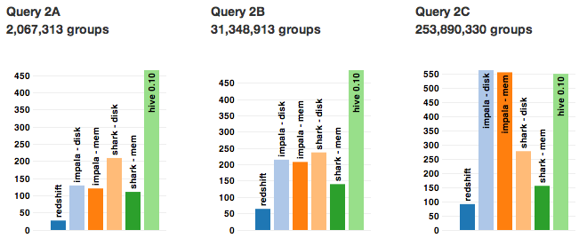
Benchmark: Grouped Aggregation
SELECT SUBSTR(sourceIP, 1, X), SUM(adRevenue)
FROM uservisits
GROUP BY SUBSTR(sourceIP, 1, X)
https://amplab.cs.berkeley.edu/benchmark/

Slide 29
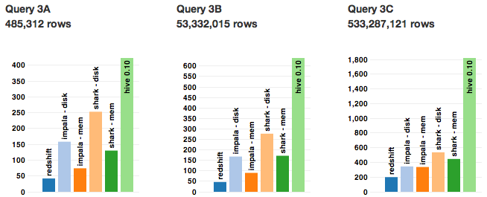
Benchmark: Join + Order By
SELECT srcIP, AVG(pageRank), SUM(adRevenue) as totalRev
FROM Rankings AS R, UserVisits AS UV
WHERE R.pageURL = UV.destURL
AND UV.visitDate BETWEEN Date(`1980-01-01') AND Date(`X')
GROUP BY UV.sourceIP
ORDER BY totalRev DESC LIMIT 1
https://amplab.cs.berkeley.edu/benchmark/

Slide 30
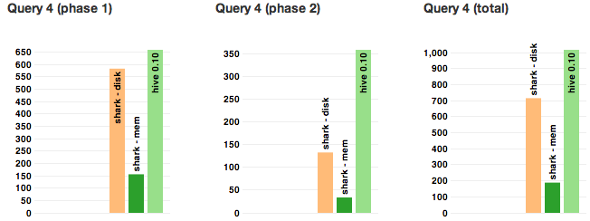
Benchmark: User-Defined Function
CREATE TABLE url_counts_partial AS
SELECT TRANSFORM (line)
USING "python /root/url_count.py" as (sourcePage, destPage, cnt)
FROM documents;
CREATE TABLE url_counts_total AS
SELECT SUM(cnt) AS totalCount, destPage
FROM url_counts_partial
GROUP BY destPage;
https://amplab.cs.berkeley.edu/benchmark/

Slide 31
A Unified System for SQL, RT & ML
Can move seamlessly between SQL and Machine Learning worlds

Slide 32
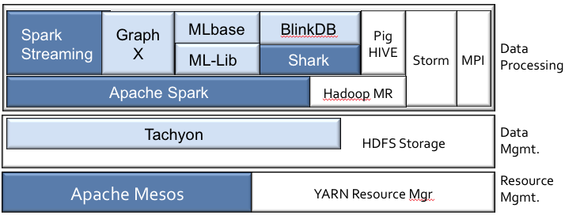
BDAS Present - Summary
Spark Streaming – Real-time Processing
Tachyon – Memory-based layer on top of HDFS
BlinkDB – Approximate Query Processing
MLlib – Scalable Distributed Machine Learning Library in Spark
GraphX – Graph processing integrated with Spark and Shark
See http://amplab.cs.berkeley.edu/publications for more information

Slide 33

BDAS – What’s Next?
Continue developing/releasing advanced components.
Make Machine Learning/Advanced Analytics Easier to Use
Enable People to participate in all aspects of analytics
Address the “3 E’s of Big Data”
Fast
Reliable
Accurate
Easy to Use

Slide 34
The 3 E’s of Big Data:
Extreme Elasticity Everywhere

Slide 35
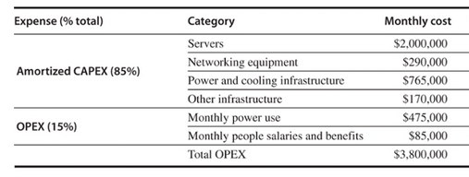
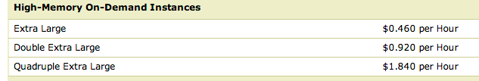
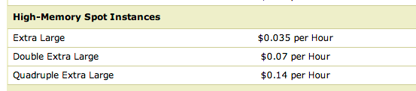
Extreme Elasticity - Machines
Option #1 – Build your own Cluster/WSC
Option #2 – Rent Machines from AWS
46K Servers
(2010 estimate from H&P book)
Option #3 – Try your luck on the Spot Market
x #Servers needed
x #Servers needed
(US East – Saturday Sept 28 @1:30am)
Notes:
24 * 30 = 720 hrs/month * 46K = 33M server/hours month
For on-demand instances – that’s 10x the cost
For spot (if you could get that many) it’s price competitive (maybe cheaper) and no capital outlay…

Slide 36
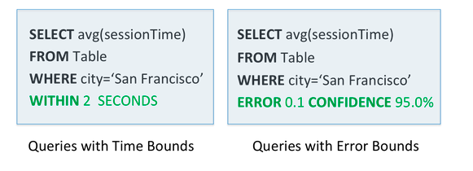
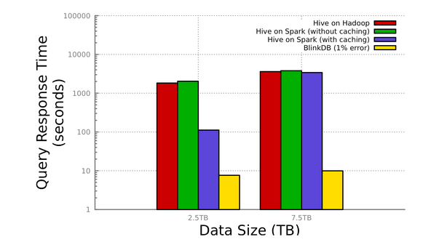
Extreme Elasticity - Algorithms
Agarwal et al., BlinkDB: Queries with Bounded Errors and Bounded Response Times on Very Large Data. ACM EuroSys 2013, Best Paper Award

Slide 37
CrowdDB – People-powered Query Processing
Other People-powered Database projects:
Qurk – MIT
Deco – Stanford
Franklin et al., CrowdDB: Answering Queries with Crowdsourcing, SIGMOD 2011
Feng et al., Query Processing with the VLDB Crowd, VLDB 2011 Best Demo Award
Trushkowsky et al., Crowdsourcing Enumeration Queries, ICDE 2013 Best Paper Award

Slide 38

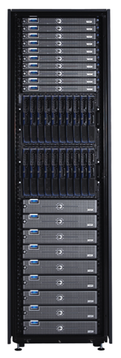
Extreme Elasticity - People
Constantly changing workforce
Adapting/Learning workers
Various Incentives
Fatigue, Fraud, & other Failure Modes
Latency & Prediction
Work Conditions
Interface <-> Answer Quality
Task Structuring & Routing

Slide 39
Extreme Elasticity
Algorithms
Approximate Answers
Machines
Cloud Computing – esp. Spot Instances
Multi-tenancy
People
Dynamic Task and Microtask Marketplaces
Visual analytics
ML Libraries and Ensemble Methods
Relaxed (eventual) consistency/ Multi-version methods
Active Learning
Manipulative interfaces and mixed mode operation

Slide 40
The Challenge
Extreme Elasticity
+ Tradeoffs
+ AMP Integration
= Extreme Complexity

Slide 41
Needed: A Declarative Approach
End Users tell the system what they want, not how to get it
SQL
Result
MQL
Model

Slide 42
Goals of MLbase
ML Experts
MLbase
Systems Experts
Easy scalable ML development (ML Developers)
Easy/user-friendly ML at scale (End Users)
T. Kraska, et al., “MLbase: A Distributed Machine-Learning System”, CIDR 2013
E. Sparks, A. Talwalkar et al., “MLI: An API for Distributed Machine Learning, ICDM 2013
Notes:
Turn ML into an engineering discipline
Mlbase is a system which consists of a library of distributed machine learning algorithms, programming abstractions to support the development of these, and a suite of tools to make building and deploying models in a distributed setting easy for end users.

Slide 43
A Declarative Approach
End Users tell the system what they want, not how to get it
Example: Supervised Classification
var X = load(”als_clinical”, 2 to 10)
var y = load(”als_clinical”, 1)
var (fn-model, summary) = doClassify(X, y)
Algorithm Independent

Slide 44
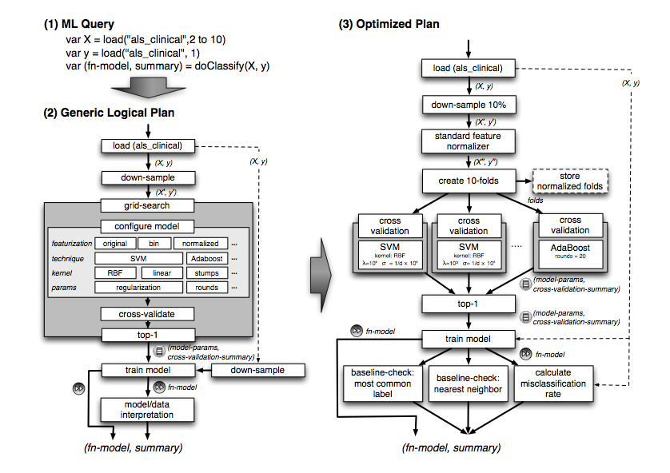
MLBase – Query Compilation

Slide 45
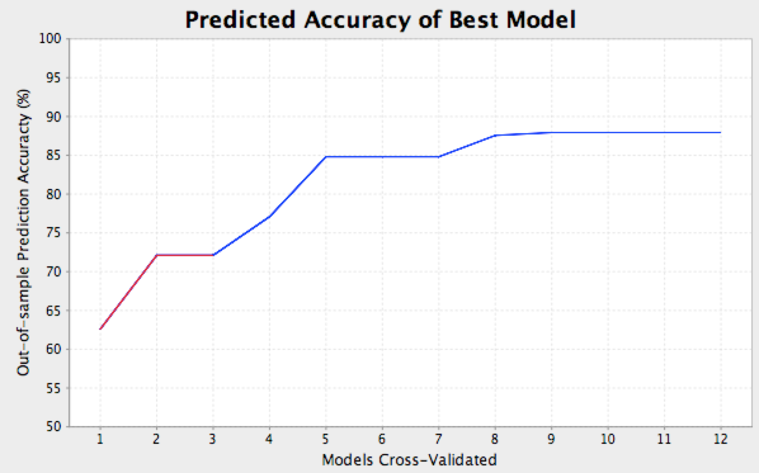
Query Optimizer: A Search Problem
System is responsible for searching through model space
Opportunities for physical optimization
5min
SVM
Boosting

Slide 46


Declarative ML: Status
initial
release:
Spring
2014
MQL Parser
Query Planner / Optimizer
ML Library
(Contracts)
ML Developer API
Runtime
Released
July 2013

Slide 47
Summary
The Berkeley AMPLab is integrating Algorithms, Machines and People to make sense of data at scale.
BDAS is our main delivery vehicle.
Open Source has been a great way to have real industry impact with academic research.
Our direction: advanced analytics, extreme elasticity, and support for people in all phases of Big Data analytics.

Slide 48
For More Information
UC BERKELEY
amplab.cs.berkeley.edu
franklin@berkeley.edu
Thanks to NSF CISE Expeditions in Computing, DARPA XData,
Founding Sponsors: Amazon Web Services, Google, and SAP,
and all our industrial sponsors and partners.

