Slide 1
THE FUTURE OF RETAIL: 2014
BI Intelligence

Slide 2
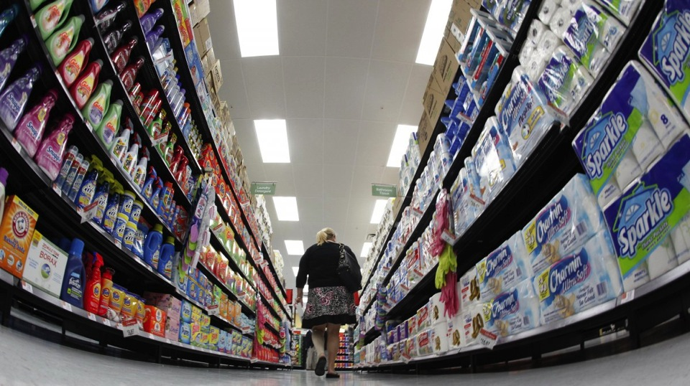
Is This How People Really Like To Shop?
Image: Reuters

Slide 3
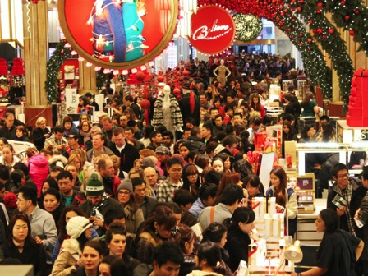
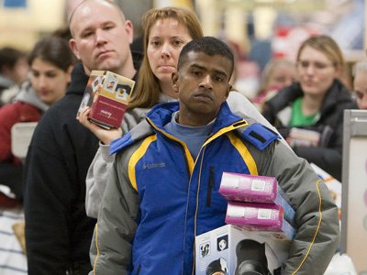
Or This?
Images: Kim Bhasin / Business Insider

Slide 4
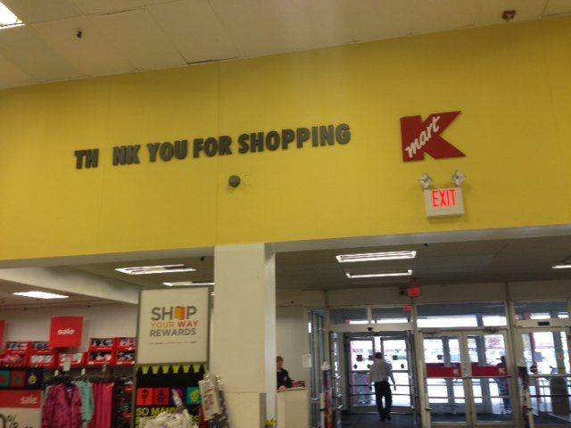
Let’s Face It — The Old Retail Model Is Dying
Image: Brian Sozzi / Belus Capital Advisors

Slide 5
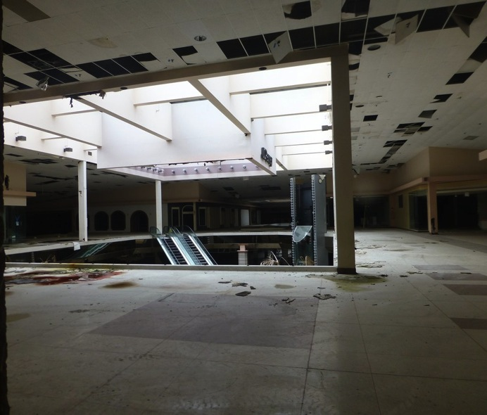
Fast
Image: Nicholas Eckhart

Slide 6
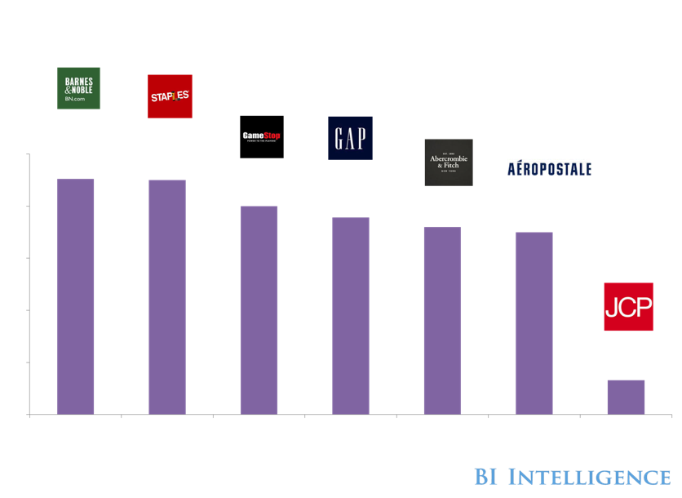
Hundreds Of Retail Stores Are Closing

Slide 7
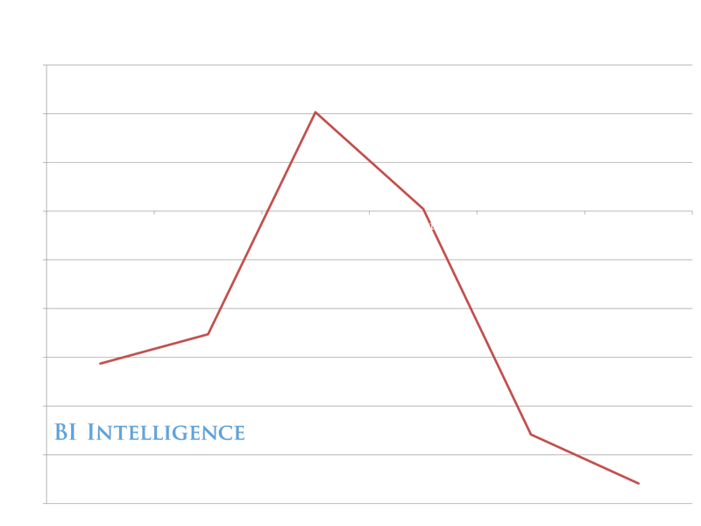
Because Store Sales Are Tanking

Slide 8
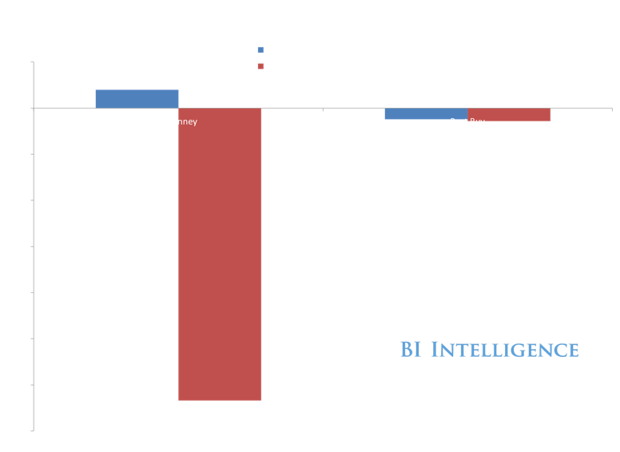


Holiday Quarters Have Been Terrible For Physical Retail

Slide 9















Where Are Shoppers Going?

Slide 10
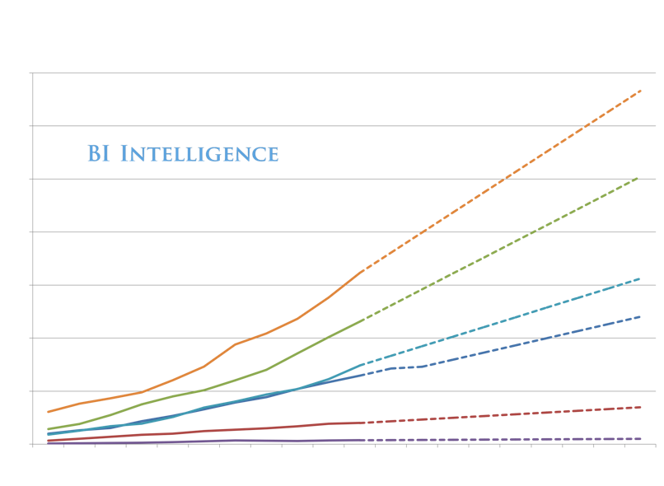
Online!
We Are Here

Slide 11
“We’re in the midst of a profound structural shift from physical to digital retail ... it’s happening faster than I could have imagined. ”
— Jeff Jordan, partner at Andreessen Horowitz, January 2014

Slide 12
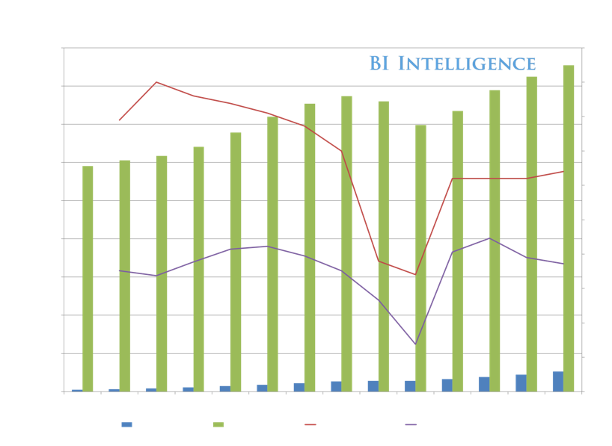
E-Commerce Is Driving Nearly All Retail Growth In US

Slide 13
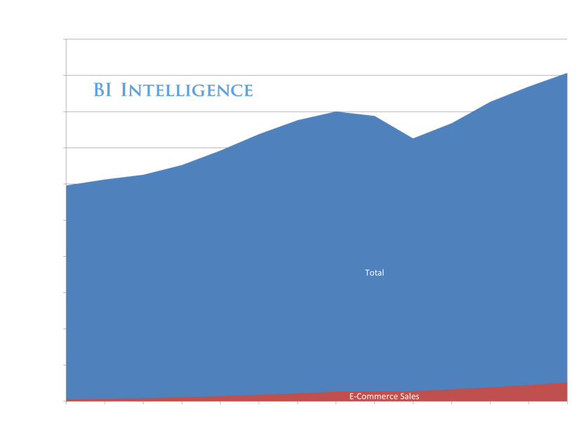
1 In 20 Retail Dollars Are Already Online

Slide 14
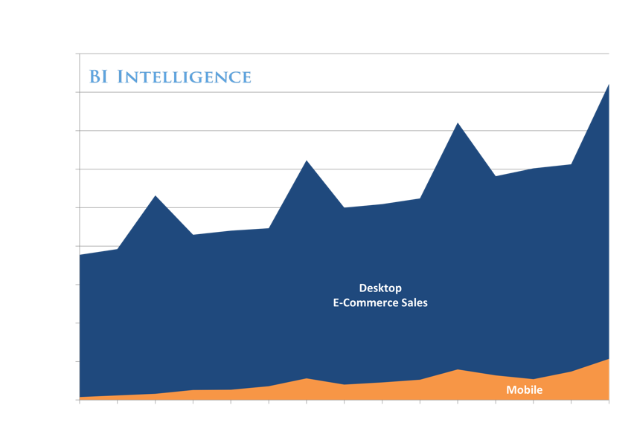
Mobile Is Also Gaining Fast

Slide 15
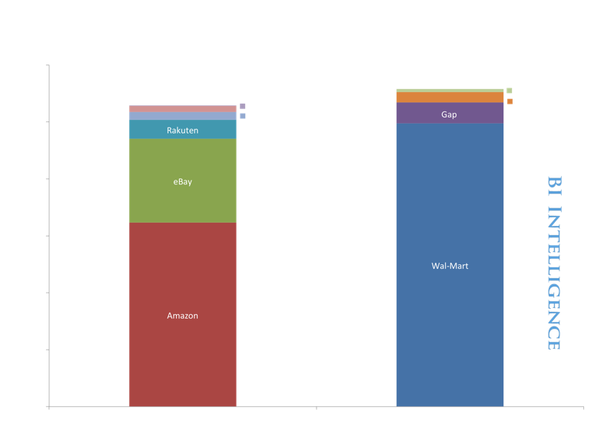
‘New Retail’ Is Nearly Equal To Old Guard In Market Value

Slide 16
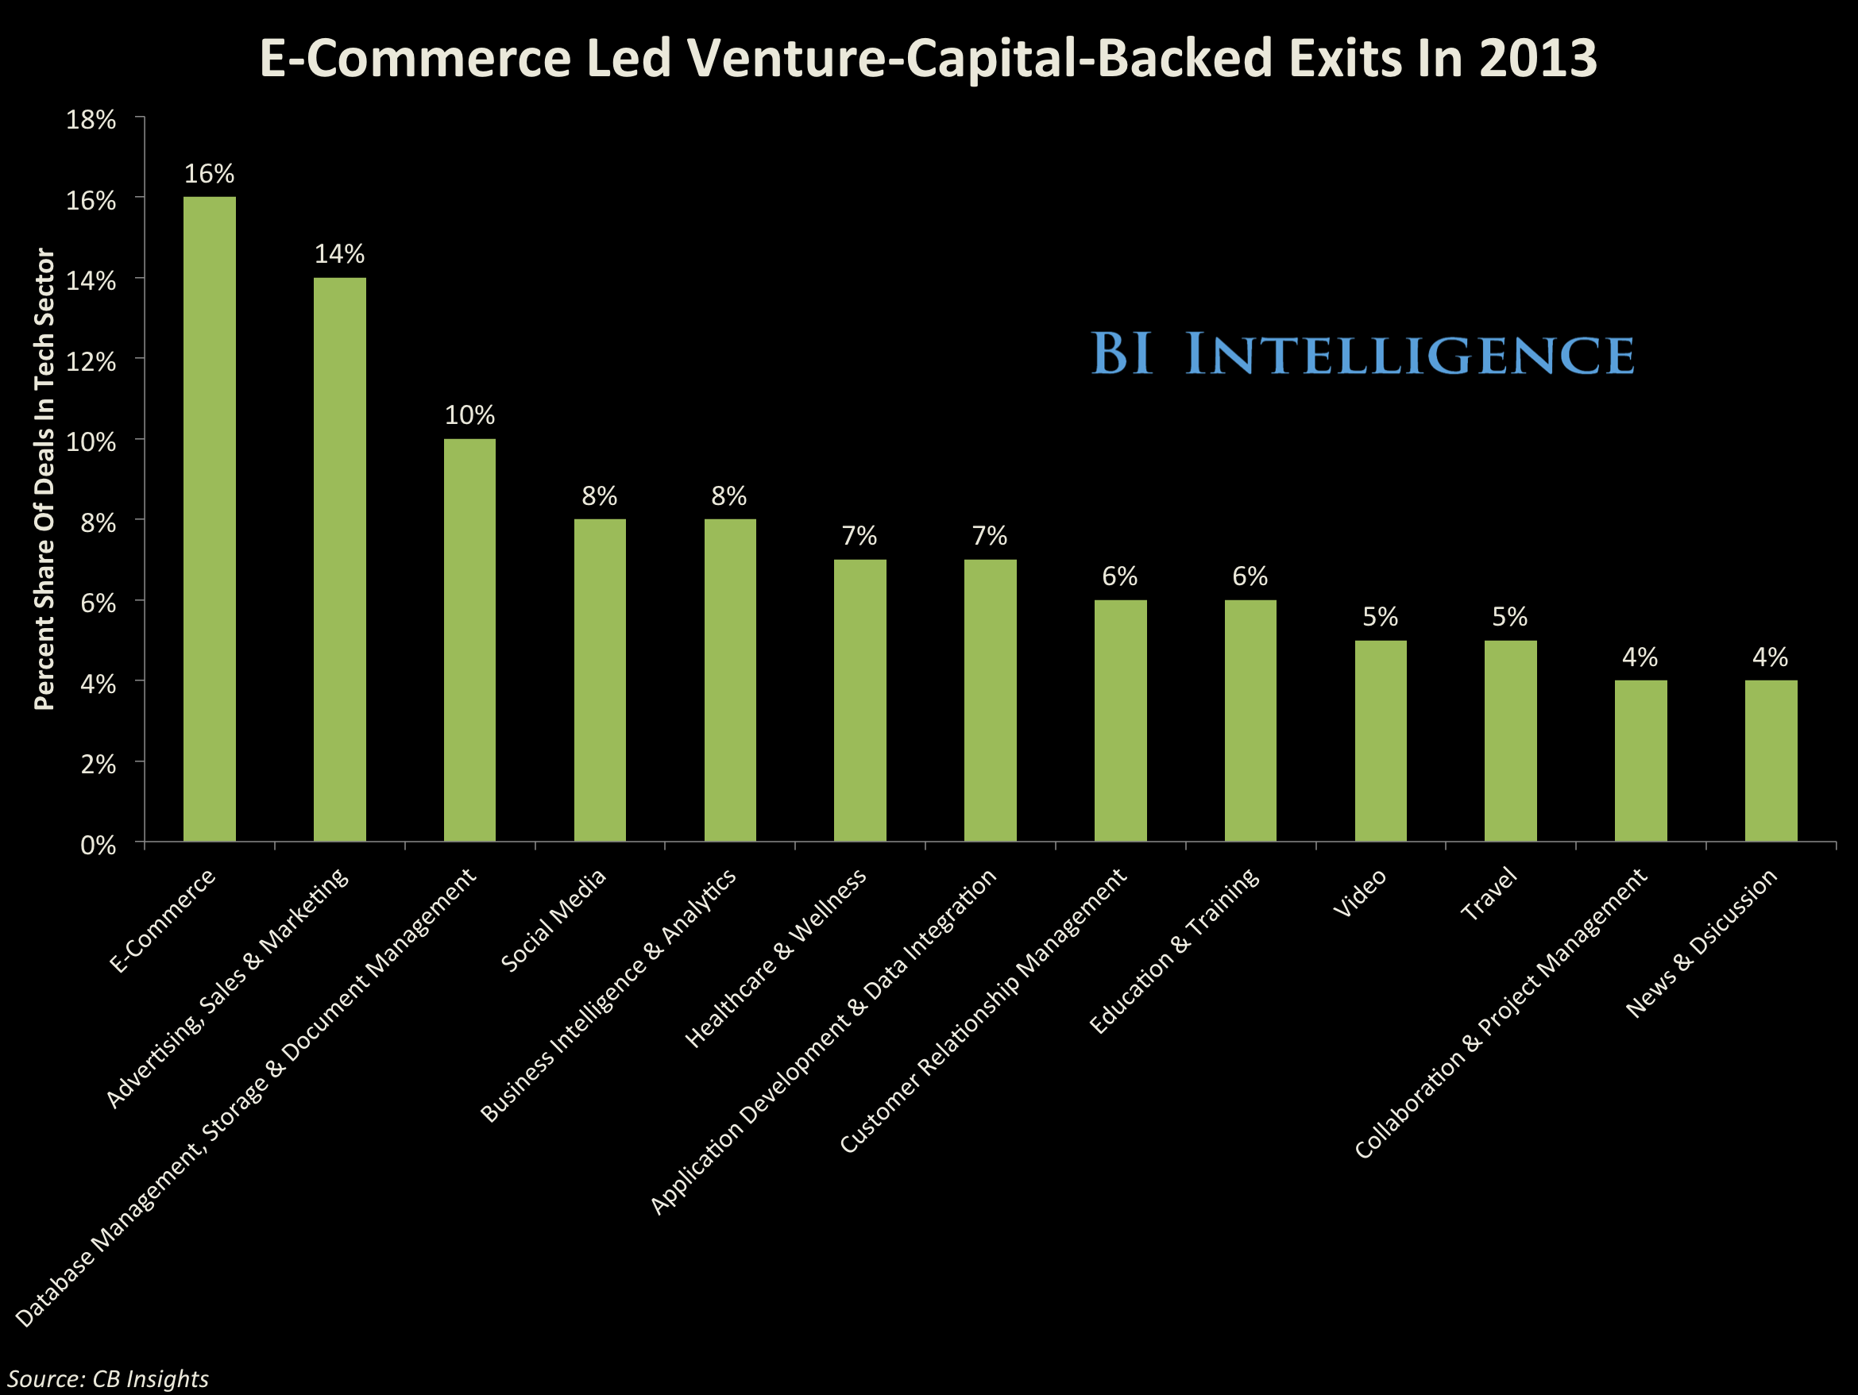
Venture Capital Is Cashing In

Slide 17
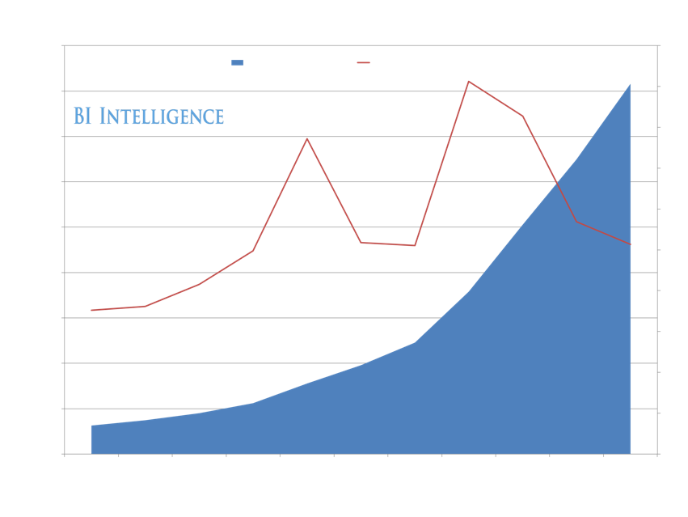
Amazon Continues Growing Very Quickly

Slide 18
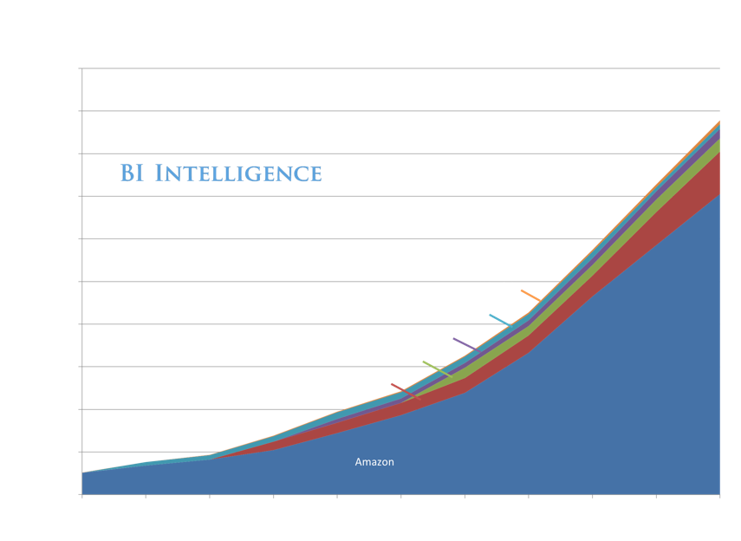
But Other Retailers Are Also Growing Online Sales

Slide 19
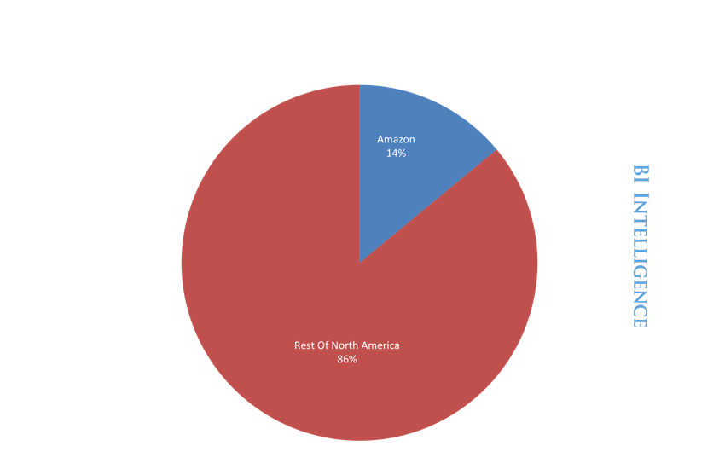
Amazon Got Started With Media Sales
Amazon Is Now ~14% Of All E-Commerce

Slide 20
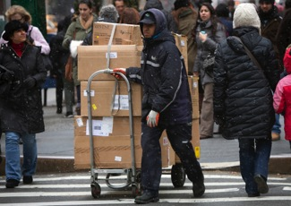
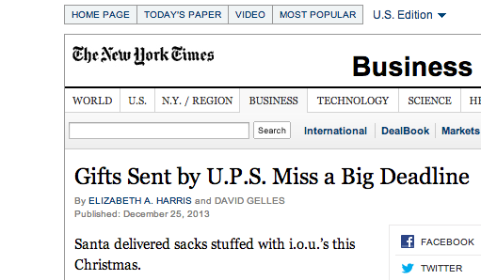
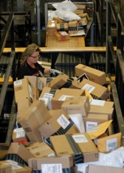
The Signs Are Clear —
E-Commerce Is Booming.
Shippers Were Overwhelmed By
The Massive Volume Of
E-Commerce Orders Over Christmas 2013
Images, Right: Reuters

Slide 21
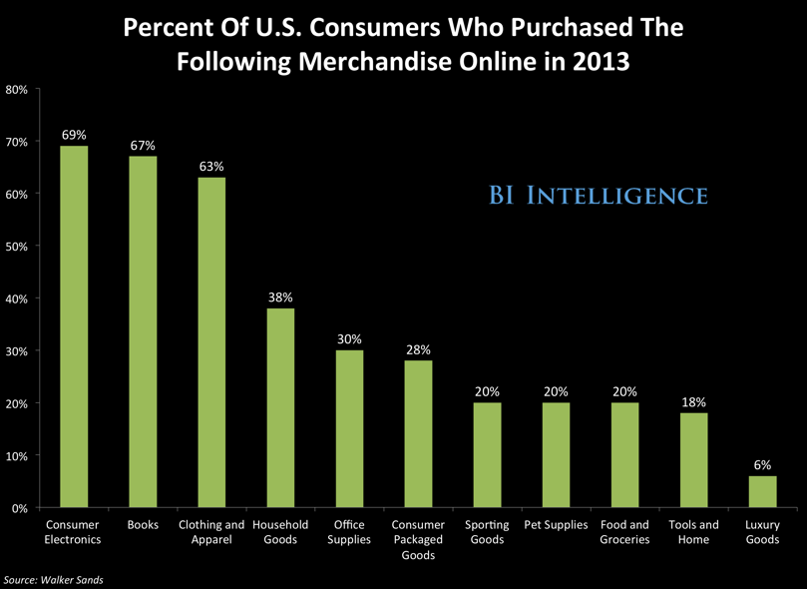
The Top Categories — Electronics, Media, Clothing

Slide 22
Let’s Look At Some Of The Retail Categories Individually

Slide 23
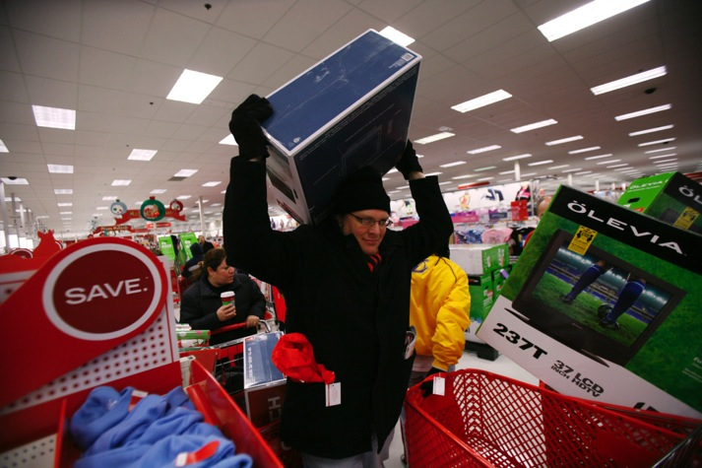
ELECTRONICS
Image: Reuters

Slide 24
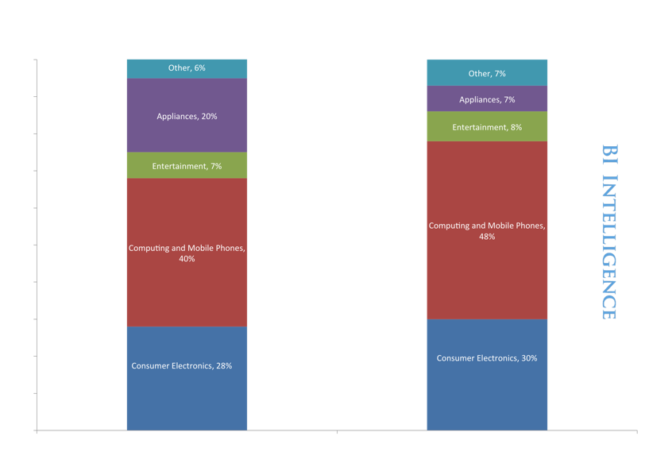

Best Buy Is Vulnerable. 85% Of Sales From Electronics.

Slide 25
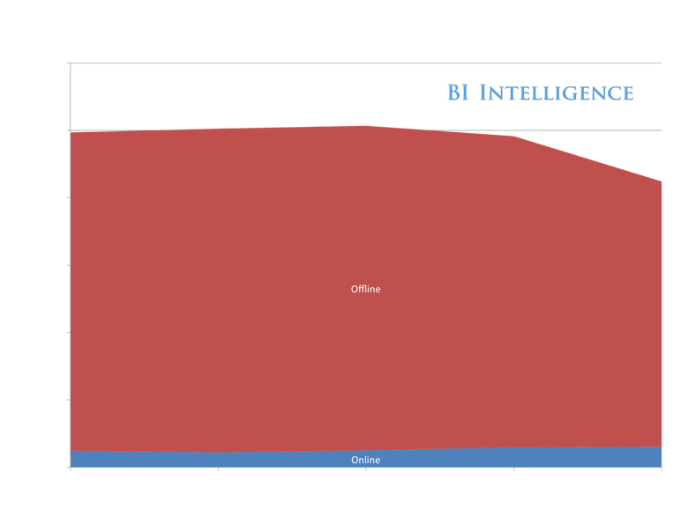
Best Buy Offline Sales Plummeted 15% Last Year
BI Intelligence Estimate

Slide 26
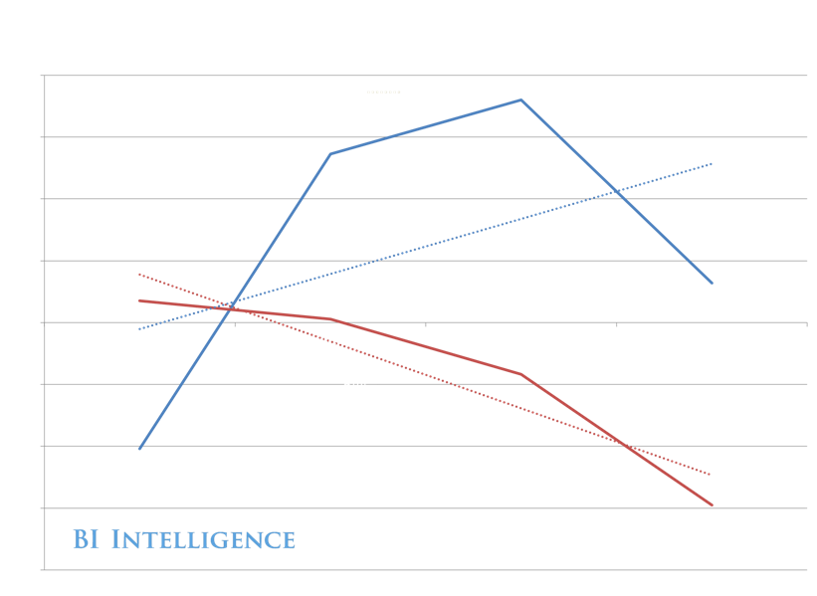
All Of Best Buy’s Growth Is Online
BI Intelligence Estimate

Slide 27
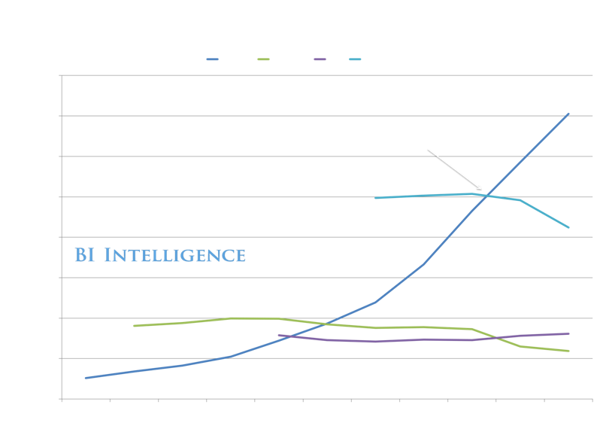



Amazon Was Once Smaller Than Best Buy. Not Anymore.
Amazon Already 1.7X Best Buy

Slide 28
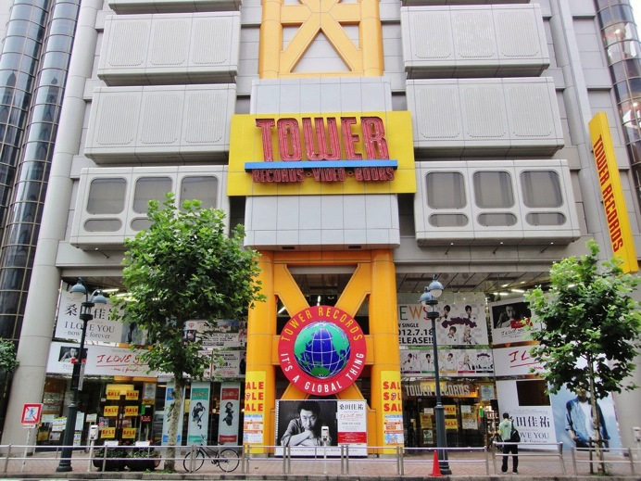
MEDIA
Image: Reuters

Slide 29
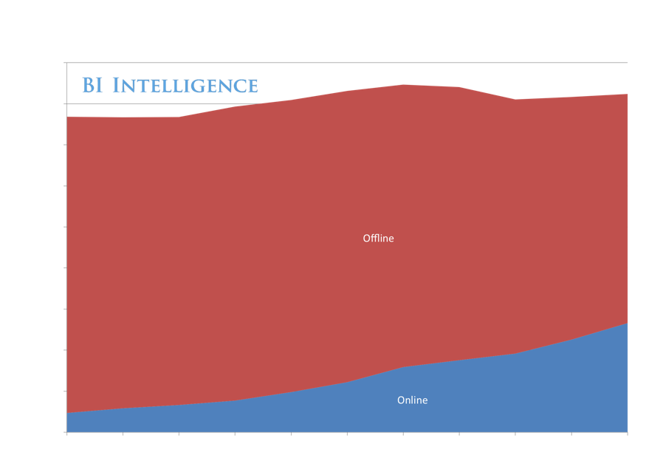
Media Is Still The Top E-Commerce Category ~$25 Billion

Slide 30
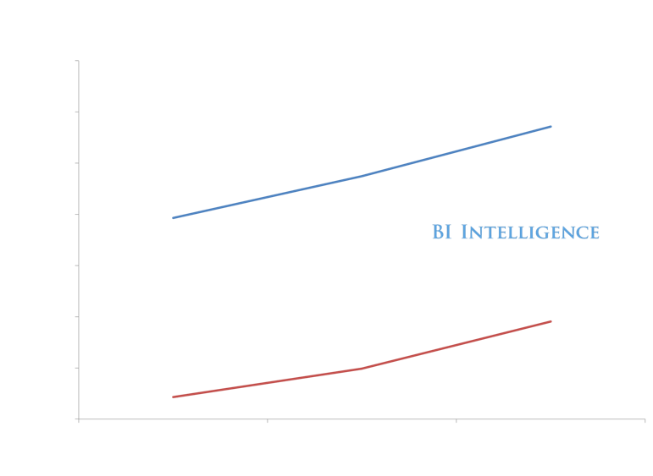


Media Sales Are Going Digital

Slide 31
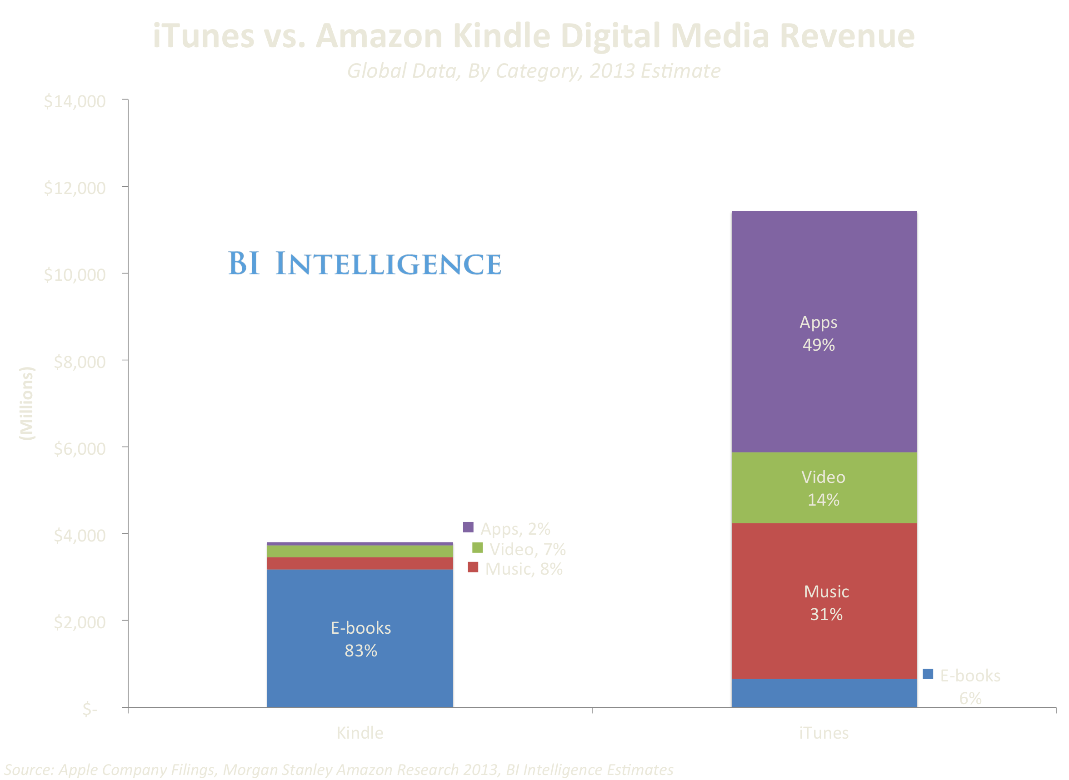
Benefiting Apple And Amazon

Slide 32
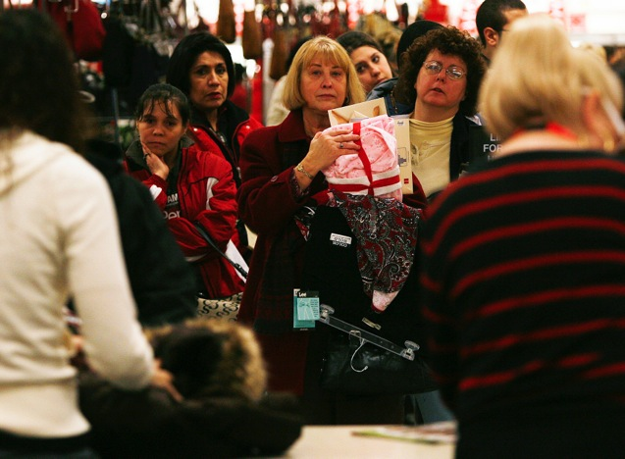
CLOTHING AND ACCESSORIES
Image: Reuters

Slide 33
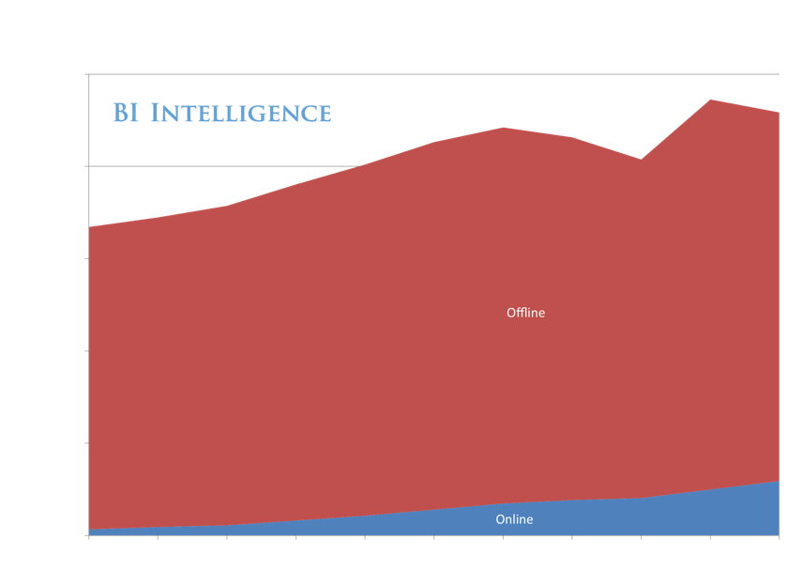
More Than 13% Of All Clothing Sales Now Occur Online

Slide 34
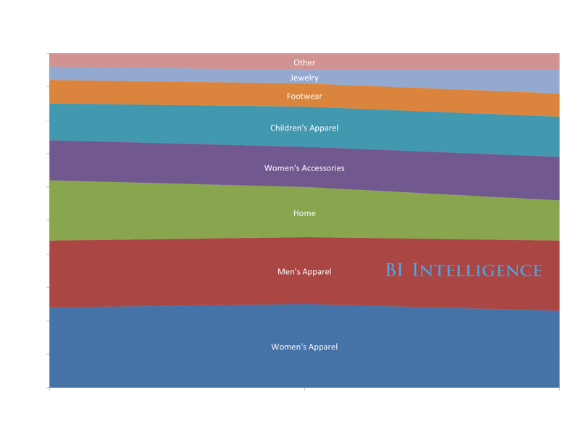
JCPenney Is Vulnerable. 83% Of Its Business Is Clothing And Accessories.

Slide 35
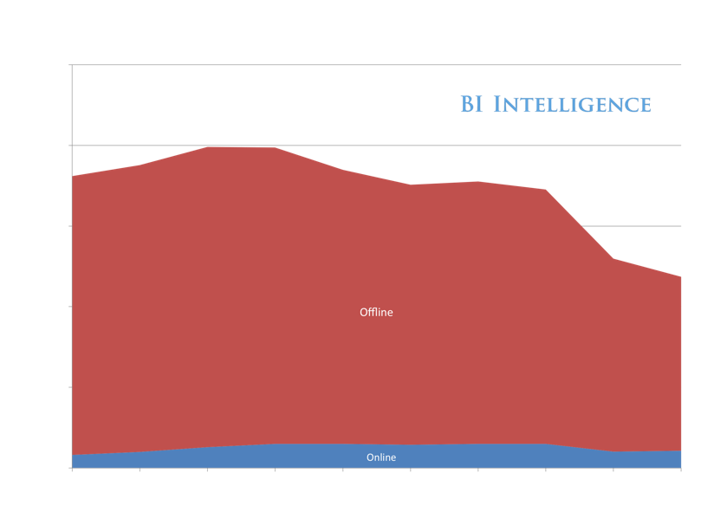
In-Store Sales At J.C. Penney Declined 10% Last Year
BI Intelligence Estimate

Slide 36
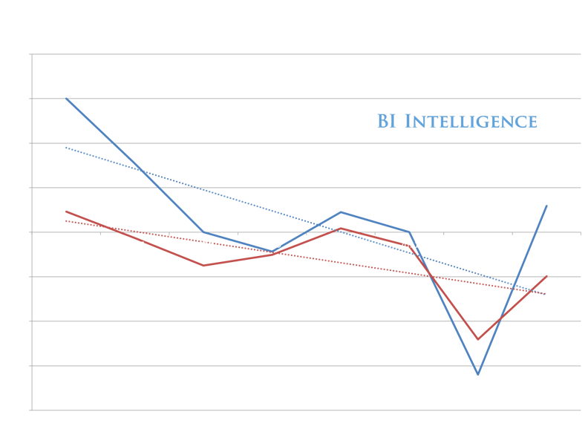
Online Is Growing, But Overall J.C. Penney Still In The Red
BI Intelligence Estimate

Slide 37
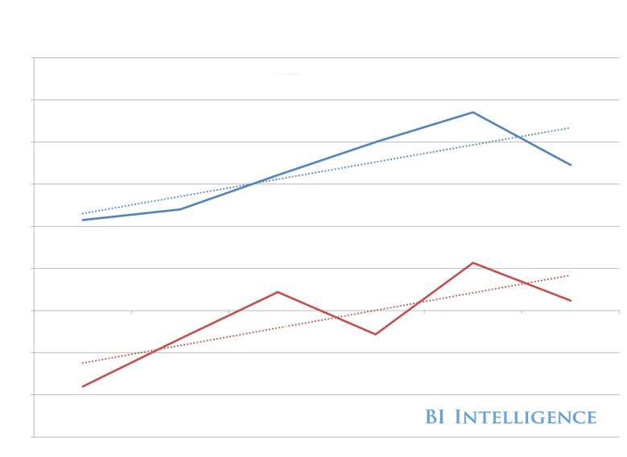
Gap Has Done Better
BI Intelligence Estimates

Slide 38
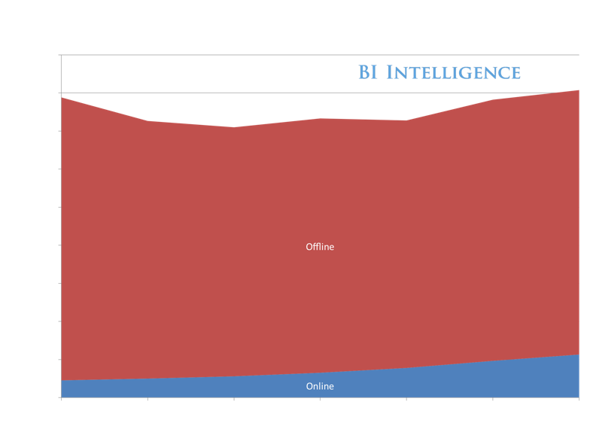
16% Of The Gap’s Total Retail Sales Are Now Online
BI Intelligence Estimates

Slide 39
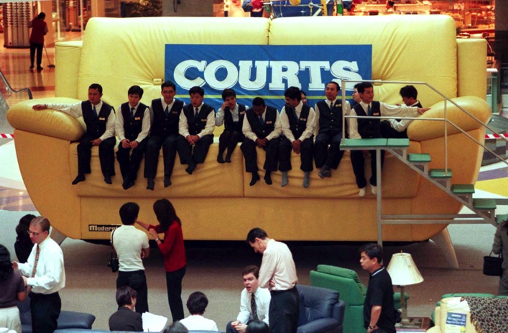
HOME AND FURNITURE
Image: Reuters

Slide 40
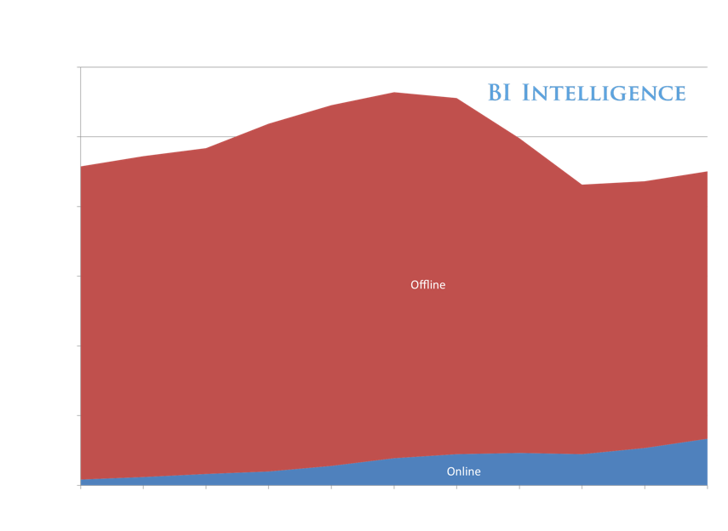
15% Of All Furniture Sales Now Occur Online

Slide 41
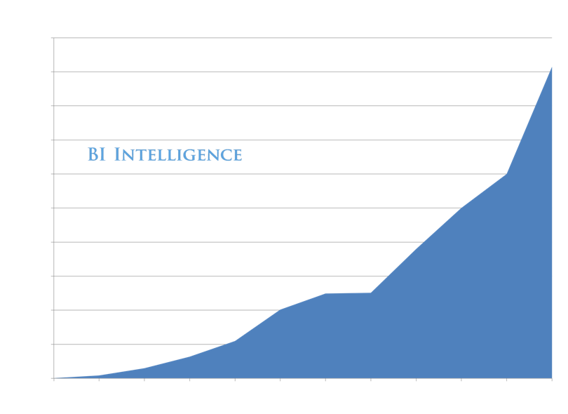

Helping Fuel The Rise Of Home Goods Online Retailers

Slide 42
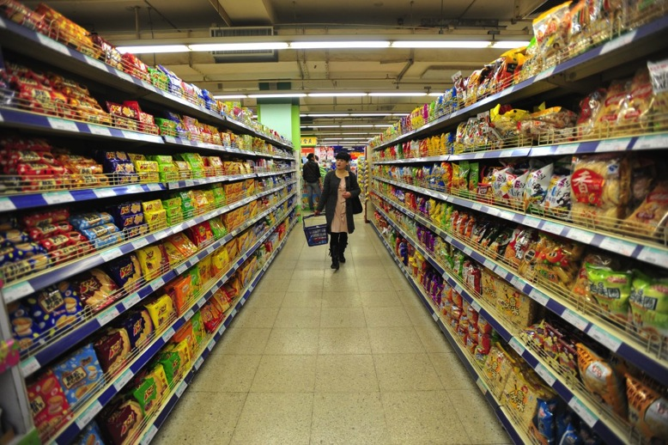
FOOD AND BEVERAGE
Image: Reuters

Slide 43
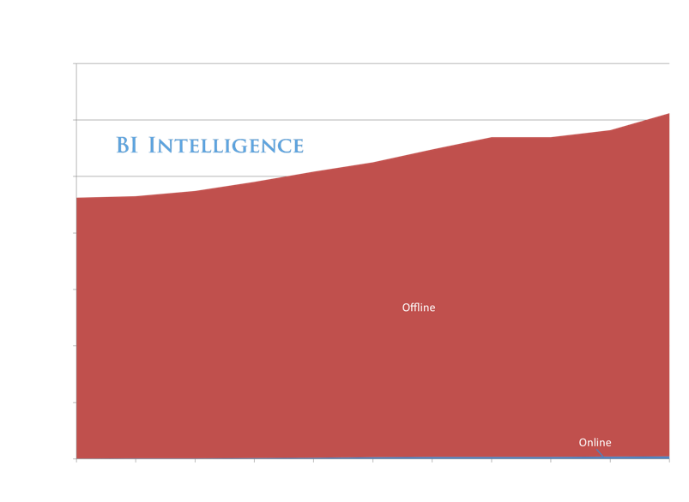
For Groceries, Online Sales Are Still A Blip

Slide 44
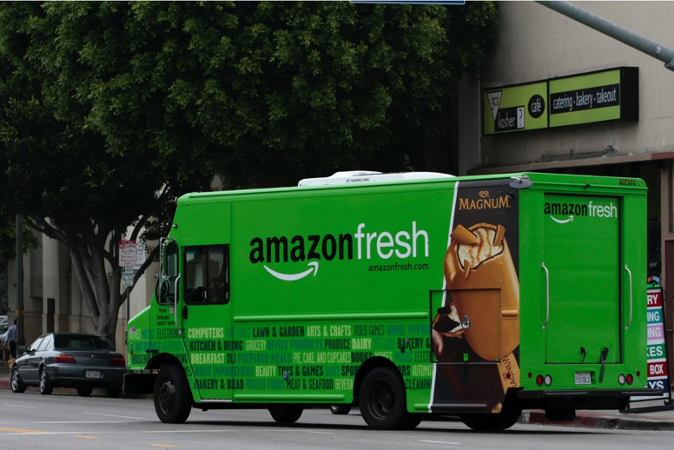
Despite The Early Efforts Of Amazon And Others
Image: Reuters

Slide 45
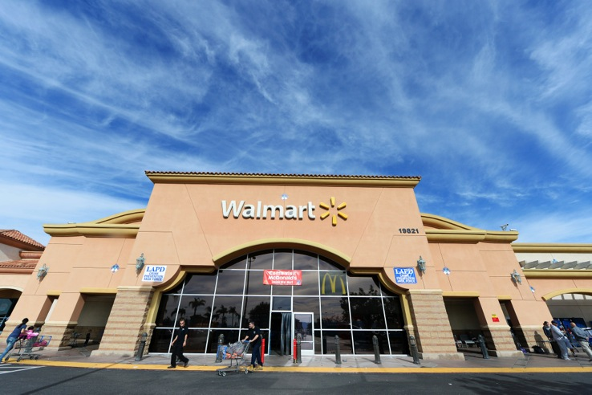
What About The
‘Everything Retailer,’ Wal-Mart?
Image: Reuters

Slide 46
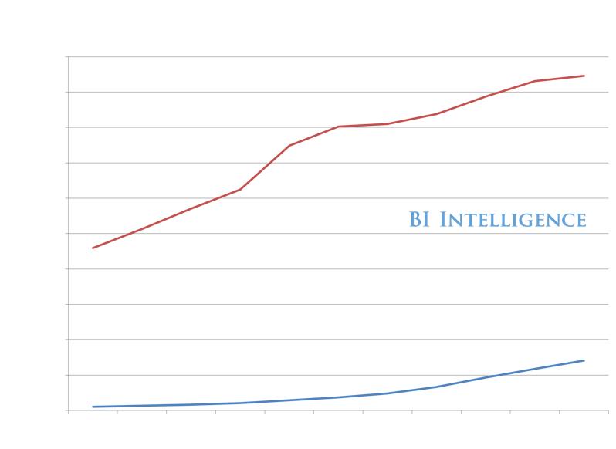
Some Perspective. Wal-Mart Is Still Much Bigger
Than Amazon.

Slide 47
Wal-Mart’s Advantage Is Still In Physical Retail
Wal-Mart still has 4,100 stores within five miles of two-thirds of the U.S. population — The Wall Street Journal, October 2013

Slide 48
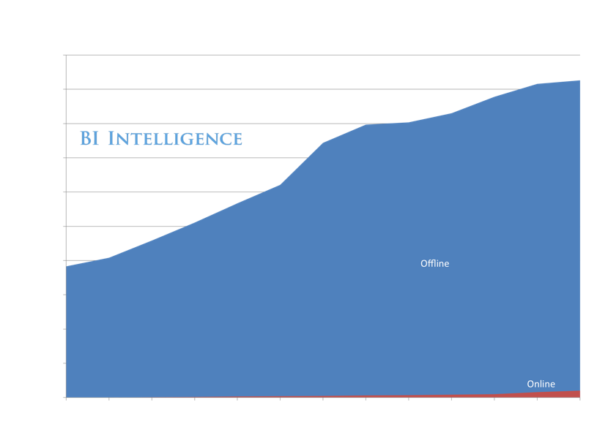
Online Is Still Just 2% Of Walmart’s Total Sales
BI Intelligence Estimates

Slide 49
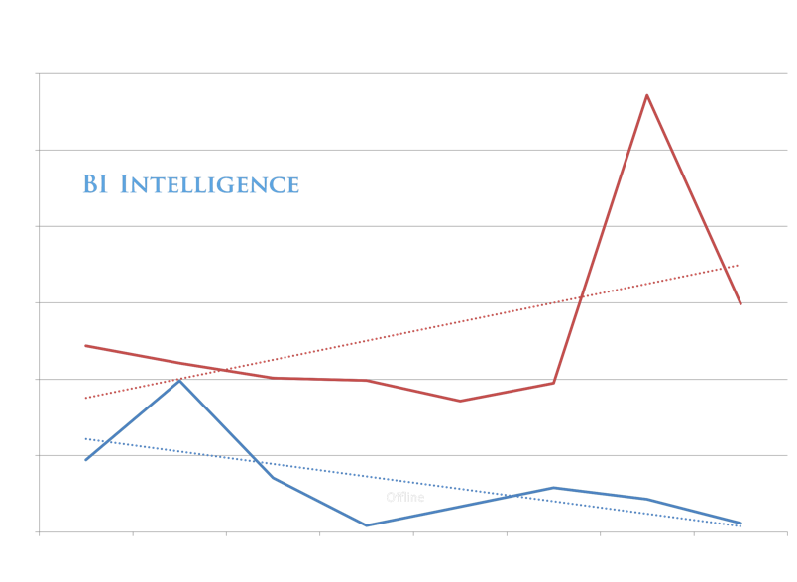
But Sales Growth Is Coming From Online
BI Intelligence Estimates

Slide 50


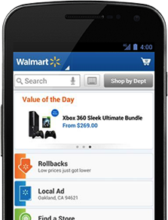

And Wal-Mart Is Investing In Social And Mobile Tech R&D

Slide 51
Retail Is About Offering People The Services And Products They Want — On The Devices And Media They Use
Image: Amazon

Slide 52
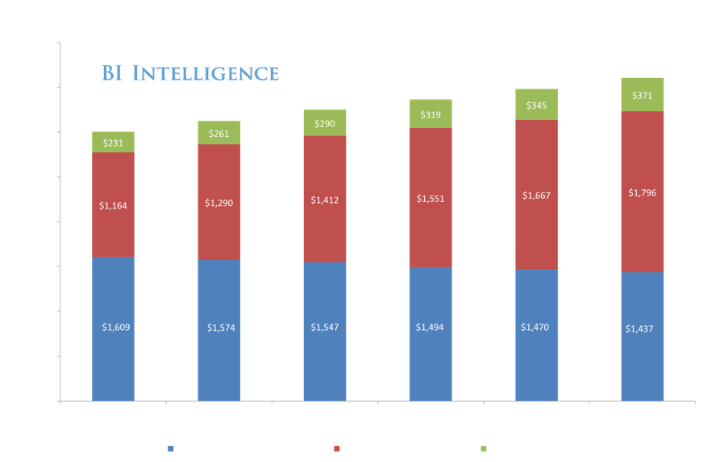
The Web
52% of all retail sales are Web-influenced

Slide 53
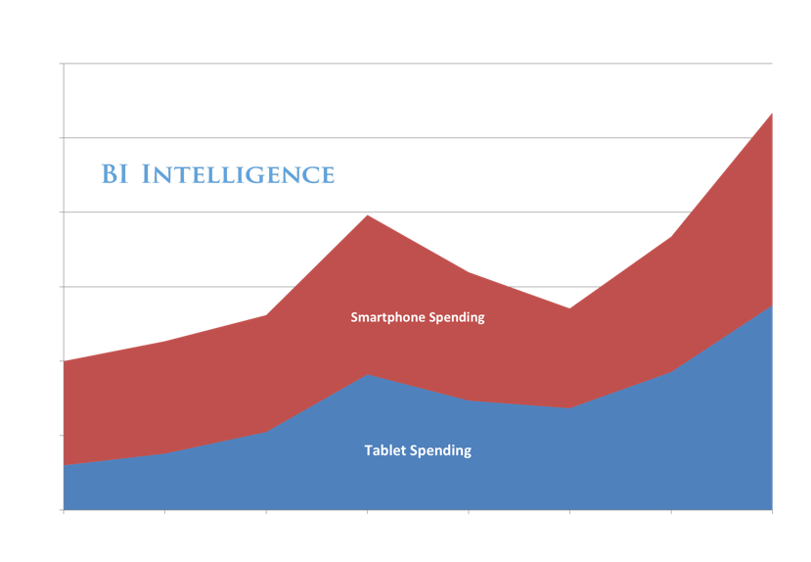
Smartphones And Tablets

Slide 54

Especially iPhones And iPads. ~75% Of Traffic.

Slide 55

Mobile Is Now ¼ Of All E-Commerce Traffic …

Slide 56
Retailers Are Finding Huge Audiences On Mobile …

Slide 57

… And On Social Networks

Slide 58
What Do Today’s Customers Want?
Image: Amazon

Slide 59

They Want Price And Convenience
Convenience
Price

Slide 60

And They Want Individualized Services And Offers

Slide 61
They Want To Buy Things On Mobile! PayPal Does
~$30 Billion In Mobile Transactions
PayPal purchased Braintree in late 2013.

Slide 62



Starbucks Payments App Does It All
Images: Starbucks And Square

Slide 63


Which Is Why It Is So Successful: $1 Billion In Annual Volume!

Slide 64

The Shift To Online Retail Is Global
Image: Reuters

Slide 65


Alibaba Drives $157 Billion In Gross Merchandise Value

Slide 66


China’s JD.Com Saw Sales Boom Last Year

Slide 67

Mobile Will Account For 15% Of Chinese E-Commerce Sales

Slide 68

E-Commerce Is Taking Off In India, Too

Slide 69








Henry Blodget
CEO & Editor-in-Chief
Marcelo Ballvé, Editorial Director
Emily Adler, Senior Research Editor
Tony Danova, Research Analyst
Mark Hoelzel, Research Analyst
Cooper Smith, Research Analyst
John Heggestuen, Research Analyst
BI Intelligence is a subscription service from Business Insider
that provides in-depth insight, data, and analysis of digital industries.
More info at intelligence.businessinsider.com

