Slide 1
The Future Of Mobile
Henry Blodget
BI Intelligence

Slide 2
PCs are now small share of connected devices…

Slide 3
Almost 1 billion smartphones shipped in 2013

Slide 4
Tablets cannibalizing PCs…

Slide 5
“Phablets” filling in the gap…

Slide 6
Wearables beginning to take off…

Slide 7
Cars increasingly connected

Slide 8
PC vendors, meanwhile, are getting smoked

Slide 9
Mobile is creating big challenges and opportunities.

Slide 10
We spend 1 hour a day on our smartphones

Slide 11
We spend ½ hour on tablet each time we use it

Slide 12
Mobile is the only media time that is growing

Slide 13
Mobile is enabling new forms of entertainment, communication, media, and commerce.

Slide 14
Staggering growth for new communication apps…

Slide 15
450 million WhatsApp users, +1 million a day

Slide 16




Similar growth for WeChat and Line…

Slide 17
Usage of these apps has blown past “texting”

Slide 18
~1 billion pictures shared each day

Slide 19
~500 million Snapchat pictures a day

Slide 20
Over 1/5th of Internet traffic is now from mobile

Slide 21
Mobile video is booming…

Slide 22
Social and music are now mostly mobile

Slide 23
Mobile is driving all of Facebook’s revenue growth

Slide 24
Mobile is now ~25% of e-commerce traffic…

Slide 25
(But only 13% of e-commerce sales)

Slide 26
Retailers are seeing huge mobile audience gains …

Slide 27
PayPal powers $30 billion in mobile transactions

Slide 28
Starbucks did $1 billion in mobile transactions last year

Slide 29
New mobile car services like Uber are thriving

Slide 30
Apple did $10 billion in app revenue last year

Slide 31
Mobile has extended digital day to 18/7
Source: Google Analytcs, Business Insider

Slide 32
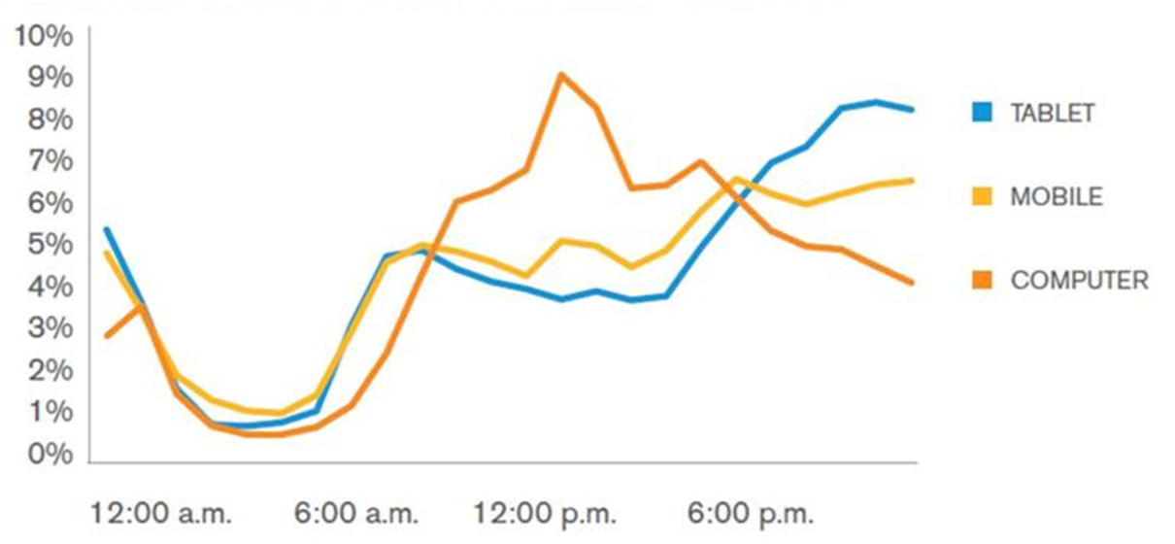
Each device has a different “prime time”
Share Of Device Page Traffic Over A Day:
Source: comScore, Telefonica, Macquarie Capital (USA), December 2011

Slide 33
Where are we in the smartphone adoption cycle?

Slide 34
Entering the late innings...

Slide 35
Smartphone sales have overtaken “dumb phones”

Slide 36
Developed markets are nearing maturity

Slide 37
US smartphone growth is slowing

Slide 38
Biggest opportunities now China and India

Slide 39
China is already twice the size of the US market…

Slide 40
…And the No. 2 market for apps

Slide 41
Prices are dropping fast

Slide 42
iPhone sales growth has cratered

Slide 43
iPad sales growth has also nose-dived

Slide 44
~225 million tablets were shipped in 2013

Slide 45
But growth is slowing rapidly

Slide 46
What about the platform war?

Slide 47
We have a winner!

Slide 48
~80% of smartphones run Android

Slide 49
~60% of tablets run Android

Slide 50
~60% of all new computing devices run Android

Slide 51
Android used to lag Apple badly with app developers.

Slide 52
Not anymore.

Slide 53
Android now as popular with global developers as iOS

Slide 54
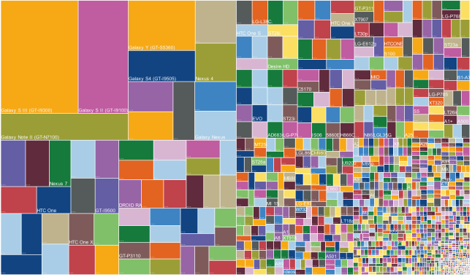
Android “fragmentation” improving
Reprinted With Permission From OpenSignal, “Android Fragmentation Visualized”

Slide 55
A majority of users now on “Jelly Bean”

Slide 56
Apple still very strong in US — but weaker globally

Slide 57
In US, Apple also still has edge in ad revenue

Slide 58
And a big edge in eCommerce traffic…

Slide 59
Should you be “mobile only?”

Slide 60
No!

Slide 61
The world is now “multi-screen”

Slide 62
You should be “mobile, too.”

Slide 63
What about ad spending?

Slide 64
One thing we can learn from the history of media…

Slide 65
Money follows eyeballs.

Slide 66
Eyeballs are moving to mobile

Slide 67
Mobile ad spending still lags time spent

Slide 68
So the money will follow…

Slide 69
Spending is moving to mobile…

Slide 70
Mobile ad prices are lower but rising

Slide 71
US mobile ad spending per sub growing fast

Slide 72
Mobile is still dominated by paid search ads

Slide 73
And Google owns almost all of it

Slide 74
So, what’s next?

Slide 75
Wearables!

Slide 76
Health devices are the most popular

Slide 77
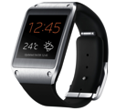
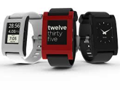
Not much interest in smart watches so far

Slide 78
Interest in glasses and headgear is only modest

Slide 79
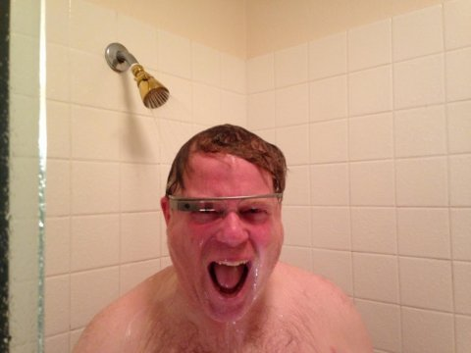
They cost a lot, and there’s the creepiness thing
Image: Google+/Robert Scoble

Slide 80
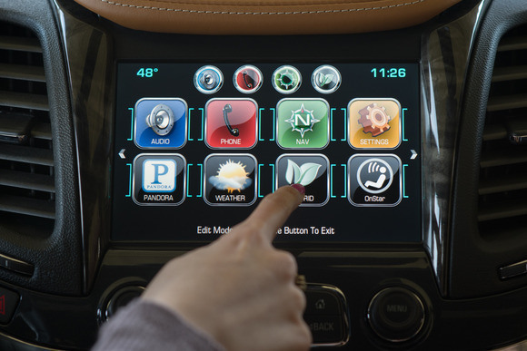
Connected Cars
Image: GM

Slide 81
We spend 1.2 hours a day in cars...
Working
8.8 hours

Slide 82
So connectivity will soon come standard

Slide 83

Music, maps, weather, traffic, news are the killer apps

Slide 84
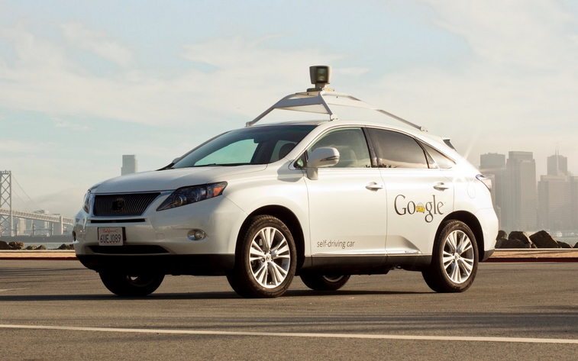
And soon you won’t even have to drive…

Slide 85
Enjoy the mobile future!

Slide 86
Thank you

Slide 87






Henry Blodget
CEO & Editor-in-Chief, Business Insider
Marcelo Ballvé, Editorial Director
Tony Danova, Research Analyst
Cooper Smith, Research Analyst
John Heggestuen, Research Analyst
BI Intelligence is a new subscription service from Business Insider
that provides in-depth insight, data, and analysis of the mobile industry.
More info at intelligence.businessinsider.com

