Slide 1
The Internet Of Everything: 2014
BI Intelligence

Slide 2
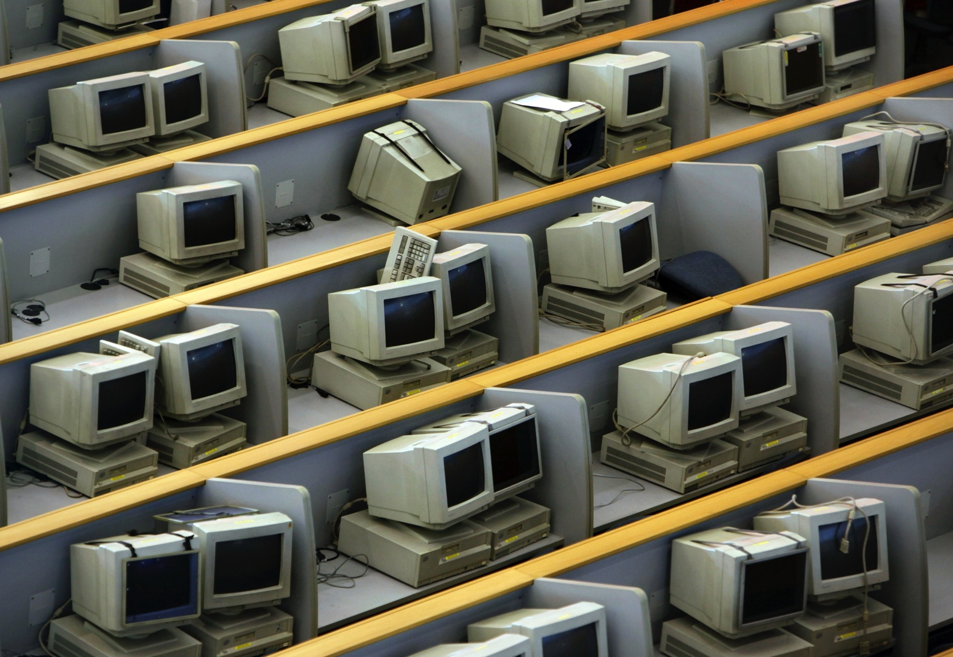
The Old Internet Ran On Personal Computers
Image: Reuters

Slide 3

For Consumers

Slide 4
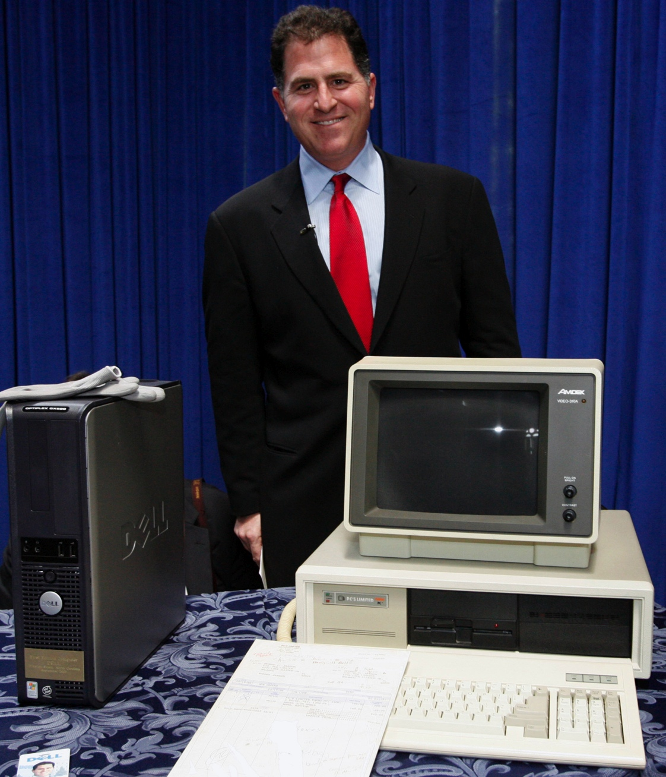
And Businesses
Image: Reuters

Slide 5
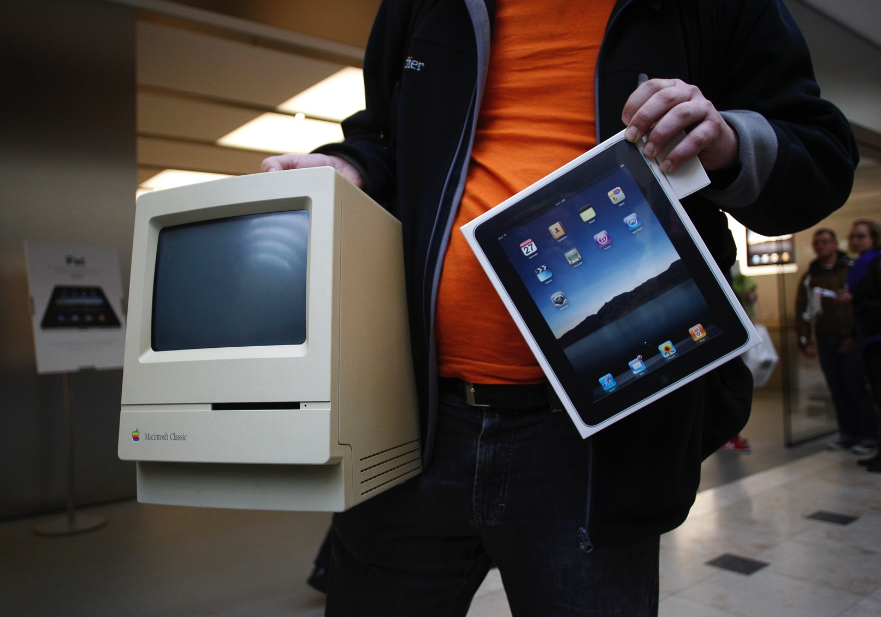
But Habits And Technology Have Changed
Image: Reuters

Slide 6
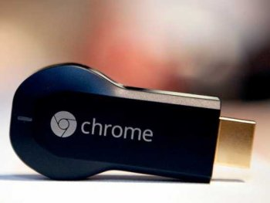
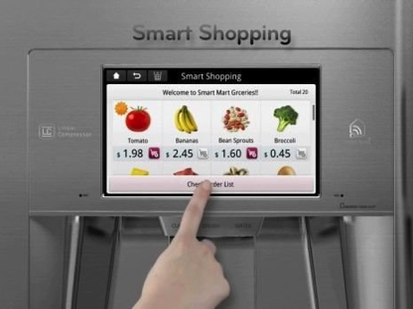
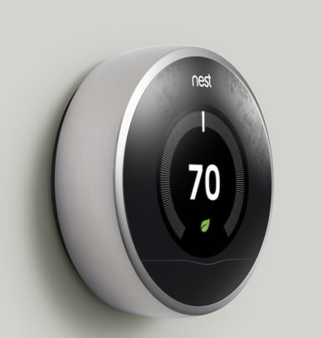

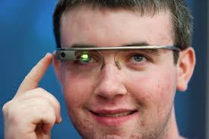
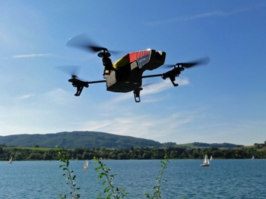
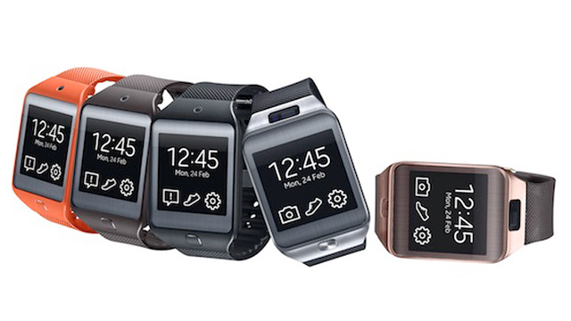

What’s Next?

Slide 7
Everything!
We are here

Slide 8

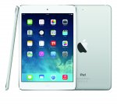

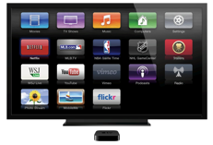

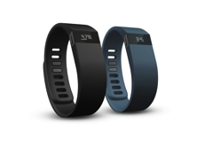




Where We Are…Devices
    PCs
    Tablets
    Smartphones
    Connected TVs
    Connected Cars
    Wearables
Where We’re Going…’Things’
    Smart homes
    Smart cities
    Smart offices
    Smart factories

Slide 9
“Connecting products to the Web will be the 21st century electrification.”
— Matt Webb, CEO of BERG Cloud

Slide 10
A New World Of ‘Connected’ Gadgets
What are the most important technology drivers of the Internet of Everything?

Slide 11
The ‘Internet of Things’ Alone Will Surpass The PC, Tablet, And Phone Market Combined By 2017!

Slide 12
The Wearables, Connected Car, And TV Markets Will Equal The Tablet Market By 2018

Slide 13








Venture Capital Is Piling Into ‘The Internet Of Things’

Slide 14
Let’s Look At Some Of The New Internet Markets Individually

Slide 15
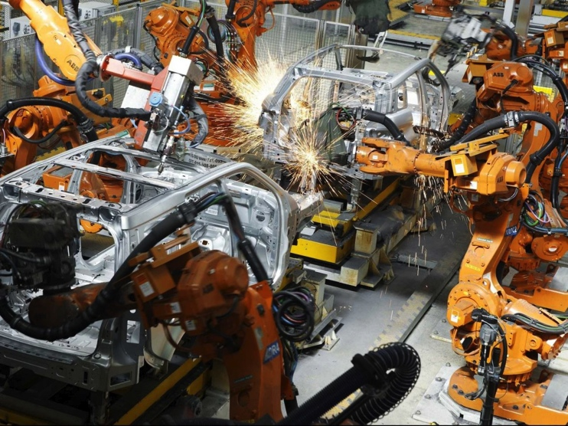
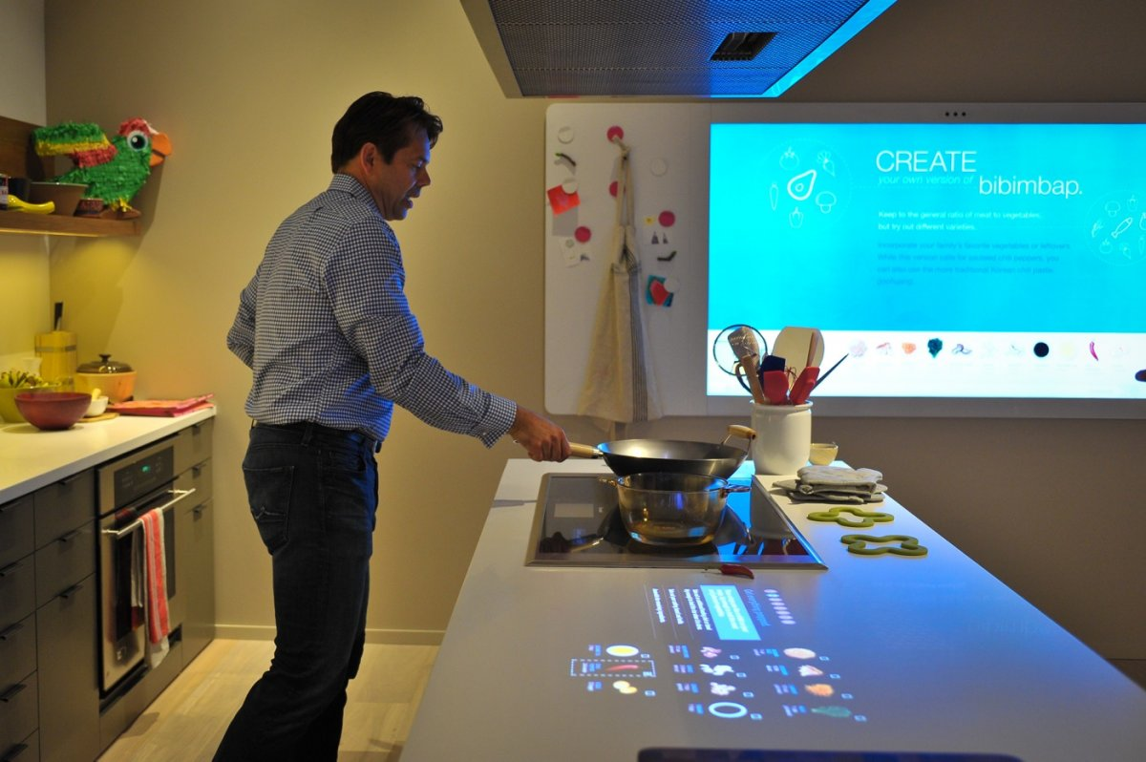

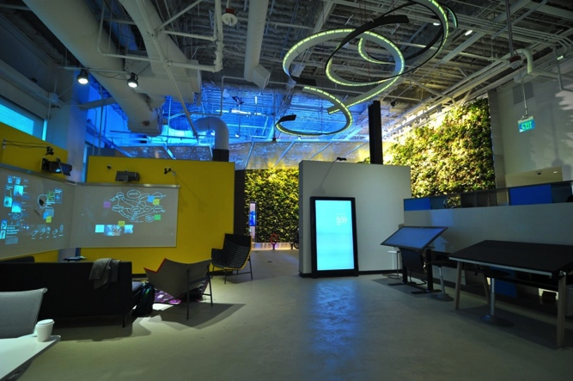
The Internet Of Things
Bottom left image: Gemalto; Top left: Jaguar Land Rover; Right images: Filmateria Digital LLC

Slide 16
The ‘IoT’ Is Going To Be Huge
We are here

Slide 17

Smart Appliances Already Going Mass Market

Slide 18
Large Companies Are Rushing Into The IoT …
82% Of Businesses Connected By 2017

Slide 19
… Because It Will Make Them More Efficient

Slide 20
Government Services Will Also Benefit

Slide 21
The ‘Internet Of Things’ Is Already Global

Slide 22
The Disadvantages? The Big One Is Cyber Security

Slide 23
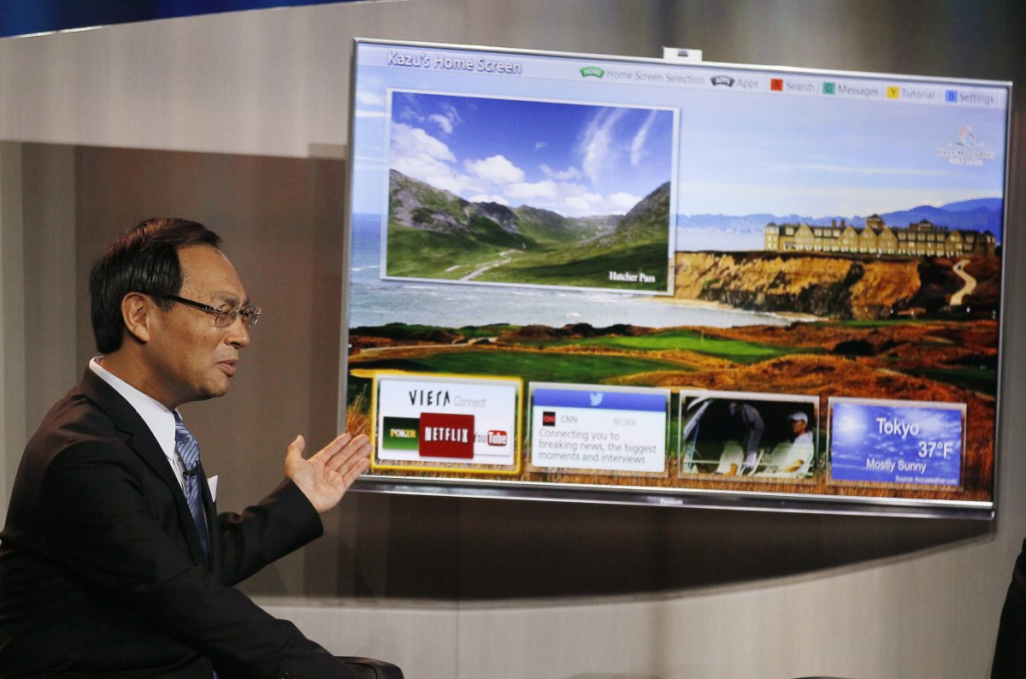
Connected TVs
Image: Reuters

Slide 24
Connected TVs Are Already Here
We are here

Slide 25
And They’re Overtaking Traditional TVs

Slide 26
One-Third Of US Homes Already Have Connected TV

Slide 27
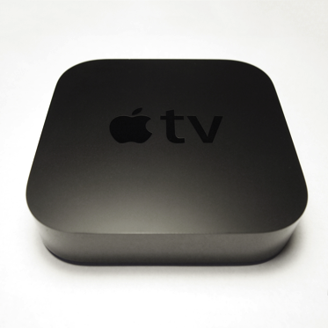
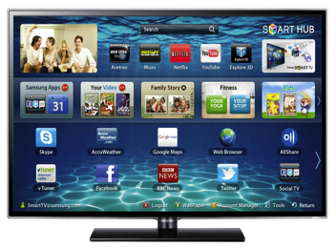
Half Are Smart TVs, And Half Rely On Add-On Streaming Devices

Slide 28
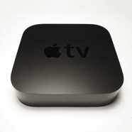
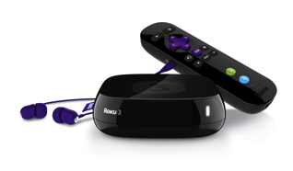
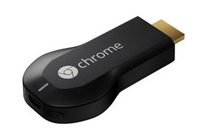
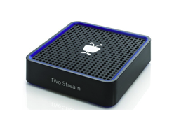
The Streaming Device Market Is Fiercely Competitive

Slide 29
Samsung And Vizio Control The US Smart TV Market

Slide 30
The Smart TV Market Will Definitely Grow — People Love Them!

Slide 31



Why? Because Smart TVs Are The Best Way To Watch TV And Movies Online

Slide 32
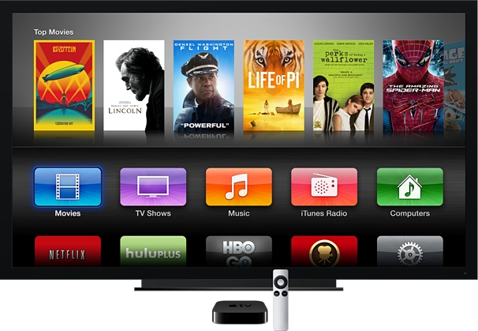
Connected TVs Bring An Explosion Of Content
Image: Apple

Slide 33



Smart TVs Are Helping Online Video Grow Revenue

Slide 34
There’s A Big Advertising Opportunity Here

Slide 35
Smart TVs Could Help Online Video Carve Out A Greater Share Of TV Spend

Slide 36
Smart TV Ads Are Less Annoying Than Online (Or Mobile) Ads … The Screens Are Bigger!

Slide 37
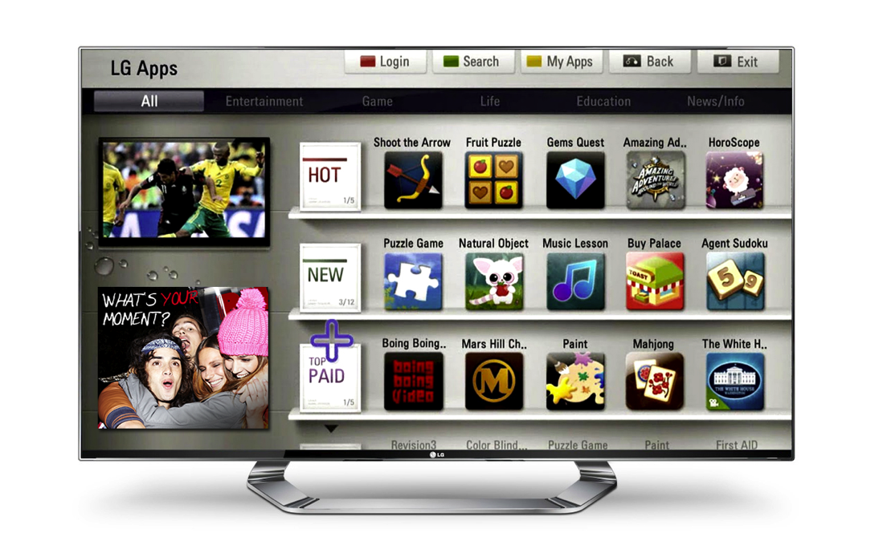
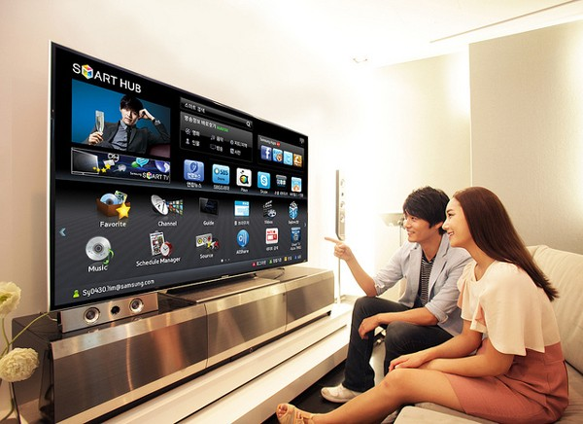
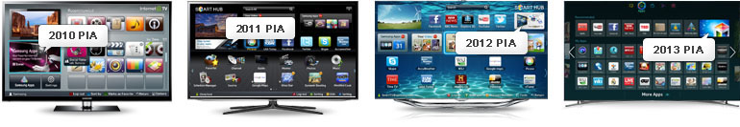
And There’s A Ton Of Different Ad Formats
Images: LG, Samsung

Slide 38
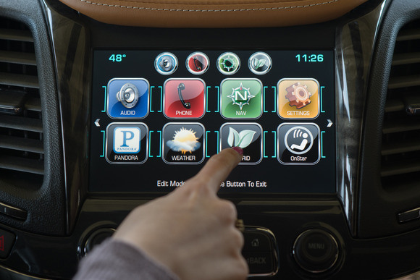
Connected Cars
Image: GM

Slide 39
Connected Cars Will Be The Next Big Tech Market
(Millions)
We are here

Slide 40
It’s A Big Opportunity Because We Spend So Much ‘Dead’ Time In Cars
Working
8.8 hours

Slide 41
Internet Will Become Common In ‘Fully Loaded’ Cars

Slide 42

Killer Car Apps? Music, Navigation, Weather, Traffic

Slide 43

Traffic App Waze Has Seen Explosive Growth

Slide 44
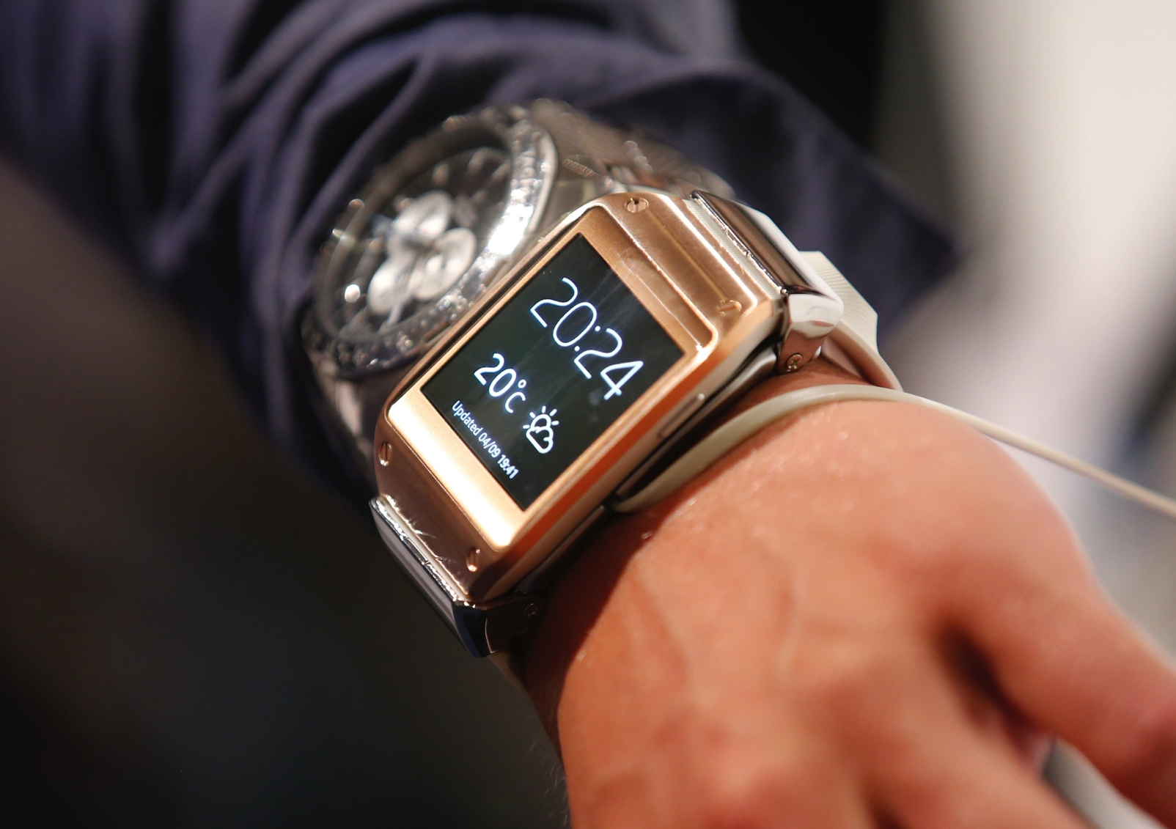
Wearables
Image: Reuters

Slide 45
Tech Execs Think It’s The Next Big Thing

Slide 46
But Is It? Consumers Are Skeptical

Slide 47
Especially When It Comes To Smart Eyeglasses

Slide 48
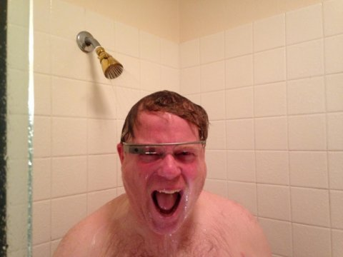
There’s A Lot Of Stigma Attached To
Smart Eyewear
Image: Google+/Robert Scoble

Slide 49
Analysts Have Wildly Different Views On Wearables’ Potential. We Are Mildly Bullish.

Slide 50
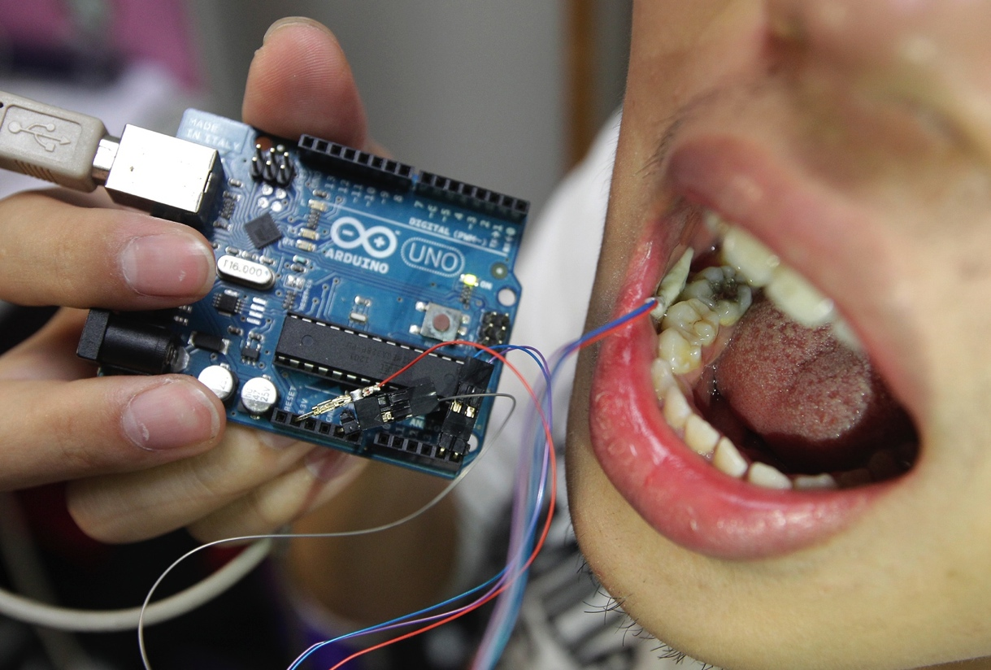
There Will Be Some Missteps As Companies
Experiment With Wearables
Smart Teeth — Really?
Image: Reuters

Slide 51
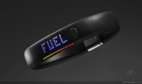

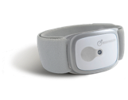



Fitness Bands And Watches Have Been The Category Leaders

Slide 52
And Will Continue To Lead

Slide 53
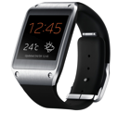
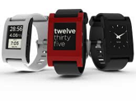
Smart Watches Have Had Respectable Launches

Slide 54
But Wearables Will Remain Mostly A US-Based Phenomenon For Some Time

Slide 55
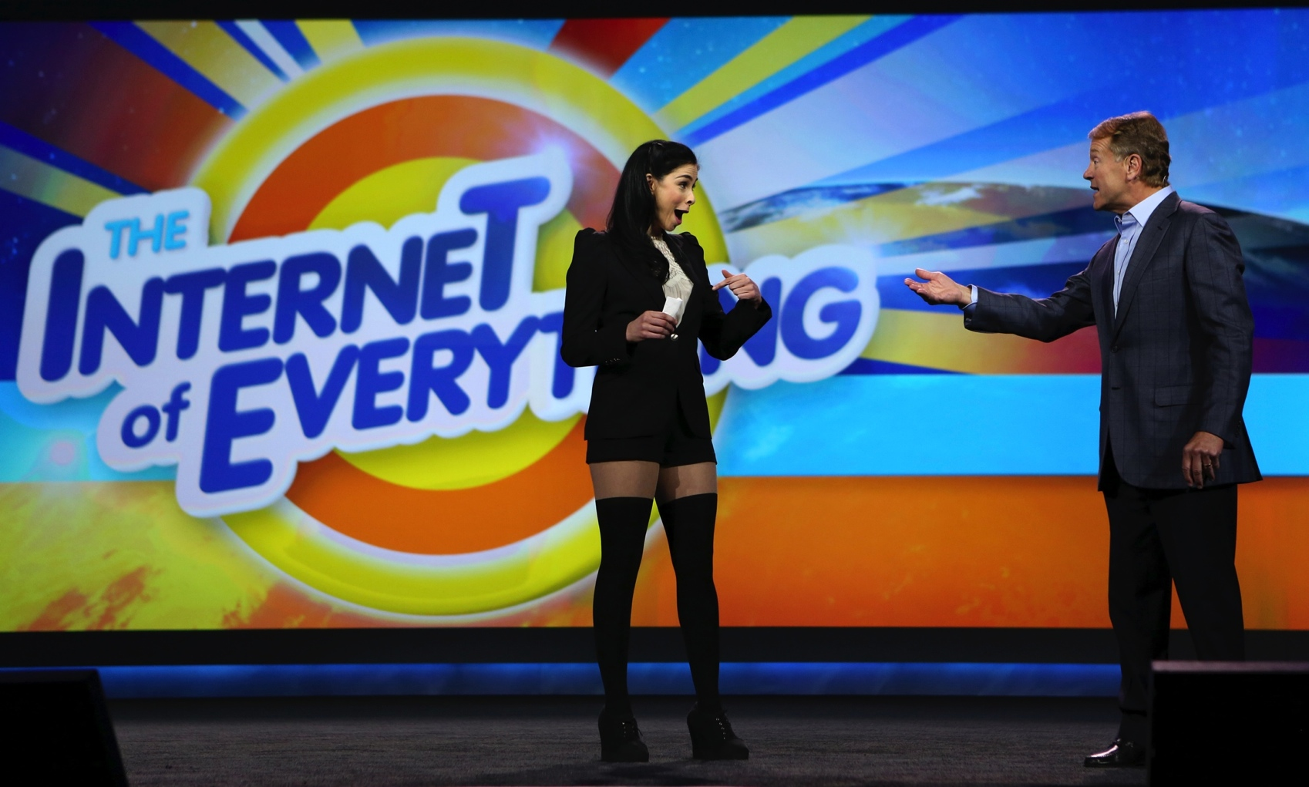
More Opportunities
Image: Reuters

Slide 56
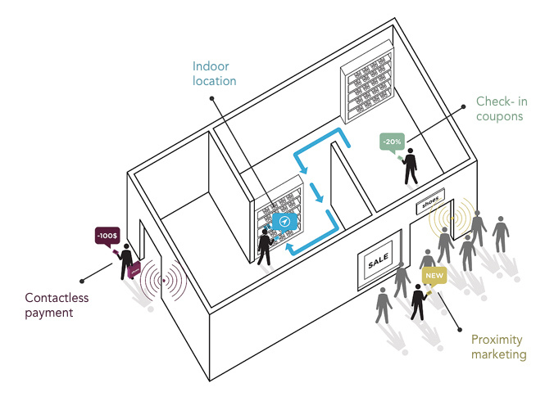

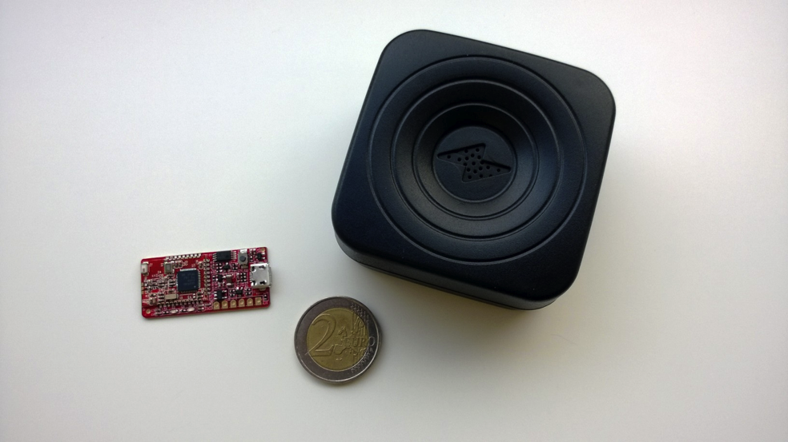
Beacons
Images: Estimote, PayPal, Insoft

Slide 57
Beacons Help Retailers Communicate With Shoppers In-Store. Apple’s iBeacon Leads.

Slide 58
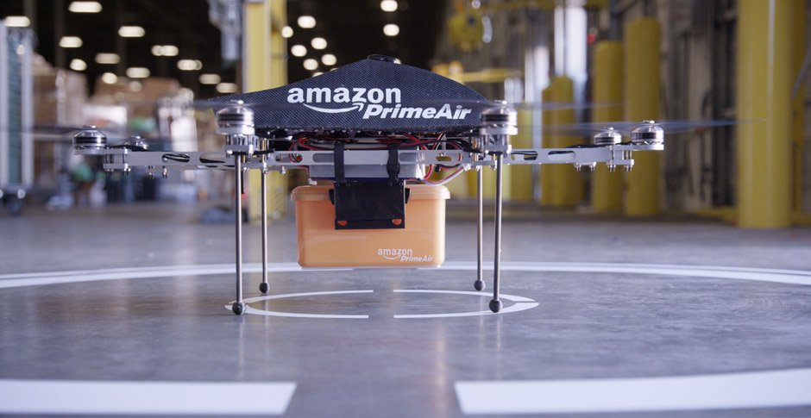
Drones
Image: Amazon

Slide 59
US Regulators Are Slowly Allowing More Aerial Drones

Slide 60
Drones Will Become A Big Market Globally As They’re Phased In For Civilian Uses

Slide 61
Investors Are Beginning To Show Interest

Slide 62
THE END

Slide 63








Henry Blodget
CEO & Editor-in-Chief
Marcelo Ballvé, Editorial Director
Emily Adler, Senior Research Editor
Tony Danova, Research Analyst
Mark Hoelzel, Research Analyst
Cooper Smith, Research Analyst
John Heggestuen, Research Analyst
BI Intelligence is a new subscription service from Business Insider
that provides in-depth insight, data, and analysis of the mobile industry.
More info at intelligence.businessinsider.com

