Slide 1
X-Informatics
Cloud Technology
February 25 and 27 2013
Geoffrey Fox
gcf@indiana.edu
http://www.infomall.org/X-InformaticsSpring2013/index.html
Associate Dean for Research and Graduate Studies, School of Informatics and Computing
Indiana University Bloomington
2013

Slide 2
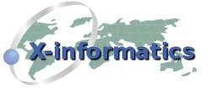



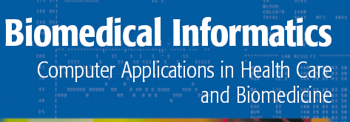


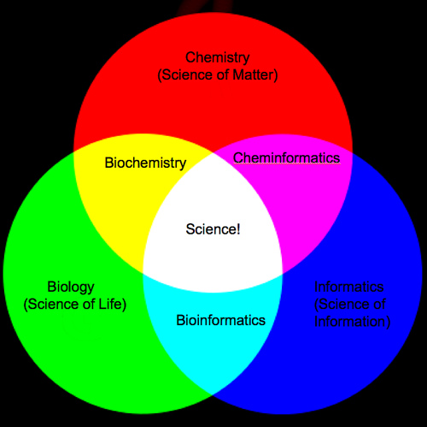
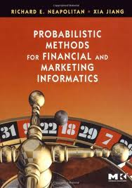
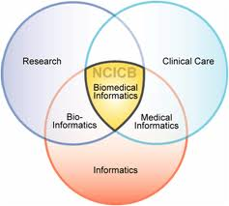
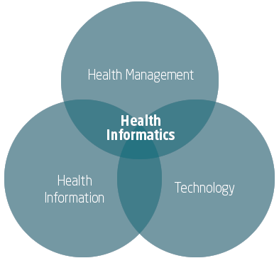
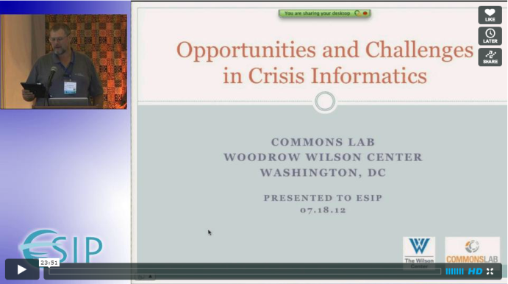
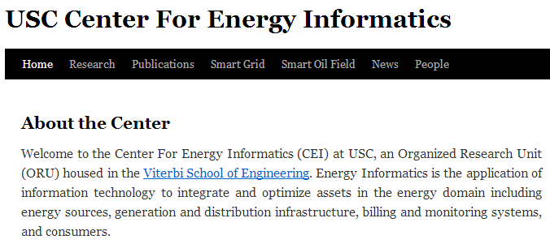
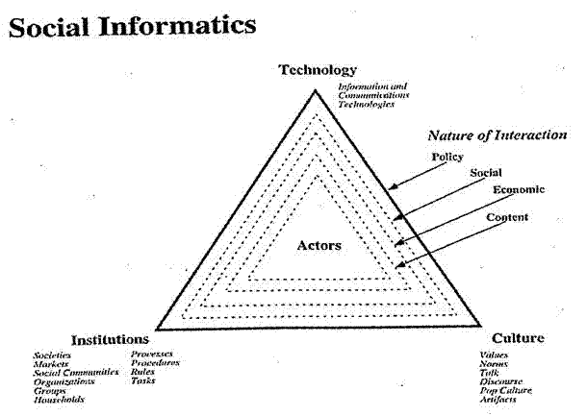

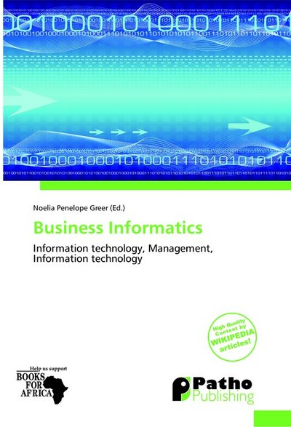
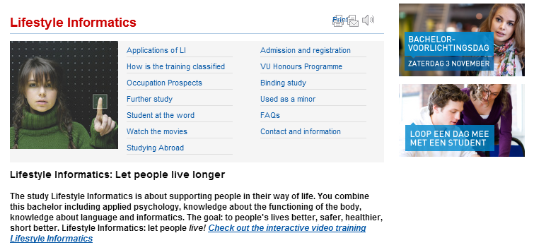
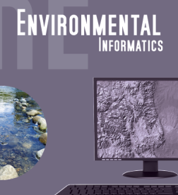


Slide 3
The Course in One Sentence
Study Clouds running Data Analytics processing Big Data to solve problems in X-Informatics

Slide 4
Cyberinfrastructure e-moreorlessanything
X = moreorlessanything
e-X is roughly X-Informatics

Slide 5
What is Cyberinfrastructure
Cyberinfrastructure is (from NSF) infrastructure that supports distributed research and learning (e-Science, e-Research, e-Education)
  Links data, people, computers
Exploits Internet technology (Web2.0 and Clouds) adding (via Grid technology) management, security, supercomputers etc.
It has two aspects: parallel – low latency (microseconds) between nodes and distributed – highish latency (milliseconds) between nodes
Parallel needed to get high performance on individual large simulations, data analysis etc.; must decompose problem
Distributed aspect integrates already distinct components – especially natural for data (as in biology databases etc.)
5
Notes:
5

Slide 6
e-moreorlessanything
‘e-Science is about global collaboration in key areas of science, and the next generation of infrastructure that will enable it.’ from inventor of term John Taylor Director General of Research Councils UK, Office of Science and Technology
e-Science is about developing tools and technologies that allow scientists to do ‘faster, better or different’ research
Similarly e-Business captures the emerging view of corporations as dynamic virtual organizations linking employees, customers and stakeholders across the world.
This generalizes to e-moreorlessanything including e-DigitalLibrary, e-SocialScience, e-LifeStyle and e-Education
A deluge of data of unprecedented and inevitable size must be managed and understood.
People (virtual organizations), computers, data (including sensors and instruments) must be linked via hardware and software networks
6
Notes:
6

Slide 7
What is Cloud Computing
Introduction

Slide 8
Physically Clouds are Clear
A bunch of computers in an efficient data center with an excellent Internet connection
They were produced to meet need of public-facing Web 2.0 e-Commerce/Social Networking sites
They can be considered as “optimal giant data center” plus internet connection
Note enterprises use private clouds that are giant data centers but not optimized for Internet access

Slide 9
Virtualization made several things more convenient
Virtualization = abstraction; run a job – you know not where
Virtualization = use hypervisor to support “images”
  Allows you to define complete job as an “image” – OS + application
Efficient packing of multiple applications into one server as they don’t interfere (much) with each other if in different virtual machines;
They interfere if put as two jobs in same machine as for example must have same OS and same OS services
Also security model between VM’s more robust than between processes

Slide 10
Next Step is Renting out Idle Clouds
Amazon noted it could rent out its idle machines
Use virtualization for maximum efficiency and security
If cloud bigger enough, one gets elasticity – namely you can rent as much as you want except perhaps at peak times
This assumes machine hardware quite cheap and can keep some in reserve
  10% of 100,000 servers is 10,000 servers
I don’t know if Amazon switches off spare computers and powers up on “mothers day”
  Illustrates difficulties in studying field – proprietary secrets

Slide 11
Service Model
This generalizes the Web where every site gobbles up commands from client and returns something – which could be quite complicated
Generalization is “Service Oriented Architecture”
  Everything has an interface that accepts information – in general from another service but perhaps from a client
  Everything spits out information to where instructed to send
Closely coupled Java/Python Methods …
Coarse Grain Service Model
Module
B
Module A
Service
B
Service A
Messages
Method Calls
.001 to 1 millisecond
0.1 to 1000 millisecond latency
Everything is a message of some sort ……

Slide 12
Different aaS (as aService)’s
IaaS: Infrastructure is “renting” service for hardware
PaaS: Convenient service interface to Systems capabilities
SaaS: Convenient service interface to applications
NaaS: Summarizes modern “Software Defined Networks”

Slide 13
Support
Computing
aaS
Custom Images
Courses
Consulting
Portals
Archival Storage
Software
(Application) SaaS
CS Research Use
Class Use
Research Applications
Commercial Use
Platform
PaaS
Cloud e.g. MapReduce
HPC e.g. PETSc, SAGA
Computer Science
Data Algorithms
Infra
structure
IaaS
Software Defined Computing (virtual Clusters)
Hypervisor, Bare Metal
Operating System
Network
NaaS
Software Defined Networks
OpenFlow GENI

Slide 14
















X as a Service
SaaS: Software as a Service imply software capabilities
(programs) have a service (messaging) interface
  Applying systematically reduces system complexity to being linear in number of components
  Access via messaging rather than by installing in /usr/bin
IaaS: Infrastructure as a Service or HaaS: Hardware as a Service – get your computer time with a credit card and with a Web interface
PaaS: Platform as a Service is IaaS plus core software capabilities on which you build SaaS
Cyberinfrastructure is “Research as a Service”
Other Services
Clients

Slide 15
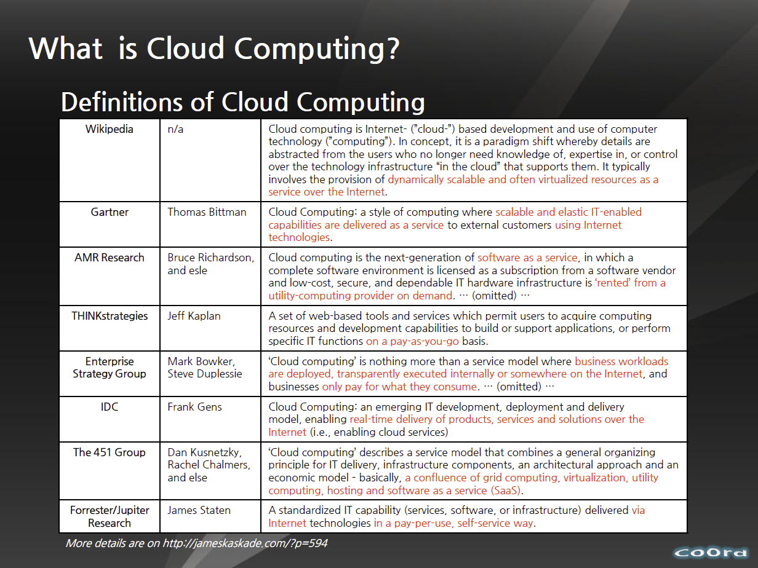
http://www.slideshare.net/woorung/trend-and-future-of-cloud-computing

Slide 16
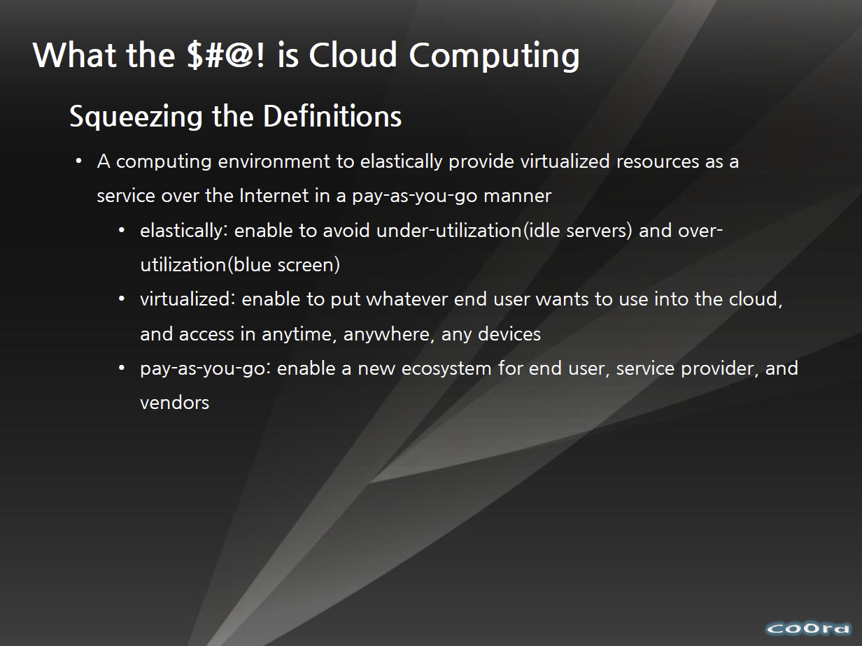
http://www.slideshare.net/woorung/trend-and-future-of-cloud-computing

Slide 17
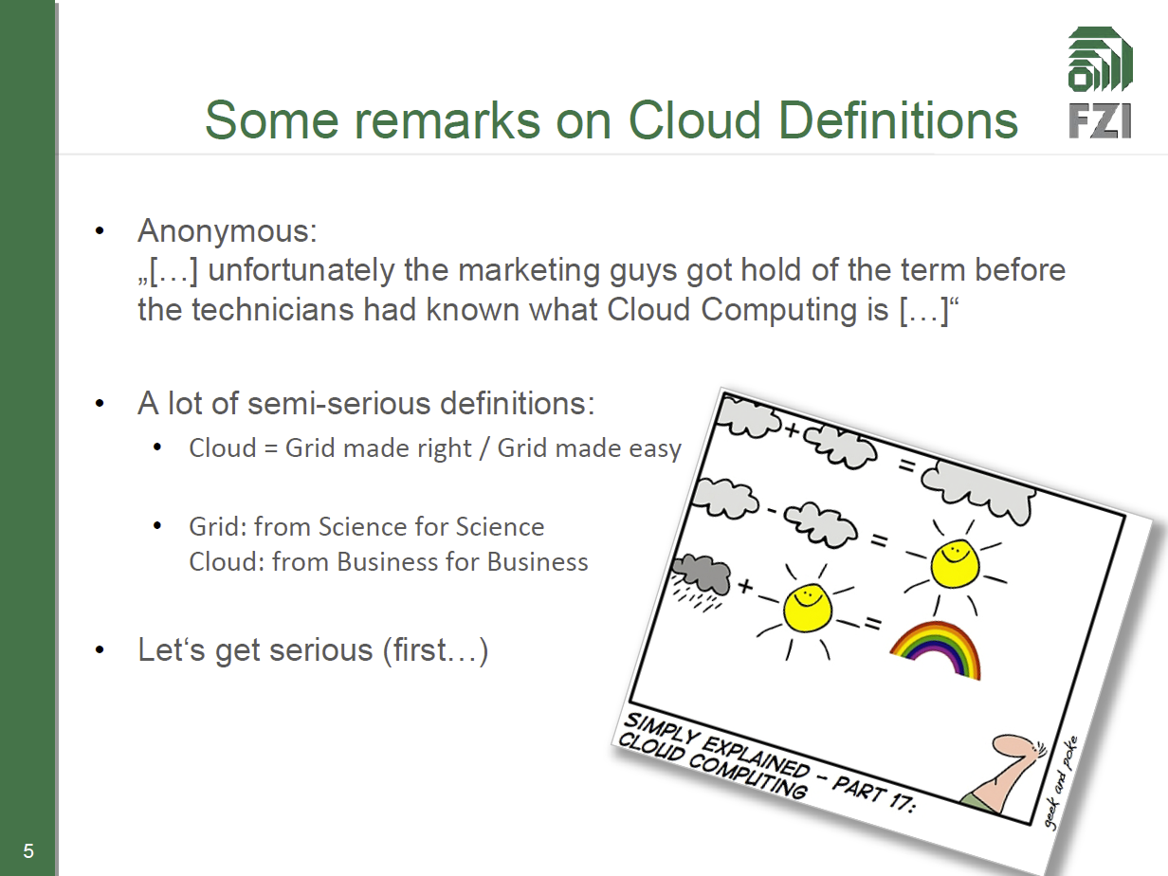
http://www.slideshare.net/JensNimis/cloud-computing-tutorial-jens-nimis

Slide 18
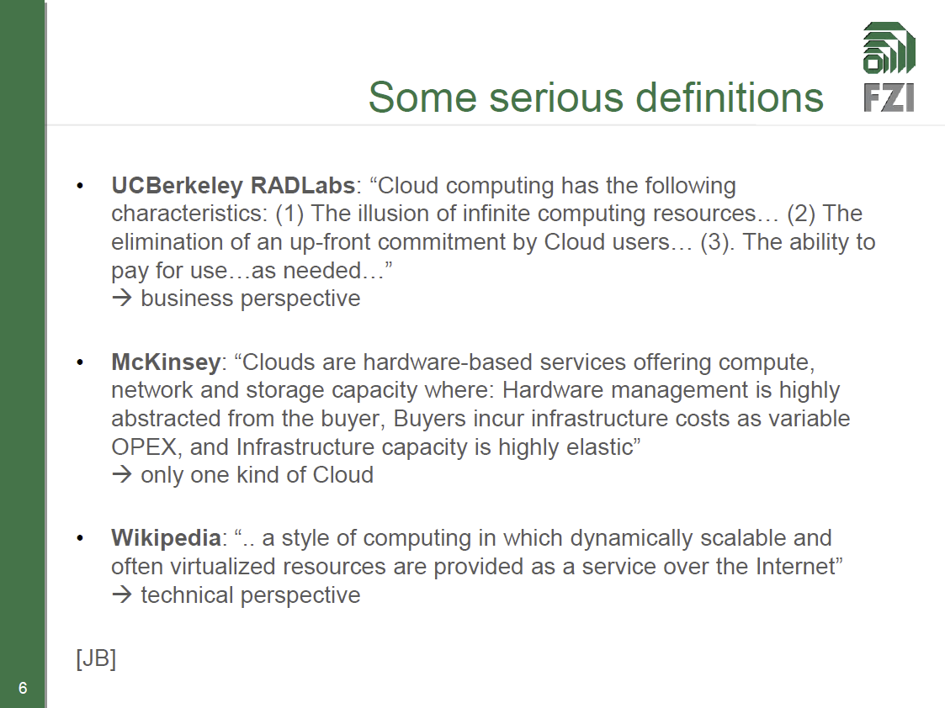
http://www.slideshare.net/JensNimis/cloud-computing-tutorial-jens-nimis

Slide 19
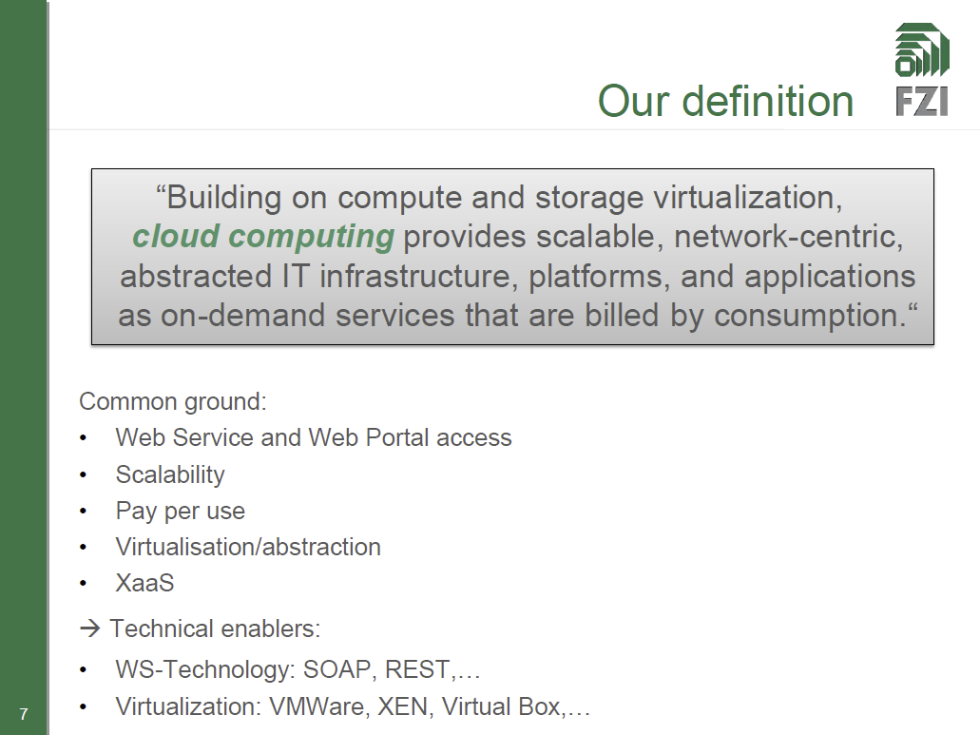
http://www.slideshare.net/JensNimis/cloud-computing-tutorial-jens-nimis

Slide 20
Gartner’s Landscape

Slide 21
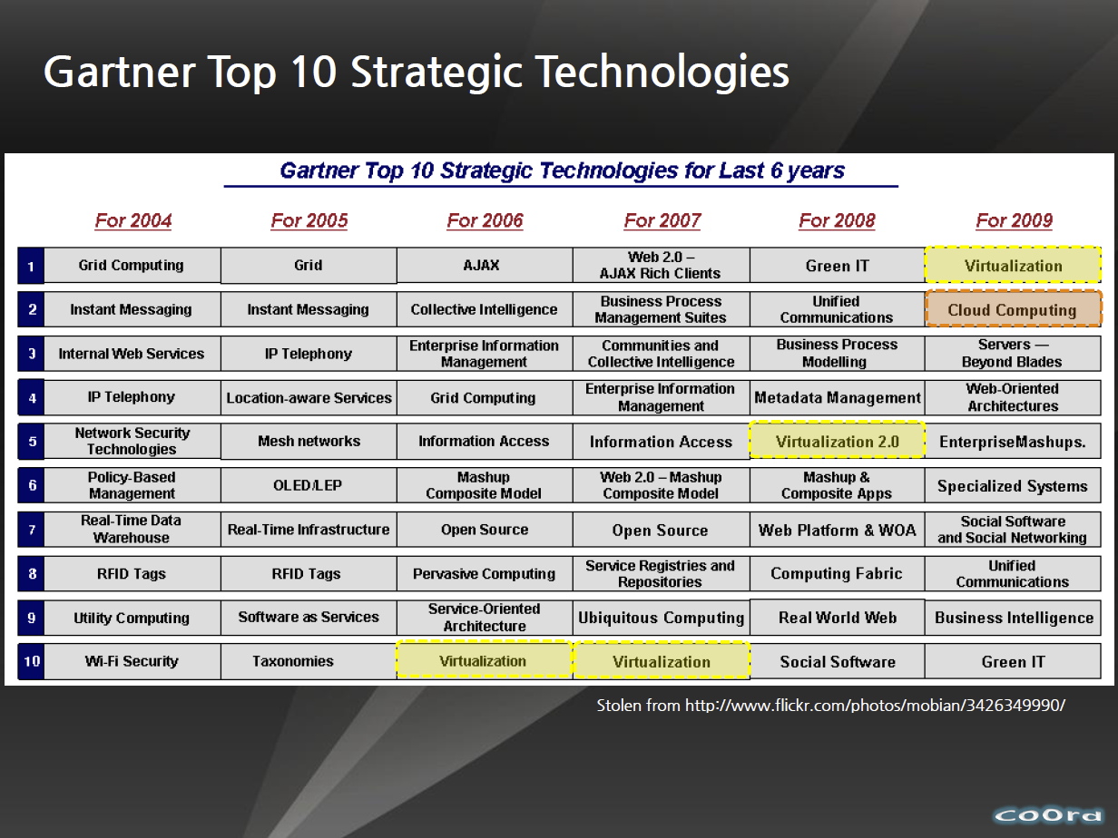
http://www.slideshare.net/woorung/trend-and-future-of-cloud-computing

Slide 22
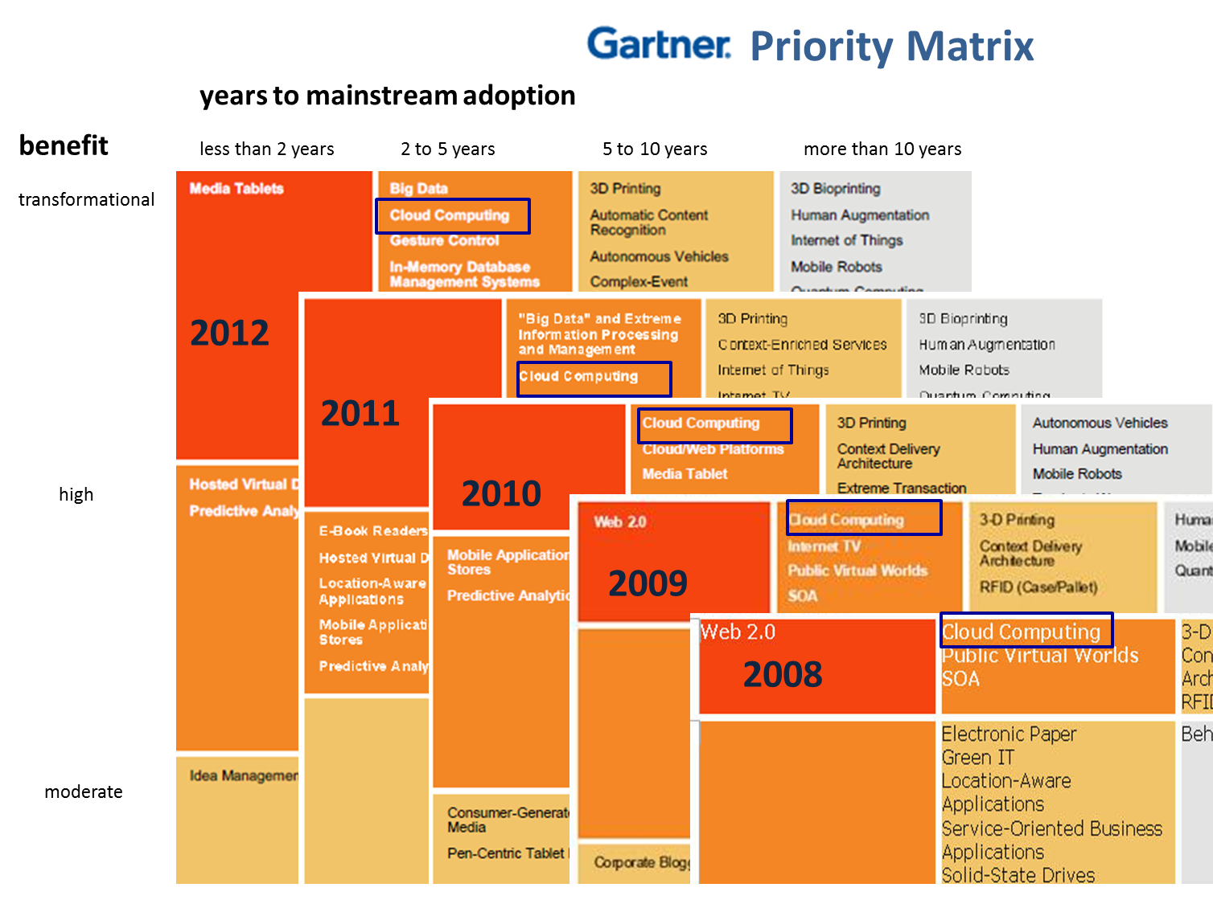

Slide 23
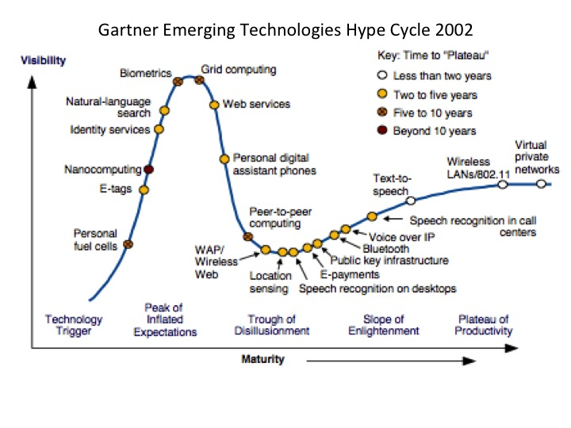

Slide 24
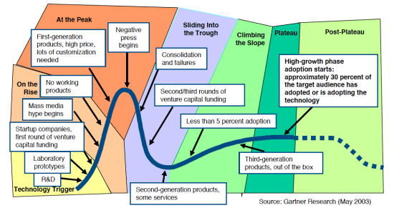
Hype Cycle
Describes Stock Prices, Popularity of artists etc.?

Slide 25
Different Cloud aaS (as a Service)’s
IaaS: Infrastructure is “renting” service for hardware
PaaS: Convenient service interface to Systems capabilities
SaaS: Convenient service interface to applications
NaaS: Summarizes modern “Software Defined Networks”

Slide 26
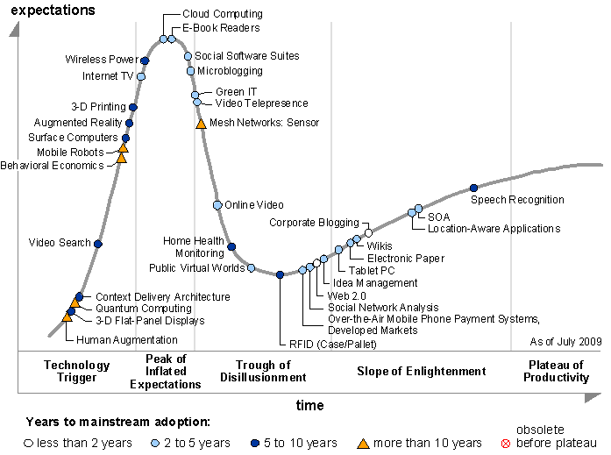
Gartner 2009 Hype Curve
Clouds, Web2.0, Green IT
Service Oriented Architectures

Slide 27
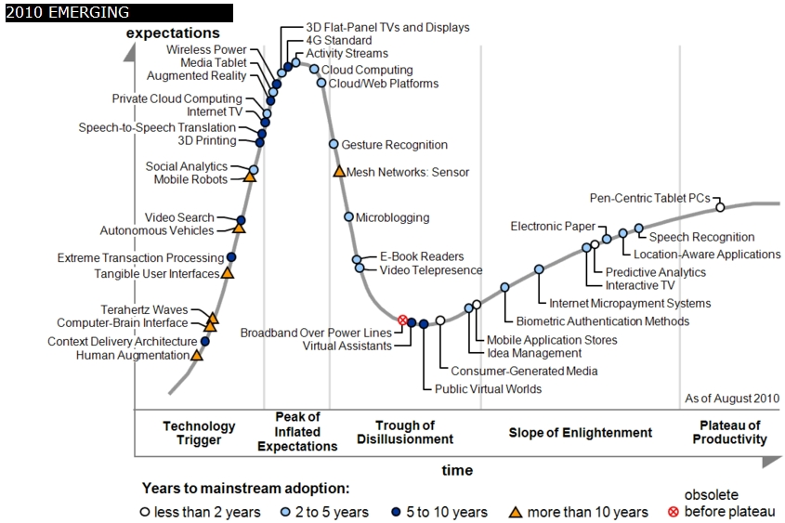

Slide 28
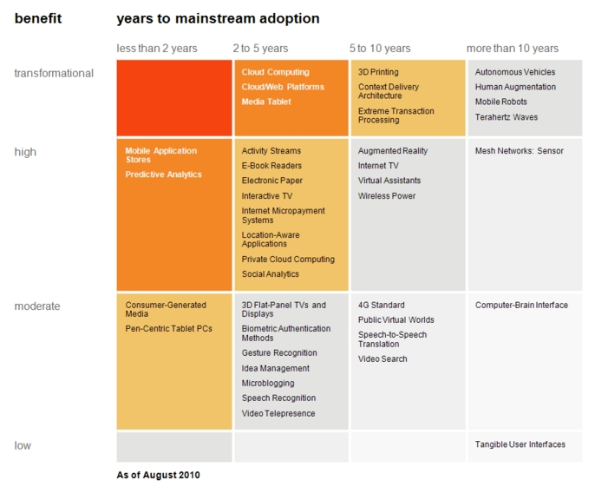
Transformational
High
Moderate
Low
Cloud Computing
Cloud Web Platforms
Media Tablet

Slide 29
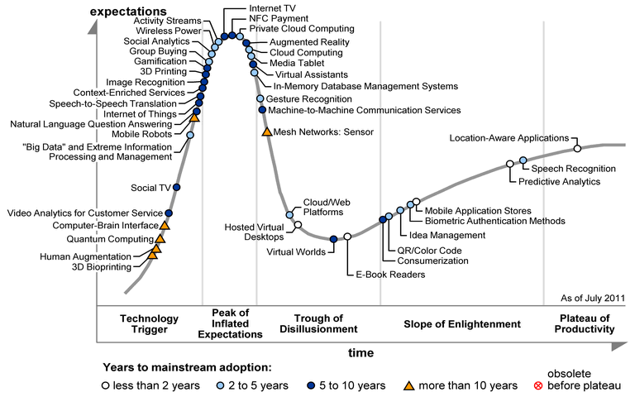

Slide 30
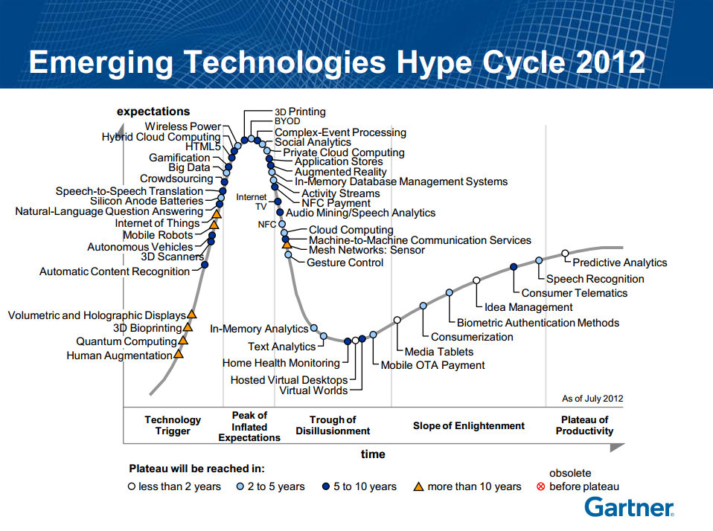

Slide 31
Summary of the Gartner Hype Cycle for “Emerging Technologies” for 2012
http://setandbma.wordpress.com/2012/08/10/hype-cycle-2012-emerging-technologies/
What is stated explicitly, what can be inferred.
This Hype Cycle is suppose provide insight into emerging technologies that have broad, cross-industry relevance, and are transformational and high impact in potential.
Most crowded hype cycle on emerging technologies in last 10 years
48 technologies are listed in this year’s hype cycle which is the highest in last ten years. Last year they had 42 – year 2008 was the lowest (27) – year 2005 was the previous highest (44).
What does this imply?
May be Gartner is right when it says:
We are at an interesting moment — a time when the scenarios we’ve been talking about for a long time are almost becoming reality.

Slide 32
Which macro trends are stated explicitly in the report?
http://setandbma.wordpress.com/2012/08/10/hype-cycle-2012-emerging-technologies/
Any Channel, Any Device, Anywhere — Bring Your Own Everything
Smarter Things – things are smart and connected to the Internet
Big Data and Global-Scale Computing at Small Prices
The Human Way to Interact with Technology – speech, gesture etc.
What Payment Could Really Become – NFC (Near Field Communication), Mobile OTA (over The Air) etc.
The Voice of the Customer Is on File – making sense of behavior data already available
3D Print It at Home
2 Implicit trends
Consumerization of IT describes the trend where technologies are adopted by consumer ahead of enterprise & government & science.
Hyper-connectivity is about connecting everything us-to-internet; things-to-internet; peer-to-peer; consumer-to-enterprise; enterprise-to-enterprise… and so on

Slide 33
14 of 48 are technologies for reaching out or interacting with consumers
Application Stores
Augmented Reality
BYOD (Bring your own device)
Consumer Telematics
Consumerization (This is not a technology – it is a trend)
Gamification
Home Health Monitoring
HTML5
Internet TV
Media Tablets
Mobile OTA (over The Air) Payment
NFC (Near Field Communication)
NFC Payment
Virtual Worlds
From http://setandbma.wordpress.com/2012/08/10/hype-cycle-2012-emerging-technologies/

Slide 34
8 of 48 are about analyzing, understanding and taking advantage of consumer behavior
Activity Streams
Big Data
Complex-Event Processing
Crowdsourcing
In-Memory Analytics
Predictive Analytics
Social Analytics
Text Analytics
From http://setandbma.wordpress.com/2012/08/10/hype-cycle-2012-emerging-technologies/

Slide 35
3 of 48 are about connecting things
Internet of Things
Machine-to-Machine Communication Services
Mesh Networks: Sensor
From http://setandbma.wordpress.com/2012/08/10/hype-cycle-2012-emerging-technologies/

Slide 36
10 of 48 are technologies for AI and Robotics nearing the Tipping Point
Audio Mining/Speech Analytics
Automatic Content Recognition
Autonomous Vehicles
Biometric Authentication Methods
Gesture Control
Human Augmentation
Mobile Robots
Natural-Language Question Answering
Speech Recognition
Speech-to-Speech Translation
From http://setandbma.wordpress.com/2012/08/10/hype-cycle-2012-emerging-technologies/

Slide 37
6 of 48 are technologies for improving efficiency or for reducing cost
Cloud Computing
Hosted Virtual Desktops
Hybrid Cloud Computing
Idea Management
In-Memory Database Management Systems
Private Cloud Computing
From http://setandbma.wordpress.com/2012/08/10/hype-cycle-2012-emerging-technologies/

Slide 38
7 of 48 are miscellaneous technologies most of them very futuristic in nature
3D Bio-printing
3D Printing
3D Scanners
Quantum Computing
Silicon Anode Batteries
Volumetric and Holographic Displays
Wireless Power
From http://setandbma.wordpress.com/2012/08/10/hype-cycle-2012-emerging-technologies/

Slide 39
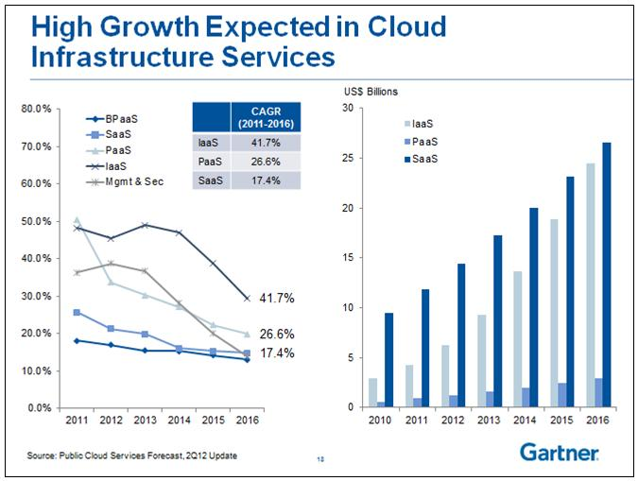
IaaS Hardware e.g. Server
PaaS Systems Services e.g. MapReduce, Database
SaaS Applications e.g. Recommender System, Clustering
BPaaS Particular Application Set
BPM = Business Process management

Slide 40
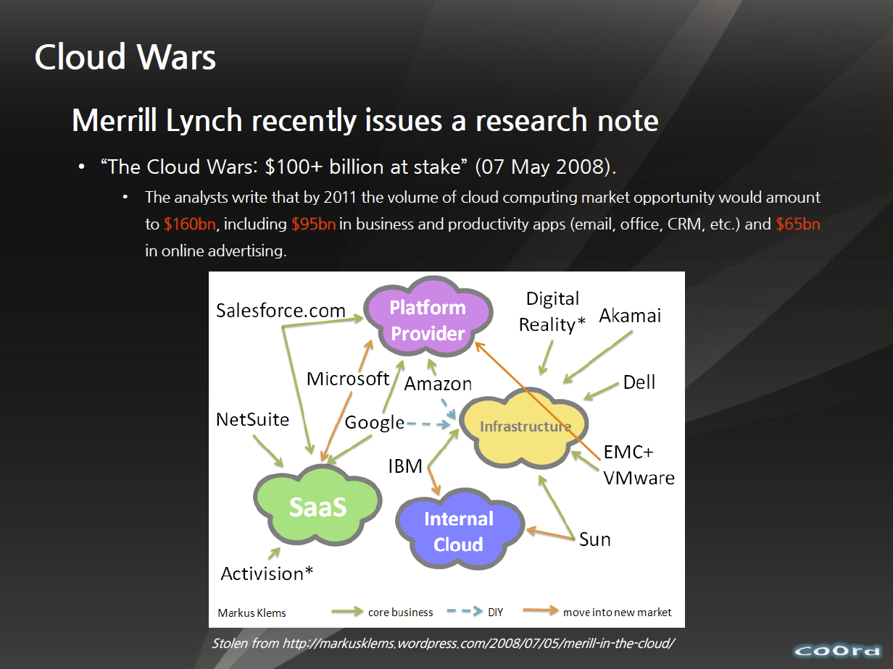
http://www.slideshare.net/woorung/trend-and-future-of-cloud-computing

Slide 41
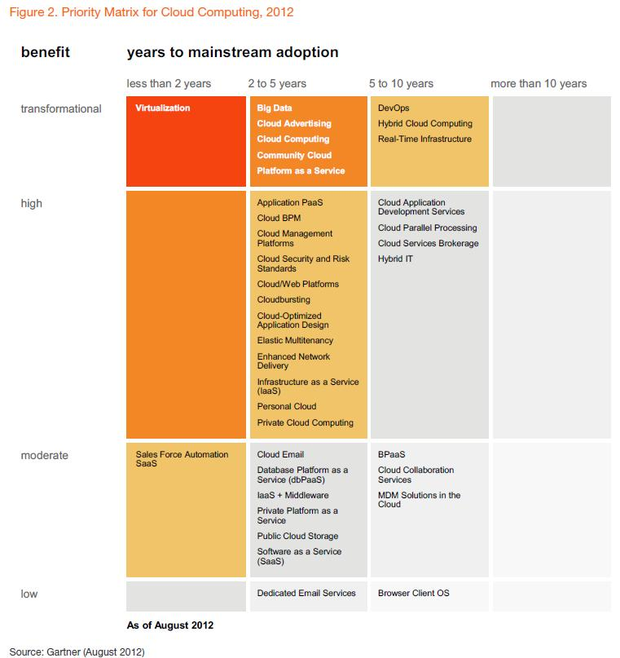

Slide 42
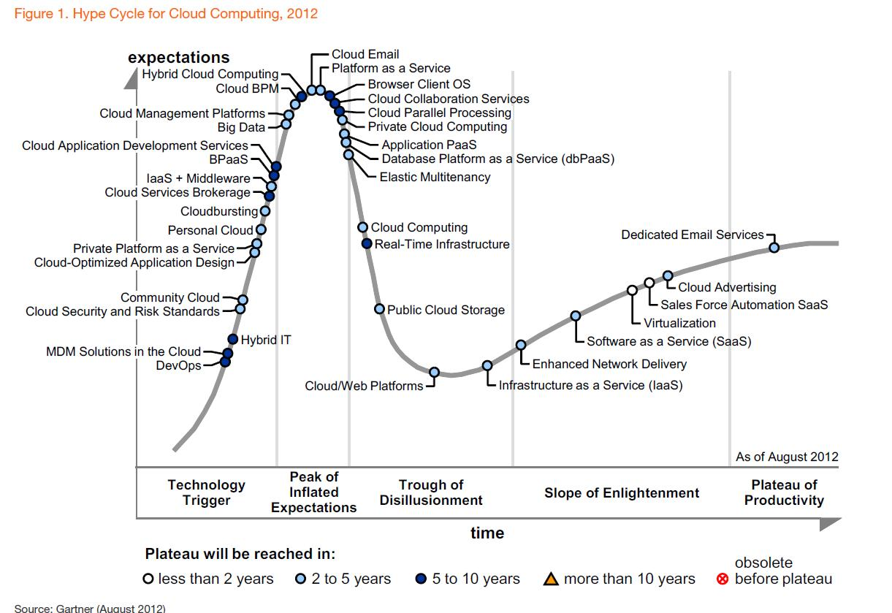

Slide 43
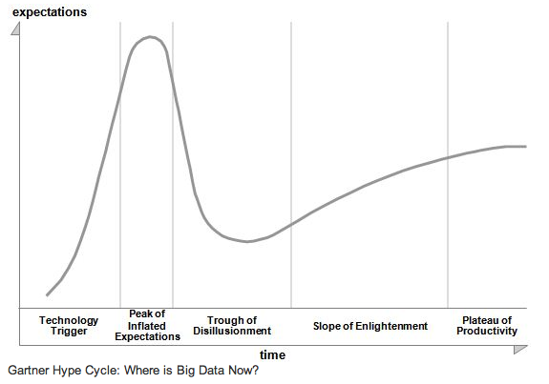
The hype over “Big Data” is about to plunge into widespread disillusionment, according to a Gartner analyst.
Big Data is plunging into a “trough of disillusionment” that will dissuade many companies from pursuing analytics technology, according to a Gartner analyst.
Gartner regularly updates what it terms the Hype Cycle, in which technologies progress from rising interest, to overexposure, to the Dante-style “trough of disillusionment,” and finally to eventual rehabilitation as productive and well-integrated technologies. Everything from cloud computing to media tablets goes through these stages; and now, according to Svetlana Sicular, Big Data is about to take the plunge into widespread disappointment and discontent.
Who’s responsible for shoving Big Data over that cliff? Users have apparently realized that dealing with massive datasets and complex analytical tools is hard. “My most advanced with Hadoop clients are also getting disillusioned,” Sicular wrote in a Jan. 22 blog posting on the Gartner Website. “Their disappointment applies to more advanced cases of sentiment analysis, which go beyond traditional vendor offerings.”
http://slashdot.org/topic/bi/big-data-hype-is-imploding-gartner-analyst/

Slide 44
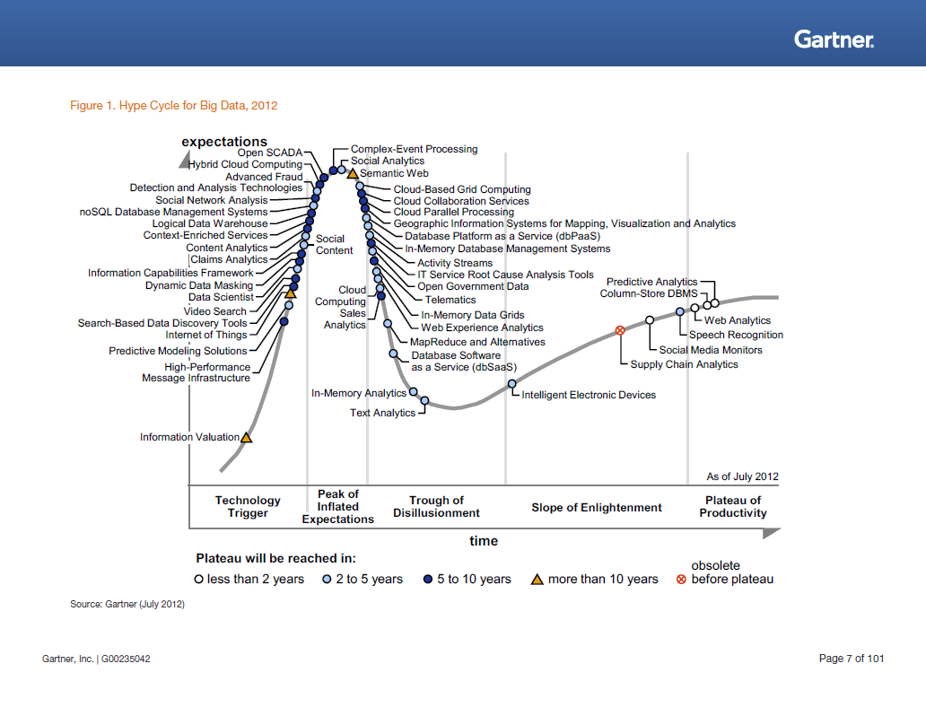

Slide 45
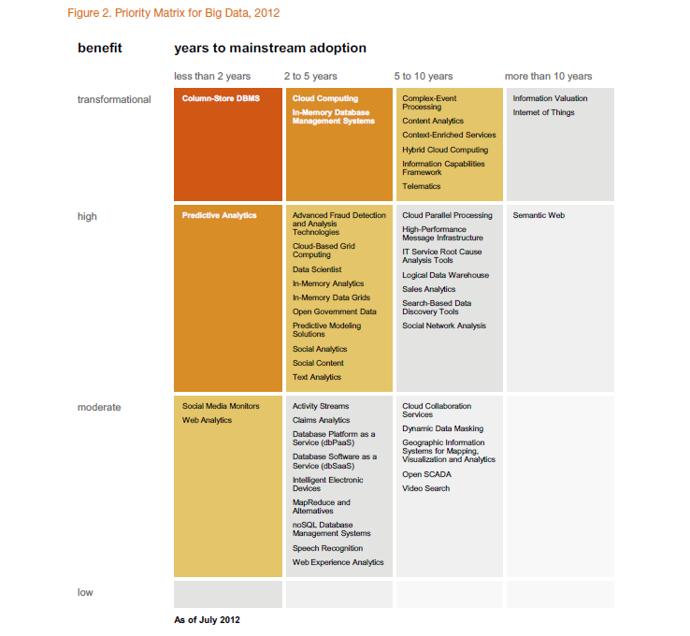

Slide 46
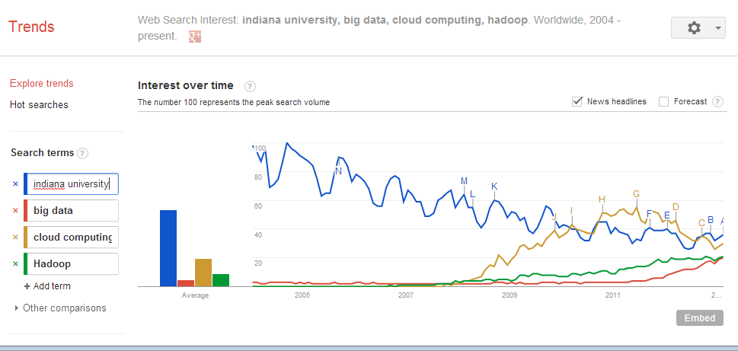

Slide 47
Simple Examples

Slide 48
Microsoft Server Consolidation
http://research.microsoft.com/pubs/78813/AJ18_EN.pdf
Typical data center CPU has 9.75% utilization
Take 5000 SQL servers and rehost on virtual machines with 6:1 consolidation
60% saving

Slide 49
The Google gmail example
http://www.google.com/green/pdfs/google-green-computing.pdf
Clouds win by efficient resource use and efficient data centers
Business Type | Number of users | # servers | IT Power per user | PUE (Power Usage effectiveness) | Total Power per user | Annual Energy per user
Small | 50 | 2 | 8W | 2.5 | 20W | 175 kWh
Medium | 500 | 2 | 1.8W | 1.8 | 3.2W | 28.4 kWh
Large | 10000 | 12 | 0.54W | 1.6 | 0.9W | 7.6 kWh
Gmail (Cloud) | ∞ | ∞ | < 0.22W | 1.16 | < 0.25W | < 2.2 kWh

Slide 50
What is Cloud Computing
Continued

Slide 51
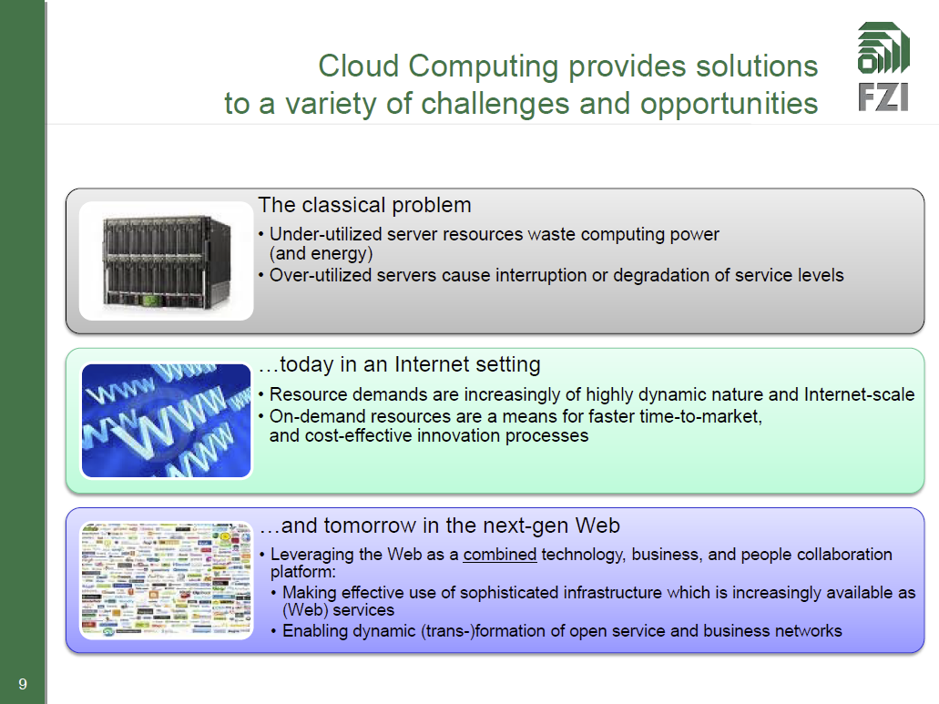
http://www.slideshare.net/JensNimis/cloud-computing-tutorial-jens-nimis

Slide 52
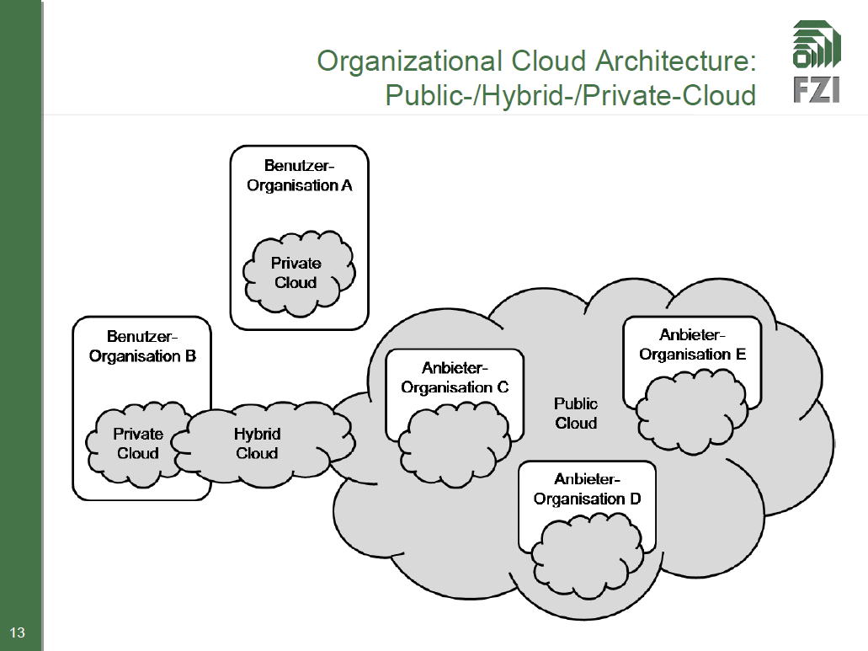
http://www.slideshare.net/JensNimis/cloud-computing-tutorial-jens-nimis

Slide 53
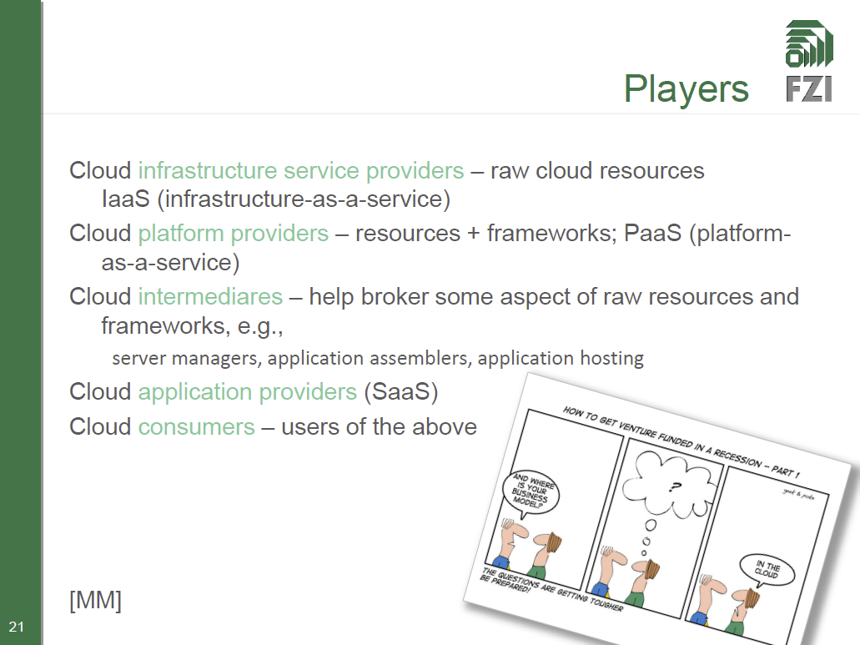
http://www.slideshare.net/JensNimis/cloud-computing-tutorial-jens-nimis

Slide 54
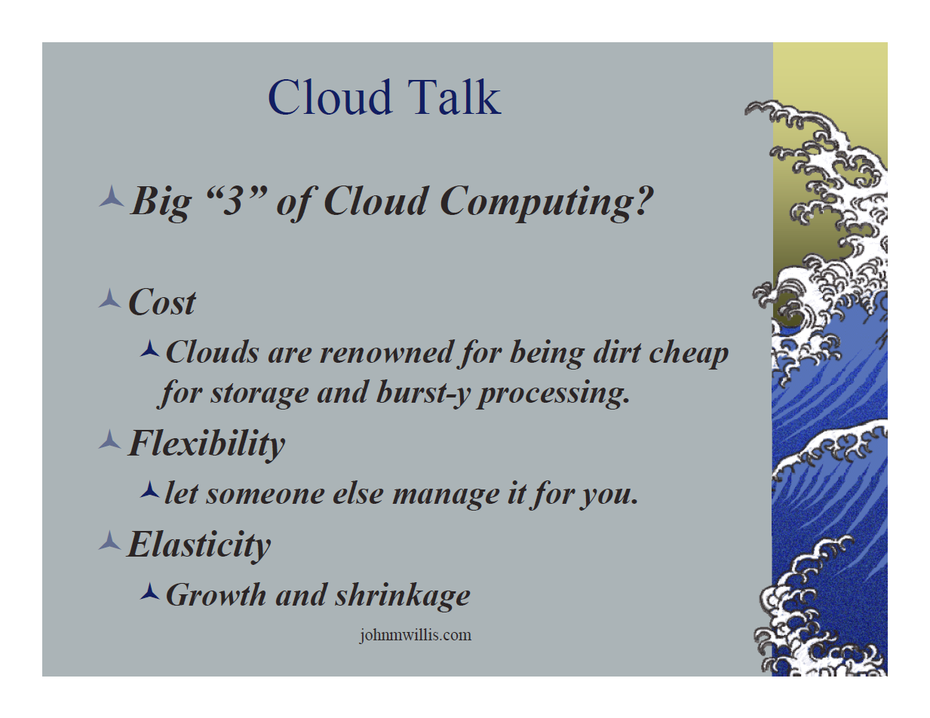
http://www.slideshare.net/botchagalupe/introduction-to-clouds-cloud-camp-columbus

Slide 55
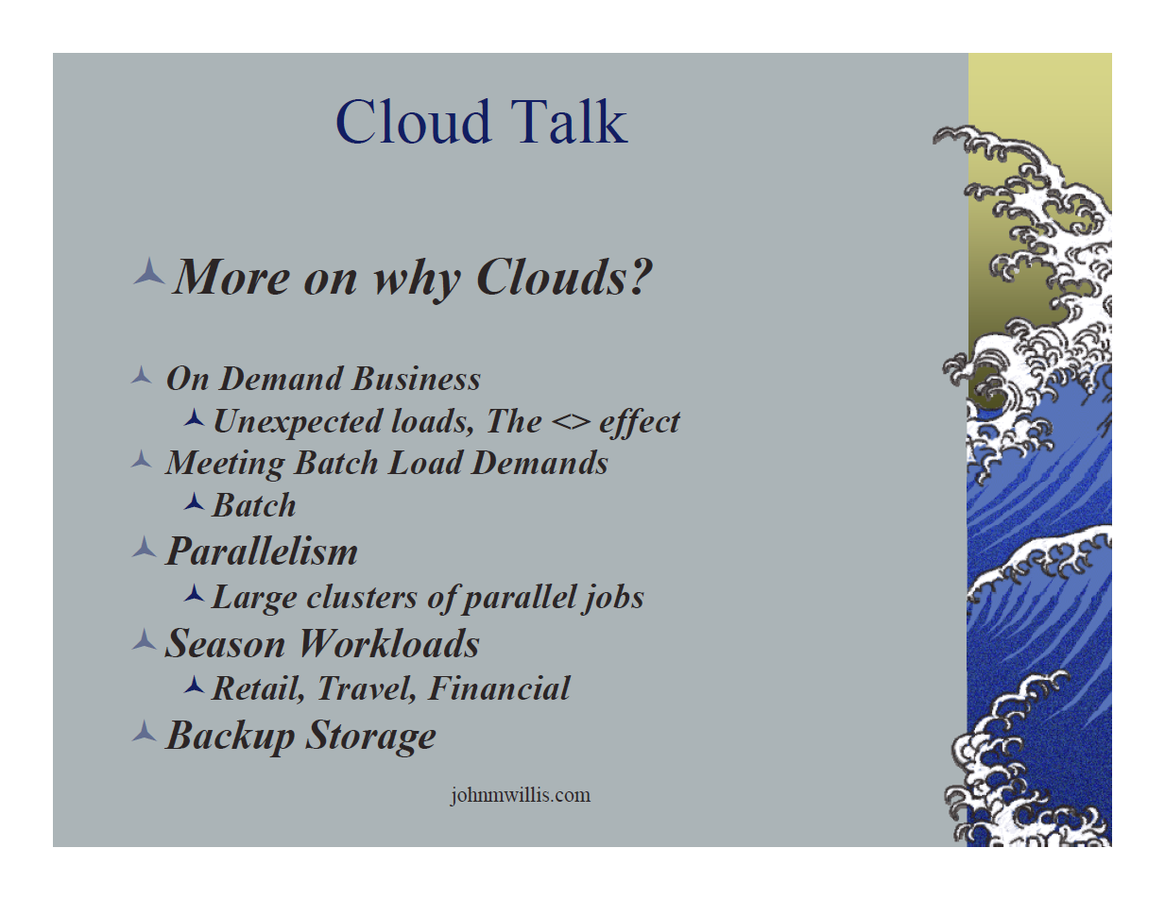
http://www.slideshare.net/botchagalupe/introduction-to-clouds-cloud-camp-columbus

Slide 56
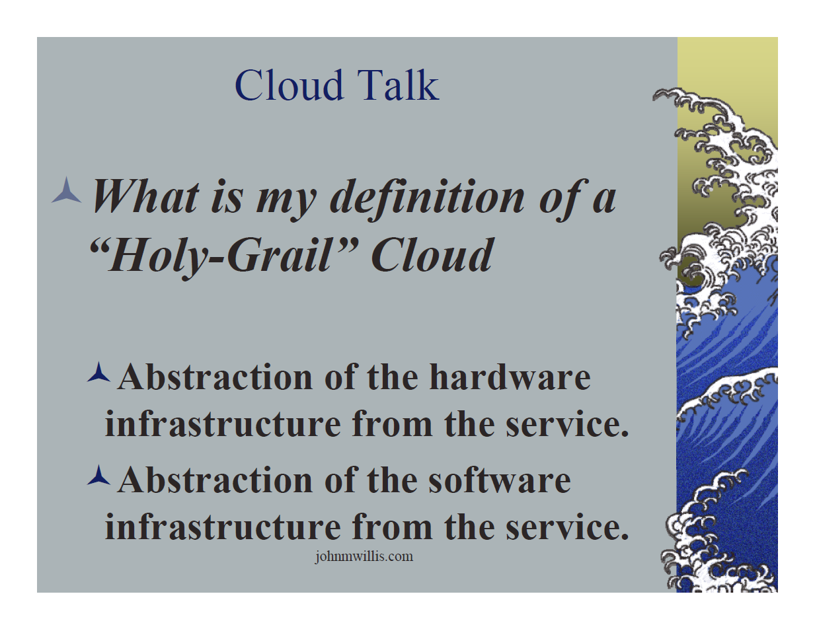
http://www.slideshare.net/botchagalupe/introduction-to-clouds-cloud-camp-columbus

Slide 57
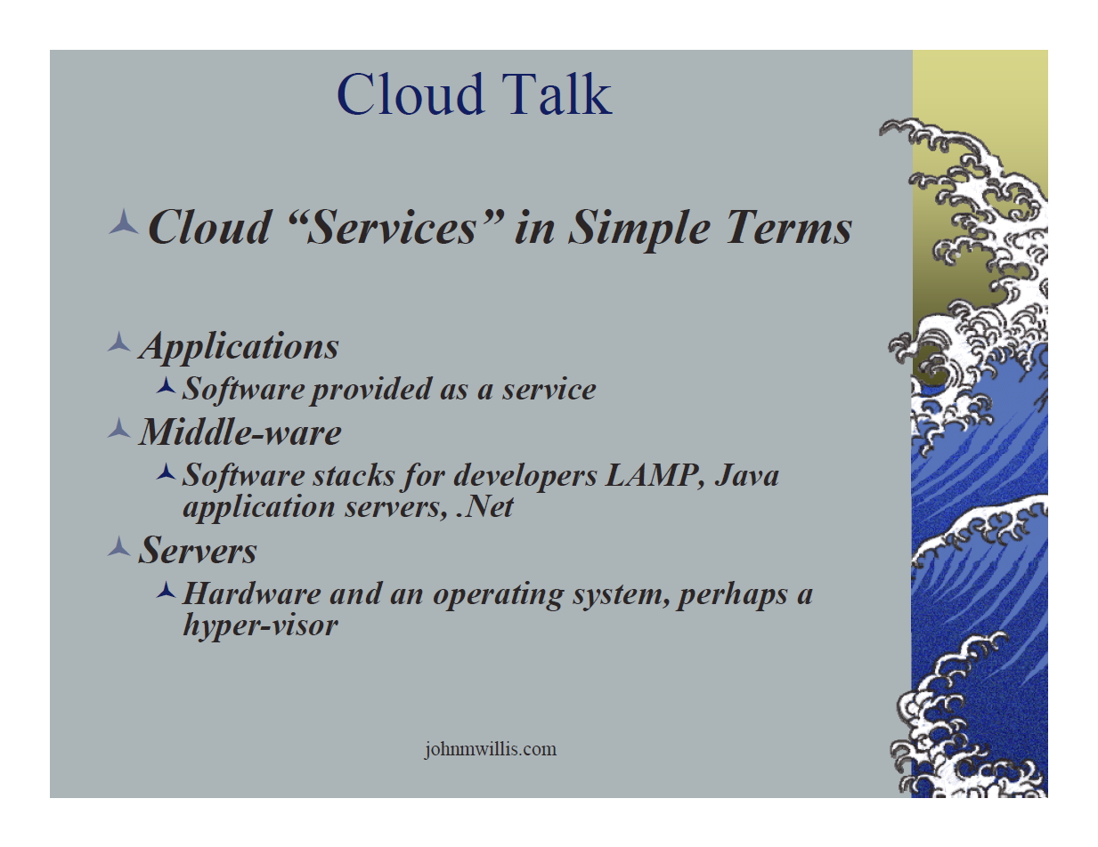
http://www.slideshare.net/botchagalupe/introduction-to-clouds-cloud-camp-columbus

Slide 58
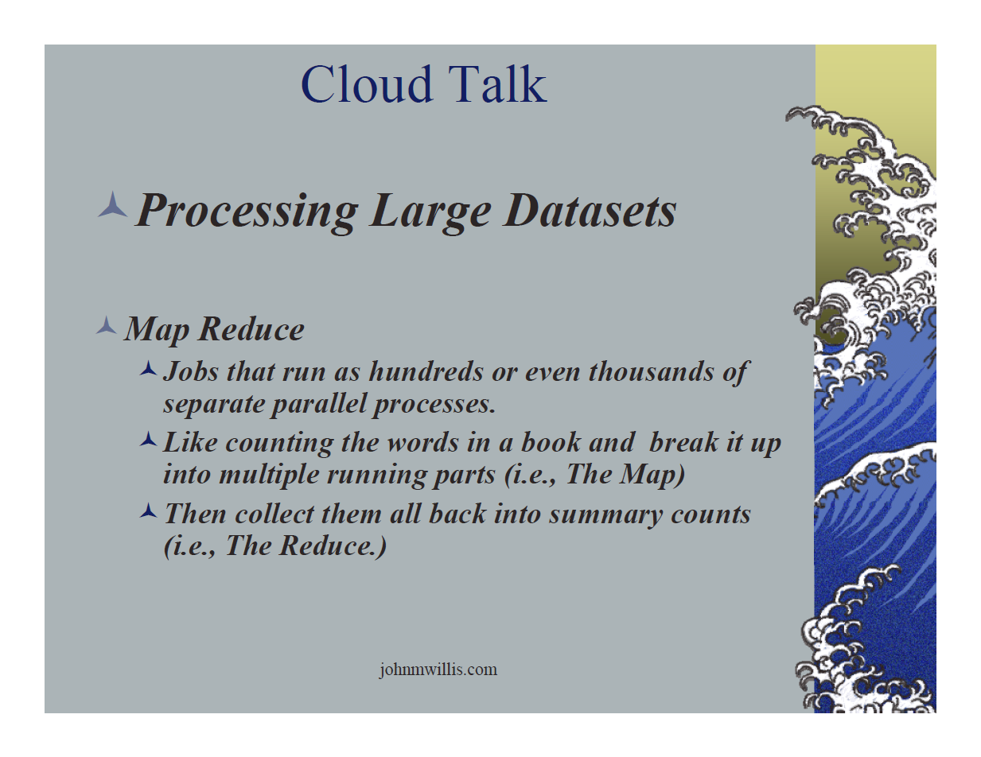
http://www.slideshare.net/botchagalupe/introduction-to-clouds-cloud-camp-columbus

Slide 59
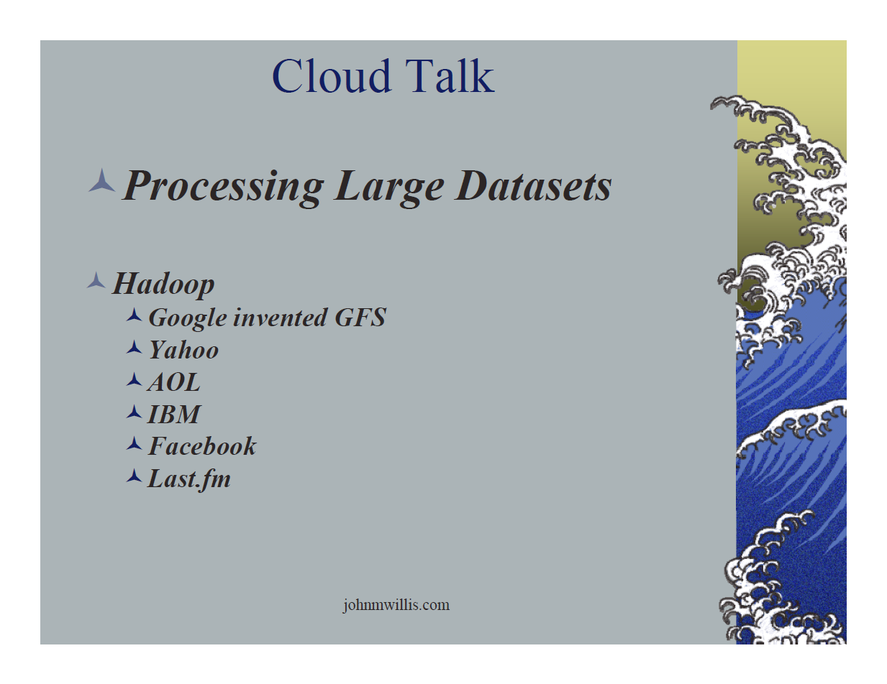
http://www.slideshare.net/botchagalupe/introduction-to-clouds-cloud-camp-columbus

Slide 60
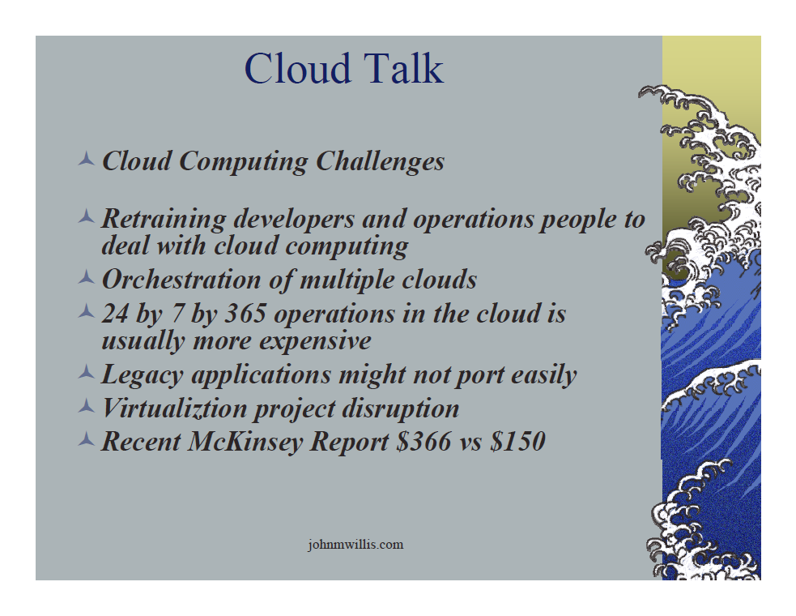
http://www.slideshare.net/botchagalupe/introduction-to-clouds-cloud-camp-columbus

Slide 61
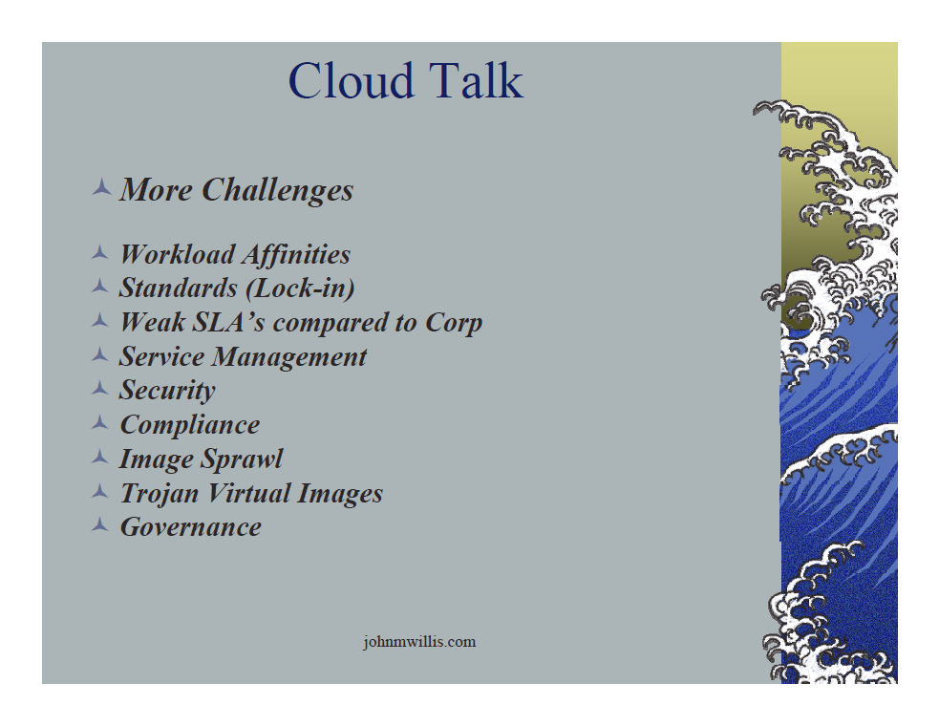
http://www.slideshare.net/botchagalupe/introduction-to-clouds-cloud-camp-columbus

Slide 62
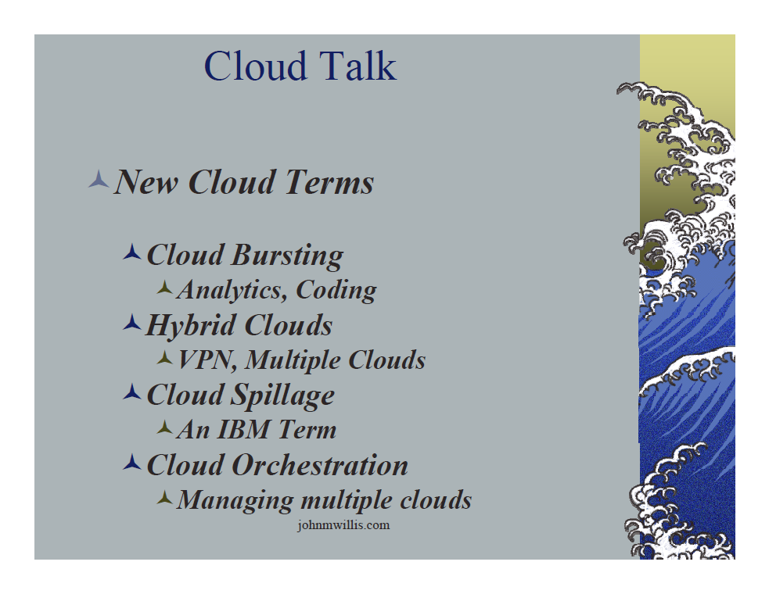
http://www.slideshare.net/botchagalupe/introduction-to-clouds-cloud-camp-columbus

Slide 63
