Slide 1
X-Informatics Cloud Technology (Continued)
March 4 2013
Geoffrey Fox
gcf@indiana.edu
http://www.infomall.org/X-InformaticsSpring2013/index.html
Associate Dean for Research and Graduate Studies, School of Informatics and Computing
Indiana University Bloomington
2013

Slide 2
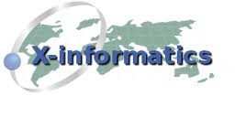
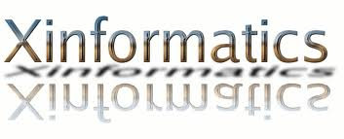
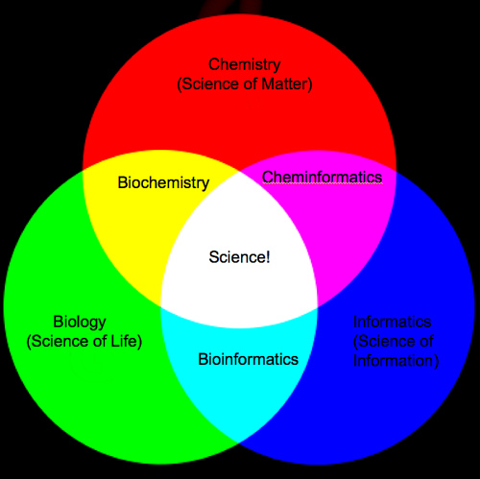
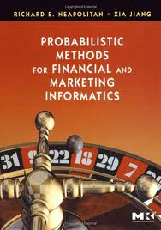
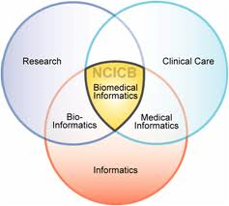
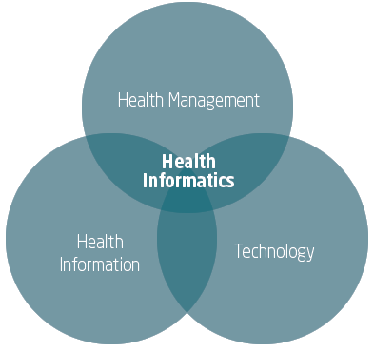
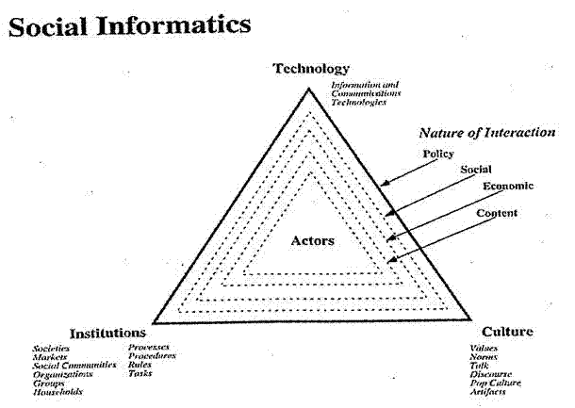
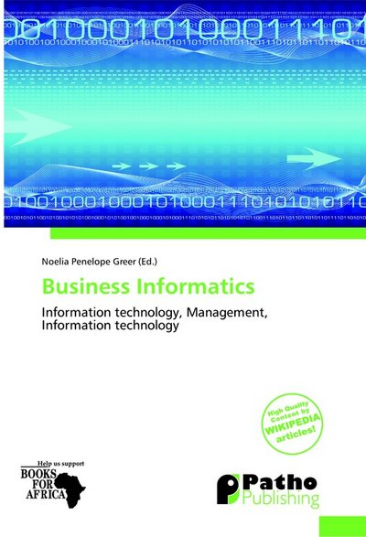

Slide 3
The Course in One Sentence
Study Clouds running Data Analytics processing Big Data to solve problems in X-Informatics

Slide 4
What is Cloud Computing
Continued

Slide 5
Cloud Properties
Designed to Provide Information and Computation to Many Users
Automatic Deployment and Management of Virtual Machine Instances
tens to thousands & dynamic scalability
Dynamic Fault Recovery of Failed Resources
Cloud Services must run 24x7
Automatic Data Replication
Geo-replication if needed
Two levels of parallelism
Thousands of concurrent users
Thousands of servers for a single task.
Gannon Talk

Slide 6
Clouds Offer From different points of view
Features from NIST:
On-demand service (elastic);
Broad network access;
Resource pooling;
Flexible resource allocation;
Measured service
Economies of scale in performance and electrical power (Green IT)
Powerful new software models
Platform as a Service is not an alternative to Infrastructure as a Service – it is instead an incredible valued added
Amazon is as much PaaS as Azure

Slide 7
What is Cloud?
A scalable, persistent outsourced infrastructure
A framework for massive data analysis
An amplifier of our desktop experience
from MICROSOFT

Slide 9
Cloud Mythologies
Cloud computing infrastructure is just a web service interface to operating system virtualization.
–“I’m running Xen in my data center –I’m running a private cloud.”
Clouds and Grids are equivalent
–“In the mid 1990s, the term grid was coined to describe technologies that would allow consumers to obtain computing power on demand.”
Cloud computing imposes a significant performance penalty over “bare metal” provisioning.
–“I won’t be able to run a private cloud because my users will not tolerate the performance hit.”
Eucalyptus

Slide 10
Why Cloud Might Matter To You?
A New Science
“A new, fourth paradigm for science is based on data intensive computing” … understanding of this new paradigm from a variety of disciplinary perspective
– The Fourth Paradigm: Data-Intensive Scientific Discovery
A New Architecture
“Understanding the design issues and programming challenges for those potentially ubiquitous next-generation machines”
– The Datacenter As A Computer

Slide 11
As a Service and Platform Model

Slide 12
http://www.slideshare.net/woorung/trend-and-future-of-cloud-computing

Slide 14
IaaS Open Source
Eucalyptus
Nimbus
OpenStack
OpenNebula (Europe)
CloudStack (break away from OpenStack)
These manage basic computing and storage but these are separable ideas
Management, Networking, Access Tools
You install on your own clusters and do have control over operation
Compare Public Clouds (Amazon Azure Google) where operation is opaque but you just need a credit card and a web browser
Compare VMware commercial version which is similar to OpenSource but with better support and probably greater robustness/functionality
Eucalyptus has Open Source and Commercial versions

Slide 15
Eucalyptus
Computing
Storage

Slide 16
Platform as a Service

Slide 18
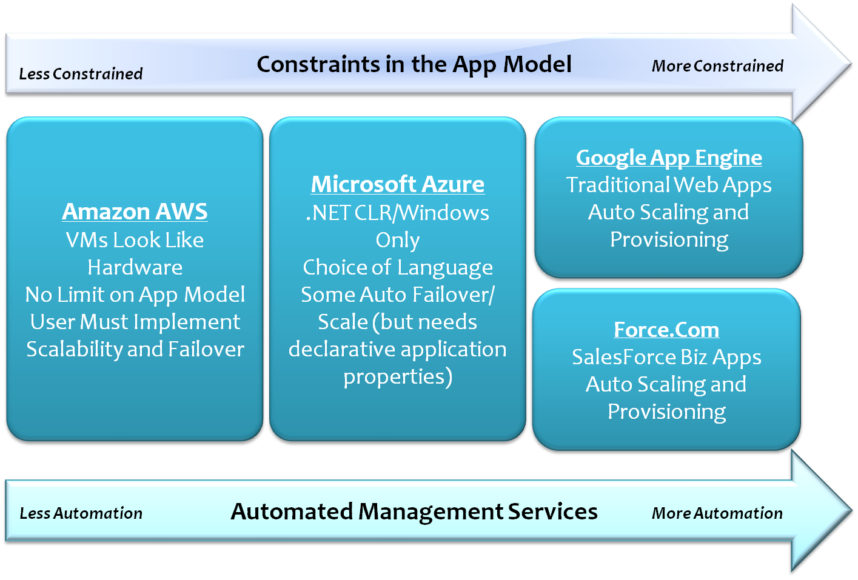
Platform Extension to Cloud is a Continuum
MICROSOFT

Slide 19
Cloud Computing: Infrastructure and Runtimes
Cloud Infrastructure: outsourcing of servers, computing, data, file space, utility computing, etc.
Handled through (Web) services that control virtual machine lifecycles.
Cloud Runtimes or Platform: tools (for using clouds) to do data-parallel (and other) computations.
Apache Hadoop, Google MapReduce, Microsoft Dryad, Bigtable, Chubby (synchronization) and others
MapReduce designed for information retrieval but is excellent for a wide range of science data analysis applications
Can also do much traditional parallel computing for data-mining if extended to support iterative operations
MapReduce not usually done on Virtual Machines

Slide 20
Cloud Data Models
Clouds have a unique processing model – MapReduce with Hadoop which we discussed
They have also inspired a revolution in data models
Originally enterprises used databases but
Science did not as not efficient and “transactions” not typical use
Rather tended to access large chunks of data and/or did not do SQL queries. Rather used custom user software to access events of interest e.g. events like the Higgs
LHC explored use of “object oriented” databases (Objectivity) but abandoned
“Web 2.0” applications had same issues as science
Huge data sizes (in fact larger than science) and non SQL queries
This spurred NOSQL approaches to data and approaches to parallelism

Slide 21
Different formats for data
Traditional Windows or UNIX file systems arranged in a hierarchy with directories
Generalize to share files across many computers
Access with standard UNIX I/O commands and in growing fashion via web (as in Oncourse or Dropbox)
Google File System – realized in Hadoop File System HDFS – splits files up for parallelism
Traditional file systems also had parallel extensions but GFS very explicit
Object stores like Amazon S3 have simpler interface than traditional file systems
Databases will appear on next page as management system

Slide 22
Clouds as Support for Data Repositories?
The data deluge needs cost effective computing
Clouds are by definition cheapest
Need data and computing co-located
Shared resources essential (to be cost effective and large)
Can’t have every scientists downloading petabytes to personal cluster
Need to reconcile distributed (initial source of ) data with shared analysis
Can move data to (discipline specific) clouds
How do you deal with multi-disciplinary studies
Data repositories of future will have cheap data and elastic cloud analysis support?
Hosted free if data can be used commercially?

Slide 23
Architecture of Data Repositories?
Traditionally governments set up repositories for data associated with particular missions
For example EOSDIS (Earth Observation), GenBank (Genomics), NSIDC (Polar science), IPAC (Infrared astronomy)
LHC/OSG computing grids for particle physics
This is complicated by volume of data deluge, distributed instruments as in gene sequencers (maybe centralize?) and need for intense computing like Blast
i.e. repositories need lots of computing?

Slide 24
Traditional File System?
S
Data
C
C
C
C
S
C
C
C
C
Archive
Data
S
C
C
C
C
Data
C
C
C
C
S
Data
Compute Cluster
Storage Nodes
Typically a shared file system (Lustre, NFS …) used to support high performance computing
Big advantages in flexible computing on shared data but doesn’t “bring computing to data”
Object stores similar structure (separate data and compute) to this

Slide 25
Data Parallel File System?
Block1
Replicate each block
File1
Block2
……
Breakup
BlockN
C
C
C
C
Data
Data
Data
Data
C
C
C
C
Data
Data
Data
Data
C
C
C
C
Data
Data
Data
Data
C
C
C
C
Data
Data
Data
Data
Block1
File1
Block2
……
Breakup
Replicate each block
BlockN
No archival storage and computing brought to data

