Slide 1
X-Informatics
Cloud Technology (Continued)
March 6 2013
Geoffrey Fox
gcf@indiana.edu
http://www.infomall.org/X-InformaticsSpring2013/index.html
Associate Dean for Research and Graduate Studies, School of Informatics and Computing
Indiana University Bloomington
2013

Slide 2
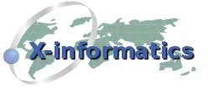

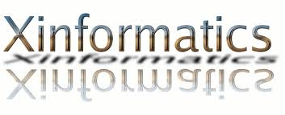

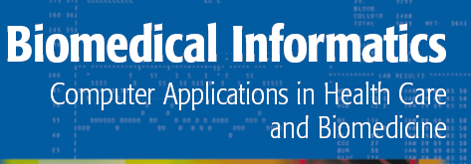


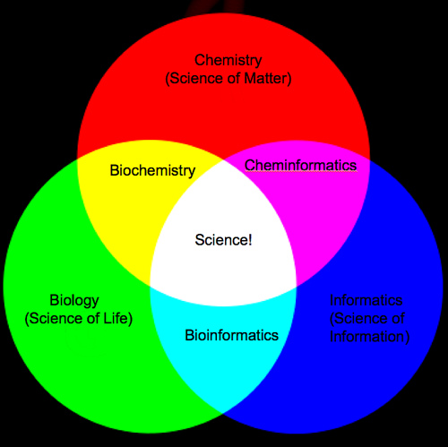
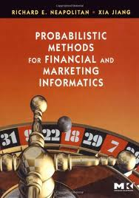
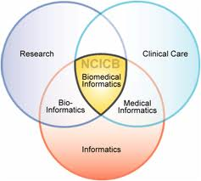
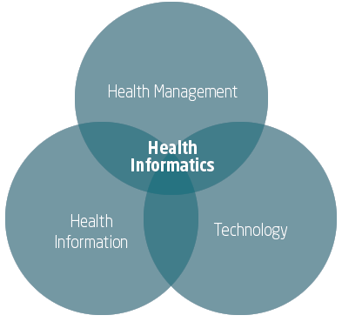
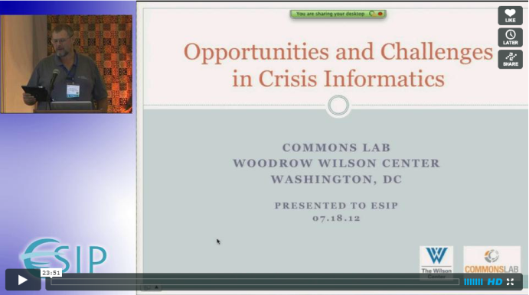
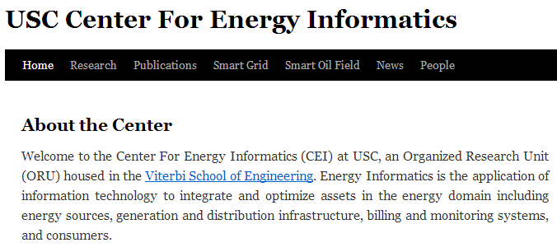
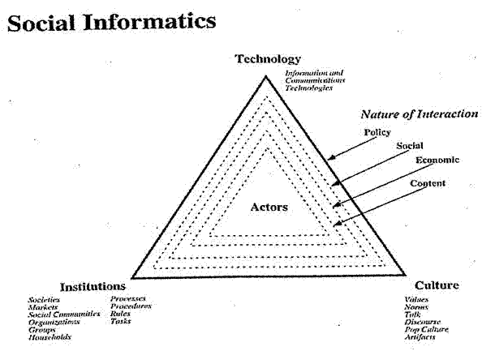
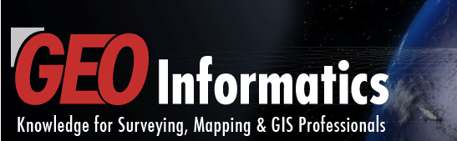
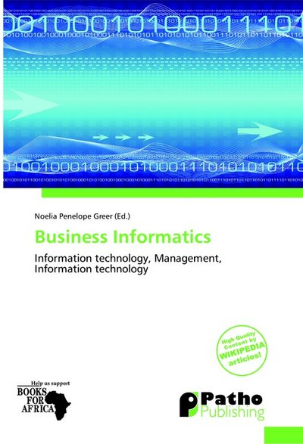
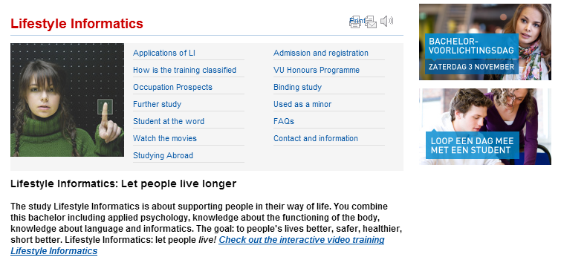
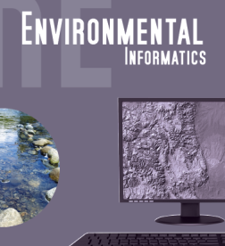


Slide 3
The Course in One Sentence
Study Clouds running Data Analytics processing Big Data to solve problems in X-Informatics

Slide 4
Platform as a Service
(Continued)

Slide 5
Different Approaches to managing Data
Traditional is Directory structure and file names
  With an add-on metadata store usually put in a database
  Contents of file also can be self managed as with XML files
Also traditional is databases which have tables and indices as core concept
Newer NOSQL approaches are Hbase, Dynamo, Cassandra, MongoDB, CouchDB,Riak
  Amazon SimpeDB and Azure table on public clouds
  These often use an HDFS style storage and store entities in distributed scalable fashion
  No fixed Schema
  “Data center” or “web” scale storage
  Document stores and Column stores depending on decomposition strategy
  Typically linked to Hadoop for processing

Slide 6
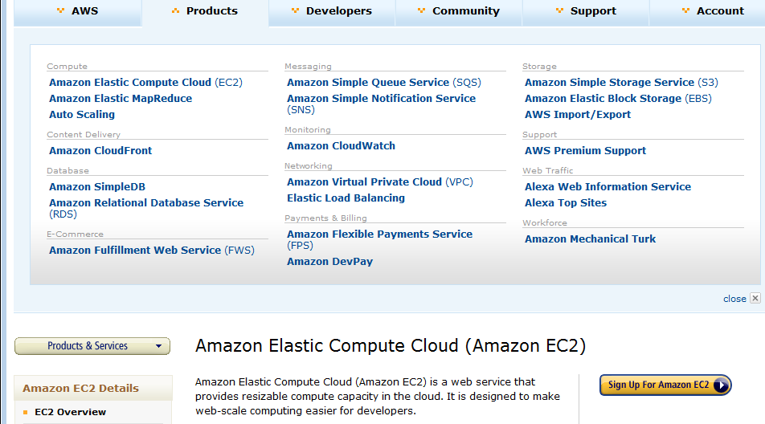
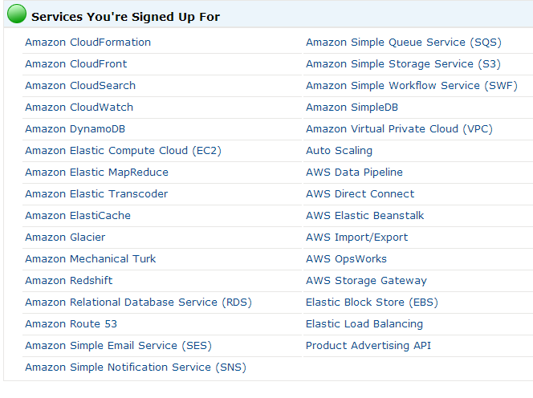
Amazon offers a lot! i.e. is PaaS
4 March 2013

Slide 7
Grid/Cloud | Authentication and Authorization: Provide single sign in to both FutureGrid and Commercial Clouds linked by workflow
 | Workflow: Support workflows that link job components between FutureGrid and Commercial Clouds. Trident from Microsoft Research is initial candidate
 | Data Transport: Transport data between job components on FutureGrid and Commercial Clouds respecting custom storage patterns
 | Software as a Service: This concept is shared between Clouds and Grids and can be supported without special attention
 | SQL: Relational Database
Cloud | Program Library: Store Images and other Program material (basic FutureGrid facility)
 | Blob: Basic storage concept similar to Azure Blob or Amazon S3
 | DPFS Data Parallel File System: Support of file systems like Google (MapReduce), HDFS (Hadoop) or Cosmos (Dryad) with compute-data affinity optimized for data processing
 | Table: Support of Table Data structures modeled on Apache Hbase (Google Bigtable) or Amazon SimpleDB/Azure Table (eg. Scalable distributed “Excel”)
 | Queues: Publish Subscribe based queuing system
 | Worker Role: This concept is implicitly used in both Amazon and TeraGrid but was first introduced as a high level construct by Azure
 | Web Role: This is used in Azure to describe important link to user and can be supported in FutureGrid with a Portal framework
 | MapReduce: Support MapReduce Programming model including Hadoop on Linux, Dryad on Windows HPCS and Twister on Windows and Linux

Slide 8
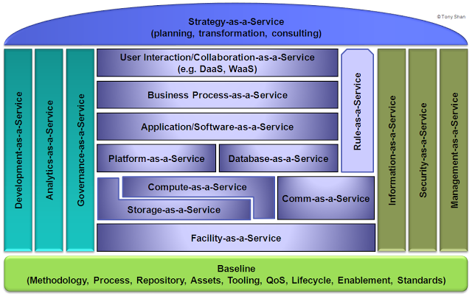
http://cloudonomic.blogspot.com/2009/02/cloud-taxonomy-and-ontology.html

Slide 9
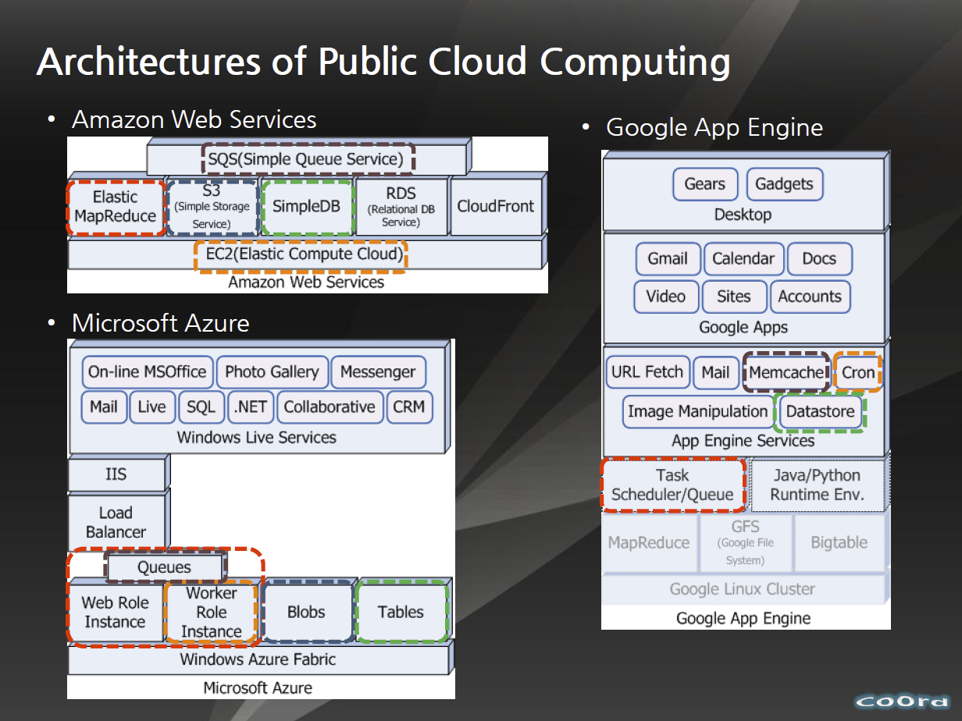
http://www.slideshare.net/woorung/trend-and-future-of-cloud-computing

Slide 10
Cloud (Data Center)
Architectures

Slide 11
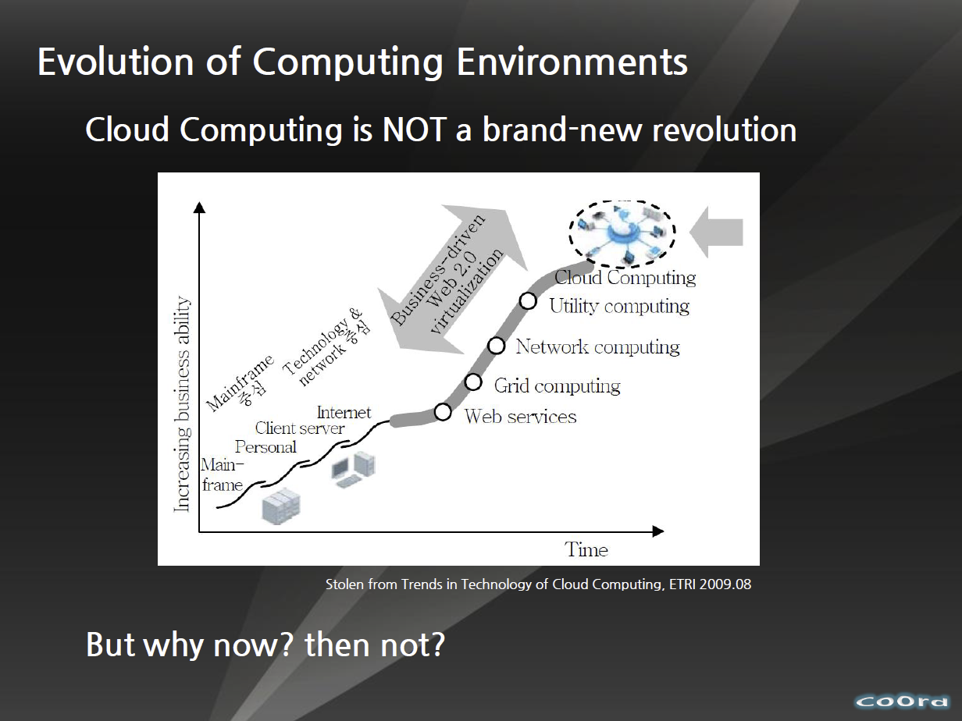
http://www.slideshare.net/woorung/trend-and-future-of-cloud-computing

Slide 12
Amazon making money
It took Amazon Web Services (AWS) eight years to hit $650 million in revenue, according to Citigroup in 2010.
Just three years later, Macquarie Capital analyst Ben Schachter estimates that AWS will top $3.8 billion in 2013 revenue, up from $2.1 billion in 2012 (estimated), valuing the AWS business at $19 billion.
It's a lot of money, and it underlines Amazon's increasingly dominant role in cloud computing, and the rising risks associated with enterprises putting all their eggs in the AWS basket.

Slide 13
Over time, the cloud will replace company-owned data centers
That is what Adam Selipsky of Amazon feels. He says it may not happen overnight, it may take 5, 10 or even 20 years, but it will happen over time.
According to Amazon, clouds enable 7 transformation of how applications are designed, built and used.
Cloud makes distributed architectures easy
Cloud enables users to embrace the security advantages of shared systems
Cloud enables enterprises to move from scaling by architecture to scaling by command
Cloud puts a supercomputer into the hands of every developer
Cloud enables users to experiment often and fail quickly
Cloud enables big data without big servers
Cloud enables a mobile ecosystem for a mobile-first world

Slide 14
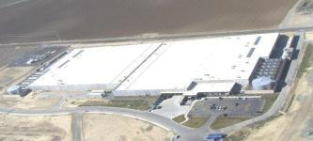
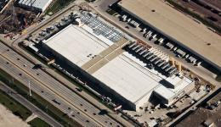
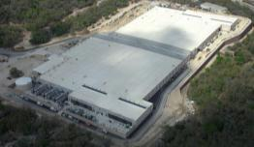
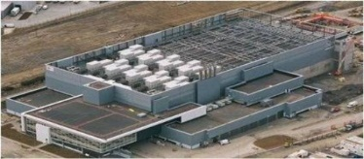
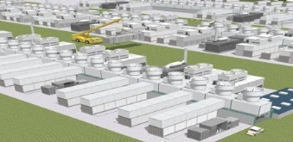
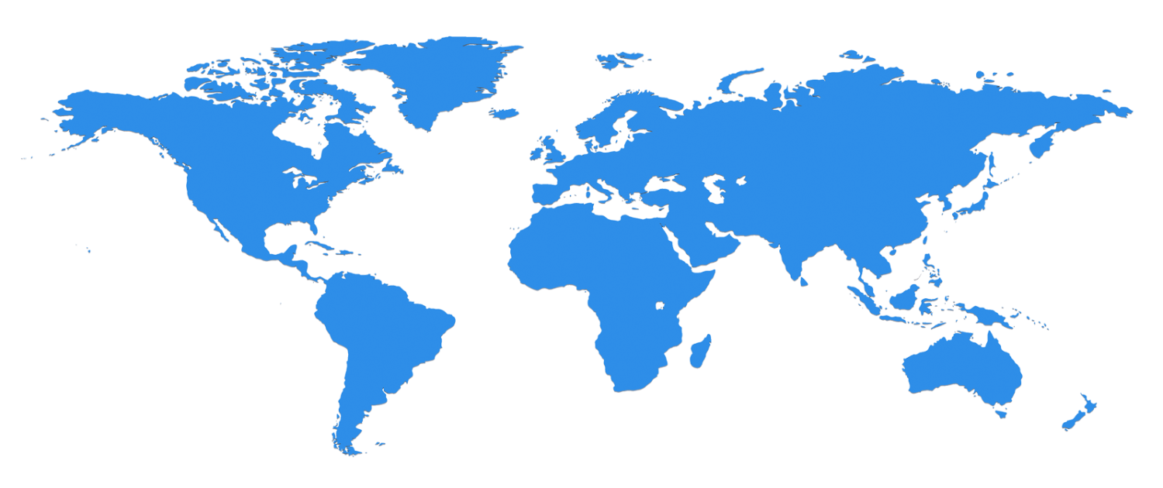
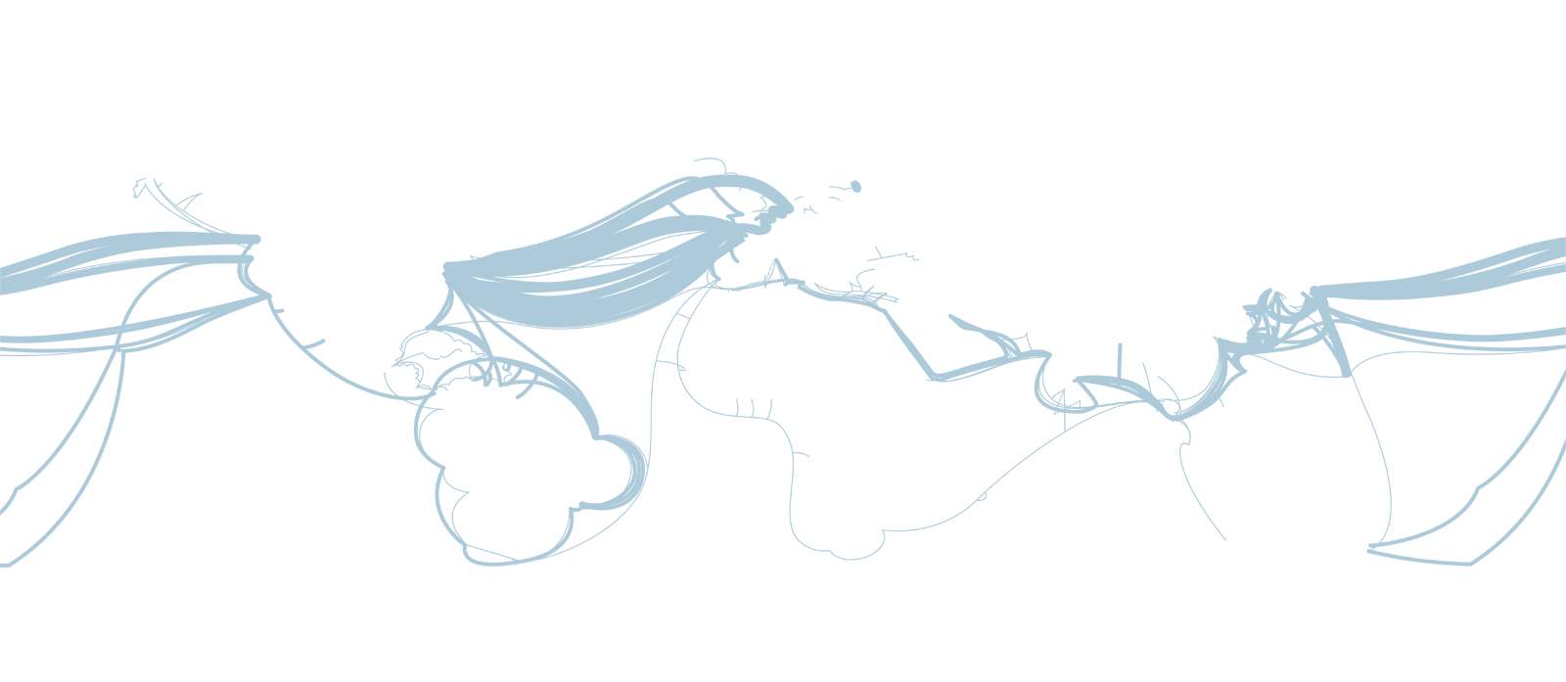

The Microsoft Cloud is Built on Data Centers
~100 Globally Distributed Data Centers
Range in size from “edge” facilities to megascale (100K to 1M servers)
Quincy, WA
Chicago, IL
San Antonio, TX
Dublin, Ireland
Generation 4 DCs
Gannon Talk

Slide 15
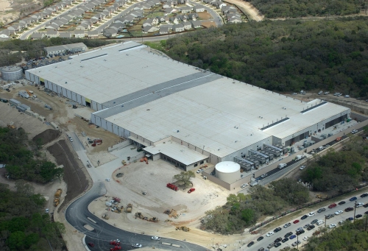
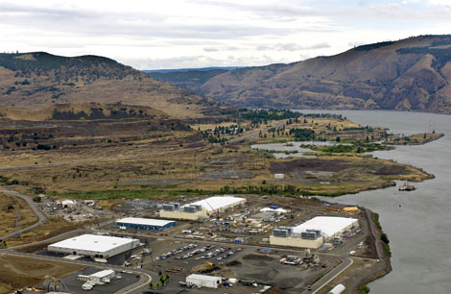
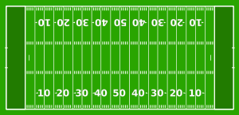
Data Centers Clouds &
Economies of Scale I
Range in size from “edge” facilities to megascale.
Economies of scale
  Approximate costs for a small size center (1K servers) and a larger, 50K server center.
2 Google warehouses of computers on the banks of the Columbia River, in The Dalles, Oregon
Such centers use 20MW-200MW
(Future) each with 150 watts per CPU
Save money from large size, positioning with cheap power and access with Internet
Technology | Cost in small-sized Data Center | Cost in Large Data Center | Ratio
Network | $95 per Mbps/ month | $13 per Mbps/ month | 7.1
Storage | $2.20 per GB/ month | $0.40 per GB/ month | 5.7
Administration | ~140 servers/ Administrator | >1000 Servers/ Administrator | 7.1
Each data center is
11.5 times
the size of a football field

Slide 16
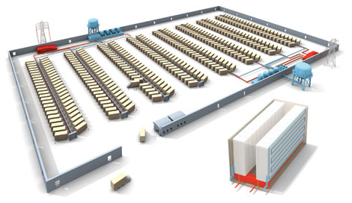
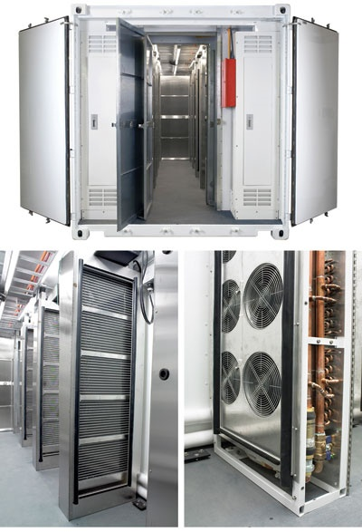
Data Centers, Clouds
& Economies of Scale II
Builds giant data centers with 100,000’s of computers;
~ 200-1000 to a shipping container with Internet access
“Microsoft will cram between 150 and 220 shipping containers filled with data center gear into a new 500,000 square foot Chicago facility. This move marks the most significant, public use of the shipping container systems popularized by the likes of Sun Microsystems and Rackable Systems to date.”

Slide 17
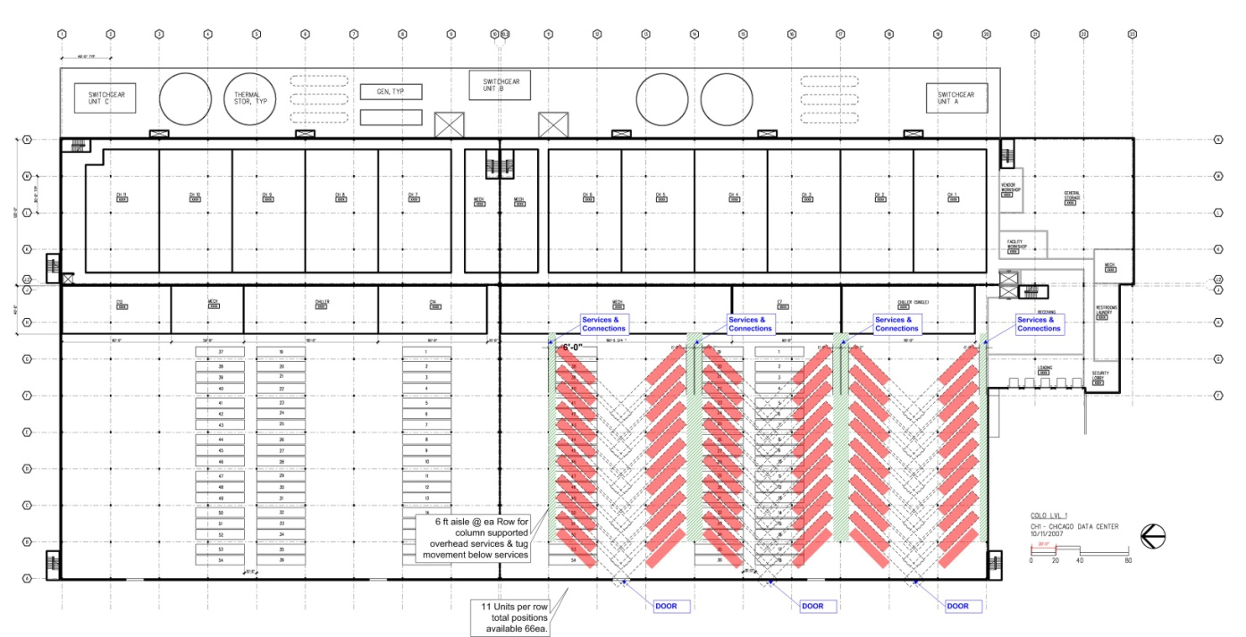
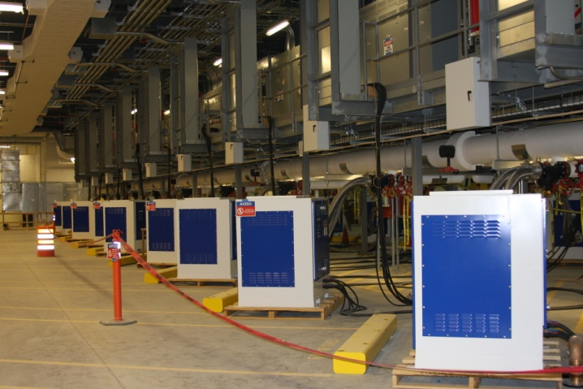
Containers: Separating Concerns
MICROSOFT

Slide 18

Green Clouds
Cloud Centers optimize life cycle costs and power use
http://www.datacenterknowledge.com/archives/2011/05/10/uptime-institute-the-average-pue-is-1-8/
Average PUE = 1.8 (was nearer 3) ; Good Clouds are 1.1-1.2
4th generation data centers (from Microsoft) make everything modular so data centers can be built incrementally as in modern manufacturing
http://loosebolts.wordpress.com/2008/12/02/our-vision-for-generation-4-modular-data-centers-one-way-of-getting-it-just-right/
Extends container based third generation

Slide 19
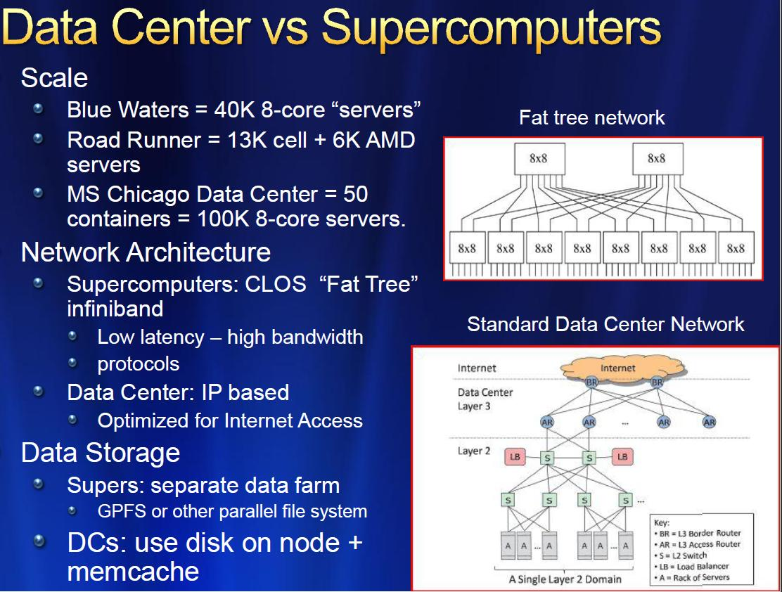
MICROSOFT

Slide 20
Some Sizes in 2010
http://www.mediafire.com/file/zzqna34282frr2f/koomeydatacenterelectuse2011finalversion.pdf
30 million servers worldwide
Google had 900,000 servers (3% total world wide)
Google total power ~200 Megawatts
  < 1% of total power used in data centers (Google more efficient than average – Clouds are Green!)
  ~ 0.01% of total power used on anything world wide
Maybe total clouds are 20% total world server count (a growing fraction)

Slide 21
Some Sizes Cloud v HPC
Top Supercomputer Sequoia Blue Gene Q at LLNL
  16.32 Petaflop/s on the Linpack benchmark using 98,304 CPU compute chips with 1.6 million processor cores and 1.6 Petabyte of memory in 96 racks covering an area of about 3,000 square feet
  7.9 Megawatts power
Largest (cloud) computing data centers
  100,000 servers at ~200 watts per CPU chip
  Up to 30 Megawatts power
  Microsoft says upto million servers
So largest supercomputer is around 1-2% performance of total cloud computing systems with Google ~20% total

Slide 22
Cloud Industry
Players

Slide 23
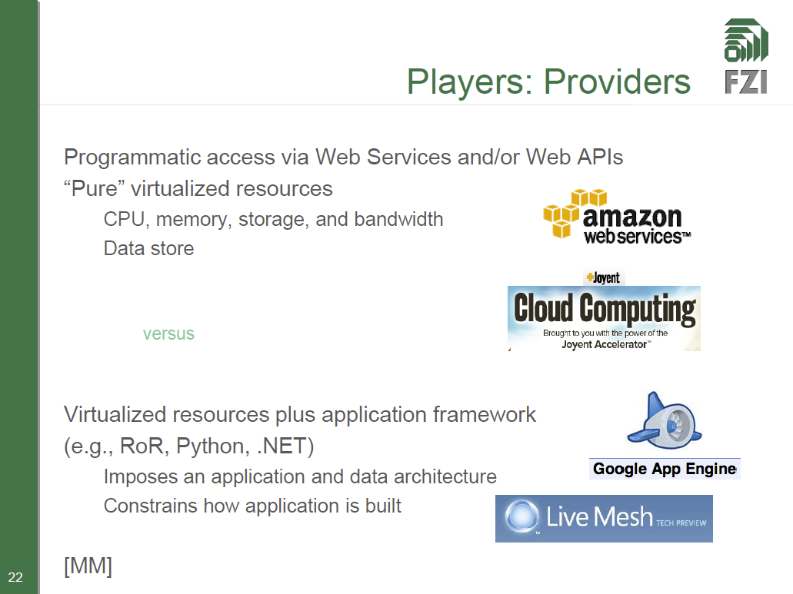
http://www.slideshare.net/JensNimis/cloud-computing-tutorial-jens-nimis

Slide 24
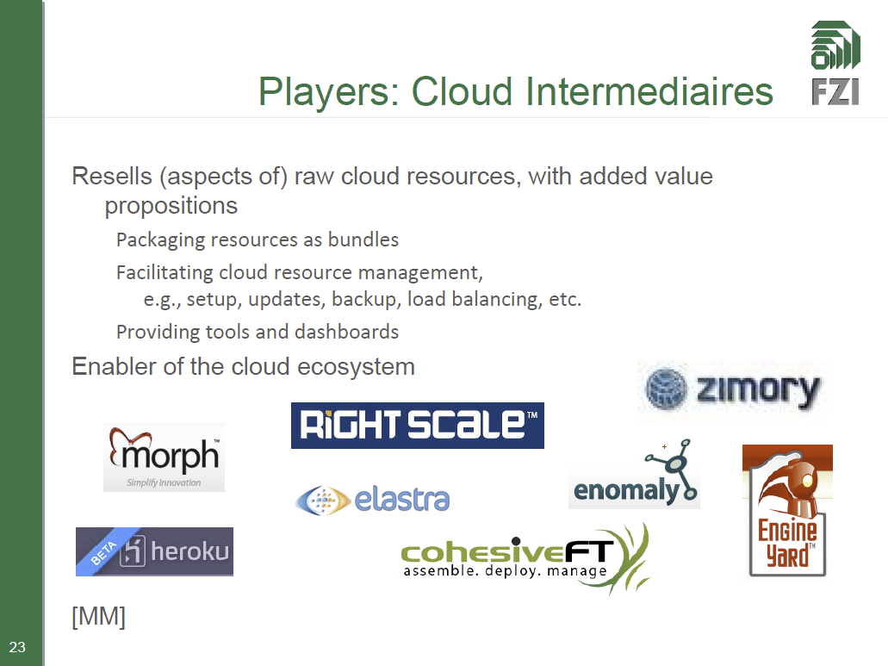
http://www.slideshare.net/JensNimis/cloud-computing-tutorial-jens-nimis

Slide 25
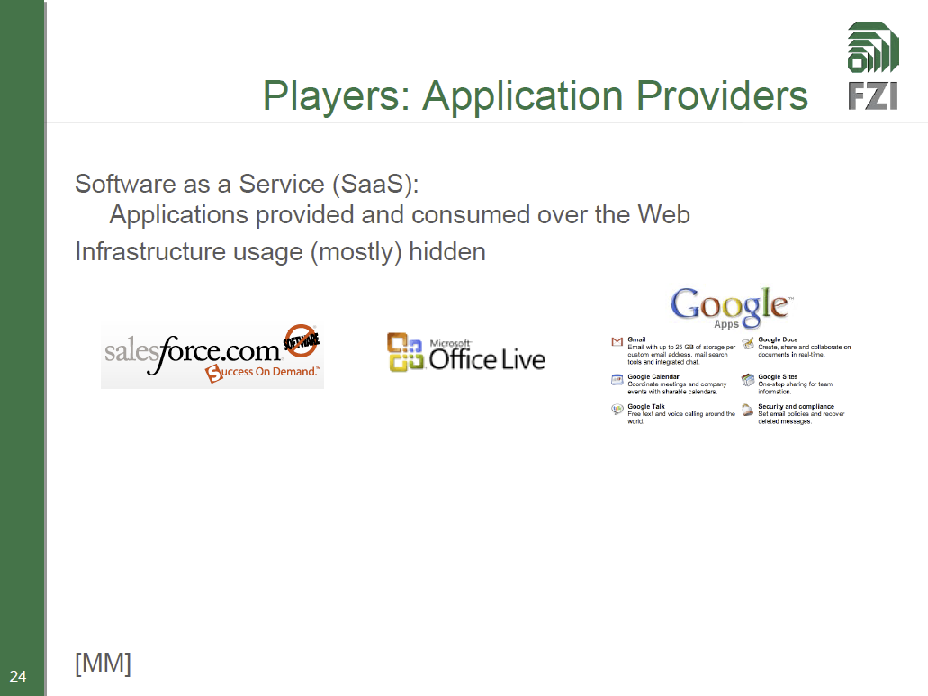
http://www.slideshare.net/JensNimis/cloud-computing-tutorial-jens-nimis

Slide 26
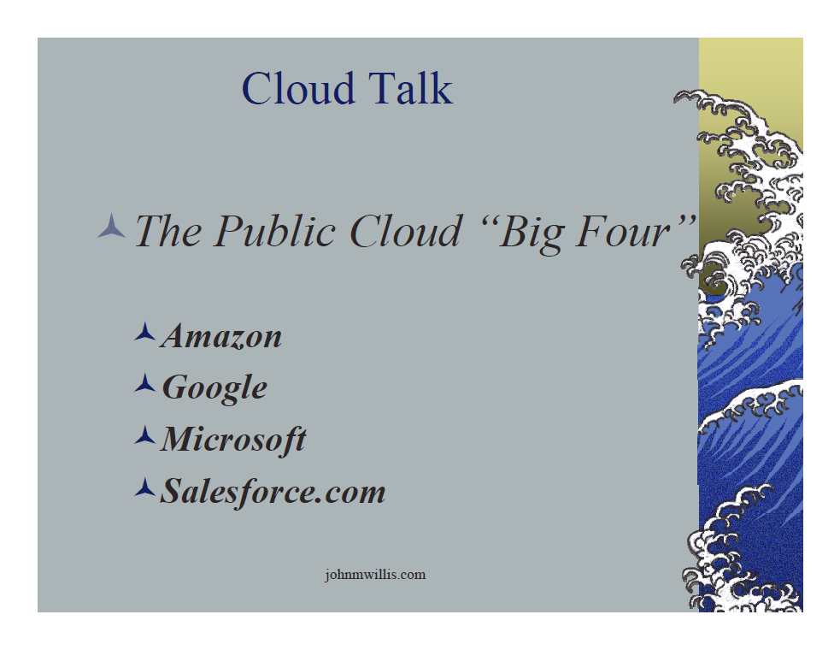
http://www.slideshare.net/botchagalupe/introduction-to-clouds-cloud-camp-columbus

Slide 27
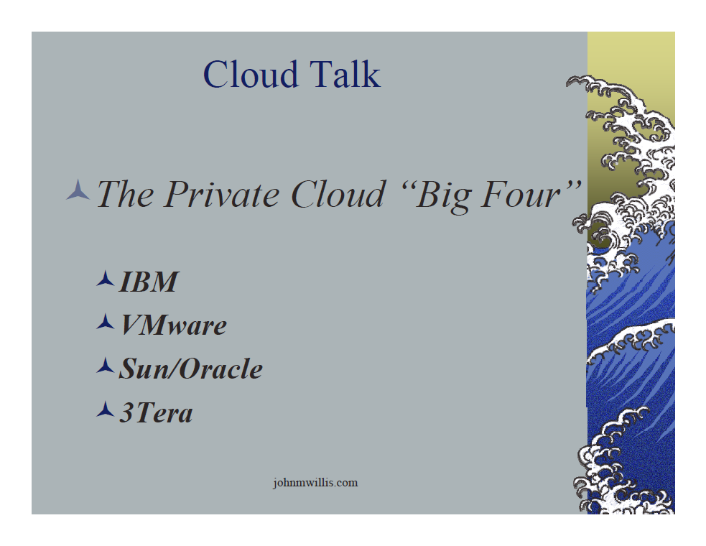
http://www.slideshare.net/botchagalupe/introduction-to-clouds-cloud-camp-columbus

Slide 28
Cloud
Applications

Slide 29
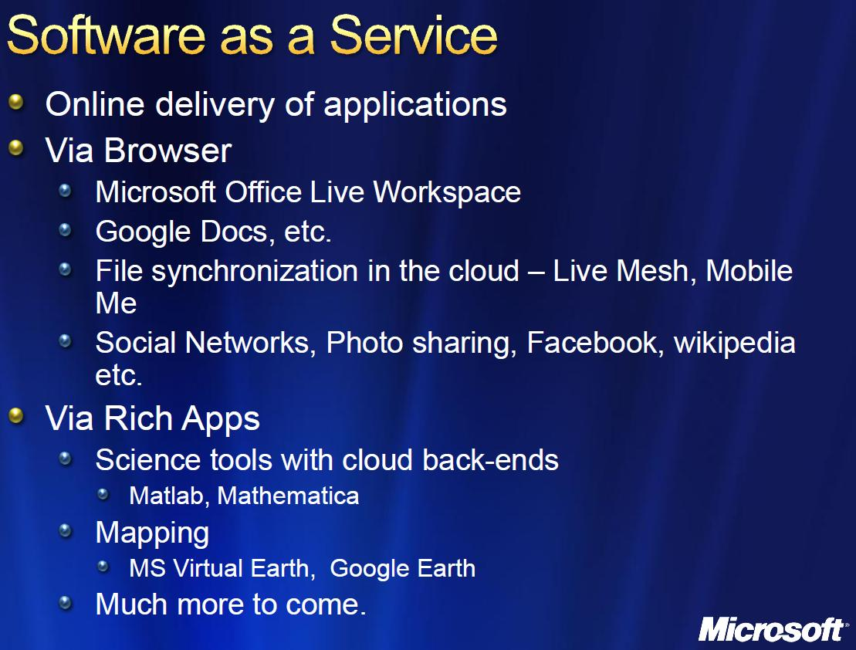

Slide 30
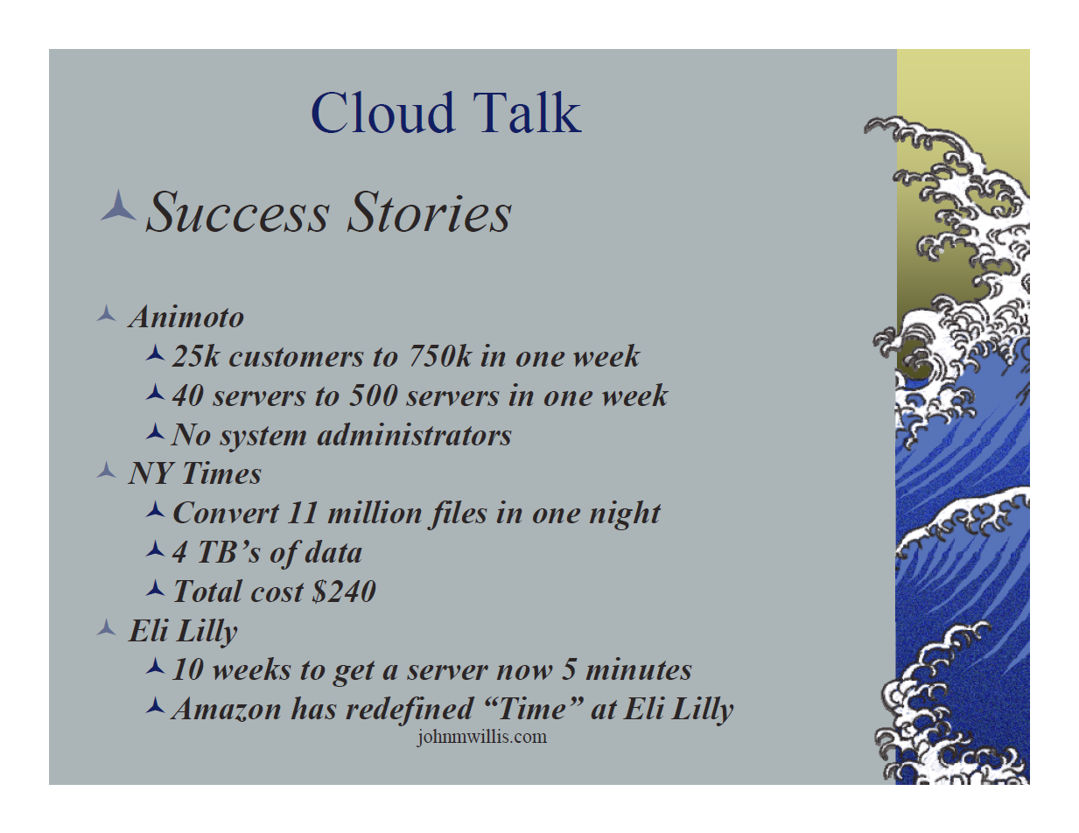
http://www.slideshare.net/botchagalupe/introduction-to-clouds-cloud-camp-columbus

Slide 31
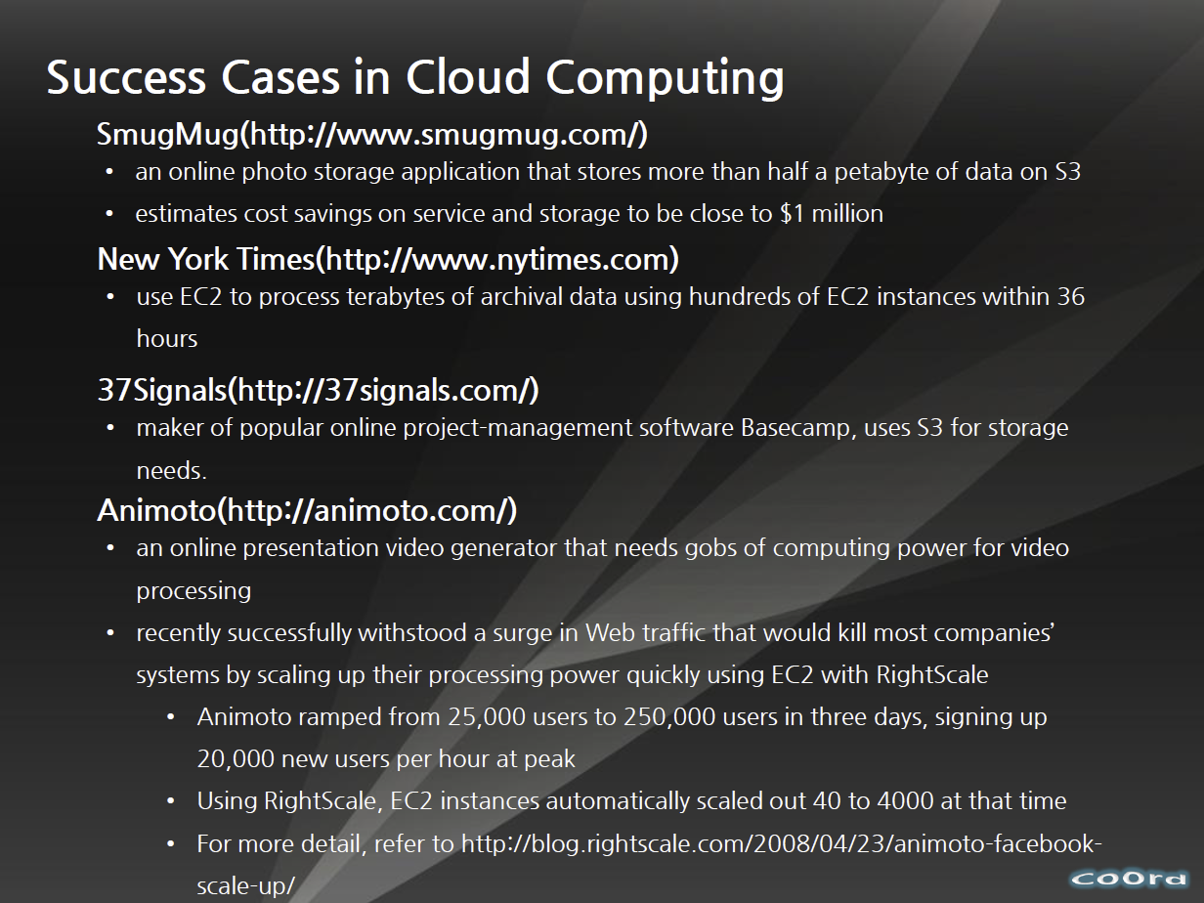
http://www.slideshare.net/woorung/trend-and-future-of-cloud-computing

Slide 32
What Applications work in Clouds
Pleasingly (moving to modestly) parallel applications of all sorts with roughly independent data or spawning independent simulations
  Long tail of science and integration of distributed sensors
Commercial and Science Data analytics that can use MapReduce (some of such apps) or its iterative variants (most other data analytics apps)
Which science applications are using clouds?
  Venus-C (Azure in Europe): 27 applications not using Scheduler, Workflow or MapReduce (except roll your own)
  50% of applications on FutureGrid are from Life Science
  Locally Lilly corporation is commercial cloud user (for drug discovery) but not IU Biolohy
But overall very little science use of clouds

Slide 33
27 Venus-C Azure Applications
Chemistry (3)
• Lead Optimization in Drug Discovery
• Molecular Docking
Civil Protection (1)
• Fire Risk estimation and fire propagation
Biodiversity &
Biology (2)
• Biodiversity maps in marine species
• Gait simulation
Civil Eng. and Arch. (4)
• Structural Analysis
• Building information Management
• Energy Efficiency in Buildings
• Soil structure simulation
Physics (1)
• Simulation of Galaxies configuration
Earth Sciences (1)
• Seismic propagation
Mol, Cell. & Gen. Bio. (7)
• Genomic sequence analysis
• RNA prediction and analysis
• System Biology
• Loci Mapping
• Micro-arrays quality.
ICT (2)
• Logistics and vehicle routing
• Social networks analysis
Medicine (3)
• Intensive Care Units decision support.
• IM Radiotherapy planning.
• Brain Imaging
Mathematics (1)
• Computational Algebra
Mech, Naval & Aero. Eng. (2)
• Vessels monitoring
• Bevel gear manufacturing simulation

Slide 34
Parallelism over Users and Usages
“Long tail of science” can be an important usage mode of clouds.
In some areas like particle physics and astronomy, i.e. “big science”, there are just a few major instruments generating now petascale data driving discovery in a coordinated fashion.
In other areas such as genomics and environmental science, there are many “individual” researchers with distributed collection and analysis of data whose total data and processing needs can match the size of big science.
Clouds can provide scaling convenient resources for this important aspect of science.
Can be map only use of MapReduce if different usages naturally linked e.g. exploring docking of multiple chemicals or alignment of multiple DNA sequences
  Collecting together or summarizing multiple “maps” is a simple Reduction

Slide 35
Internet of Things and the Cloud
It is projected that there will be 24 billion devices on the Internet by 2020. Most will be small sensors that send streams of information into the cloud where it will be processed and integrated with other streams and turned into knowledge that will help our lives in a multitude of small and big ways.
The cloud will become increasing important as a controller of and resource provider for the Internet of Things.
As well as today’s use for smart phone and gaming console support, “Intelligent River” “smart homes and grid” and “ubiquitous cities” build on this vision and we could expect a growth in cloud supported/controlled robotics.
Some of these “things” will be supporting science
Natural parallelism over “things”
“Things” are distributed and so form a Grid

Slide 36
Classic Parallel Computing
HPC: Typically SPMD (Single Program Multiple Data) “maps” typically processing particles or mesh points interspersed with multitude of low latency messages supported by specialized networks such as Infiniband and technologies like MPI
  Often run large capability jobs with 100K (going to 1.5M) cores on same job
  National DoE/NSF/NASA facilities run 100% utilization
  Fault fragile and cannot tolerate “outlier maps” taking longer than others
Clouds: MapReduce has asynchronous maps typically processing data points with results saved to disk. Final reduce phase integrates results from different maps
  Fault tolerant and does not require map synchronization
  Map only useful special case
HPC + Clouds: Iterative MapReduce caches results between “MapReduce” steps and supports SPMD parallel computing with large messages as seen in parallel kernels (linear algebra) in clustering and other data mining

Slide 37
Data Intensive Applications
Applications tend to be new and so can consider emerging technologies such as clouds
Do not have lots of small messages but rather large reduction (aka Collective) operations
  New optimizations e.g. for huge messages
EM (expectation maximization) tends to be good for clouds and Iterative MapReduce
  Quite complicated computations (so compute largish compared to communicate)
  Communication is Reduction operations (global sums or linear algebra in our case)
We looked at Clustering and Multidimensional Scaling using deterministic annealing which are both EM
  See also Latent Dirichlet Allocation and related Information Retrieval algorithms with similar EM structure

Slide 38
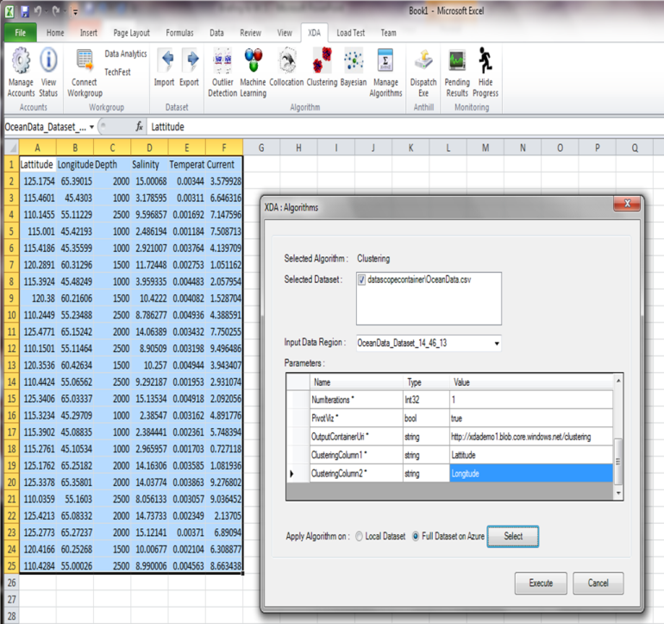
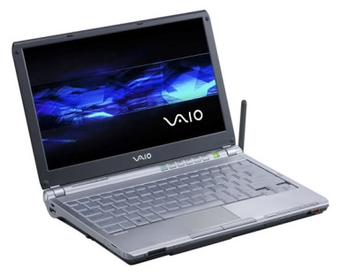
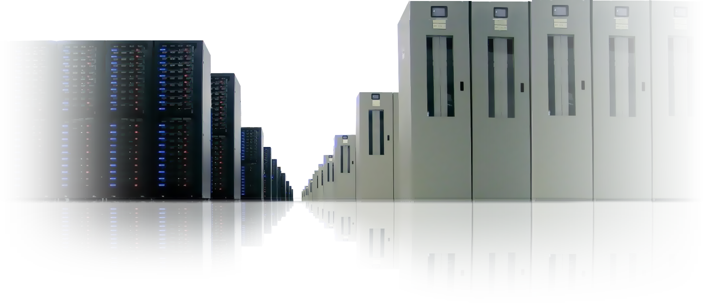
Excel DataScope
Cloud Scale Data Analytics from Excel
Bringing the power of the cloud to the laptop
Data sharing in the cloud, with annotations to facilitate
discovery and reuse;
Sample and manipulate extremely large data collections in the cloud;
Top 25 data analytics algorithms, through Excel ribbon running on Azure;
Invoke models, perform analytics and visualization to gain insight from data;
Machine learning over large data sets to discover correlations;
Publish data collections and visualizations to the cloud to share insights;
Researchers use familiar tools, familiar but differentiated.
Gannon Talk

Slide 39
Big Data
Processing

Slide 40
20120119berkeley.pdf Jeff Hammerbacher

Slide 41
“Taming the Big Data Tidal Wave” 2012
(Bill Franks, Chief Analytics Officer Teradata)
Parallel Computing, Clouds, Grids, MapReduce,
Sandbox for separate standalone Analytics experimentation

Slide 42
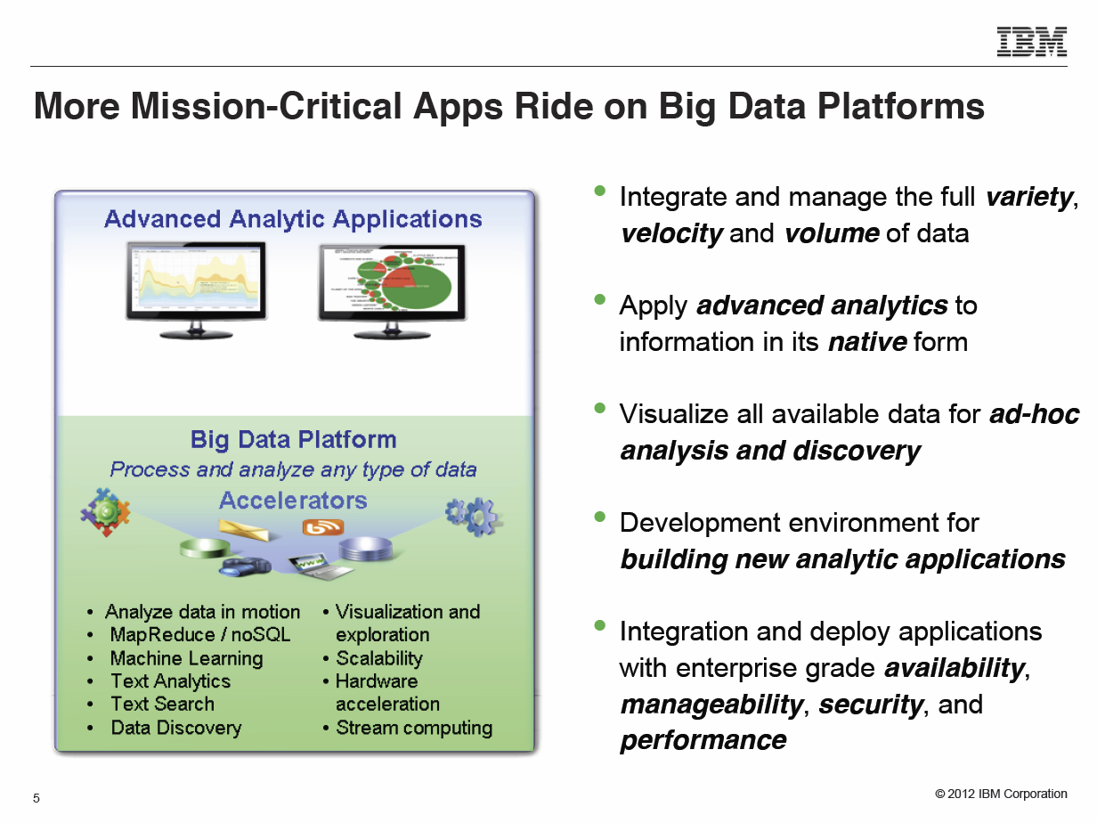
Anjul Bhambhri, VP of Big Data, IBM http://fisheritcenter.haas.berkeley.edu/Big_Data/index.html

Slide 43
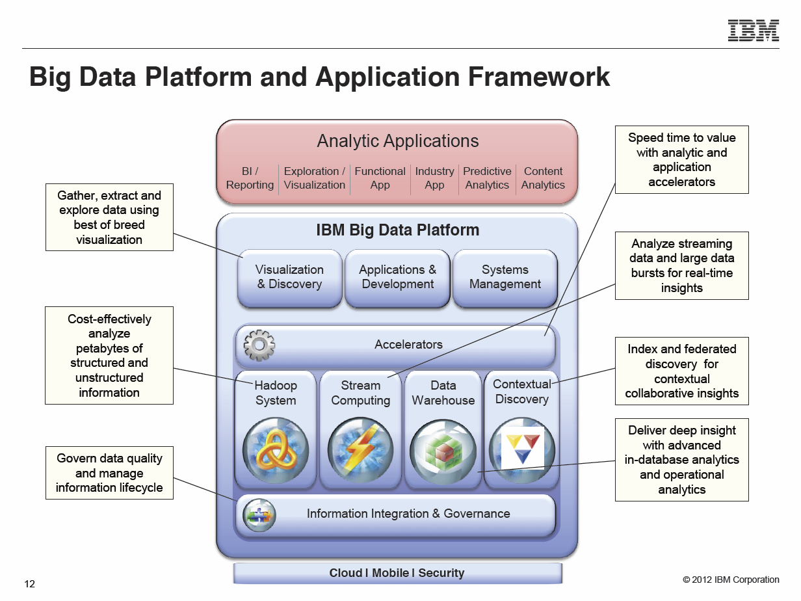
Anjul Bhambhri, VP of Big Data, IBM http://fisheritcenter.haas.berkeley.edu/Big_Data/index.html

Slide 44
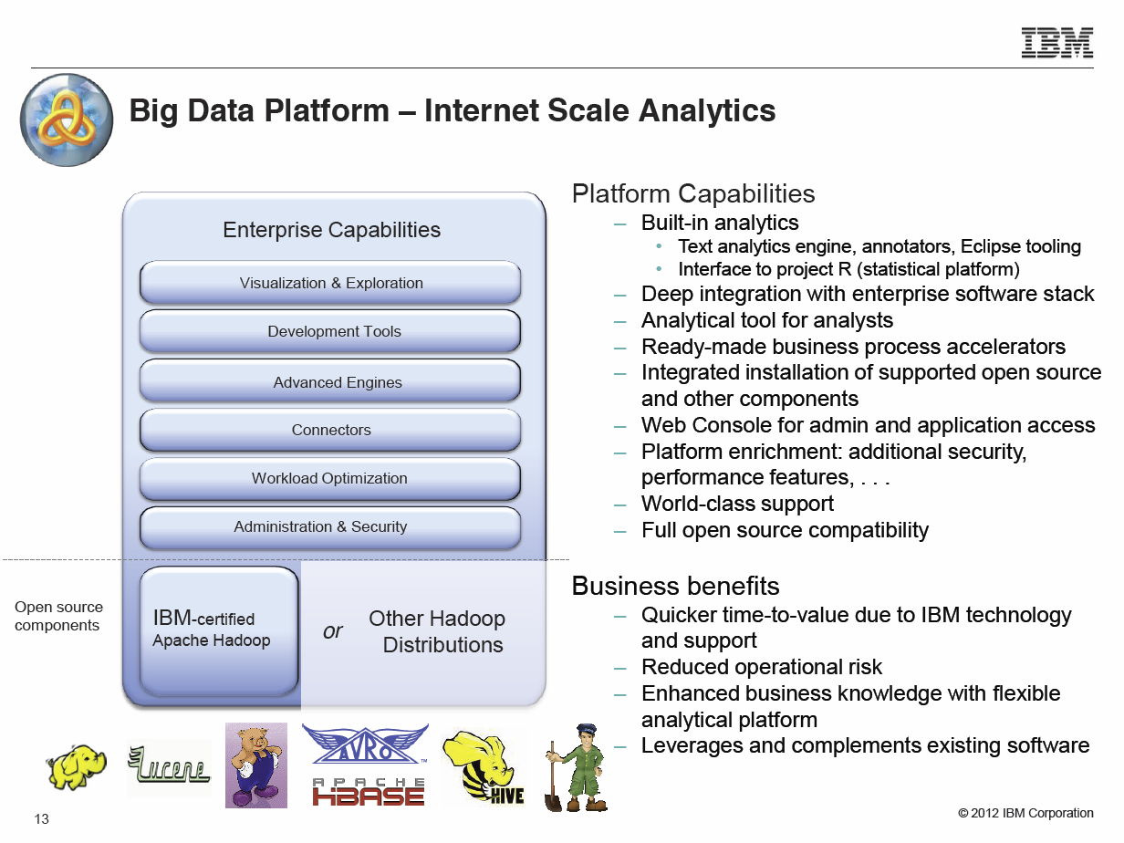
Anjul Bhambhri, VP of Big Data, IBM http://fisheritcenter.haas.berkeley.edu/Big_Data/index.html

Slide 45
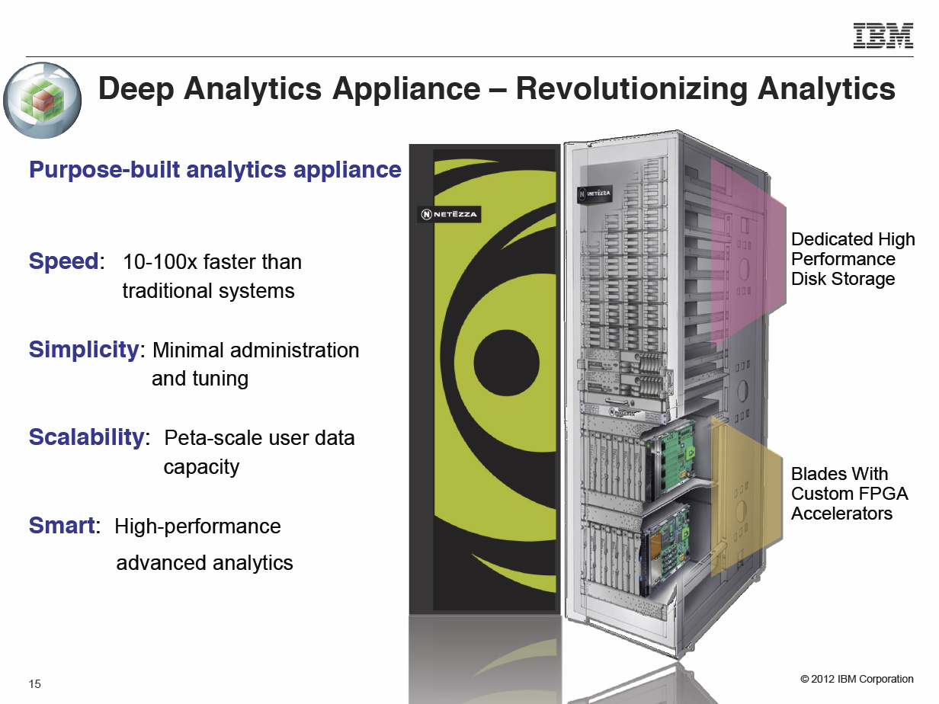
Anjul Bhambhri, VP of Big Data, IBM http://fisheritcenter.haas.berkeley.edu/Big_Data/index.html

Slide 46
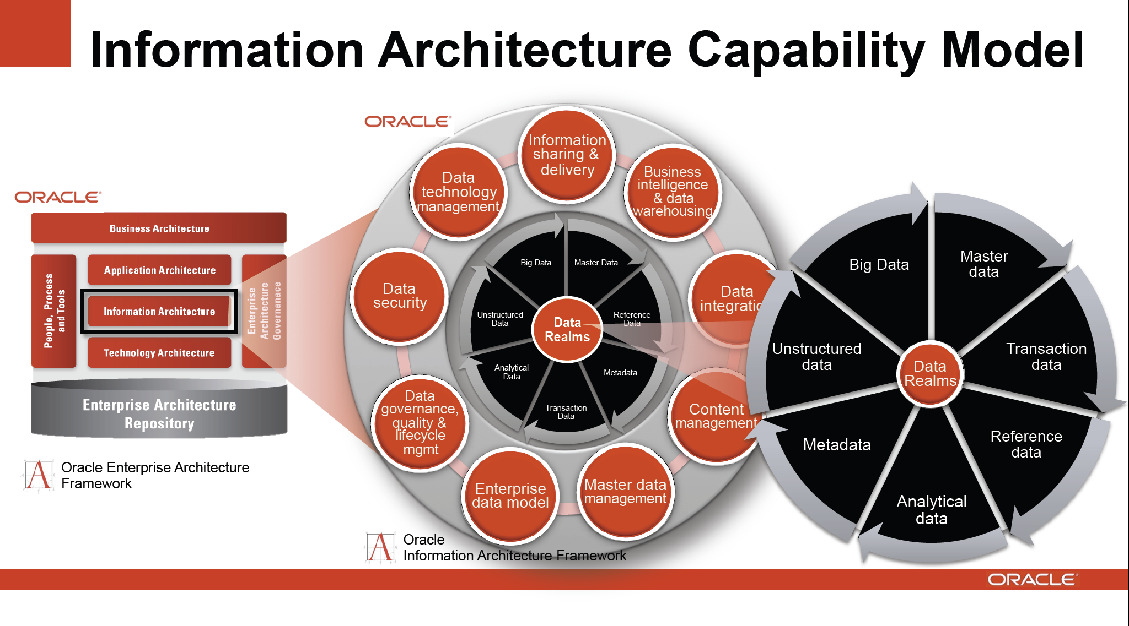
http://cs.metrostate.edu/~sbd/ Oracle

Slide 47


Slide 48


