Slide 1
Health Informatics
April 8, 10 2013
Geoffrey Fox
gcf@indiana.edu
http://www.infomall.org/
Associate Dean for Research and Graduate Studies, School of Informatics and Computing
Indiana University Bloomington
2013

Slide 2




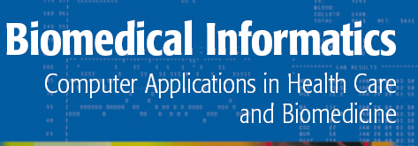


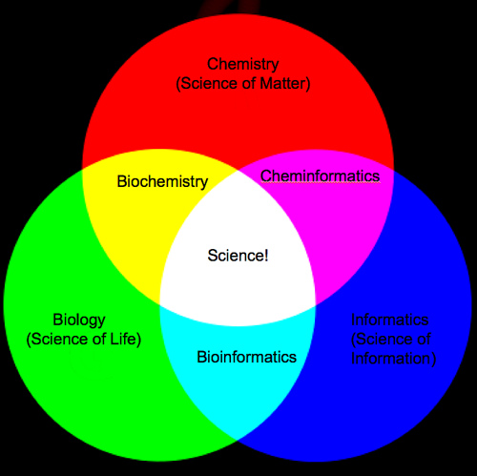

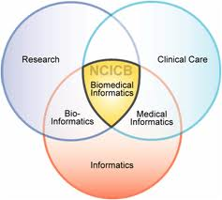
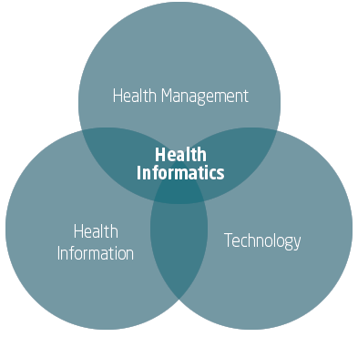
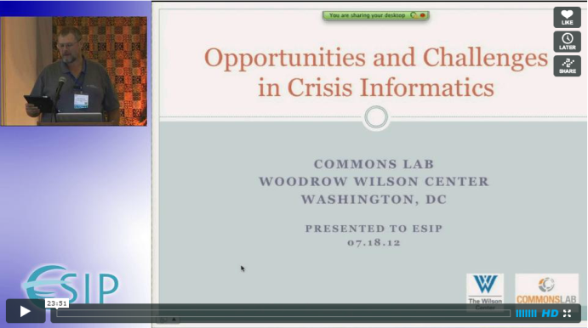
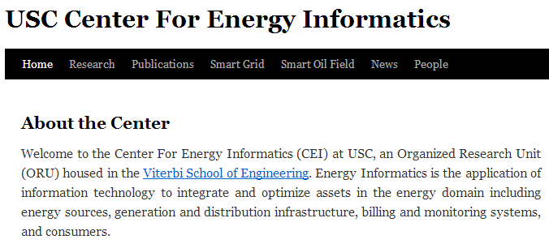
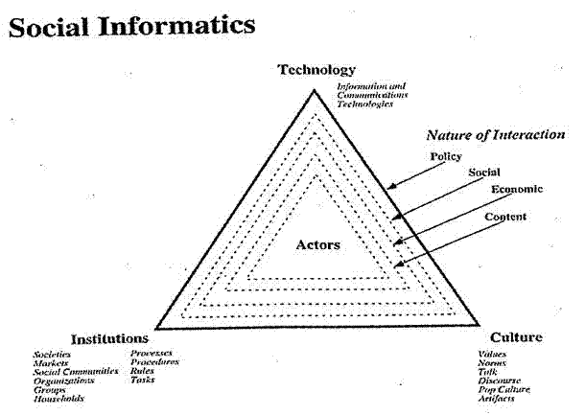

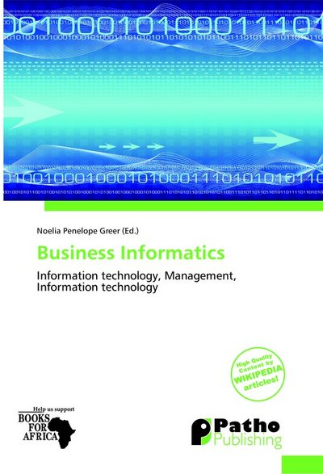
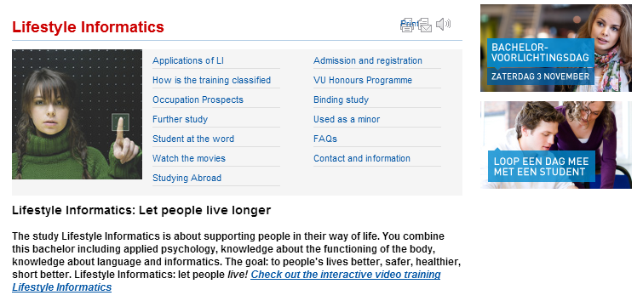



Slide 3
Big Data and Health

Slide 4
Big Data Ecosystem in One Sentence
Use Clouds running Data Analytics processing Big Data to solve problems in X-Informatics
X = Health, Medical, Bio, Biomedical, Chem, Pathology, Lifestyle

Slide 5
Types of Biomedical Big Data Problems
Pervasive Health Sensors including data entered into or from smart phones (events)
Radiology (images)
Genomics/Proteomics
Electronic medical records sizewise dominated by omics and images?
  Updated by events
Classic data access and sophisticated datamining

Slide 6
Ninety-six percent of radiology practices in the USA are filmless and Table below illustrates the annual volume of data across the types of diagnostic imaging; this does not include cardiology which would take the total to over 10⁹ GB (an Exabyte).
http://grids.ucs.indiana.edu/ptliupages/publications/Where%20does%20all%20the%20data%20come%20from%20v7.pd
Modality | Part B non HMO | All Medicare | All Population | Per 1000 persons | Ave study size (GB) | Total annual data generated in GB
CT | 22 million | 29 million | 87 million | 287 | 0.25 | 21,750,000
MR | 7 million | 9 million | 26 million | 86 | 0.2 | 5,200,000
Ultrasound | 40 million | 53 million | 159 million | 522 | 0.1 | 15,900,000
Interventional | 10 million | 13 million | 40 million | 131 | 0.2 | 8,000,000
Nuclear Medicine | 10 million | 14 million | 41 million | 135 | 0.1 | 4,100,000
PET | 1 million | 1 million | 2 million | 8 | 0.1 | 200,000
Xray, total incl. mammography | 84 million | 111 million | 332 million | 1,091 | 0.04 | 13,280,000
All Diagnostic Radiology | 174 million | 229 million | 687 million | 2,259 | 0.1 | 68,700,000 68.7 PETAbytes

Slide 7
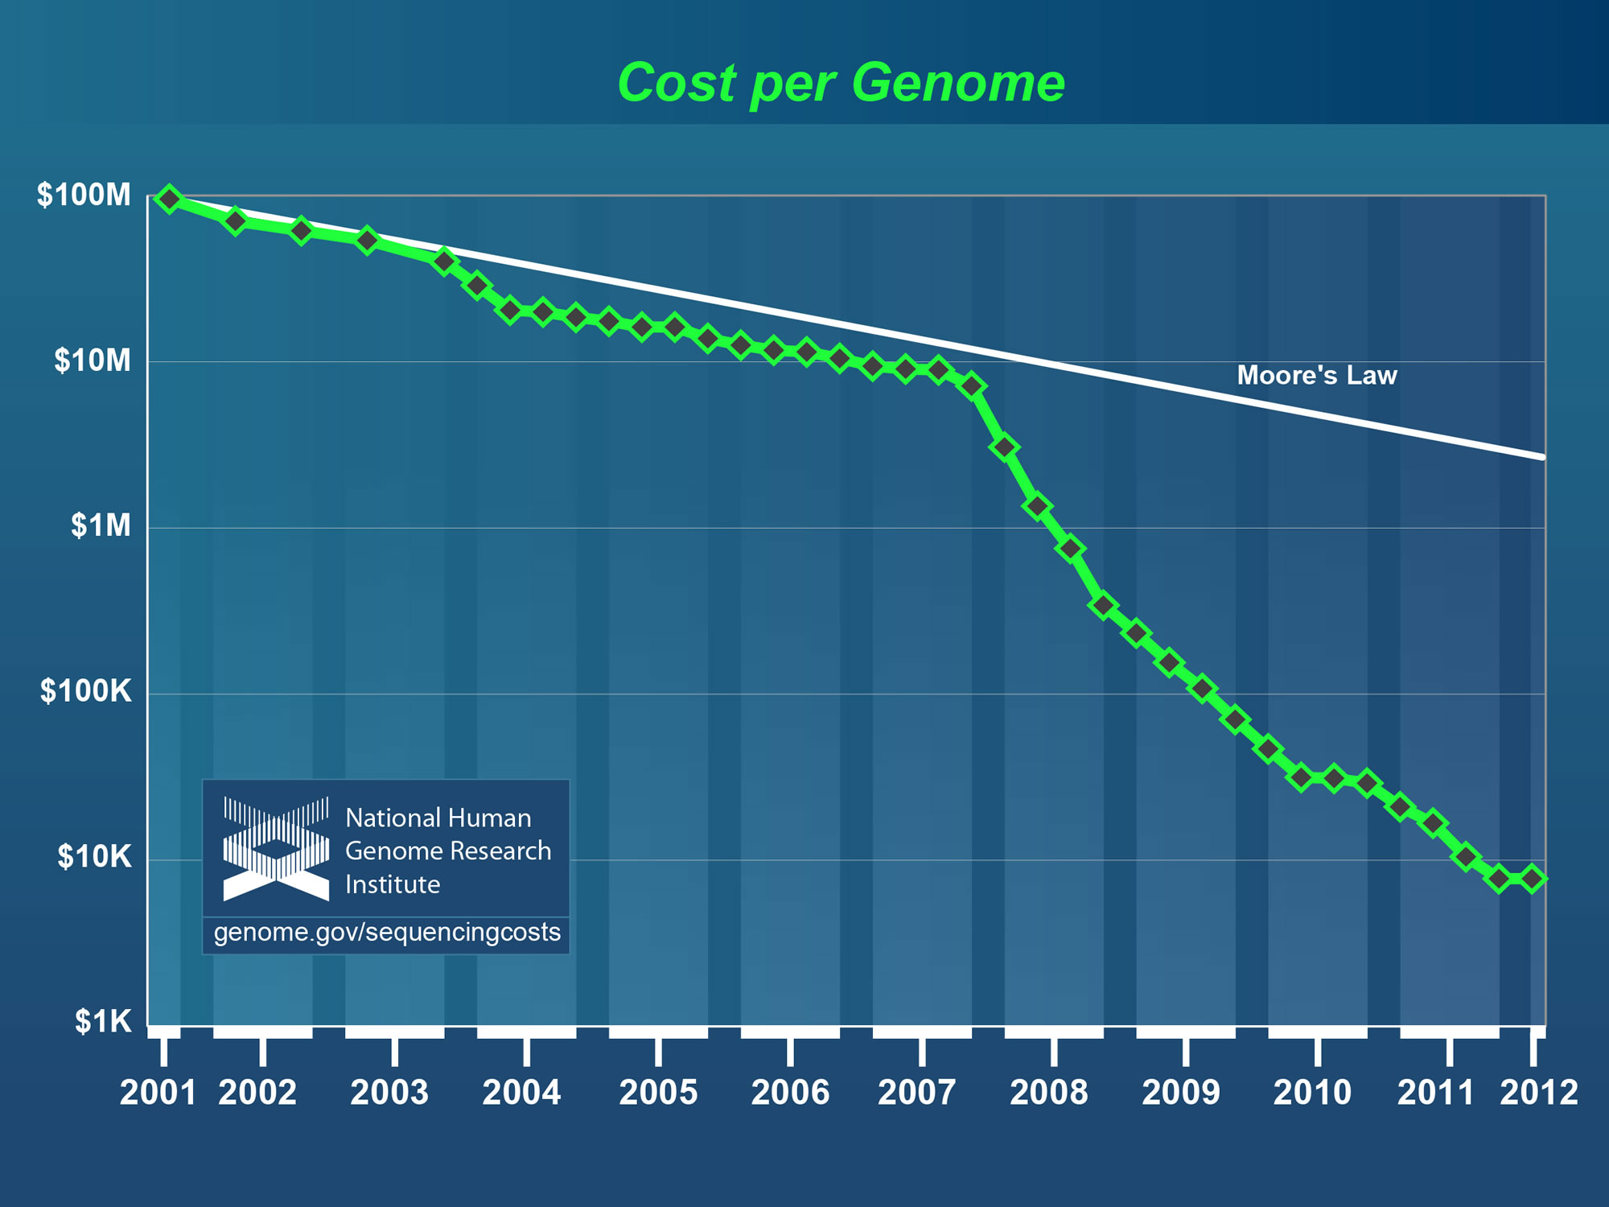
Why need cost effective
Computing!
Full Personal Genomics: 3 petabytes per day
http://www.genome.gov/sequencingcosts/

Slide 8
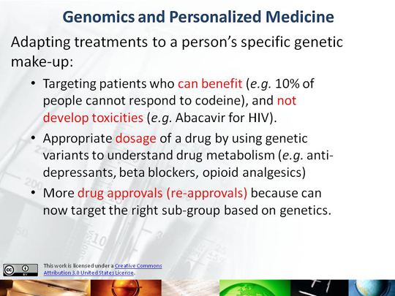

Slide 9
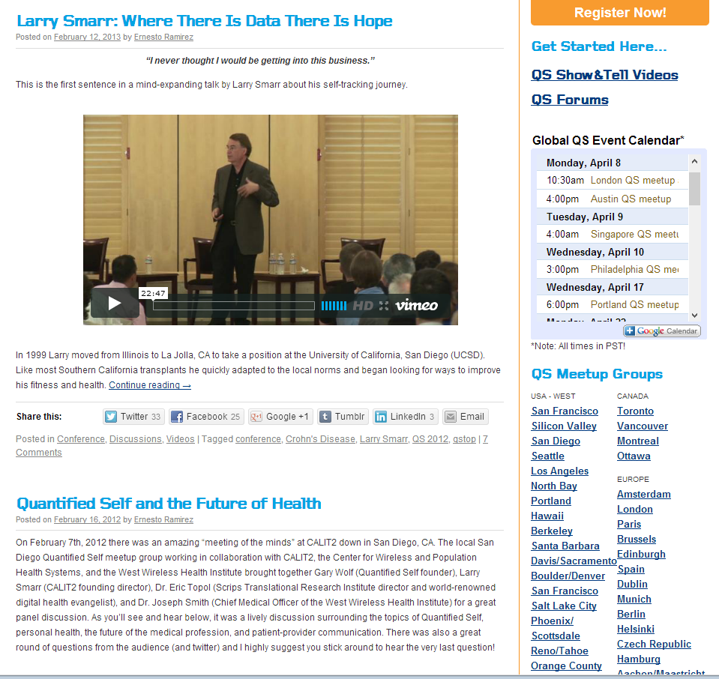
http://quantifiedself.com/larry-smarr/

Slide 10
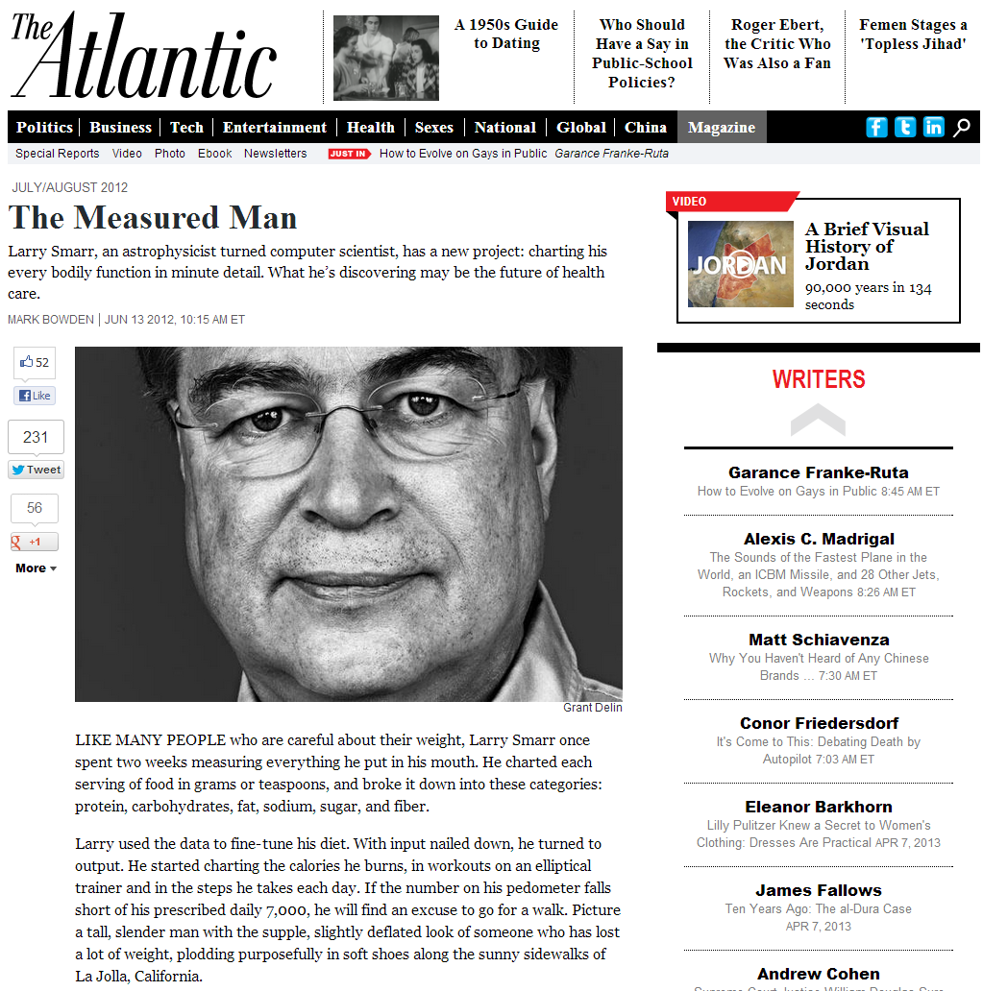
Quantified Self
New approach to democratic science
“Open access” for medical data
Flip side of privacy

Slide 11
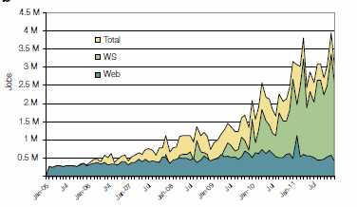
2005-20011 Job request at European Bioinformatics Institute EBI for Web hits and automated services WS
http://www.ebi.ac.uk/Information/Brochures/

Slide 12
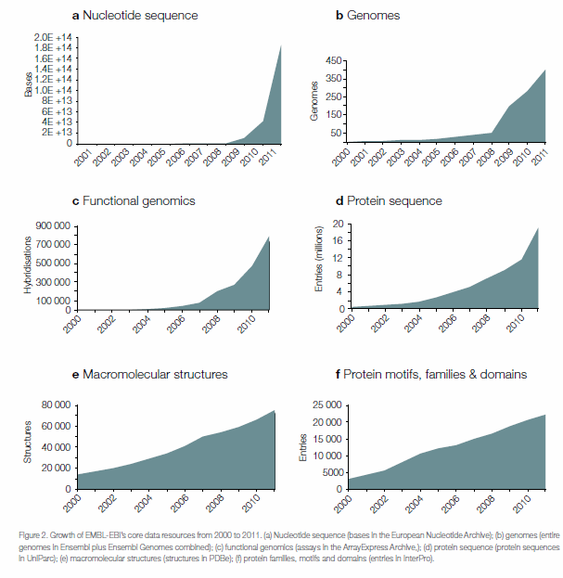
2005-20011 Data stored at European Bioinformatics Institute EBI
http://www.ebi.ac.uk/Information/Brochures/

Slide 13
McKinsey Report on
The big-data revolution in US health care: Accelerating value and innovation
April 2013
Full
http://www.mckinsey.com%2F~%2Fmedia%2Fmckinsey%2Fdotcom%2Fclient_service%2FHealthcare%2520Systems%2520and%2520Services%2FPDFs%2FThe_big_data_revolution_in_healthcare.ashx
Summary http://www.mckinsey.com/~/media/McKinsey/dotcom/Insights/Health%20care/The%20big-data%20revolution%20in%20US%20health%20care/The%20big-data%20revolution%20in%20US%20health%20care%20Accelerating%20value%20and%20innovation.ashx

Slide 14
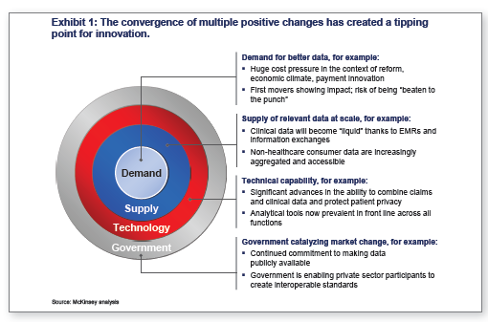

Slide 15
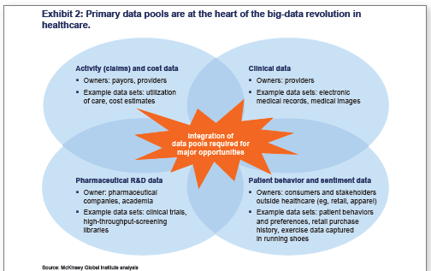

Slide 16
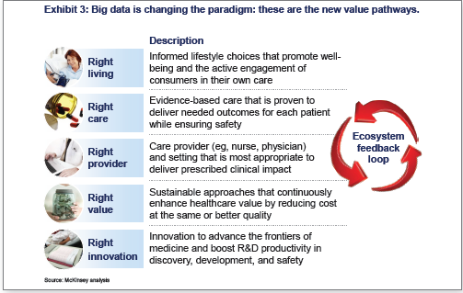

Slide 17
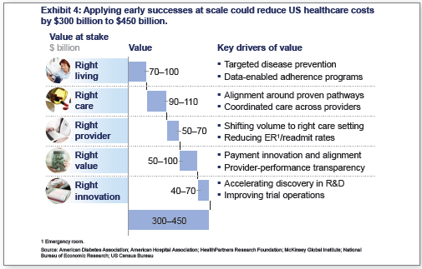

Slide 18
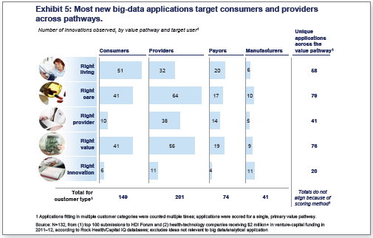

Slide 19
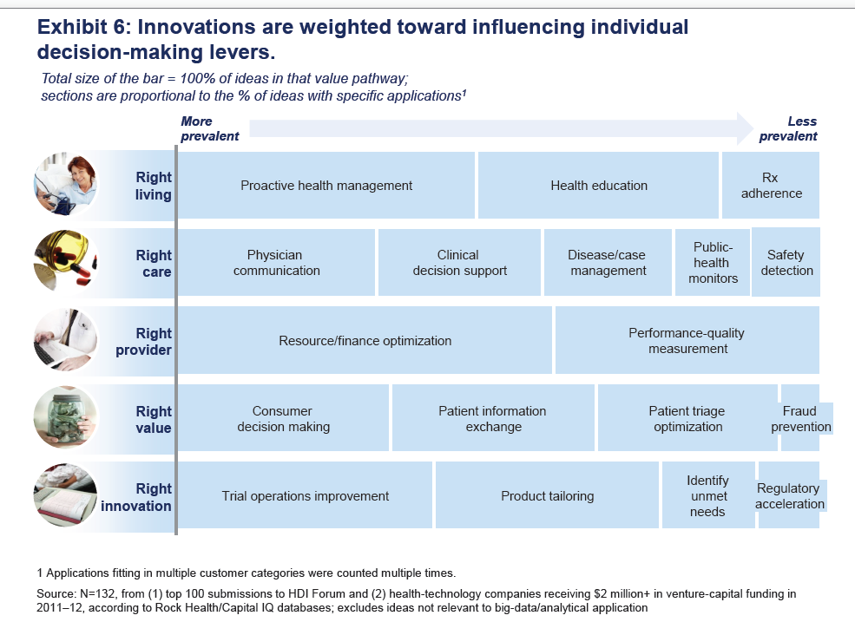

Slide 20
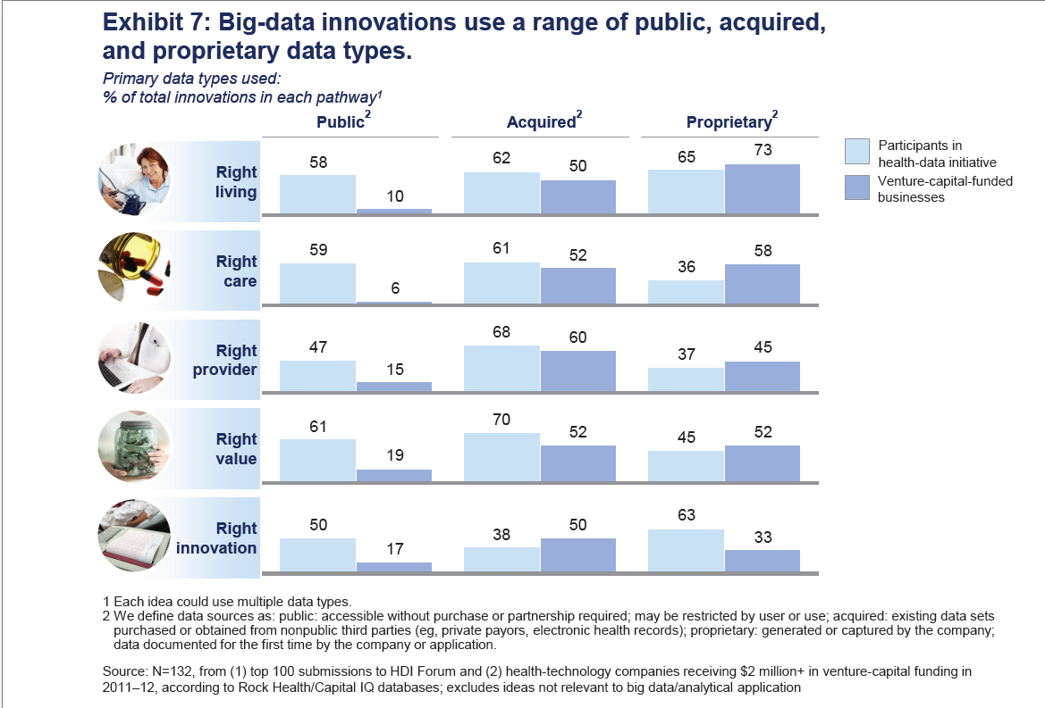

Slide 21
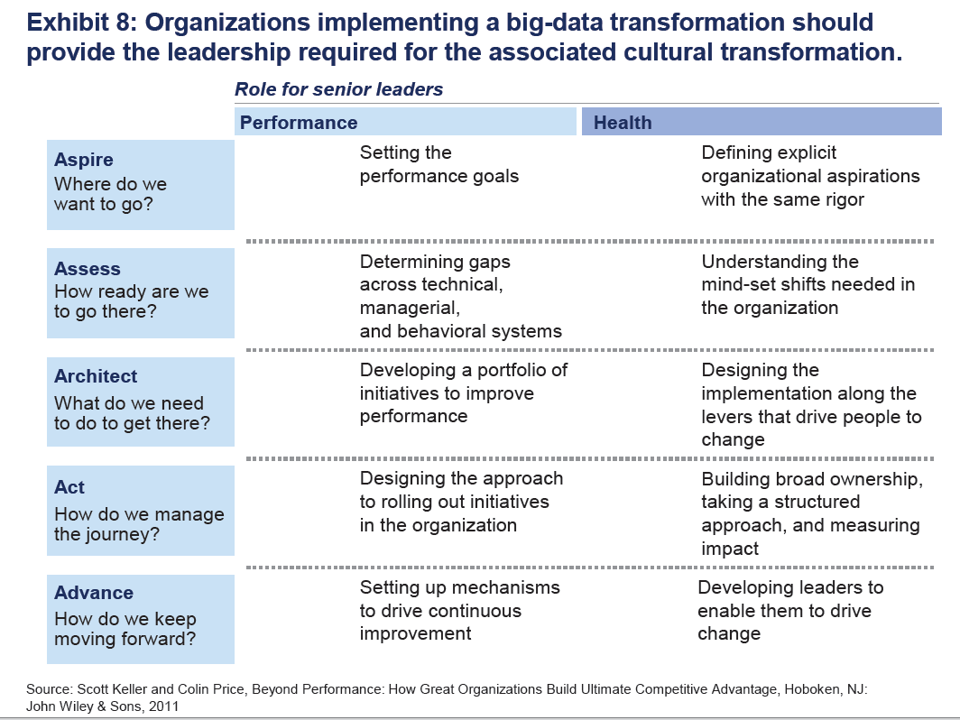

Slide 22
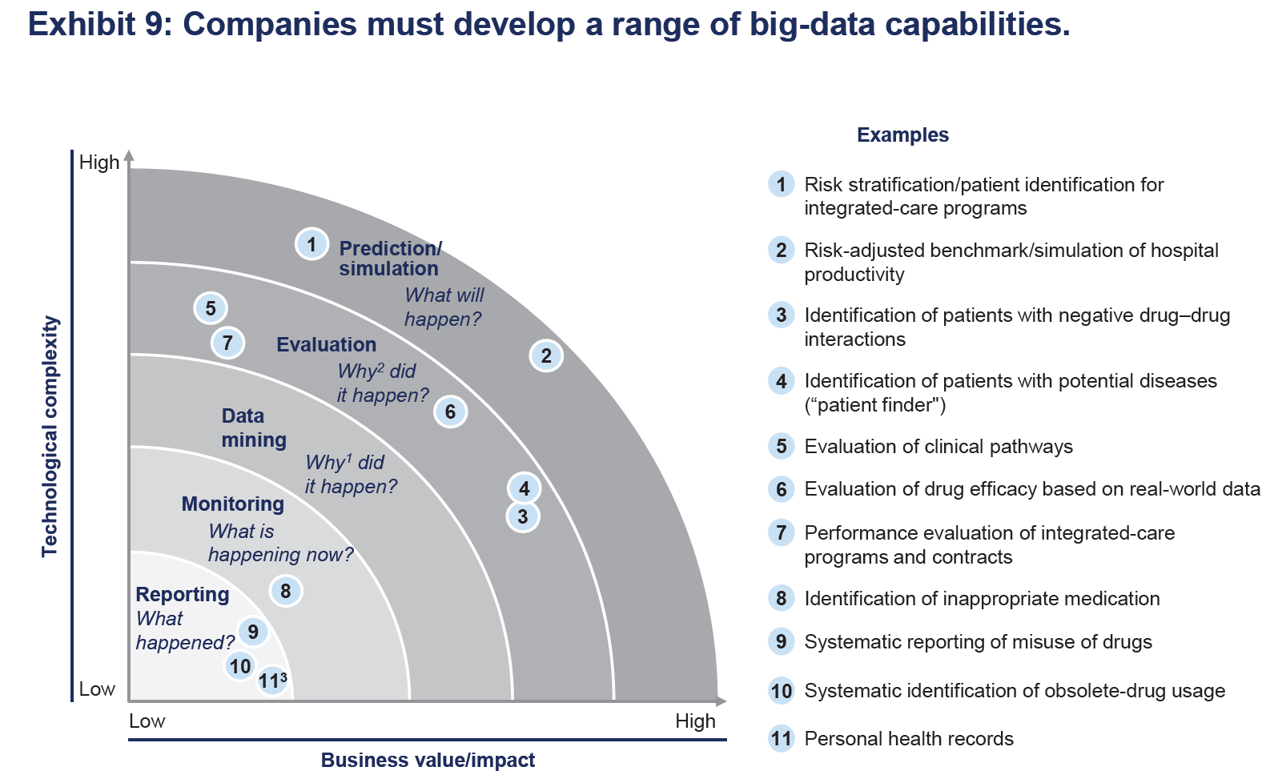

Slide 23
Microsoft Report
https://partner.microsoft.com/download/global/40193764

Slide 24
Big Data opportunities in health
Section 2: Big Data in Health
The promise of Big Data to transform health and social services comes from new capabilities to increases “Data Convergence” opportunities.
Correlational Data
Geo-environmental, weather patterns, etc.
Clinical Data
EMRs, diagnostic images
Claims & Cost Data
Claims, revenue cycle
Big Data
Opportunities
Pharma & Life Science Data
Clinical trials, genomics
Patient & Consumer Data
Purchasing patterns,
social media
https://partner.microsoft.com/download/global/40193764
Table of Contents

Slide 25

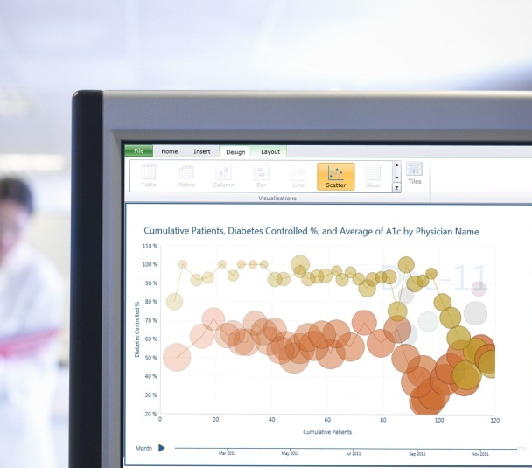

New possibilities with Big Data
Section 2: Big Data in Health
Live data feed
Based on a “snapshot” of large and different datasets right now, what can I predict will happen going forward?
For example, how do I optimize my resources to see and plan for the emerging outbreak of infectious diseases?
Social analytics
What are the top health topics and issues on the minds of consumers now?
What can I predict based on social media topics?
Advanced analytics
How might I determine the best care pathways for treating a population of patients with the same medical condition?
What actions might I take to decrease the likelihood of a medical condition?
https://partner.microsoft.com/download/global/40193764
Table of Contents

Slide 26
EU Report
http://ec.europa.eu/information_society/activities/health/docs/policy/taskforce/redesigning_health-eu-for2020-ehtf-report2012.pdf

Slide 27
Use the power of data
Data often sits in silos in primary, secondary and tertiary health institutions. This silo mentality mirrors the way that health professionals guard their own competence and areas of expertise. In the new era of eHealth, this has to end.
Multidisciplinary teams of different actors, not all of whom are healthcare professionals, are part of future picture of health. Currently there is a sharp divide between ‘official’ medical data and the wealth of other health information generated by users that is not used for care. We need to find a way of making this data more trustworthy.
The key question is what people do with this information and how they can use it. New rules are needed to define how to integrate official data and user data to create a more holistic picture of patient situation for health care as well provide early feedback for preventive care. Certification of applications is one way forward but it should be based on a set of principles for how health related data should be treated rather than regulation.
Health institutions must publish the data on their performance and health outcomes. This information should be regularly collected, comparable and publicly available. This will support a drive to the top as high performing organisations and individuals can be identified and used as an example to inspire change. In health, performance is not just how efficiently the system operates but also the patient experience of the care. Publication of such data in other sectors has led to strong public demand for better performance and a greater focus on accountability and results.
http://ec.europa.eu/information_society/activities/health/docs/policy/taskforce/redesigning_health-eu-for2020-ehtf-report2012.pdf

Slide 33
Clouds and Health

Slide 34
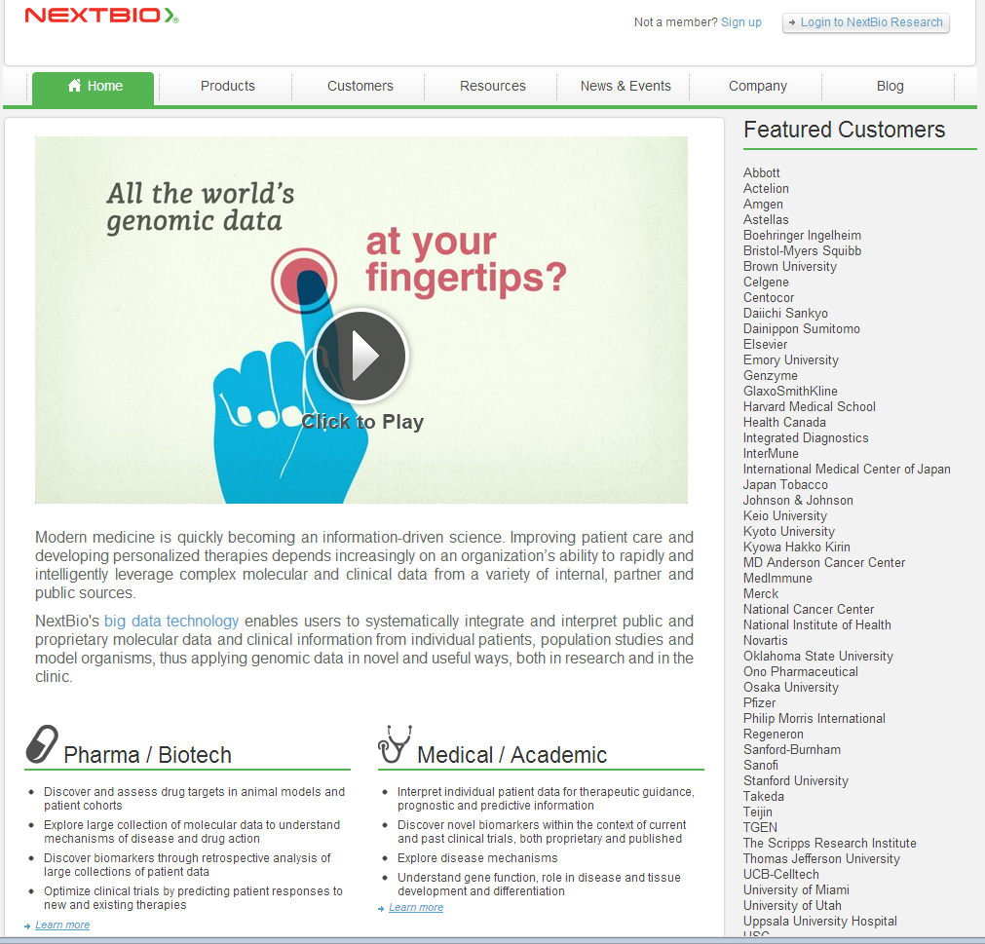
Medical Cloud Start up

Slide 35
Healthcare & Cloud Computing
Patient’s information would be stored in a cloud
Accessed and managed over the Internet
Since we are on a paperless route, this is a great idea to store information
Authorized users
Information on one cloud is connected to bigger clouds
  Ex. Big Bend RHIO connected to the NHIN
http://healthinformatics.wikispaces.com/file/view/cloud_computing.ppt

Slide 36
Considerations With Cloud Computing in Healthcare
Since information is stored over the Internet, precautions must be taken
Cloud system must conform to the HIPAA act
  Personal Health Information
  Secure transmission of PHI over the Internet
  Need to maintain a secure, safe, and authorized environment for the prevention of information leakage

Slide 37
Advantages of Cloud Computing
Low costs
  Outsourcing information reduces amount spent on new technology
  Easier to maintain
More secure
  Companies are hired to watch over the information
Interoperability
  Access information from anywhere
  Can be accessed using different devices

Slide 38

Advantages of Cloud Computing
Increases the adoption of EMRs
Beneficial for small companies
Easy to share information among different organizations and doctors

Slide 39
Cloud Computing Disadvantages
Security is the main disadvantage of cloud computing
Consumers are worried about Insurance companies getting a hold of there information and discriminating based upon current medical conditions they may have or medical conditions that they could develop later in life.
They are also worried about government agencies getting a hold of there information and exploiting it to third party vendors, or there place of work.

Slide 40
Disadvantages Cont.
The cloud companies do not always handle all of the security themselves and sometimes pass it off to third party vendors
Consumers need to make sure to thoroughly check out these companies to see who else they are involved with and check out there reputation to see if you trust them to not share your information with any other outside sources. If the third party vendor looks trustworthy then you are probably safe to send your medical records over the cloud safely.

Slide 41
Genomic Proteomics and Information Visualization
So far genome not a major part of Big Open Data in medicine

Slide 42

Genomics in Personal Health
  Suppose you measured everybody’s genome every 2 years
    30 petabits of new gene data per day
    factor of 100 more for raw reads with coverage
  Data surely distributed
  1.5*10⁸ to 1.5*10¹⁰ continuously running present day cores to perform a simple Blast analysis on this data
    Amount depends on clever hashing and maybe Blast not good enough as field gets more sophisticated
  Analysis requirements not well articulated in many fields – See http://www.delsall.org for life sciences
    LHC data analysis well understood – is it typical?
    LHC Pleasing parallel (PP) – some in Life Sciences like Blast also PP

Slide 43
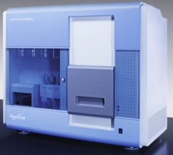
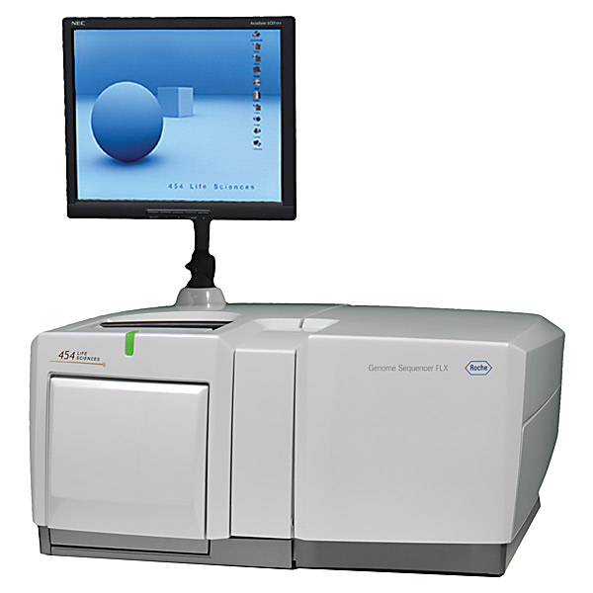
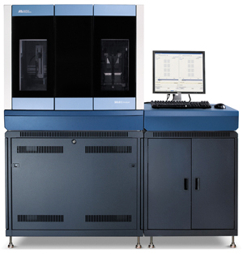
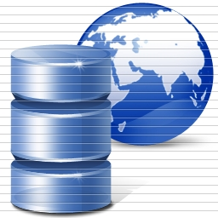
DNA Sequencing Pipeline
Illumina/Solexa Roche/454 Life Sciences Applied Biosystems/SOLiD
Internet
~300 million base pairs per day leading to
~3000 sequences per day per instrument
? 500 instruments at ~0.5M$ each
Read Alignment
Pairwise
clustering
Form block
Pairings
Sequence
alignment
Dissimilarity
Matrix
N(N-1)/2 values
Visualization
Plotviz
FASTA File
N Sequences
Blocking
MPI
MDS
MapReduce

Slide 44
COG: Clusters of Orthologous Groups
COG database was developed by NCBI.
Proteins classified into groups with common function encoded in complete genomes.
Prokaryotes (COG): 66 genomes, 200K proteins, 5K clusters.
Eukaryotes (KOG): 7 genomes, 113K proteins, 5K clusters.
Valuable scientific resource: 5K citations.
Last updated: 2006.

Slide 45
Protein Sequence Universe
PSU Goal: Enhance annotation resources with analytic and visualization (browser) tools.
One component of PSU is to project sequence data into 3D using multidimensional scaling (MDS).
MDS interpolation allows expanding the universe without time consuming all vs all O(N²)
  3D map allows much faster interpolation
Use set of pairwise dissimilarities – don’t do MSA – so don’t have vectors in some space

Slide 46
High Performance Dimension Reduction and Visualization
Need is pervasive
  Large and high dimensional data are everywhere: biology, physics, Internet, …
  Visualization can help data analysis
Visualization of large datasets with high performance
  Map high-dimensional data into low dimensions (2D or 3D).
  Need Parallel programming for processing large data sets
  Developing high performance dimension reduction algorithms:
    MDS(Multi-dimensional Scaling)
    GTM(Generative Topographic Mapping)
    DA-MDS(Deterministic Annealing MDS)
    DA-GTM(Deterministic Annealing GTM)
  Interactive visualization tool PlotViz
Notes:
With David Wild

Slide 47
Multi-Dimensional Scaling (MDS)
Sammon‘s objective function
is dissimilarity measure between sequences i and j
d is Euclidean distance (here in 3D for visualization) between projections x_{i} and x_{j}
Denominator chosen to get larger contribution in objective function from smaller dissimilarities
f is monotone transformation of dissimilarity measure chosen “artistically”

Slide 48
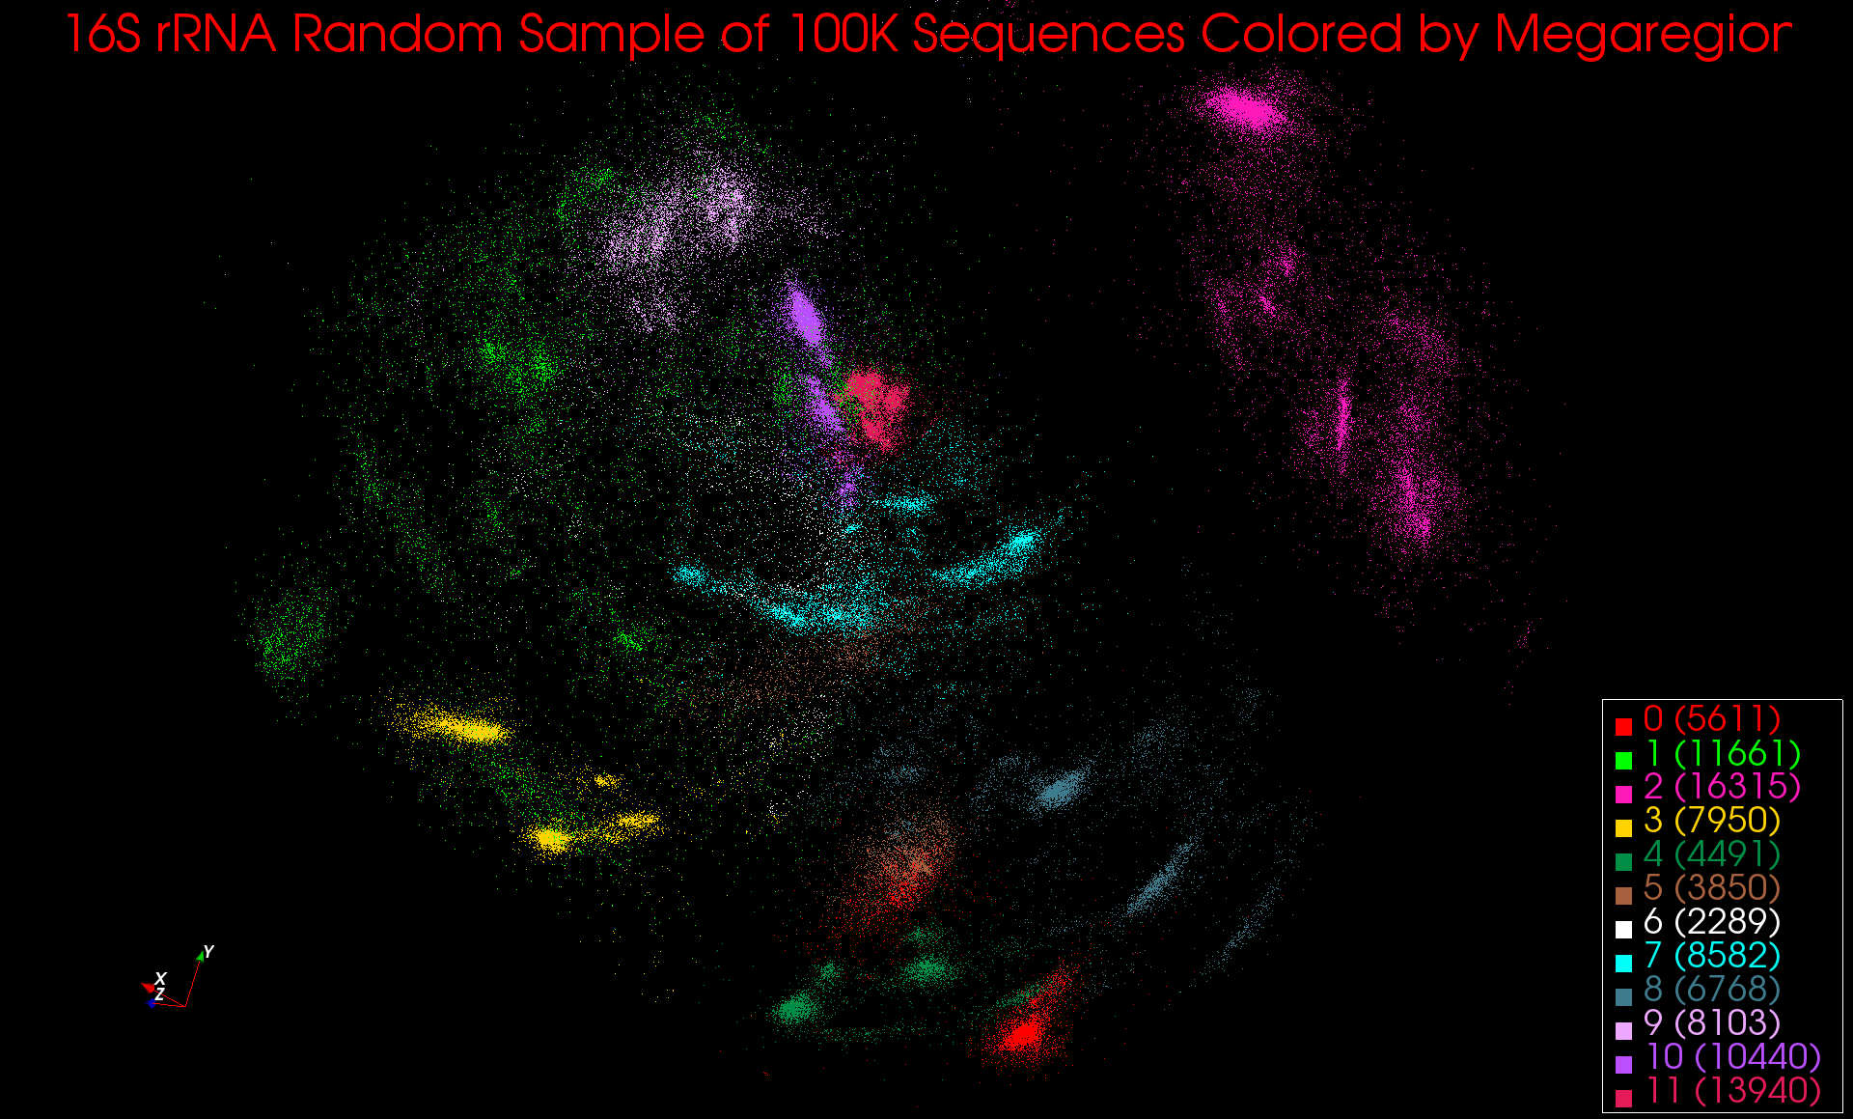
Typical Metagenomics MDS

Slide 49
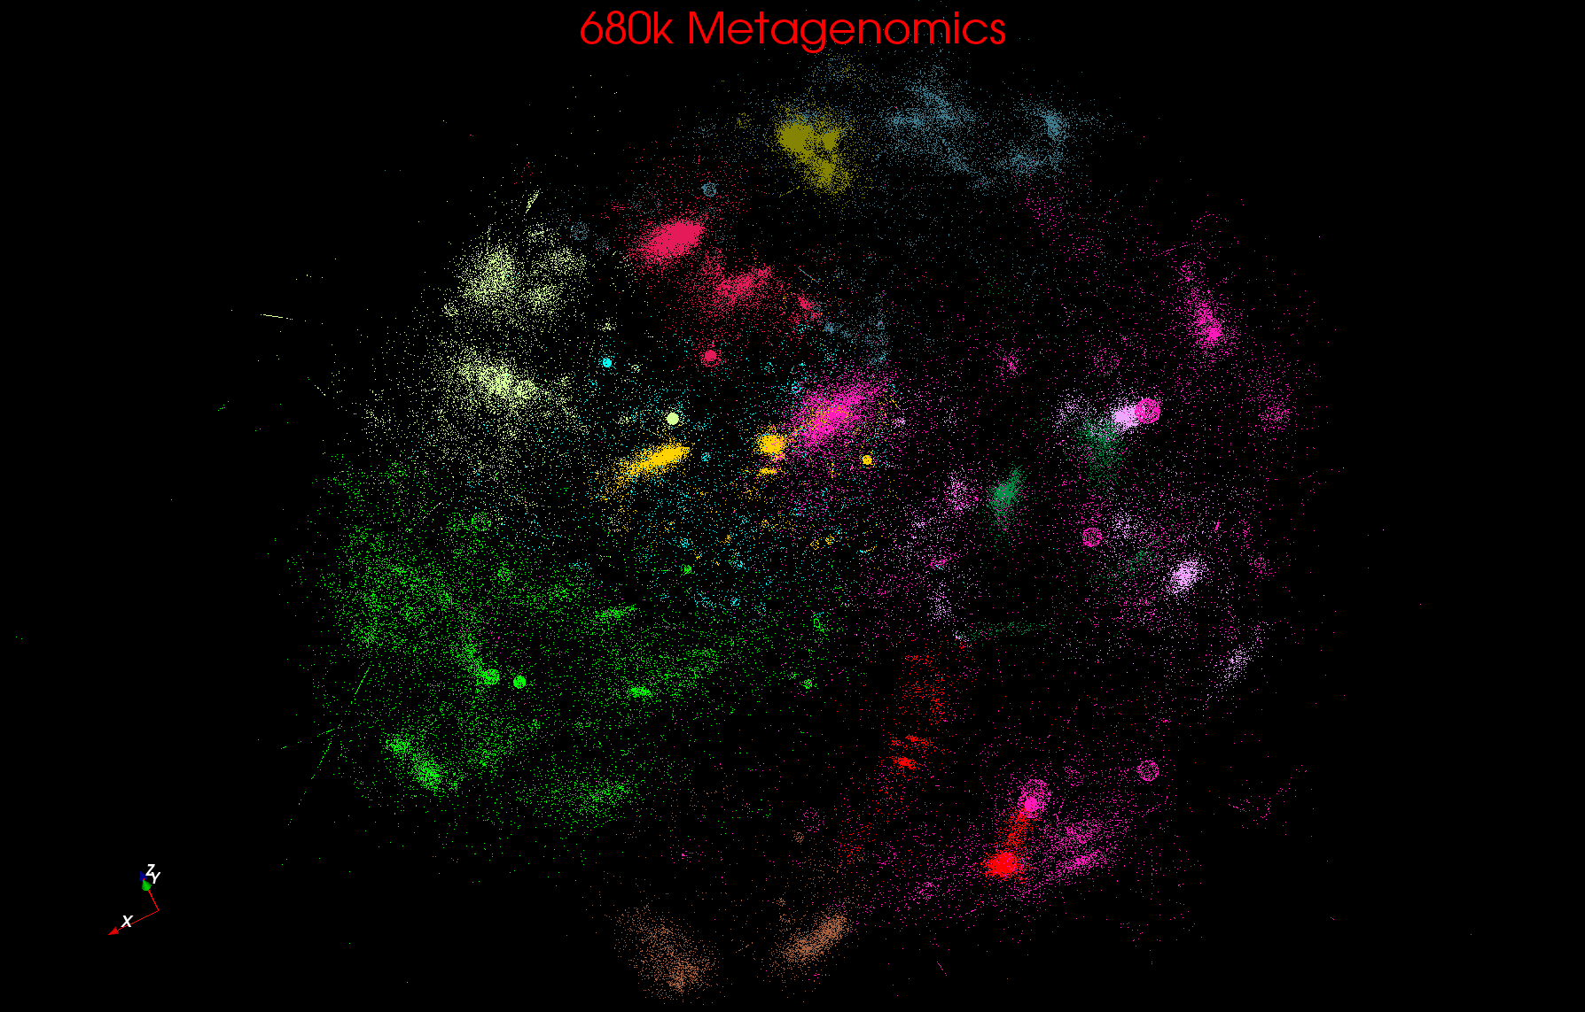
Metagenomics
http://salsahpc.indiana.edu/millionseq/mina/16SrRNA_index.html

Slide 50
MDS Details
f chosen heuristically to increase the ratio of standard deviation to mean for and to increase the range of dissimilarity measures.
O(n²) complexity to map n sequences into 3D.
MDS can be solved using EM (SMACOF – fastest but limited) or directly by Newton's method (it’s just χ² )
Used robust implementation of nonlinear χ² minimization with Levenberg-Marquardt
3D projections visualized in PlotViz

Slide 51
MDS Details
Input Data: 100K sequences from well-characterized prokaryotic COGs.
Proximity measure: sequence alignment % scores
Scores calculated using Needleman-Wunsch
Scores “sqrt 4D” transformed and fed into MDS
  Analytic form for transformation to 4D
  δ_{ij}^{n} decreases dimension n > 1; increases n < 1
“sqrt 4D” reduced dimension of distance data from 244 for δ_{ij} to14 for f(δ_{ij})
Hence more uniform coverage of Euclidean space

Slide 52
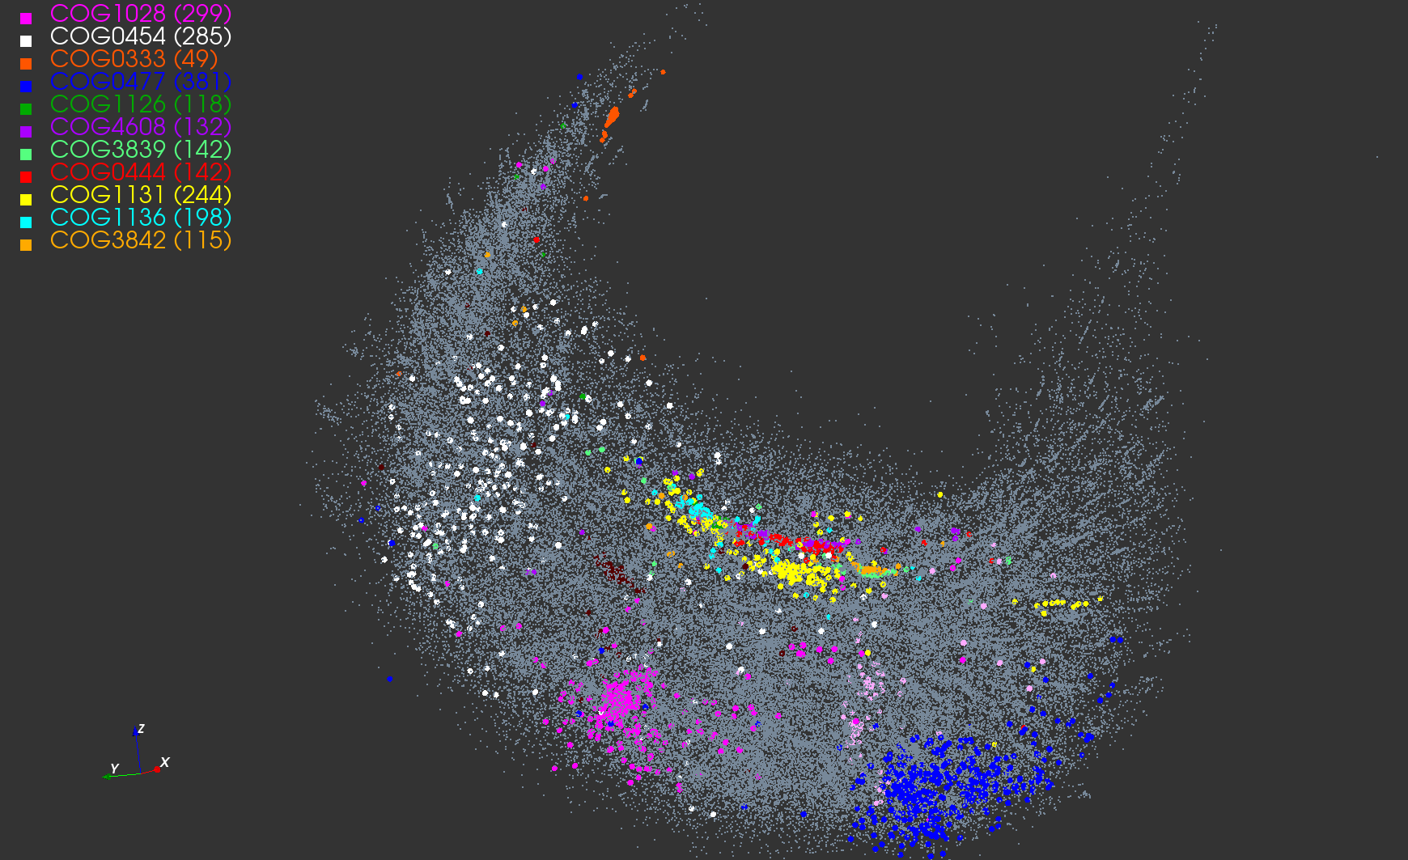
3D View of 100K COG Sequences

Slide 53
Cluster Annotation
COG | Annotation | Uniref100
COG1131 | ABC-type multidrug transport system, ATPase component | 14406
COG1136 | ABC-type antimicrobial peptide transport system, ATPase component | 7306
COG1126 | ABC-type polar amino acid transport system, ATPase component | 4061
COG3839 | ABC-type sugar transport systems, ATPase component | 4121
COG0444 | ABC-type dipeptide/oligopeptide/nickel transport system ATPase comp | 3520
COG4608 | ABC-type oligopeptide transport system, ATPase component | 3074
COG3842 | ABC-type spermidine/putrescine transport systems, ATPase comp | 3665
COG0333 | Ribosomal protein L32 | 1148
COG0454 | Histone acetyltransferase HPA2 and Related acetyltransferases | 14085
COG0477 | Permeases of the major facilitator superfamily | 48590
COG1028 | Dehydrogenases with different specificities | 37461

Slide 54
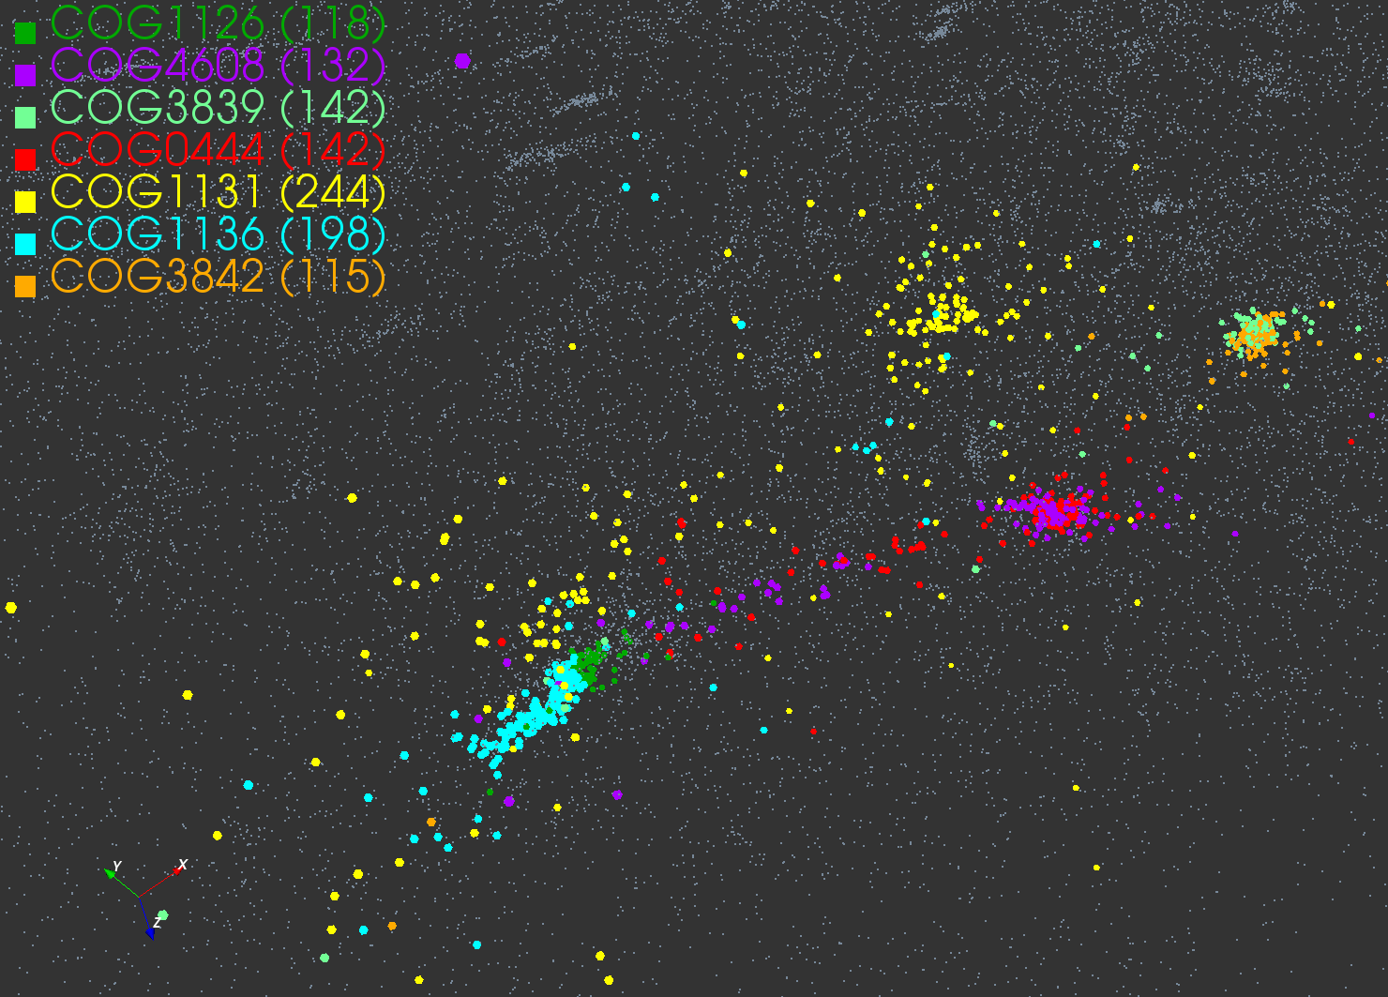
Selected Clusters

Slide 55
Metagenomics with 3 Clustering Methods
DA-PWC 188 Clusters; CD-Hit 6000; UCLUST 8418
DA-PWC doesn’t need seeding like other methods – All clusters found by splitting
# Clusters

Slide 56
Advantages of GTM
Computational complexity is O(KN), where
  N is the number of data points
  K is the number of latent variables or clusters. K << N
Efficient, compared with MDS which is O(N²)
Produce more separable map (right) than PCA (left)
PCA
GTM
Oil flow data
1000 points
12 Dimensions
3 Clusters

Slide 57
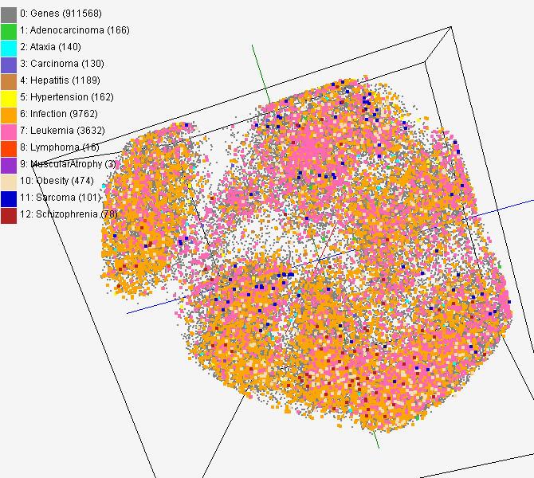
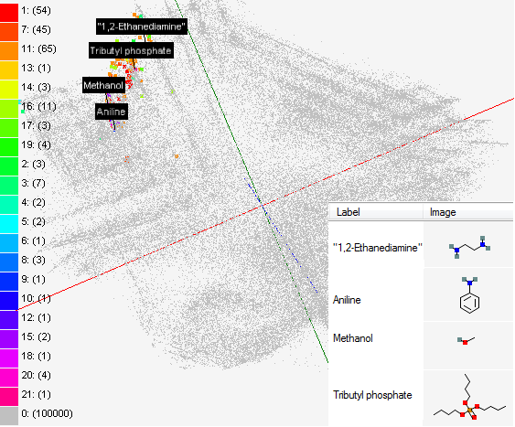
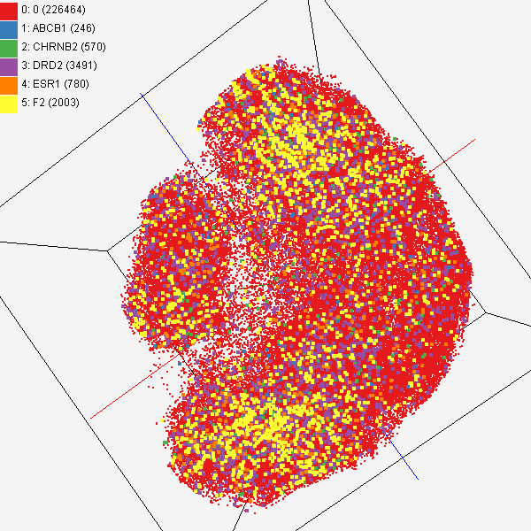
Data Mining Projects using GTM
Visualizing 215 solvents by GTM-Interpolation
215 solvents (colored and labeled) are embedded with 100,000 chemical compounds (colored in grey) in PubChem database
Chemical compounds reported in literatures
Visualized 234,000 chemical compounds which may be related with a set of 5 genes of interest (ABCB1, CHRNB2, DRD2, ESR1, and F2) based on the dataset collected from major journal literatures
PubChem data with CTD visualization
About 930,000 chemical compounds are visualized in a 3D space, annotated by the related genes in Comparative Toxicogenomics Database (CTD)

Slide 58
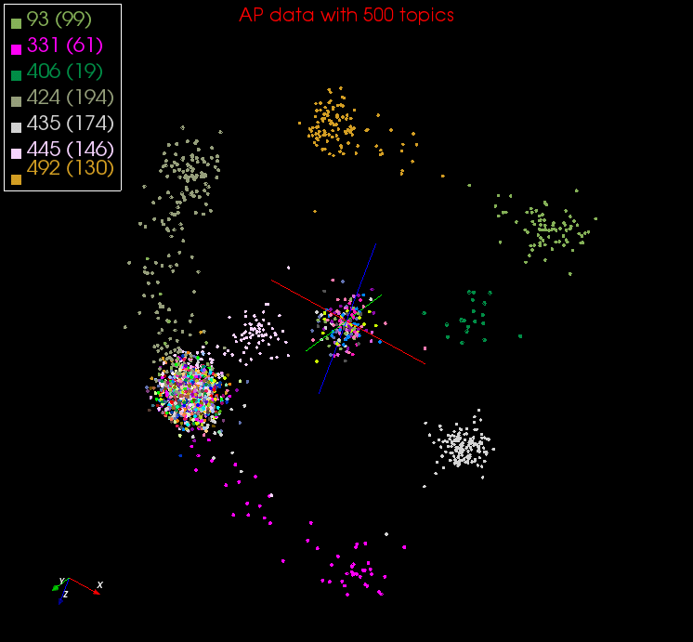
DA-PLSA with DA-GTM
Corpus
(Set of documents)
DA-PLSA
Corpus
in K-dimension
DA-GTM
Embedded Corpus in 3D

Slide 59
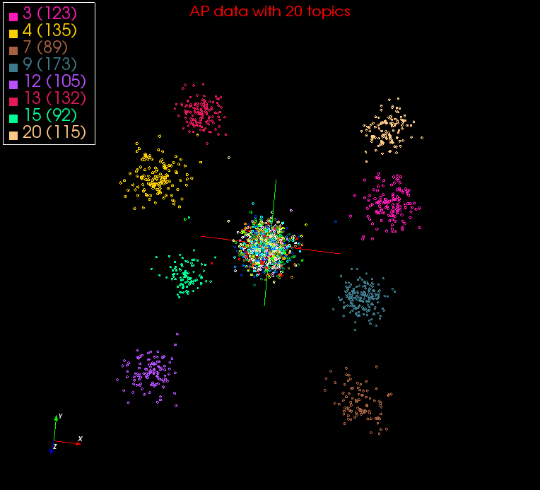

Slide 60
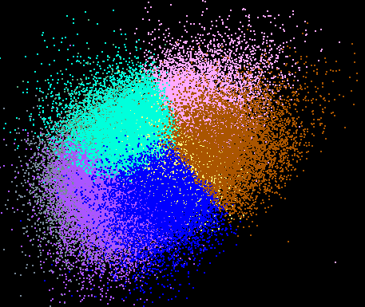
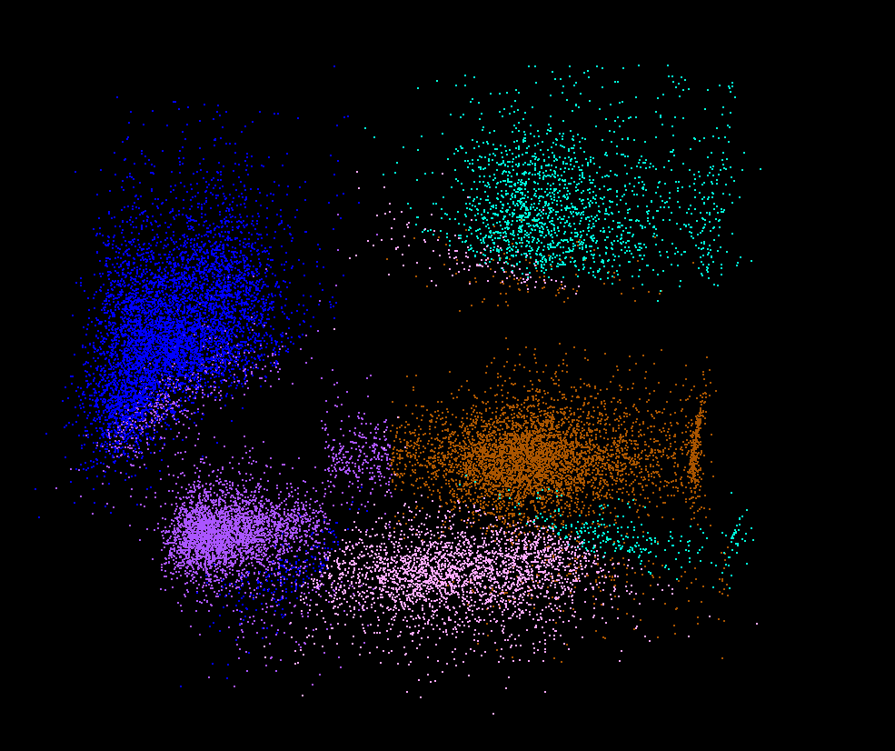
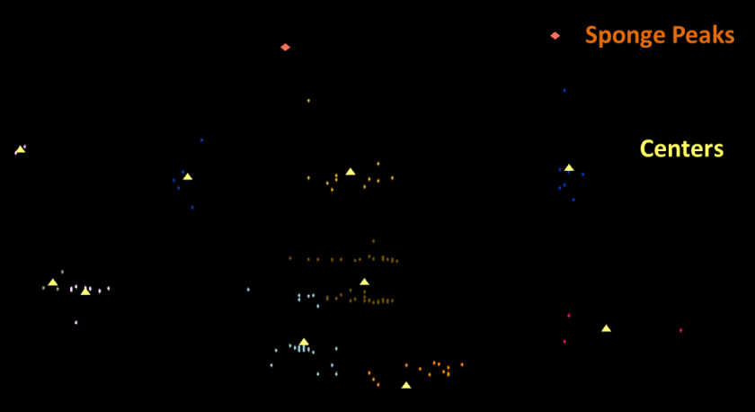
Lymphocytes 4D
Pathology 54D
Dimension Reduction/MDS helps address
You can get answers (from clustering) but do and how do you believe them!
LC-MS 2D

Slide 61
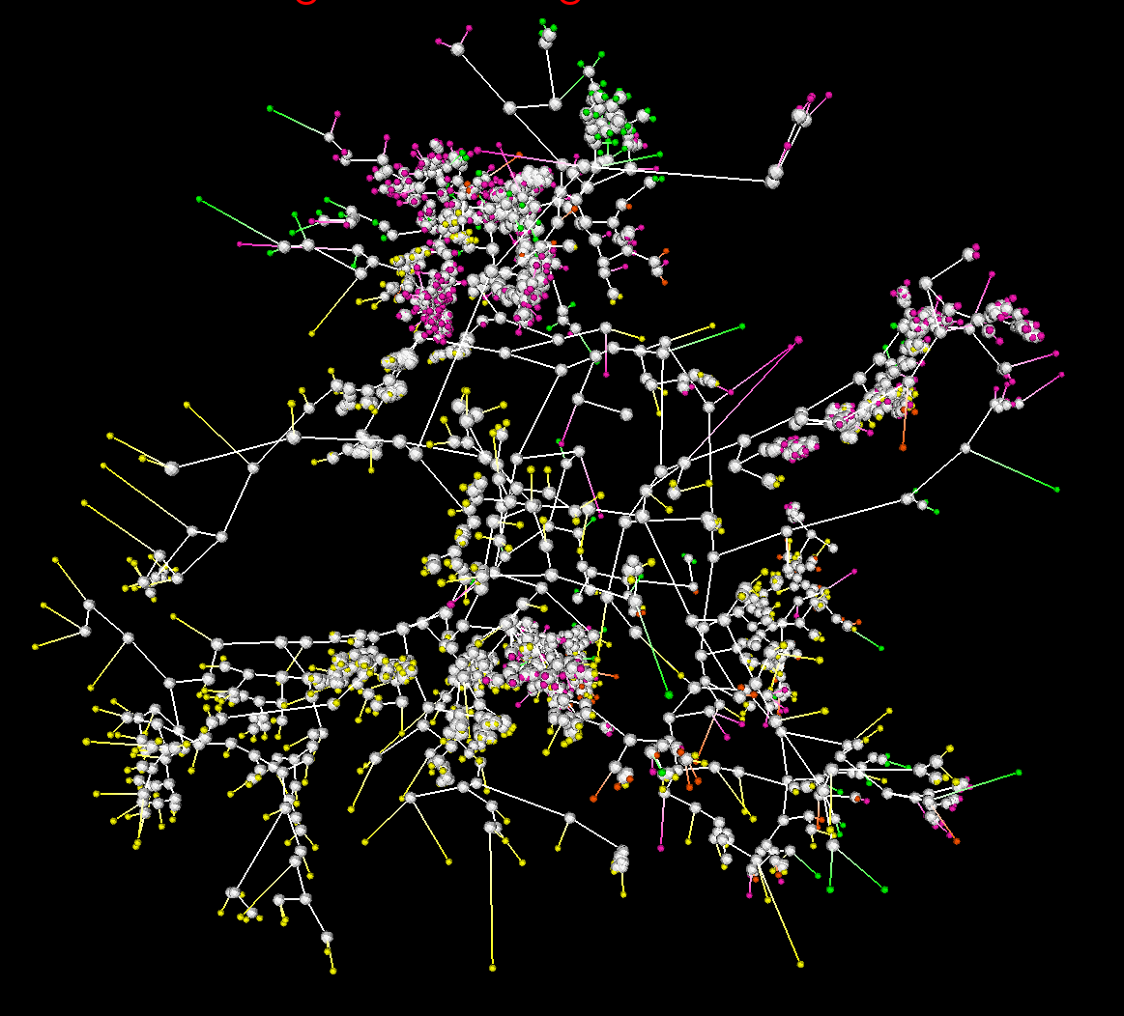
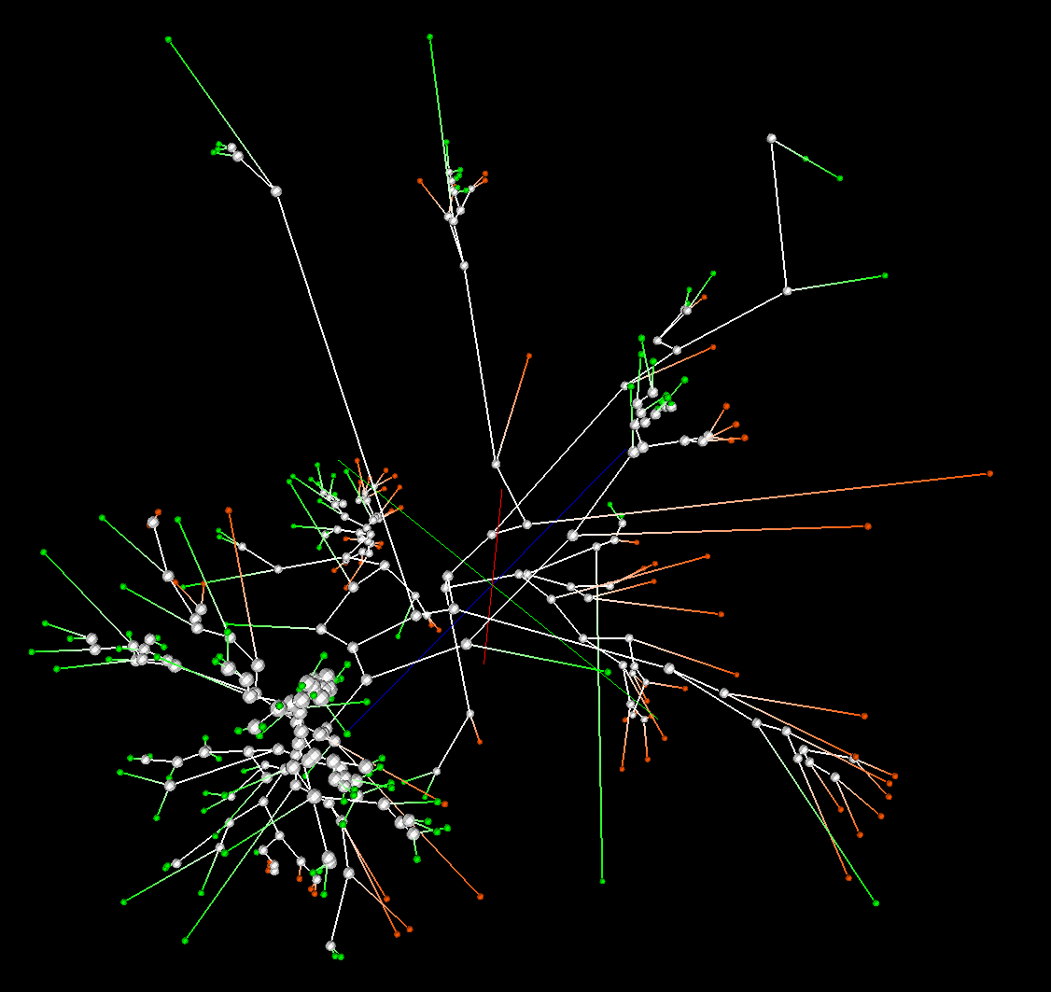
Phylogenetic tree using MDS
200 Sequences
(126 centers of clusters found from 446K)
Tree found from mapping sequences to 10D using Neighbor Joining
Whole collection mapped to 3D
2133 Sequences
Extended from set of 200
Trees by Neighbor Joining in 3D map
Silver Spheres Internal Nodes

