Slide 1
Technology for Informatics Kmeans and MapReduce Parallelism
April 1 2013
Geoffrey Fox
gcf@indiana.edu
http://www.infomall.org/
Associate Dean for Research and Graduate Studies, School of Informatics and Computing
Indiana University Bloomington
2013

Slide 2
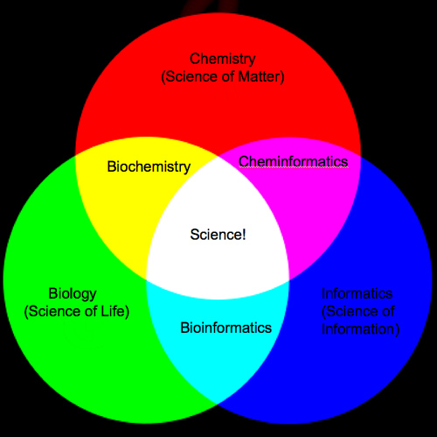
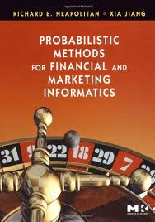
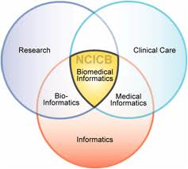
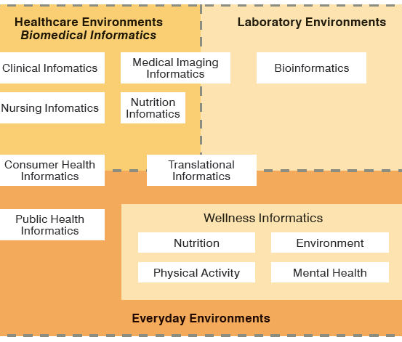
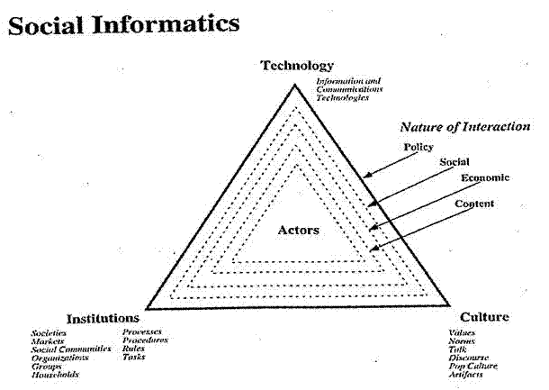
Social Informatics

Slide 3
Big Data Ecosystem in One Sentence
Use Clouds running Data Analytics processing Big Data to solve problems in X-Informatics

Slide 4
Kmeans in Python

Slide 5
Kmeans
Have a set N of Points – find a specified number K of clusters
Choose a “random” starting point e.g. randomly choose K points to be centers
Iterate until converged
Associate points with cluster whose center they are nearest
Calculate new center positions as centroid (average) of points associated with center
Note Python has a Kmeans code which we use
As source available we modify to illustrate parallel computing

Slide 6
Sequential version I
Overall iteration over starting positions
Initialize Centroids
Iterate until converged
Find association of points and centers
Calculate distortion (Point-Center distance)
Find centroids as mean of point vectors
Delete zero size clusters
Check convergence
Return best solution based on Goodness criterion
Later tweak algorithm to put in MapReduce form

Slide 7
Kmeans on 4 “Artificial” Clusters
Fixed Center positions at
(0,0) radius 0.375
(3,3) radius 0.55
(0,3) radius 0.6
(3,0) radius 0.25
These are “large clusters”
“Small Clusters” have radius multiplied by 0.25
“Very Large Clusters” radius multiplied by 1.5
Each clusters has 250 points generated in normal (Gaussian) distribution with standard deviation 1
We used Kmeans with 2, 4 and just for fun 6 or 8 clusters

Slide 8
Comments
As random data and random starting points, get different answers each time
Can fix seeds for reproducible results
Generally get “correct” answers
Reduce number of iterations (20 default in Python) of independent runs to increase “interesting” results

Slide 9
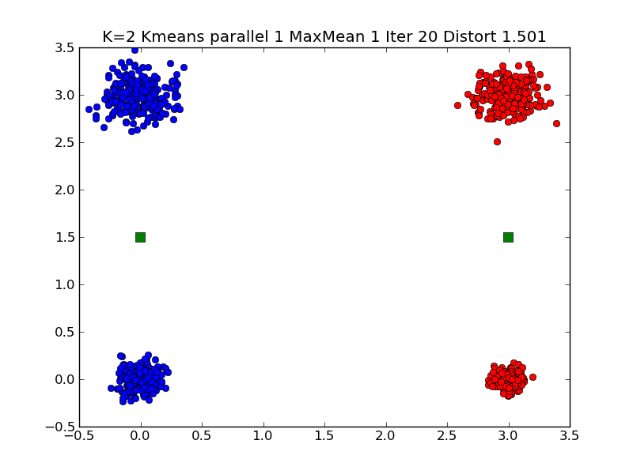
Typical K=2 Small Clustering Note distortion ~1.5

Slide 10
In Graph Title
K is number of clusters looked for K = 2…8
Parallelism is level of (pseudo) parallelism. Used for illustrating MapReduce
MaxMean = 1 Judge goodness by mean distortion
Distortion is distance from point to its center
MaxMean = 2 Judge goodness by max distortion
Iter is number of totally independent Kmeans iterations to run; return lowest “goodness”
Distort is “Goodness”

Slide 11
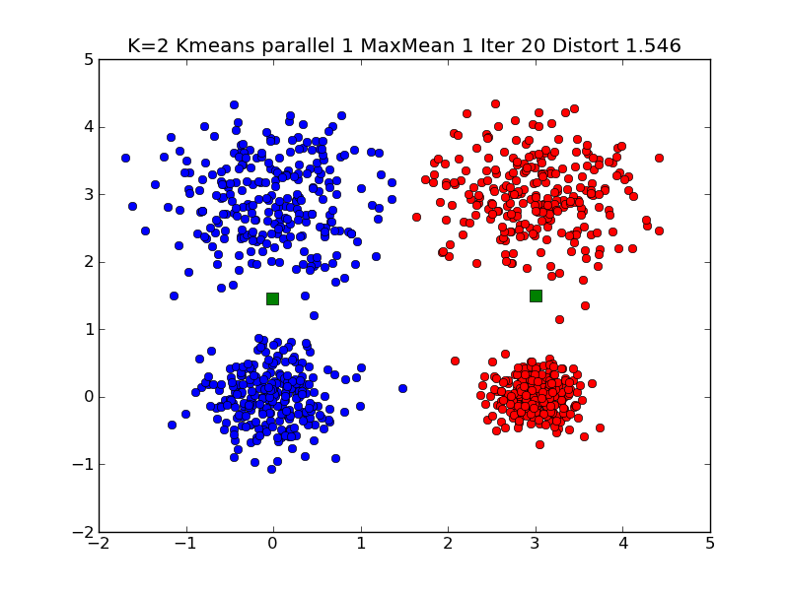
Typical K=2 Large Clustering

Slide 12
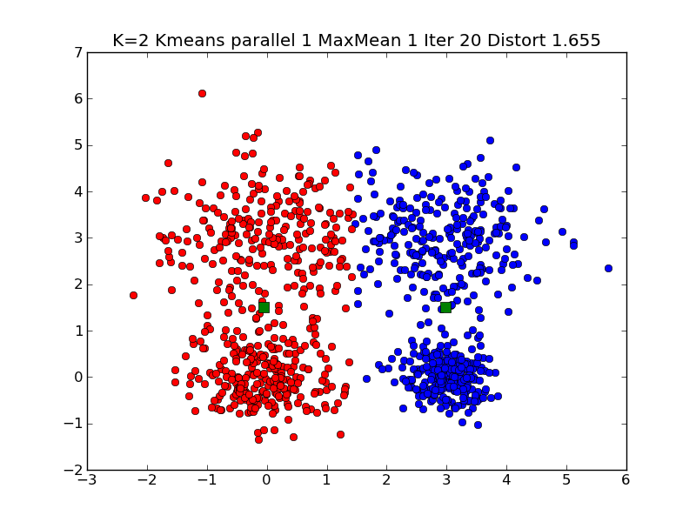
Typical K=2 Very Large Clustering

Slide 13
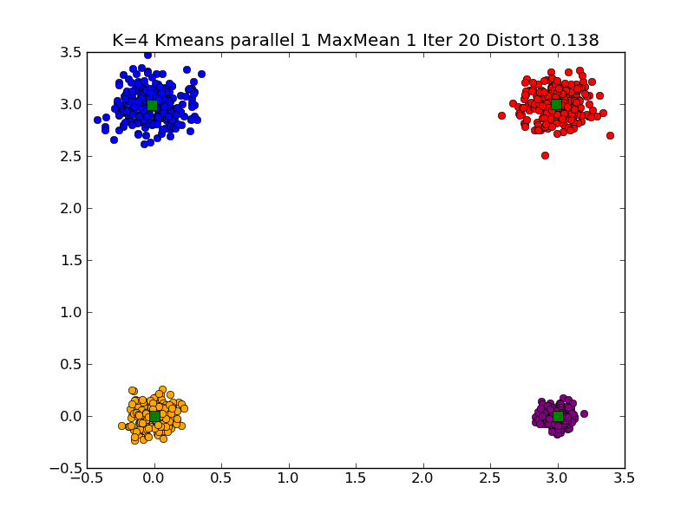
Typical K=4 Small Clustering

Slide 14
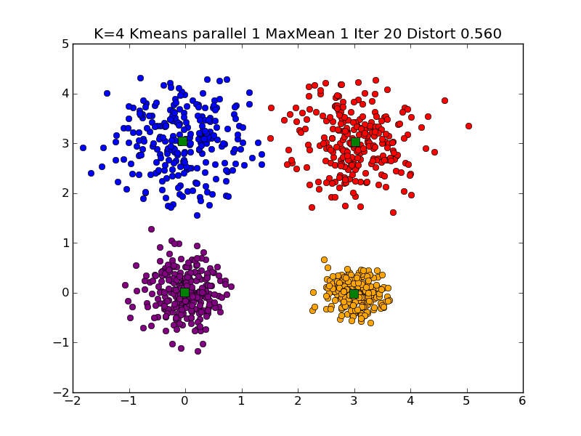
Typical K=4 Large Clustering

Slide 15
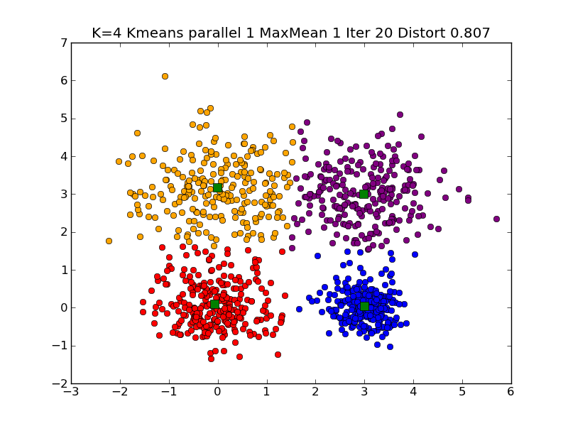
Typical K=4 Very Large Clustering

Slide 16
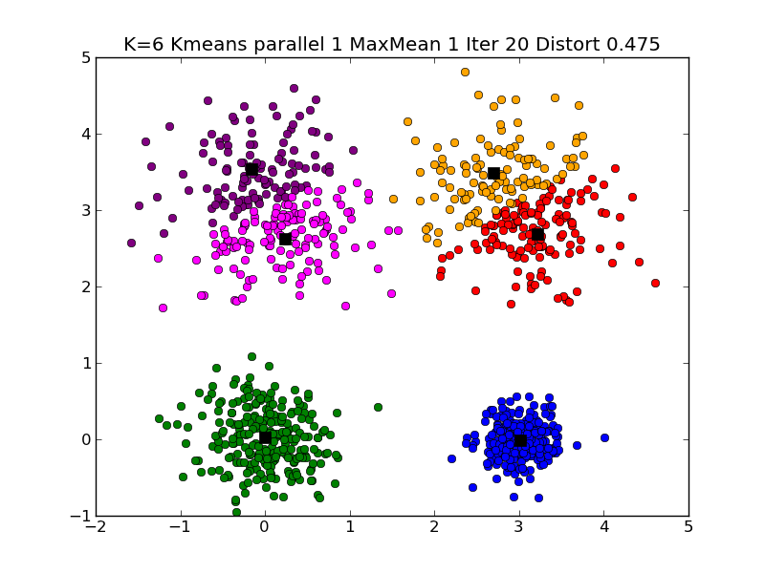
Typical K=6 Large Clustering

Slide 17
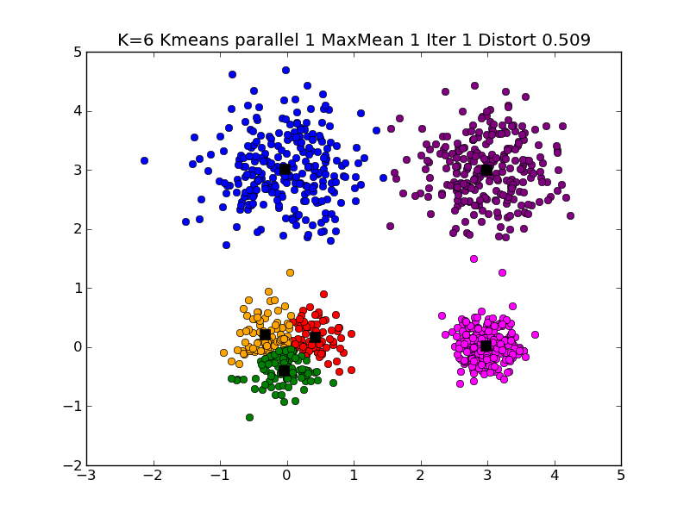
Different K=6 Large Clustering

Slide 18
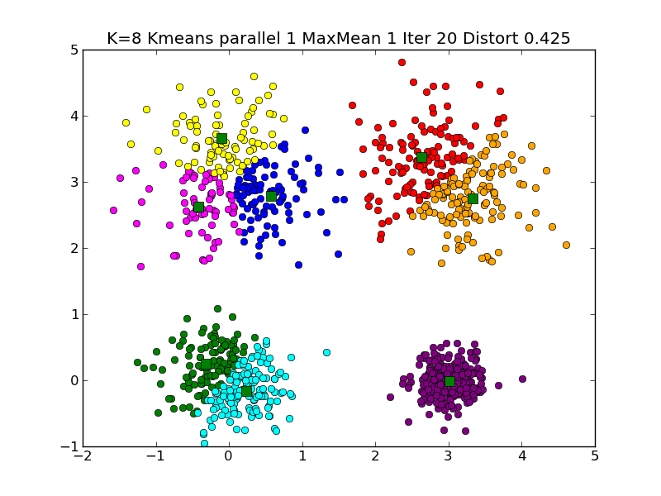
Typical K=8 Large Clustering

Slide 19
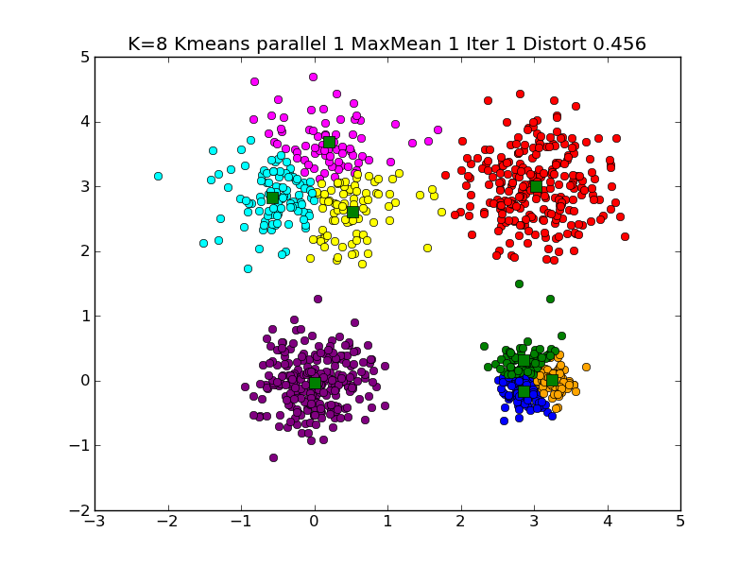
Another K=8 Large Clustering

Slide 20
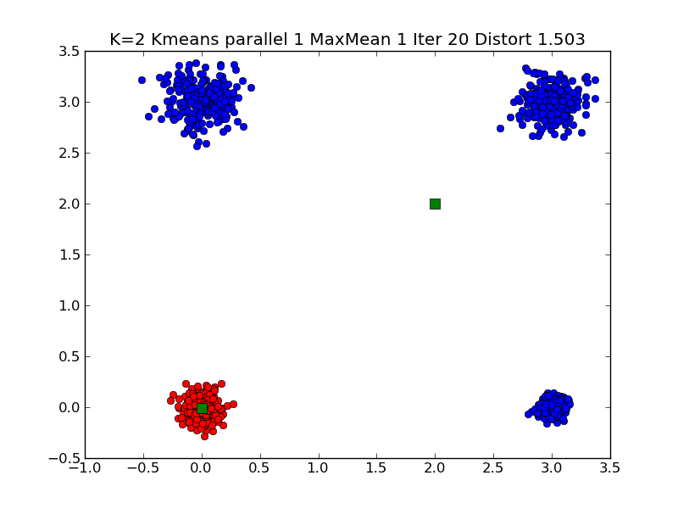
A different solution of K=2 Small Clustering

Slide 21
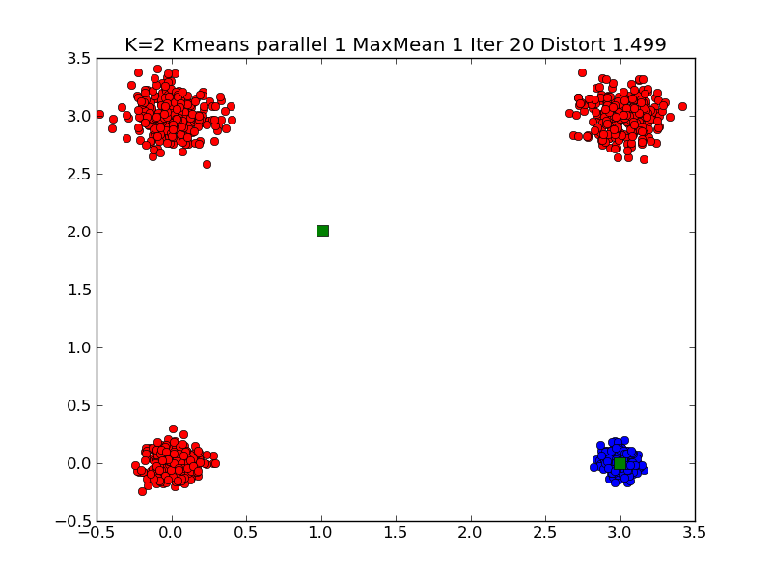
Note Symmetry related solutions
A second look at a different solution of K=2 Small Clustering

Slide 22
Typical K=2 Small Clustering

Slide 23
Note 4 Small Cluster Case is Ambiguous
There are two solutions for K =2 which have similar measures of goodness
2 Clusters each of 2 real clusters
1 Cluster is 1 real cluster, the other is three real clusters
Current measure of goodness is “Average distance between point and its cluster”. This roughly 1.5 for both solutions
Details of starting point determines which solution you find
Also sensitive to “random clusters” i.e. solutions are so near that they can change with choice of Gaussianly distributed points
Typical function with two widely separated minima
Goodness of Fit
Cluster positions (4 parameters for K=2

Slide 24
Ambiguous Solutions
The Python code runs Kmeans 20 times and chooses best solution out of this 20.
The 4 small cluster case has such similar goodness values for two cases that results vary from run to run
The 2 real cluster case has goodness ~ 3 (distance between generated centers)/2 = 1.5
In other solution a typical case is centers at (0,0) and (2,2) with goodness = (2√5 + √2 + 0)/4 = 1.47
Exact for very small size clusters
Changing goodness to Maximum not mean distance of points to centers will lead to unique solution with each cluster having two real clusters
Max values is 1.5 which is much less than √5 = 2.24

Slide 25
Note the Hill between Solutions
There are 2 symmetry related solutions with 2 real clusters per Kmeans solution
There are 4 symmetry related solutions with 3+1 real clusters per Kmeans solution
These 6 solutions are separated by hills and are local minima
They are stable on small perturbations
Need big change to get from one to another
Very common feature seen in change of leadership in both democratic and non democratic societies
Perhaps in play in battle IoS v Android v Blackberry v Windows 8 in smart phones
Blackberry messed up enough to let Android/IoS take over
To change state, it is insufficient to be better
You need to be so much better that can jump hill

Slide 26
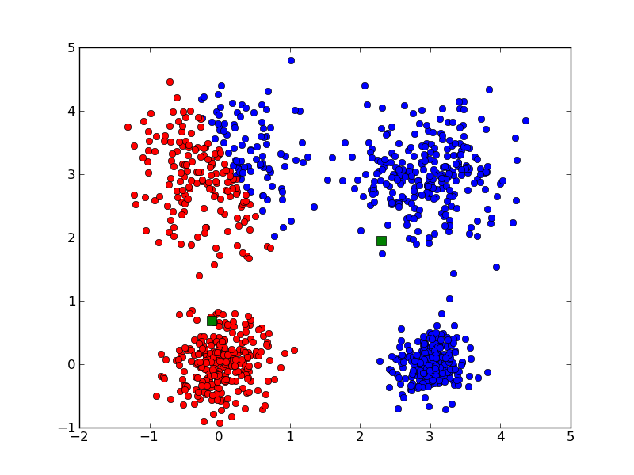
Messy K=2 large Clustering

Slide 27
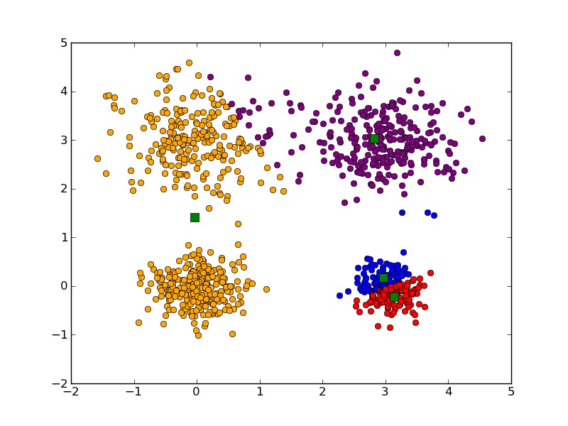
Messy K=4 large Clustering

Slide 28
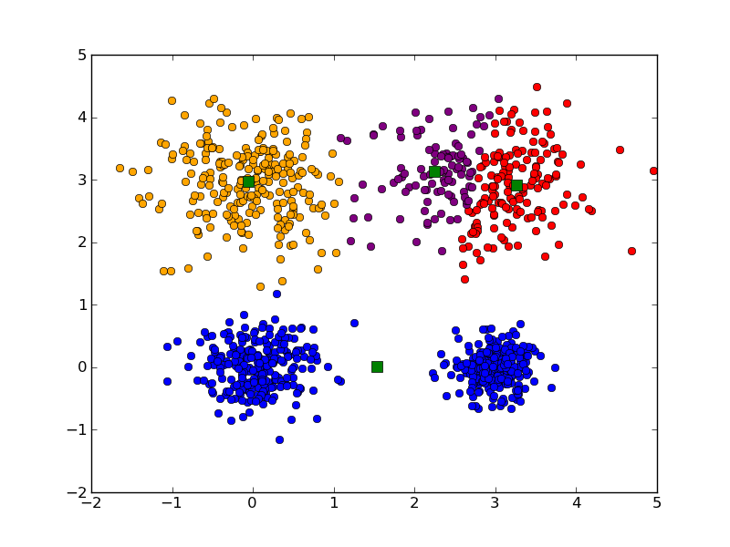
Messy K=4 large Clustering

Slide 29
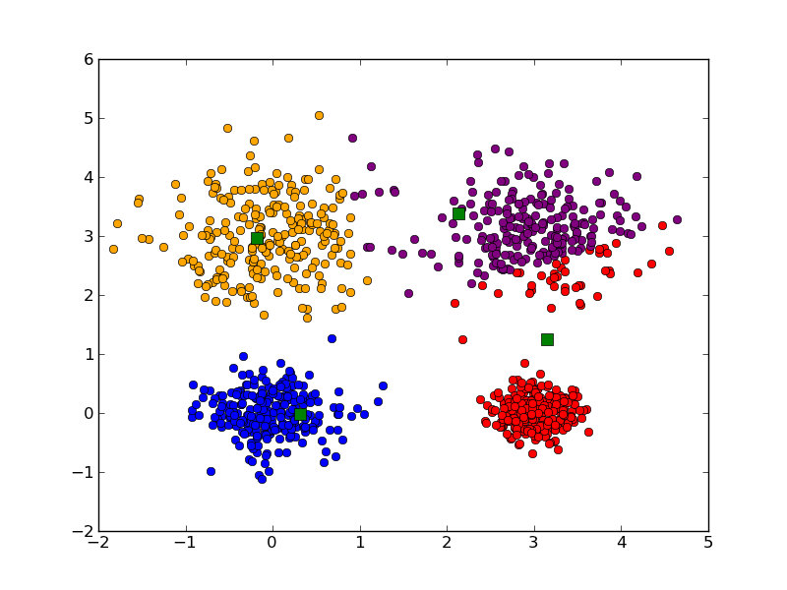
Messy K=4 large Clustering

Slide 30
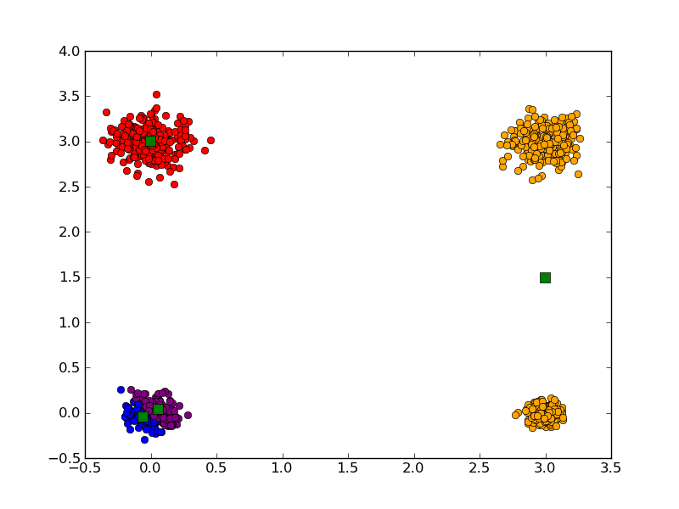
Messy K=4 Small Clustering

Slide 31
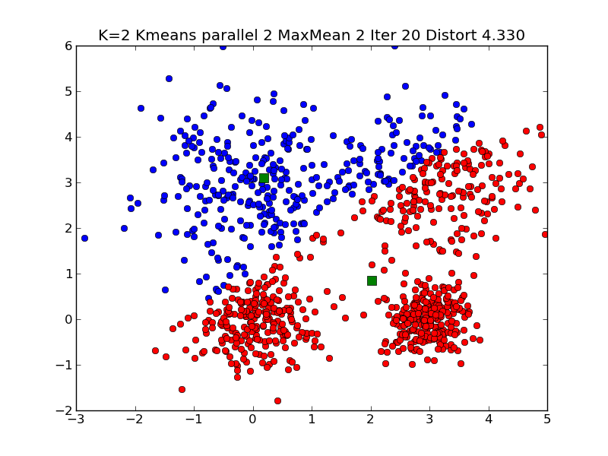
Messy K=2 Very large Clustering

Slide 32
Different K=6 Large Clustering

Slide 33
Another K=8 Large Clustering

Slide 34
MapReduce Kmeans in Python

Slide 35
Sequential version II
Overall iteration over starting positions
Initialize Centroids
Iterate until converged
Call map to find association and find centroids as sum over point vectors and distortion
Reduce step: Divide summed centers by points in center to get centroid
Do other book keeping
Delete zero size clusters
Check convergence
Return best solution based on Goodness criterion

Slide 36
Parallel MapReduce Version
Iseven = np.empty([tot], dtype=bool)
for i in arange(tot):
Iseven[i] = (i%2 == 0);
obs1 = compress(Iseven, obs, 0)
obs2 = compress(logical_not(Iseven), obs, 0)
avg_dist = []
diff = thresh+1.
while diff > thresh:
#
if Parallelism == 1:
code_book, NumPointsinClusters, distortsum, distortmax, NumPoints = Kmeans_map(obs, code_book)
if Parallelism == 2:
# Can be Parallel Map Operations
code_book1, NumPointsinClusters1, distortsum1, distortmax1, NumPoints1 = Kmeans_map(obs1, code_book)
code_book2, NumPointsinClusters2, distortsum2, distortmax2, NumPoints2 = Kmeans_map(obs2, code_book)
#
# Following are 4 Reduction Operations
# Note maps include local reductions
code_book = np.add( code_book1, code_book2)
NumPointsinClusters = np.add( NumPointsinClusters1, NumPointsinClusters2)
distortsum = distortsum1 + distortsum2
distortmax = np.maximum(distortmax1, distortmax2)
NumPoints = NumPoints1 + NumPoints2
#
code_book = compress(np.greater(NumPointsinClusters, 0), code_book, 0)
# remove code_books that didn't have any members
#
j = 0
nc = code_book.shape[0]
for i in arange(nc):
if NumPointsinClusters[i] > 0:
code_book[j,:] = code_book[j,:] / NumPointsinClusters[i]
j = j + 1
Map
Reduce

Slide 37
Map for Kmeans
def Kmeans_map(obs, code_book):
No = obs.shape[0]
nc = code_book.shape[0]
# nc is current number of clusters (may decrease if zero clusters last iteration)
#
#compute membership and distances between obs and code_book
obs_code, distort = vq(obs, code_book)
distortsum = np.sum(distort)
distortmax = np.amax(distort)
#
# vq returns an indexing array obs_code mapping rows of obs (the points) to code_book (the centroids)
# distort is an array of length No that has difference between observation and chosen centroid
# vq stands for vector quantization and is provided in SciPy
#
VectorDimension = obs.shape[1]
NewCode_Book = np.zeros([nc, VectorDimension])
NumPointsinClusters = np.zeros([nc])
for i in arange(nc):
# Loop over clusters labelled with i
cell_members = compress(equal(obs_code, i), obs, 0)
NumPointsinClusters[i] = cell_members.shape[0]
# Extract Points in this Cluster; extract points whose quantization label is i
#
NewCode_Book[i] = np.sum(cell_members, 0)
# Calculate centroid of i'th cluster
return NewCode_Book, NumPointsinClusters, distortsum, distortmax, No
This routine takes Points in obs and Centroids in code_book and associates each point with nearest centroid
It calculates Non normalized centroids (sum over vectors in cluster), Number of points in each cluster and convergence measures (mean and max of distance between points and centers)

Slide 38
Comments!
Extension to P-way parallelism simple
Divide data into P parts
Run P separate maps with each having all centers
Sum (or max) P versions of center sums, Point sums, convergence criterion in Reduce
Maps can run in parallel
Reduce would run in a single process except for large levels of parallelism
Sequential code uses mean directly not sums
Parallel code does center sums and
Divides by total number of points in Reduce

Slide 39
Files etc.
xmean.py
Uses Python built in Kmeans to read data from CSV file
sample.csv Sample height/weight data from http://www.kosbie.net/cmu/fall-10/15-110/
http://www.kosbie.net/cmu/fall-10/15-110/handouts/notes-clustering/tshirts-GHIJ-nooutliers.csv
KmeansExtra.py
Uses Python built in Kmeans to address 4 artificial cluster case
ParallelKmeans.py
Uses my modification of Python Kmeans code to explore parallelism and convergence criterion

Slide 40
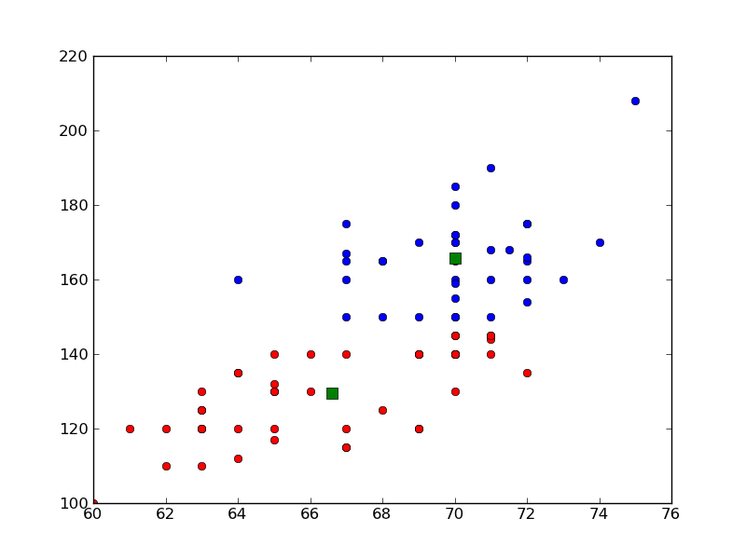
Weight (y) versus Height(x)
2 T-Shirt Sizes
Kmeans K=2 on data from a file

Slide 41
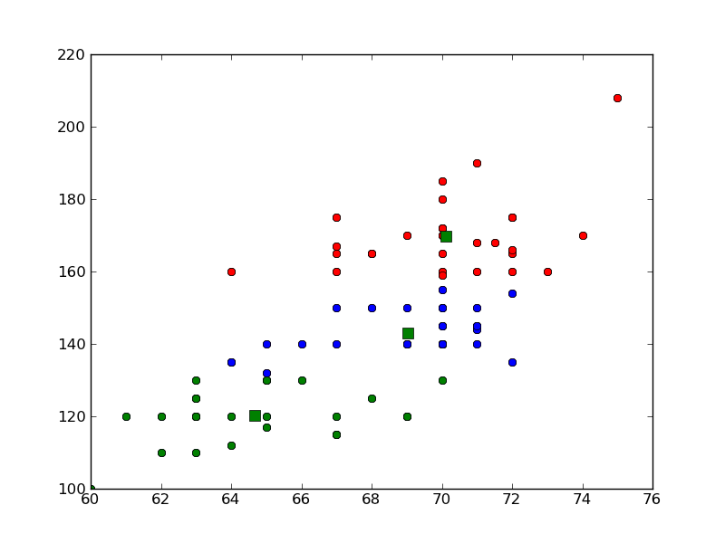
Weight (y) versus Height(x)
3 T-Shirt Sizes

