Slide 1
Technology for Informatics PageRank
April 1 2013
Geoffrey Fox
gcf@indiana.edu
http://www.infomall.org/
Associate Dean for Research and Graduate Studies, School of Informatics and Computing
Indiana University Bloomington
2013

Slide 2
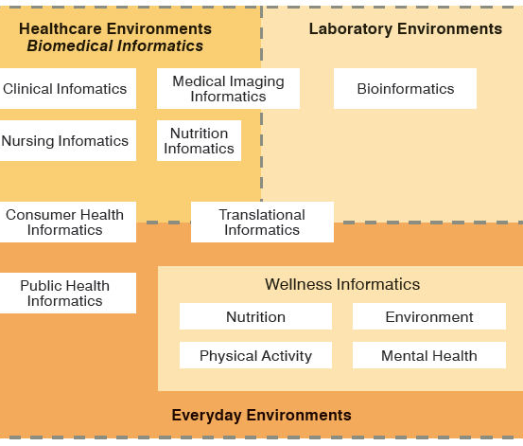
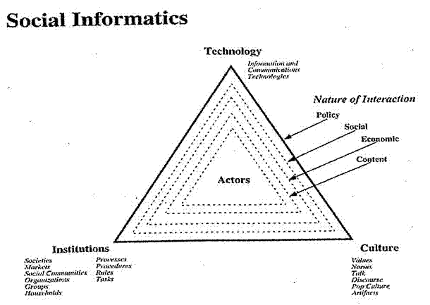
Social Informatics

Slide 3
Big Data Ecosystem in One Sentence
Use Clouds running Data Analytics processing Big Data to solve problems in X-Informatics

Slide 4
PageRank in Python http://glowingpython.blogspot.com/2011/05/four-ways-to-compute-google-pagerank.html See file pagerank2.py
Calculate PageRank from Web Linkage Matrix

Slide 5
""" basic power method """
def powerMethodBase(A,x0,iter):
for i in range(iter):
x0 = dot(A,x0)
x0 = x0/linalg.norm(x0,1)
return x0
Better to test on change in x0 for stopping rather than guessing number of iterations as here

Slide 6
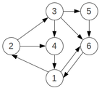
The little Graph
A = array([ [0, 0, 0, 1, 0, 1],
[1/2.0, 0, 0, 0, 0, 0],
[0, 1/2.0, 0, 0, 0, 0],
[0, 1/2.0, 1/3.0, 0, 0, 0],
[0, 0, 1/3.0, 0, 0, 0],
[1/2.0, 0, 1/3.0, 0, 1, 0] ])
A(i,j) = 0 if page j does not point at page I = 1/(Number of links on page j) otherwise
e.g. on first row, page 1 is pointed at by pages 4 and 6 which have no other links

Slide 7
Matrix-Vector Power Method
numpy.linalg.norm(x, option) Matrix or vector norm
For a 1D vector x, it is √{Σ_{i=0}^{N-1} x(i)²} for option = 2 and Σ_{i=0}^{N-1} |x(i)| for option = 1
numpy.dot(a, b) Dot product of two arrays.
For 2-D arrays it is equivalent to matrix multiplication, and for 1-D arrays to inner product of vectors (without complex conjugation). For N dimensions it is a sum product over the last axis of a and the second-to-last of b.
If a 2D and b 1D, it is matrix vector multiplication c = ab with c(i) = Σ_{j=0}^{M-1}a(i, j) b(j)

Slide 8
Basic Formalism
We create a damped array M = d A + (1-d) S where S is 6 by 6 matrix with all 1/6’s
d is usual value 0.85
We set x₀ to be any vector normed to be e.g. x₀ = ones(N)/N where N =6
Then we need to iterate x₀ → Mx₀/Norm(x₀)

Slide 9
""" Modified basic power method """
def powerMethodBase1(A,x0,thresh,iter):
x0 = x0/linalg.norm(x0,1)
x1 = x0 # The previous value of x0
for i in range(iter):
x0 = dot(A,x0)
x0 = x0/linalg.norm(x0,1)
stop = linalg.norm(x0-x1,1)
if stop < thresh:
print "Stop ",stop, " After ", i, " iterations"
break
x1 = x0
return x0

Slide 10
""" Original basic power method """
def powerMethodBase1(A, x0, iter):
x0 = x0/linalg.norm(x0,1)
for i in range(iter):
x0 = dot(A,x0)
x0 = x0/linalg.norm(x0,1)
return x0
They use 130 iterations; 20 gives fine answers as seen in modified version

Slide 11
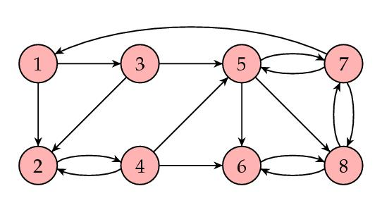
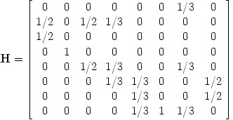
Another 8 by 8 Matrix
See http://www.ams.org/samplings/feature-column/fcarc-pagerank
Run with d = 1

Slide 12
3 Other Methods I
We are iteratively solving the equations
x = dAx + (1-d)S₂x where S₂ is N by N matrix of 1’s
That’s essentially powerMethodBase approach
Now Σ_{i=0}^{N-1} x(i) = 1 (Probabilities add to one)
So S₂x always = S₁ = [1, 1, 1] – the vector of 1’s
There we can iteratively solve x = dAx + (1-d)S₁
This is method powerMethod

Slide 13
3 Other Methods II
Alternatively we can write x = dAx + S₁
as (1- dA)x = (1-d)S₁ and solve these N linear equations
This is method linearEquations and only works if d>0
I don’t think it’s a serious method for real problem
Finally an equation like
x = [dA + (1-d)S₂]x is a special case of Matrix [dA + (1-d)S₂] x = λ x which is an equation for eigenvalue λ and eigenvector x.
The matrix we have is very special and has eigenvalue λ = 1 and this is largest eigenvalue
Thus final method finds largest eigenvalue with general eigenvalue routine maximalEigenvector
This is “too general” for practical use
In fact best way of finding largest eigenvalue of any matrix is the power method powerMethodBase and one does not use general method if you just need largest eigenvalue

Slide 14
PageRank in Python http://www.schurpf.com/google-pagerank-python/ http://coreygoldberg.blogspot.com/2010/01/python-lookup-google-pagerank-score.html See file pagerank1.py
Calculate PageRank of a real page

Slide 15
Pagerank1.py
You just change last line in script to fetch PageRank of a given URL
print GetPageRank("http://www.infomall.org") returns 5
This PageRank is modified (by Google)from formal definition as an integer between 1 and 10 and not a probability <1

