Slide 1
X-Informatics Clustering to Parallel Computing
February 18 and 20 2013
Geoffrey Fox
gcf@indiana.edu
http://www.infomall.org/X-InformaticsSpring2013/index.html
Associate Dean for Research and Graduate Studies, School of Informatics and Computing
Indiana University Bloomington
2013

Slide 2
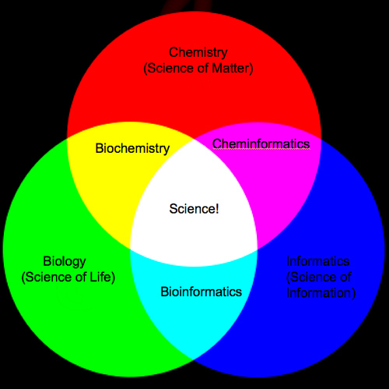
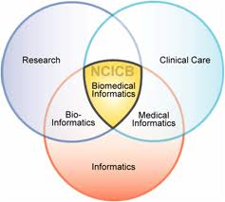
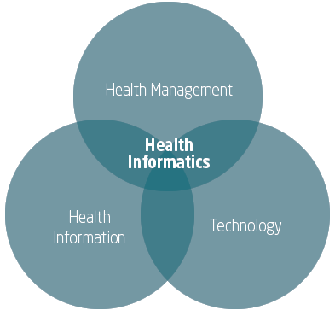
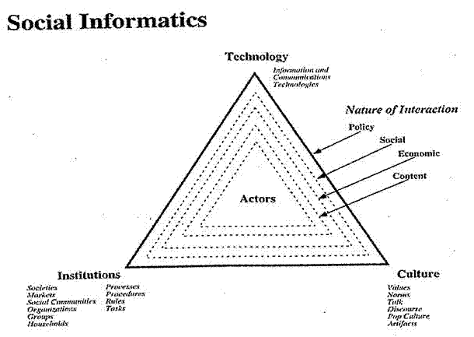

Slide 3
The Course in One Sentence
Study Clouds running Data Analytics processing Big Data to solve problems in X-Informatics

Slide 4
k means Clustering
Choose k=2 to 10 million (or more) clusters according to some intuition
Initialize k cluster centers (this only works in real spaces)
Then Iterate
Assign each point to cluster whose center it is nearest to
Calculate new center position as centroid (average in each component) of points assigned to it
Converge when center positions change < cut
Lots of variants that are better but k means used as simple and fast
Also methods for when only some distances available and no vector space
Sometimes gets wrong answer – trapped in a local minima

Slide 5
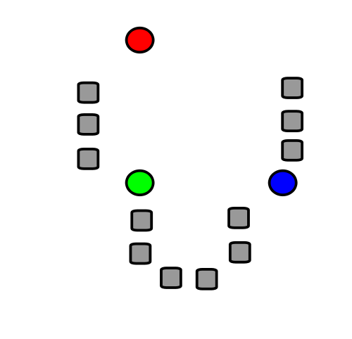
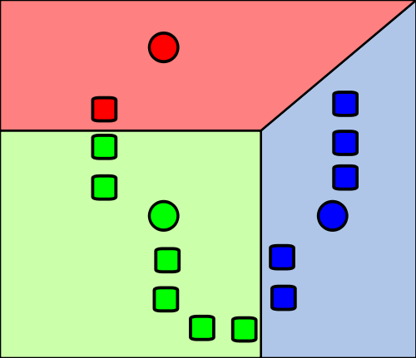
1) k initial "means" (in this case k=3) are randomly generated within the data domain (shown in color).
2) k clusters are created by associating every observation with the nearest mean. The partitions here represent the Voronoi diagram generated by the means.
Wikipedia

Slide 6
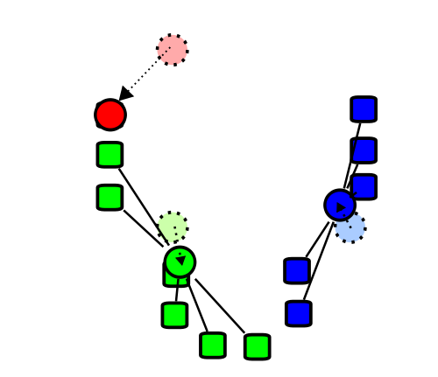
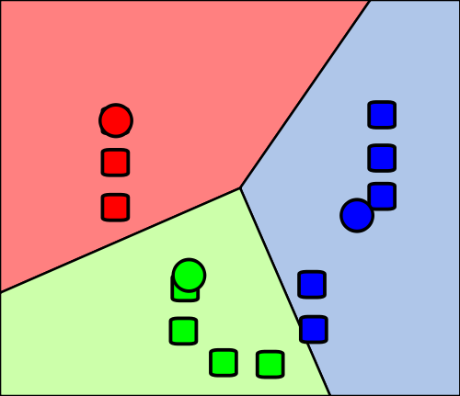
4) Steps 2 and 3 are repeated until convergence has been reached.
But red and green centers (circles) are clearly in wrong place!!! (stars about right)
3) The centroid of each of the k clusters becomes the new mean.
Wikipedia

Slide 7
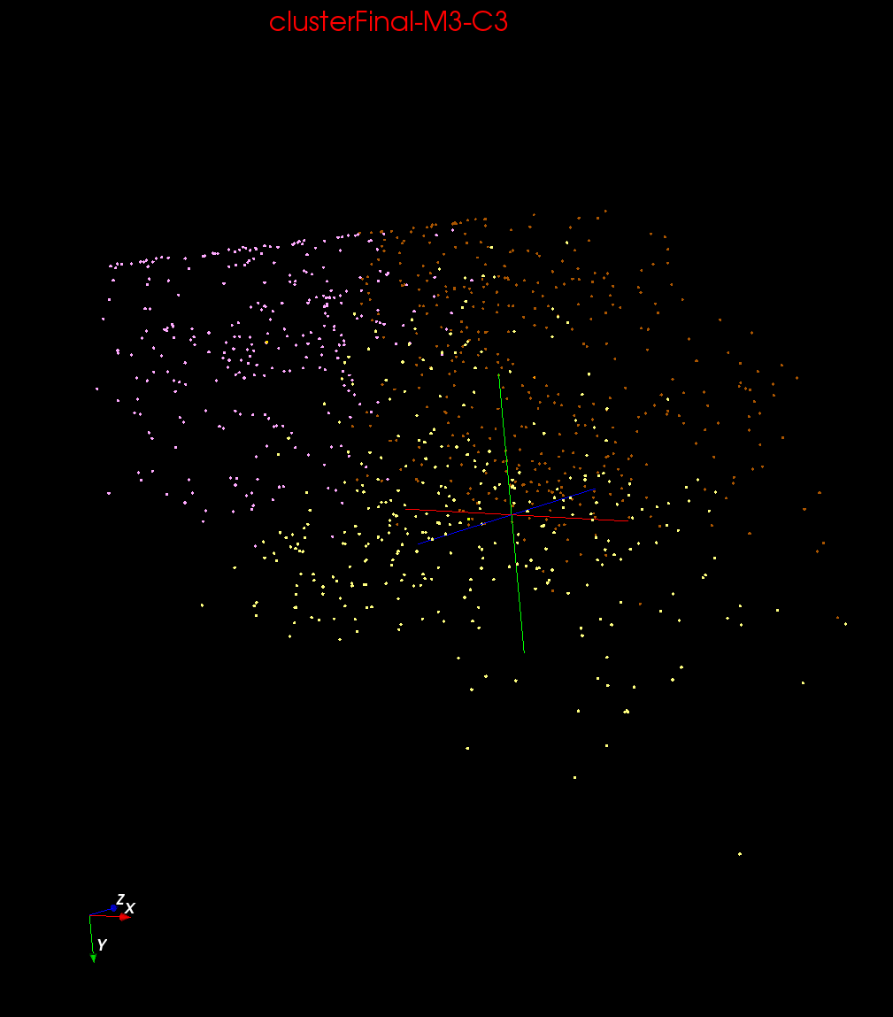
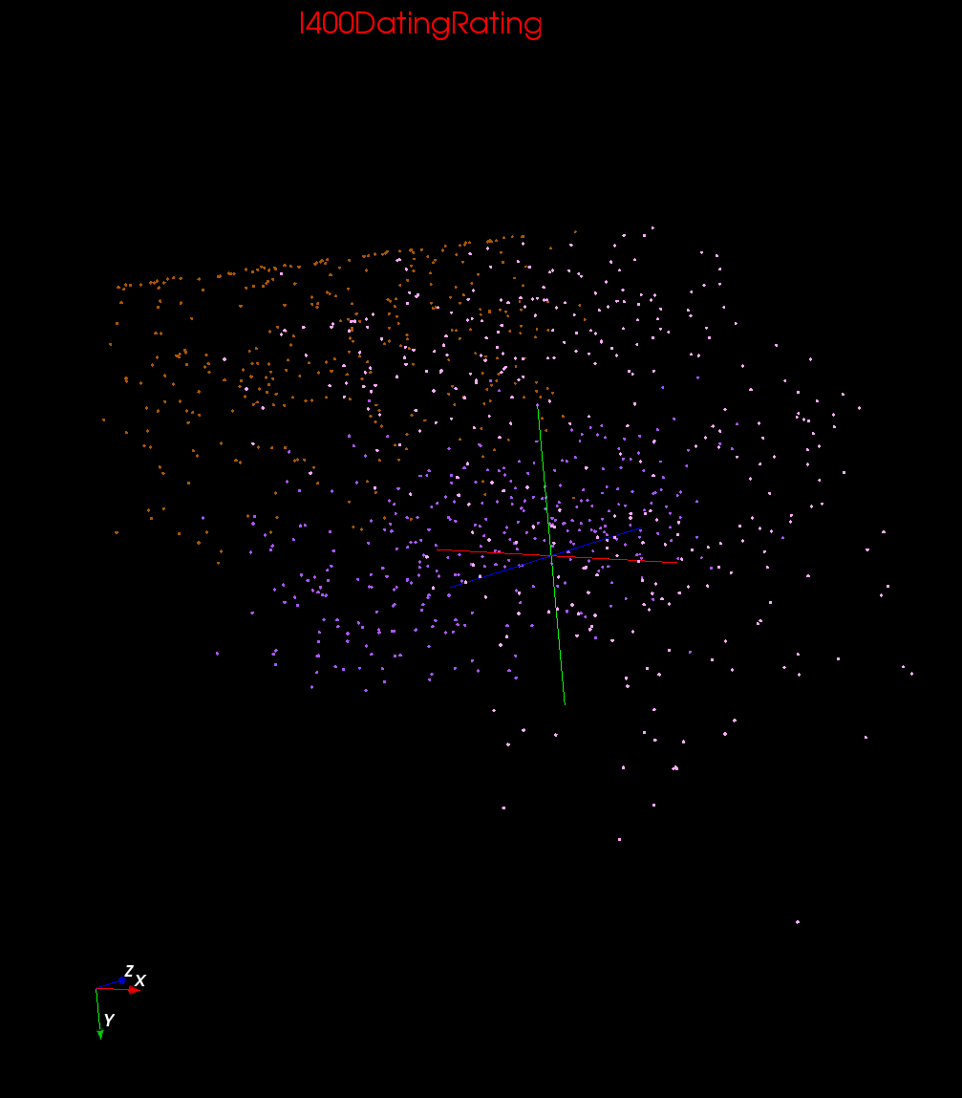
Clustering v User Rating

Slide 8
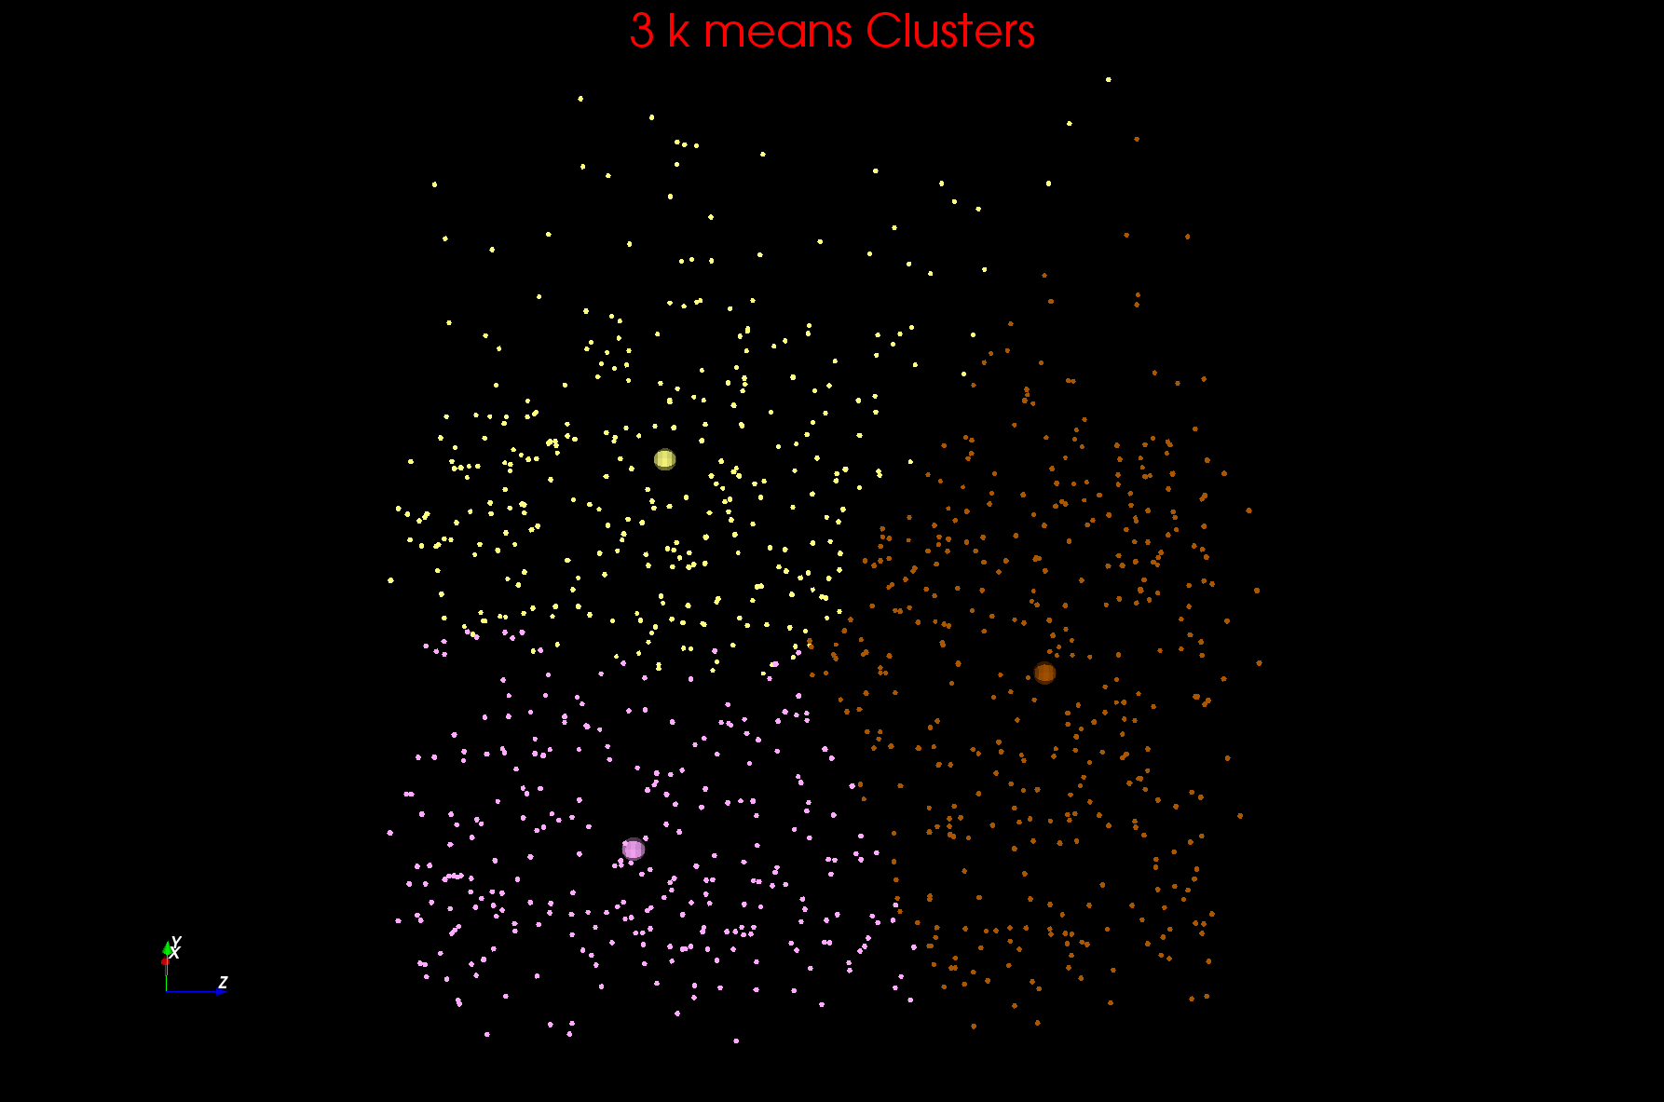
Two views of a 3D Clustering I

Slide 9
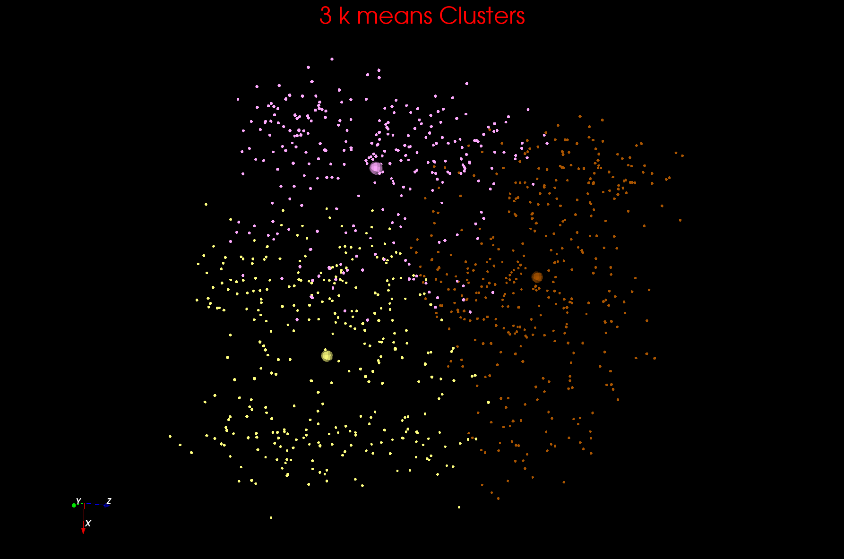
Two views of a 3D Clustering II

Slide 10
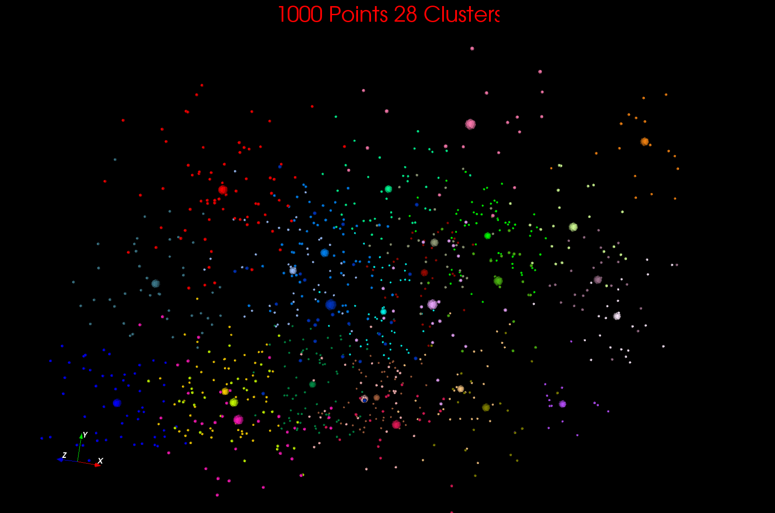

Slide 11
Getting the wrong answer
Remember all things in life – including clustering – are optimization problems
Lets say it’s a minimization (change sign if maximizing)
k means always ends at a minimum but maybe a local minimum
Initial Position
Unhappiness
Local Minimum Wrong Answer
Real Minimum
Center Positions

Slide 12
Annealing
Physics systems find true lowest energy state if you anneal i.e. you equilibrate at each temperature as you cool
Allow atoms to move around
Corresponds to fuzzy algorithms

Slide 13
Annealing
Objective Function
Fixed Temperature – false minima
T3
Annealing -- correct minima
T3
T2
T2
T3 < T2 < T1
T1
T1
Configuration – Center Positions Y(k)

Slide 14
Greedy Algorithms
Many algorithms like k Means are greedy
They consist of iterations
Each iterations makes the step that most obviously minimizes function
Set of short term optima; not always global optima
Same is true of life (politics, wall street)

Slide 15
Parallel Computing I
Our applications are running in a cloud with up to 100K servers in it
A million or so cores each of which is independent
When you or rather your phone/tablet/laptop accesses cloud, you take a core which handles your request
So we can easily handle a million requests at same time
This is simplest form of parallel computing – parallelism over jobs or users
But other forms are needed to
Access giant databases
Calculate model-based recommendations linking items together
Do a large clustering
Answer a search question (similar to accessing giant database)
These use “data parallelism” also used on supercomputers to calculate complex model of universe, fusion, battery, deformation of car in crash, evolution of molecules in a protein dynamics

Slide 16
Parallel Computing II
Instead of dividing cores by users we (also) divide (some of) cores so each has a fraction of data
In study of air flow over a plane, you divide air into a mesh and determine pressure, density, velocity at each mesh point
Weather forecasting similar
Here data is mesh points
For search, data is web pages
For eCommerce, data is items and/or people
For Kmeans, data is points to be clustered

Slide 17
Update on the Mesh
14 by 14 Internal Mesh

Slide 18
Parallelism is Straightforward
If one has 16 processors, then decompose geometrical area into 16 equal parts
Each Processor updates 9 12 or 16 grid points independently

Slide 19
Irregular 2D Simulation -- Flow over an Airfoil
The Laplace grid points become finite element mesh nodal points arranged as triangles filling space
All the action (triangles) is near near wing boundary
Use domain decomposition but no longer equal area as equal triangle count

Slide 20
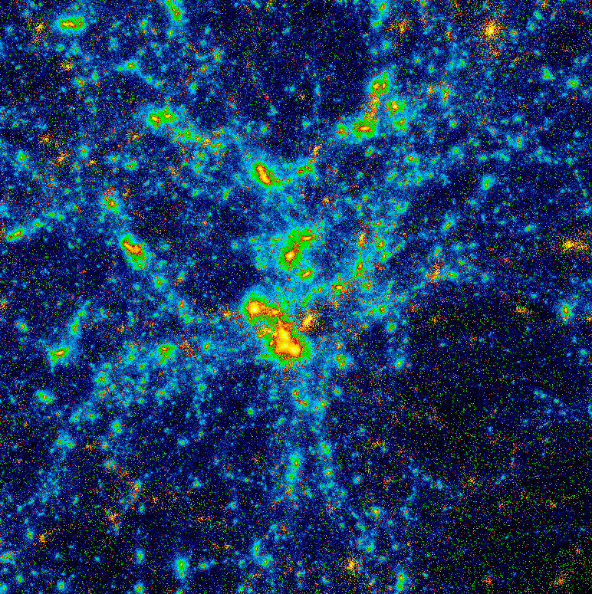
Heterogeneous Problems
Simulation of cosmological cluster (say 10 million stars )
Lots of work per star as very close together ( may need smaller time step)
Little work per star as force changes slowly and can be well approximated by low order multipole expansion

Slide 21
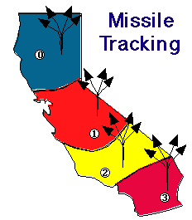
Further Decomposition Strategies
California gets its independence
Not all decompositions are quite the same
In defending against missile attacks, you track each missile on a separate node -- geometric again
In playing chess, you decompose chess tree -- an abstract not geometric space
Computer Chess Tree
Current Position (node in Tree) First Set Moves Opponents Counter Moves

Slide 22
Optimal v. stable scattered Decompositions
Optimal overall
Consider a set of locally interacting particles simulated on a 4 processor system

Slide 23
Parallel Computing III
Note if I chop points up in Kmeans, then a given cluster is likely to need points in multiple cores
As a user, I want search results from all web pages
As an item, I want to be linked to all other items in eCommerce
In parallel chess, I need to find best move whatever core discovered it and fancy optimal search algorithm (alpha-beta search) needs shared database and can have very different time complexity on each core
Need equal number of good moves on each core
The things in red are decomposed across cores and communication between cores needed to either synchronize or send information
If cores on same CPU can use “shared memory”
Fundamental problem in parallel computing is to efficiently coordinate cores and
Minimize synchronization and communication overhead
Make cores do roughly equal amount of work
Famous cloud parallel computing approach called MapReduce invented by Google with sweetly named software called Hadoop from Yahoo
Science used software called MPI – Message passing Interface

Slide 24
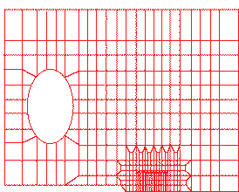
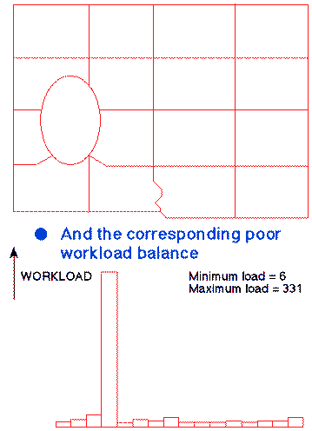
Parallel Irregular Finite Elements
Here is a cracked plate and calculating stresses with an equal area decomposition leads to terrible results
All the work is near crack
Processor

Slide 25
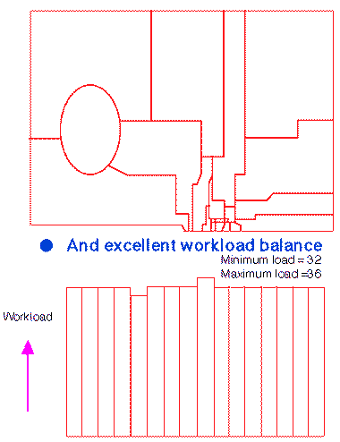
Irregular Decomposition for Crack
Region assigned to 1 processor
Concentrating processors near crack leads to good workload balance
equal nodal point -- not equal area -- but to minimize communication nodal points assigned to a particular processor are contiguous
This is NP complete (exponenially hard) optimization problem but in practice many ways of getting good but not exact good decompositions
Work Load
Not Perfect !
Processor

Slide 26
Parallel Processing in Society
It’s all well known ……

Slide 28
8-person parallel processor
Divide problem into parts; one part for each processor

Slide 30
Amdahl’s Law of Parallel Processing
Speedup S(N) is ratio Time(1 Processor)/Time(N Processors); we want S(N) ≥ 0.8 N
Amdahl’s law said no problem could get a speedup greater than about 10
It is misleading as it was gotten by looking at small or non-parallelizable problems (such as existing software)
For Hadrian’s wall S(N) satisfies our goal as long as l > about 60 meters if l_{overlap} = about 6 meters
If l is roughly same size as l_{overlap} then we have “too many cooks spoil the broth syndrome”
One needs large problems to get good parallelism but only large problems need large scale parallelism

Slide 35
Neural Network
The Web is also just message passing

Slide 36
1984 Slide – today replace hypercube by cluster

Slide 39
Between CPU’s Called Outer Parallelism
Inside CPU or Inner Parallelism

Slide 40
Key to MapReduce

